Slide 1
Department of Computer science and Engineering
Annasaheb Dange College of Engineering and technology, Ashta
Micro-Project Presentation
Subject: Advanced Programming
Project Title : Captcha generater using python.
Group Members:
1) Abhishek Sudhakar Sawant (3025)
2) Proushthil Ajay Walvekar (3026)
Under guidance: Mr. Y. S. Lubal
Year: 2022-2023

Slide 2
“captcha generating system Using Python”
‘Advance Programming-Python’

Slide 3
Introduction
Captcha generating system is simply the process of generating captcha for the particular system which are generated digitally by the python program to generate the captcha.
The Captcha Creator A straightforward project created in Python. The project includes a text field and an image captcha. By examining the captcha, the user can type in the letters and numbers in the text field here. The user can just click the submit button at that point to verify the accuracy.

Slide 4
Objectives
To design a system that will produce the captcha successfully.
To develop a captcha producing system to check the accuracy.

Slide 5
Modules in project
Tkinter Module
Tkinter is the standard GUI library for python.
For using the labels, buttons and entry box.
2) Random Module
Text-based CAPTCHA uses a set of words or phrases or a random combination of different letters, numbers, and symbol.
3) Captcha Module
A captcha library that generates audio and image CAPTCHAs. which will be different every time we run the program.

Slide 6
Aim of the Project
To differentiate humans from robotic computer programs.
To use as security checks from the spammers and the hackers.
To block the automated increased usage of the services.
To address importance of captcha in the security of the system.
To make the activities safer.

Slide 7
Applications of the Project
For mitigating the comment spam captcha generating system is used for the security.
For the registration purpose it is used as registration might get attacked by flooding if the captcha is not used in the system.
For protecting the confidential web pages the captcha is used in the protection of the system.

Slide 8
Conclusion
CAPTCHA though has many applications in varied fields;. We have seen that by distinguishing between humans and computers, CAPTCHAs offer protection against automated attacks on systems and applications. The criterion for success of a text-based CAPTCHA are its robustness and usability.

Slide 9
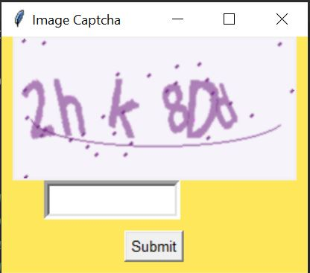

Slide 10
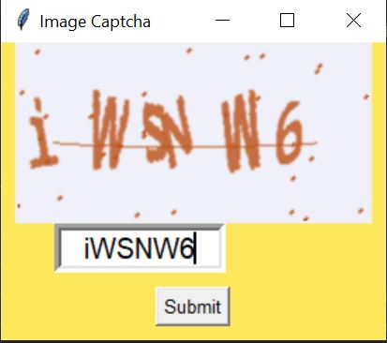

Slide 11
Thank You…

