Slide 1

Bank Marketing
This bank marketing containing data which is
Age
Job
Education
Default
Loan
Balance
Duration
Campaign
deposite

Slide 2
Index
Project objective
Dataset
Graphical representation & outcomes
Prediction
Conclusion

Slide 3
Project objective
The objective is to analyze the dataset to find insights and develop strategies to improve the effectiveness of future marketing campaigns for a financial institution
Term deposit is a fixed deposit or time deposit, is a type of investment offered by banks and financial institutions.

Slide 4
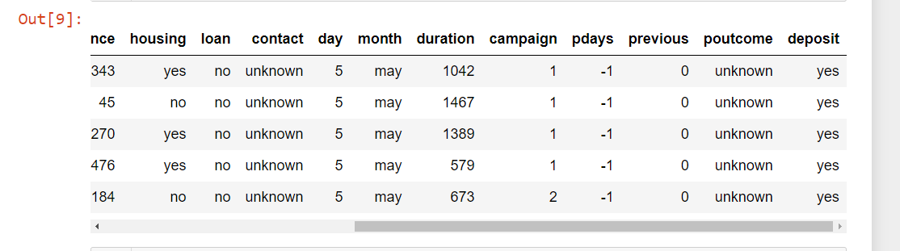
Dataset

Slide 5
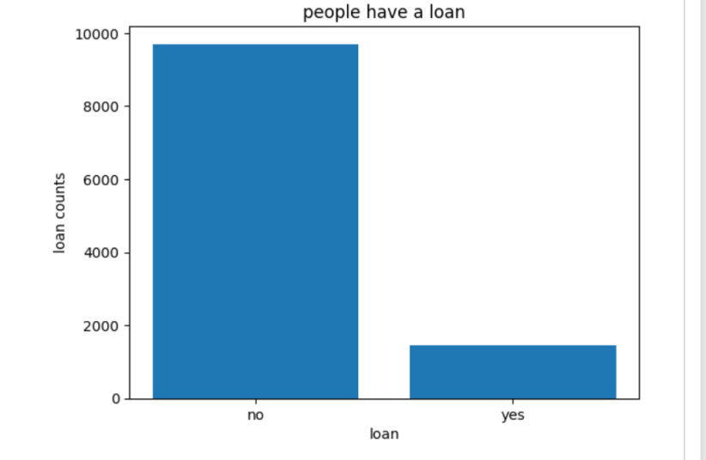
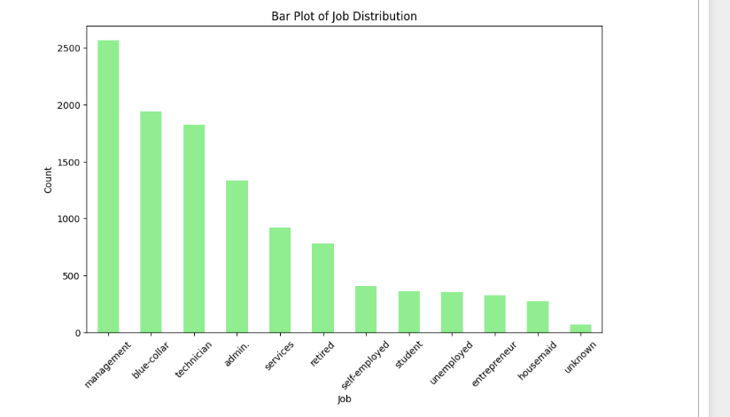
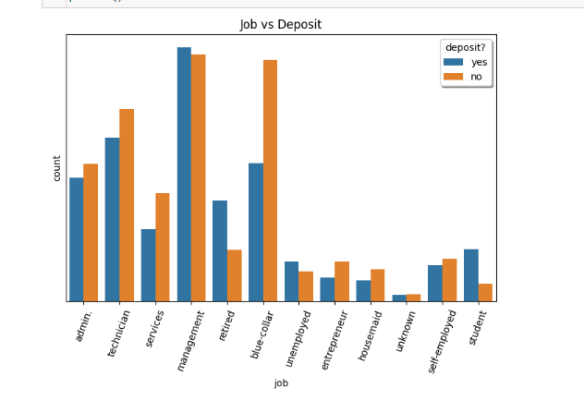
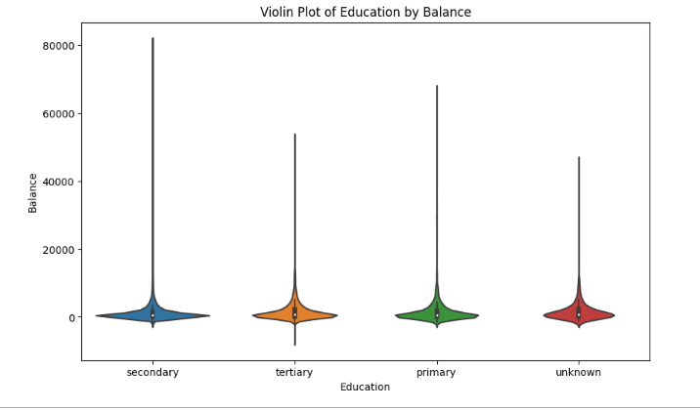
Graphical representaion

Slide 6
Model name | Accuracy Score ( %)
0 Liner Regression | 0.781460
1 Random forest | 0.818182
2 Logistic Regression | 0.789521
3 Linear SVC | 0.785938
PREDICTION

Slide 7
conclusion
Wealth management & private banking business is currently a major area for development for many of the worlds financial firmes.
The market is large, growing and highly profitable industry is fragmented & there is no agreed single ‘preferred ‘ model.
To summarize Analytics provides bank with more marketing muscle.

