Slide 1
ATM MACHINE
PROJECT

Slide 2
INTRODUCTION:
The “ THE ATM MACHINE PROJECT ” (Fast Transaction ATM machine )
is developed to user for easily get the details about the ATM machine and
to transact the money.
The main aim of “ATM MACHINE PROJECT” An automated teller machine(ATM) shows customer to perform banking transaction anywhere and at anytime without the need of human teller.
By using Debit or ATM card at an ATM individuals can withdraw cash from checking and saving accounts ,make a deposit or transfer money from one account to another or perform other functions.
You can get cash advances using a credit card at an ATM.

Slide 3
Use Case Diagram:
ATM MACHINE
Login
Current Account
Customer
ATM
Saving Account
ATM MACHINE
View Balance
Deposit funds
Withdraw funds
Mini Statement

Slide 4
ER-Diagram:
View Balance
Deposit Funds
ATM
Customer Login
Current Account
Withdraw Funds
View Balance
Mini Statement
Saving Account
Deposit Funds
Mini Statement
Withdraw Funds
EXIT

Slide 5
Module Implementation:
Customer Login:
In ATM machine first user enter the costumer number and next enter the pin number . If costumer or pin number is wrong then its showing result is wrong account details.
Current Account/Saving Account:
If the enter right number then display the message like select the account we want to access then the module display from View balance , Deposit funds , Withdraw funds , Mini Statements / summary etc. Then first the view balance the account balance will be display . and next Deposit Funds amount we want from current Account or Saving account then amount will be deposited successfully. And next Withdraw Funds enter amount we want to withdraw from your account the amount will be greater than account balance then its shows insufficient balance. Then it is less than in account balance is shows withdraw amount successfully. And next Mini Statement its showing the message like how many amount are deposited and how many amount are withdraw. Then Exit the message display collect your card . Thank you for using this ATM !!

Slide 6
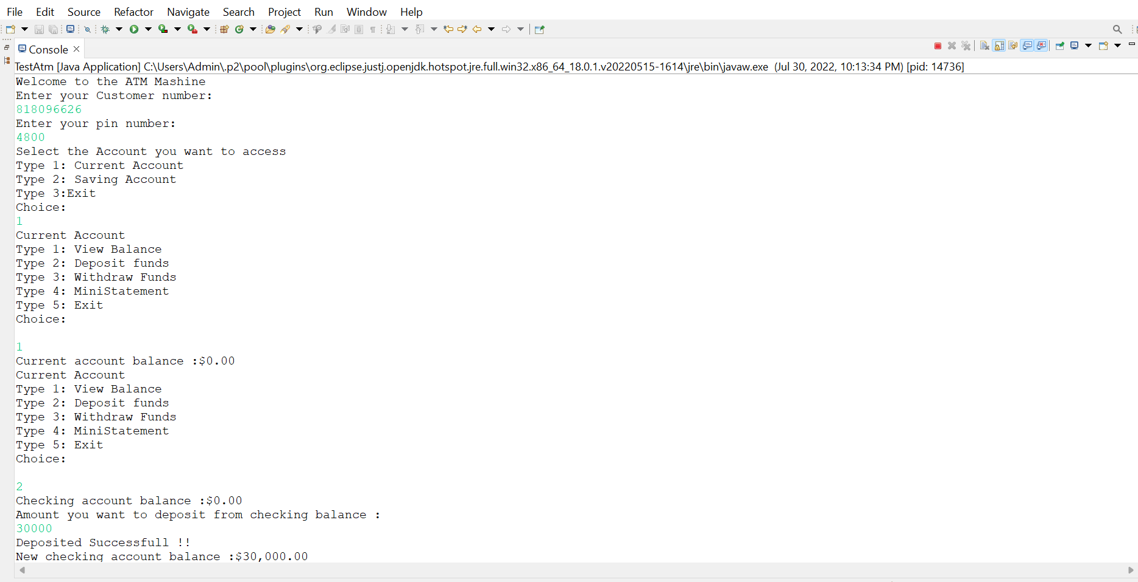
Output:
1:Current Account

Slide 7
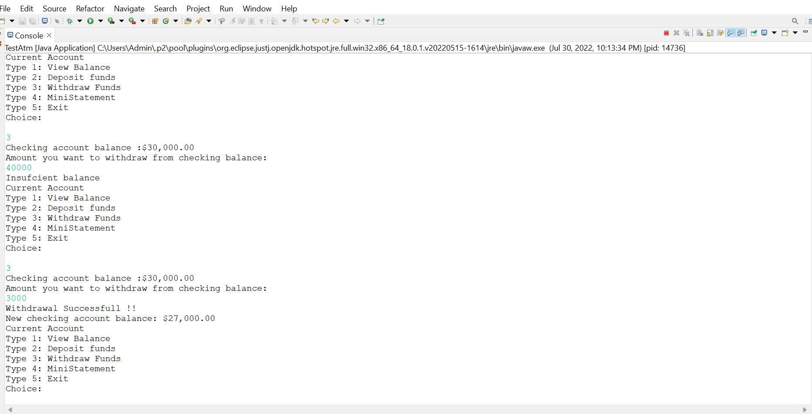

Slide 8
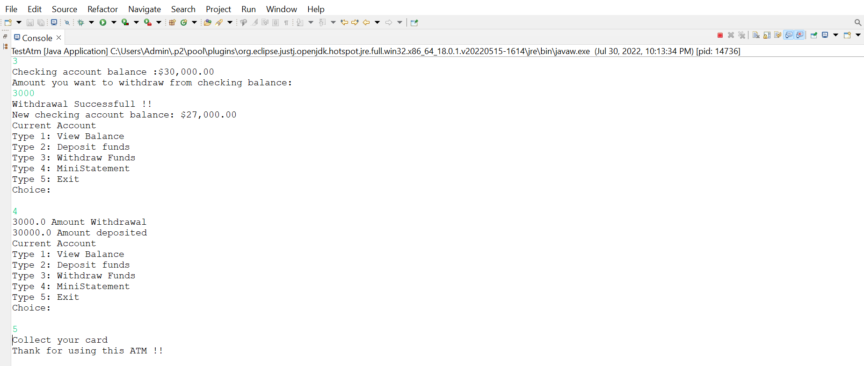

Slide 9
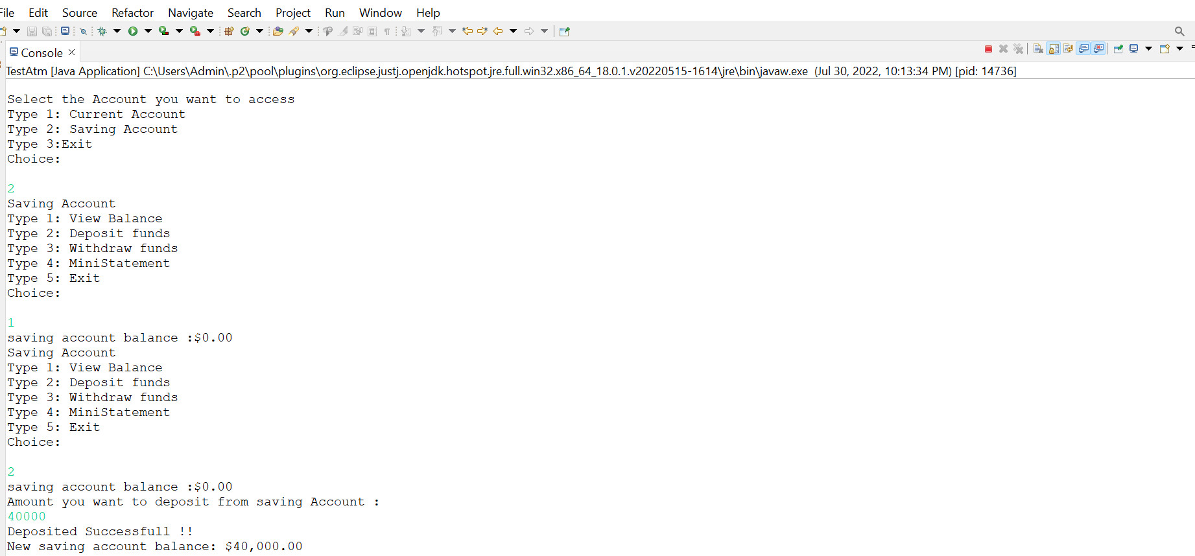
2.Saving Account:

Slide 10
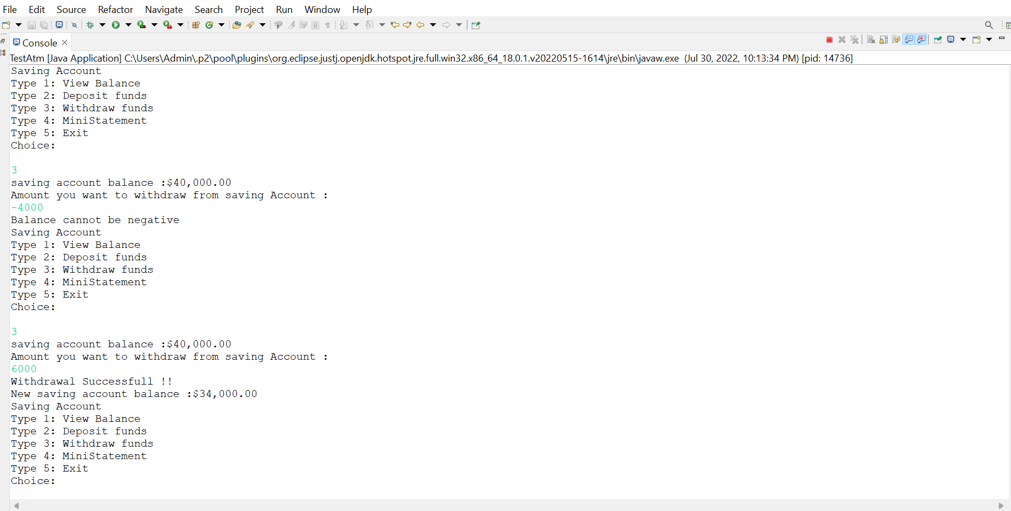

Slide 11
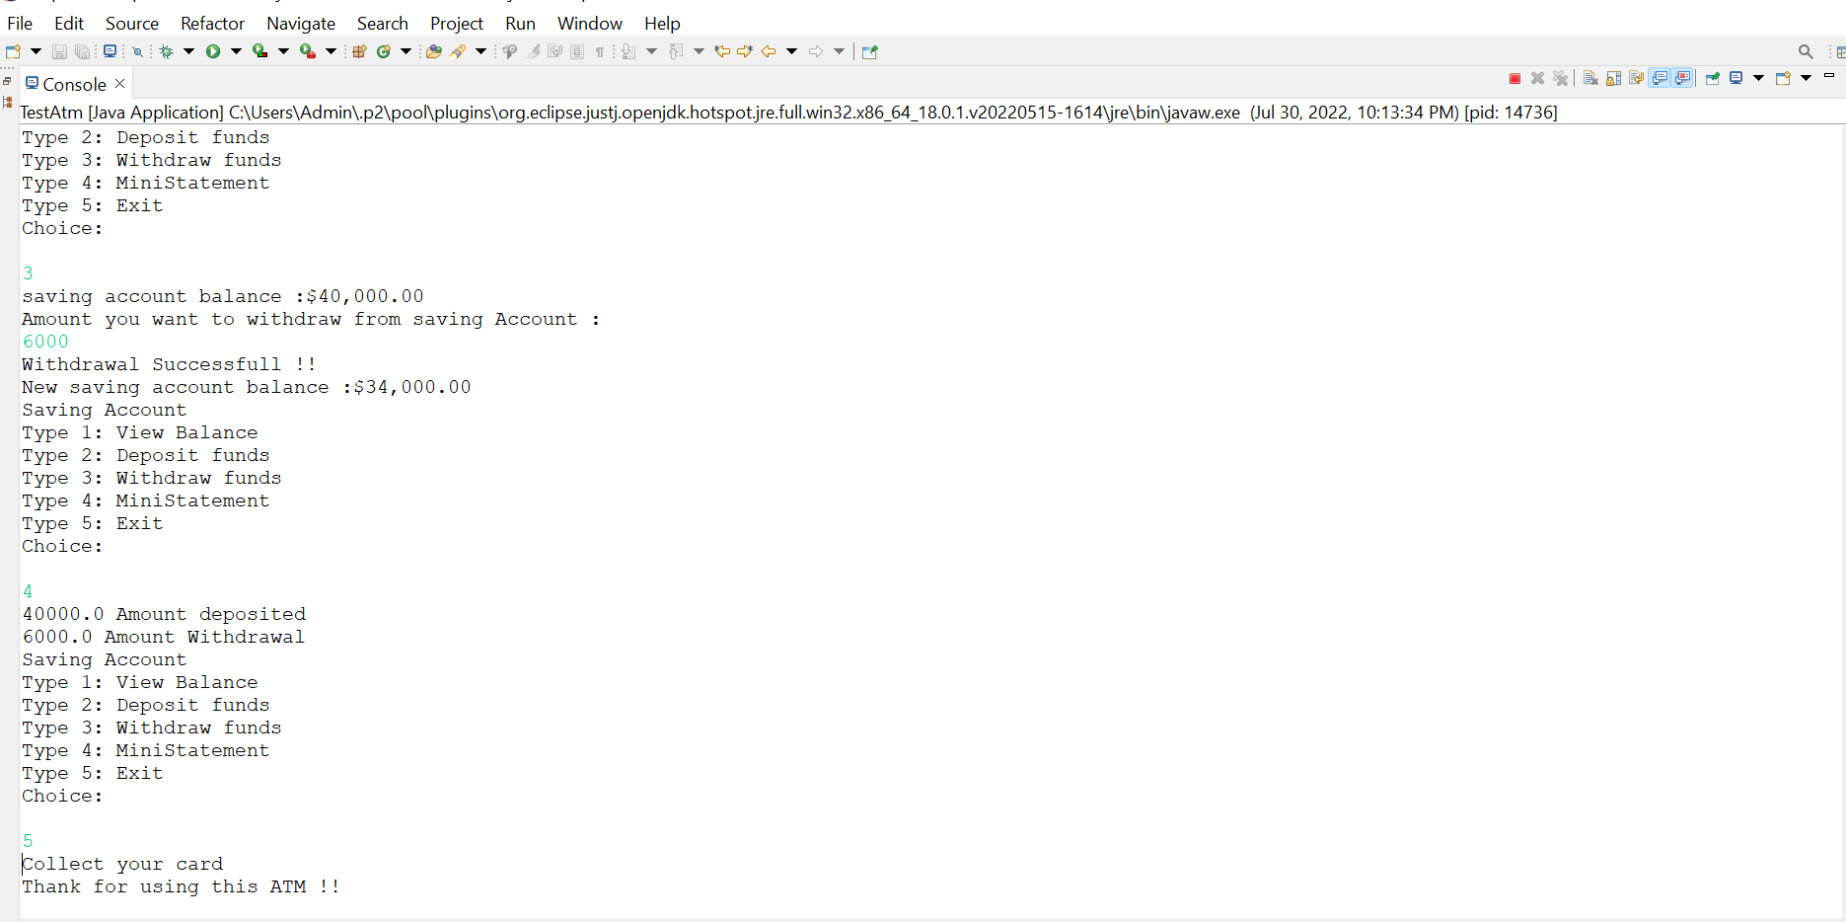

Slide 12
Conclusion:
From this presentation, one can observe that an ATM system is associated with the bank transactions of the consumers
Majorly, the ATM system is utilized for the money associated transactions from the consumers. Consumers make major use of ATM to withdraw money from their bank account.

Slide 13
References:
https://www.youtube.com
https://www.google.co.in

Slide 14
THANK YOU !!

