Slide 1
ASTROSAT WORKSHOP 2017

Slide 2
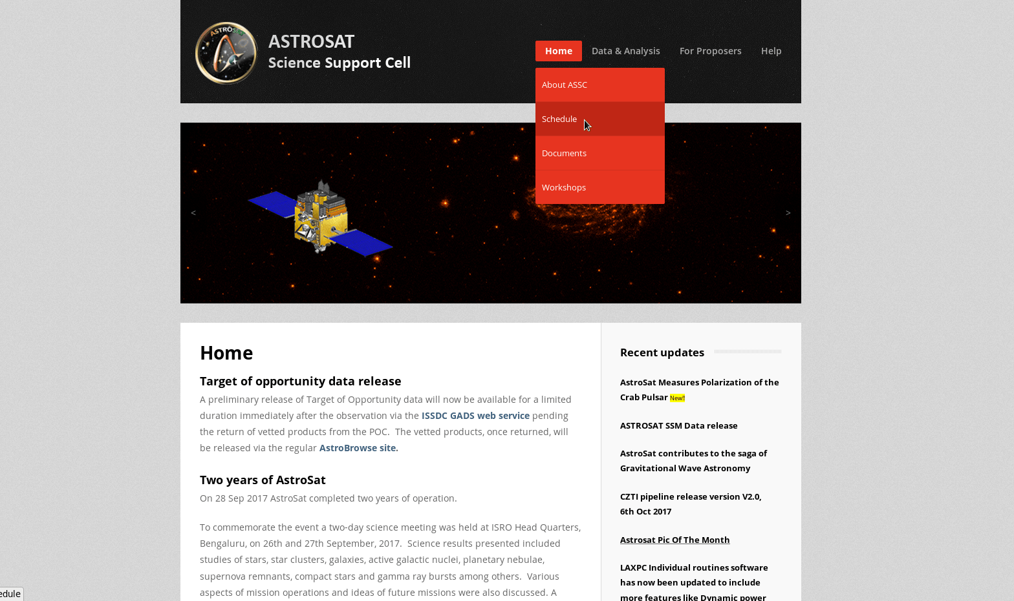
GO TO LINK -
http://astrosat-ssc.iucaa.in/

Slide 3
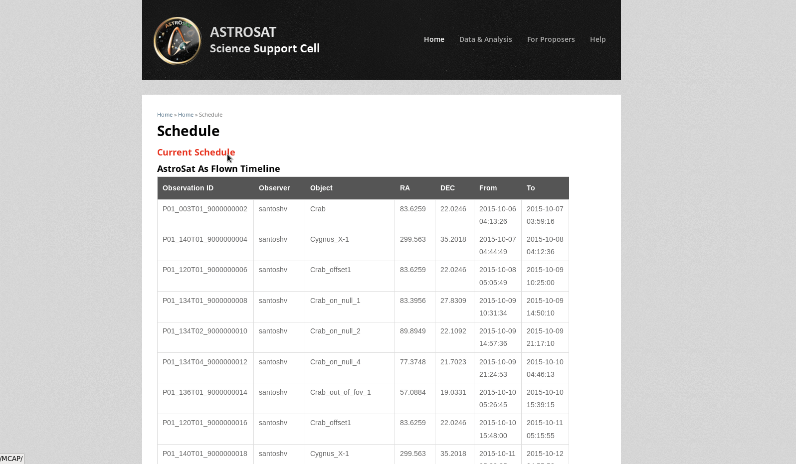
Current SCHEDULE option

Slide 4
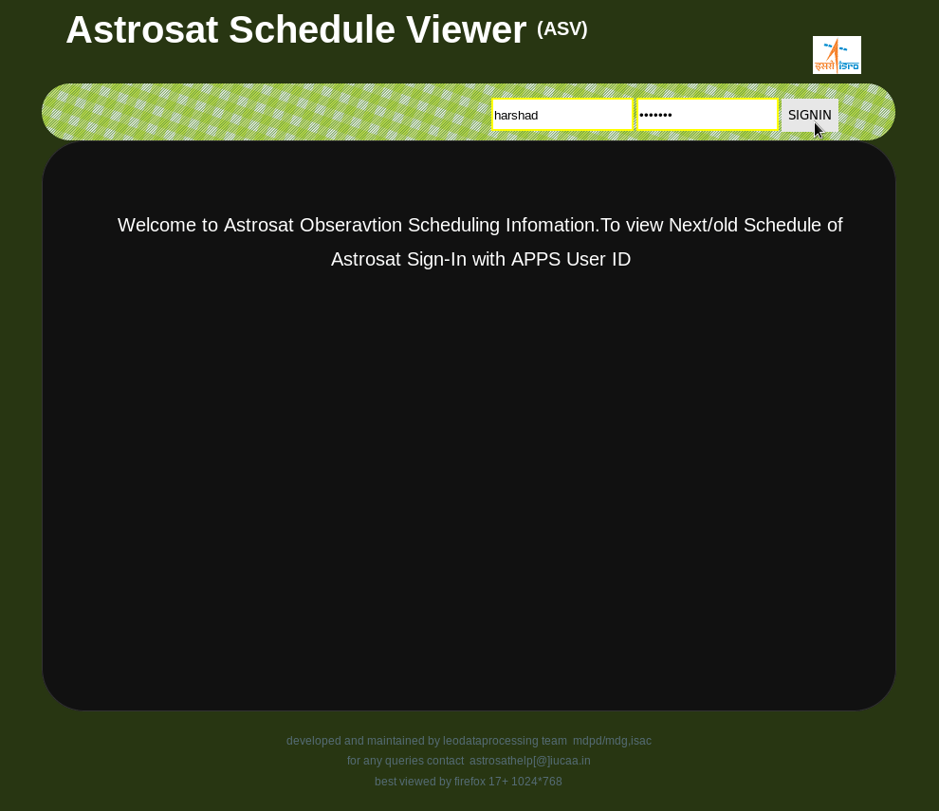
status viewer

Slide 5
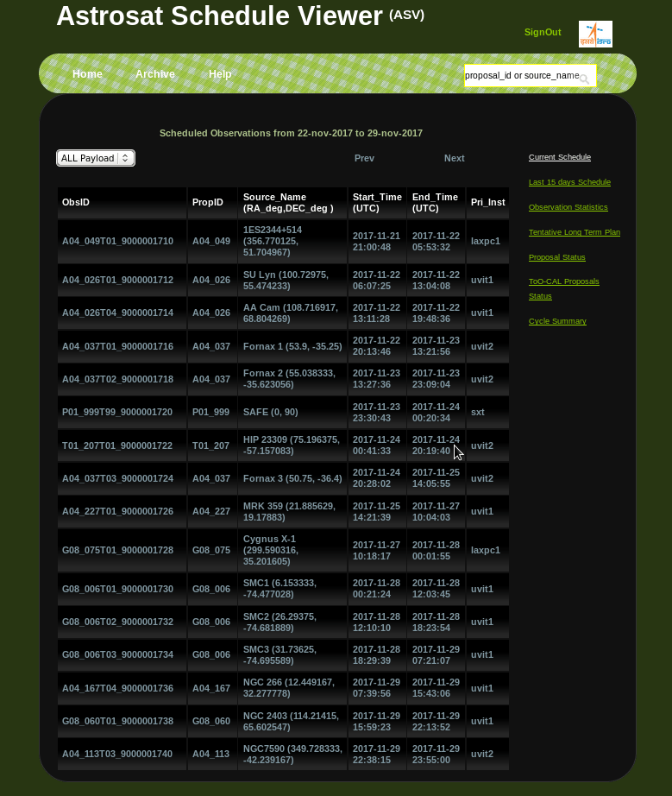
current SCHEDULE Observations

Slide 6
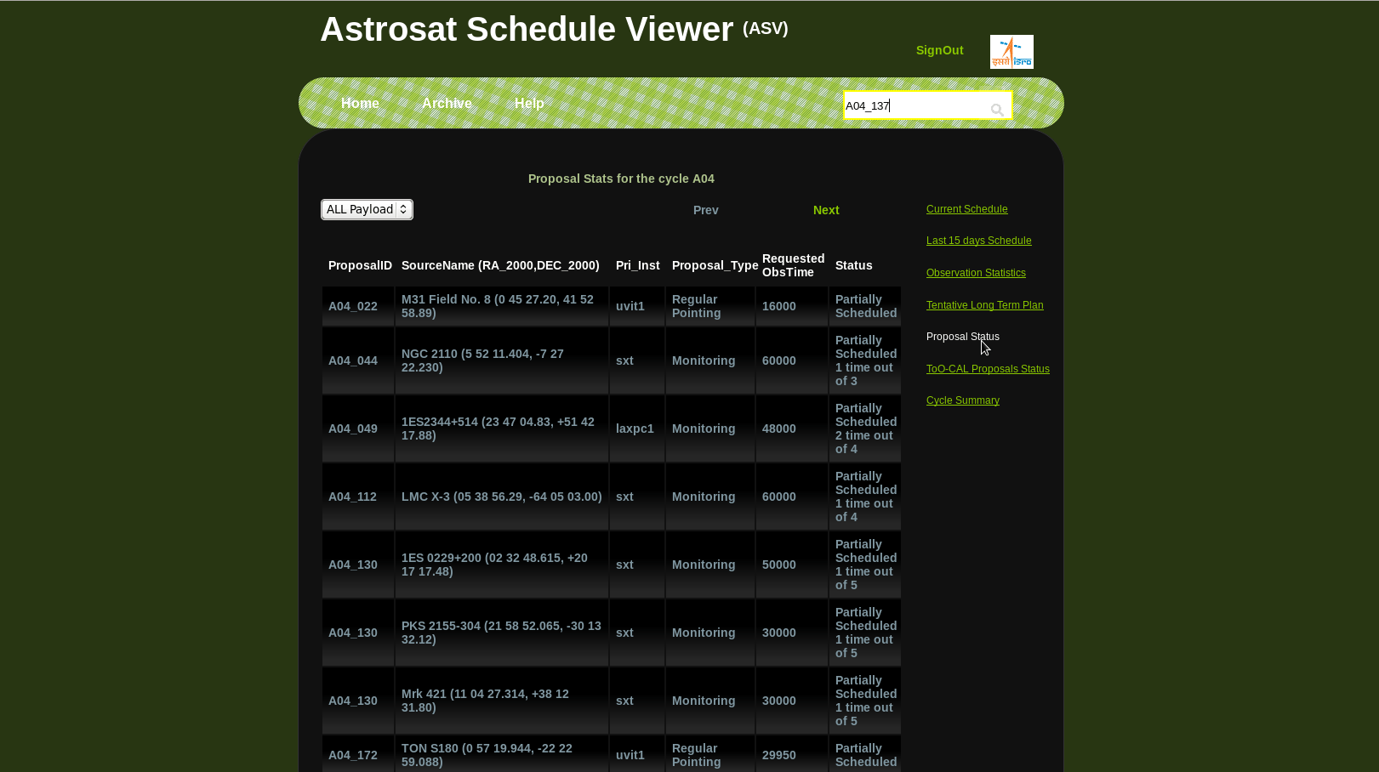
proposal status

Slide 7
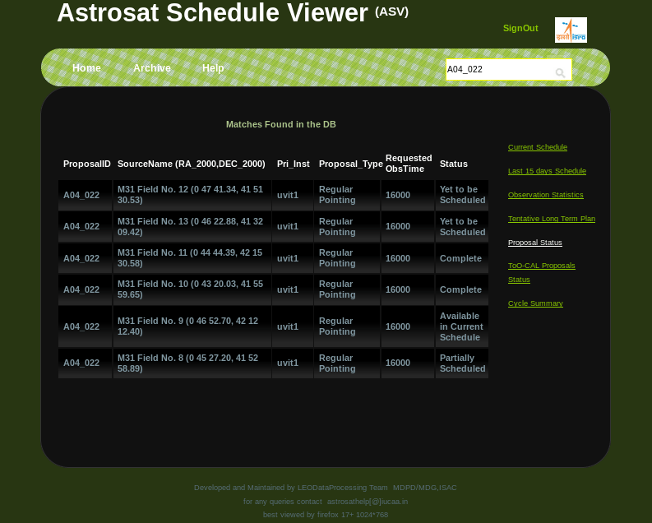

Slide 8
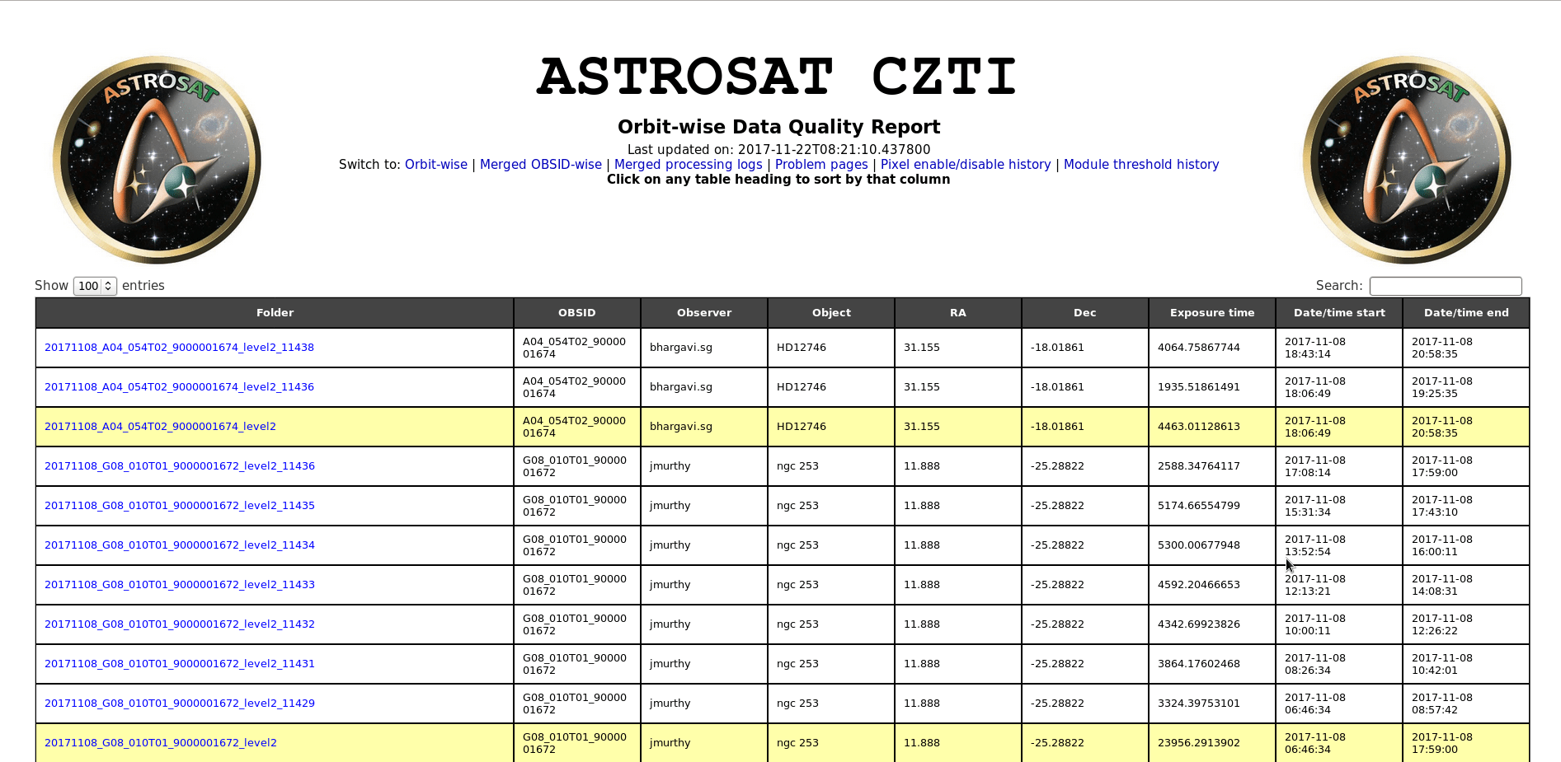
CZTI DQR PAGE
LINK- http://www.iucaa.in/~astrosat/czti_dqr/

Slide 9
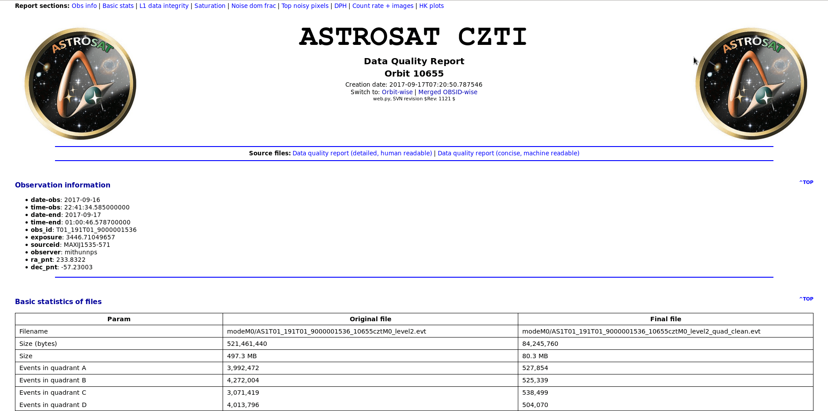
BASIC INFORMATION

Slide 10
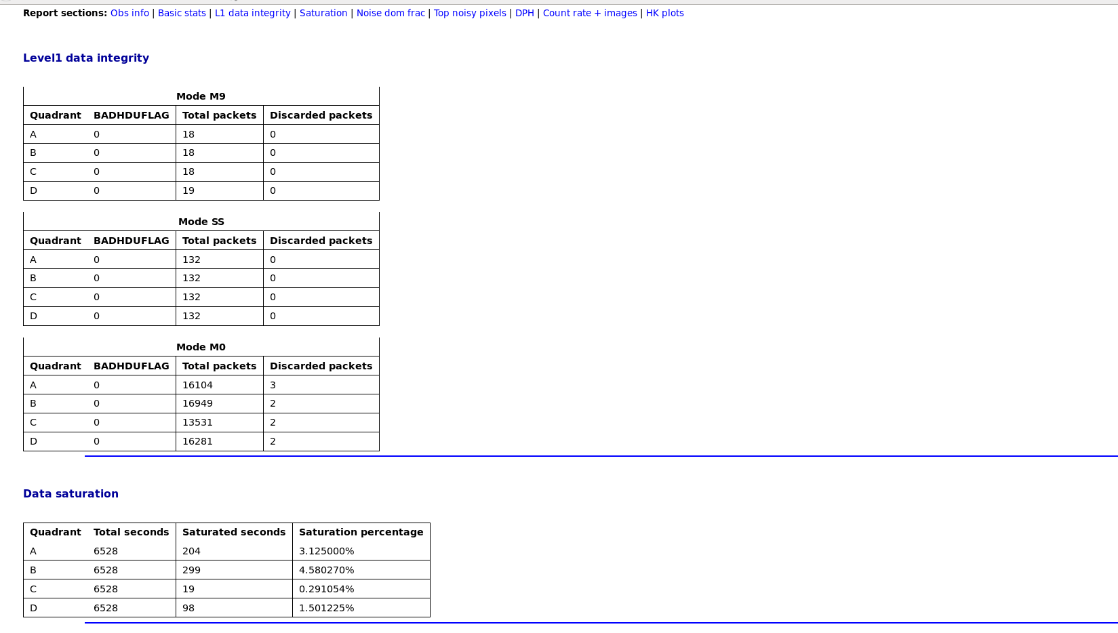

Slide 11
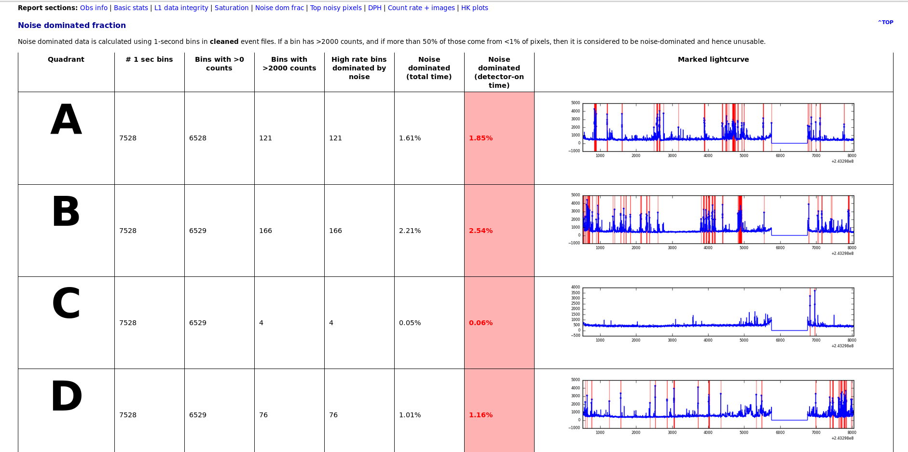
noise DISPLAY quadrant wise

Slide 12
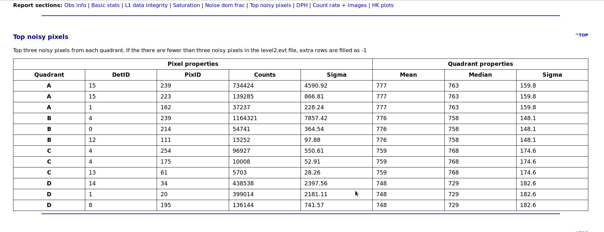
counts and mean-median

Slide 13
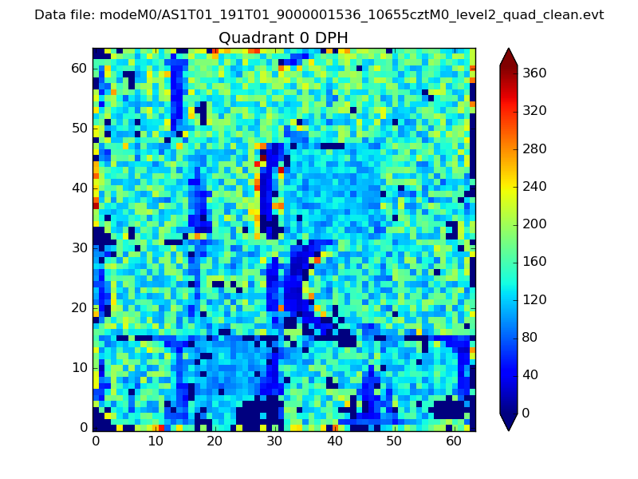
Histogram quadrant wise

Slide 14
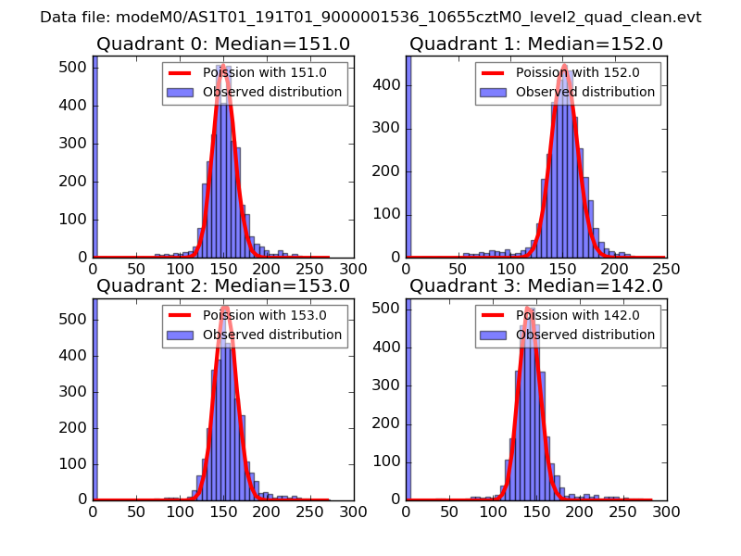
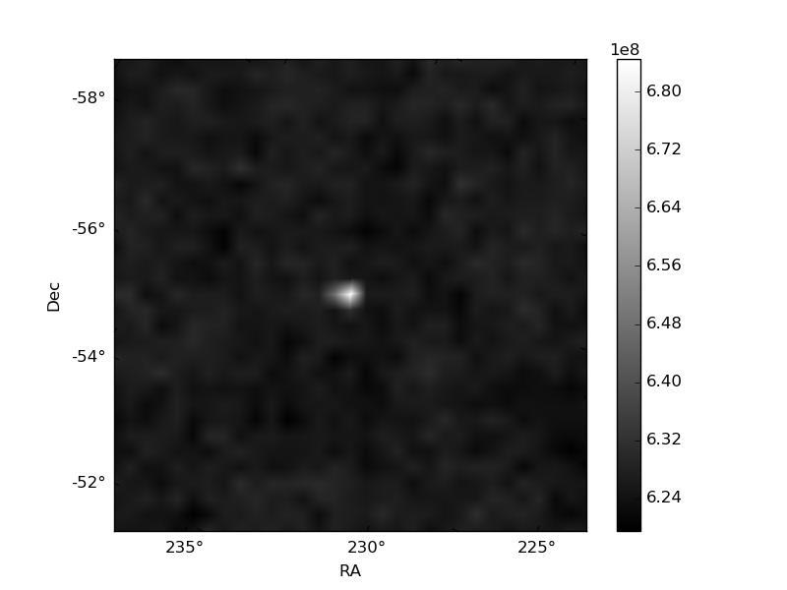
DISTRIBUTION

Slide 15
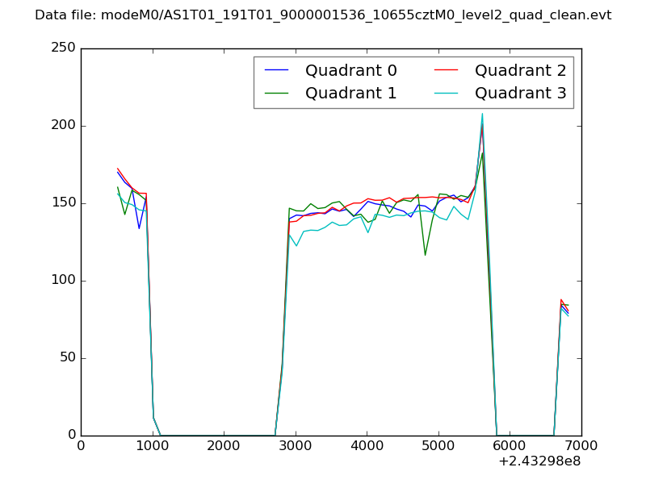
QUADRANT WISE Count RATE PLOTS

Slide 16
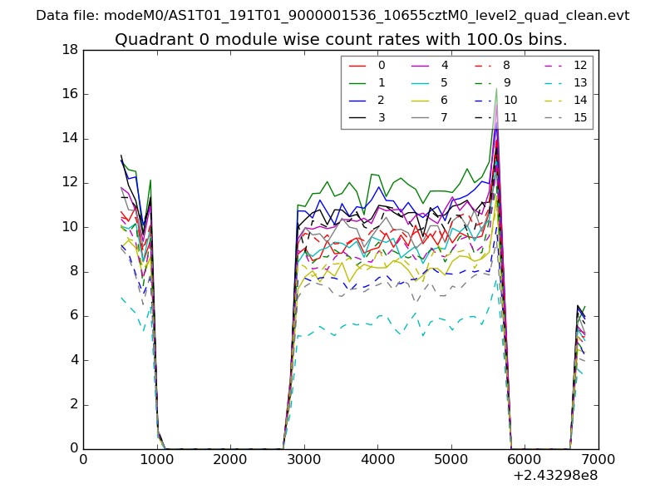
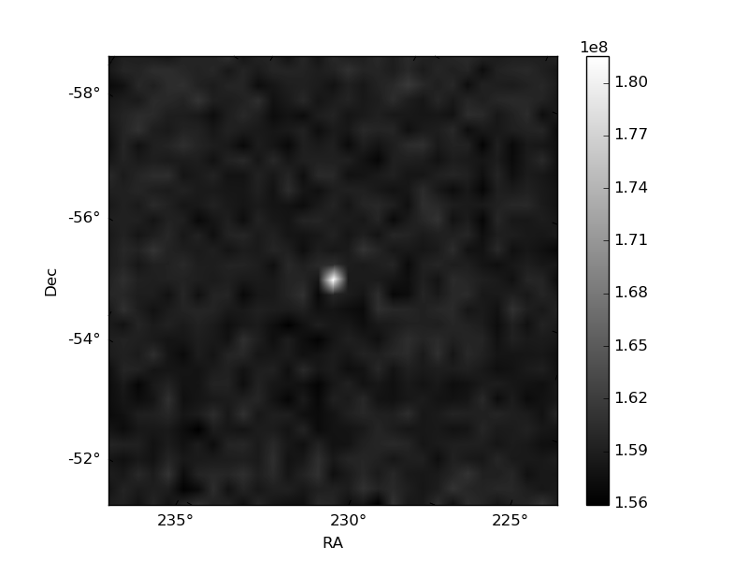
MODULE WISE QUADRANT Count RATE PLOTS

Slide 17
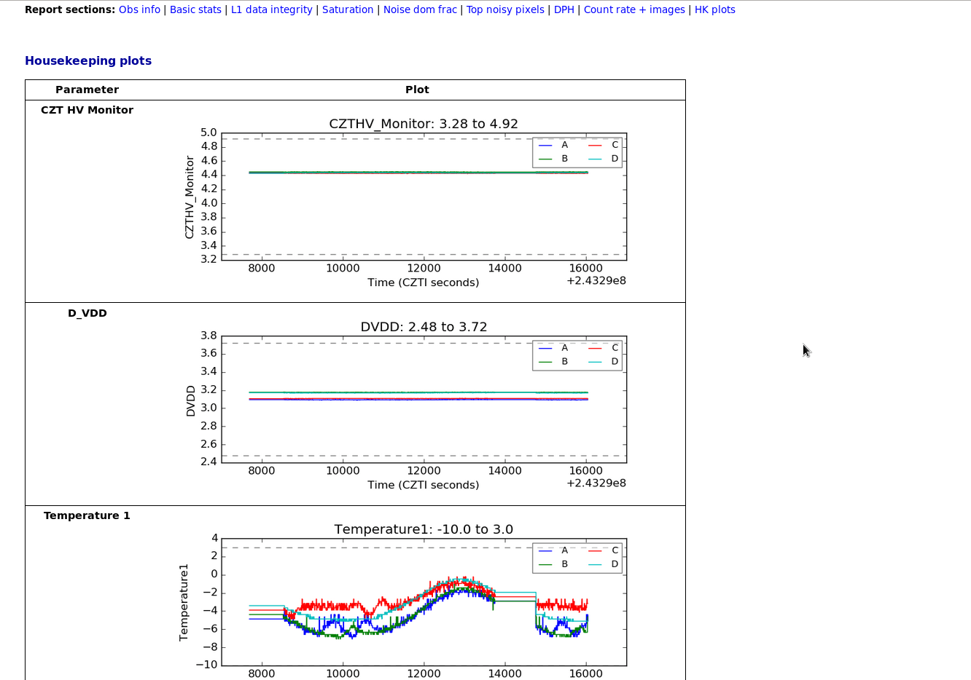

Slide 18
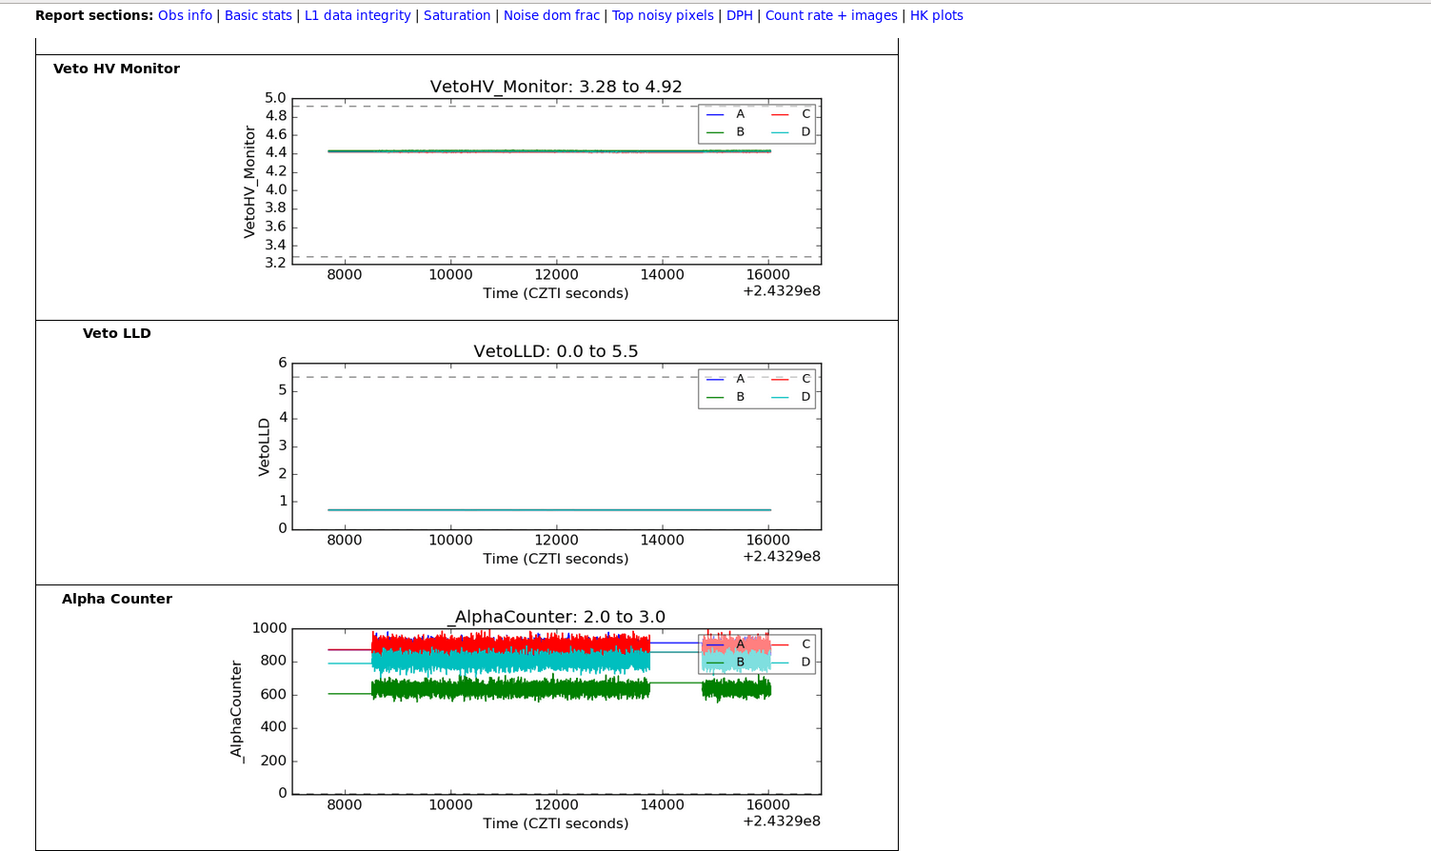

Slide 19
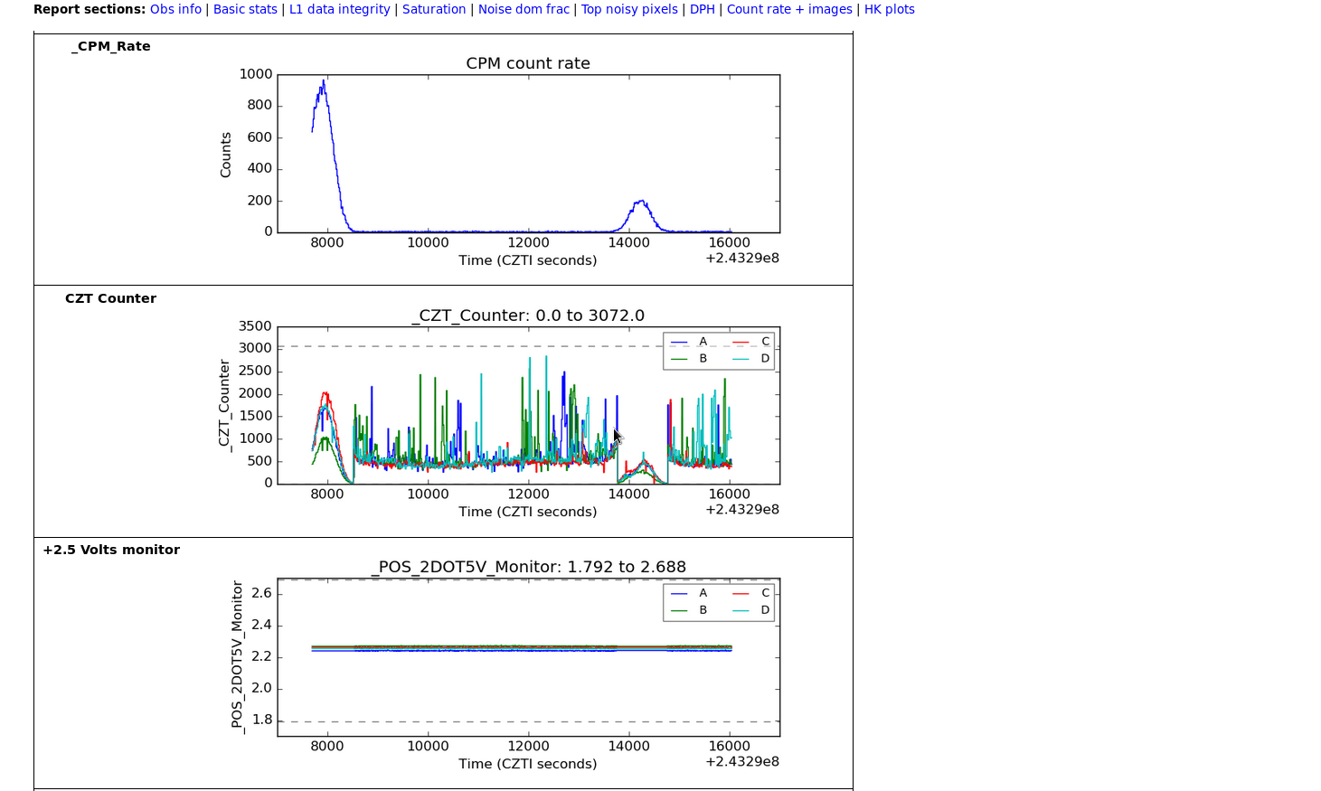

Slide 20
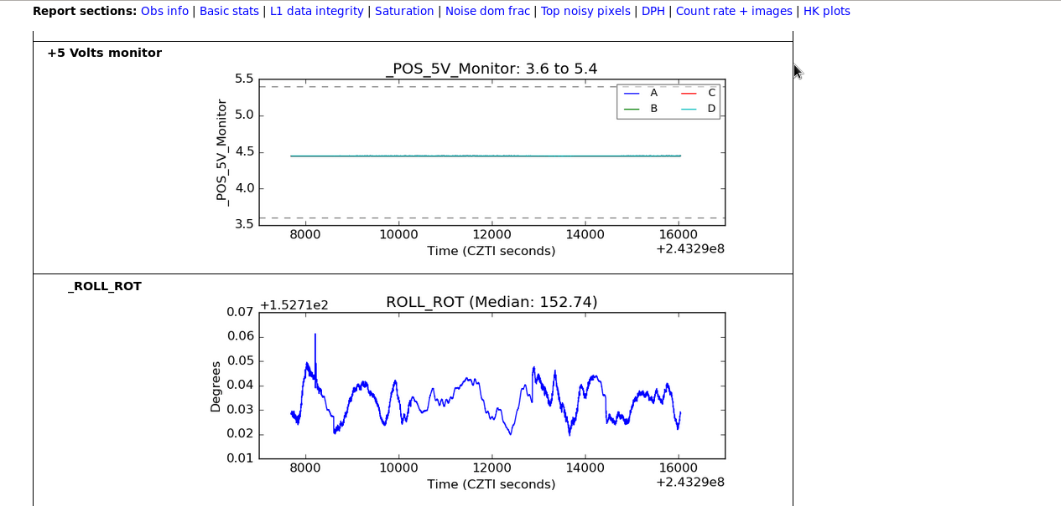

Slide 21
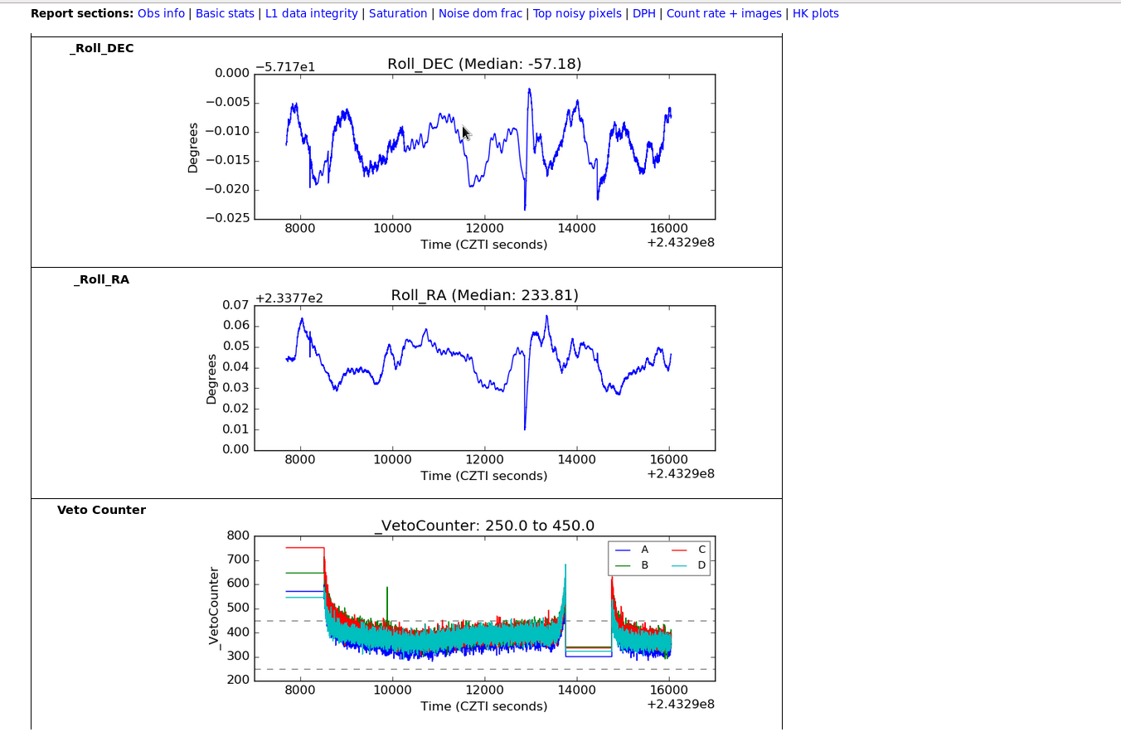

Slide 22
THANK YOU…….!

