Slide 1
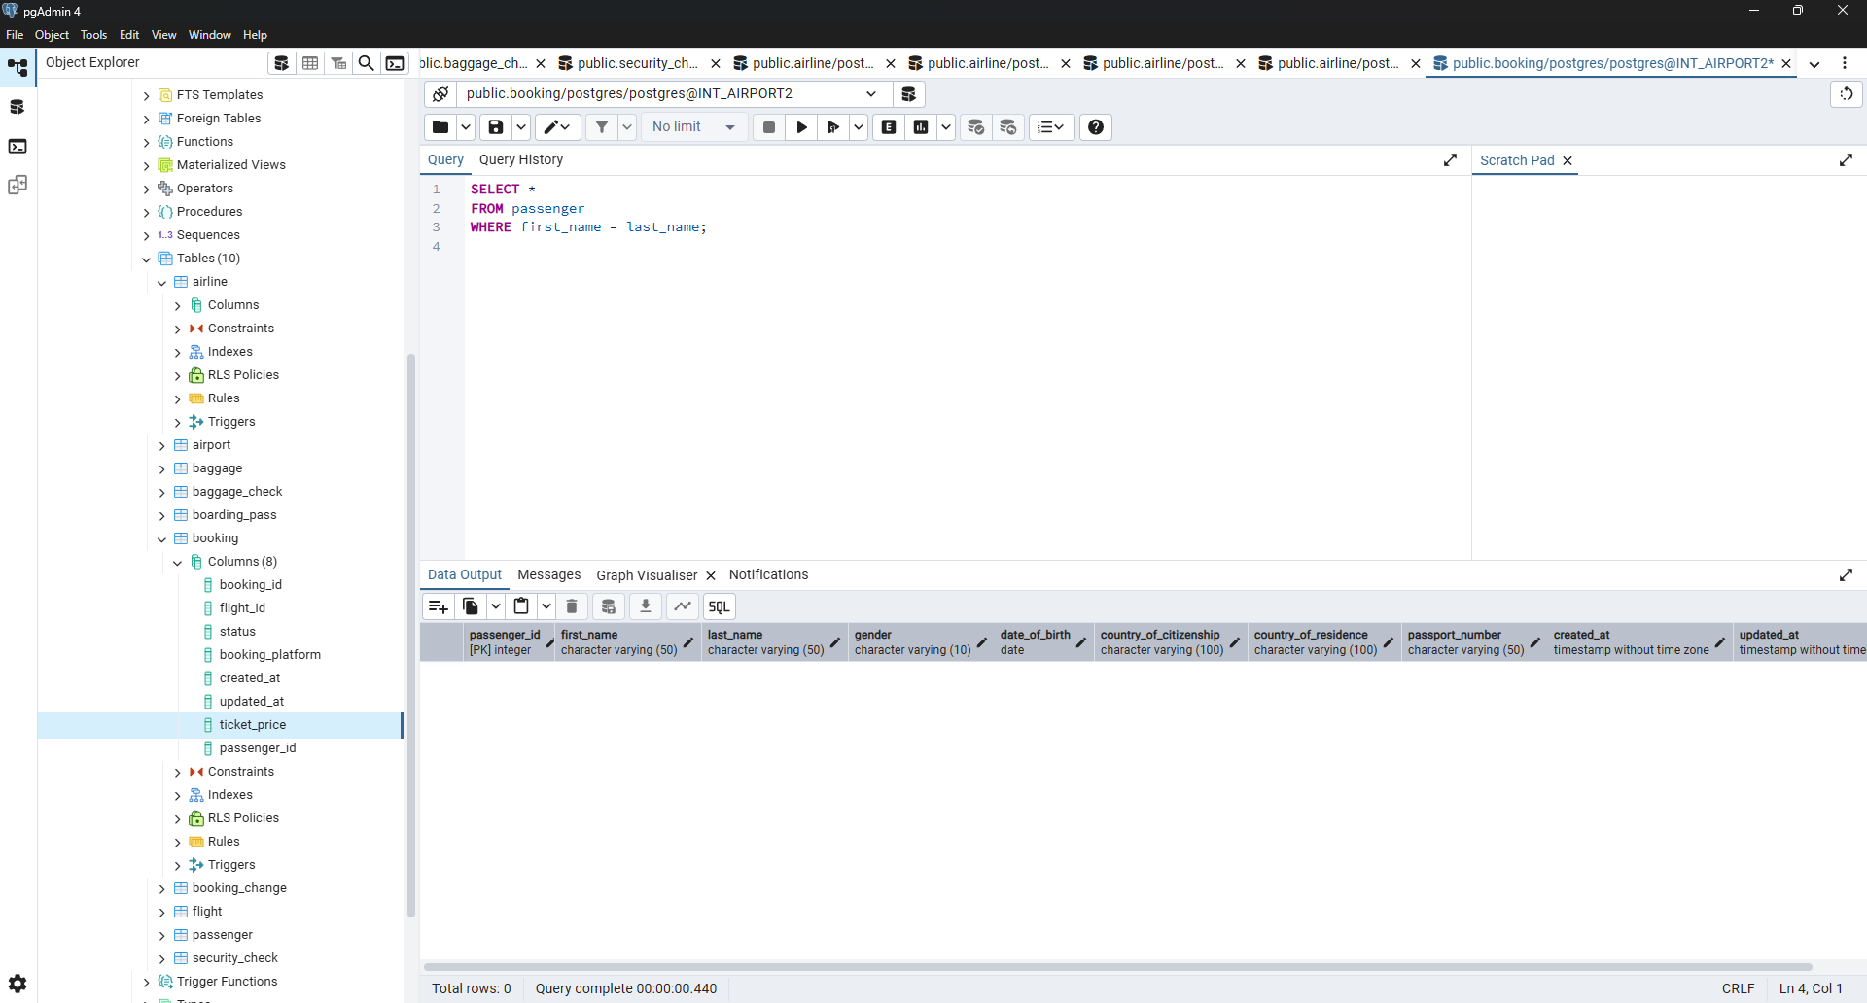
1. Select all the data of passengers whose last name is same as first name.

Slide 2
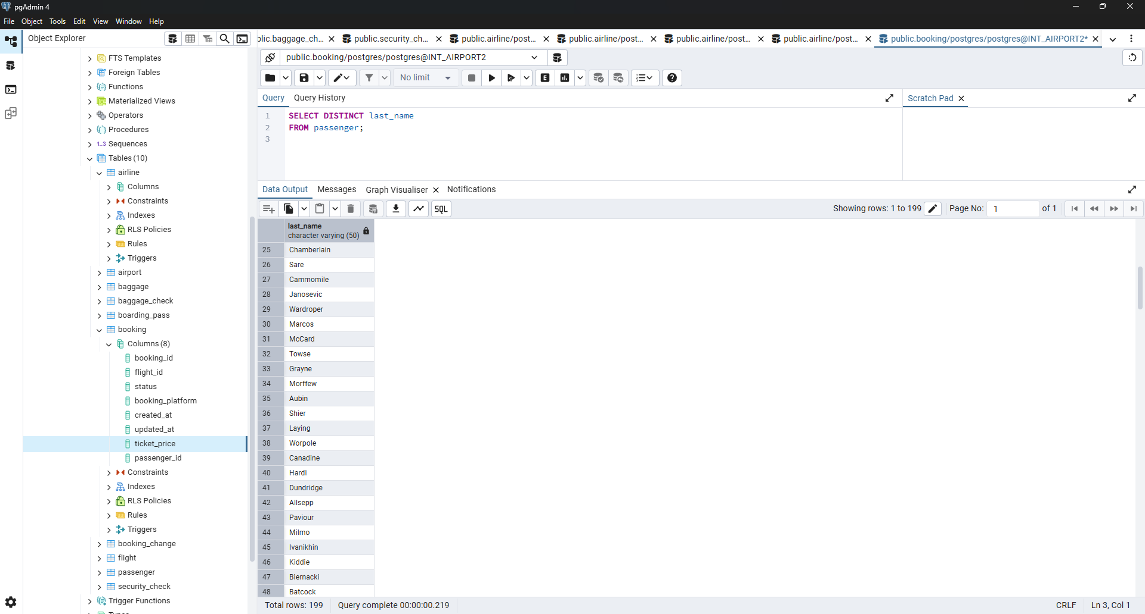
2. Select the last name of all passangers without duplicates.

Slide 3
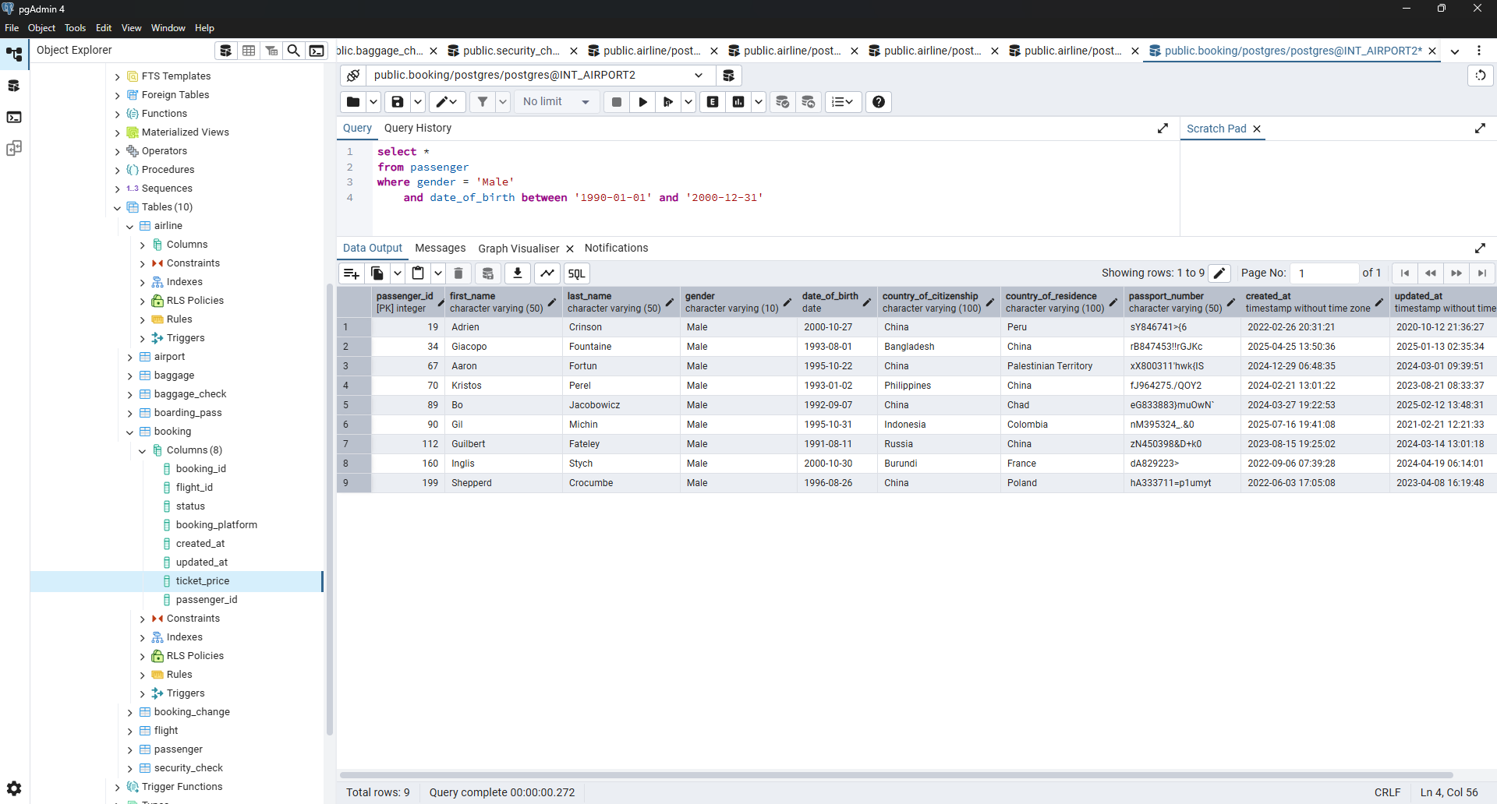
3. Find all male passengers born between 1990 and 2000.

Slide 4
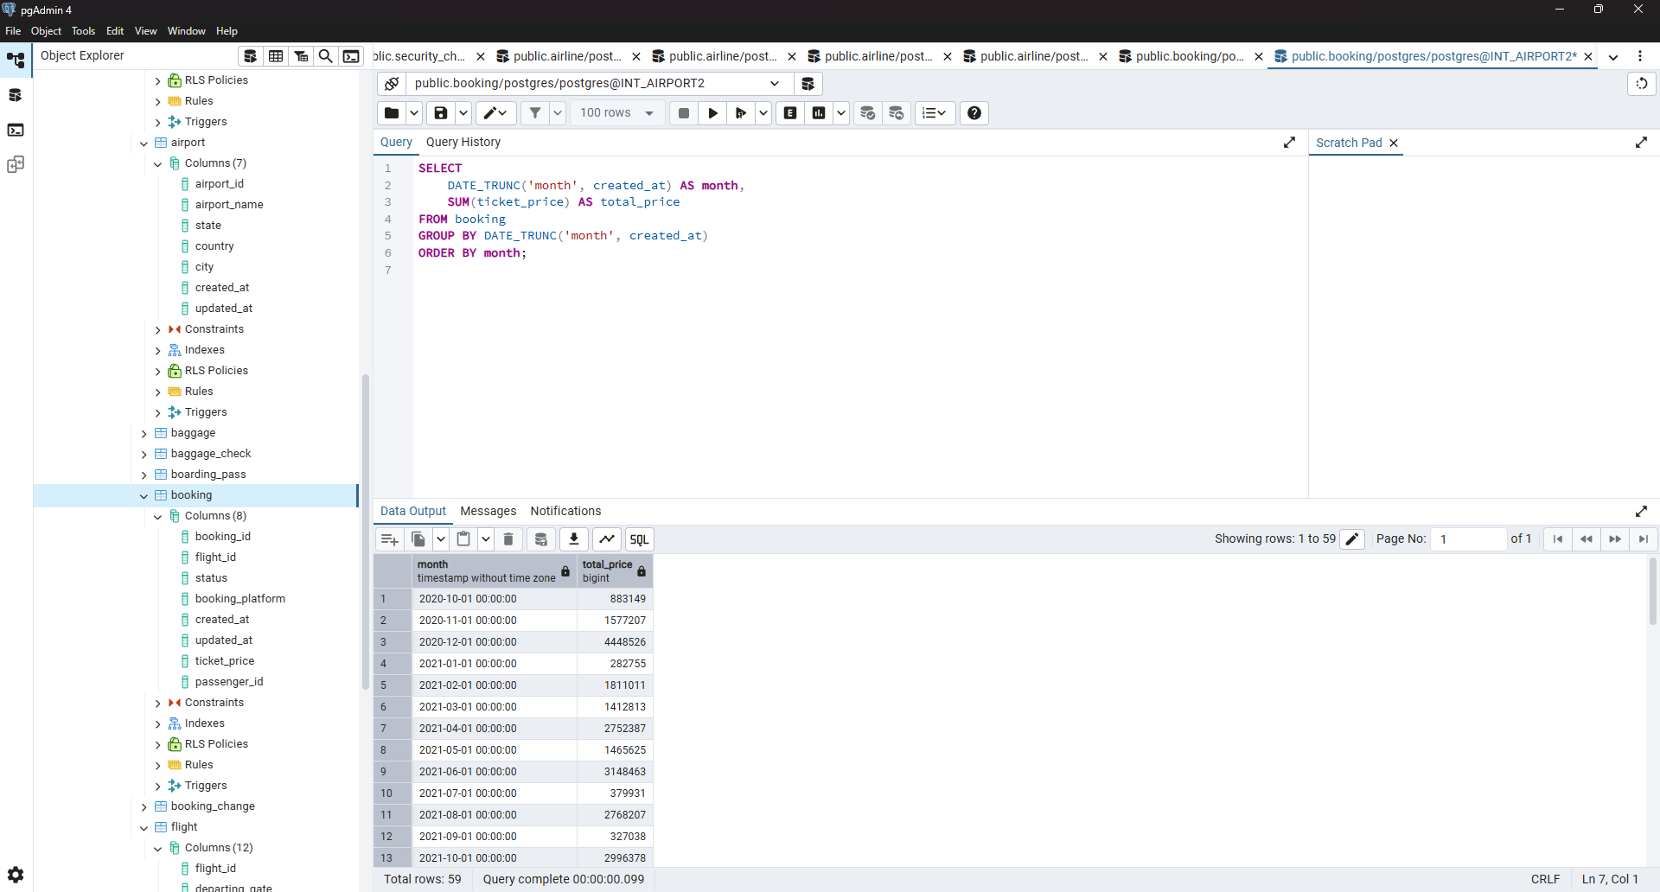
4. Find price of tickets sold for each month in sorted way.

Slide 5
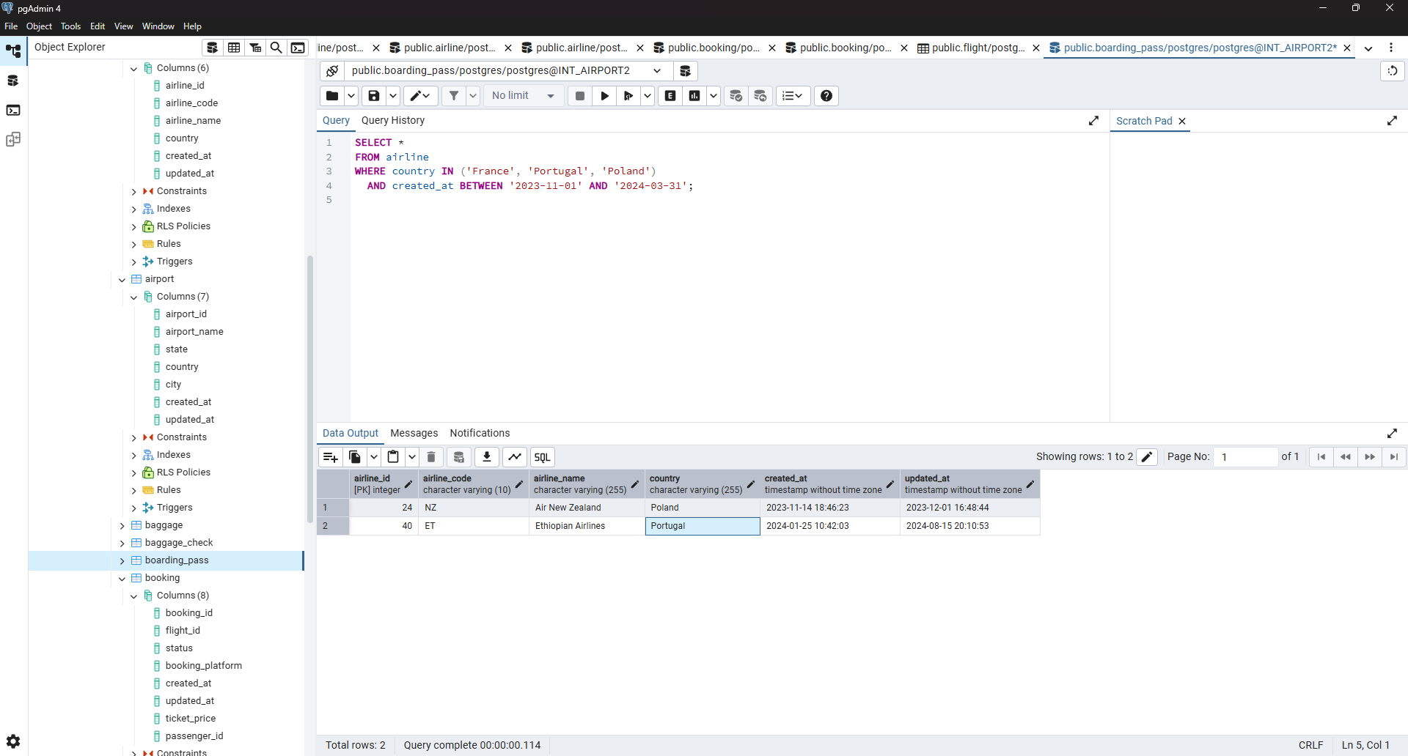
6. Show airlines from any of: ('France','Portugal','Poland') created between '2023-11-01' and '2024-03-31'.

Slide 6
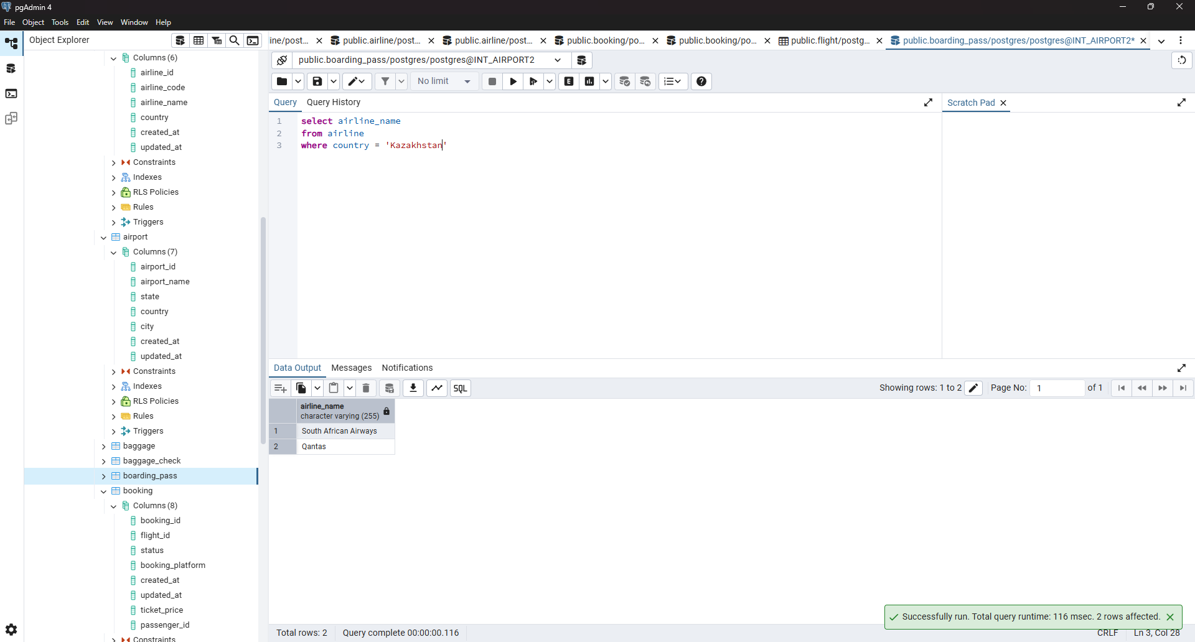
7. Find all airline names based in Kazakhstan.

Slide 7
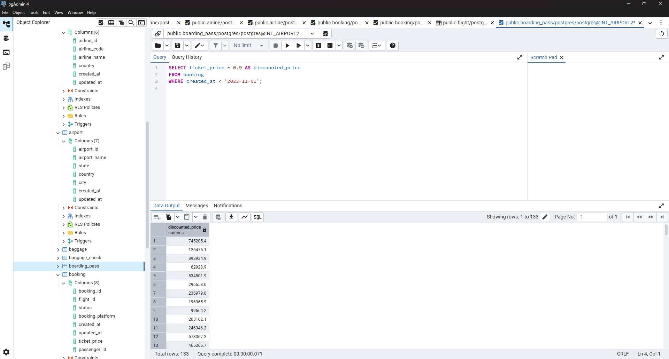
8. Reduce the cost of booking price by 10% created before ’11-01-2023’.

Slide 8
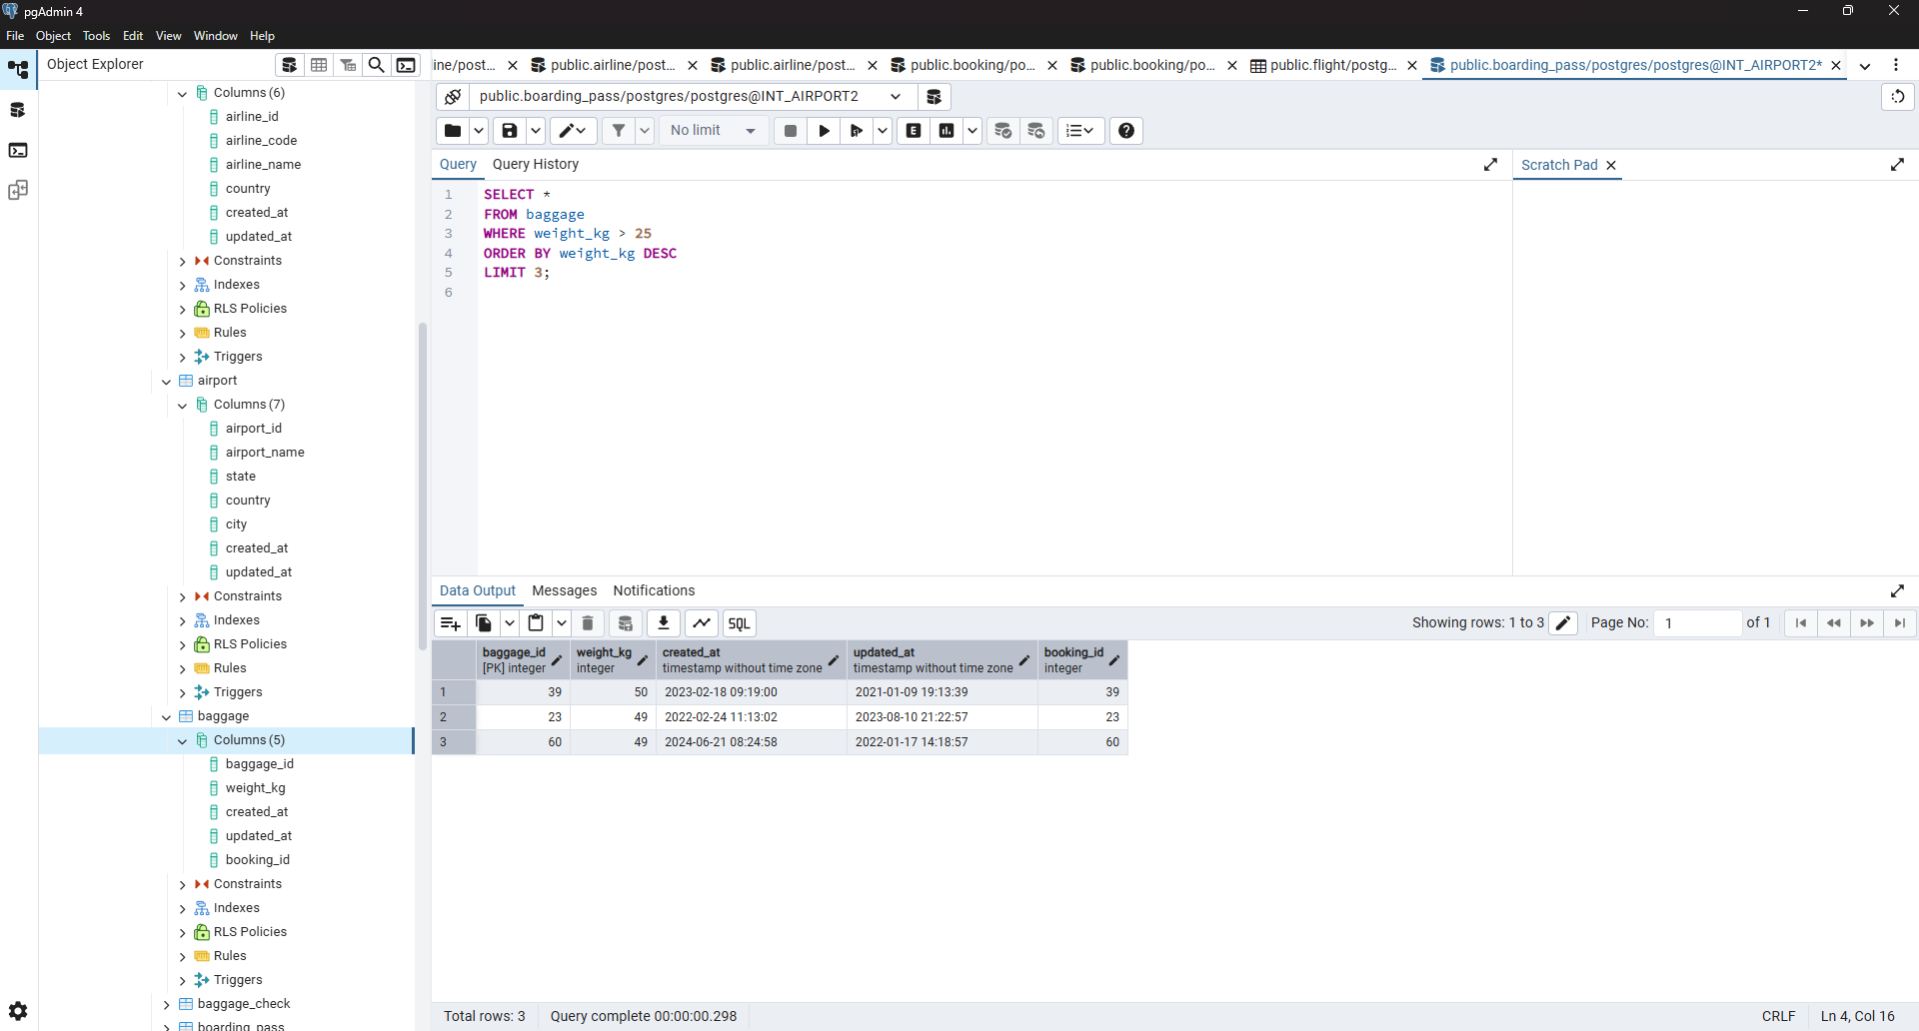
9. Find top 3 overweighted baggage with more than 25kg.

Slide 9
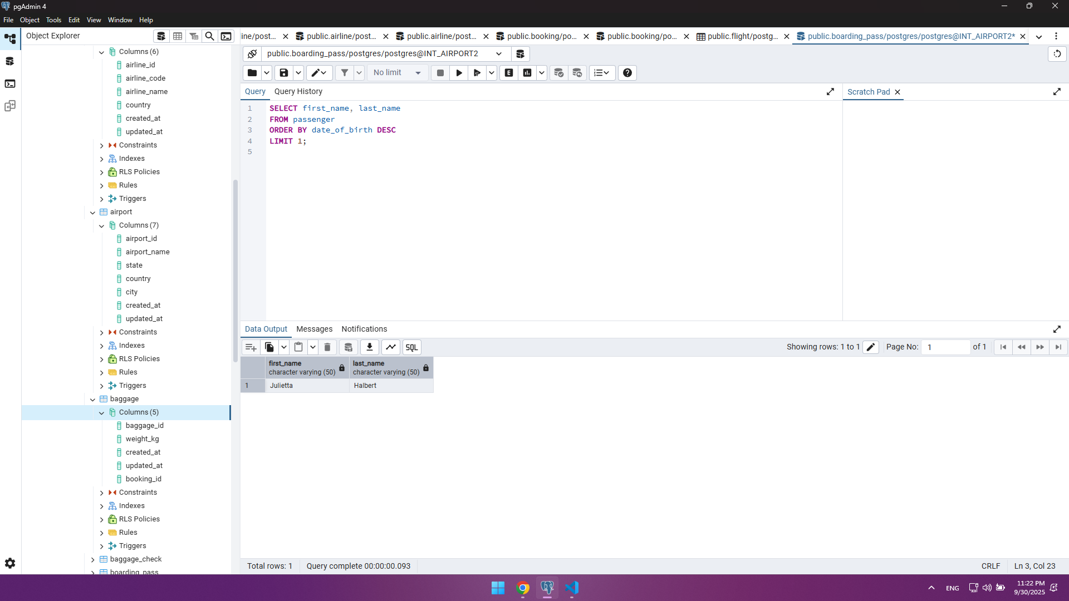
10. Find the youngest passengers’ full name.

Slide 10
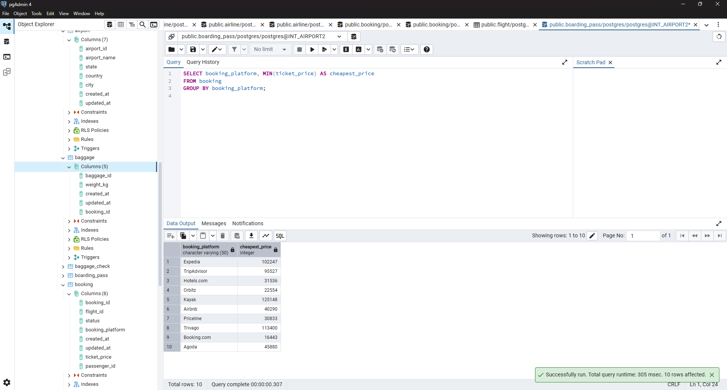
11. Find the cheapest booking price on each booking platform.

Slide 11
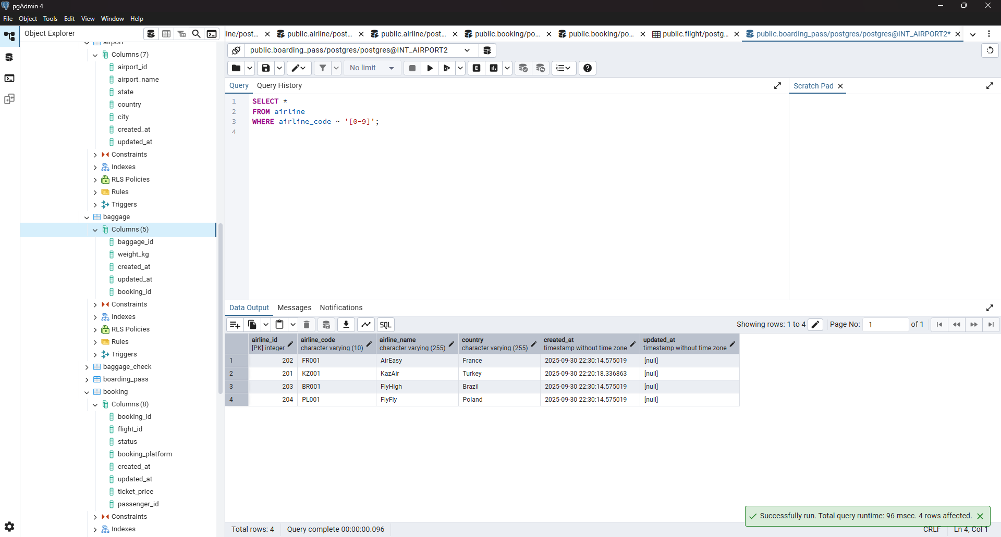
12. Return airlines whose airline_code contains a digit.

Slide 12
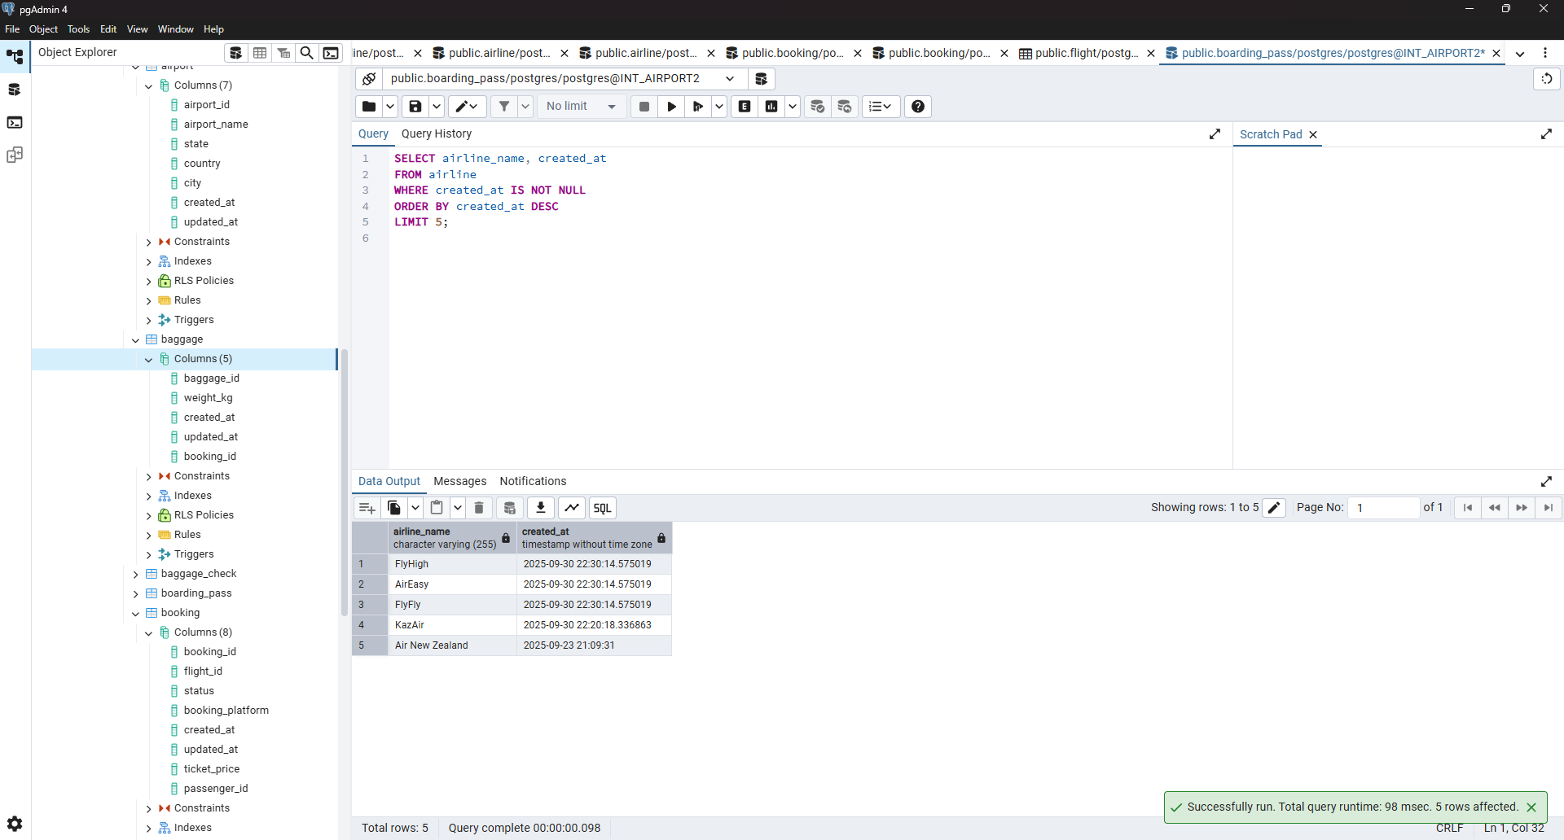
13. List the top 5 most recently created airlines.

Slide 13
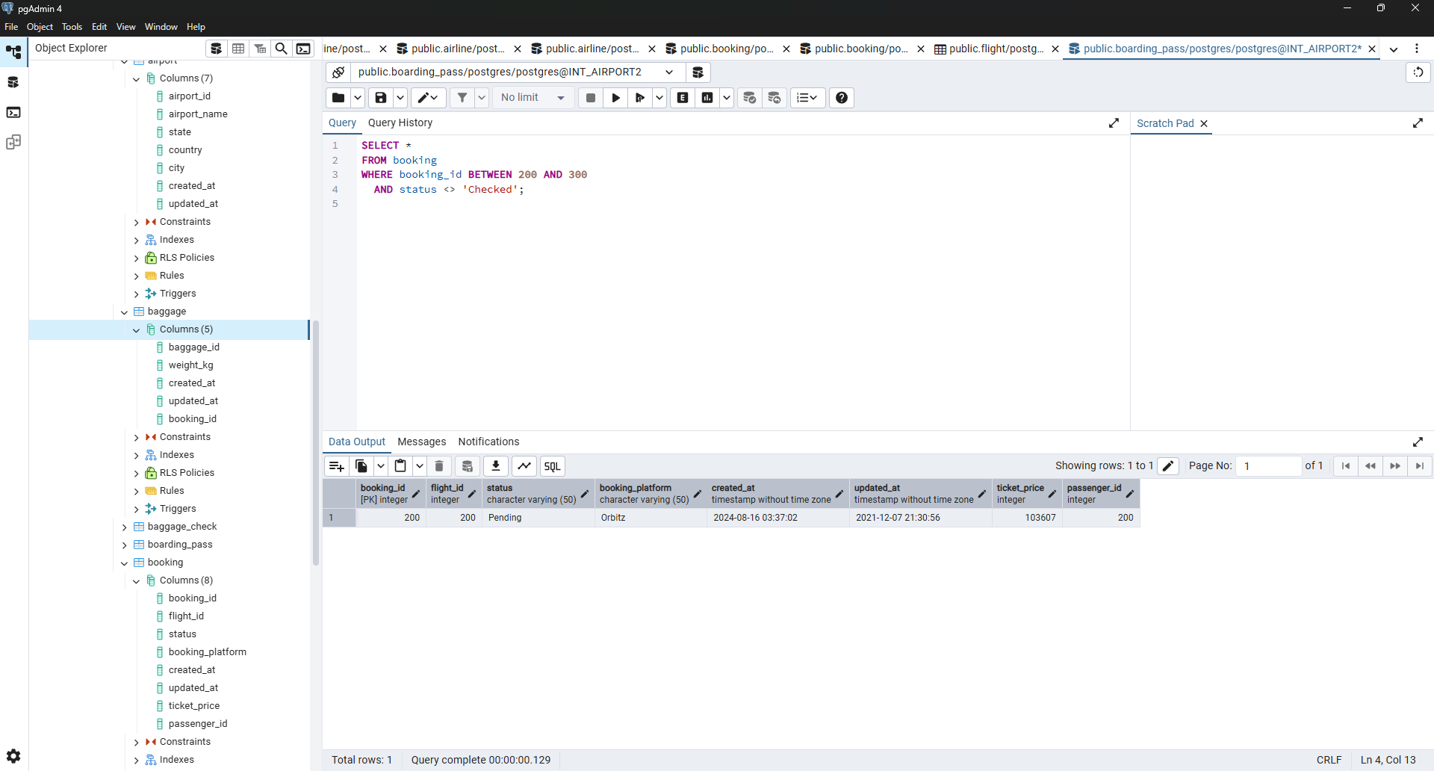
14. Return all rows where booking_id is between 200 and 300 inclusive and check_result <> 'Checked'.

Slide 14
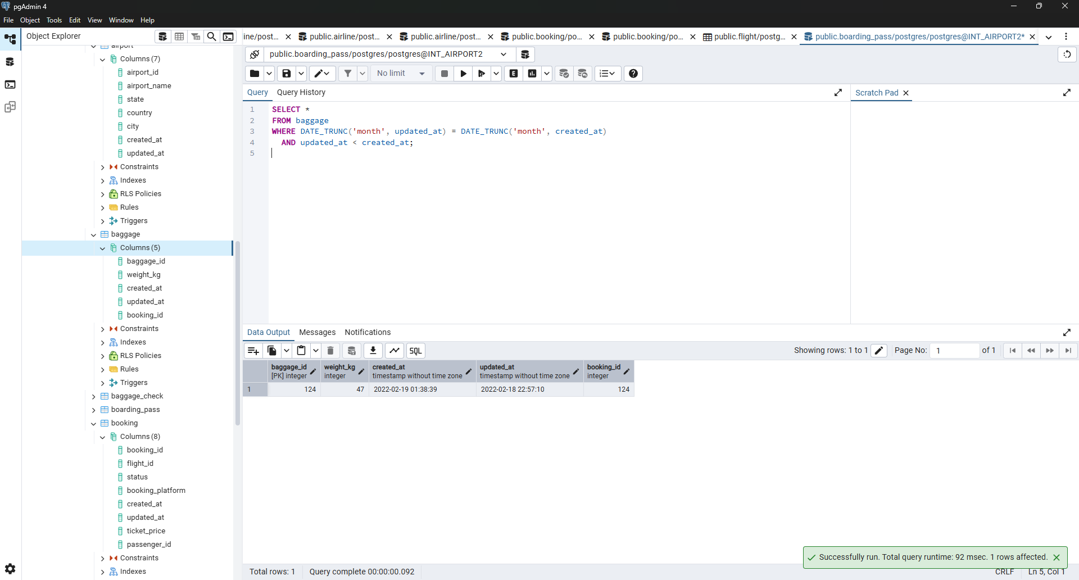
15. Baggage checks where update_at is in the same month as created_at but occurs earlier than created_at.

