Slide 1
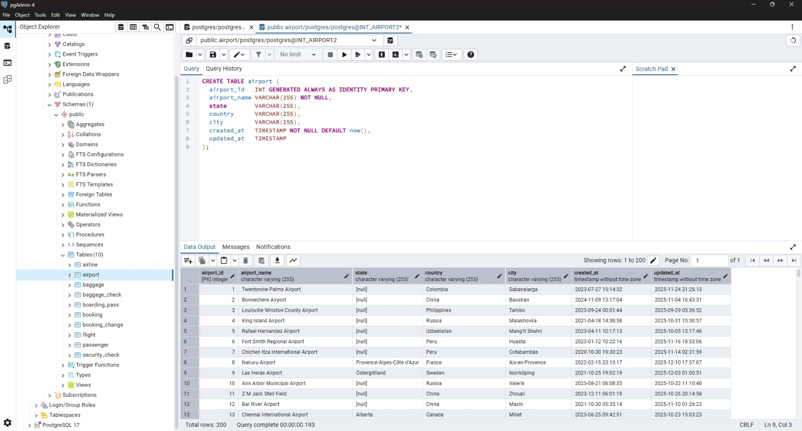
Airline table:

Slide 2
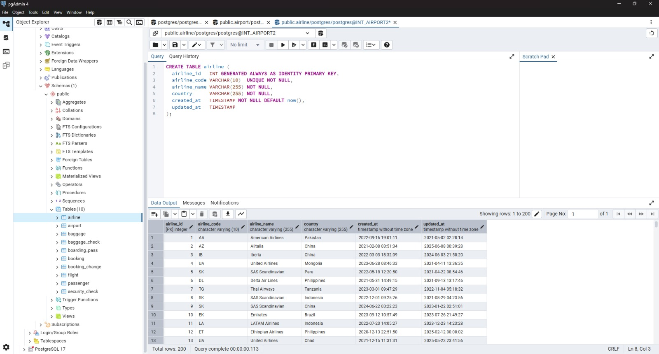
2. Airport table:

Slide 3
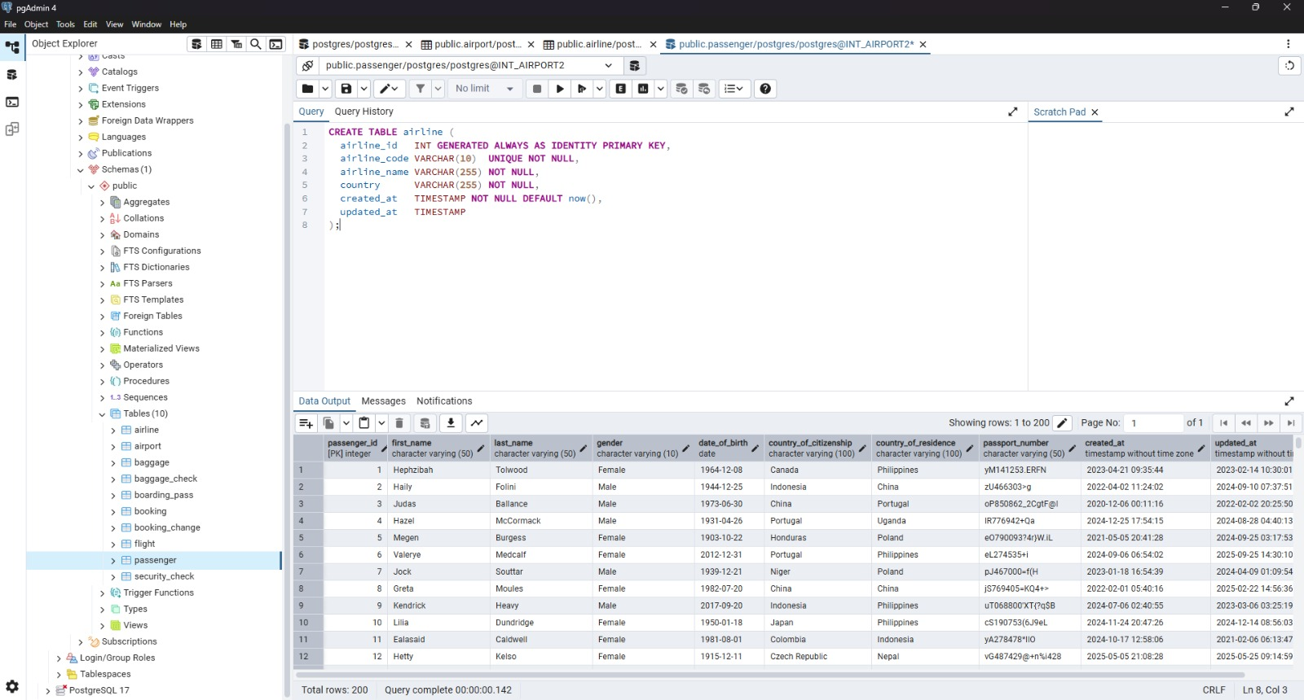
3. Passenger table:

Slide 4
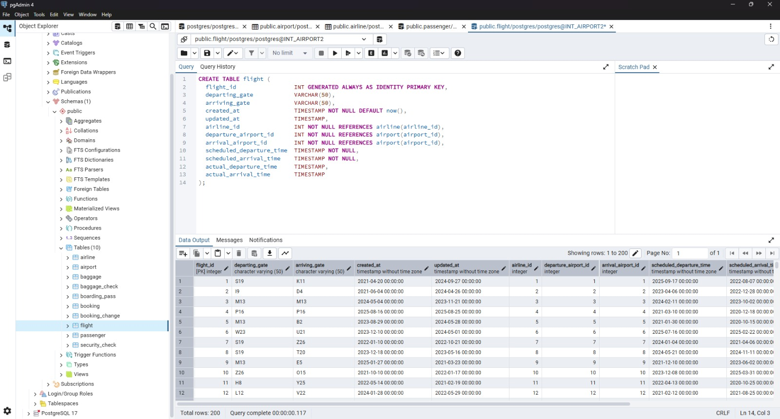
4. Flight table:

Slide 5
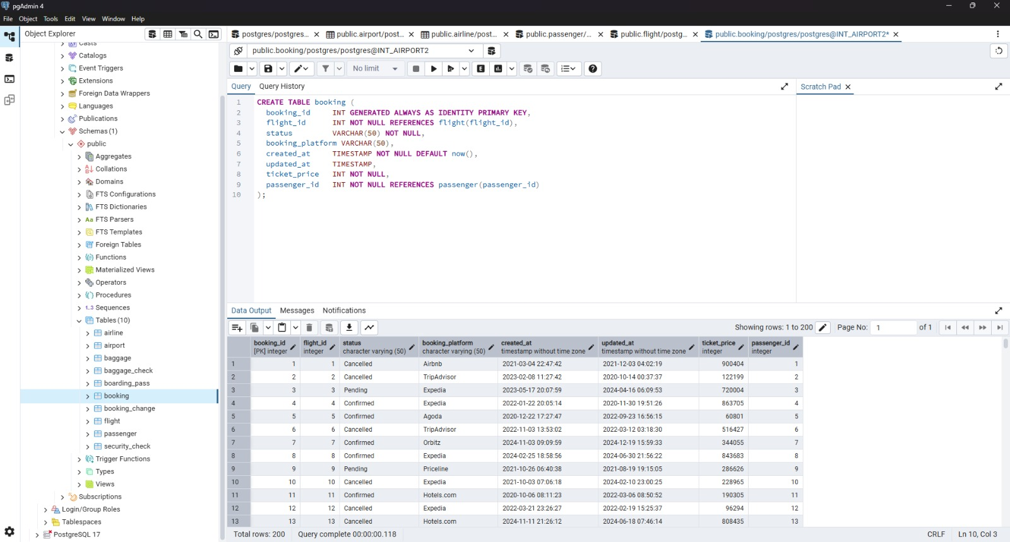
5. Booking table:

Slide 6
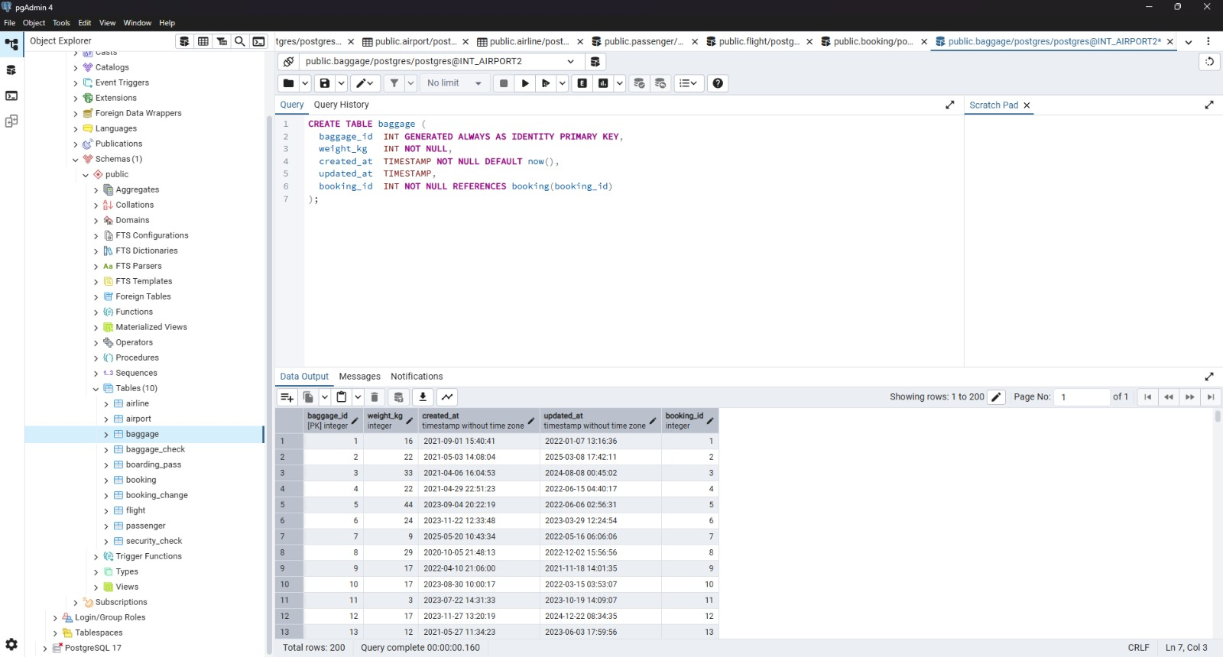
6. Baggage table:

Slide 7
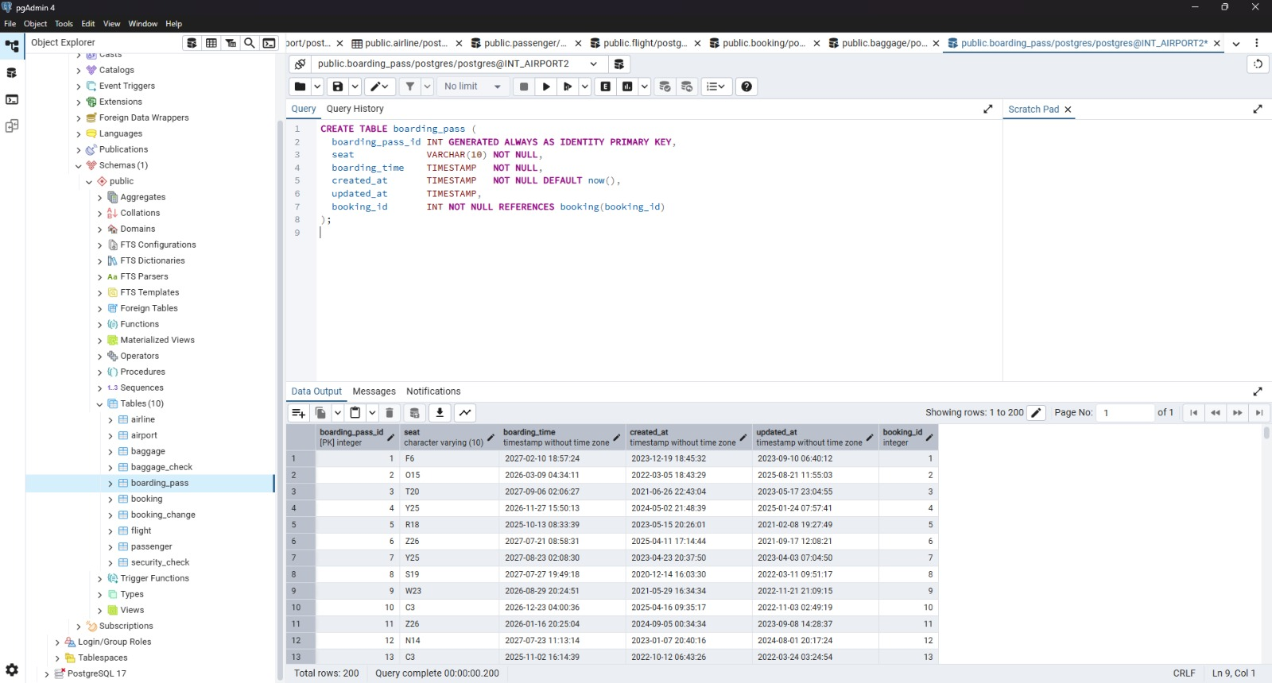
7. Boarding pass table:

Slide 8
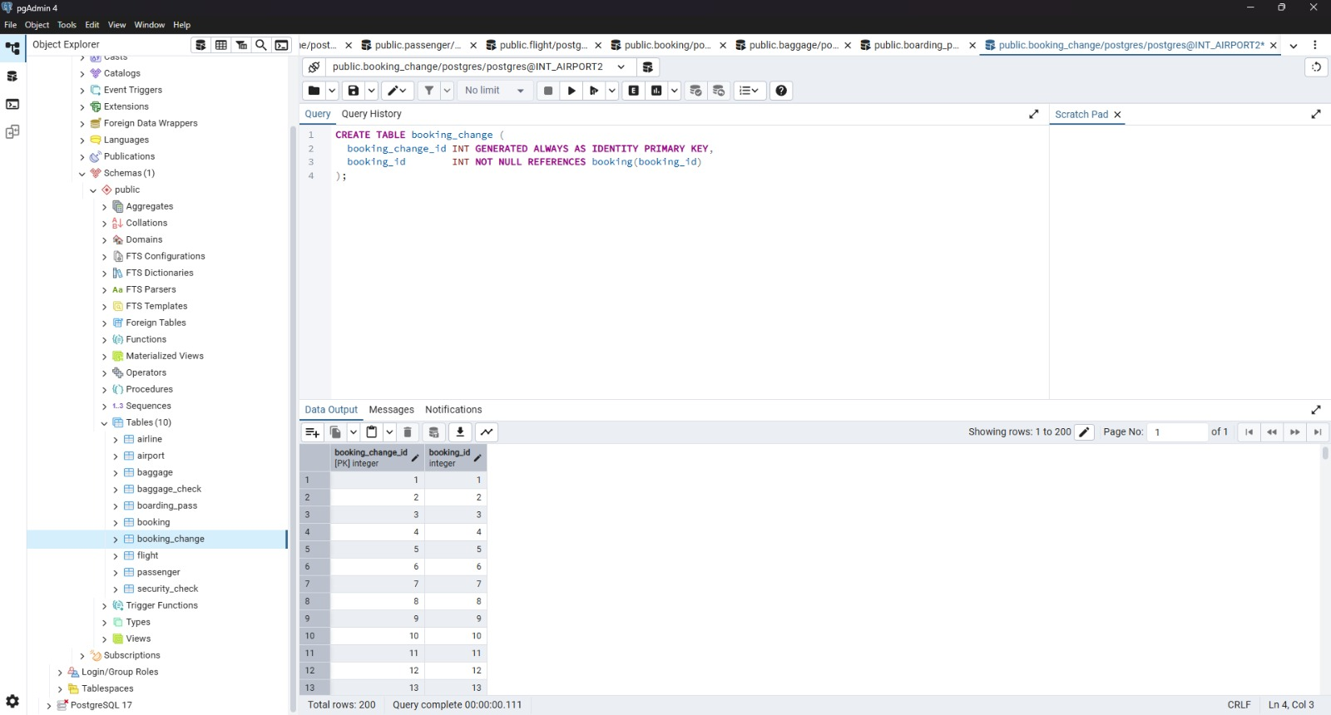
8. Booking change table:

Slide 9
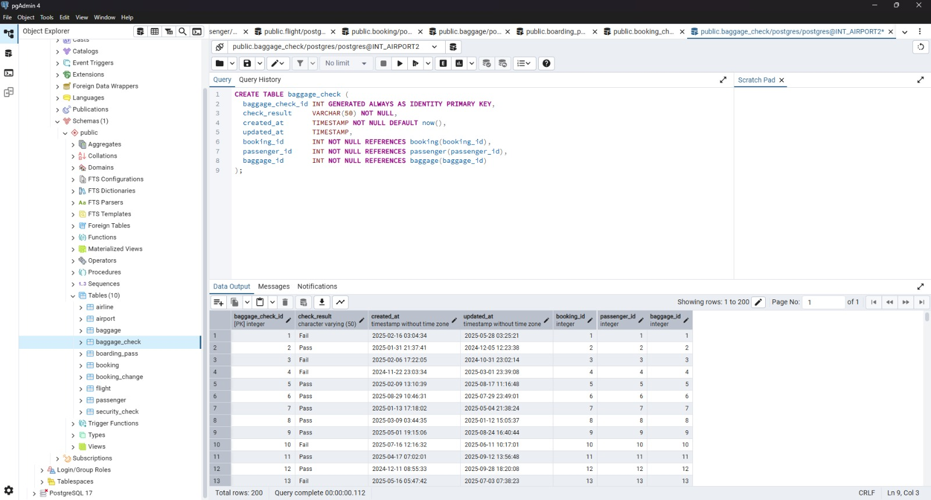
9. Baggage check table:

Slide 10
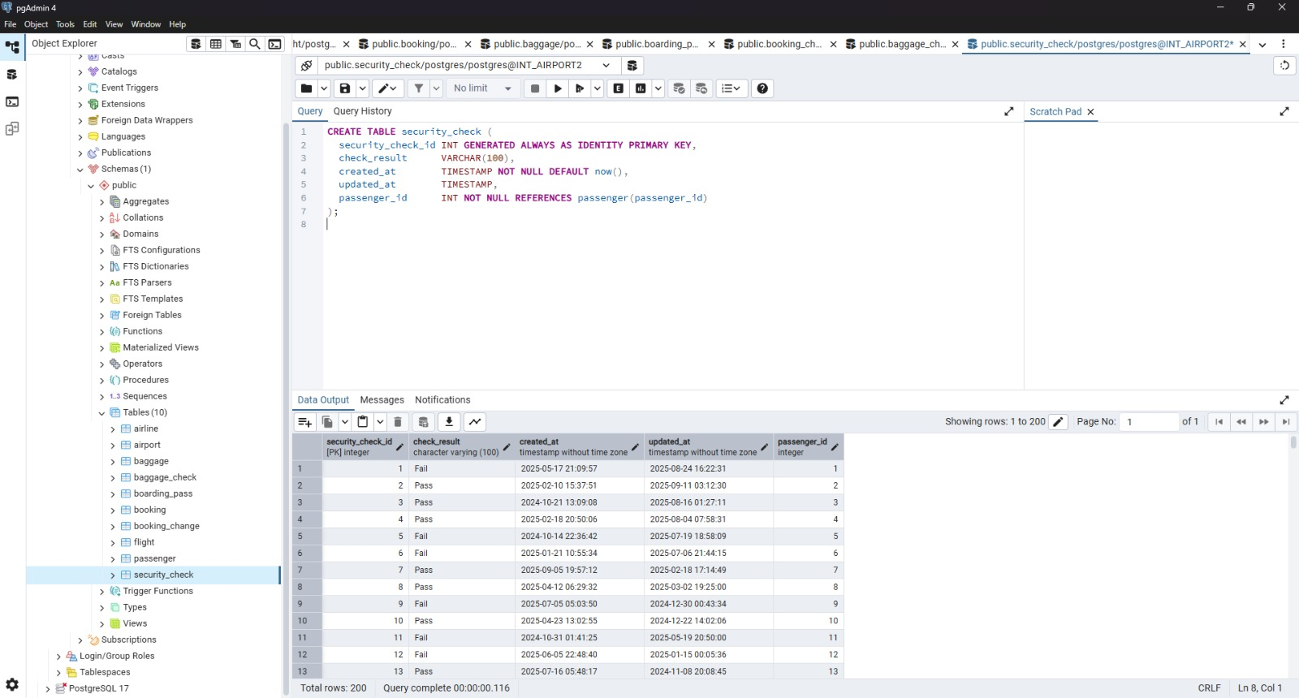
10. Security check table:

Slide 11
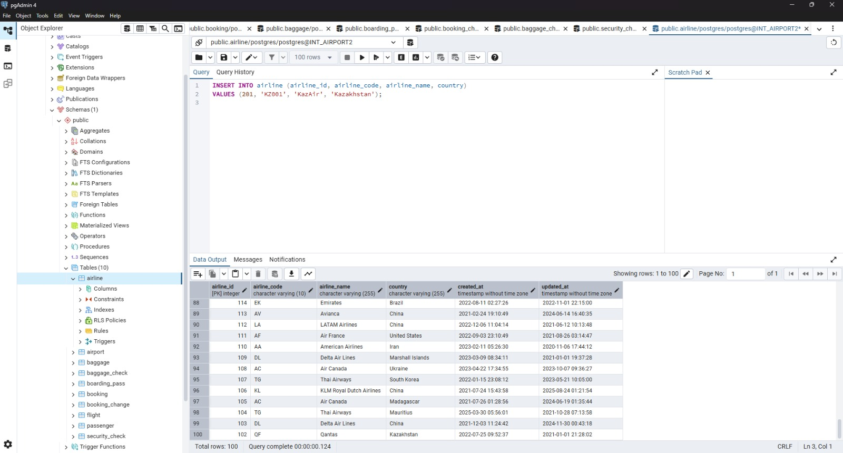
2. Add a new airline named "KazAir" based in "Kazakhstan" to the airline table.

Slide 12
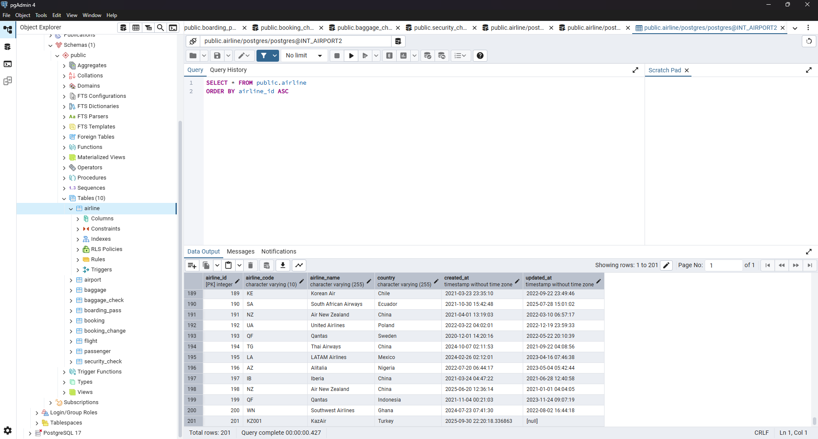
3. Update the airline country "KazAir" to "Turkey".

Slide 13
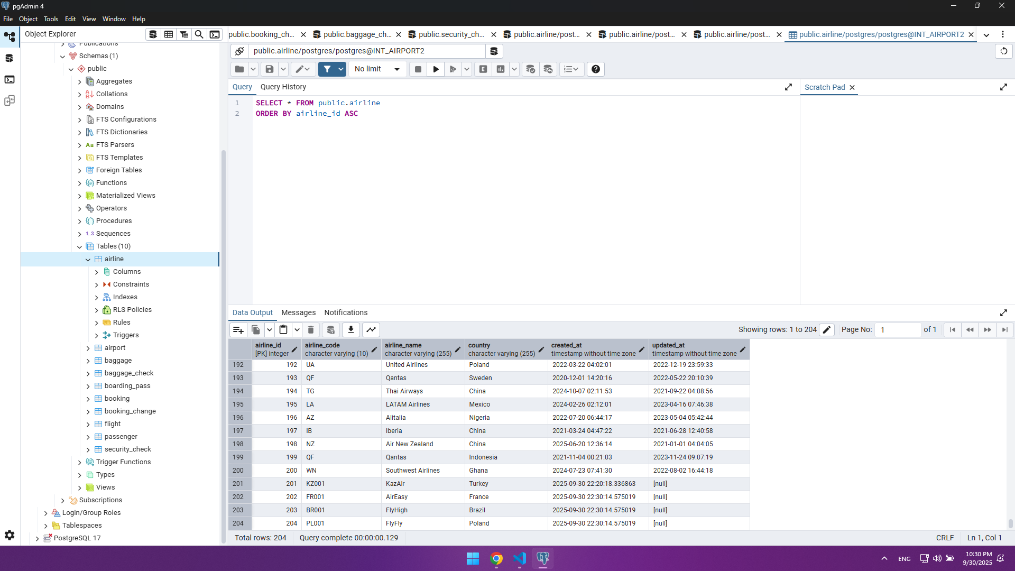
4. Add three airlines at once: "AirEasy" in "France", "FlyHigh" in "Brazil" and "FlyFly" in "Poland".

Slide 14
4. Add three airlines at once: "AirEasy" in "France", "FlyHigh" in "Brazil" and "FlyFly" in "Poland".

Slide 15
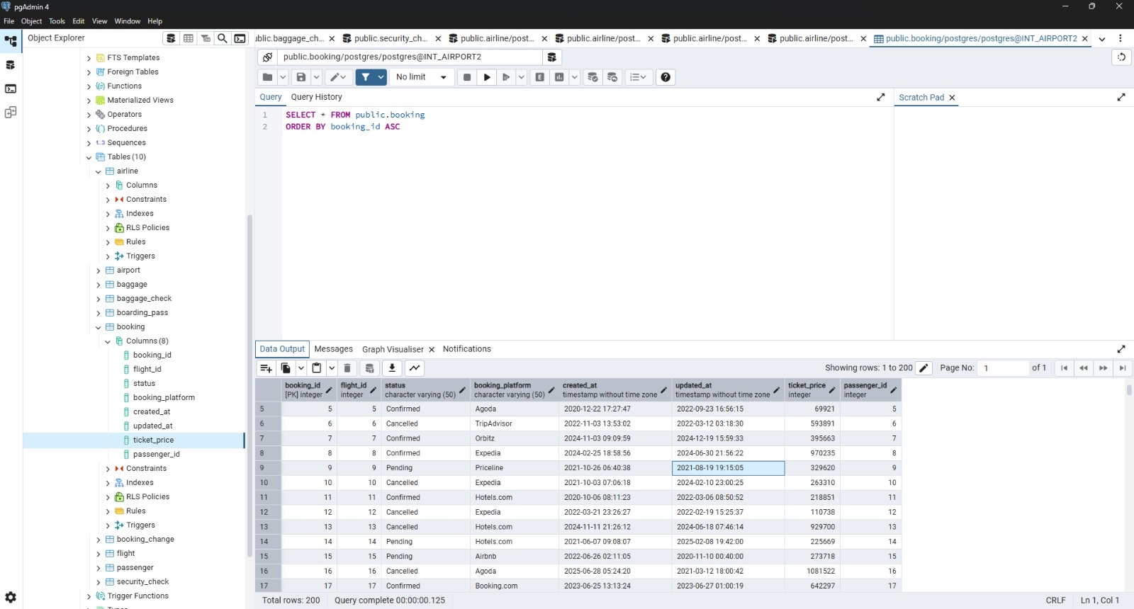
6. Increase the price of all tickets in booking table for flights by 15%.

