Slide 1
Yeskenov Aldiyar

Slide 2
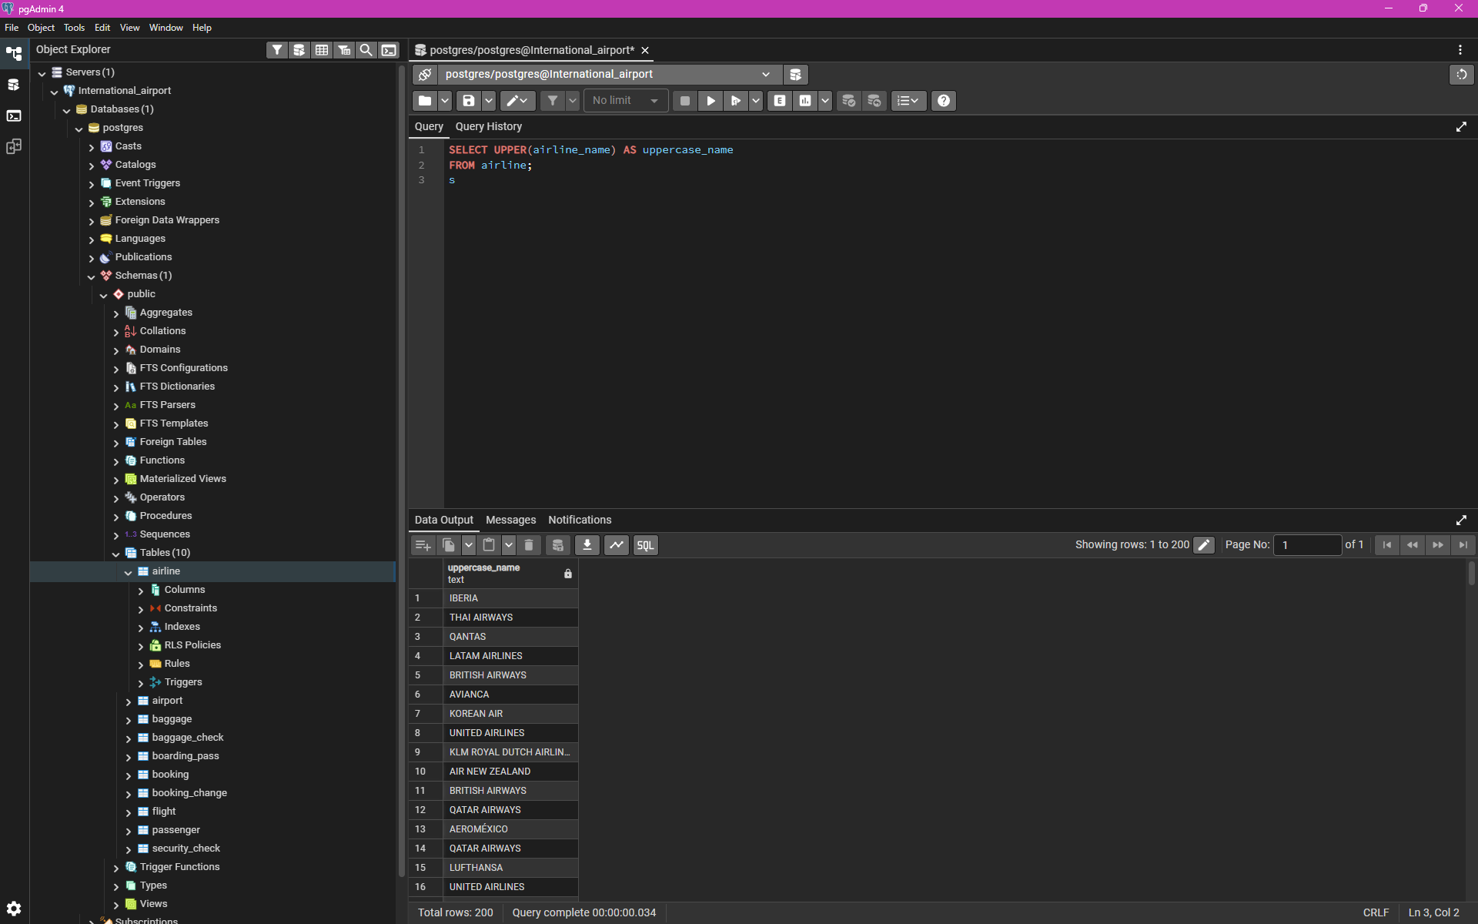
1. Retrieve all airline names in uppercase.

Slide 3
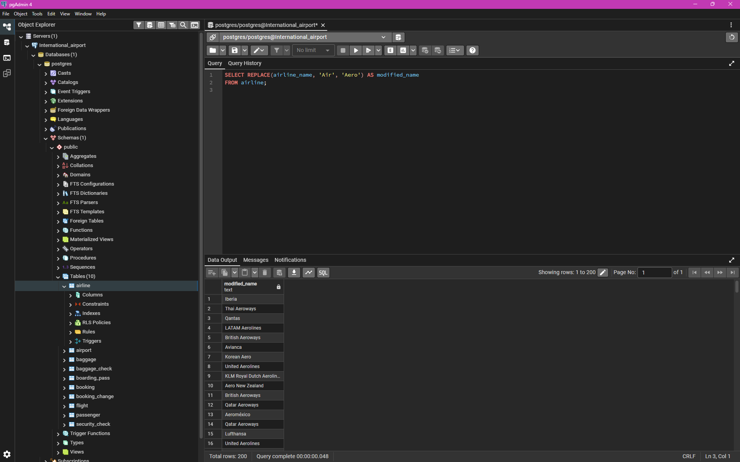
2. Replace any occurrence of the word "Air" in airline names with "Aero".

Slide 4
2. Replace any occurrence of the word "Air" in airline names with "Aero".

Slide 5
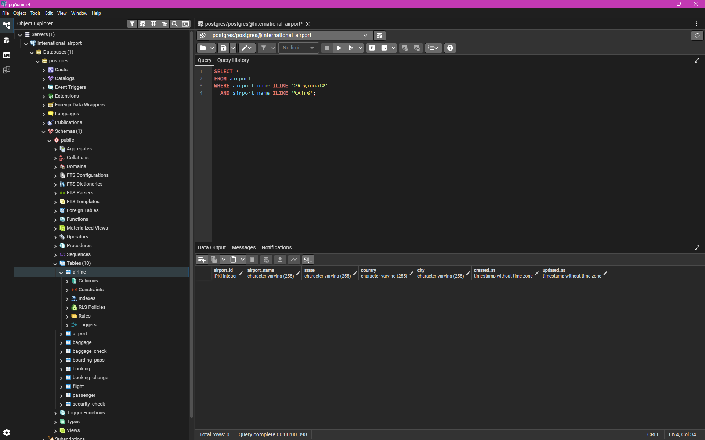
4. Retrieve airports that contain the words "Regional" and "Air" in their names

Slide 6
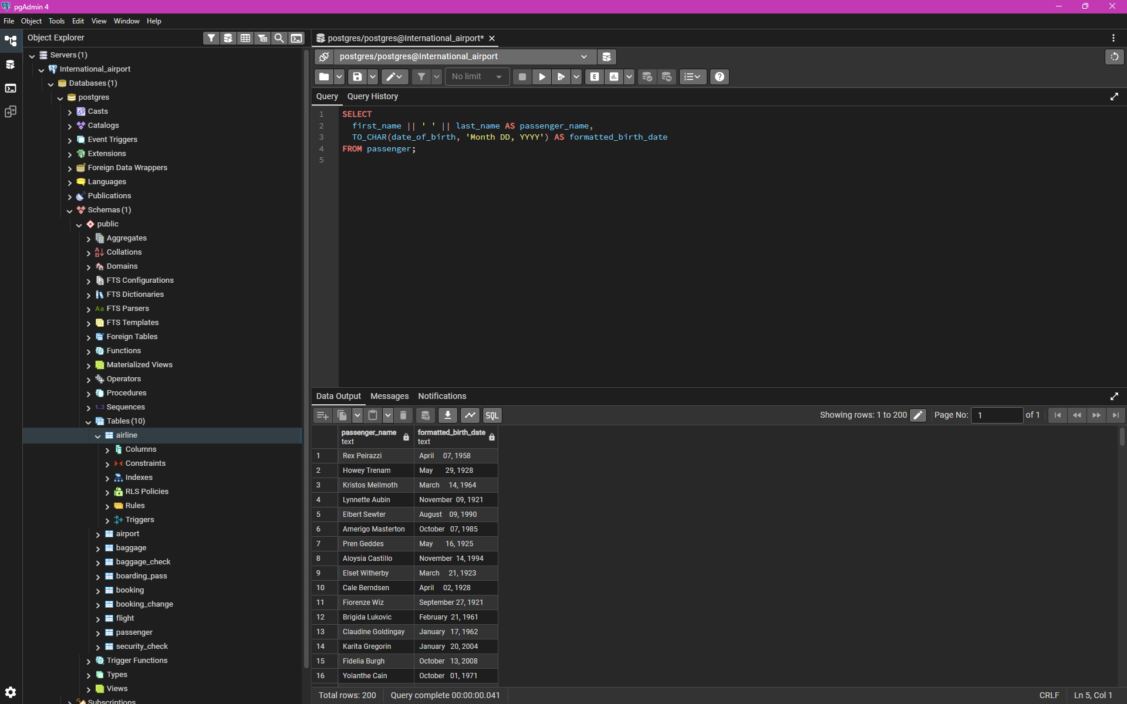
5. Retrieve passenger names and format their birth dates as 'Month DD, YYYY'

Slide 7
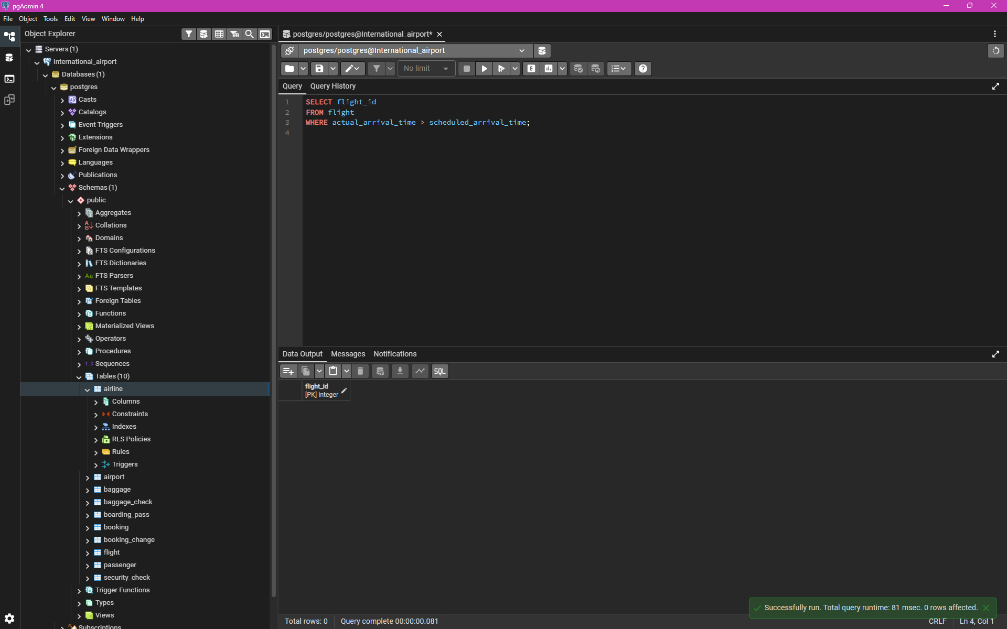
6. Find flight IDs that have been delayed based on the actual arrival time

Slide 8
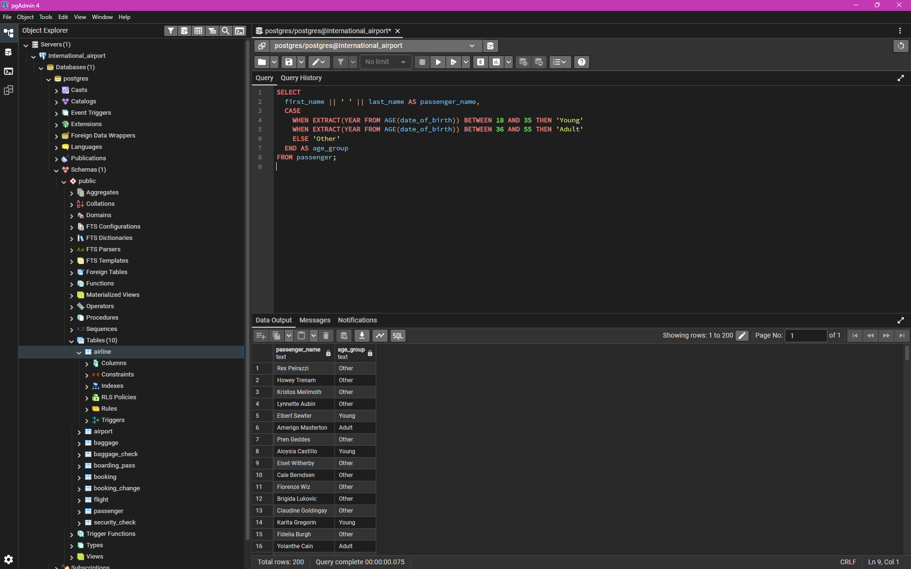
7. Divide passengers into age groups (‘Young’ 18–35, ‘Adult’ 36–55)

Slide 9
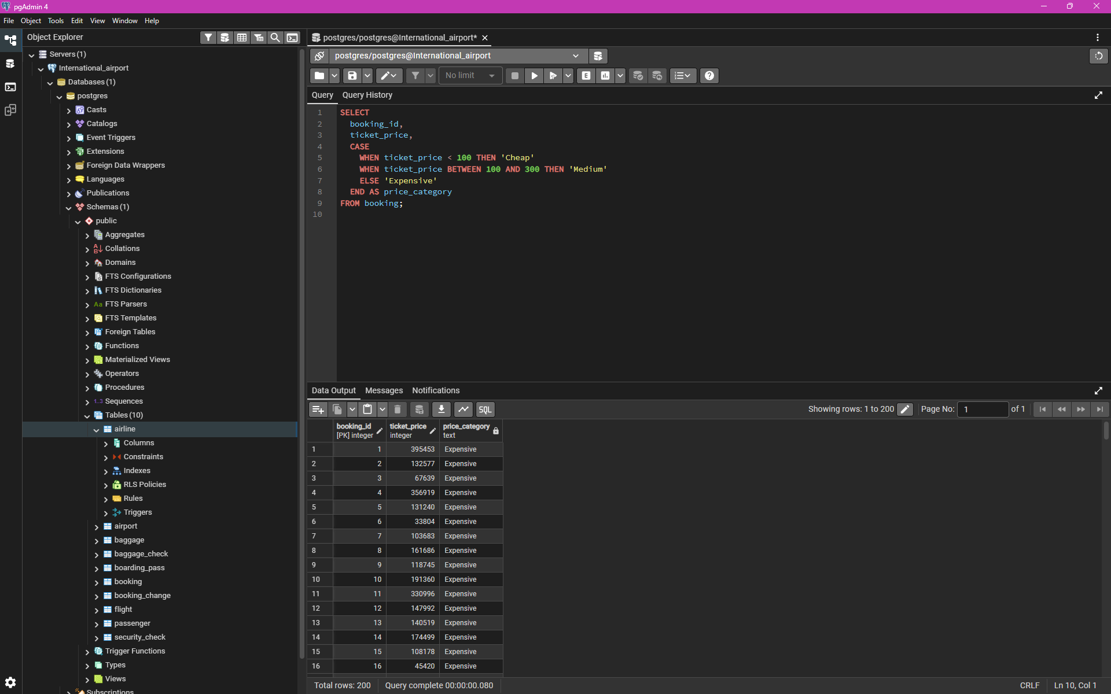
8. Categorize ticket prices as "Cheap", "Medium" or "Expensive"

Slide 10
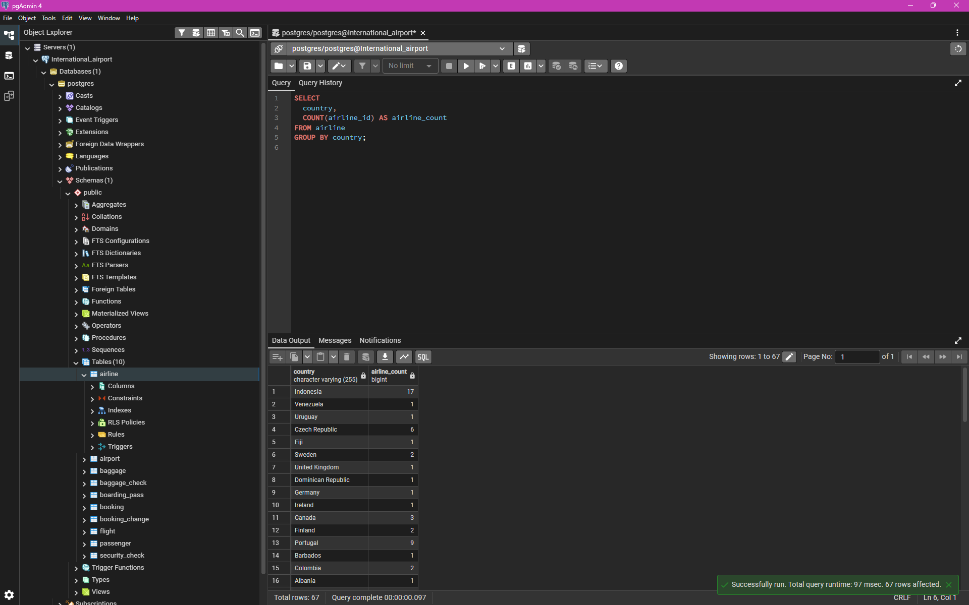
9. Find number of airline names in each airline country

Slide 11
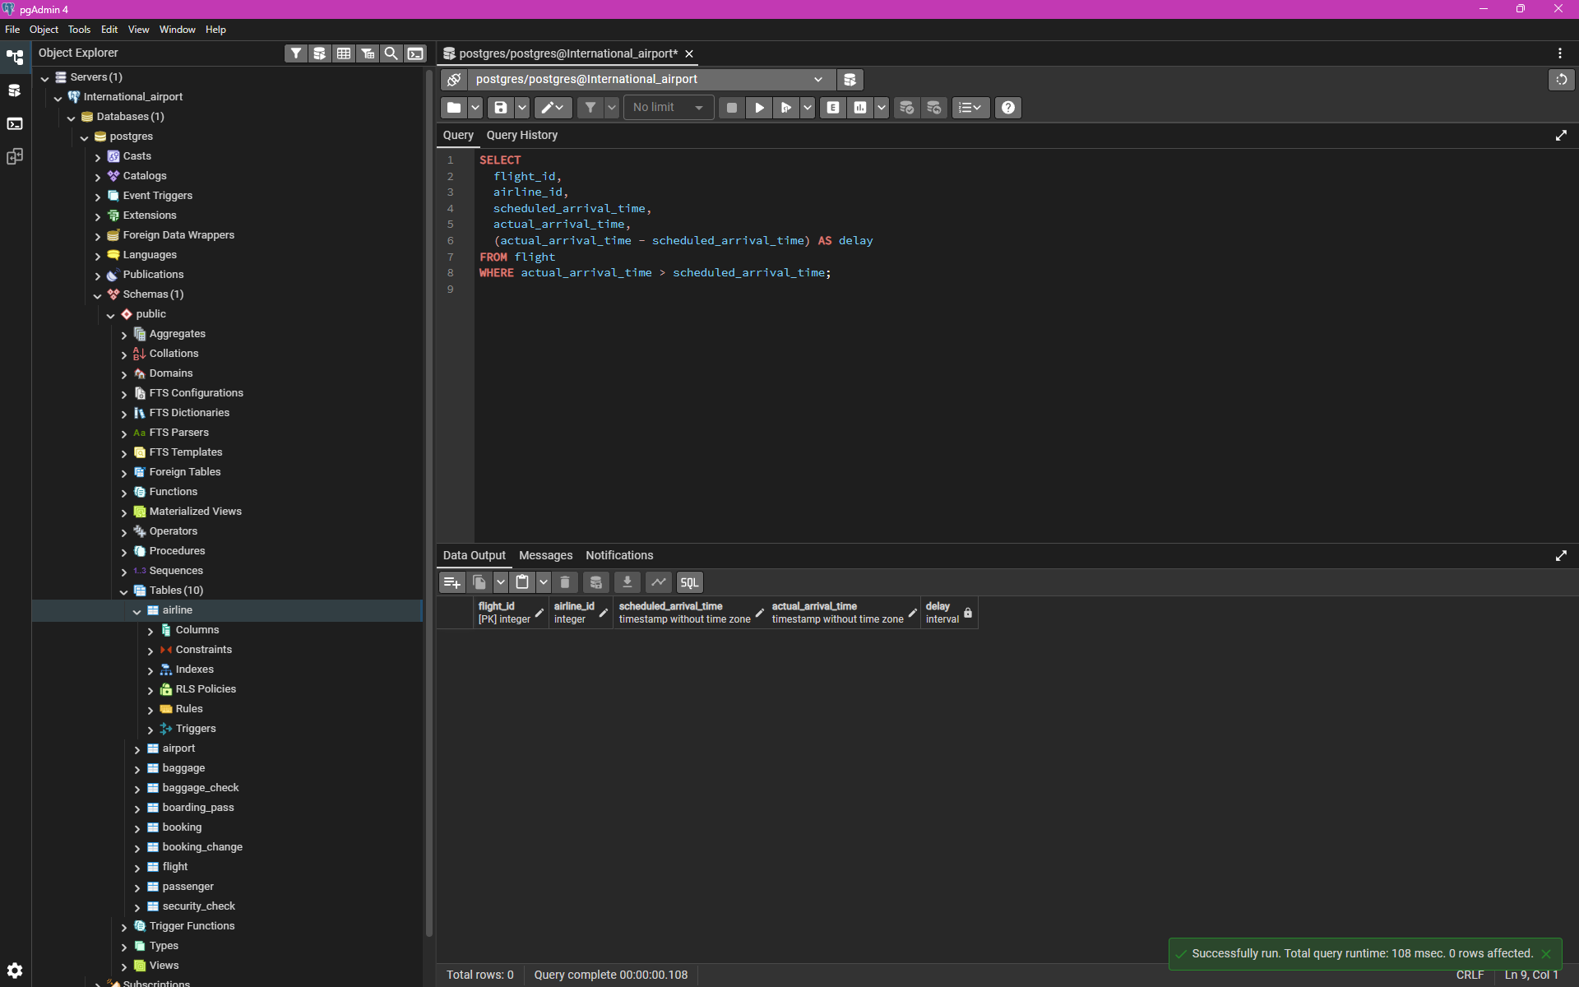
10. Find flights that arrived late compared to their scheduled arrival time

