Slide 1
Yeskenov Aldiyar
DBS 7th lab

Slide 2
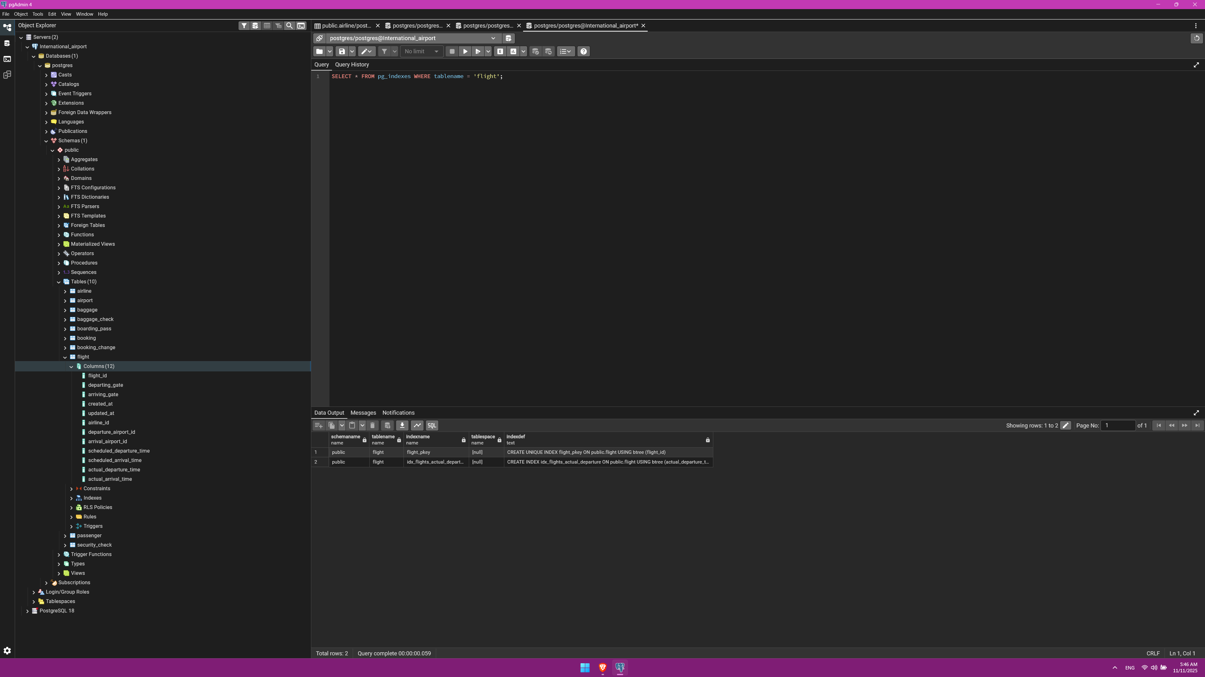
1. Create an index on the actual_departure column in the flights table.

Slide 3
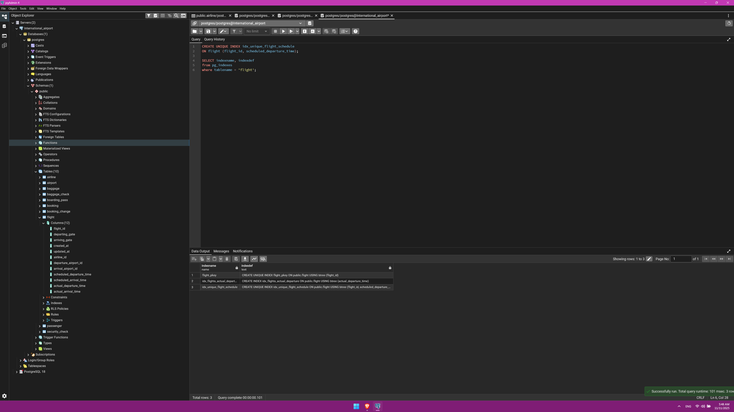
2. Create a unique index to ensure flight_no and scheduled_departure combinations are unique.

Slide 4
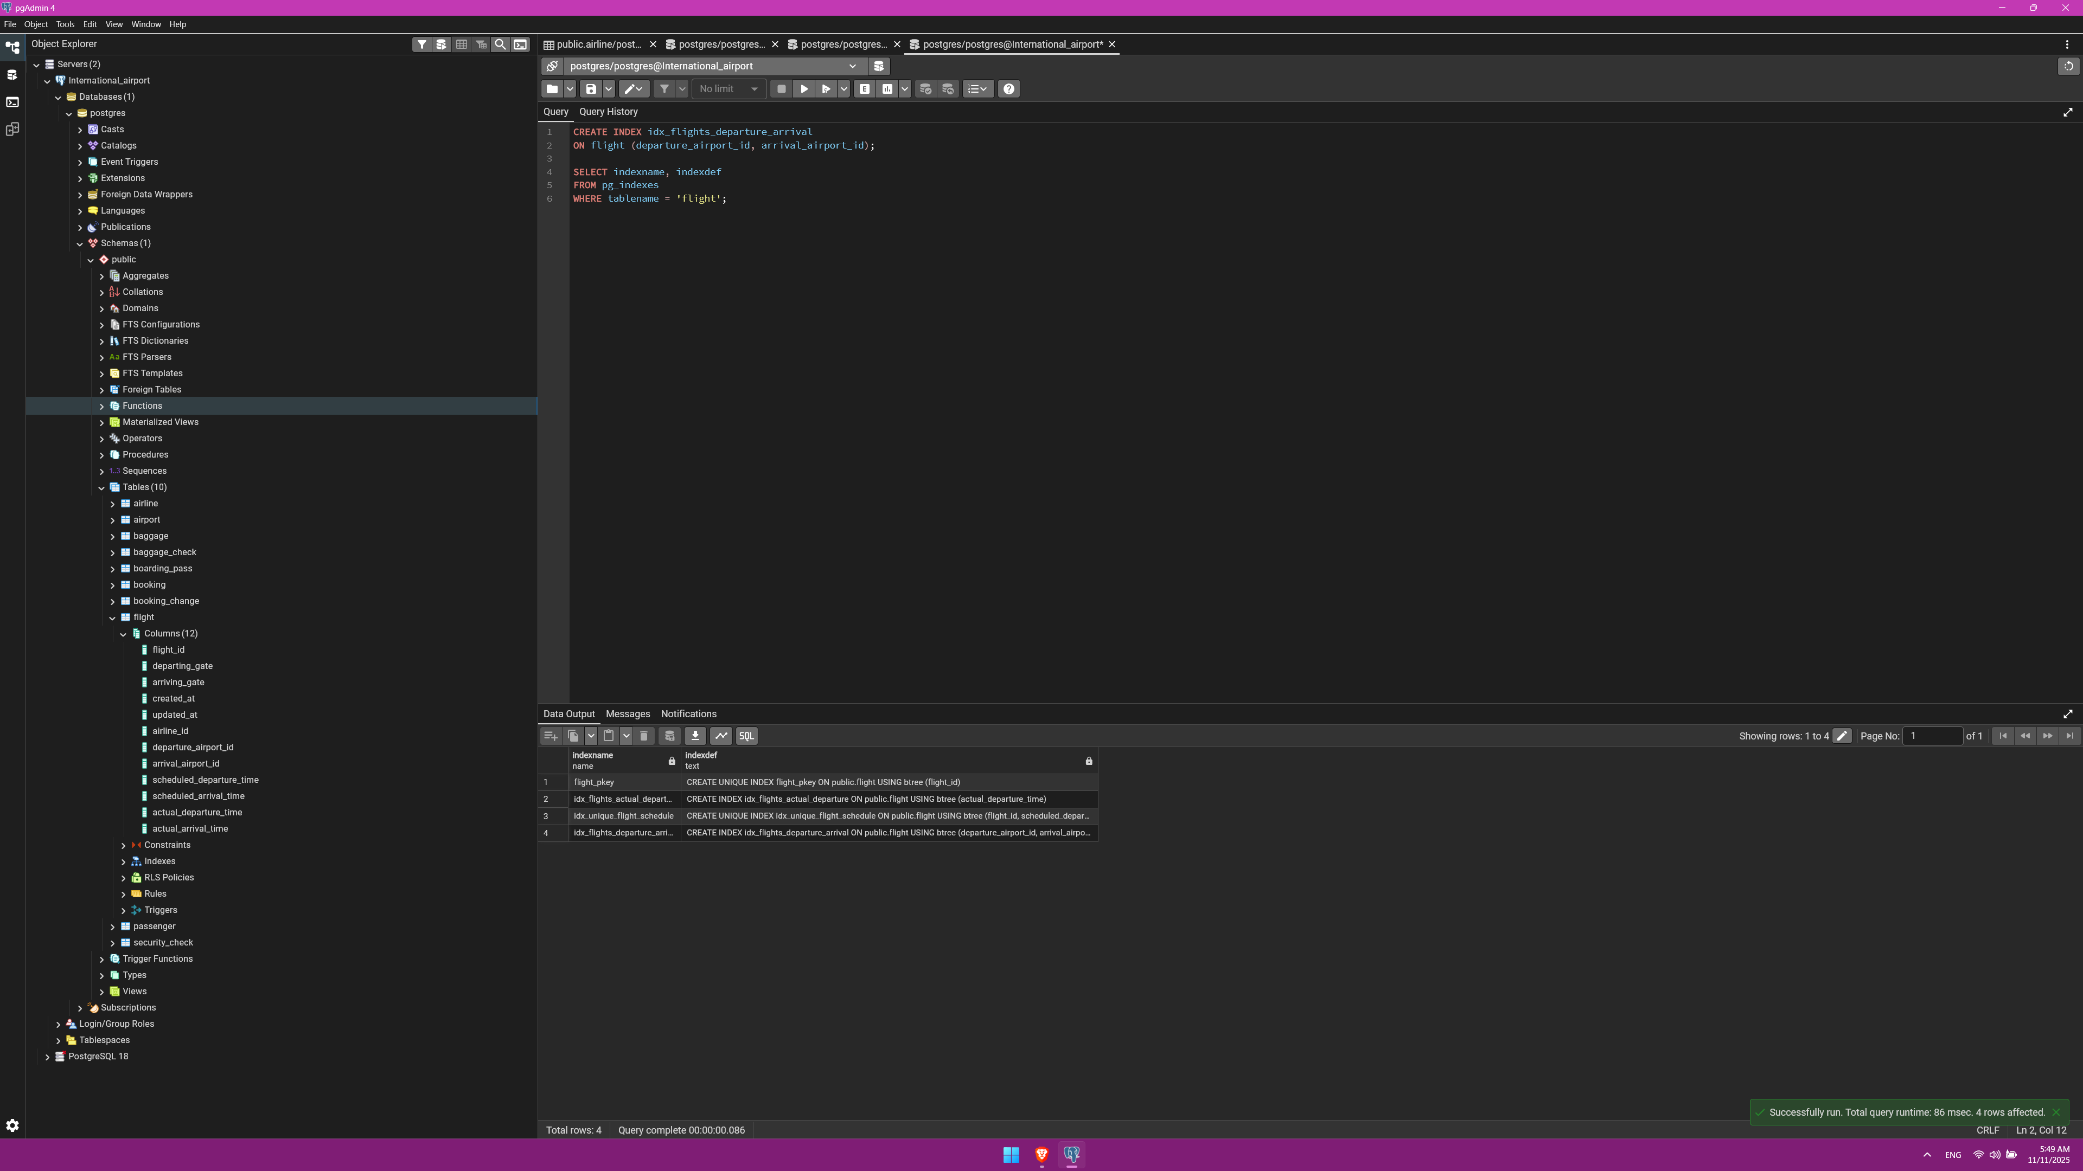
3. Create a composite index on the departure_airport_id and arrival_airport_id columns.

Slide 5
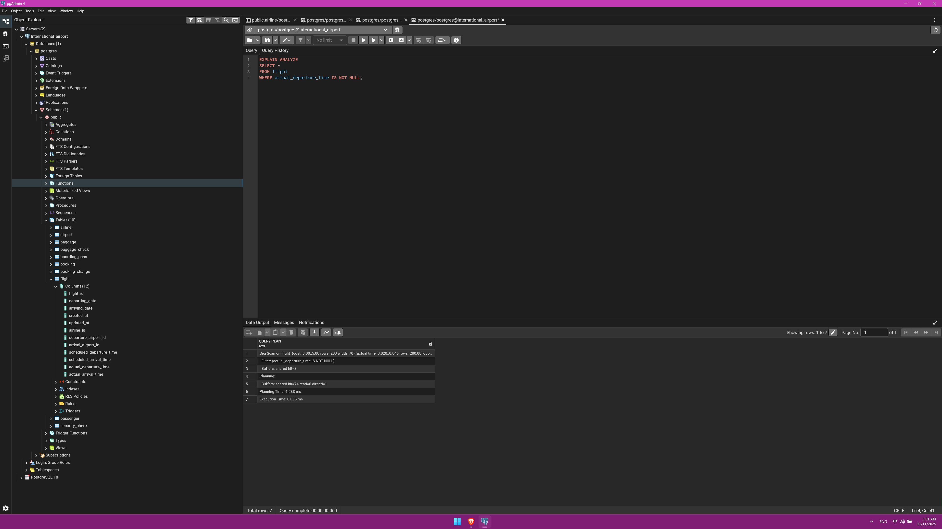
4. Evaluate the difference in query performance with and without indexes. Measure performance differences.

Slide 6
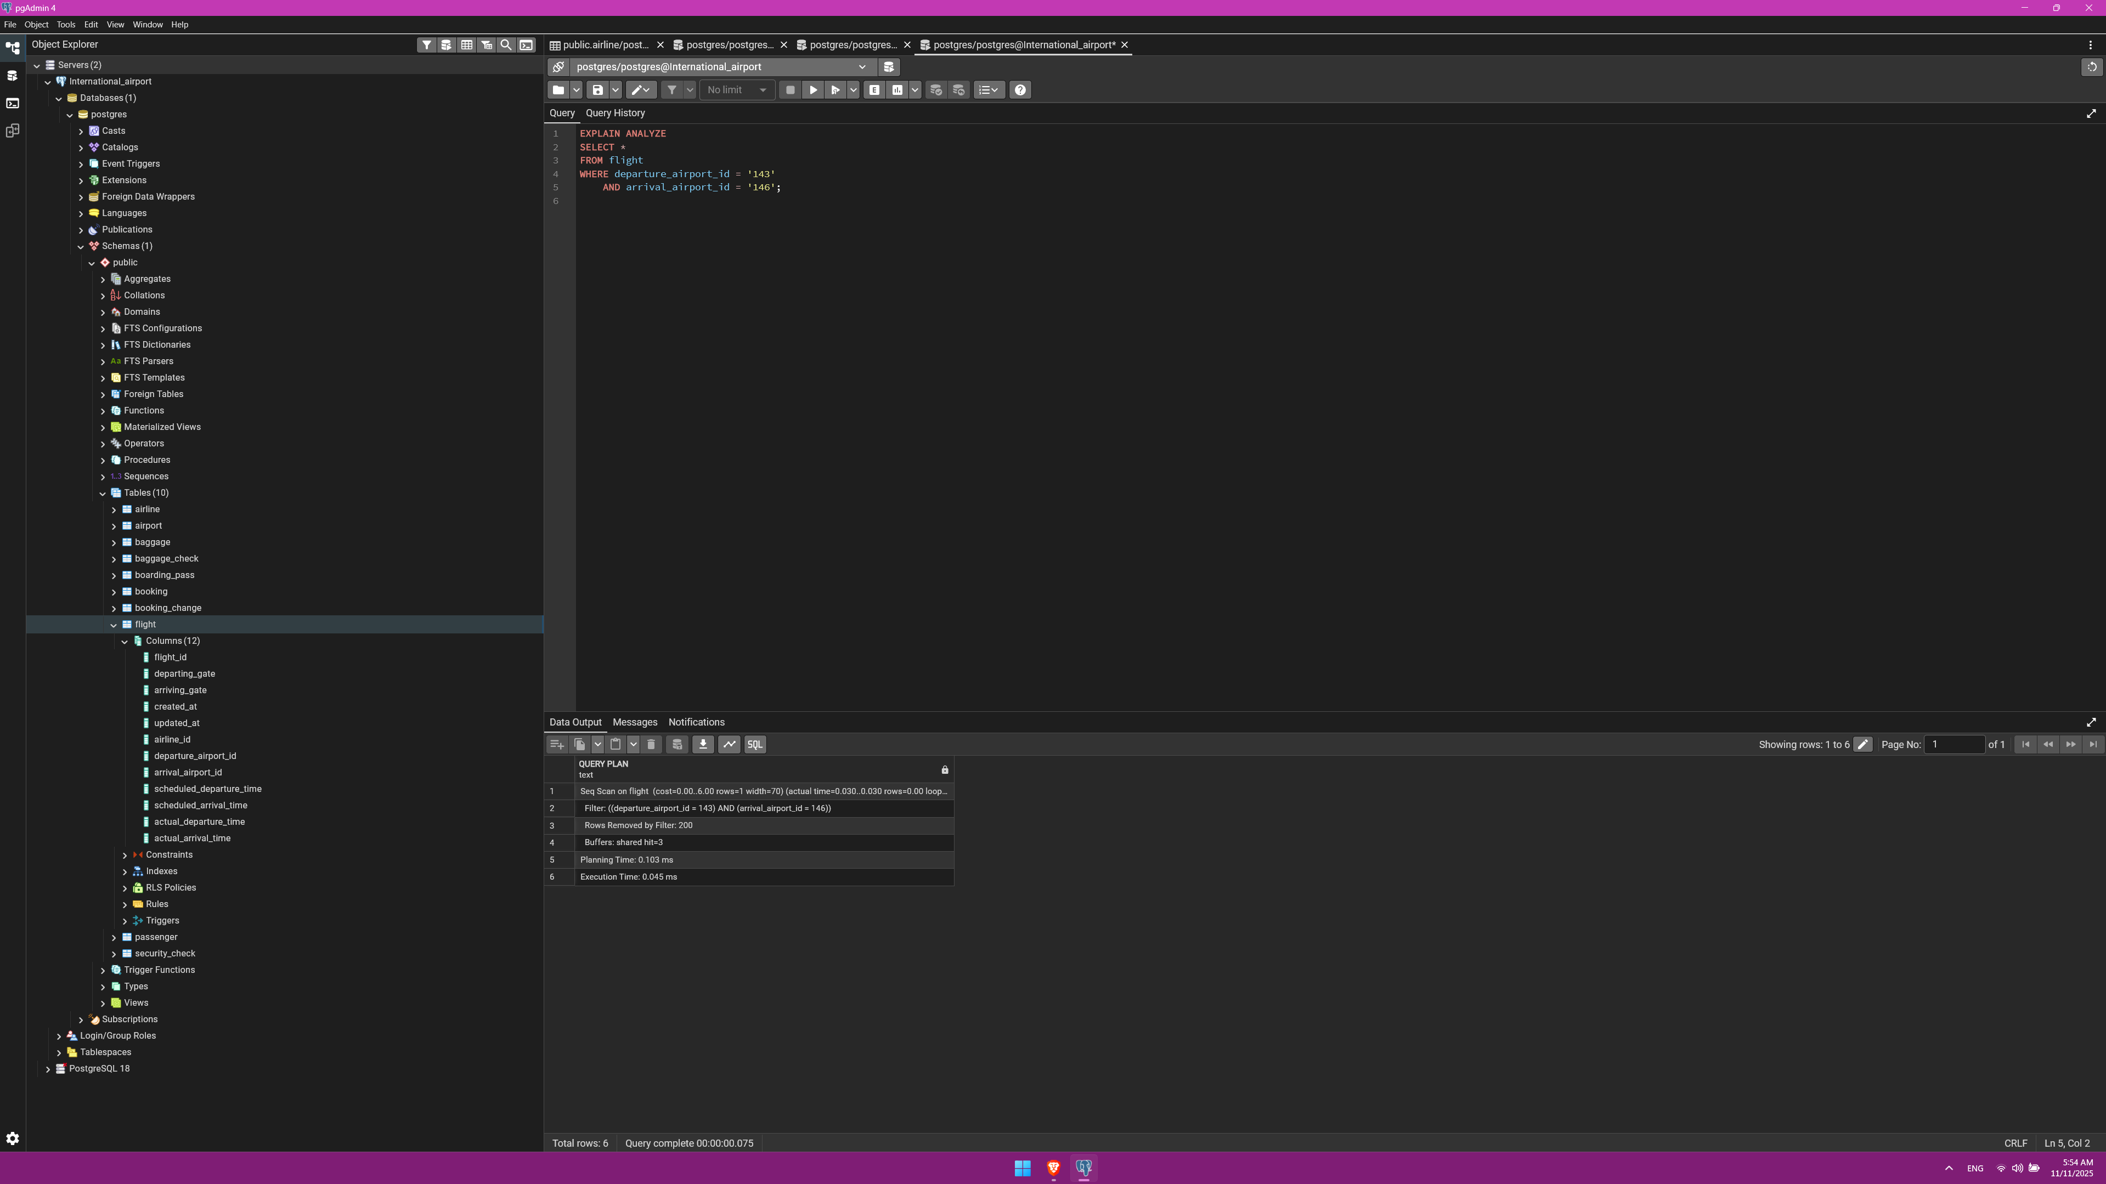
5. Use EXPLAIN ANALYZE to check index usage in a query filtering by departure_airport and arrival_airport.

Slide 7
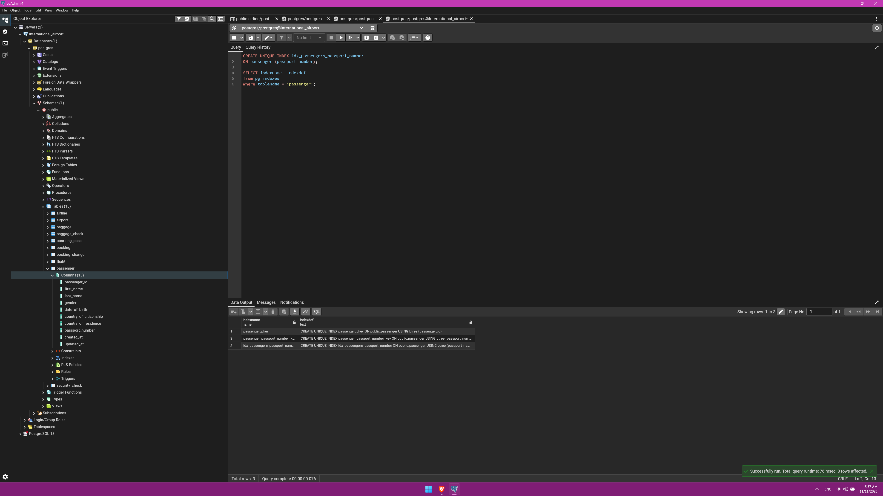
6.1 Create a unique index for the passport_number of the Passengers table. Check if the index was created or not. Insert into the table two new passengers.
Explain in your own words what is going on in the output?

Slide 8
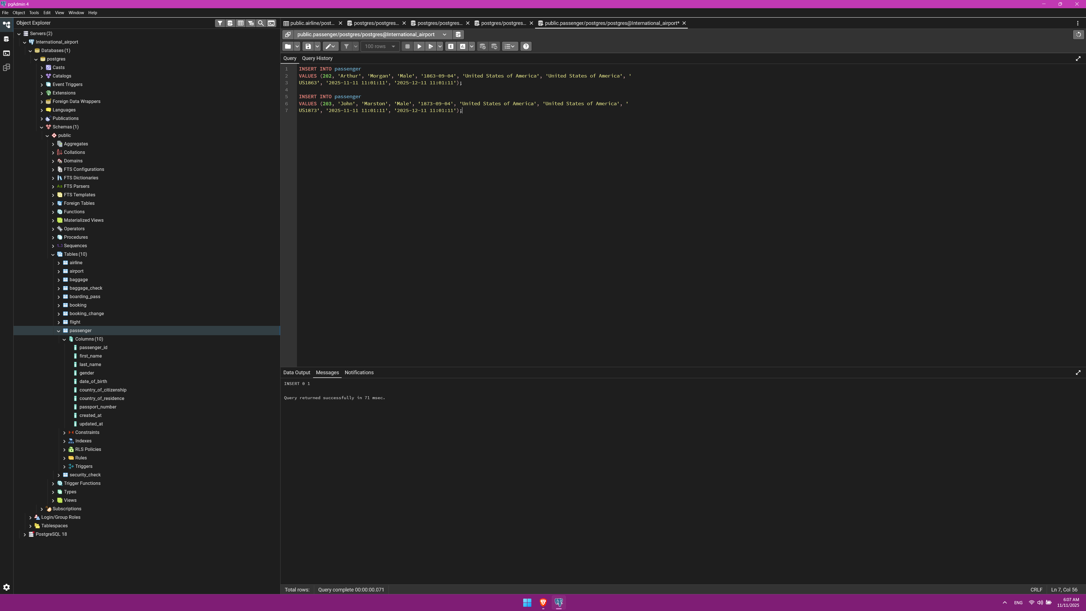
6.2 Create a unique index for the passport_number of the Passengers table. Check if the index was created or not. Insert into the table two new passengers.
Explain in your own words what is going on in the output?

Slide 9
6.3 Create a unique index for the passport_number of the Passengers table. Check if the index was created or not. Insert into the table two new passengers.
Explain in your own words what is going on in the output?
The unique index enforces a uniqueness constraint at the database level. When the first record is inserted, the index registers the passport number. When the second insert tries to reuse the same number, PostgreSQL checks the index, detects a duplicate key, and rejects the operation to preserve data integrity.

Slide 10
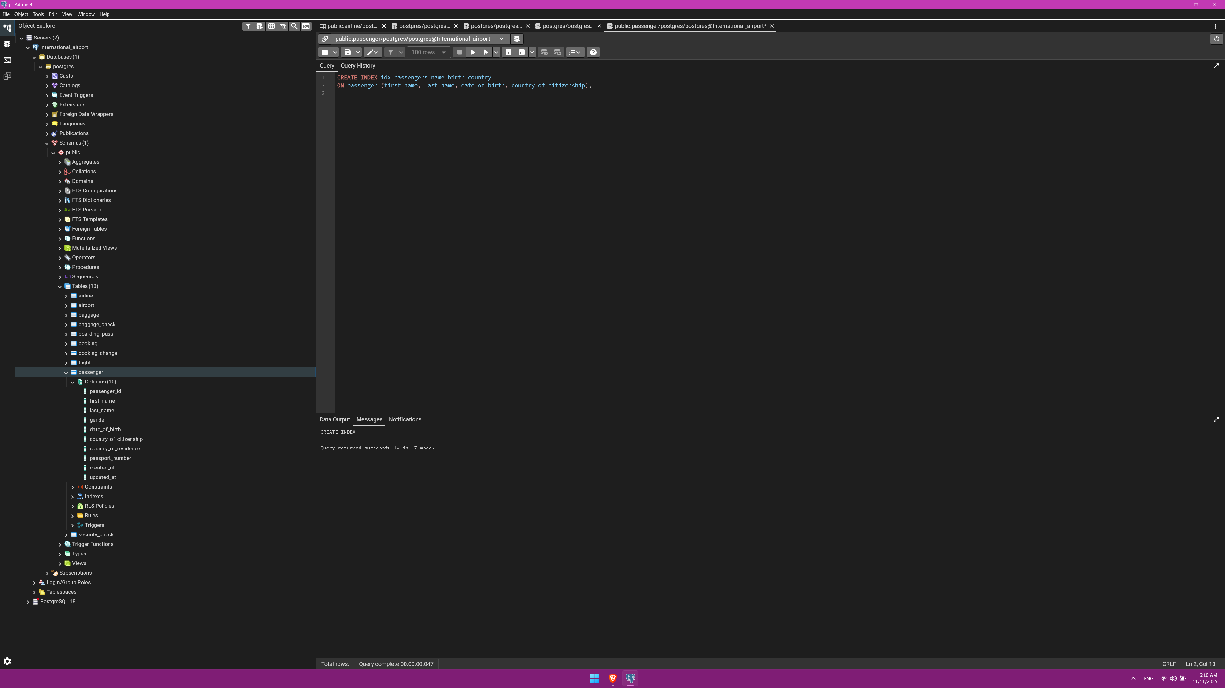
7.1 Create an index for the Passengers table. Use for that first name, last name, date of birth and country of citizenship.

Slide 11
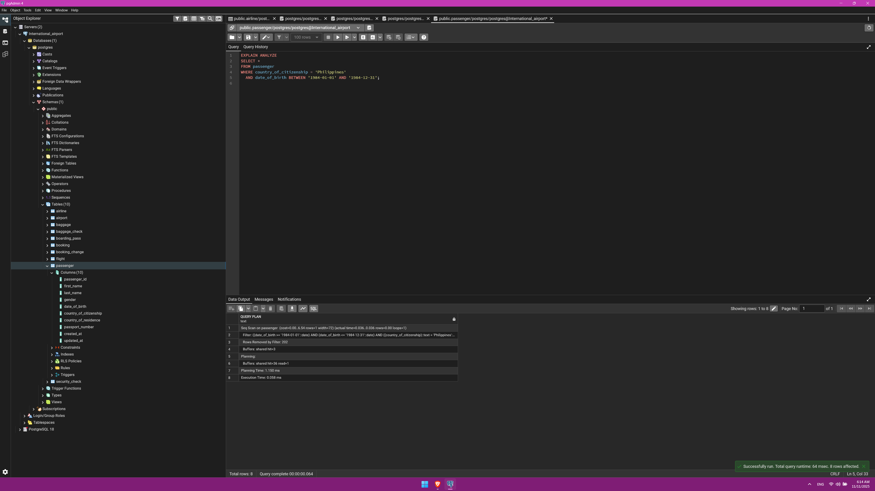
Then, write a SQL query to find a passenger who was born in Philippines and was born in 1984 and check if the query uses indexes or not.

Slide 12
7.3 Give the explanation to the output
PostgreSQL scanned all rows instead of using the index.
Likely, it is because table is relatively small, only having 200 elements. Really don't know other reasons.

Slide 13
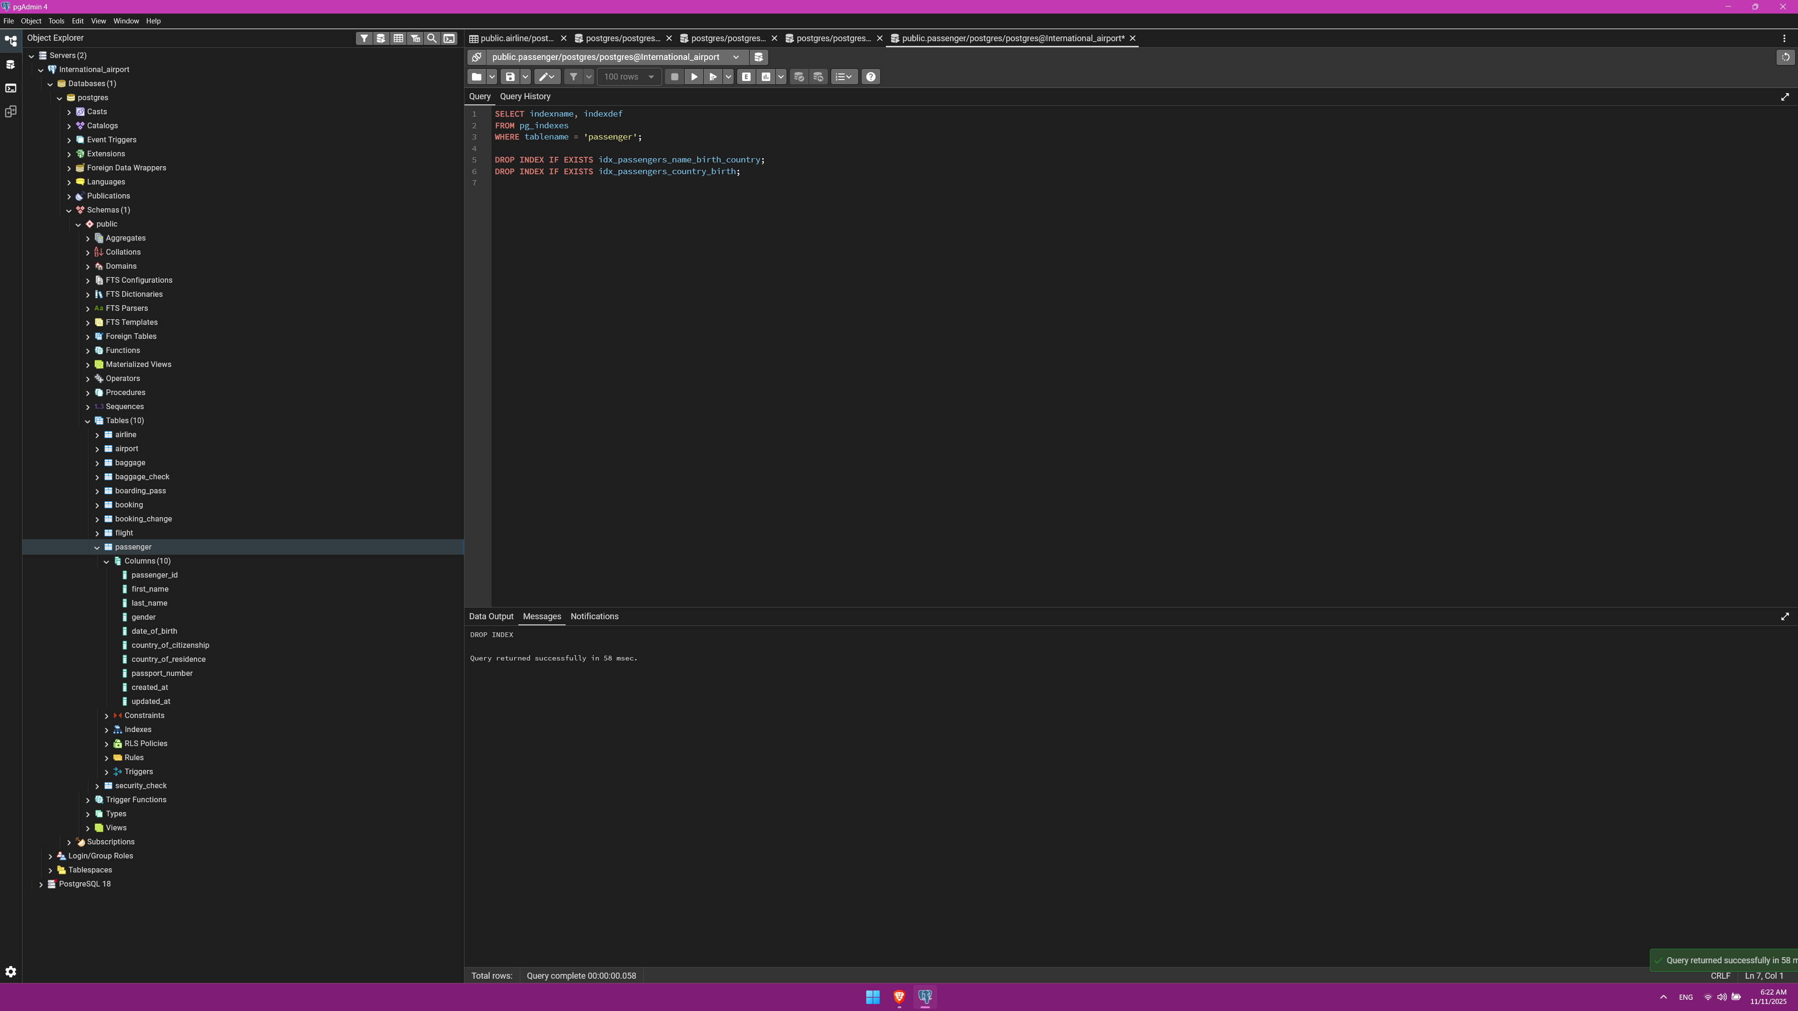
8. Write a SQL query to list indexes for table Passengers. After delete the created indexes.

