Slide 1

Entity Online Web Application Server
PERCI Web Application Server
PERCI Application
Entity Online Application
PERCI
Web Service
Entity Online Portal
Spring Security
Struts Authorisation
PERCI Framework
IPro Portal
Corporate Portal
Employee Portal
JQuery 1.10.3
Customised JS/CSS Lib
Framework
Apache POI
Hibernate
Quartz 2.3.0
Axis 2
JQuery 2.1.4
Bootstrap 3.3.5
Customised JS/CSS Lib
Hibernate 5.0.4
IBatis 3.4.6
ActiveMQ 5.15.5
JBoss 6.0.0
Apache commons
Apache POI 3.17
Quartz 2.3.0
Java 1.6.0
Spring 5.0.8
Struts 2 2.5.16
Apache CXF 3.2.6
Linux / Windows Operating System
Tomcat 9.0.10
Java 10.0.2
PERCI DB Server
Linux / Windows Operating System
PERCI Database

Slide 2
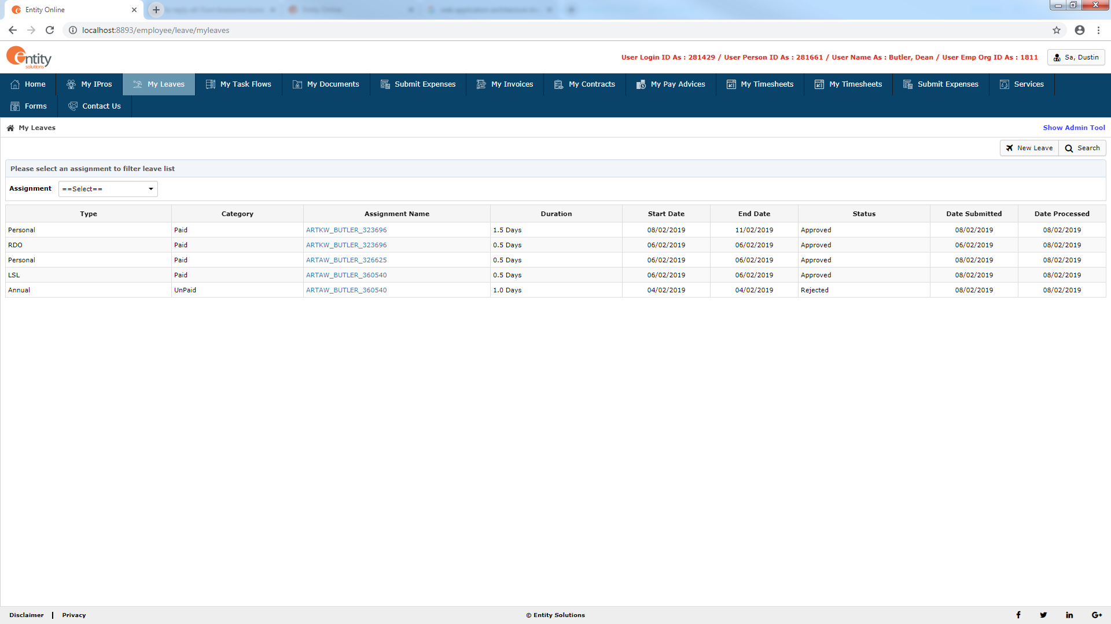
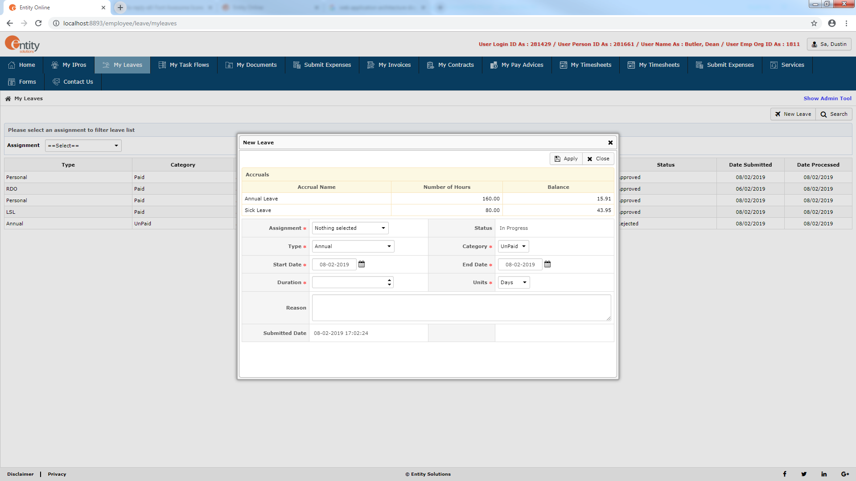
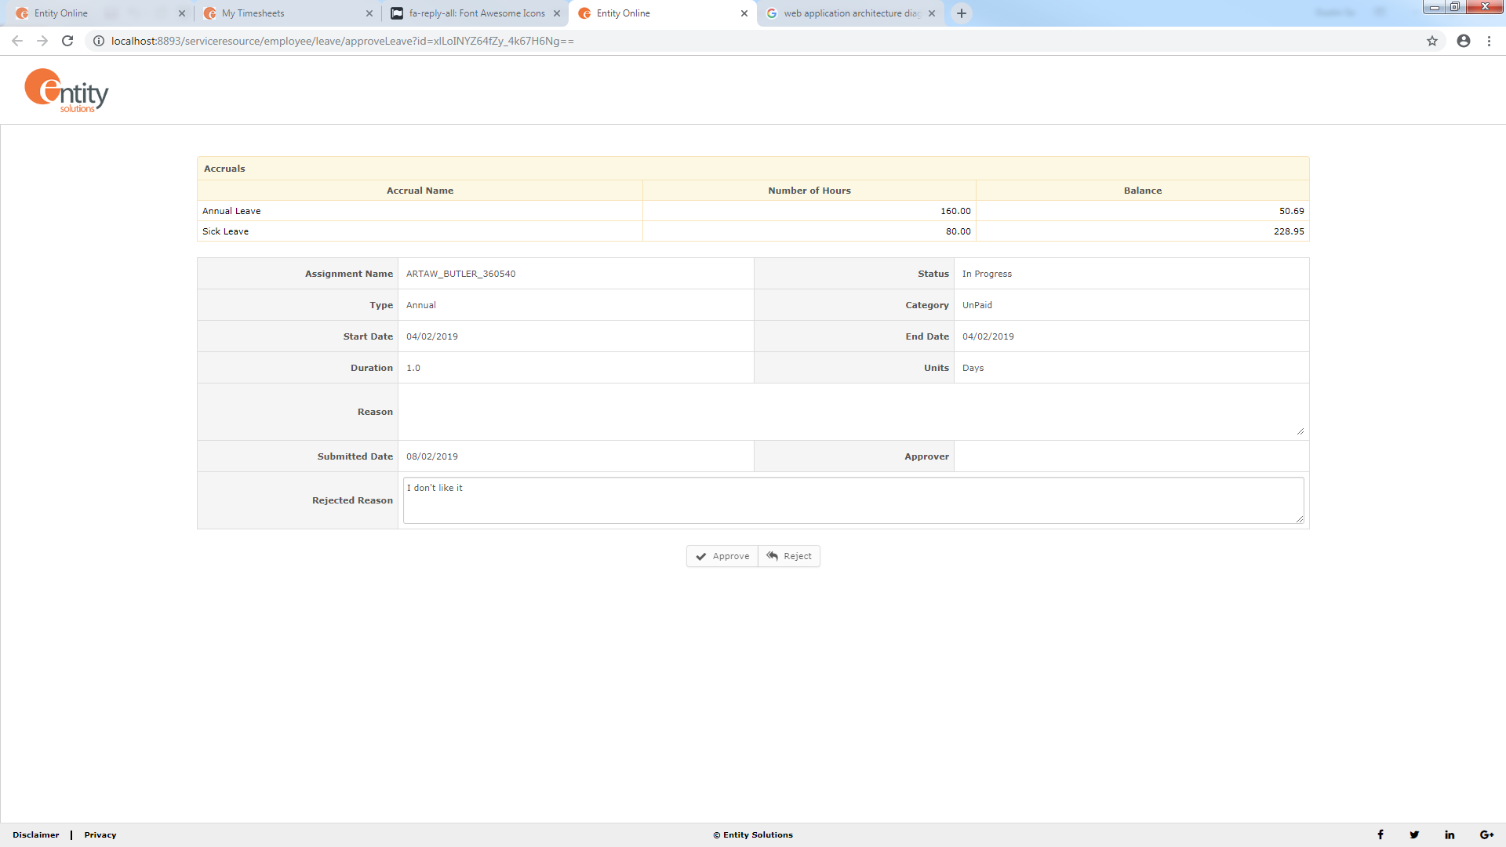
Leave Request Function Flow
User
Approver
Approve / Reject and Email to the User
View Detail
Leave Request List
Create New Leave Request
Leave Request Detail
View Leave Request to approve / reject
Save and Email to Approver
Create New / Edit and Apply

