Slide 1

Sidney Akers
Will Maxwell

Slide 2
User Stories
Chess Game 10 days (30 days)
Instructions ½ day (1/2 day)
Available Moves 1 day (1 day)
Check Notify ½ (1 day)
Rule Variants 2 days
Promotion – (1½ days)
Castling – ¼ day
Online Play (not Implemented) 10 days

Slide 3
Utilities
Eclipse
ADK
GIT
E-GIT
ADT
ArgoUML
Paint.net

Slide 4
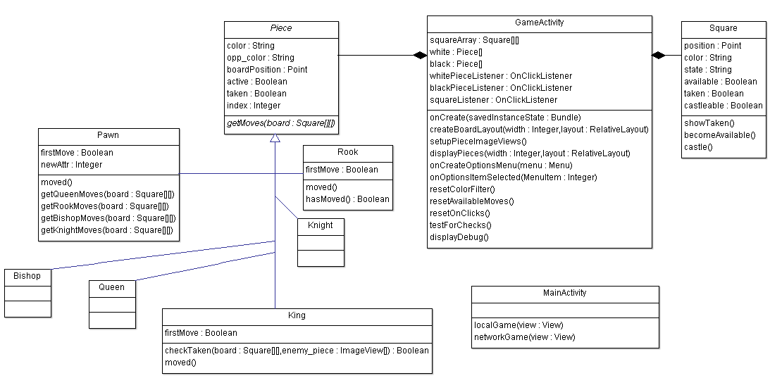
Class Diagram

Slide 5
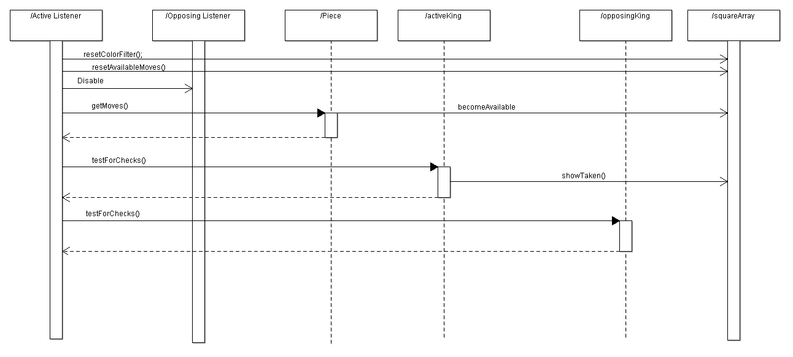
Piece Listener

Slide 6
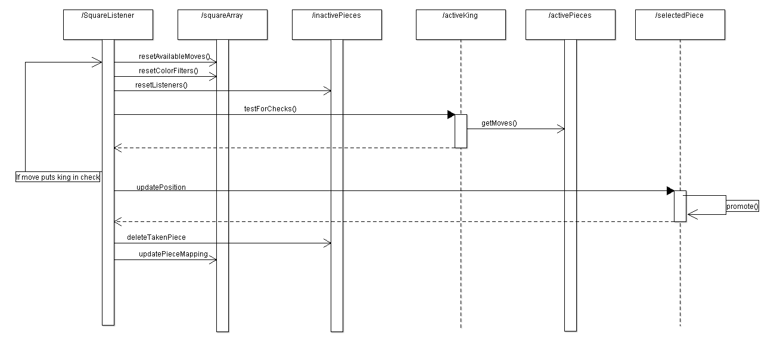
squareListener

Slide 7
Design Principles
Strongly Cohesive
Lightly Coupled
Extensive use of Inheritence

Slide 8
Automated Testing
10¹²⁰ possible terminating chess games
Many of which could be very, very dull
We didn’t have that kind of time
We Created random game generator, recorded games that threw exceptions, repaired as many as possible

Slide 9
Iterations
First proposed (Full working chess game)
Second proposed (Full working online play)

Slide 10
Problems
Learning Curve
Android API
Android Development Environment
API levels
Refactoring

