Slide 1
Real-time GS Mapping
on Aria
Efficient online learning of Gaussian maps
Sangwon Park, Dong Hwi Kim, Chaehyeon Song
RPM Lab, Seoul National University
Internship Presentation · September 18, 2026
1
Notes:
00:00–00:10 | Presenter: Sangwon Park. Names: Sangwon Park, Dong Hwi Kim, Chaehyeon Song. Equal emphasis, as in the reference.

Slide 2
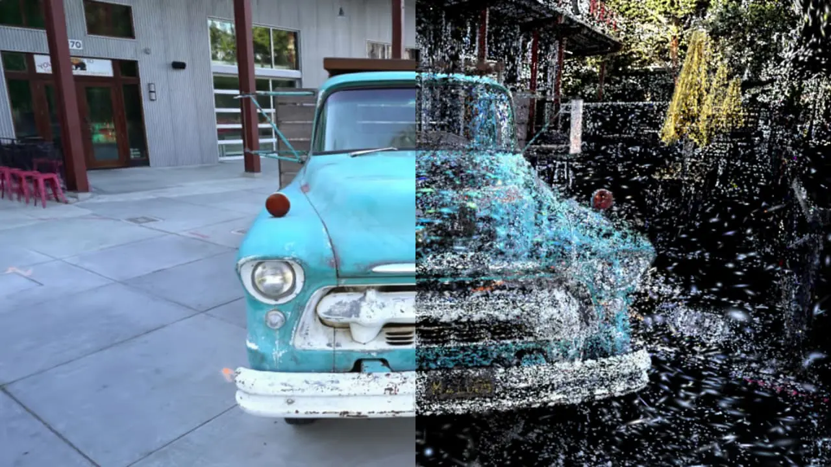
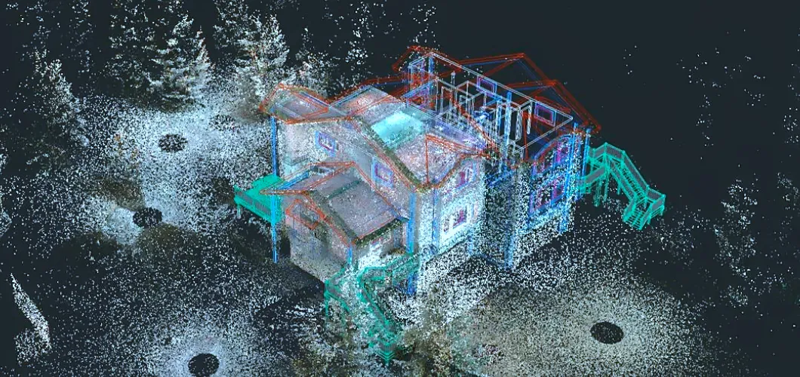
Why Gaussian Splatting?
Build a renderable scene that can be refined with new observations.
Point cloud
Gaussian representation / rendering
Photorealistic views + an updatable scene representation
Image source: supplied reference deck, slide 3. Kerbl et al., 3D Gaussian Splatting, SIGGRAPH 2023.
2
Notes:
00:10–00:40 | Representation → photorealism → fast rendering. Reference images are illustrative, not our results.

Slide 3
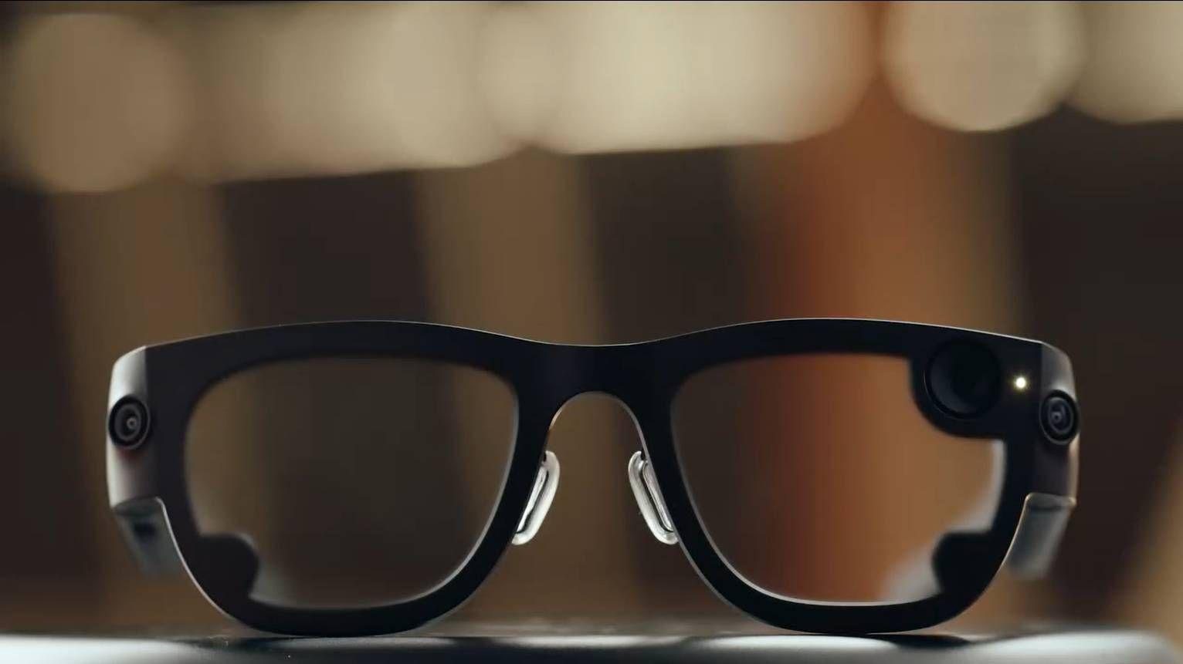
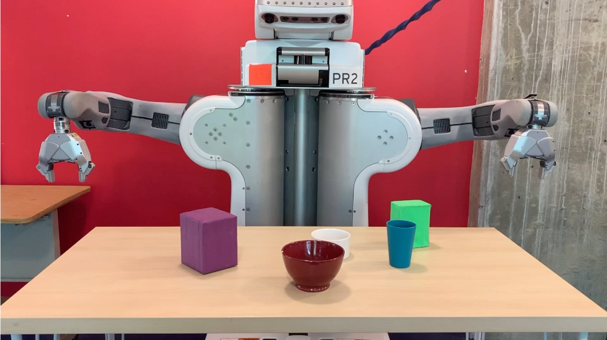
Why Real-time Mapping?
A robot or AR user needs a useful map while observations are still arriving.
Observe the environment
Build and use the map now
Map quality matters when it becomes available.
Image credit: Meta / Tom’s Guide (2025), as credited in the supplied reference deck. MIT CSAIL. MIT, August 2022. https://www.csail.mit.edu/sites/default/files/styles/primary_image/public/2022-08/LIS-PR2_1.png
3
Notes:
00:40–01:05 | Aria is the sensing platform; do not imply on-device computation. Map image slot is a real project output.

Slide 4
Mapping under Limited Compute
Online mapping has limited time to learn from growing observations.
Incoming frames
1
2
3
4
5
6
7
8
time →
Shared GPU
(schematic)
Tracking
Mapping
Tracking
Mapping
Tracking
Mapping
How should we spend the available mapping updates?
Use effective observations within available computation.
Conceptual allocation only; block widths are not measured timings.
4
Notes:
01:05–01:35 | Single shared compute resource; sequential input; no future views. Timing drawing is schematic.

Slide 5
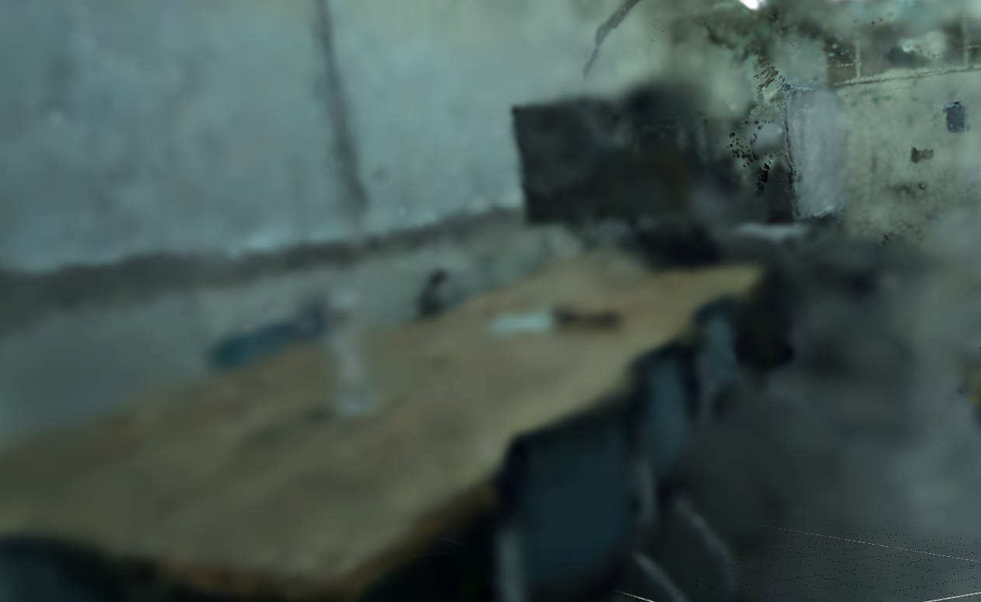
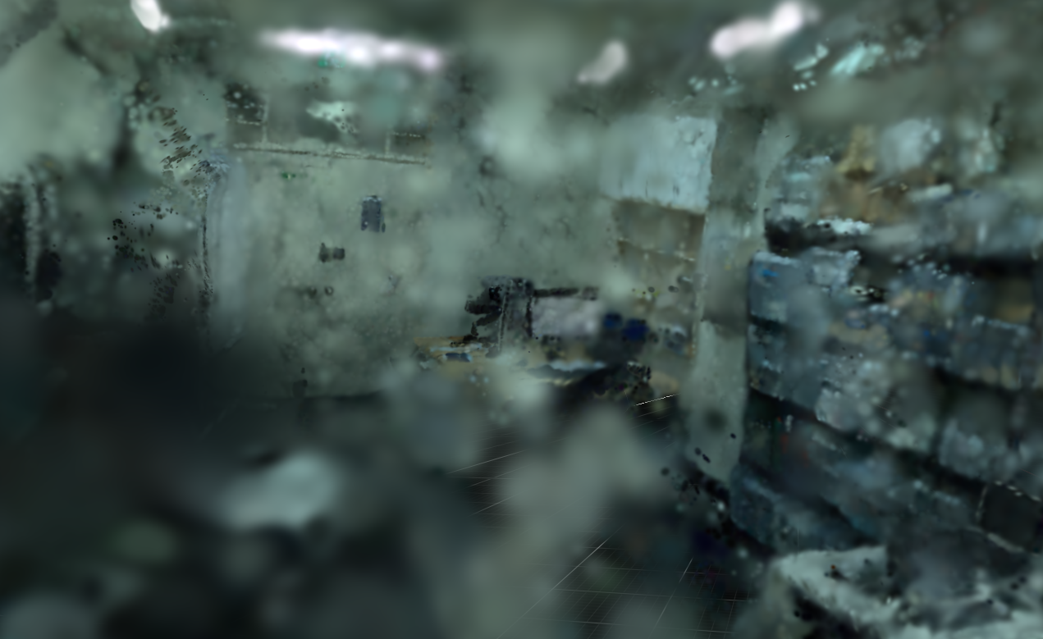
What Makes Online Mapping Difficult?
New observations compete for updates; appearance alone cannot ensure geometry.
Under-optimized appearance
Incorrect geometry
Too little useful supervision
Opacity in observed free space
How quickly can a newly observed region become reliable?
5
Notes:
01:35–02:00 | Two distinct failure modes. Add actual crops; do not treat a conceptual image as experimental evidence.

Slide 6
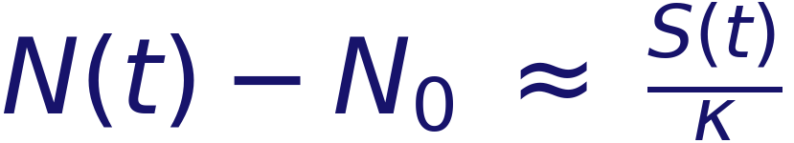
When Should We Add More Views?
More views add information, but leave fewer updates for each view.
Tracking
keyframes
KF
RGB
RGB
RGB
KF
RGB
RGB
RGB
KF
Intermediate RGB frames also carry mapping information.
Completed updates
Add a new view
Training pool
N: training-pool size S: completed GPU mapping updates κ: updates per added view
Grow the training pool with completed optimization.
§3.1 Optimization-Guided View Growth. Schematic; growth is capped by available observations.
6
Notes:
02:00–02:35 | N(t)-N0 approximately S(t)/kappa for available candidates and work-conserving admission. Exact cap: min(M(t),N0+floor(S(t)/kappa)). N is pool size; S is completed mapping updates, not GPU utilization. No hardware-invariance claim.

Slide 7
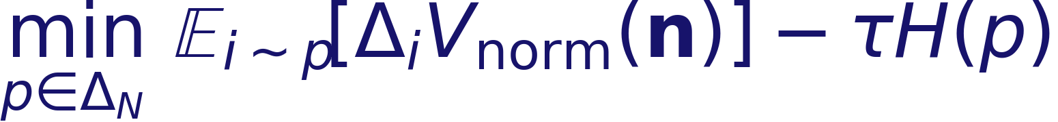
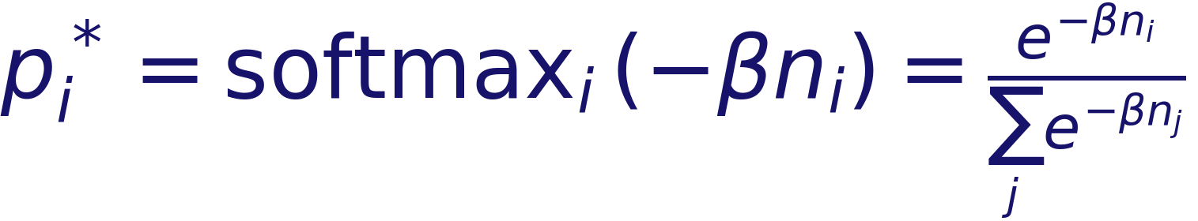
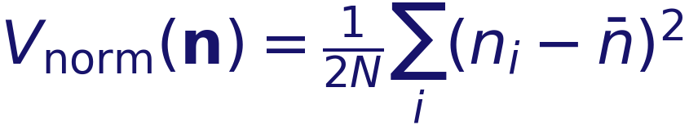
Which Views Should We Optimize?
Balance learning opportunities while preserving sampling diversity
Uneven optimization exposure
Count-aware randomized selection
Update Counts
4
2
3
1
Less-trained views + diverse sampling
frame 1
frame 2
frame 3
frame 4
Normalized variance
+ entropy
Softmax solution
nᵢ: selection count H: sampling entropy
§3.2 ERCB — one-step formulation. Normalization by candidate count N; illustrative counts.
7
Notes:
02:35–03:10 | Per-view count derivation from §3.2. Vnorm(n)=sum((n_i-mean(n))²)/(2N); Δ_i is its change after one selection. Minimize expected next-step variance change minus tau*entropy. Exact p_i=softmax(-beta*n_i), beta=1/(N*tau). N-normalization rescales temperature; it is not mean-normalization/CV². Candidate set fixed for this derivation; actual block sampling uses remaining candidates without replacement. No global equality/convergence guarantee. See MATH_NOTES.md.

Slide 8
Keeping Observed Free Space Empty
RGB alignment can still hide an incorrect 3D structure.
Observed free space
Unobserved
space
Camera
Reduce opacity
No free-space claim
Observed
surface
Use causal depth evidence to suppress premature opacity.
Carve concept from the current manuscript. Schematic; integrated geometry results remain to be validated.
8
Notes:
03:10–03:45 | One-sided Carve intuition: suppress opacity before a depth-supported surface; leave unobserved space unconstrained. Carve/Hit choice still under study.

Slide 9
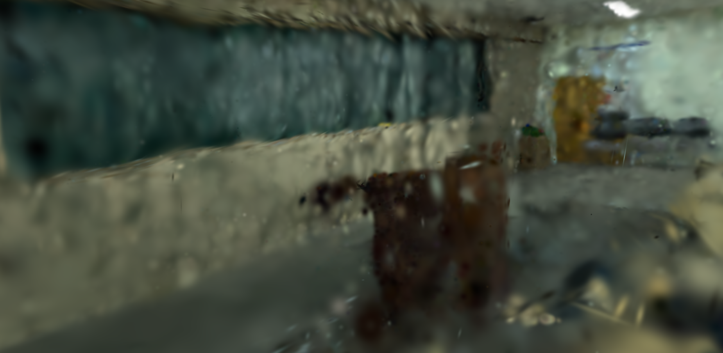
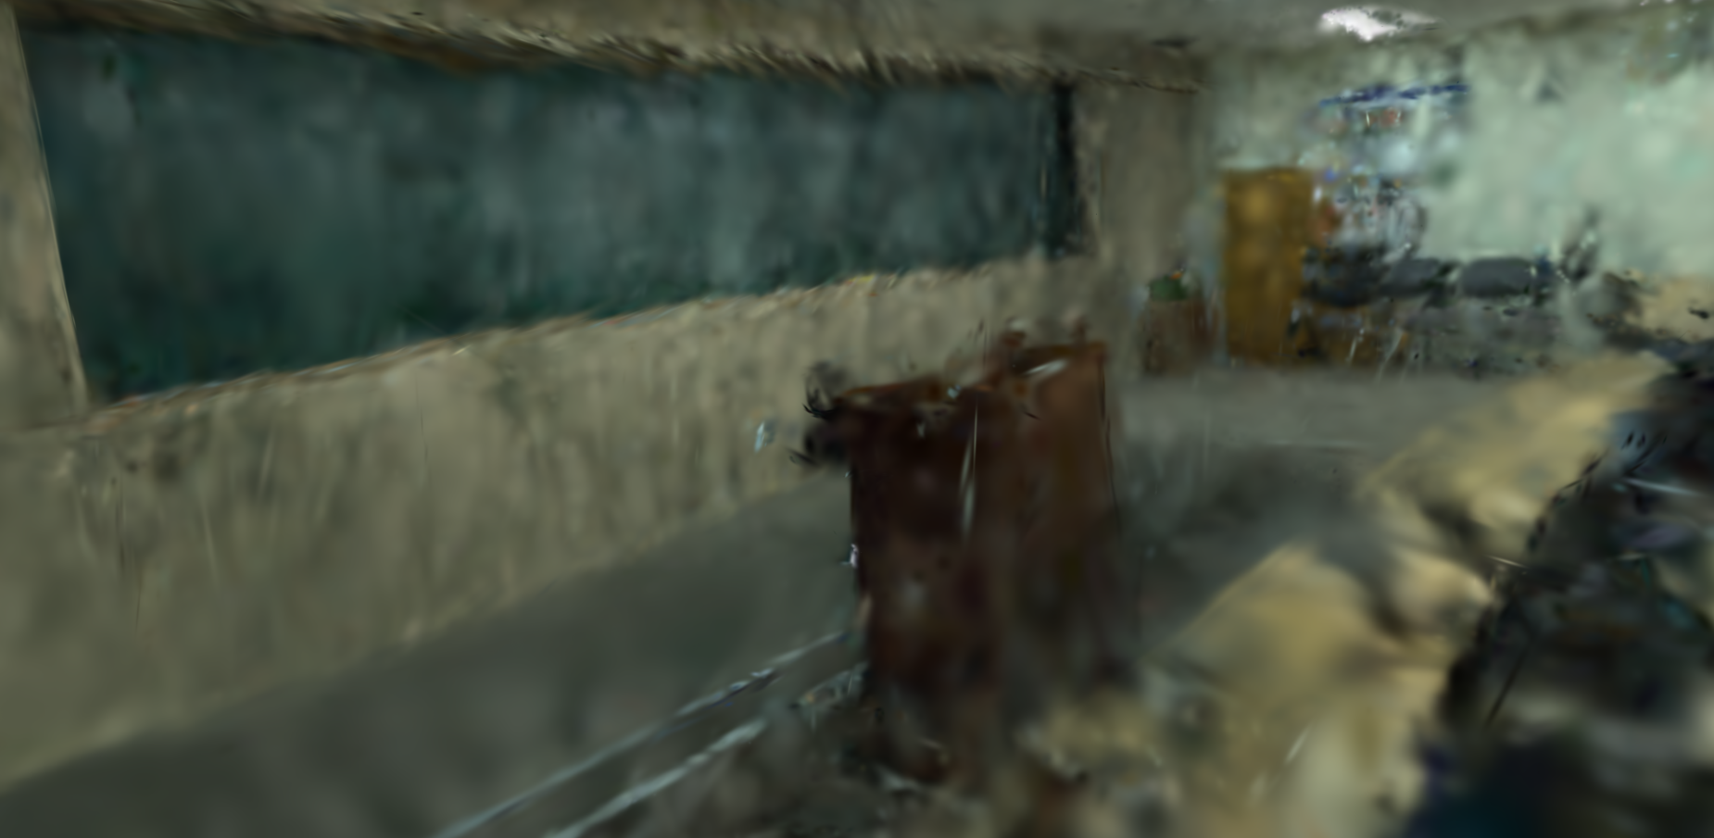
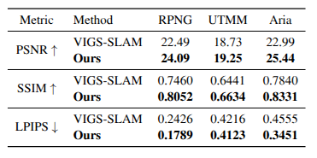
Current Progress & Evaluation
View scheduling and geometry are improved.
Baseline
Ours
Quantitative Metrics
matched-budget appearance + geometry evaluation
Ongoing work: evaluate appearance, free-space consistency, and surface completeness together.
9
Notes:
03:45–04:35 | Fill comparison and metric before presentation. No invented numbers. Report dataset, GPU, budget, held-out split, repeats, tail policy. Identify personal contribution after confirming division of work.

Slide 10
Takeaway & Next Step
Build better maps through efficient online optimization.
01
02
03
When to add
What to optimize
Where to constrain
Pace view growth
Balance exposure
Use free-space evidence
Next: validate appearance and geometry gains at the native input rate.
10
Notes:
04:35–05:00 | Recap research direction, not an unverified success claim. Hold conclusion for final five seconds.

