Slide 1
ICT PROJECT · NATURAL LANGUAGE PROCESSING
Bengali Hate Speech Detection: A Multi-Track Benchmark with Fusion, Explainability and Uncertainty Quantification
Presented by
Supervised by
Dipta Sarker · ID: 12221125
Md. Rahmatullah Mia · ID: 12221100
Mahdi Hasan · ID: 12221067
M. Shawan Biswas · ID: 12221096
Md. Zahid Akon
Lecturer
Department of Computer Science and Engineering,
University of Global Village
Department of Computer Science and Engineering
University of Global Village

Slide 2
ROADMAP
Contents
1
Introduction
8
Model Zoo & Fusion Strategies
2
Problem Statement
9
Training Dynamics & Embedding Space
3
Objectives & Contributions
10
Comparative Evaluation
4
Related Works
11
Significance, Data Audit & Generalization
5
Dataset & Resource Creation
12
Explainable AI (XAI)
6
Exploratory Data Analysis
13
Uncertainty & Calibration
7
Methodology & Data Pipeline
14
Conclusion & Future Work
Bengali Hate Speech Detection — Multi-Model NLP Benchmark
2 / 33

Slide 3
SECTION 1
Introduction
Bangla is the 6th-most spoken language worldwide, with rapidly growing social-media use across Bangladesh and West Bengal.
Comment sections, groups, and pages increasingly carry abusive, threatening, and demeaning language directed at individuals and communities.
Manual moderation cannot scale to the volume of Bangla user-generated content — automated detection is essential.
This project builds and benchmarks an end-to-end NLP pipeline that flags bullying content in Bangla text with accuracy, transparency, and calibrated confidence.
29.8K
33.4%
Bangla posts curated
Labelled bullying
17
0.895
Models benchmarked
Best F1-macro
Key figures from this study — detailed in later sections
Bengali Hate Speech Detection — Multi-Model NLP Benchmark
3 / 33

Slide 4
SECTION 2
Problem Statement
Bangla is a low-resource language for NLP: informal spelling, code-mixing with English, and heavy use of transliteration make text noisy.
Real bullying/hate datasets are class-imbalanced — harmful posts are the minority class, biasing naive classifiers toward “safe” predictions.
Most prior systems report a single accuracy number and stop — they do not explain which words drove a decision, nor how confident the model really is.
A production moderation tool needs all three: strong minority-class recall, human-readable explanations, and well-calibrated uncertainty for safe abstention.
Class balance
Non-bullying — 66.6%
Bullying — 33.4%
1 in 3 posts in the corpus is labelled bullying — a realistic, imbalanced moderation setting.
Bengali Hate Speech Detection — Multi-Model NLP Benchmark
4 / 33

Slide 5
SECTION 3
Objectives
1
2
3
4
5
Build a clean corpus
Benchmark broadly
Fuse & ensemble
Explain decisions
Quantify uncertainty
Curate, clean, and stratify-split a ~30K-post Bangla bullying corpus.
Train & evaluate 17 models across classical ML, static embeddings, deep nets, and transformers.
Combine model families via early/late fusion and soft-vote / stacking ensembles for peak F1.
Surface the words and phrases driving predictions with SHAP, LIME, and attention maps.
Calibrate confidence and enable selective prediction (abstain on uncertain posts).
Bengali Hate Speech Detection — Multi-Model NLP Benchmark
5 / 33

Slide 6
SECTION 3
Four Contributions
A controlled 17-model benchmark — validated with bootstrap 95% confidence intervals and pairwise McNemar tests across five model families on one common protocol.
Fusion & ensembling that wins — a stacked ensemble and validation-weighted late fusion outperform every individual model, edging out the best transformer.
Explainability + uncertainty as first-class criteria — SHAP, LIME, and attention comparisons alongside MC-Dropout uncertainty and temperature-scaling calibration.
Leakage-audited & cross-corpus replicated — a data-audit/ablation phase rules out leakage; the full protocol re-runs end-to-end on a second, independent corpus (BD-SHS).
Bengali Hate Speech Detection — Multi-Model NLP Benchmark
6 / 33

Slide 7
SECTION 4
Related Works
Classical baselines — TF-IDF / Bag-of-Words features with Logistic Regression, SVM, or Naive Bayes dominate early Bangla text-classification work; fast, but limited by sparse, static features.
Static embeddings (Word2Vec, FastText, GloVe) improve generalization slightly but still miss context and word-sense disambiguation.
Transformer encoders pretrained on Bangla corpora (BanglaBERT, Bangla-Electra) achieve strong accuracy but are typically reported as single opaque numbers.
Gap this project targets: very few Bangla hate-speech studies combine multi-family fusion/ensembling with rigorous statistical testing, explainability, and calibrated uncertainty in one pipeline.
Bengali Hate Speech Detection — Multi-Model NLP Benchmark
7 / 33

Slide 8
SECTION 5 · RESOURCE CREATION
Dataset Overview
Source: real-world Bangla social-media comments spanning news, politics, entertainment, and personal posts.
Binary label per post: Hate speech (1) vs. Non-hate speech (0), assigned via annotated ground truth.
Stratified train / validation / test split preserves the natural 66.6% / 33.4% class ratio in every partition.
Rich metadata retained (post length, token counts) to support downstream exploratory analysis.
Corpus at a glance
Total posts
29,836
Non-hate speech
19,878 (66.6%)
Hate speech
9,958 (33.4%)
Avg. words / post
14.69
Median words
9
Vocabulary size
62,419 tokens
Bengali Hate Speech Detection — Multi-Model NLP Benchmark
8 / 33

Slide 9
SECTION 5 · RESOURCE CREATION
Dataset Statistics
29,836
62,419
14.69
Total labelled posts
Unique vocabulary tokens
Average words per post
537
9
0.501
Longest post (words)
Median words per post
Class imbalance ratio (min/max)
Bengali Hate Speech Detection — Multi-Model NLP Benchmark
9 / 33

Slide 10
SECTION 5 · RESOURCE CREATION
Data Cleaning & Final Modeling Split
01
02
03
Actual dataset
NA-drop + deduplication
After clean_text()
30,000
29,836
29,829
Actual modeling split
Cleaning note
The working note records 7 posts removed after clean_text() (29,836 → 29,829).
Train
20,879
Validation
4,475
Test
4,475
Split total = 29,829 posts
Bengali Hate Speech Detection — Multi-Model NLP Benchmark
34 / 35

Slide 11
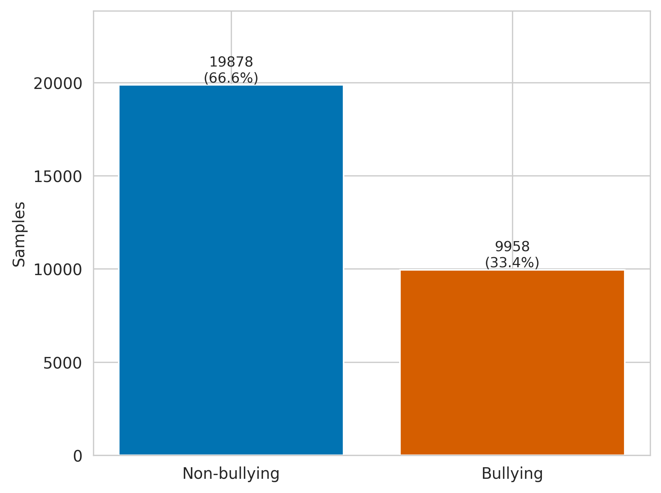
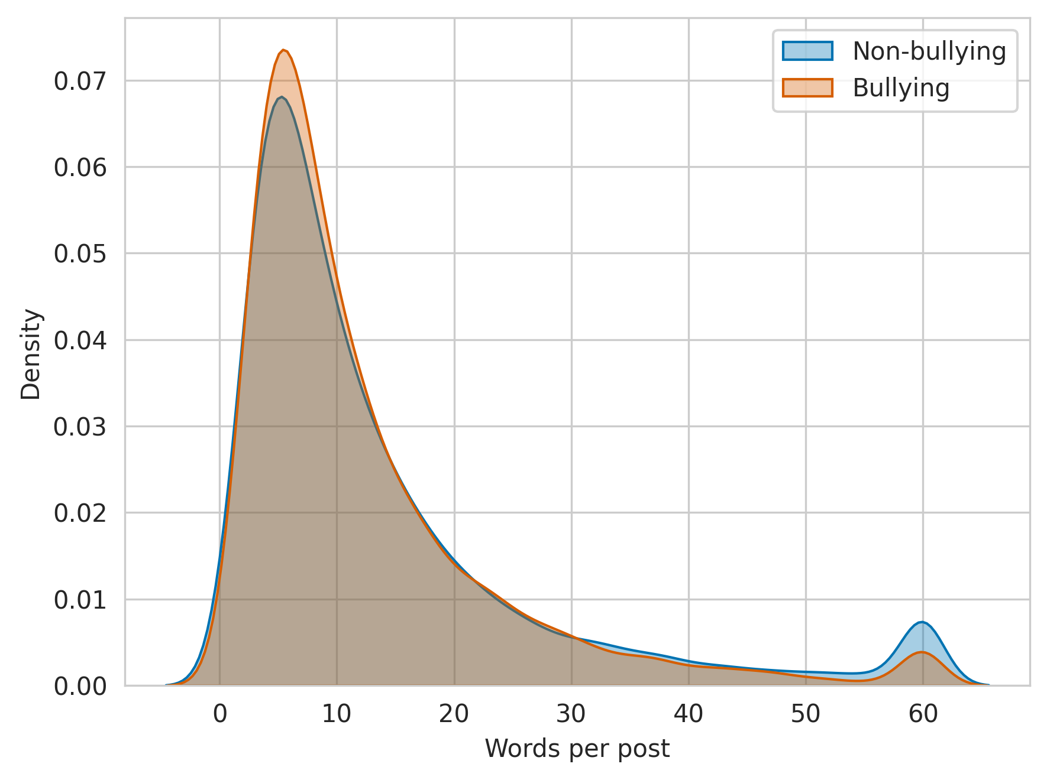
SECTION 6 · EDA
Class Distribution & Post Length
Left: 2:1 class imbalance (non-bullying vs. bullying). Right: both classes share a similar short-post-heavy length distribution.
Bengali Hate Speech Detection — Multi-Model NLP Benchmark
10 / 33

Slide 12
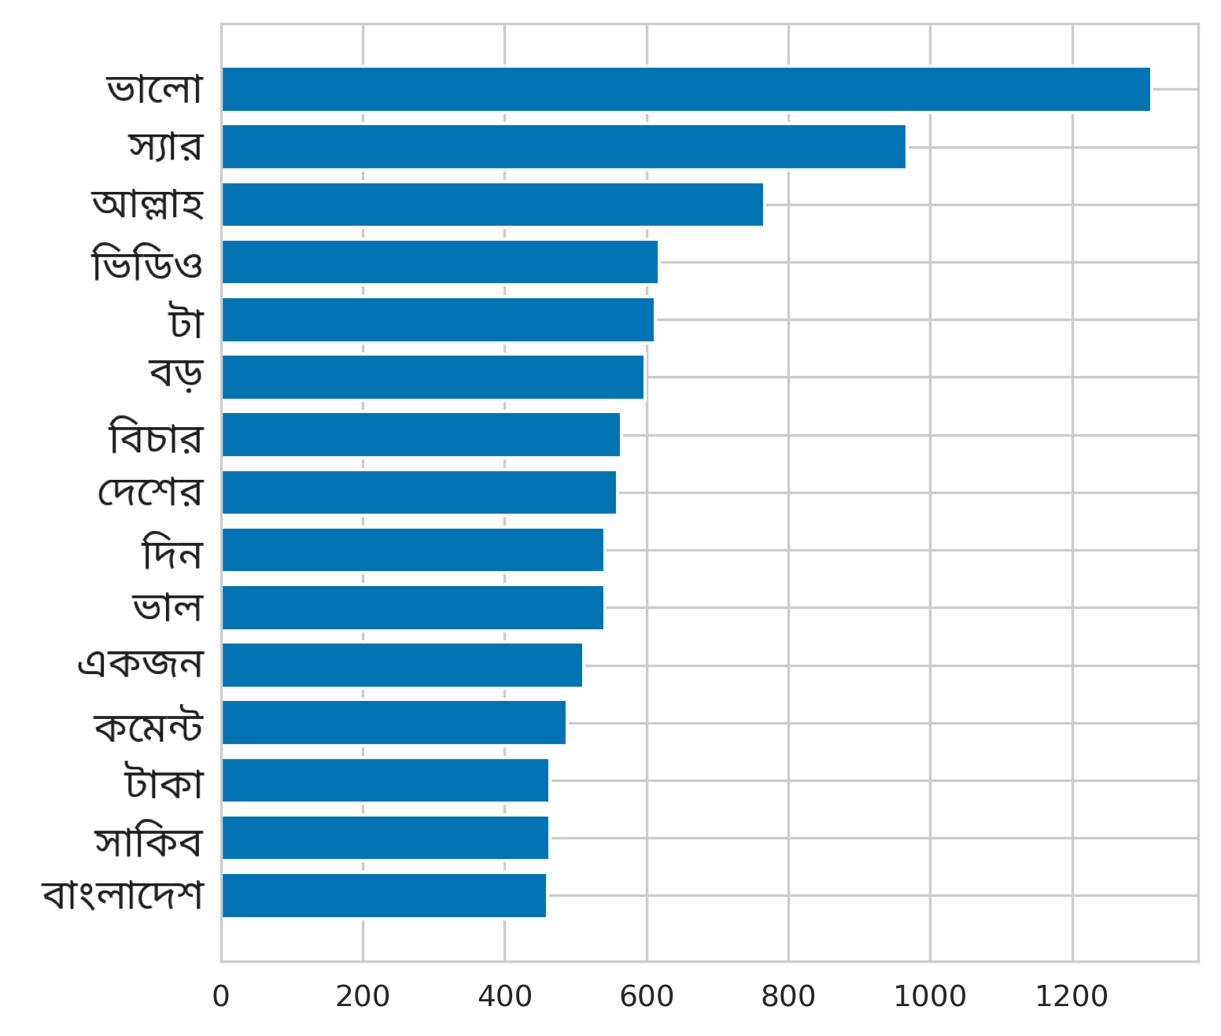
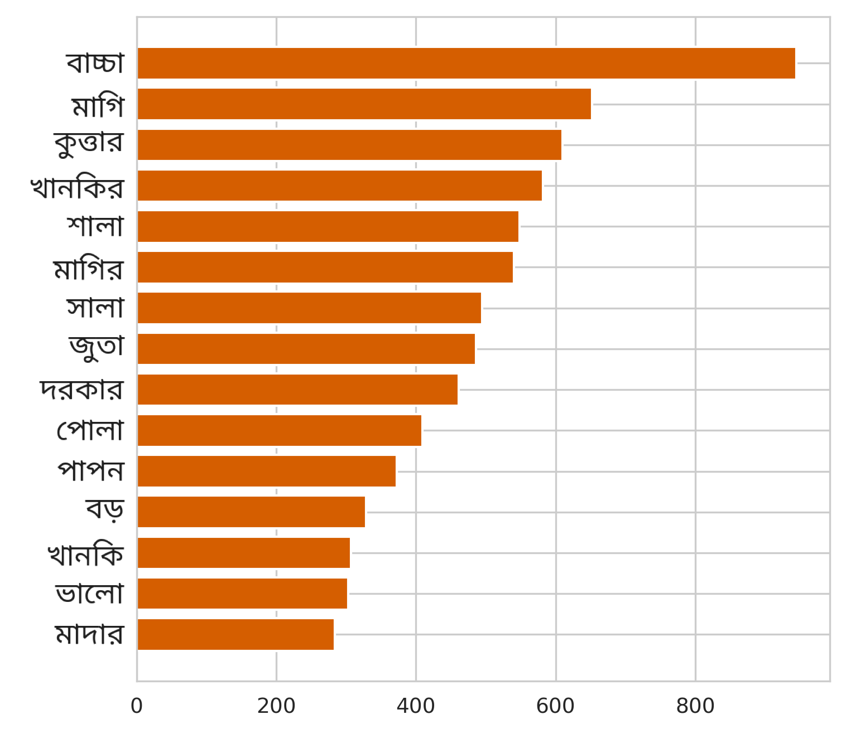
SECTION 6 · EDA
Lexical Patterns by Class
Non-hate speech posts skew toward polite / religious / topical words; hate speech posts are dominated by explicit slurs and profanity.
Bengali Hate Speech Detection — Multi-Model NLP Benchmark
11 / 33

Slide 13


SECTION 6 · EDA
Word Clouds by Class
Non-bullying
Bullying
Hate-speech vocabulary clusters around explicit profanity and second-person insults; non-hate vocabulary stays topical and conversational — a strong but superficial lexical signal.
Bengali Hate Speech Detection — Multi-Model NLP Benchmark
12 / 33

Slide 14
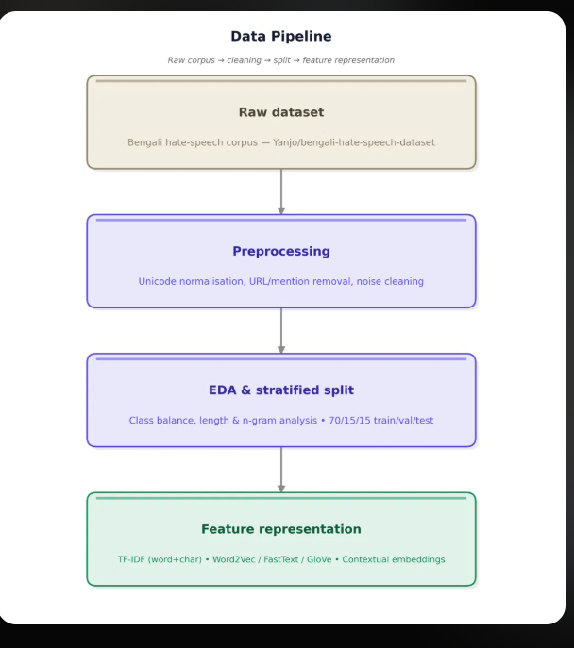
SECTION 7 · METHODOLOGY
Data Pipeline
Deduplication and Unicode cleanup remove under 1% of rows
Fixed random seed keeps the split reproducible
Class balance is preserved exactly across train/val/test
70 / 15 / 15 stratified split by label
Three parallel feature views feed different model families
Test set touched exactly once, after model selection
Raw corpus → Unicode normalisation & noise cleaning → stratified 70/15/15 split → feature representation.
Bengali Hate Speech Detection — Multi-Model NLP Benchmark
13 / 33

Slide 15
SECTION 7 · METHODOLOGY
Feature Representation
Sparse lexical
1
TF-IDF (word + char n-gram), Bag-of-Words
Static embeddings
2
Word2Vec, FastText, GloVe — dense but context-free
Contextual embeddings
3
BanglaBERT, BanglaElectra transformer representations
Bengali Hate Speech Detection — Multi-Model NLP Benchmark
14 / 33

Slide 16
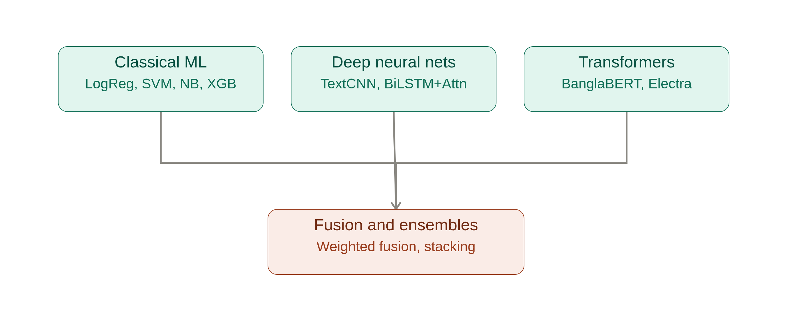
SECTION 8 · MODELS
Model Zoo — 17 Models, 5 Families
Classical ML
Static Emb.
Deep NN
Transformers
LogReg · SVM · Naive Bayes · XGBoost
Word2Vec · FastText · GloVe
TextCNN · BiLSTM + Attention
BanglaBERT · BanglaElectra
Bengali Hate Speech Detection — Multi-Model NLP Benchmark
15 / 33

Slide 17
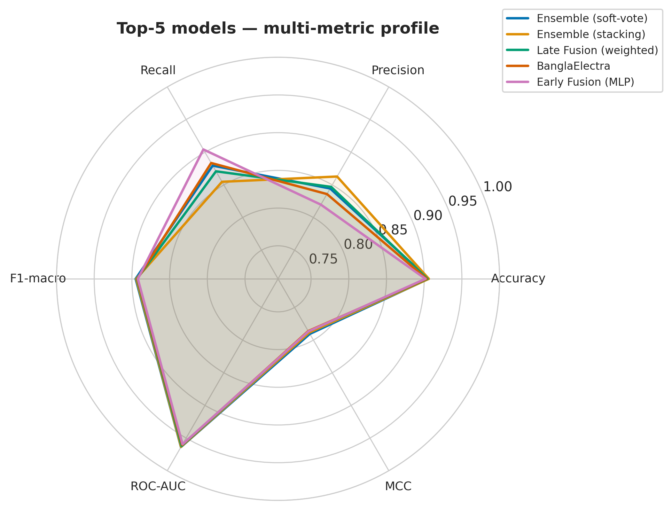
SECTION 8 · MODELS
Fusion & Ensemble Strategies
Early Fusion — concatenate TF-IDF + embedding features, then classify with LogReg or an MLP.
Late Fusion (weighted) — combine each model's predicted probabilities with tuned per-model weights.
Ensemble (soft-vote) — average class probabilities across the strongest base models.
Ensemble (stacking) — train a meta-learner on out-of-fold base-model predictions.
Result: fusion & ensemble strategies occupy 4 of the top 5 leaderboard positions.
Top-5 multi-metric profile
Bengali Hate Speech Detection — Multi-Model NLP Benchmark
16 / 33

Slide 18
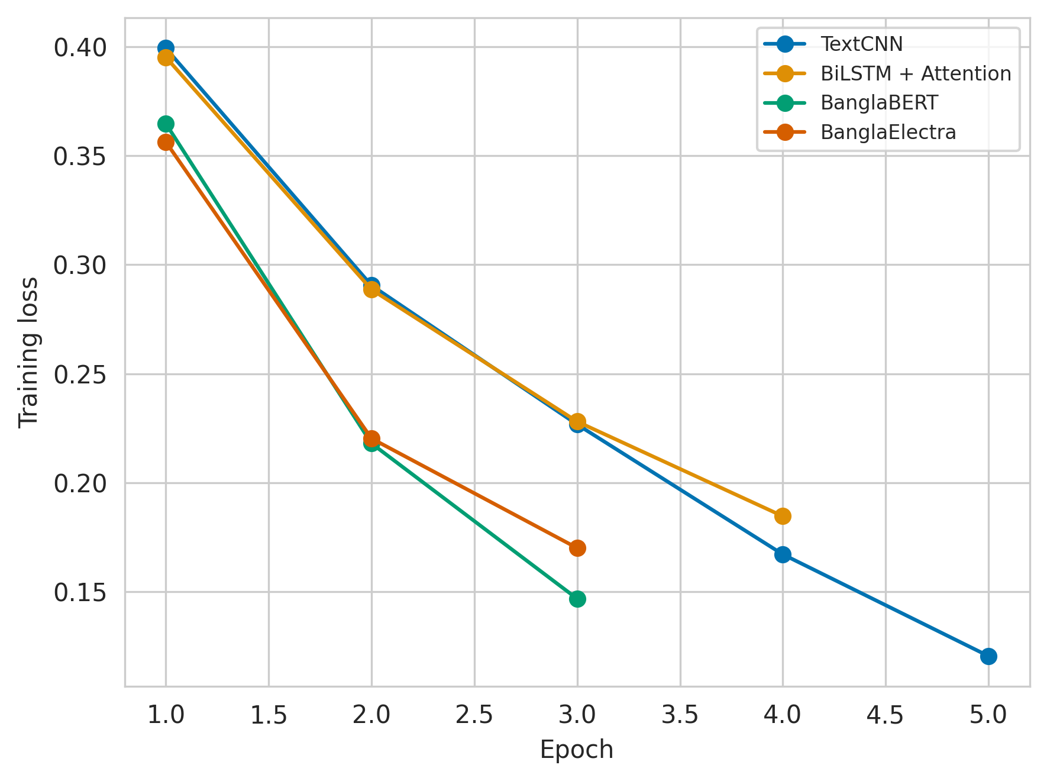
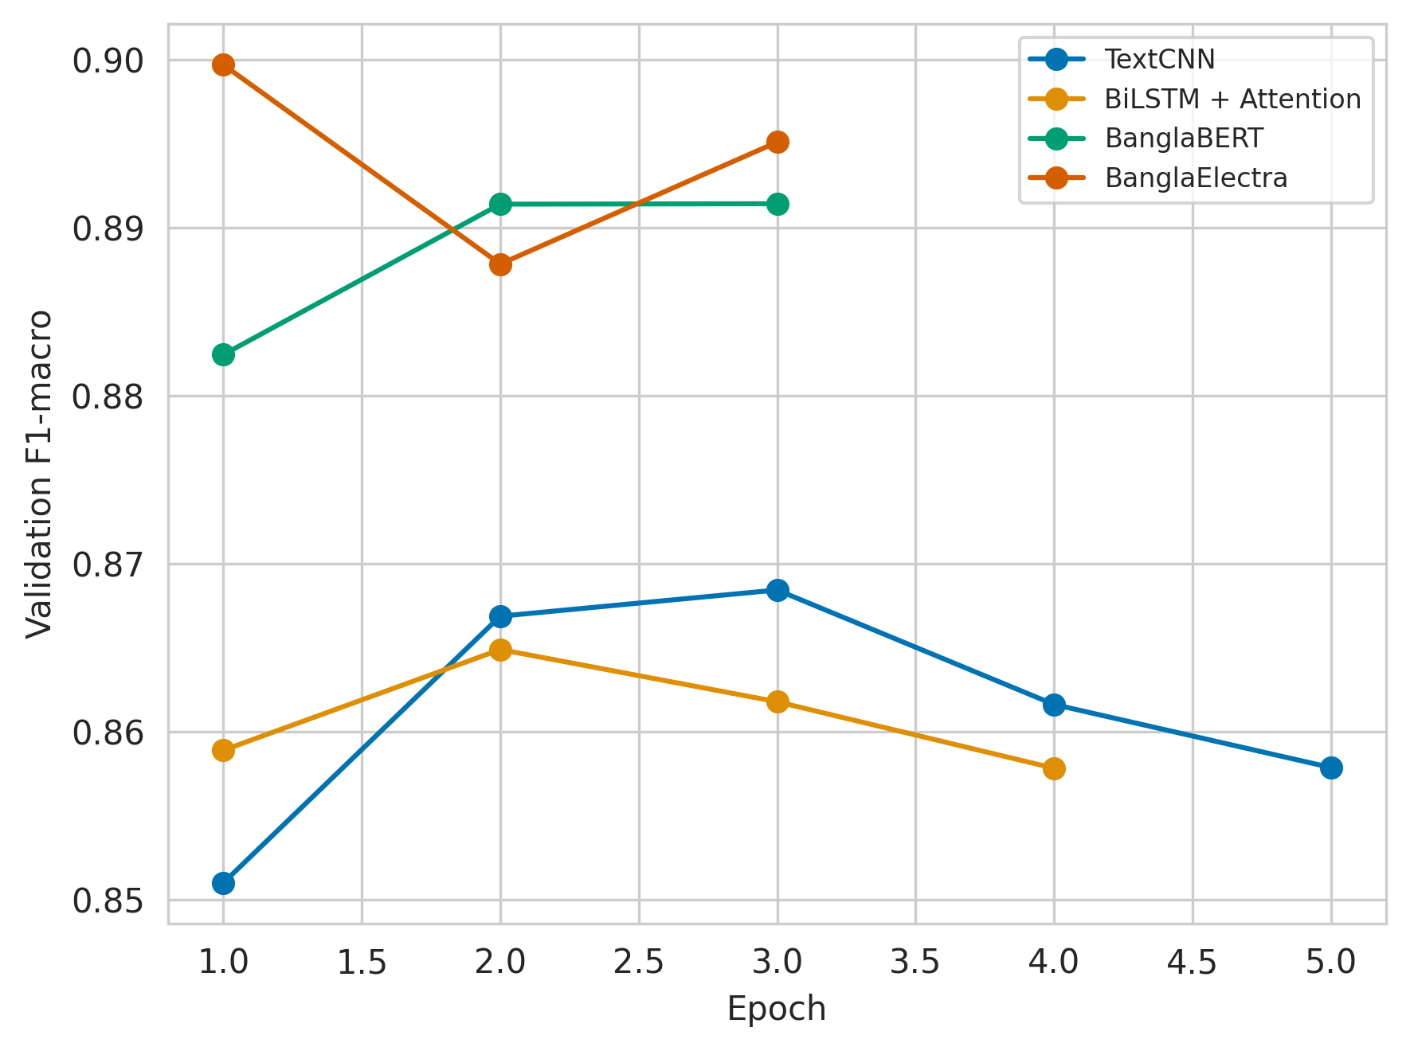
SECTION 9 · TRAINING
Training Dynamics
Transformers (BanglaBERT / BanglaElectra) converge fastest and reach the highest validation F1 within 3 epochs.
Bengali Hate Speech Detection — Multi-Model NLP Benchmark
17 / 33

Slide 19
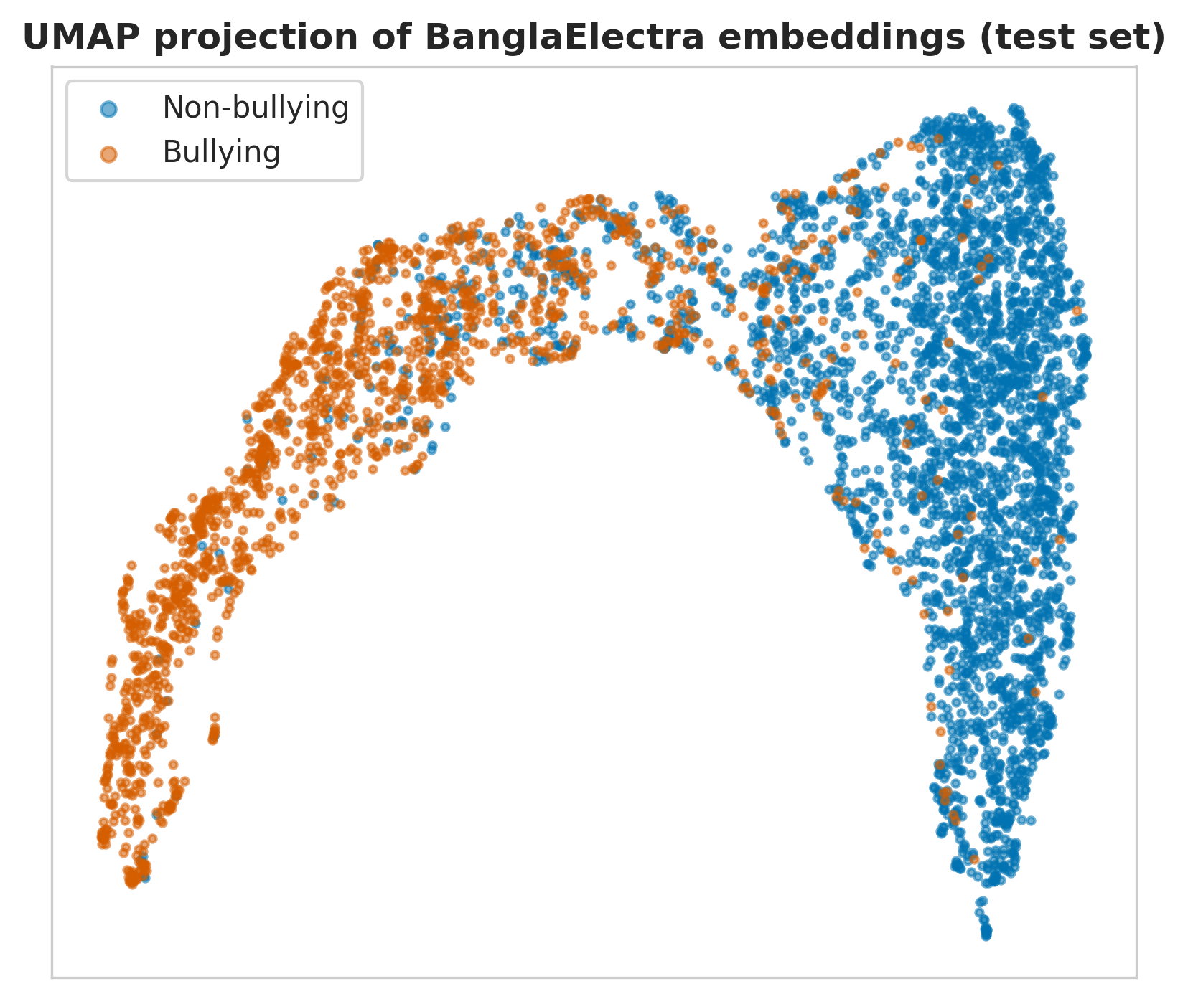
SECTION 9 · TRAINING
Embedding Space (UMAP)
Each point = one test-set post
768-d BanglaElectra embeddings, projected to 2-D
Colour = ground-truth label
Two-lobe structure emerges without explicit supervision at this layer
Overlap zone flags posts that likely need human review
BanglaElectra test-set embeddings form two largely separable arms — bullying (orange) vs. non-bullying (blue) — with overlap concentrated near the decision boundary.
Bengali Hate Speech Detection — Multi-Model NLP Benchmark
18 / 33

Slide 20
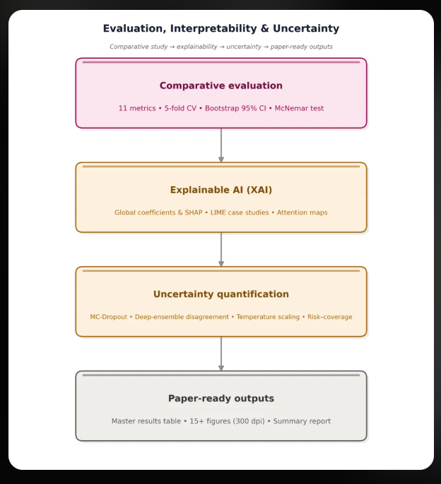
SECTION 10 · EVALUATION
Evaluation Pipeline
Every model scored on the same held-out test set with 11 shared metrics
XAI and uncertainty analyses run on the top-performing models only
One script regenerates all figures and tables end-to-end from raw data
One pipeline, four stages: comparison → explanation → uncertainty → camera-ready outputs.
Bengali Hate Speech Detection — Multi-Model NLP Benchmark
19 / 33

Slide 21
SECTION 10 · EVALUATION
Master Results — Top Models
Model | Accuracy | Precision | Recall | F1-macro | ROC-AUC
Ensemble (stacking) | 90.68 | 86.26 | 85.74 | 89.51 | 96.39
Ensemble (soft-vote) | 90.57 | 84.45 | 87.95 | 89.51 | 96.37
Late Fusion (weighted) | 90.44 | 84.70 | 87.08 | 89.32 | 96.21
BanglaElectra | 90.32 | 83.60 | 88.35 | 89.27 | 96.05
Early Fusion (MLP) | 90.17 | 81.98 | 90.43 | 89.21 | 95.94
TF-IDF + XGBoost | 89.59 | 84.54 | 84.20 | 88.28 | 94.95
BanglaBERT | 89.16 | 80.26 | 89.56 | 88.14 | 95.72
TF-IDF + LogReg | 89.30 | 84.18 | 83.67 | 87.95 | 95.02
Full leaderboard of 17 models spans classical ML, static embeddings, deep nets, transformers, and fusion/ensembles.
Bengali Hate Speech Detection — Multi-Model NLP Benchmark
20 / 33

Slide 22
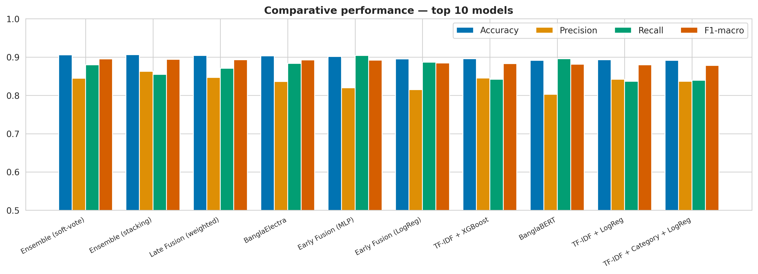
SECTION 10 · EVALUATION
Comparative Performance
All top-10 models sit within a few points of each other on every metric — no single approach dominates accuracy, precision, recall, and F1 simultaneously.
Bengali Hate Speech Detection — Multi-Model NLP Benchmark
21 / 33

Slide 23
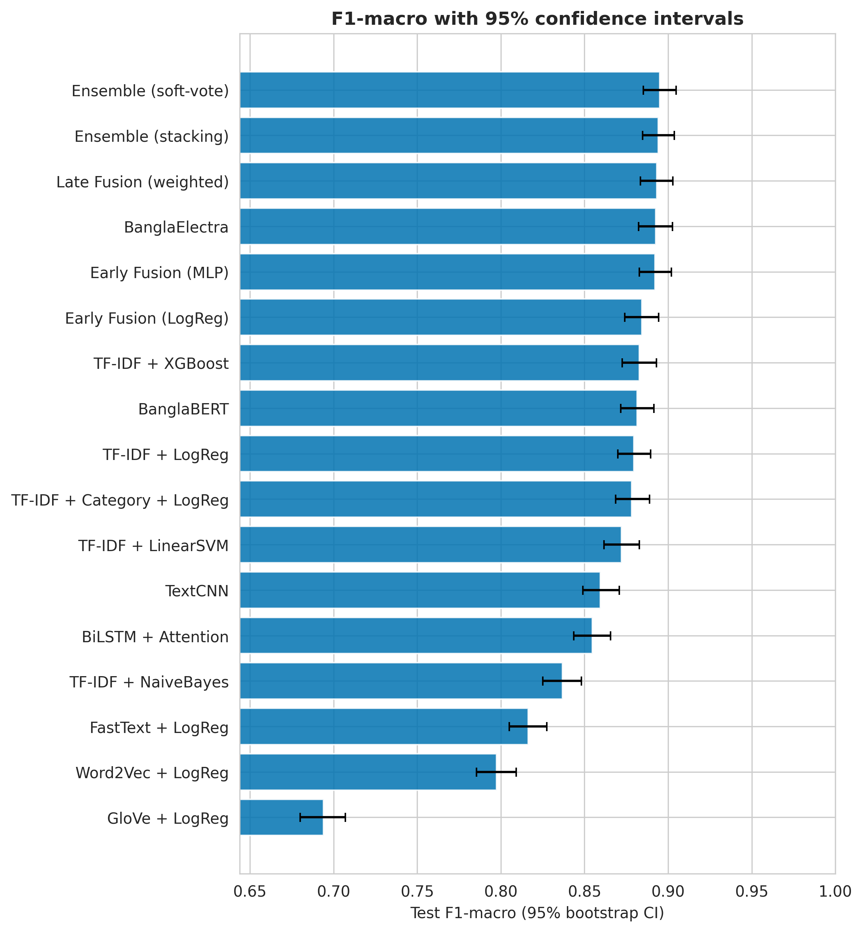
SECTION 10 · EVALUATION
F1-macro with 95% Confidence Intervals
Whiskers show 95% bootstrap confidence intervals
Top-5 intervals overlap heavily
Wide overlap means the visual ranking is not yet a statistically confirmed ordering
See the McNemar test, next slide, for pairwise significance
A tighter estimate needs either more test data or a paired significance test — both are covered next.
Bengali Hate Speech Detection — Multi-Model NLP Benchmark
22 / 33

Slide 24
SECTION 10 · EVALUATION
Accuracy–Efficiency Trade-off
What the F1 result means
Stacked Ensemble
F1-macro 0.8951
Highest score
F1-macro is the primary selection criterion because the dataset has an approximately 1:2 class imbalance.
BanglaELECTRA
F1-macro 0.8927
Near-optimal single model
The practical question is not only “Which model scores highest?” but also “Is the small gain worth the added deployment cost?”
TF-IDF + XGBoost
F1-macro 0.8828
Strong classical baseline
Takeaway: a near-optimal single transformer can be preferable to a costlier ensemble.
Only a small F1-macro gain separates the ensemble from BanglaELECTRA.
Bengali Hate Speech Detection — Multi-Model NLP Benchmark
35 / 35

Slide 25
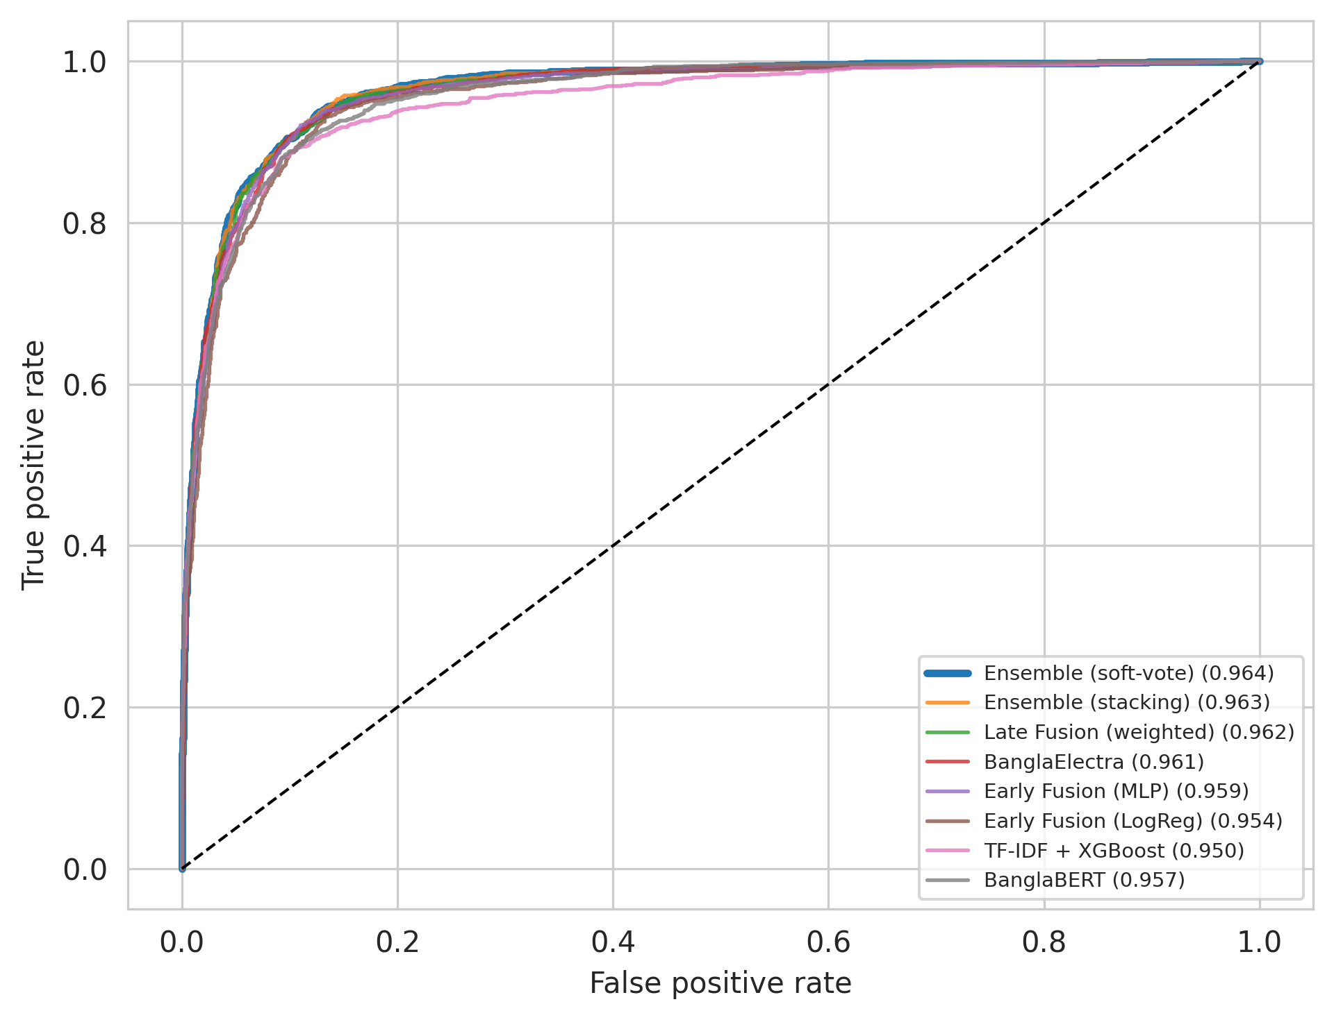
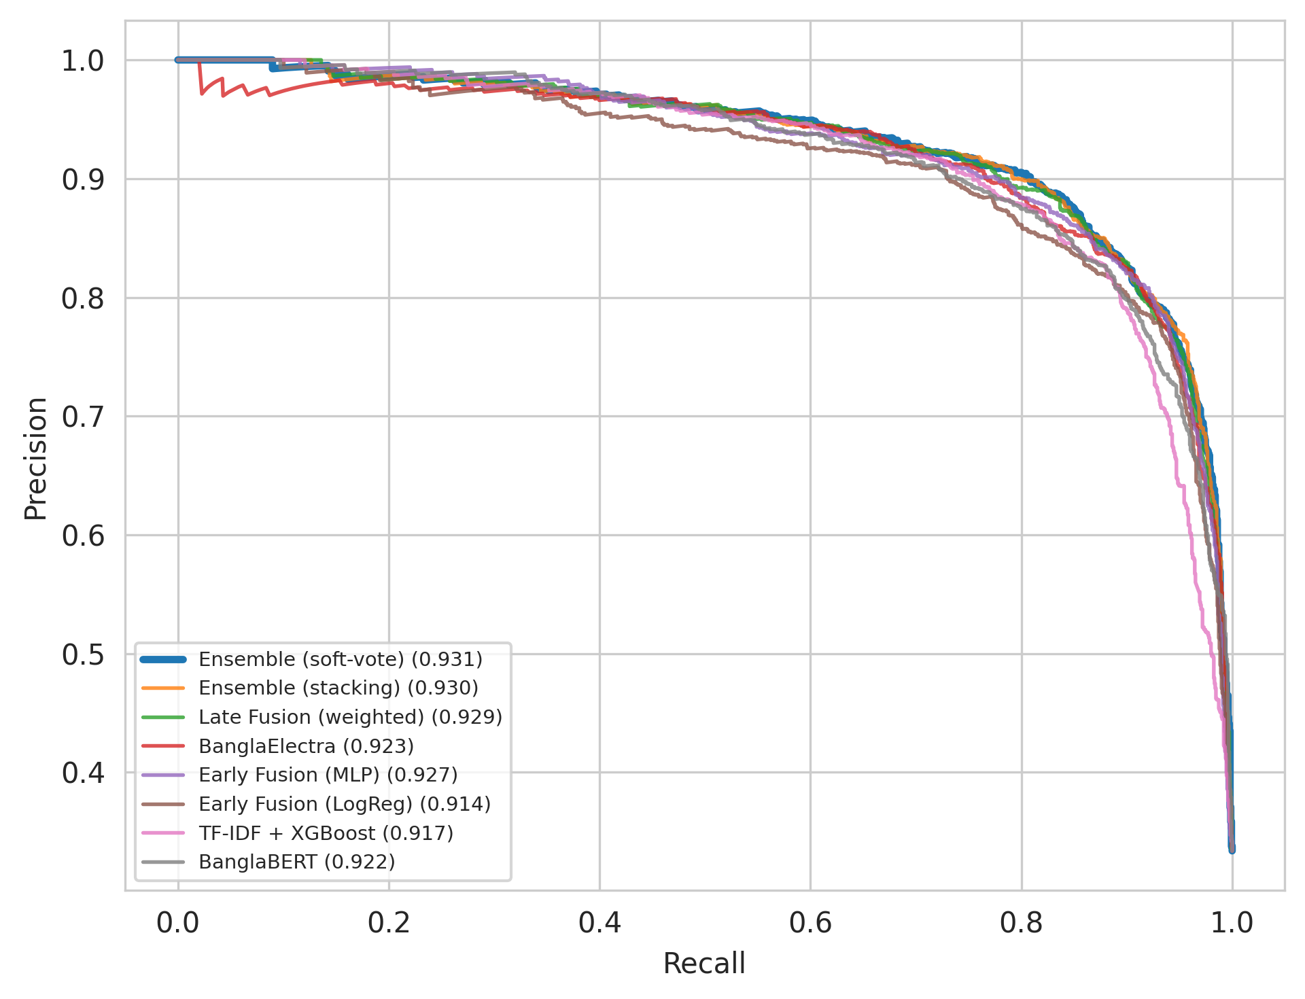
SECTION 10 · EVALUATION
ROC & Precision–Recall Curves
Top models cluster tightly: ROC-AUC up to 0.964 and PR-AUC up to 0.931 for the soft-vote ensemble.
Bengali Hate Speech Detection — Multi-Model NLP Benchmark
23 / 33

Slide 26
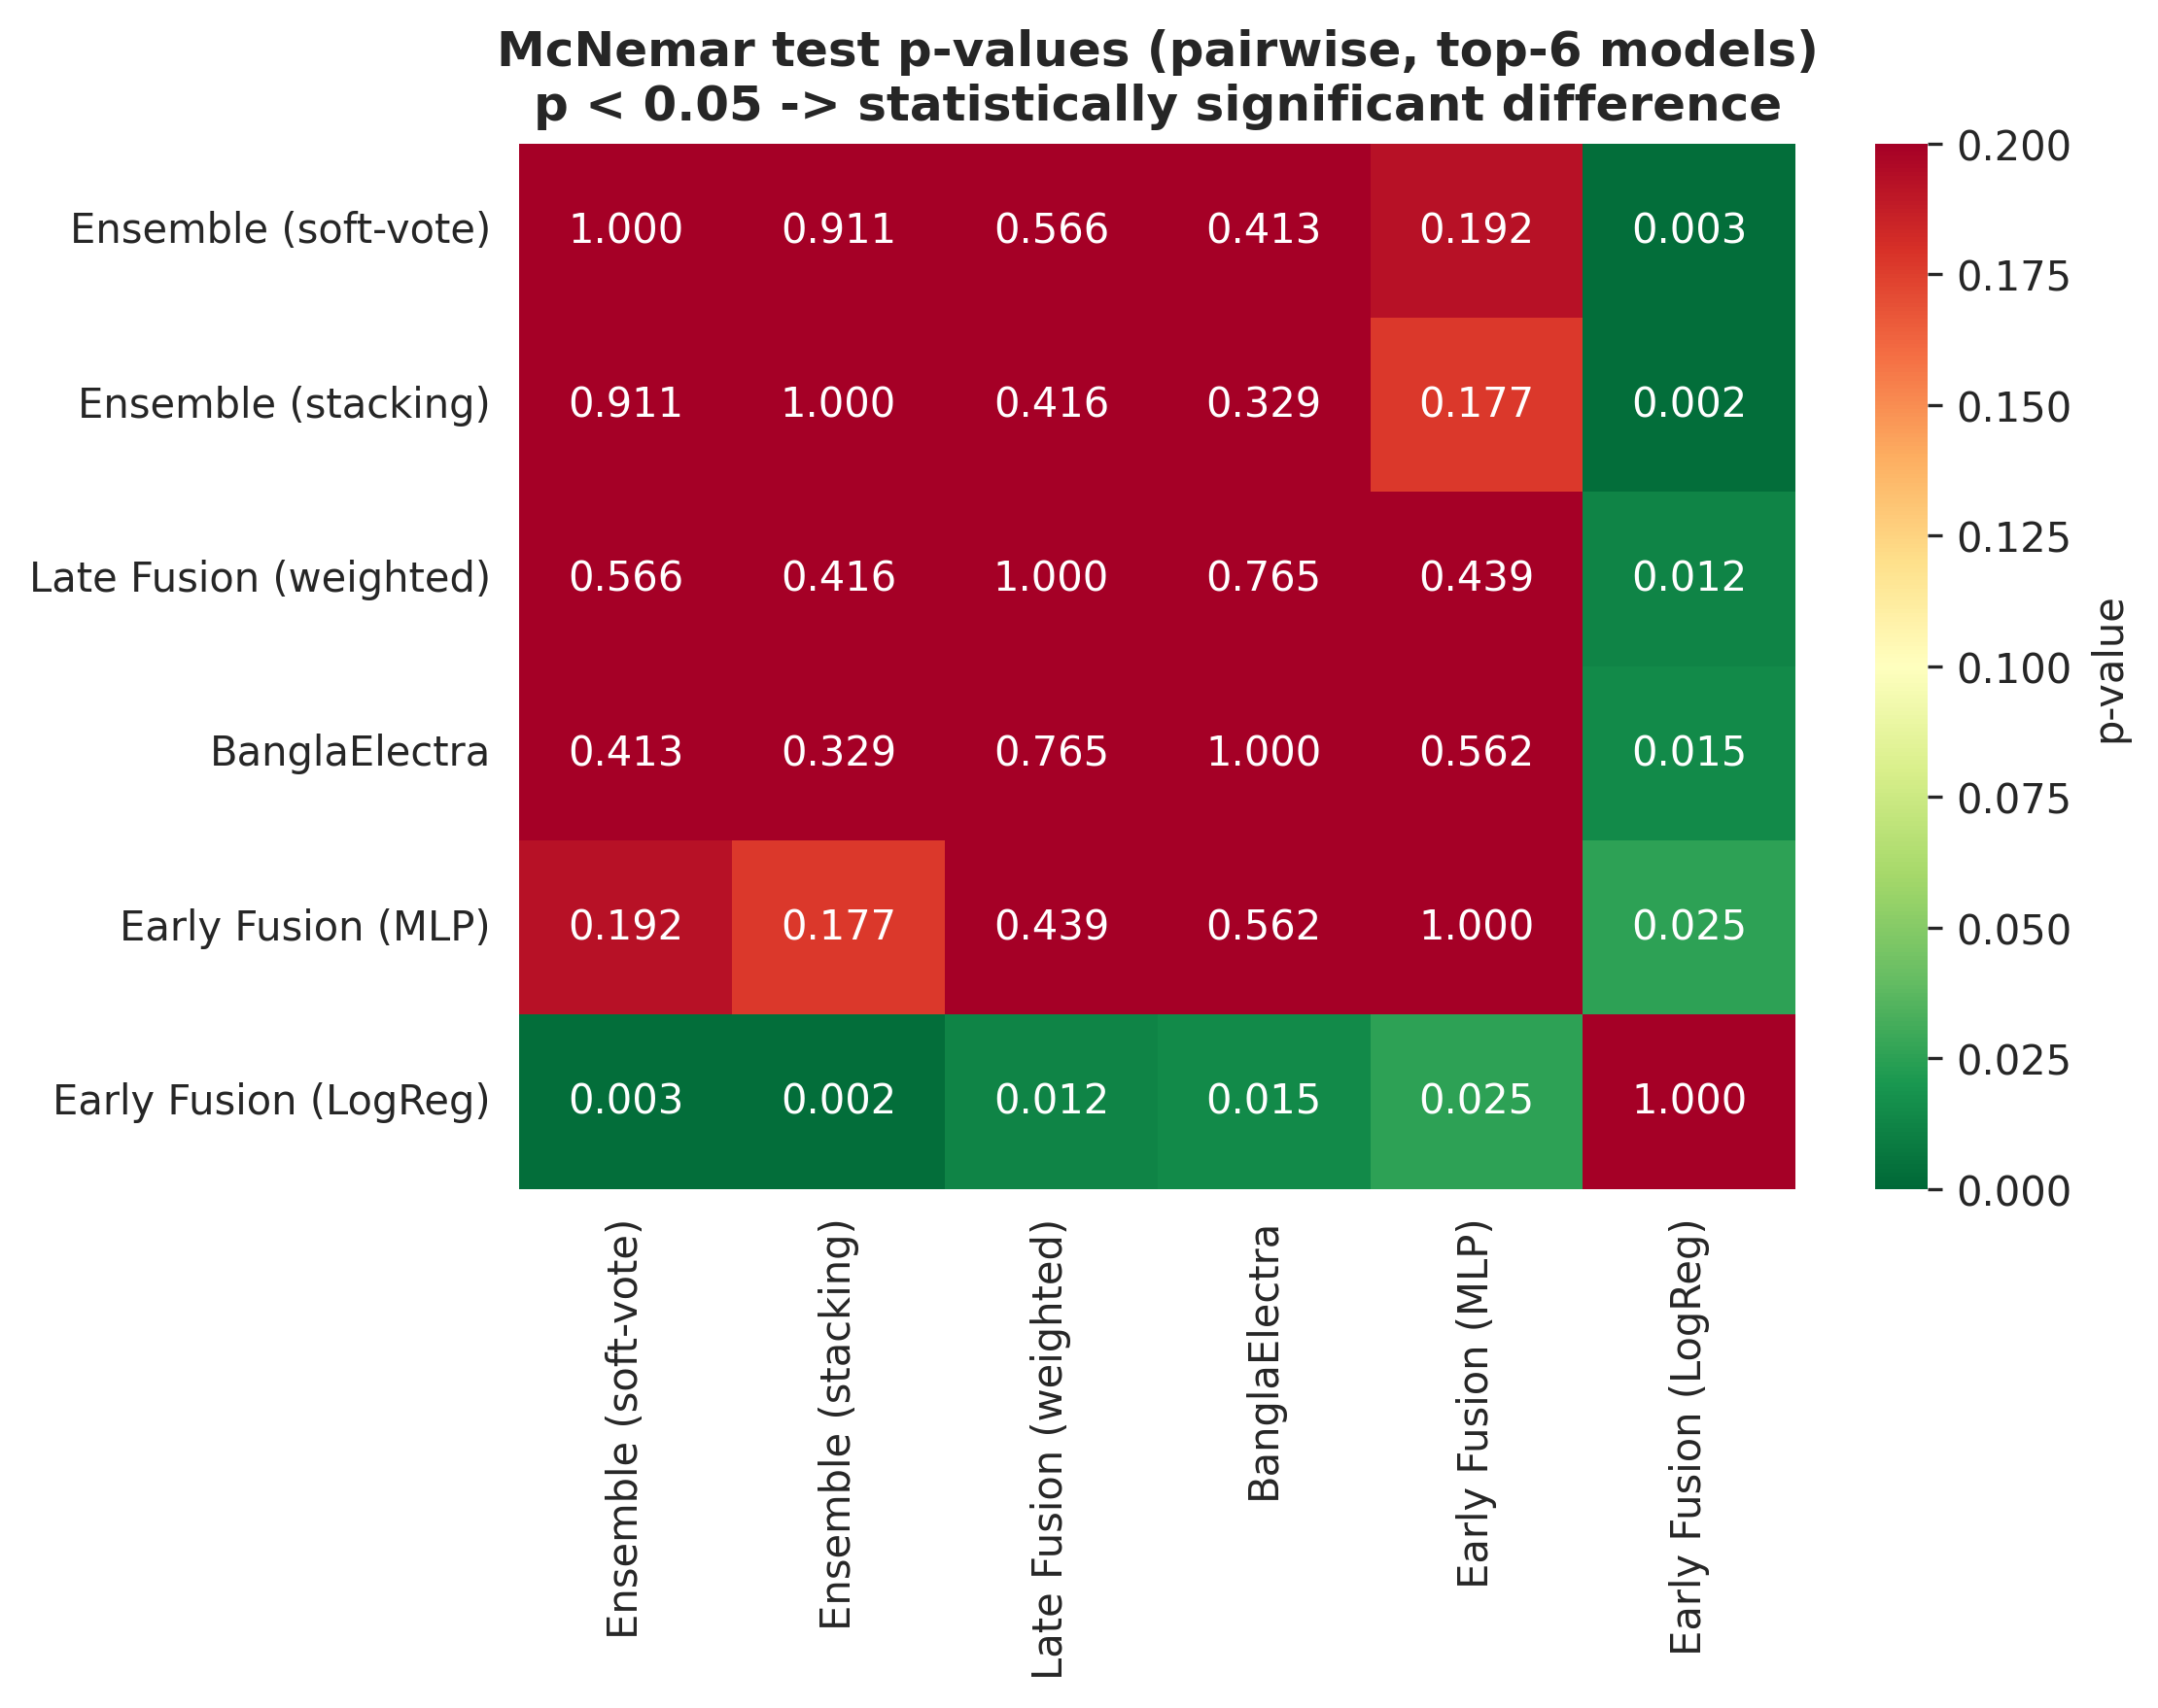
SECTION 11 · SIGNIFICANCE & ERRORS
Statistical Significance (McNemar Test)
The top-5 models are statistically indistinguishable (p > 0.05); Early Fusion (LogReg) is significantly weaker (p < 0.05 vs. every top model).
Bengali Hate Speech Detection — Multi-Model NLP Benchmark
24 / 33

Slide 27
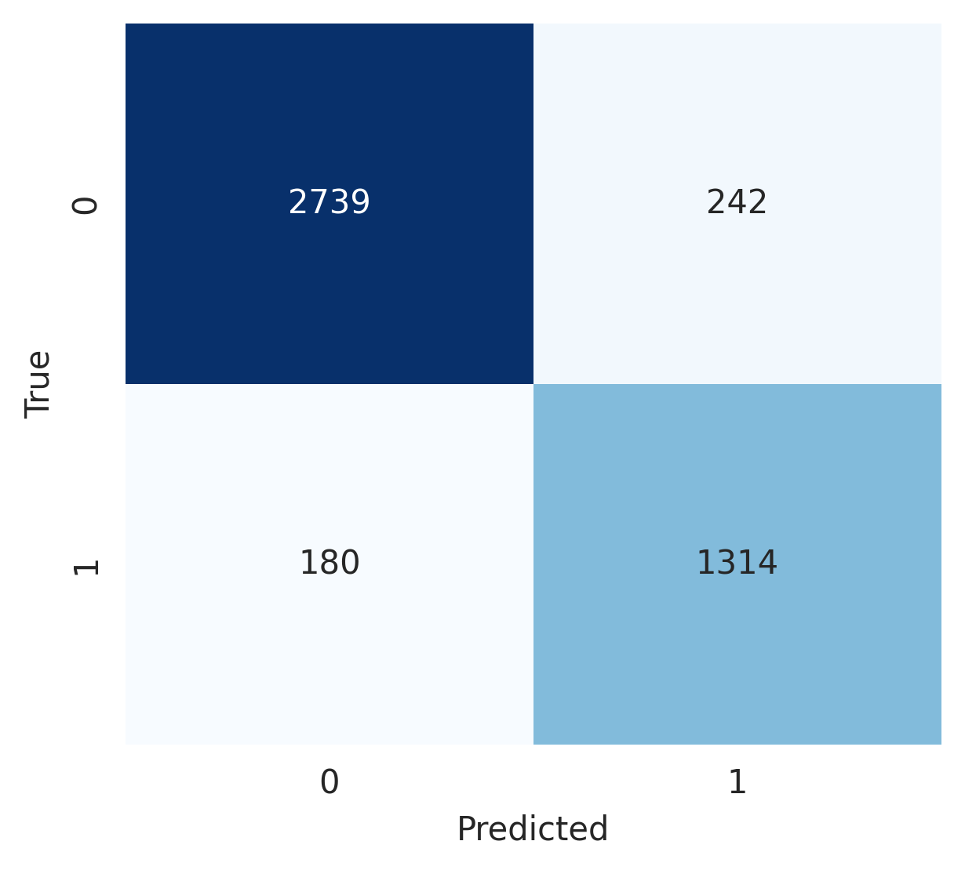

SECTION 11 · SIGNIFICANCE & ERRORS
Confusion Matrices — Best Models
Ensemble (soft-vote) · F1=0.895
BanglaElectra · F1=0.893
Both top models miss roughly 1 in 7 hate-speech posts (recall ≈ 86%) — false negatives concentrate on implicit or sarcastic hate lacking explicit slurs.
Bengali Hate Speech Detection — Multi-Model NLP Benchmark
25 / 33

Slide 28
SECTION 11 · SIGNIFICANCE & ERRORS
Ruling Out Leakage as the Cause
Stage | Rows | Pos. Share
Raw | 30,000 | —
Parsed labels | 30,000 | 33.33%
After NA drop | 30,000 | 33.33%
After de-duplication | 29,836 | 33.38%
Zero NaN label-parsing failures; de-dup. removes a near-identical share of positives (0.4%) and negatives (0.6%) — class ratio essentially unchanged. TF-IDF beats raw bag-of-words by 1.3–1.5 F1-macro pts; longer-context transformers (128 tok) did not improve on the 64-token config.
Bengali Hate Speech Detection — Multi-Model NLP Benchmark
26 / 33

Slide 29
SECTION 11 · SIGNIFICANCE & ERRORS
Does the Ranking Hold on a Second Corpus?
Model | F1-macro | ROC-AUC
Ensemble (stacking) | 91.97 | 97.34
BanglaELECTRA | 91.68 | 97.34
TF-IDF + XGBoost | 90.38 | 96.11
TextCNN | 88.76 | 95.23
GloVe + LogReg | 70.03 | 77.09
Full protocol re-run end-to-end on BD-SHS (50,281 comments, 48.0% hate speech). Family ordering reproduces almost exactly: Spearman ρ = 0.988 (p < 0.001). Uncertainty findings replicate too — ECE drops 62% (0.0326 → 0.0125) after temperature scaling.
Bengali Hate Speech Detection — Multi-Model NLP Benchmark
27 / 33

Slide 30
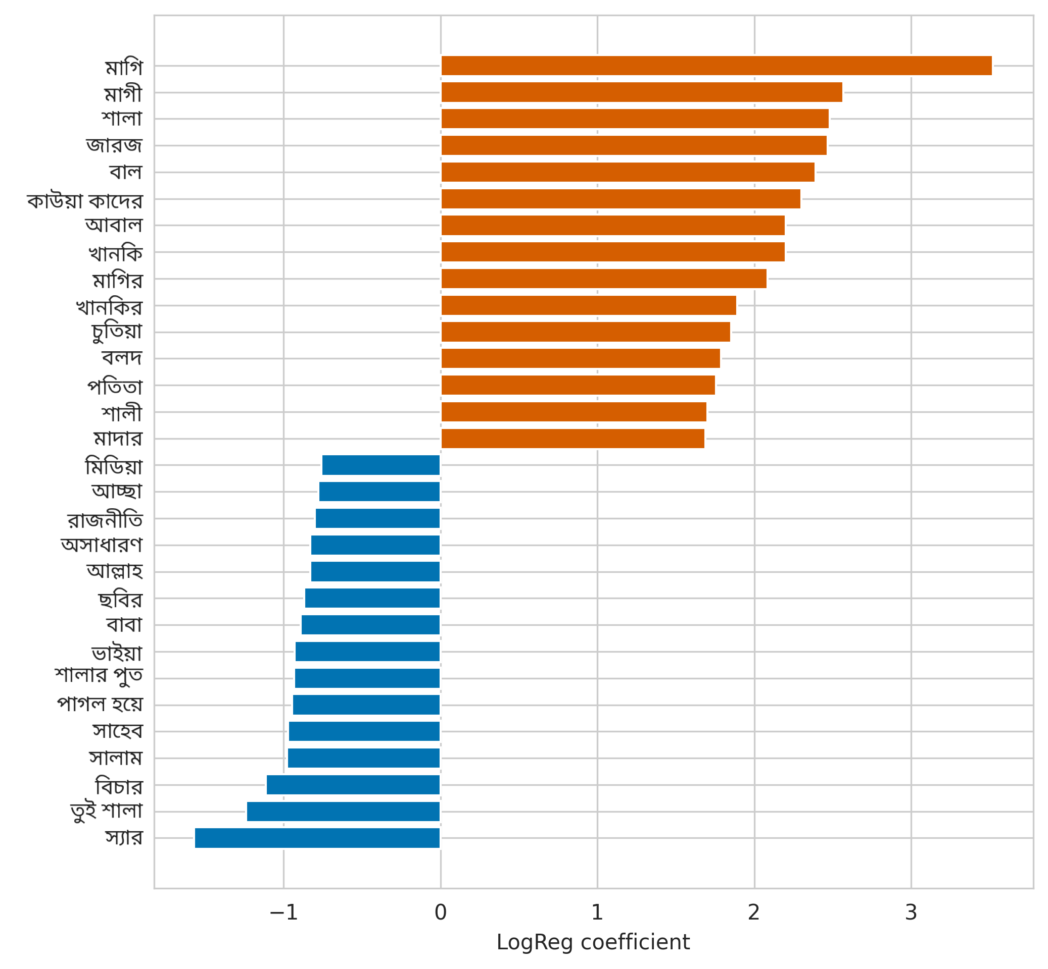
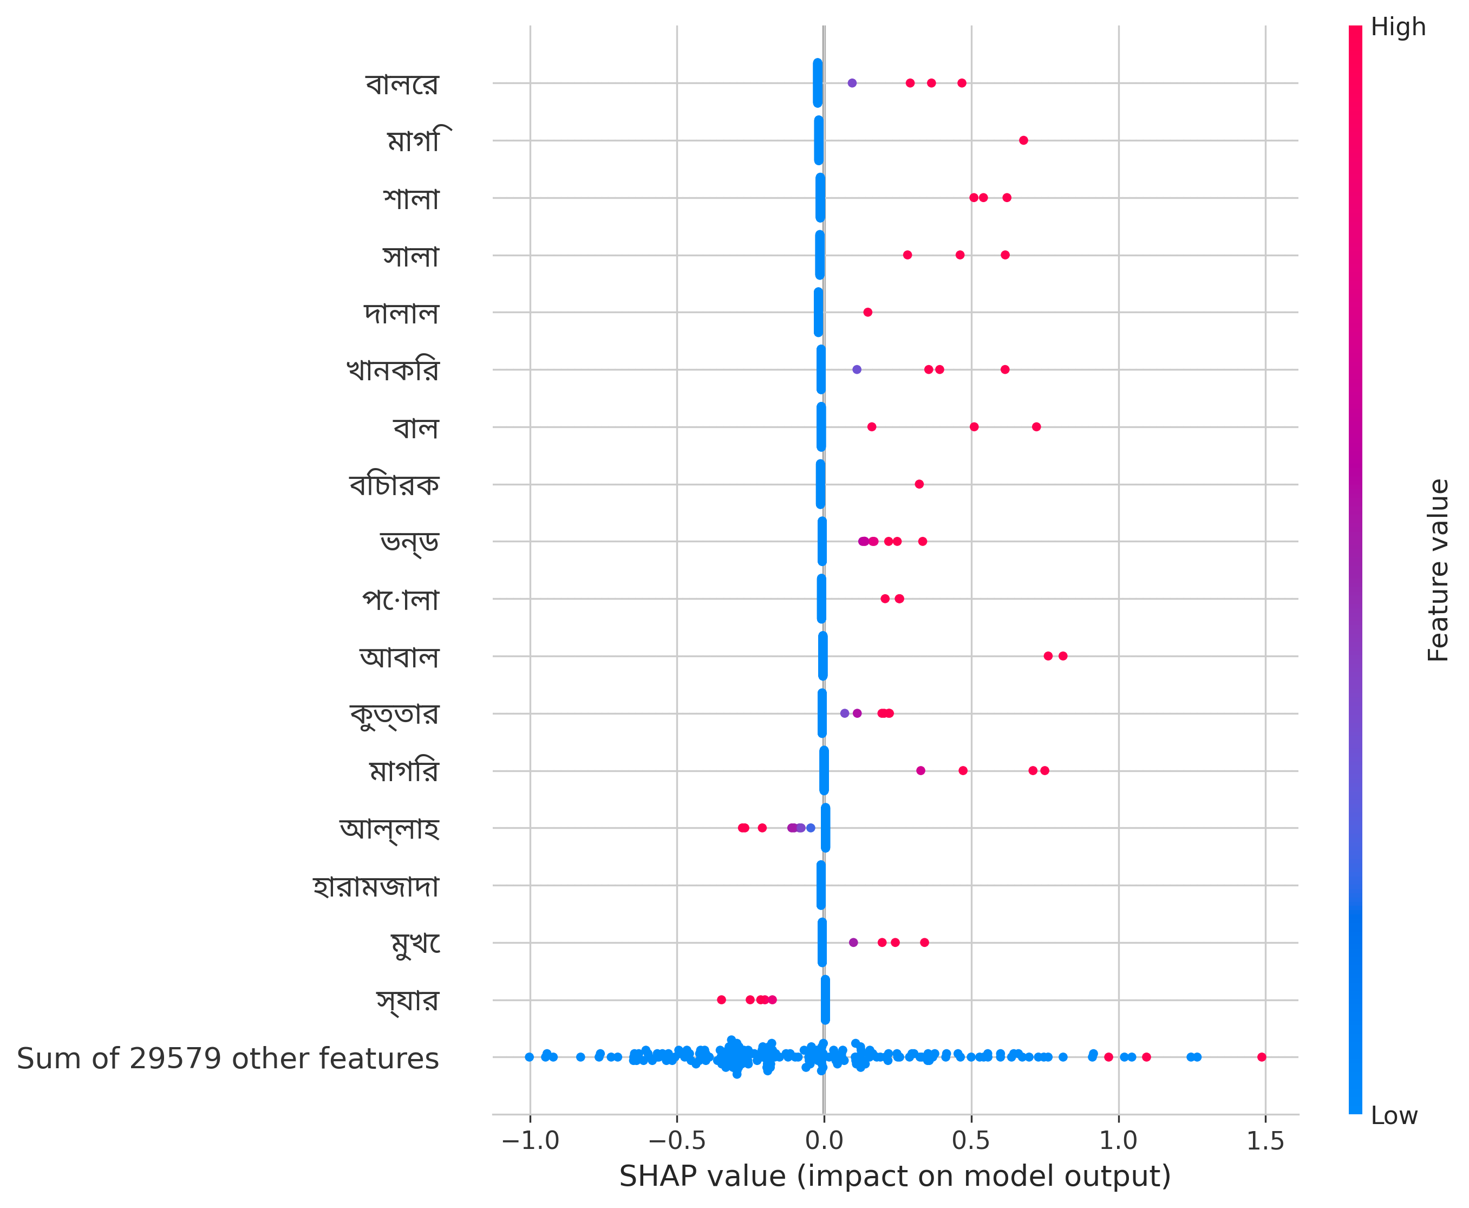
SECTION 12 · EXPLAINABLE AI
Global Feature Importance
LogReg coefficients (left) and SHAP values (right) agree: explicit slurs push predictions toward “bullying”; formal / respectful terms push toward “non-bullying.”
Bengali Hate Speech Detection — Multi-Model NLP Benchmark
28 / 33

Slide 31
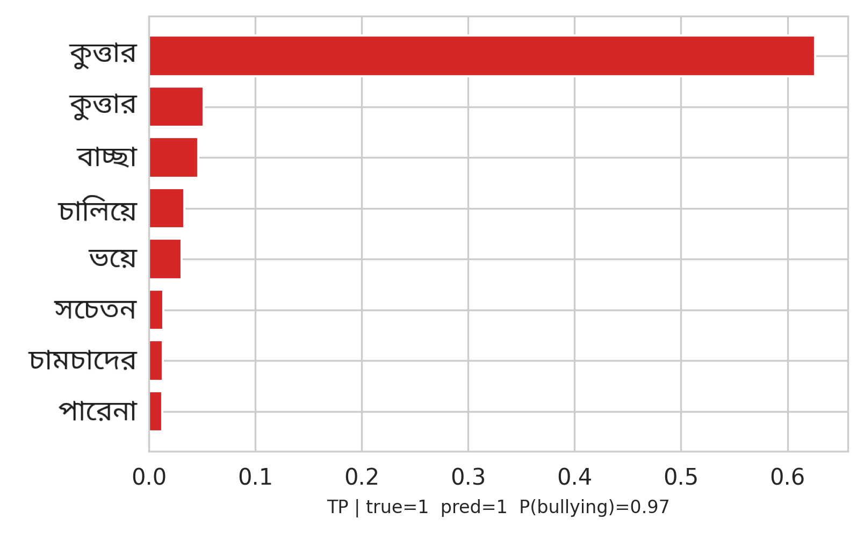
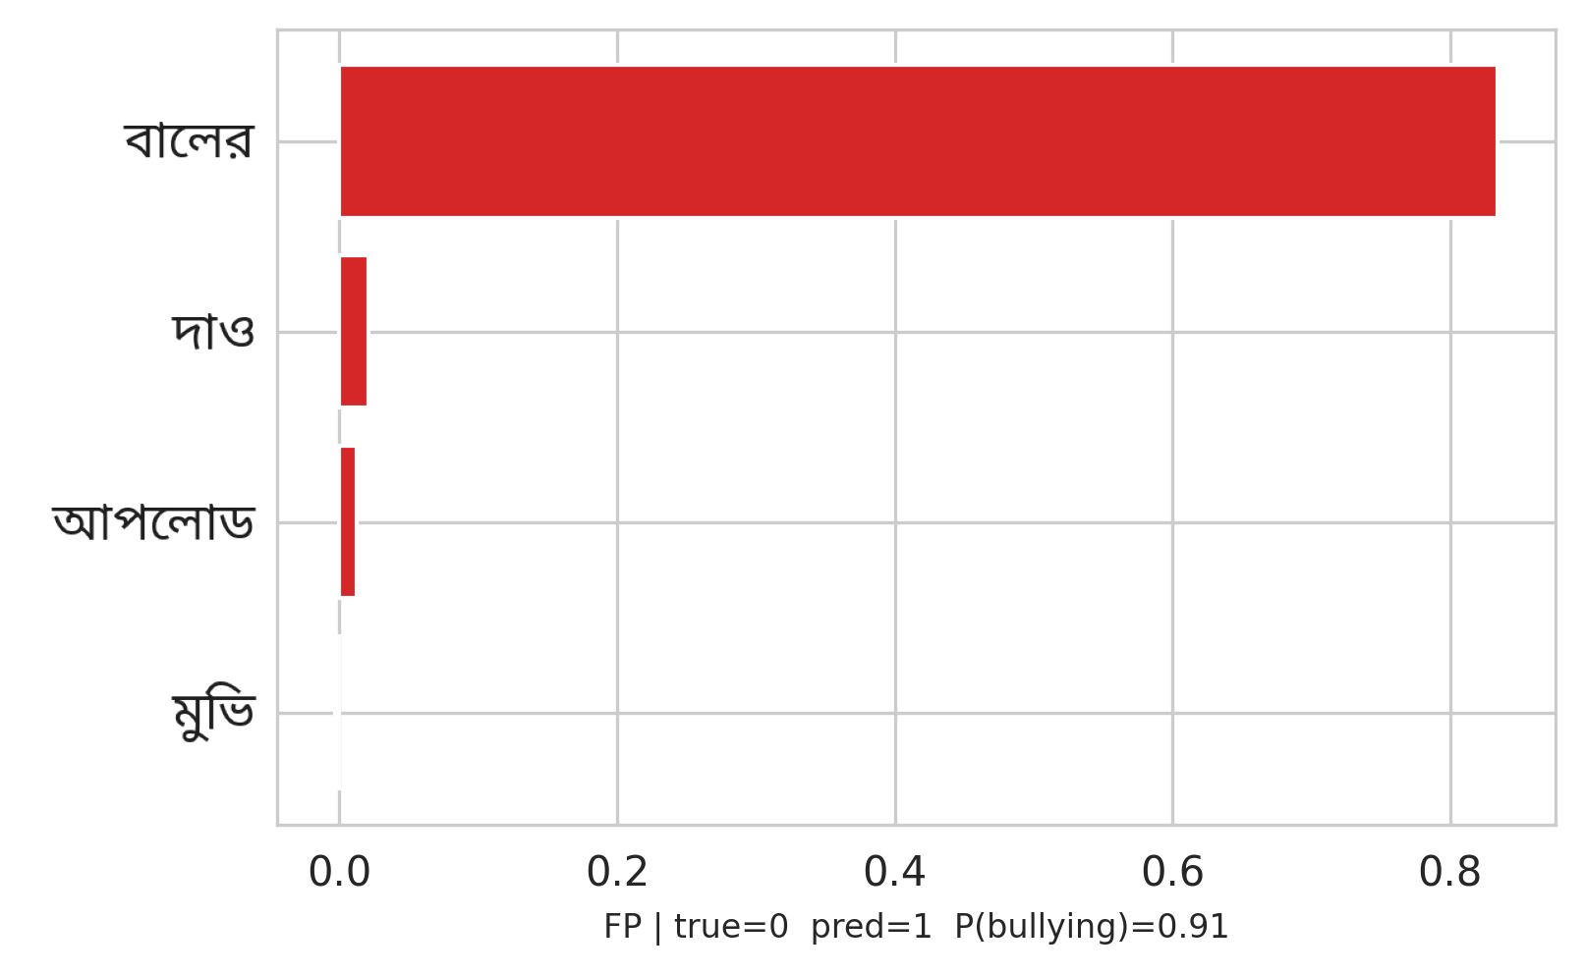
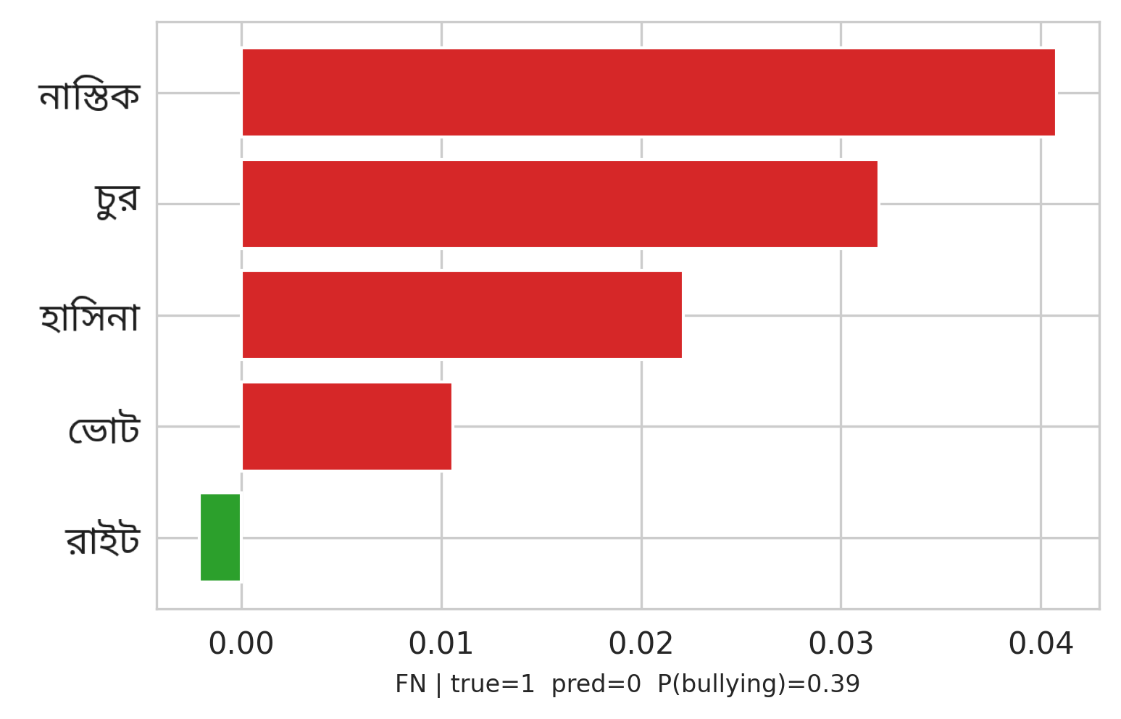
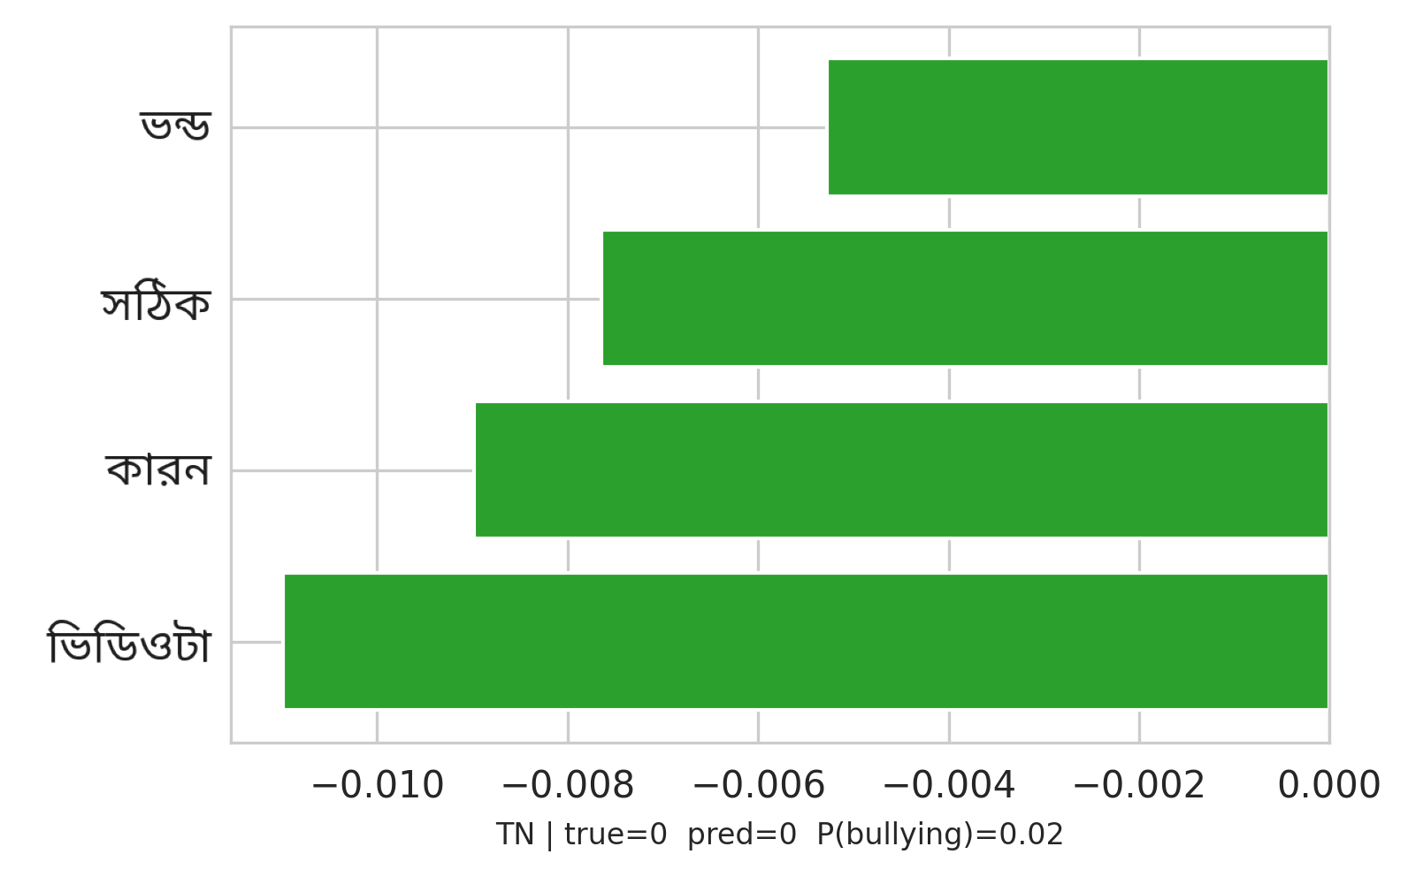
SECTION 12 · EXPLAINABLE AI
Case Studies — LIME Explanations
True Positive
False Positive
False Negative
True Negative
One consistent pattern across all four outcomes: explicit slurs are caught reliably; sarcasm, coded language, and topical-but-neutral phrasing are what the model still gets wrong.
Bengali Hate Speech Detection — Multi-Model NLP Benchmark
29 / 33

Slide 32
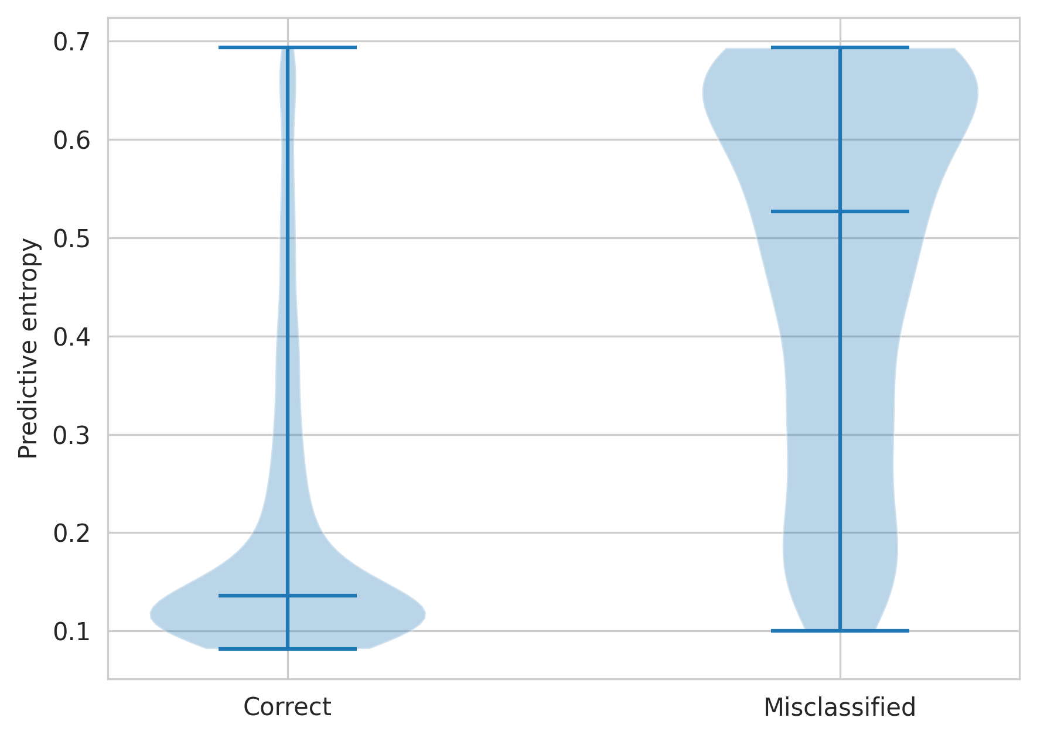
SECTION 13 · UNCERTAINTY
Uncertainty Quantification
Predictive entropy by outcome
Correct predictions (n=4,024)
0.208
Misclassified (n=451)
0.476
Epistemic (MI) — correct
0.0044
Epistemic (MI) — misclassified
0.0194
Misclassified posts carry ~2.3x higher predictive entropy and ~4.4x higher epistemic uncertainty — a strong signal for selective abstention.
Bengali Hate Speech Detection — Multi-Model NLP Benchmark
30 / 33

Slide 33
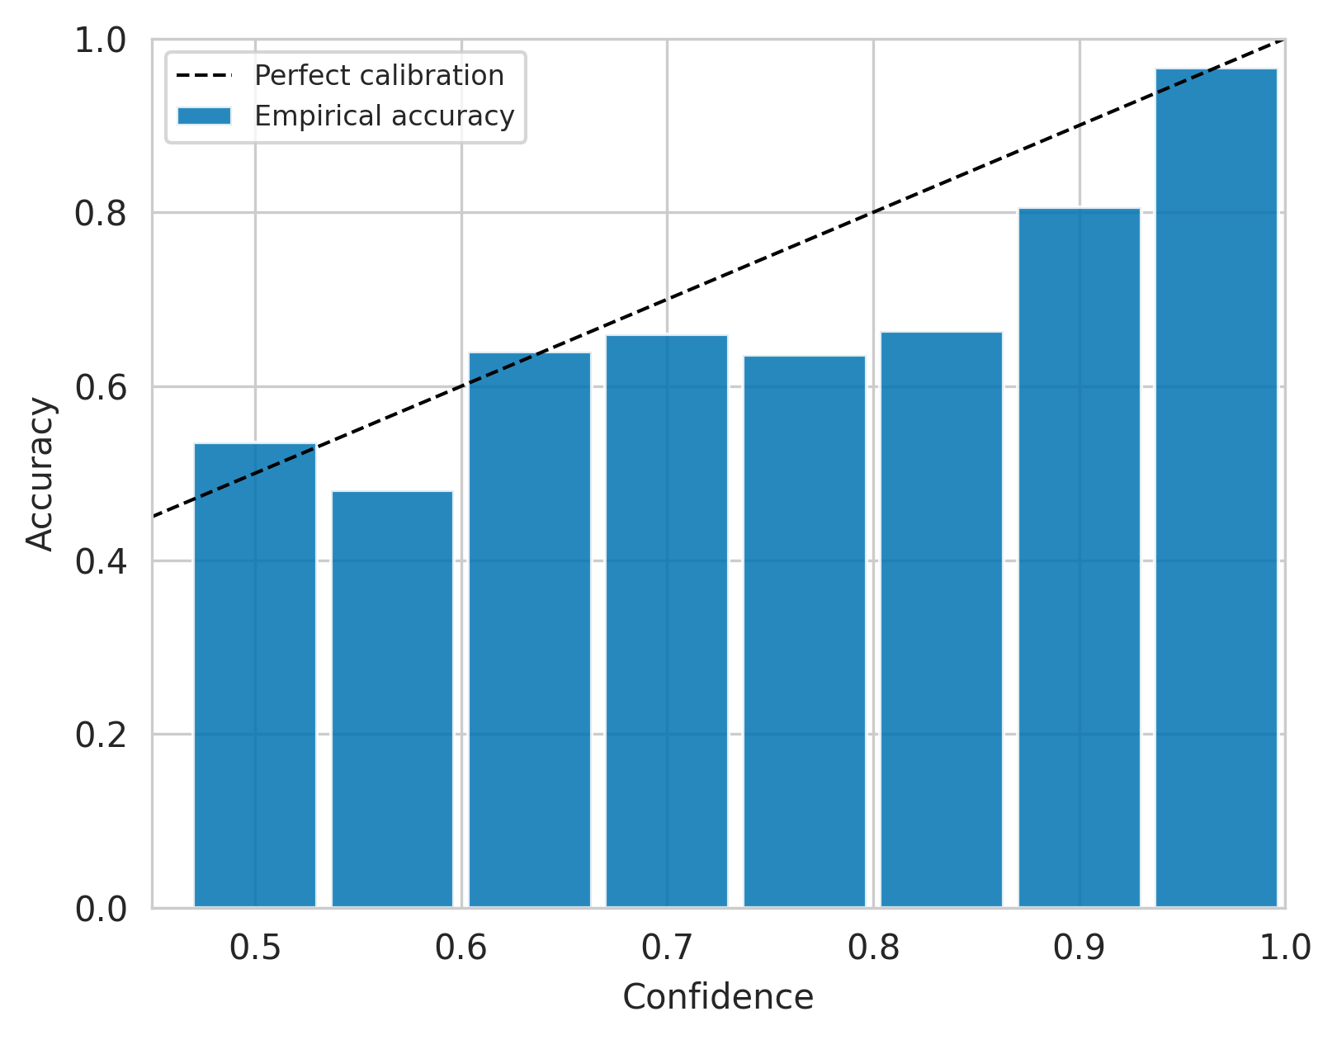
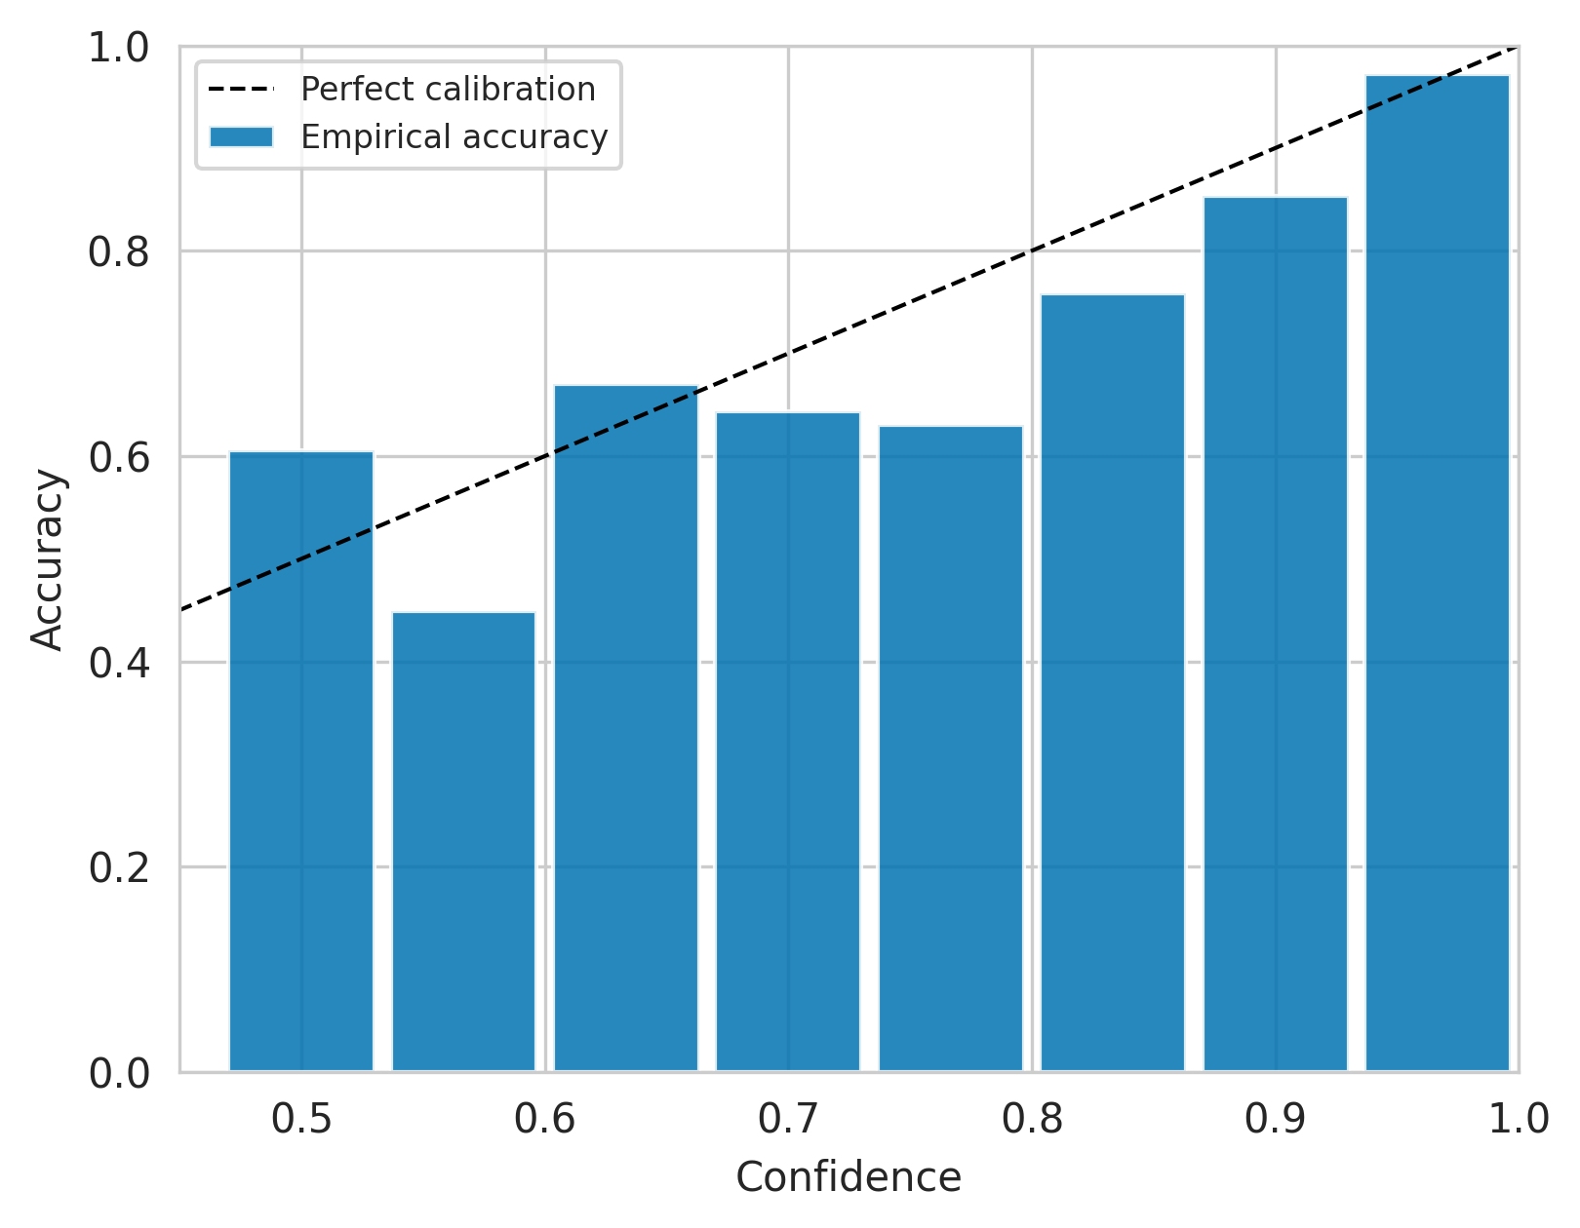
SECTION 13 · UNCERTAINTY
Calibration & Selective Prediction
Before · ECE = 0.0324
After · ECE = 0.0248
Temperature scaling (T=1.15) tightens calibration — empirical accuracy now tracks predicted confidence far more closely.
Bengali Hate Speech Detection — Multi-Model NLP Benchmark
31 / 33

Slide 34
SECTION 14 · WRAP-UP
Conclusion & Contributions
Curated and released a stratified ~29.8K-post Bangla bullying corpus with rich EDA (class balance, length, lexical, word-cloud analysis).
Benchmarked 17 models across classical ML, static embeddings, deep neural nets, and transformers under one evaluation protocol.
Fusion and ensembling (soft-vote, stacking, weighted late fusion) delivered the best result: F1-macro = 0.895, ROC-AUC = 0.964.
Verified with 5-fold CV, bootstrap 95% confidence intervals, and McNemar significance testing — top-5 models are statistically tied.
Made the model transparent and safe to deploy via SHAP / LIME / attention explanations and calibrated, abstention-ready uncertainty.
Bengali Hate Speech Detection — Multi-Model NLP Benchmark
32 / 33

Slide 35
SECTION 14 · WRAP-UP
Limitations & Future Work
Limitation — single corpus, single variety: generalisation to Banglish or dialects is untested beyond the BD-SHS replication.
Limitation — illustrative explainability: LIME/SHAP/attention are case studies, not a human-validated faithfulness evaluation.
Future work — multi-label corpora (HateCorpBN-XL), code-mixed Banglish evaluation, and LoRA/QLoRA fine-tuning with a systematic zero/few-shot LLM baseline.
Future work — a human-rated faithfulness study for explainability, and human-in-the-loop deployment routing only uncertain posts for manual review.
Thank You
Questions & Discussion Welcome
Bengali Hate Speech Detection — Multi-Model NLP Benchmark
33 / 33

