Slide 1
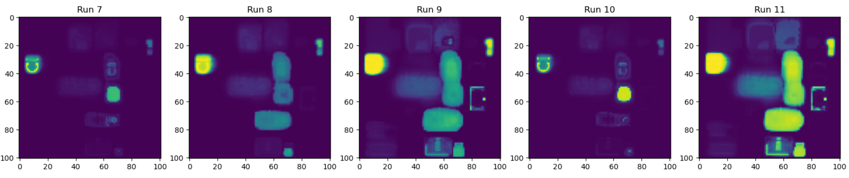
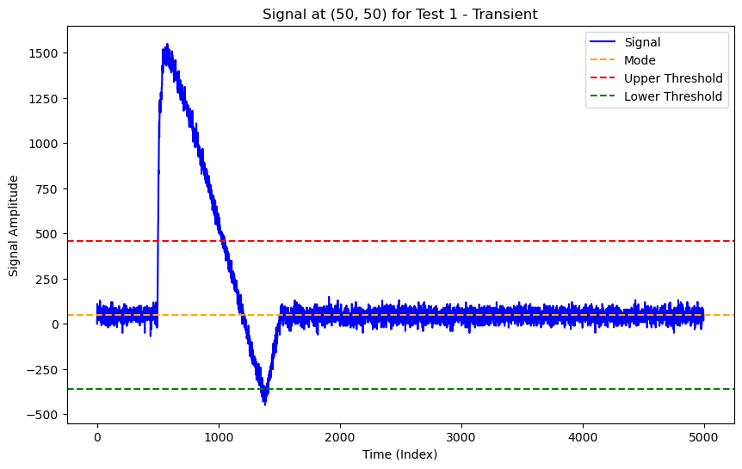
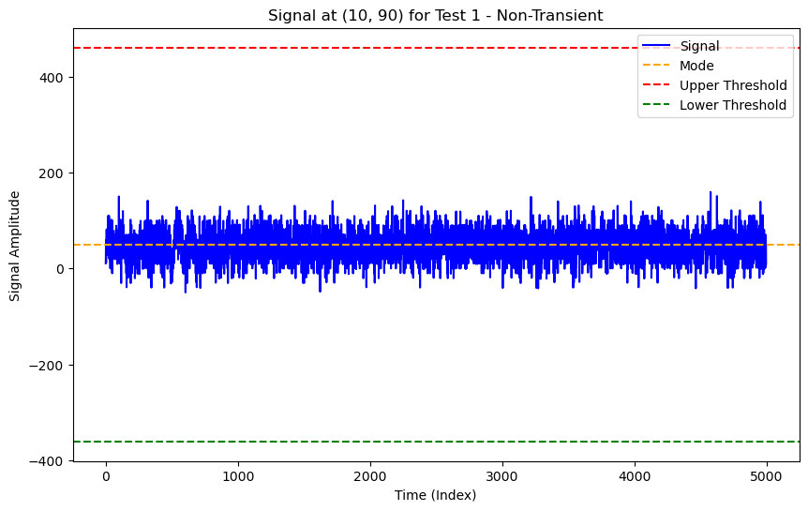
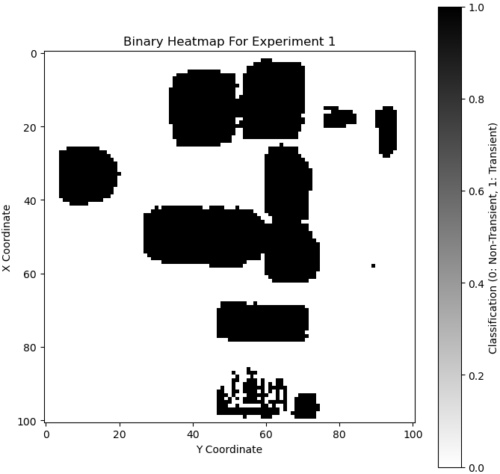
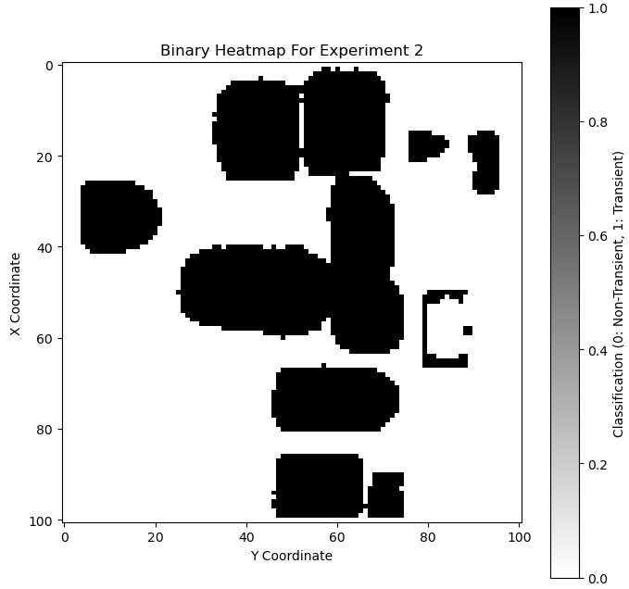
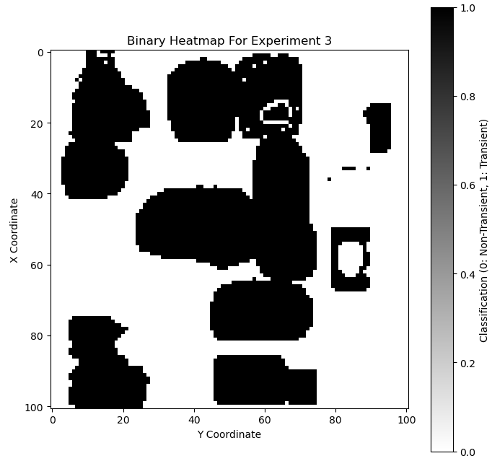
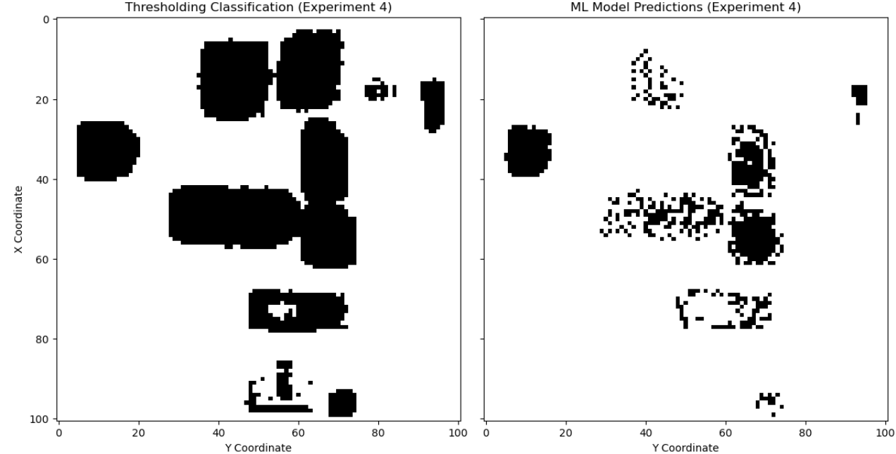
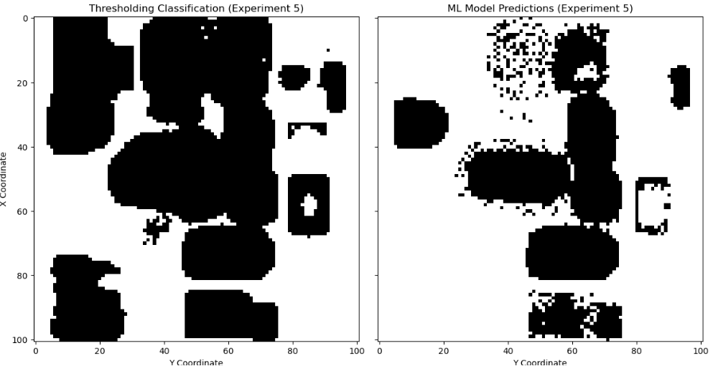
Single-Event Transient Data Classification Using Traditional Statistical Approach and Machine Learning
Samuel Teye, and Samantha Woodward
Indiana University - Bloomington
INDIANA UNIVERSITY
LUDDY SCHOOL OF INFORMATICS, COMPUTING, AND ENGINEERING
Abstract
This study investigates the classification of an experimental dataset of Single Event Transients (SETs) using a combination of traditional statistical techniques and machine learning (ML) methodologies. These methodologies possess computational efficiency, interpretability, and adaptability making them essential for initial SET classification. Statistical techniques, such as thresholding based on the mode and standard deviation, are compared with ML algorithms such as k-nearest neighbor (KNN) and k-means clusters to identify and classify SETs. The methodologies are validated using an experimental dataset generated during radiation testing, utilizing an ion-induced SET in an Operational Amplifier (Op-Amp) with Quasi-Bessel Beam (QBB) Pulsed-Laser (PL). These approaches demonstrate their ability to handle noisy and complex SET data, paving the way for advancements in radiation effects research and electronic system resilience.
Motivation
Project Description
Importance: SETs, caused by radiation, can disrupt electronic systems and lead to failures
System Reliability: Accurate classification of signals is crucial to ensure reliable hardware performance when testing
Traditional Limitations: Near the Signal edges, the statistical methods are not reliable and require advanced computation and analysis
Advancements: KNN machine learning model can improve classification accuracy
This study aims to investigate an effective methodology for SET detection and classification for transient and non-transient signals by comparing two approaches: statistical thresholding and machine learning classification using k-nearest neighbors (KNN).
Heatmap of raw data illustrating Standard Deviation of the entire dataset
Methodology
Transient and Non-Transient Signals
Statistical thresholding Approach
  Determine the mode for entire dataset
  Determine the standard deviation on each run
  Determine the upper and lower threshold bounds
  Determine k value for threshold sensitivity
Machine Learning Approach
  Split training and test data (60%, 40% respectively)
  Determine optimal k-means value on training data
  Label training clusters
  Extract signal features from training data
  Train KNN Model on features and labels
  Predict classification on testing set
Upper threshold= mode + k * std_dev
Lower threshold= mode - k * std_dev
Transient Signal at (50,50) in Experiment 1
Non-Transient Signal at (50,50) in Experiment 1​
Results
Thresholding Approach
Machine Learning Approach
Binary classification for Experiment 1
Binary classification for Experiment 2
Binary classification for Experiment 3​
Thresholding Key Observations
The accuracy of the thresholding results depends on selecting an optimal k value
All transient sections were identified in each experiment
Potential overclassification of transient signals at the boundaries at certain transient regions
Comparison of Experiment 4 results
Machine Learning Key Observations
KNN demonstrated effective classification of the most prominent transient sections
KNN exhibited successful classification in certain less prominent regions
Comparison
Experiment 4: 69% fewer transient detections using machine learning prediction with 85.1% similarity score
Experiment 5: 50.29% fewer transient detections using machine learning predictions with 73.51% similarity score
Comparison of Experiment 5 results
Conclusion
This study compares two methods for classifying Single Event Transient (SET) datasets: traditional statistical methods and machine learning (ML) techniques. The statistical method is effective for binary classification but may overclassify transient signals. ML methods like k-means and KNN are effective but may under classify noisy and low-intensity transients. Optimizing these methods can enhance precision, automate classification, and provide insights into radiation impacts and microelectronic system resilience. Future research can identify additional features to refine classification and apply these methods to a wider range of circuits.
This work was supported in part by <IUCREATE>

