Slide 1
"Joy's Brave Journey: The King's Generous Request"

Slide 2

Once upon a time, there lived a powerful King named Sawradip in Bangladesh. The King had commanded all of his citizens to be killed, and the people trembled in fear of their lives.

Slide 3

Among them was a small boy named Joy, who was worried for his parents. Joy knew he must quickly come up with a plan to save them. He searched deep within himself and found the courage to act.

Slide 4

Joy went to King Sawradip and plead with him to spare his parents’ lives. The King was overwhelmed with Joy’s bravery and kindness, and decided to grant his wish. He arranged for Joy’s parents to accompany him into exile in a faraway land.

Slide 5
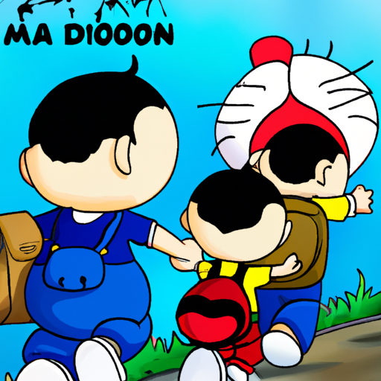
Joy and his parents journeyed together to a place of safety and freedom, never to return to Bangladesh again. Joy was happy to have saved his parents, and he would carry this courage with him throughout his life.

Slide 6
THE END

