Slide 1

CORPORATE INTRANET
Syeda Sara Afzaal || 215264

Slide 2
SCENARIO
A corporate intranet is a private network within an organization that shares information, resources, and communication among its members. It serves as an internal communication platform for employees within a company. The word "intranet" is a combination of "intra" (meaning within) and "net" (short for network), emphasizing its role as an internal network.

Slide 3
DEVICES USED IN NETWORK
ROUTER : used to connect Accounts and Sales departments.
SWITCH : used to connect all devices in each department.
PC : Devices to send and receive information
DLC : used to connect wireless and wired devices.

Slide 4
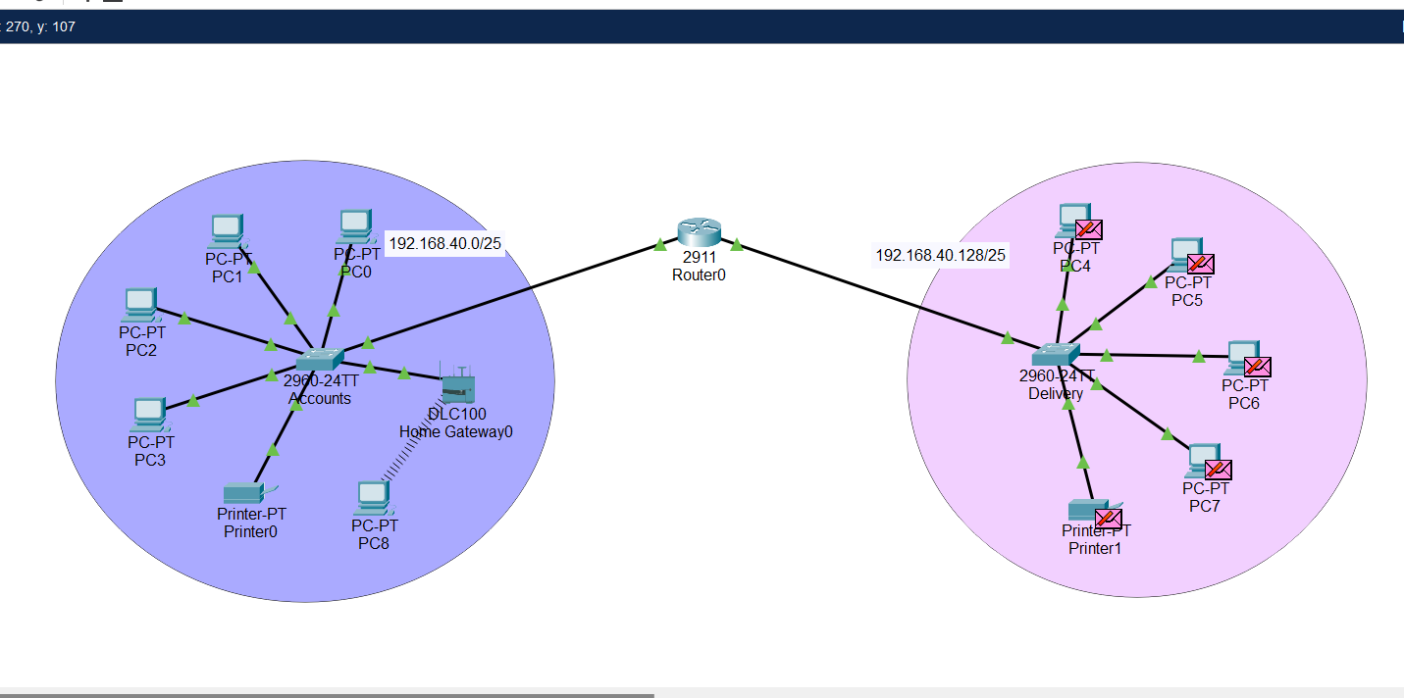
NETOWRK

Slide 5
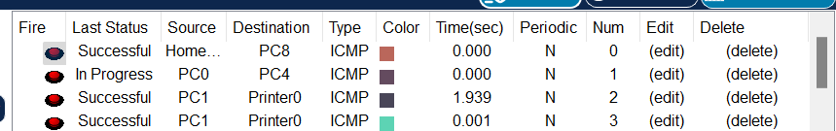
CHECKING CONNECTION

Slide 6
THANK YOU !

