Slide 1
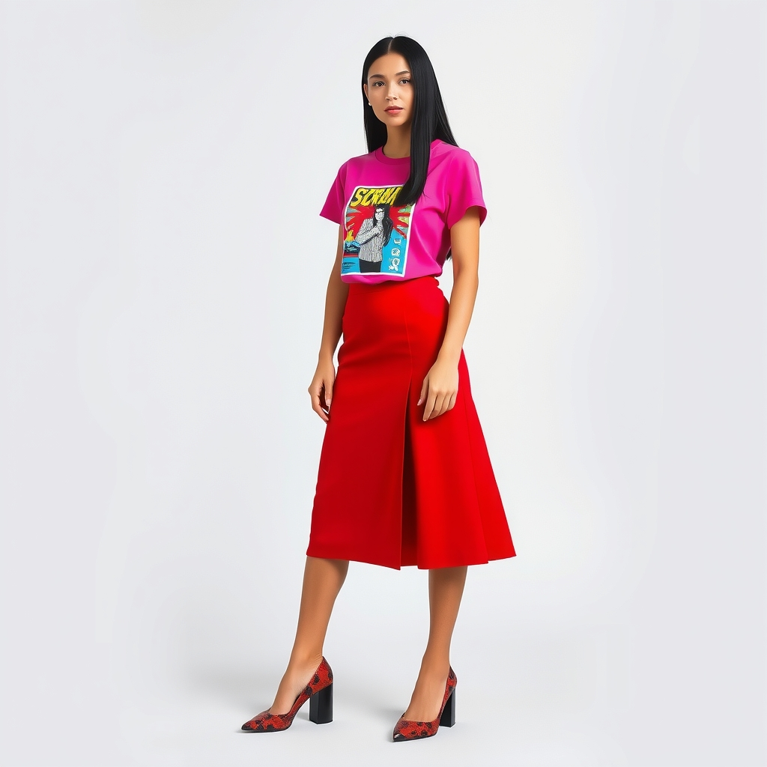
DressMe
An AI personal fashion assistant that turns phone photos of your clothes into daily outfits, smarter purchases and a coherent style
ADSP — Final Validation · November 2026
Notes:
Introduce the team and DressMe in one sentence: a web app that digitises the wardrobe from photos and uses computer vision, a learned compatibility model and LLM agents to help users dress and buy better. The picture on the right was generated by the app from real garment photos.

Slide 2




General context
Full wardrobes, few outfits
The phone is the new fitting room
Most people repeat a small set of combinations and forget what else they own.
A photo is enough to digitise a garment: no manual catalogue needed.
A Tunisian reality
AI is now affordable
Local budgets, hot and mid seasons, and traditional garments (jebba, farmla, kaftan) that global apps ignore.
Fashion foundation models (FashionCLIP) and free LLM APIs make a personal stylist possible on a laptop CPU.
Notes:
Context: clothing is a daily decision and a recurring expense. Phones and fashion AI models now make it possible to digitise a wardrobe and reason about it. The Tunisian context (budget, climate, traditional garments) is not covered by existing apps.

Slide 3



Problem statement
How can we help people get more value from the clothes they already own — and buy only what truly fits their wardrobe — starting from simple phone photos?
Amine Trabelsi
Yasmine Ben Salah
Sami Belhadj
Avoiding waste / tight budget
Daily efficiency
Personal brand / credibility
“Is this item worth buying before I pay for it?”
“What do I wear this morning — quickly, and right for the weather?”
“What is my recognisable signature look?”
Notes:
Three personas, three non-overlapping axes: budget (Amine), time (Yasmine), identity (Sami). Their pains drive every objective of the project.

Slide 4






Proposed solution: the DressMe web app
My wardrobe
Does it match?
Photo → cleaned cut-out → item card (category, colour, season…) in a few seconds
Before buying: score with the wardrobe, best partners, duplicate warning
Outfit studio
Outfit of the day
Screenshot
The app — « Outfit of the day » screen
screenshots/00_app_outfit_of_the_day.png
A jury of rules + LLM judges an outfit for the weather and the occasion
Agenda in free text (FR / AR / EN) + weather → 3 explained outfits
Pieces to add
My style
Missing items that unlock the most new outfits, with online offers
Dominant style, palette, formality and coherent suggestions
+ realistic outfit preview (virtual try-on) · user accounts with a private wardrobe each
Notes:
One web app, six screens, one per data science objective. Each screen answers a persona's question. Extra: realistic outfit preview and accounts.

Slide 5






Methodology
CRISP-DM
Business understanding
Data understanding
Data preparation
Modeling
Evaluation
Deployment
Notes:
CRISP-DM, applied per objective and iterated. (Shown without explanation, as requested.)

Slide 6
Ideation phase: business and data science objectives
Business objectives (BO)
Data science objectives (DSO)
BO1 · Reduce daily outfit decision time
DSO | What | Serves
DSO1 | Clothing classification from photos (vision) | BO3, BO5
DSO2 | Compatibility score item ↔ wardrobe | BO2, BO3
DSO3 | Outfit recommendation: style rules + learned preferences | BO1, BO4
DSO4 | Wardrobe gap detection | BO2, BO3
DSO5 | User style profiling (clustering / embedding) | BO4
DSO6 | Contextual model (weather, occasion, calendar) | BO1, BO5
BO2 · Reduce regretted or incompatible purchases
BO3 · Extract more value from the existing wardrobe
BO4 · Strengthen style confidence and consistency
BO5 · Adapt to the Tunisian context (budget, season, garments)
Notes:
Five business objectives derived from the personas, translated into six data science objectives; each DSO maps to at least one BO and to one screen of the app.

Slide 7
Solution architecture
User
browser / phone
DSO1 Recognition
FashionCLIP + vision LLM
LLM & AI APIs
Gemini · Groq · HF Spaces · Cloudflare
DSO2 Compatibility
PairMLP ensemble
React front
Vite · 6 screens
FastAPI gateway :8000
auth · per-user wardrobe · orchestration
DSO3 Jury
rules + LLM judges
Web services
Open-Meteo · Tavily
DSO4 Gaps
LLM candidates + counting
Storage
ItemCards (JSON) · crops · FashionCLIP .npy · SQLite
Shared contracts
ItemCard v1 · 7 slots (top, bottom, onepiece, outer, footwear, bag, accessory) · FashionCLIP embeddings 512-d, L2-normalised, shared by all objectives
DSO5 Style profile
PCA + K-Means
DSO6 Outfit of the day
agents · RAG · :8006
Notes:
The front talks to a single FastAPI gateway. DSO1-5 run in-process; DSO6 is its own service on port 8006. External APIs are optional: without keys, everything falls back to rules and nearest neighbours.

Slide 8
Technical part
Data preparation · models · evaluation · implementation & integration

Slide 9
Data and data preparation
Datasets
Polyvore Outfits · real outfits for DSO2; 8,000 calibration pairs from 1,107 validation outfits
Tunisian photos · 200 labelled images incl. traditional garments; 28 worn photos as a real test set
Reference catalogue · 423 item cards (DSO5 style taxonomy)
Hand-written RAG corpus · 15 local dress-code sheets (wedding, Aïd, jomaa, thesis defence…)
Preparation
Segmentation + cut-out on white, 512 px squares
FashionCLIP embeddings, 512-d, L2-normalised
Deduplication, rare classes merged (threshold 40)
Splits by group: no photo leaks into the test set
Split: train 12,708 · val 2,723 · test 2,724 (vision of DSO6, knowledge base of DSO1)
Notes:
Main public dataset: Fashion Product Images, cleaned from 44,424 to 18,155 usable rows. Polyvore for compatibility, a Tunisian set for local garments, a reference catalogue for style profiling, and a small hand-written corpus for RAG.

Slide 10
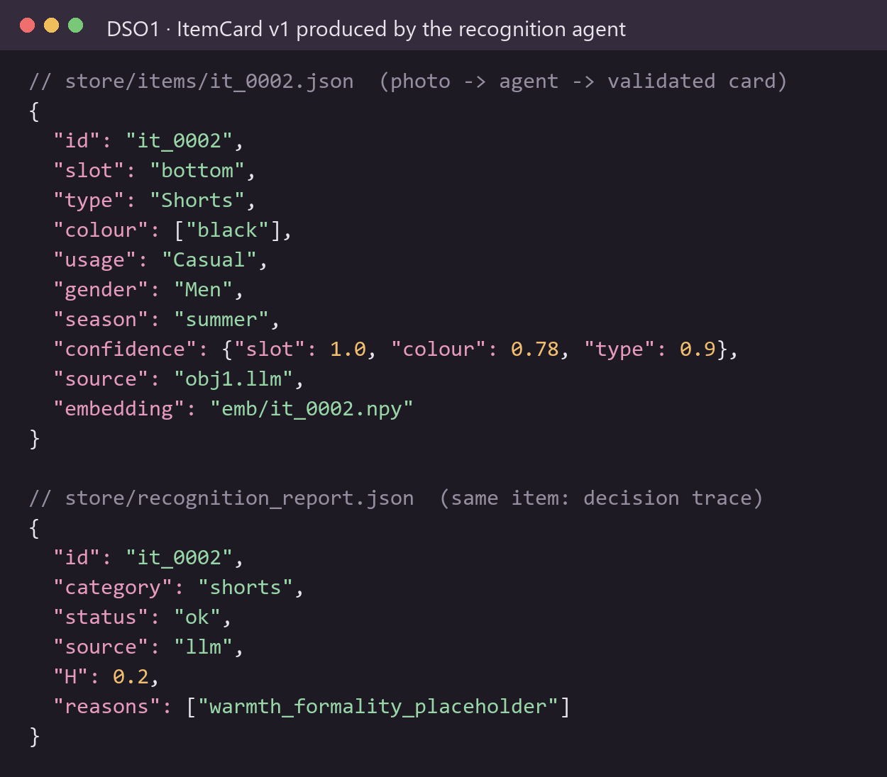
DSO1 · Clothing recognition from photos
Pipeline & models
Cut-out: SegFormer (clothes) + rembg U²-Net, on user click
Embedding: FashionCLIP, frozen (shared space)
Agent: vision LLM ⇄ kNN / RAG over 300 references per class, hallucination score H, 4-level decision policy
LLM: Qwen2.5-VL-7B (4-bit, Colab) · Gemini in the app
Prompting: closed vocabulary, evidence-first JSON, anchored confidence, RAG revision prompt
0.917
89 %
7 / 8
agent accuracy · 120 catalogue images
colour right · 28 Tunisian worn photos (29 % w/o LLM)
traditional garments recognised
Notes:
DSO1 turns a phone photo into a structured item card. A frozen FashionCLIP embedding feeds a kNN; a vision LLM proposes attributes; a hallucination score decides whether to trust it, retrieve neighbours (RAG) or ask the user. Results: 0.917 accuracy on catalogue images; on real Tunisian photos the LLM raises colour accuracy from 29 % to 89 %.

Slide 11
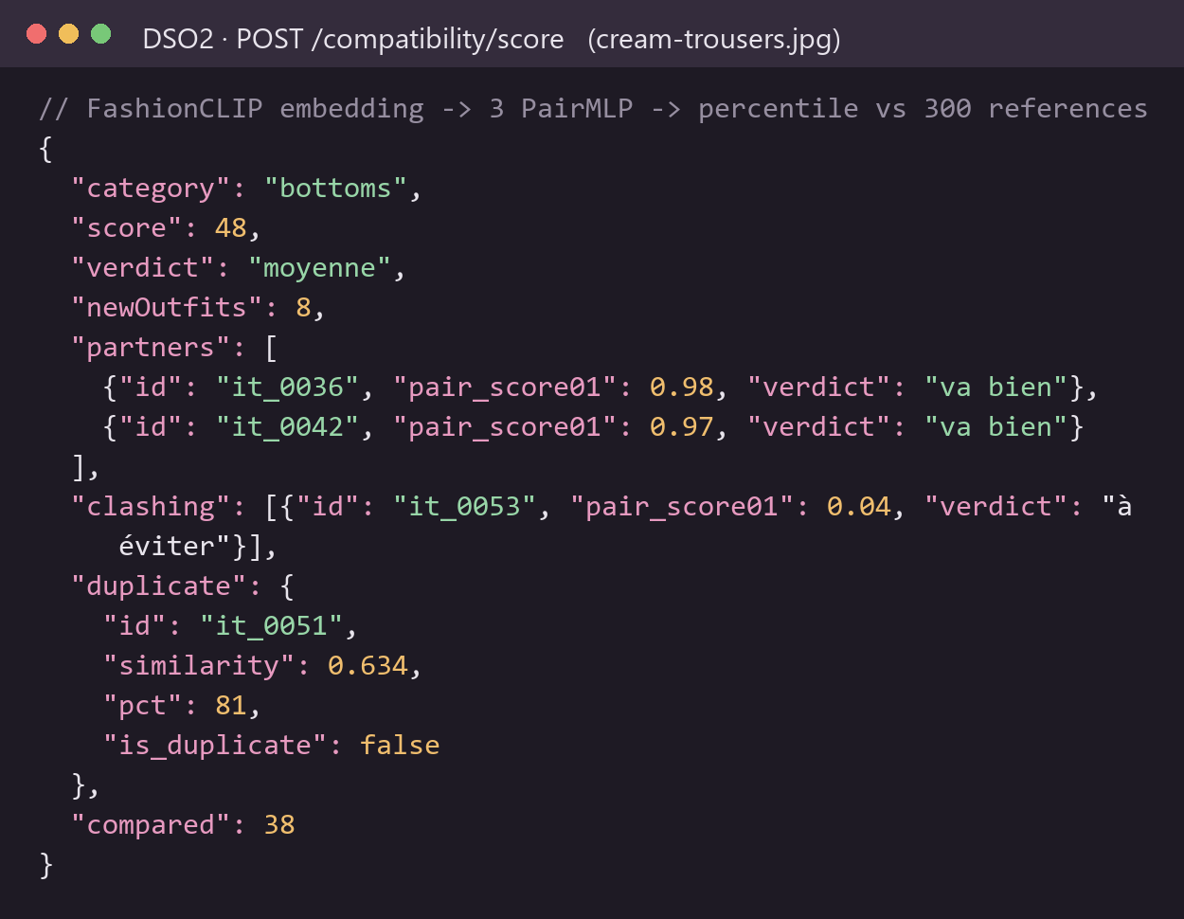
DSO2 · Compatibility scoring
Pipeline & models
Model: ensemble of 3 PairMLP (seeds 0-2) on frozen FashionCLIP, FITB loss, Polyvore
Pair head: [zi ⊙ zj , |zi − zj|] → 256 → 1, GELU, dropout 0.1
Calibration: percentile vs 300 same-type references; pair thresholds 0.75 / 0.35; duplicate ≥ 90th pct
LLM layer: Gemini vision explains the score (never changes it): grounded facts, evidence-first JSON, ids validated by code
0.74
3 ms
+0.44
AUC · 8,000 validation pairs
per pair on CPU, no API
Spearman on a real wardrobe (pilot)
Notes:
The score comes from a learned model, not an LLM: measurable, reproducible and instant. Calibrated thresholds turn scores into « goes well / average / avoid ». The LLM only explains the result and is validated by code.

Slide 12
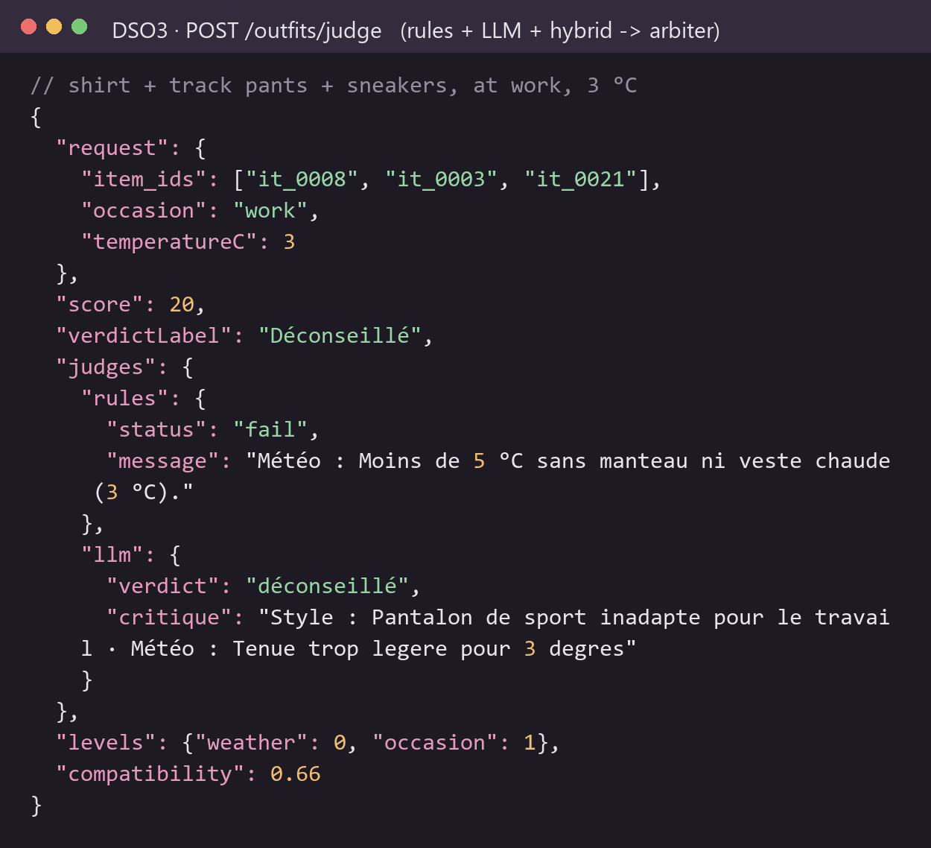
DSO3 · Outfit judging and recommendation
Pipeline & models
Judges: rules (annotator policy) · LLM · hybrid (LLM + rules opinion) · optional visual judge
Arbiter: ordinal median per criterion (colours, formality, weather, coherence)
LLMs: Gemini flash-lite → flash, Groq gpt-oss-120b fallback, cached, 40 calls/h cap
Prompting: anchored rubric, reason before level, 6-shot leave-one-out, structured inputs only
4
3+1
59 %
criteria scored 0 / 1 / 2
judges + arbiter
repairs reliable → hidden from UI
Notes:
A jury rather than a single model: explicit rules, an LLM, and a hybrid judge, combined by an ordinal median. We measured the repair suggestions (59 % reliable) and removed them from the interface rather than ship something unreliable.

Slide 13
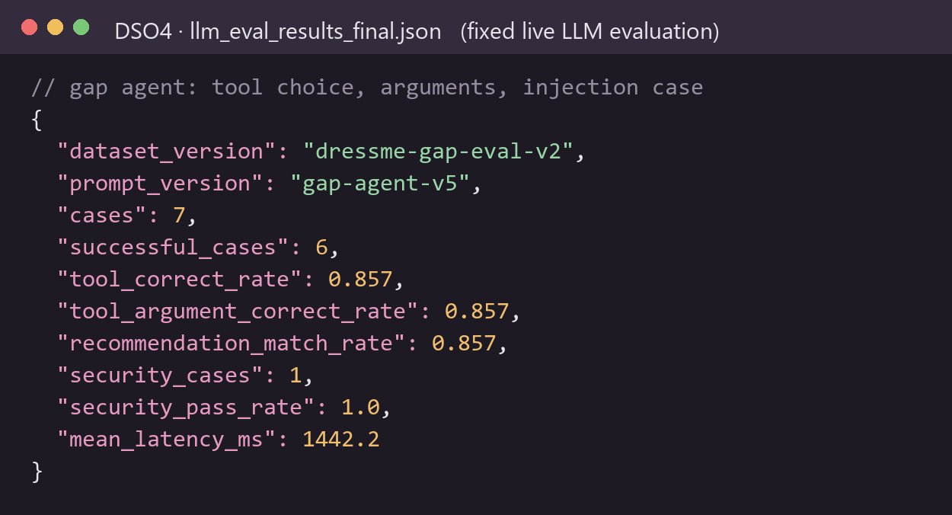
DSO4 · Wardrobe gap detection
Pipeline & models
Candidates: LLM proposes missing pieces (gpt-oss-120b, T = 0.2, prompt gap-agent-v6)
Scoring: same-slot proxy → DSO2 pair scores → deterministic outfit counting (gain bounds)
Tools: 3 read-only JSON-schema tools, ≤ 1 call per request, arguments validated
Shopping: Tavily « [item] buy online », 3 offers with photo and price in TND
6 / 7
1 / 1
1.4 s
evaluation cases passed
prompt-injection case blocked
mean LLM latency
Notes:
The LLM proposes, the code counts: outfit gains never come from the LLM. Tools are read-only and schema-validated; the shopping search is a separate layer that never changes the ranking.

Slide 14
DSO5 · User style profiling
Pipeline & models
Vectors: FashionCLIP if ≥ 90 % coverage, else attribute vectors
Taxonomy: PCA (64) + K-Means, k ∈ [6, 16] by silhouette, n_init 10, seed 42
Profile: dominant style, palette, formality, diversity (normalised entropy)
Suggestions: cosine to the wardrobe centre + style bonuses, gender-filtered
0.44
423
18
silhouette at k = 16 (0.28 at k = 6)
item cards in the reference catalogue
items minimum, else reference model
Notes:
Unsupervised and deterministic: no LLM needed, runs in seconds on CPU. Small wardrobes use the reference model. Economy scores were removed because item prices are not available. The chart is the k_table saved in the trained model: silhouette for each k tested.

Slide 15
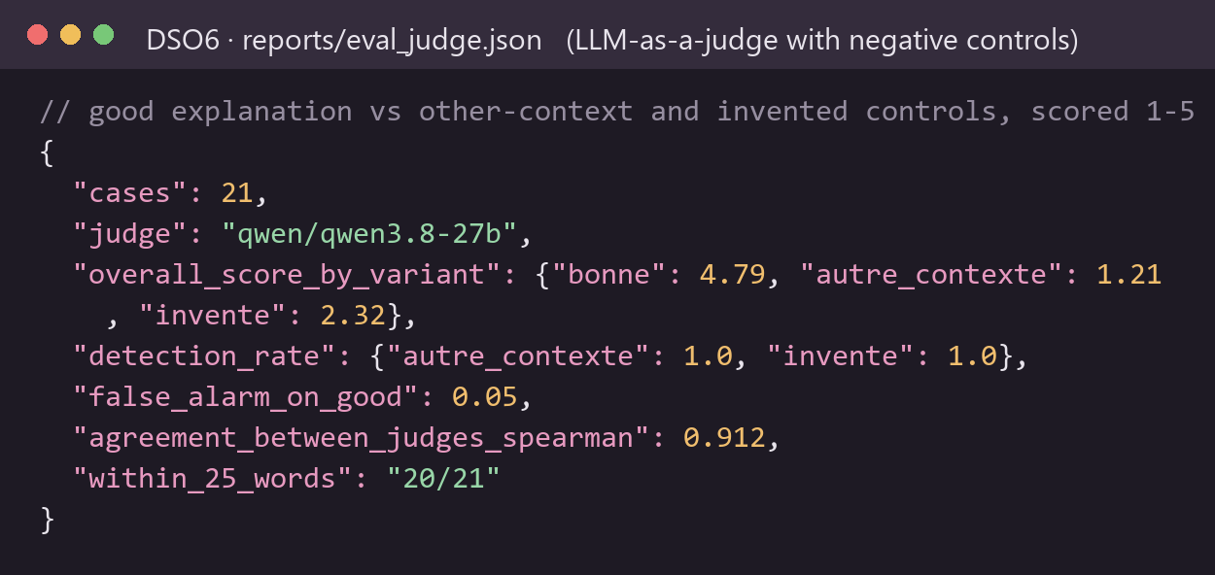
DSO6 · Contextual outfit of the day
Pipeline & models
Agents: agenda (gpt-oss-20b) · stylist (gpt-oss-20b) · tool assistant (gpt-oss-120b), T = 0
RAG: TF-IDF char 3-5-grams over 15 local dress-code sheets, top-3
Tools: get_weather, search_dress_code, recommend_outfits — function calling and MCP
Models: CLIP ViT-B/32 probe + fine-tune; HistGradientBoosting ranker retrained on 👍 / 👎
0.93
0.87
0.91
RAG hit@1 (hit@3 = 1.0)
AUC of the context ranker
agreement of the 2 LLM judges
Notes:
Each agent has one role and its own model. Free-text agendas in French, Arabic or English are parsed with few-shot prompts and RAG; the explanations are evaluated by two LLM judges from different families, with negative controls.

Slide 16

LLM engineering across the project
Use | Model | Key settings | Prompt techniques
Recognition (DSO1) | Qwen2.5-VL-7B / Gemini | greedy, 200 tokens, JSON | closed vocabulary, evidence first, RAG revision
Compatibility advice (DSO2) | Gemini vision | JSON mode, cached | grounded facts, one-shot, id validation
Outfit jury (DSO3) | Gemini → Groq gpt-oss | cache, 40 calls/h | anchored rubric, 6-shot leave-one-out
Gap agent (DSO4) | gpt-oss-120b | T 0.2, 600 tokens, 30 s | tool schemas, grounding, anti-injection
Outfit of the day (DSO6) | gpt-oss-20b / 120b | T 0, retry on 429 | few-shot FR/AR, RAG, function calling, MCP
Evaluation (DSO6) | qwen3 27b + gpt-oss-120b | 2 judges | LLM-as-a-judge with negative controls
Fine-tuning decisions FashionCLIP stays frozen (shared embedding space); DSO2 heads and the DSO6 ranker are trained; CLIP fine-tuned on the 2 last blocks (DSO6). LLMs are not fine-tuned: prompt engineering, RAG and validation reach the goal without labelled data; LoRA / QLoRA kept as next step.
Notes:
Every LLM is used for what it is good at: extraction, explanation and tool selection. Numbers (scores, gains, outfit counts) always come from code or learned models. No LLM fine-tuning: no labelled data, free APIs, and prompting plus validation were sufficient.

Slide 17
Evaluation summary
Objective | Metric | Result | Reference
DSO1 Recognition | Accuracy (catalogue, n = 120) | 0.917 [0.853 ; 0.954] | LLM alone 0.833
DSO1 Recognition | Colour on real Tunisian photos (n = 28) | 89 % | 29 % without LLM
DSO2 Compatibility | AUC, true vs random pairs (n = 8,000) | 0.74 [0.73 ; 0.75] | 0.50 = chance
DSO3 Jury | Repairs judged acceptable (n = 164) | 59 % | → removed from UI
DSO4 Gaps | Agent cases passed (n = 7) | 6 / 7 · injection 1 / 1 | —
DSO5 Profile | Silhouette of the style taxonomy | 0.44 (k = 16) | 0.28 at k = 6
DSO6 Vision | articleType accuracy / macro-F1 | 0.849 / 0.811 | majority 0.083
DSO6 Context | Ranker AUC · top-1 violations | 0.87 · 27 % | 61 % random
DSO6 LLM judge | Bad explanations detected · false alarms | 100 % · 5 % | Spearman 0.91
Every result is reported with its sample size and a baseline; small samples are flagged as such.
Notes:
Honest reporting: confidence intervals where available, a baseline for each metric, and the limits of small samples. The context ranker uses synthetic labels, so its AUC is partly circular.

Slide 18

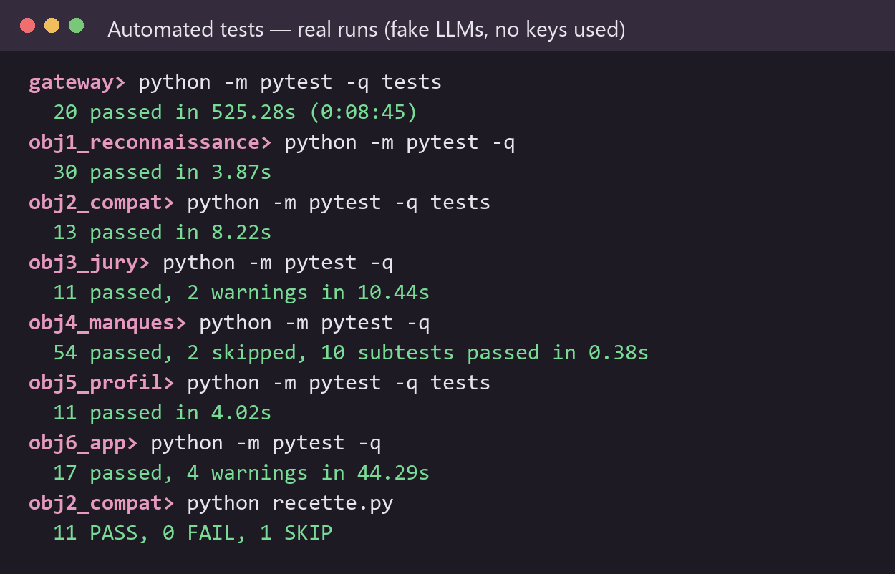



Technical implementation and integration
156 tests · all green
Stack
React + Vite · FastAPI gateway · PyTorch / scikit-learn · Docker-ready DSO6 service
automated tests across the gateway and the six objectives (real runs below)
Accounts & privacy
PBKDF2-SHA256 (200k), HttpOnly session cookie, one private wardrobe per account
LLM safety
structured inputs only, JSON outputs validated, read-only tools, keys in .env never in git
Resilience
every AI feature degrades gracefully: rules / kNN fallback, clear messages, caches
Tests use fake LLMs: no key or quota consumed, nothing written to real data.
Notes:
Integration: one gateway, shared contracts, per-user wardrobes. 156 automated tests across the modules, all passing. Security: hashed passwords, HttpOnly cookies, keys never committed, LLM outputs always validated by code.

Slide 19
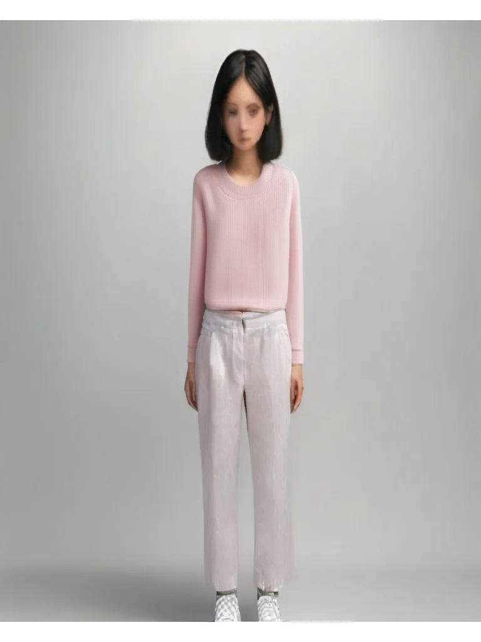
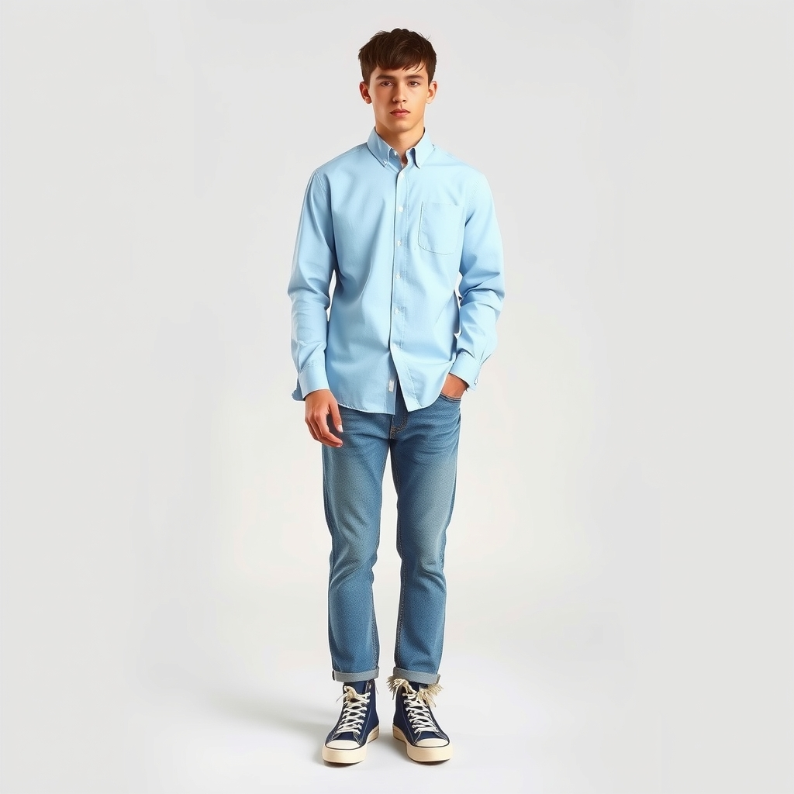
Realistic outfit preview
Virtual try-on
Inspired outfit
Inspired outfit (men)
Leffa (bottoms) + IDM-VTON (tops) wear the user's real photos
Gemini describes each photo → FLUX.1 schnell generates the look
Same pipeline, 5 to 15 s, free daily allowance
Notes:
All three images were produced by the app from the user's own garment photos. Try-on is the most faithful (diffusion models on Hugging Face Spaces, a few outfits per day for free); the inspired view is unlimited but only inspired by the photos.

Slide 20


Limitations and next steps
Limitations
Next steps
Small real-world test sets (28 photos, 7 agent cases)
Compatibility learned on Polyvore (western style), image only
Gap candidates use same-slot proxies; thresholds not yet calibrated
Traditional garments all mapped to « onepiece »
Free GPU quota limits virtual try-on to a few outfits per day
Collect and label a larger Tunisian test set with users
Fine-tune compatibility on local outfits; calibrate thresholds
Sub-types for traditional garments (jebba, farmla, kaftan)
LoRA on a small open LLM for the agenda agent
Mobile app with camera capture and offline cache
Notes:
We state the limits we measured and the concrete steps that would address them.

Slide 21

Video demonstration
3 minutes · voice-over · solution workflow and main functionalities
1
Sign in → my wardrobe
2
Add an item from a photo
3
Does it match? + AI advice
4
Outfit studio & try-on
Insert the demo video here (Insert → Video)
5
Outfit of the day
6
Pieces to add · My style
Notes:
Play the 3-minute video. Voice-over follows the six steps listed on the right.

Slide 22
Thank you
Questions?
Notes:
Thank the jury and open the floor to questions.

