Slide 1
Effectiveness of shutdown policies on slowing SARS-CoV-2 transmissibility
Sawson Gholami, Grant Pointon
2020-08-25

Slide 2
Introduction
Social distancing has been found to reduce the spread of COVID-19 in U.S.
(Courtemanche, Garuccio, Pinkston, & Yelowitz, 2020)
One study estimated that 3-4 months of moderate social distancing could save 1.7 million lives and $8 trillion.
(Greenstone & Nigam, 2020)
Social distancing is difficult to enforce.
Policies vary by state, in restrictions and duration
It is difficult to measure individuals’ adherence to social distancing mandates.

Slide 3
Objectives
Explore the effects of economic shutdown policies on the transmission of SARS-CoV-2 and case-counts of COVID-19 within each state and nationwide.
Hypothesis: U.S. states that implemented relatively longer shutdowns had fewer cases per capita and/or lesser R₀ values at the time of reopening.

Slide 4
Data: Overview
For each of the 50 states:
Shutdown policies
Mobility of individuals
Basic reproduction number (R₀)
Case and death counts

Slide 5
Data: Shutdown policies
Type of order (e.g. stay-at-home order, state of emergency, health mandate)
Extent of restrictions (e.g. state-wide, county-based)
Limits on gathering sizes, during and after shutdown
Dates of implementation and expiration
Shutdown dates
Mobility-defined: First date when weekday-mobility decreased 20% from baseline
Official: Specified in policy, or when first businesses were asked to close
Opening dates
Initial expiration: First expiration date on first order
Official: Specified in policy, or when first non-essential businesses allowed to open

Slide 6
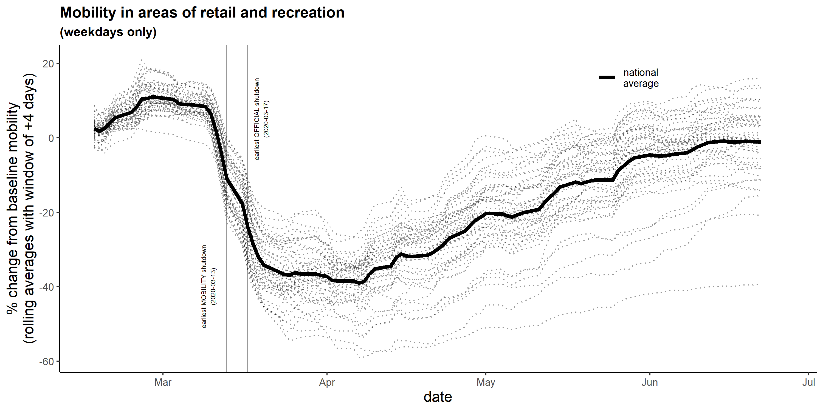
Data: Mobility of individuals
Source: Google

Slide 7
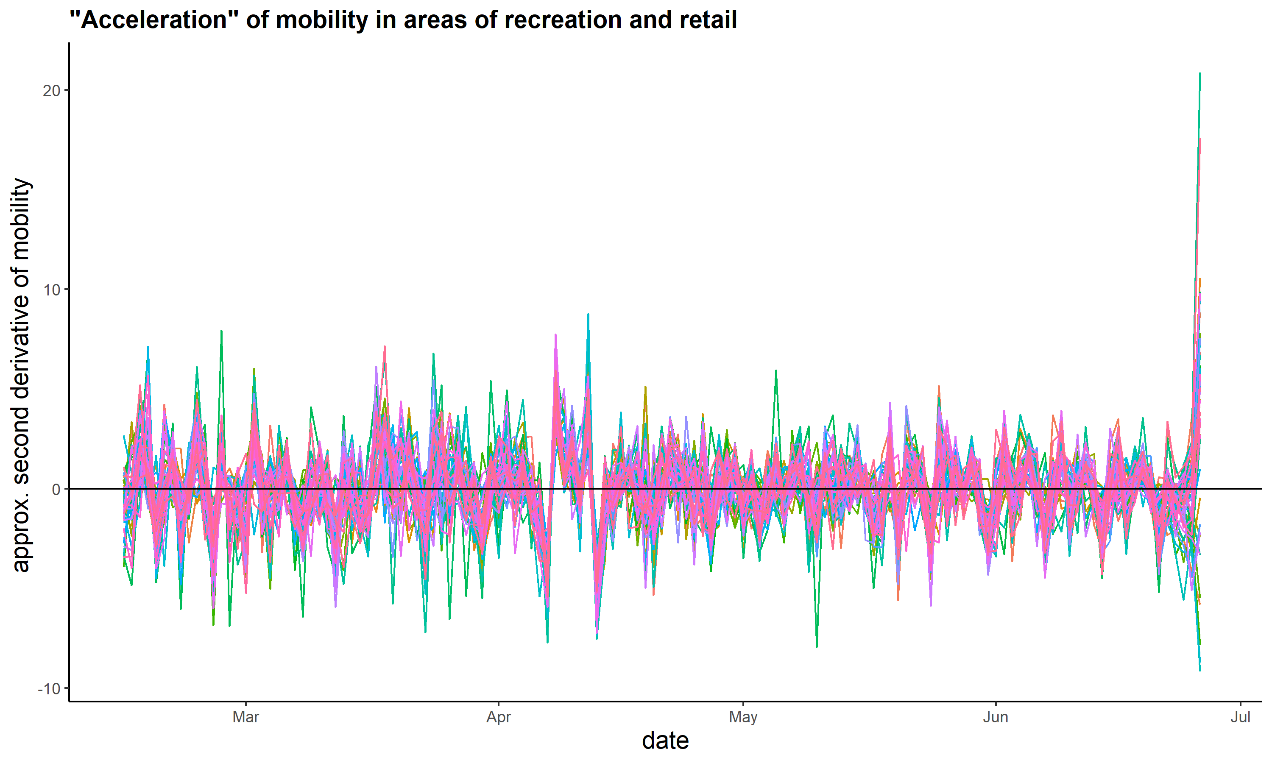
Data: Mobility of individuals
Source: Google

Slide 8
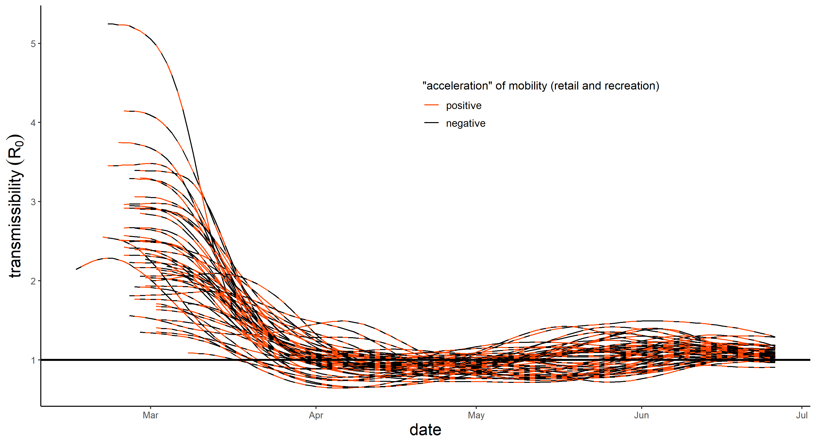
Data: Mobility of individuals
Sources: Google, Rt.live

Slide 9
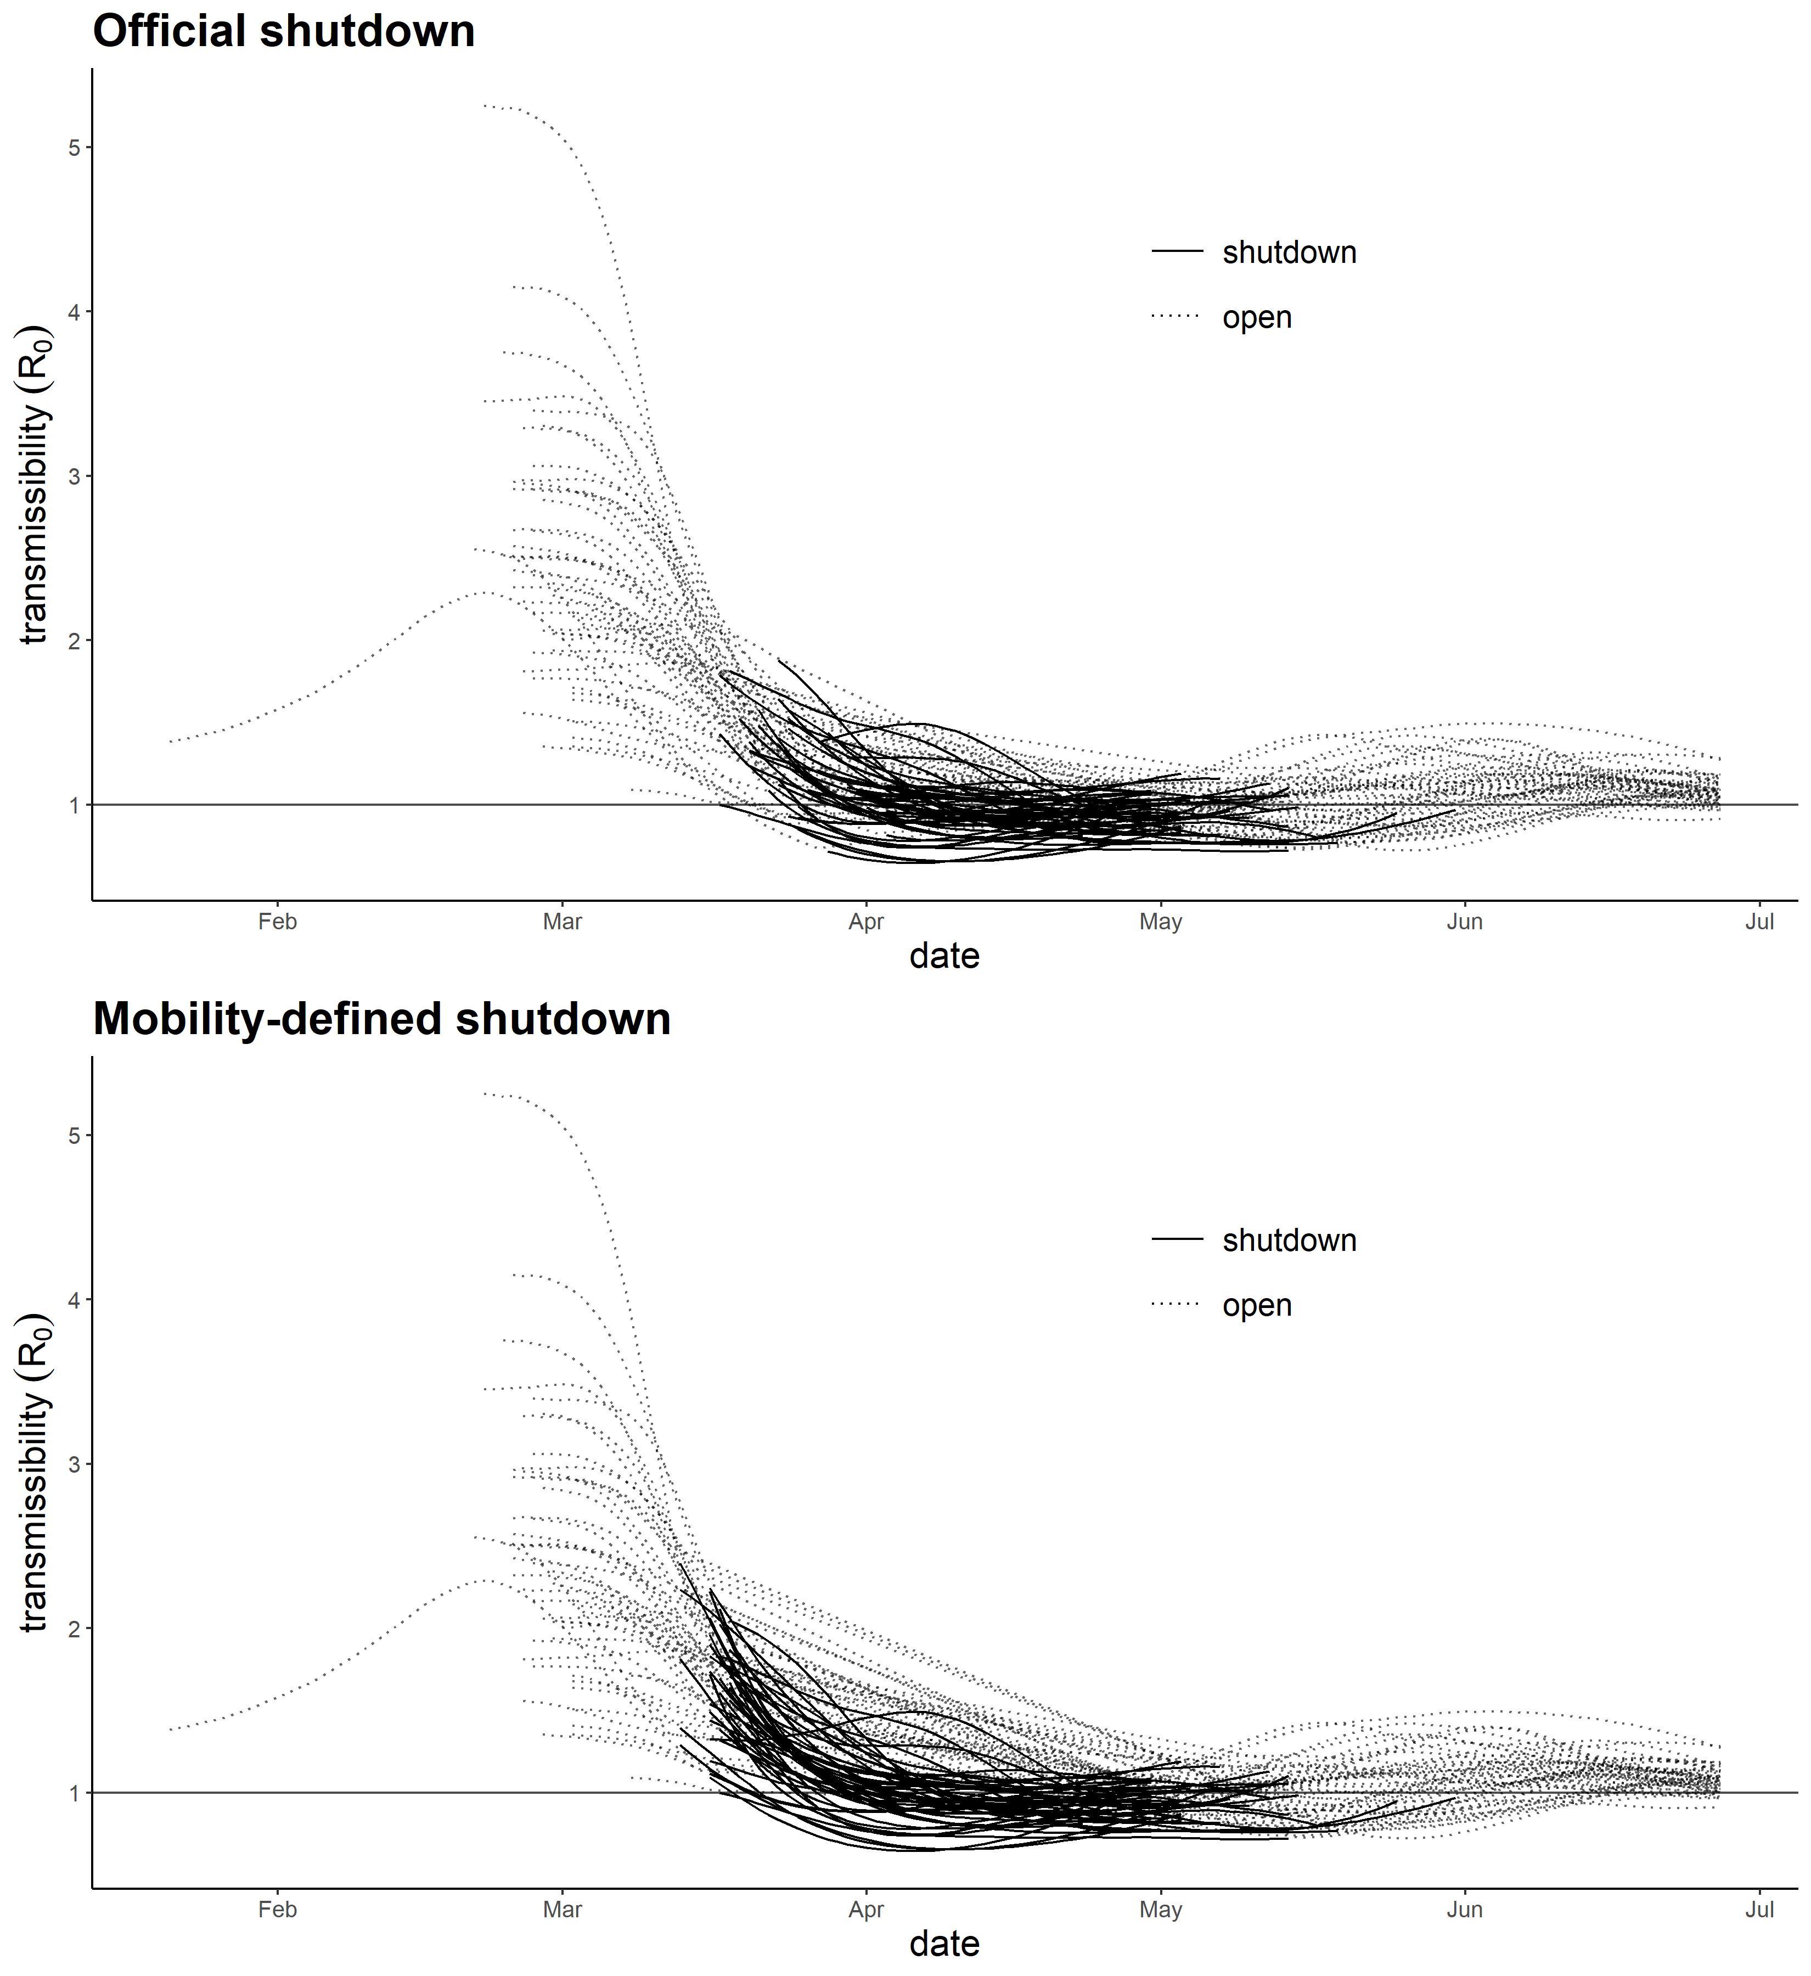
Data: R₀
A measure of how many people are likely to be infected by a single carrier
R₀ ≥ 1 → virus is spreading
R₀ < 1 → virus is not spreading
Dimensionless
Not a biological constant
Accounts for incubation period of virus
Source: Rt.live

Slide 10
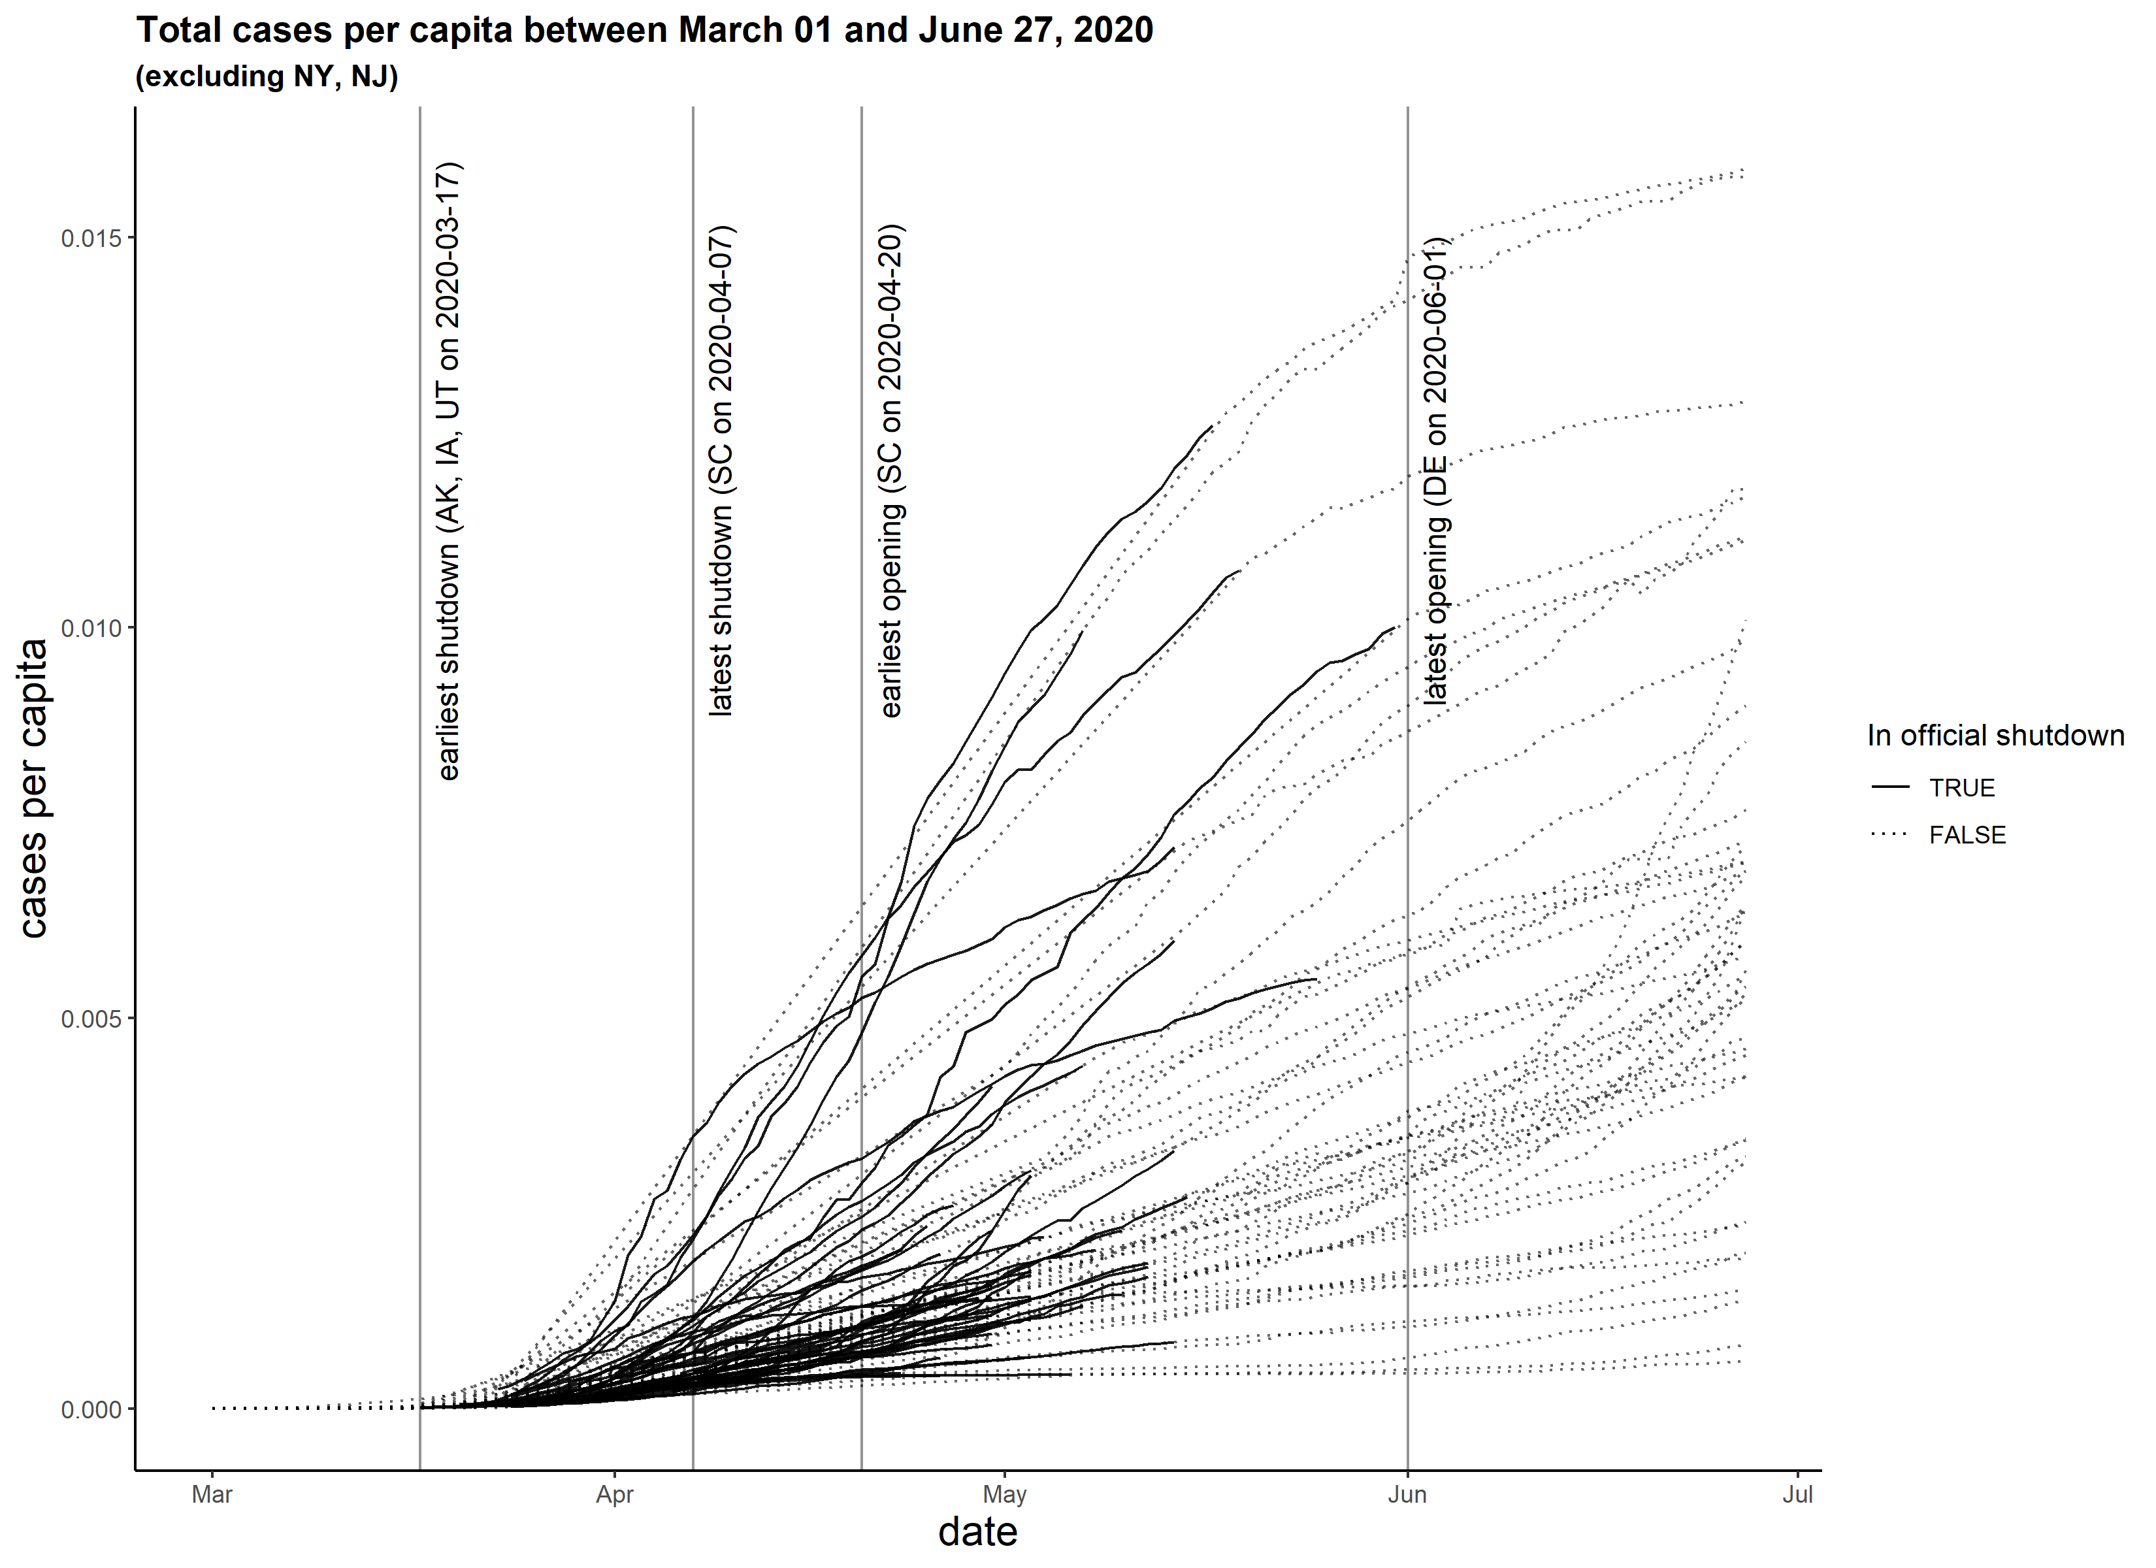
Data: Case and death counts
Source: NY Times

Slide 11
Data: Overview
For each of the 50 states:
Shutdown policies
Mobility of individuals
Basic reproduction number (R₀)
Case and death counts

Slide 12
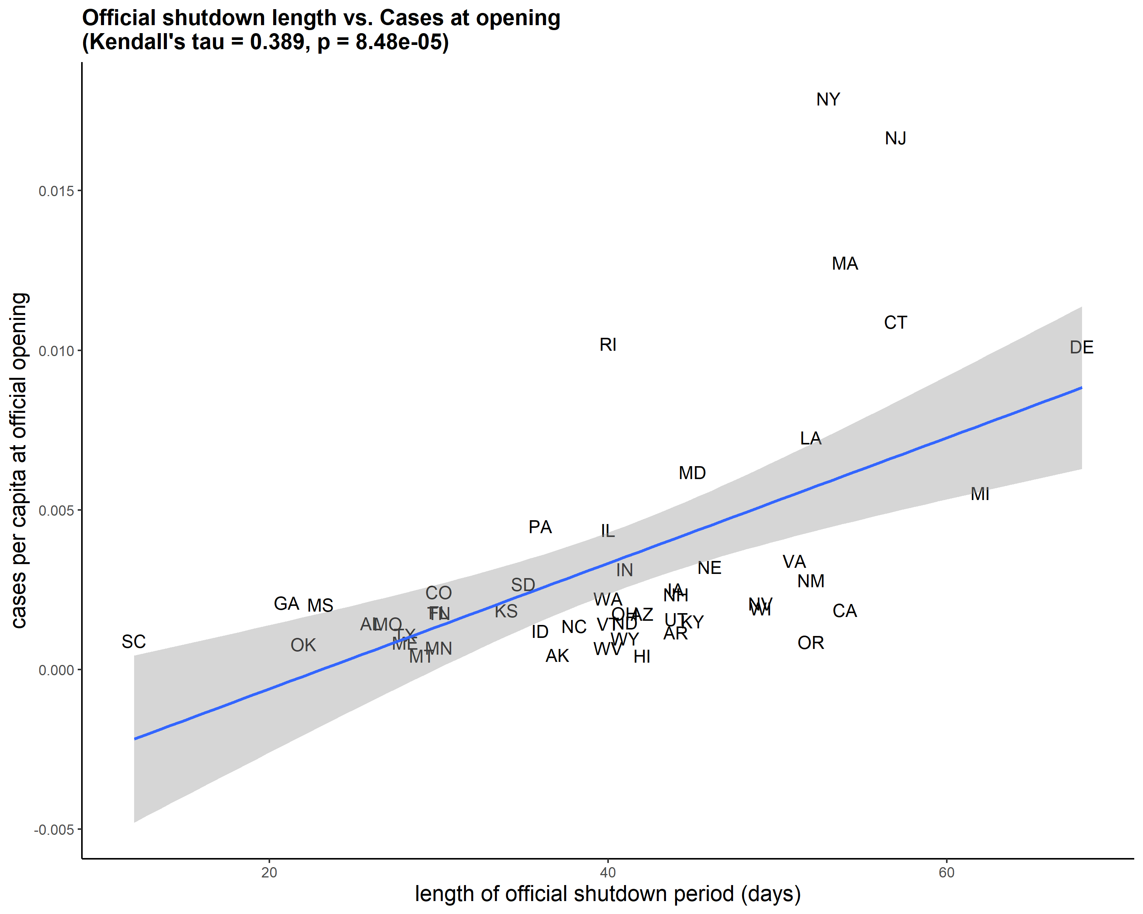
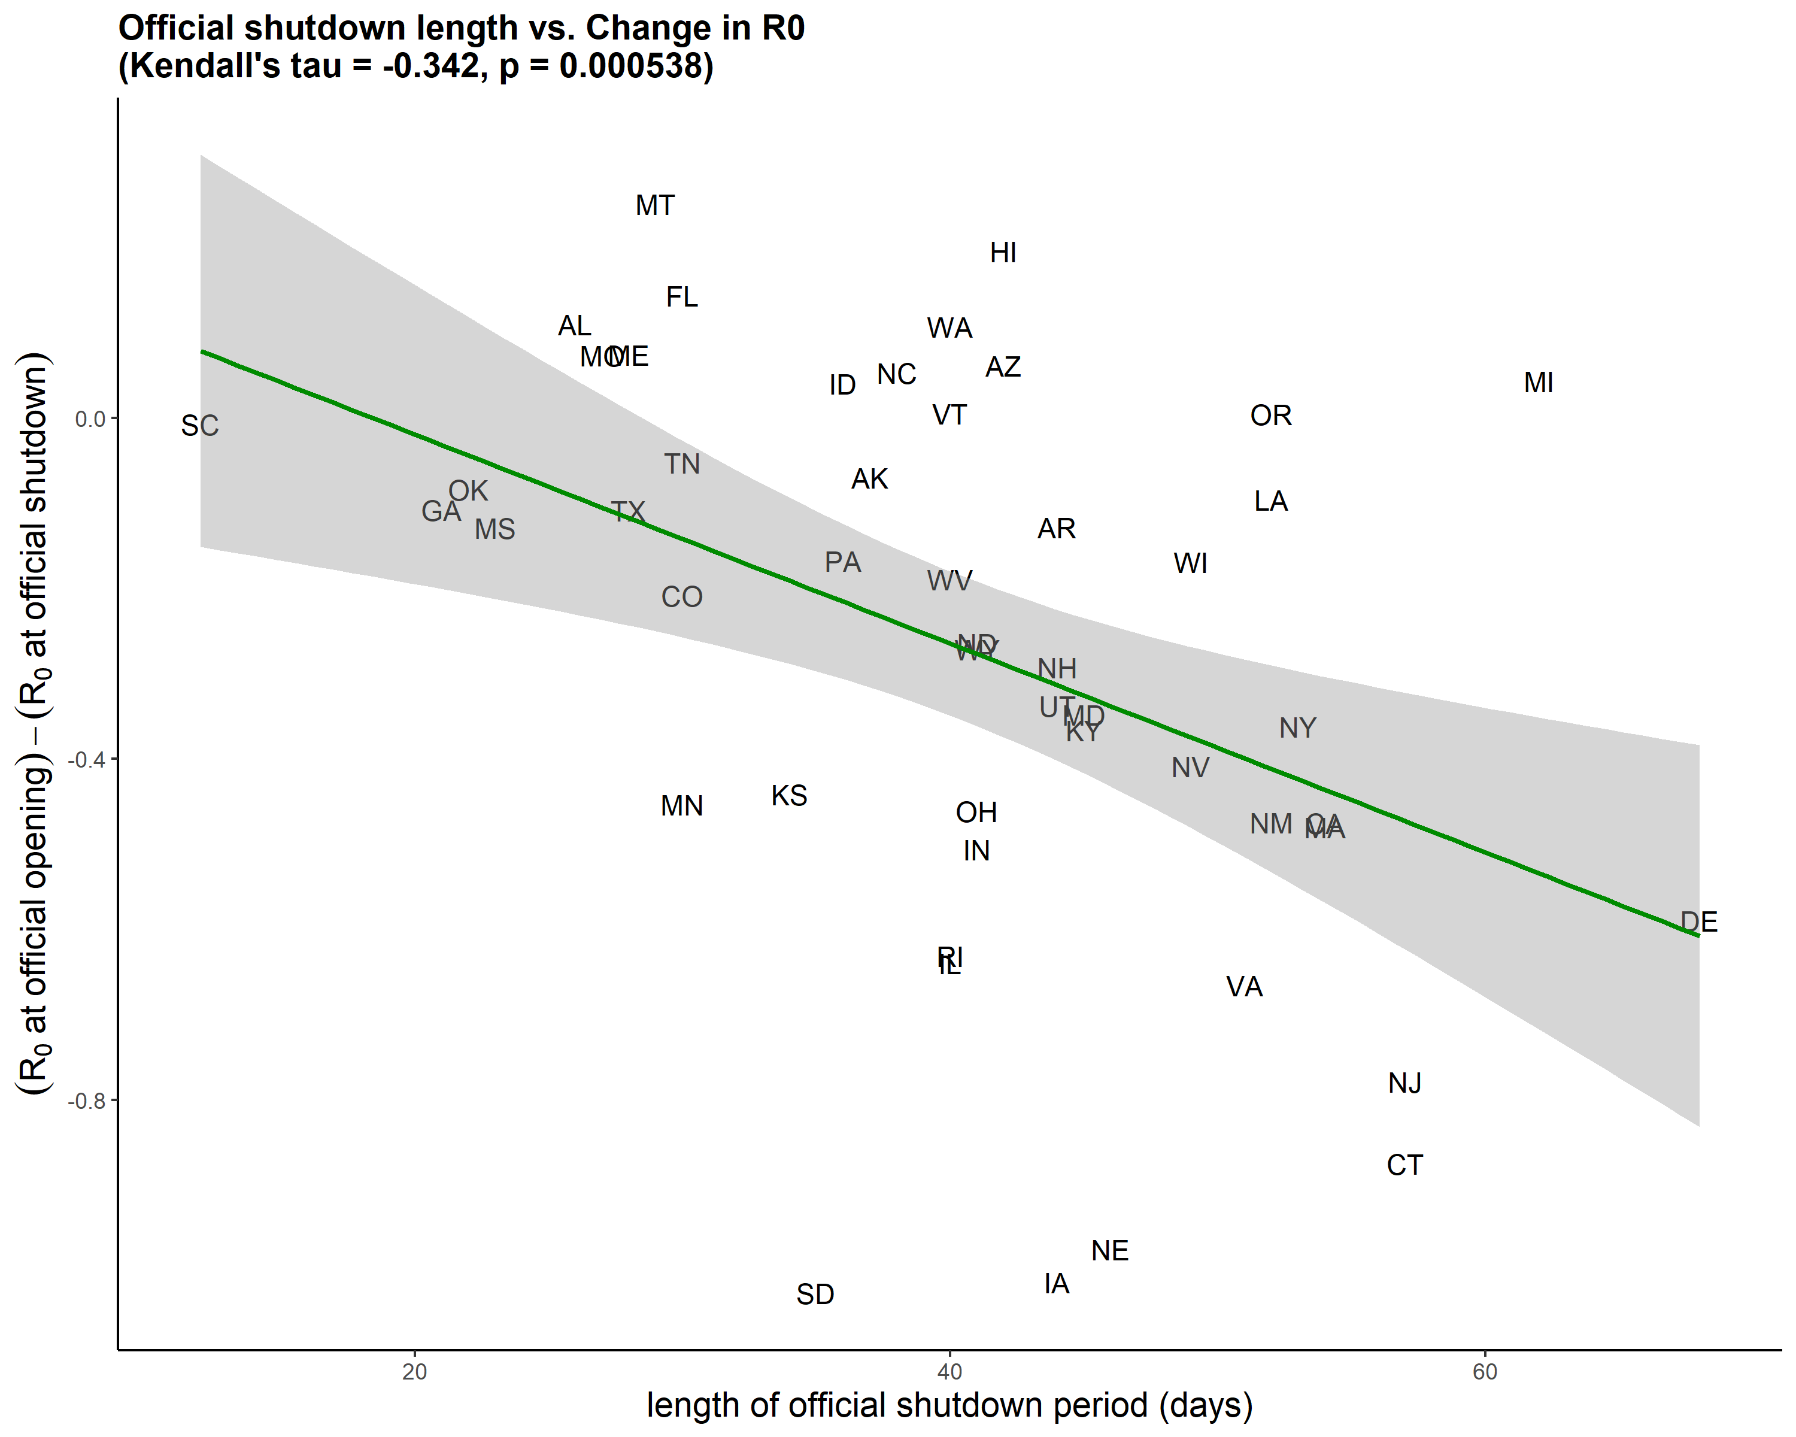
Exploratory analyses: Length of shutdown

Slide 13
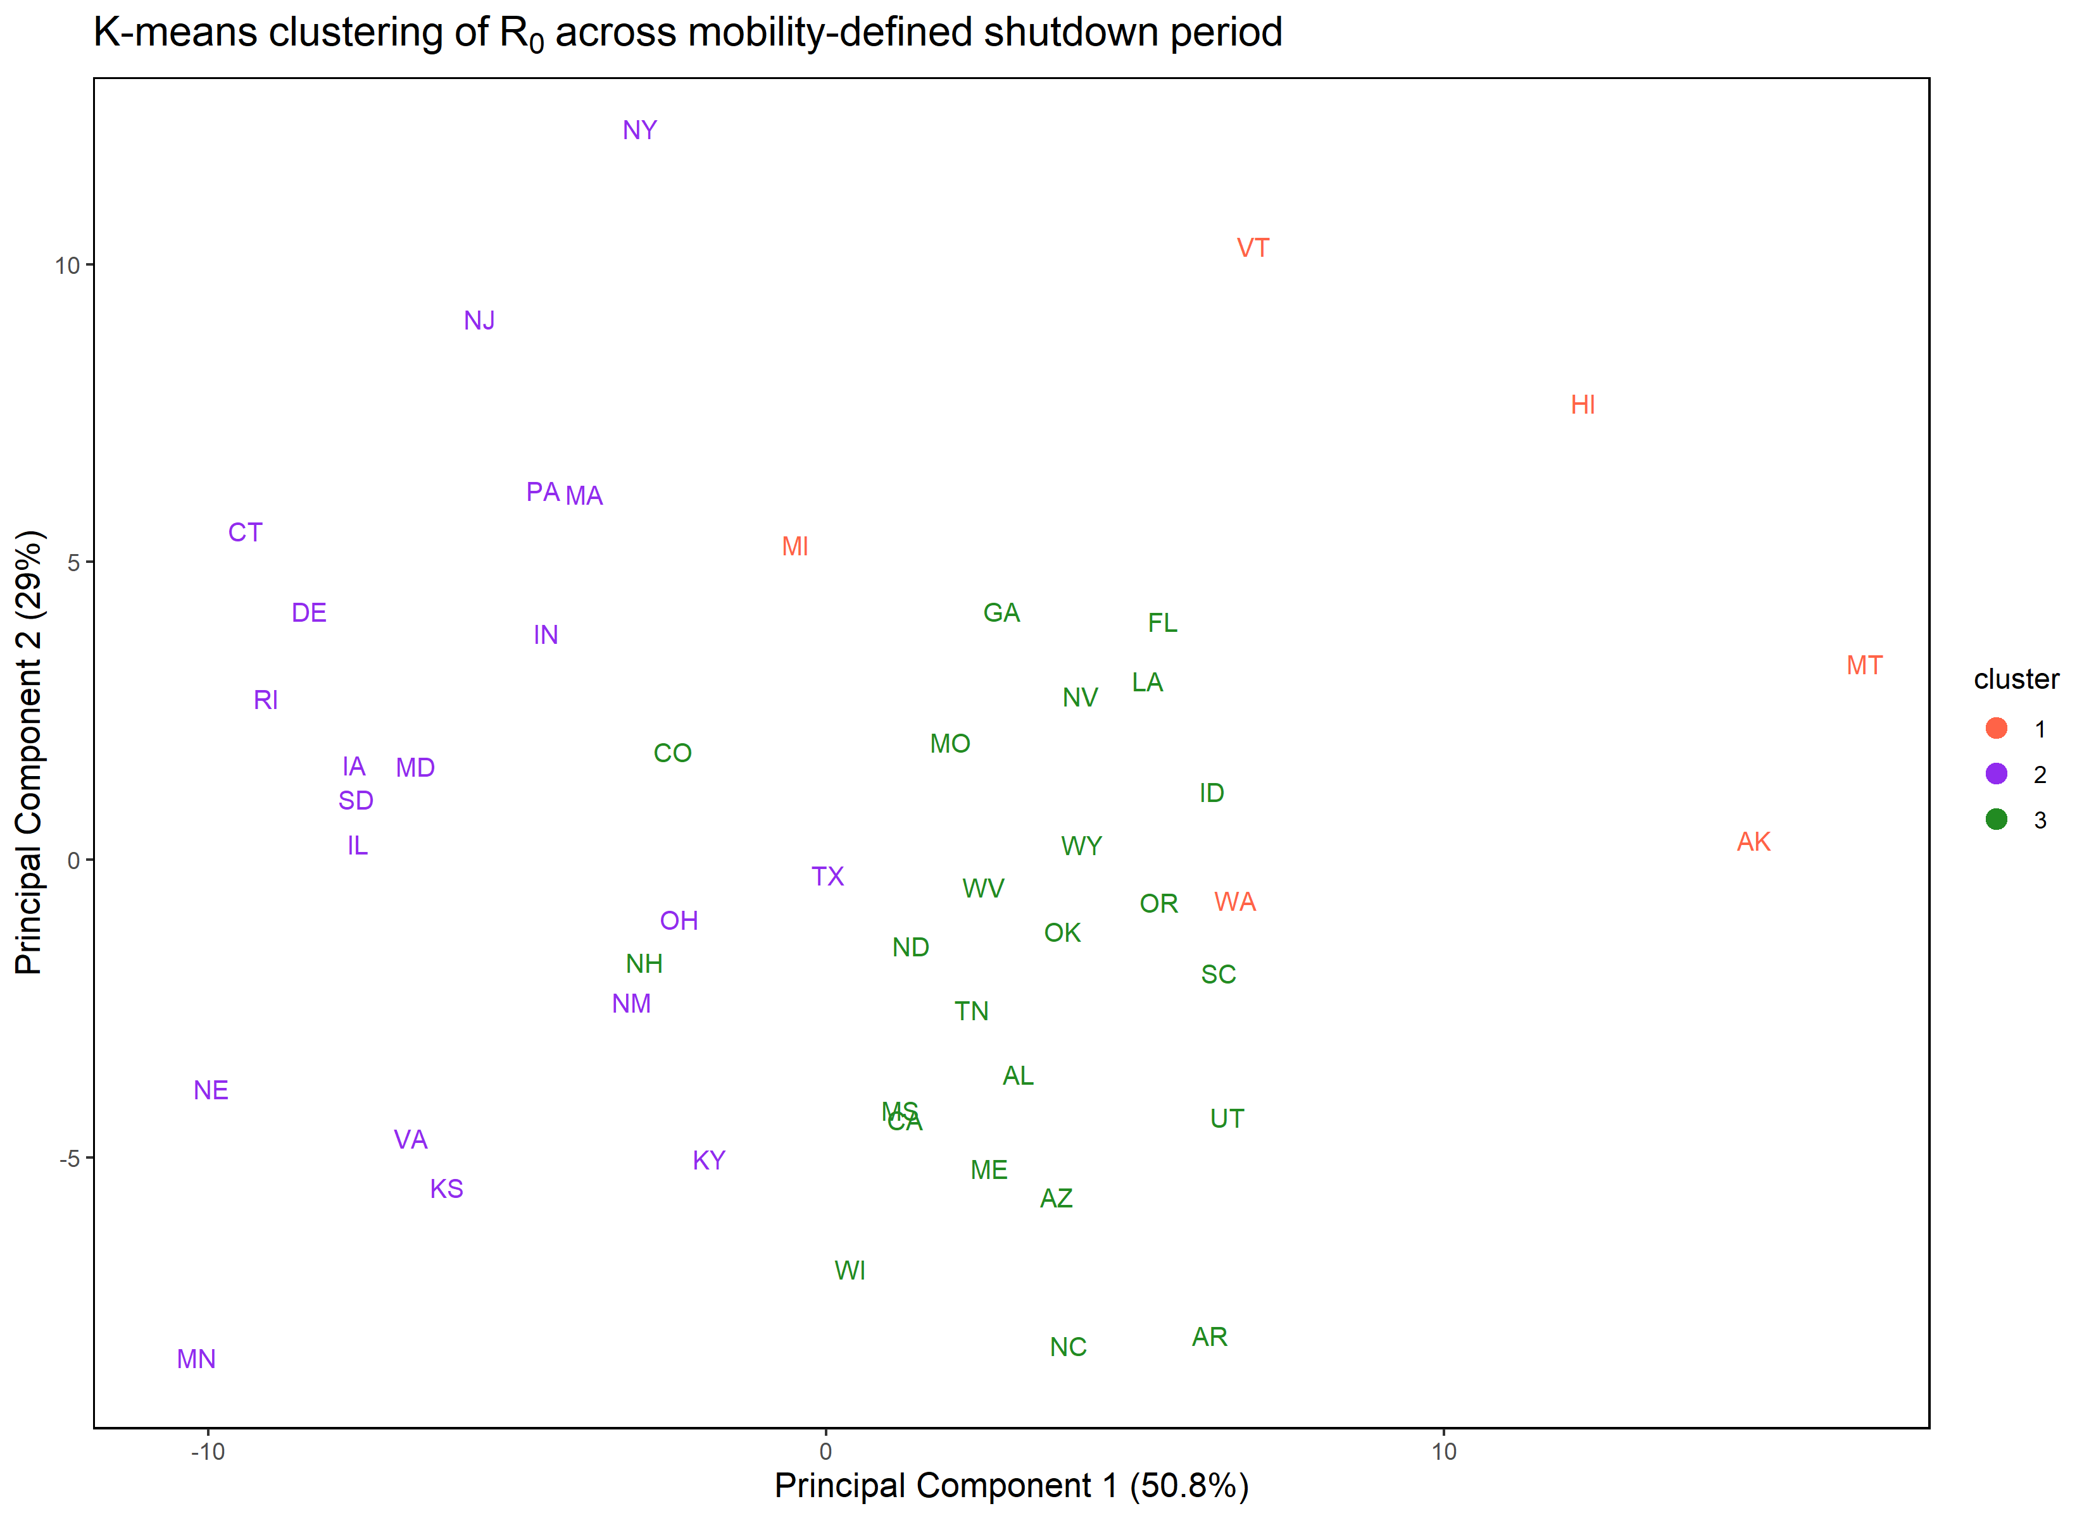
Exploratory analyses: Clustering the states

Slide 14
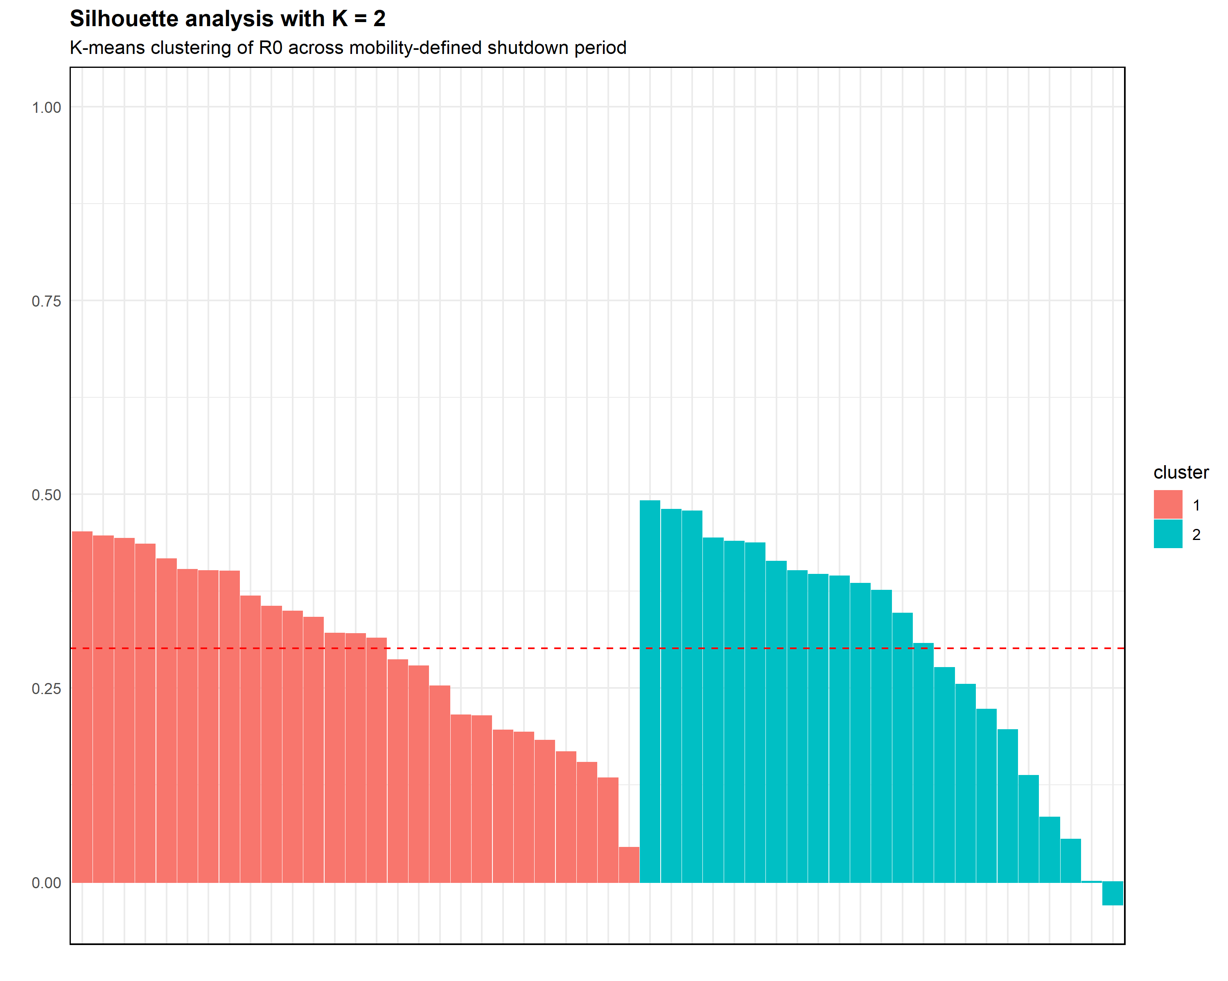
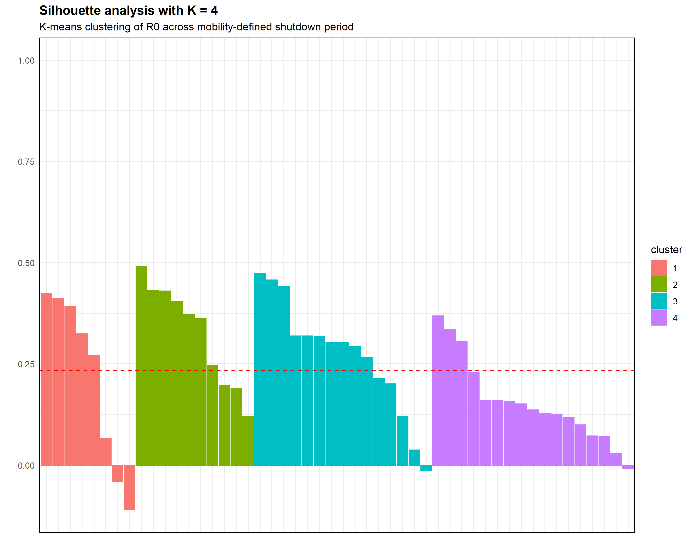
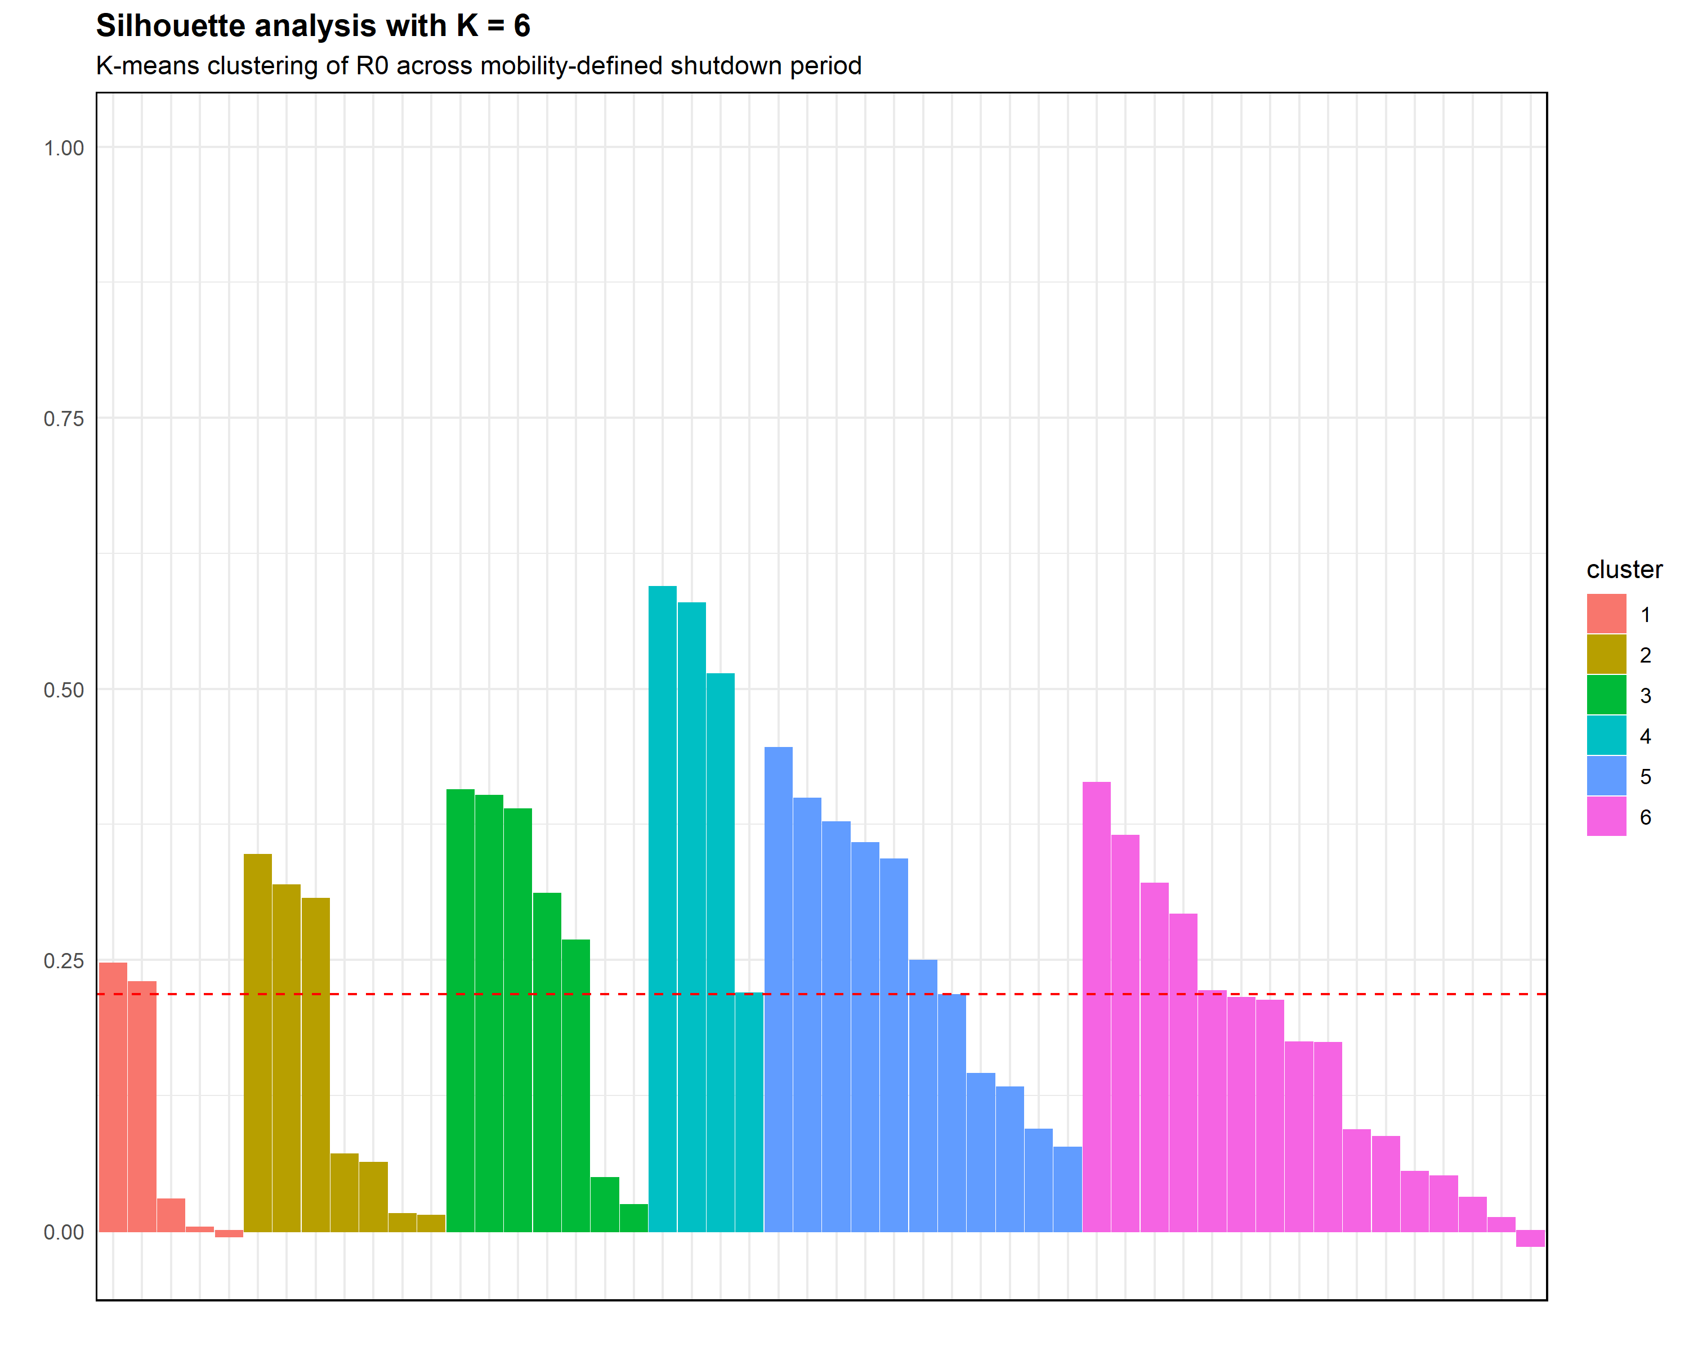
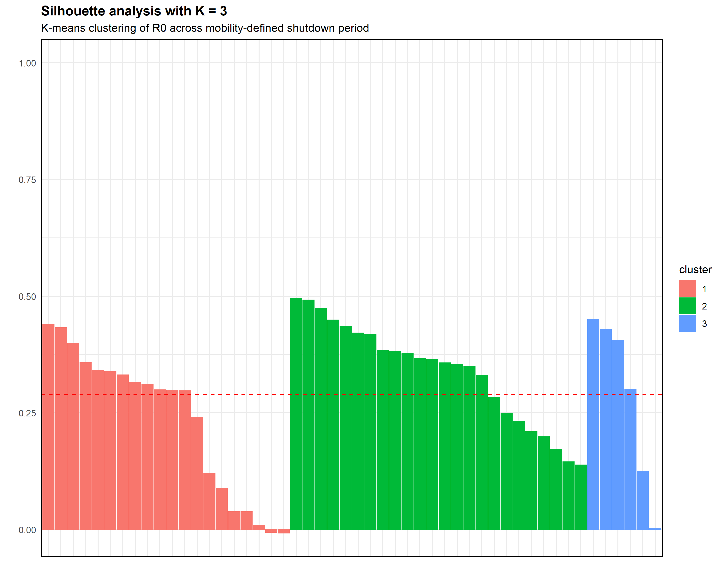
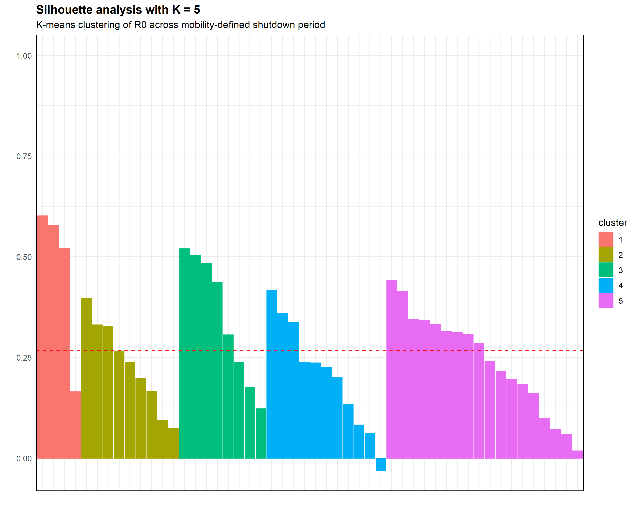
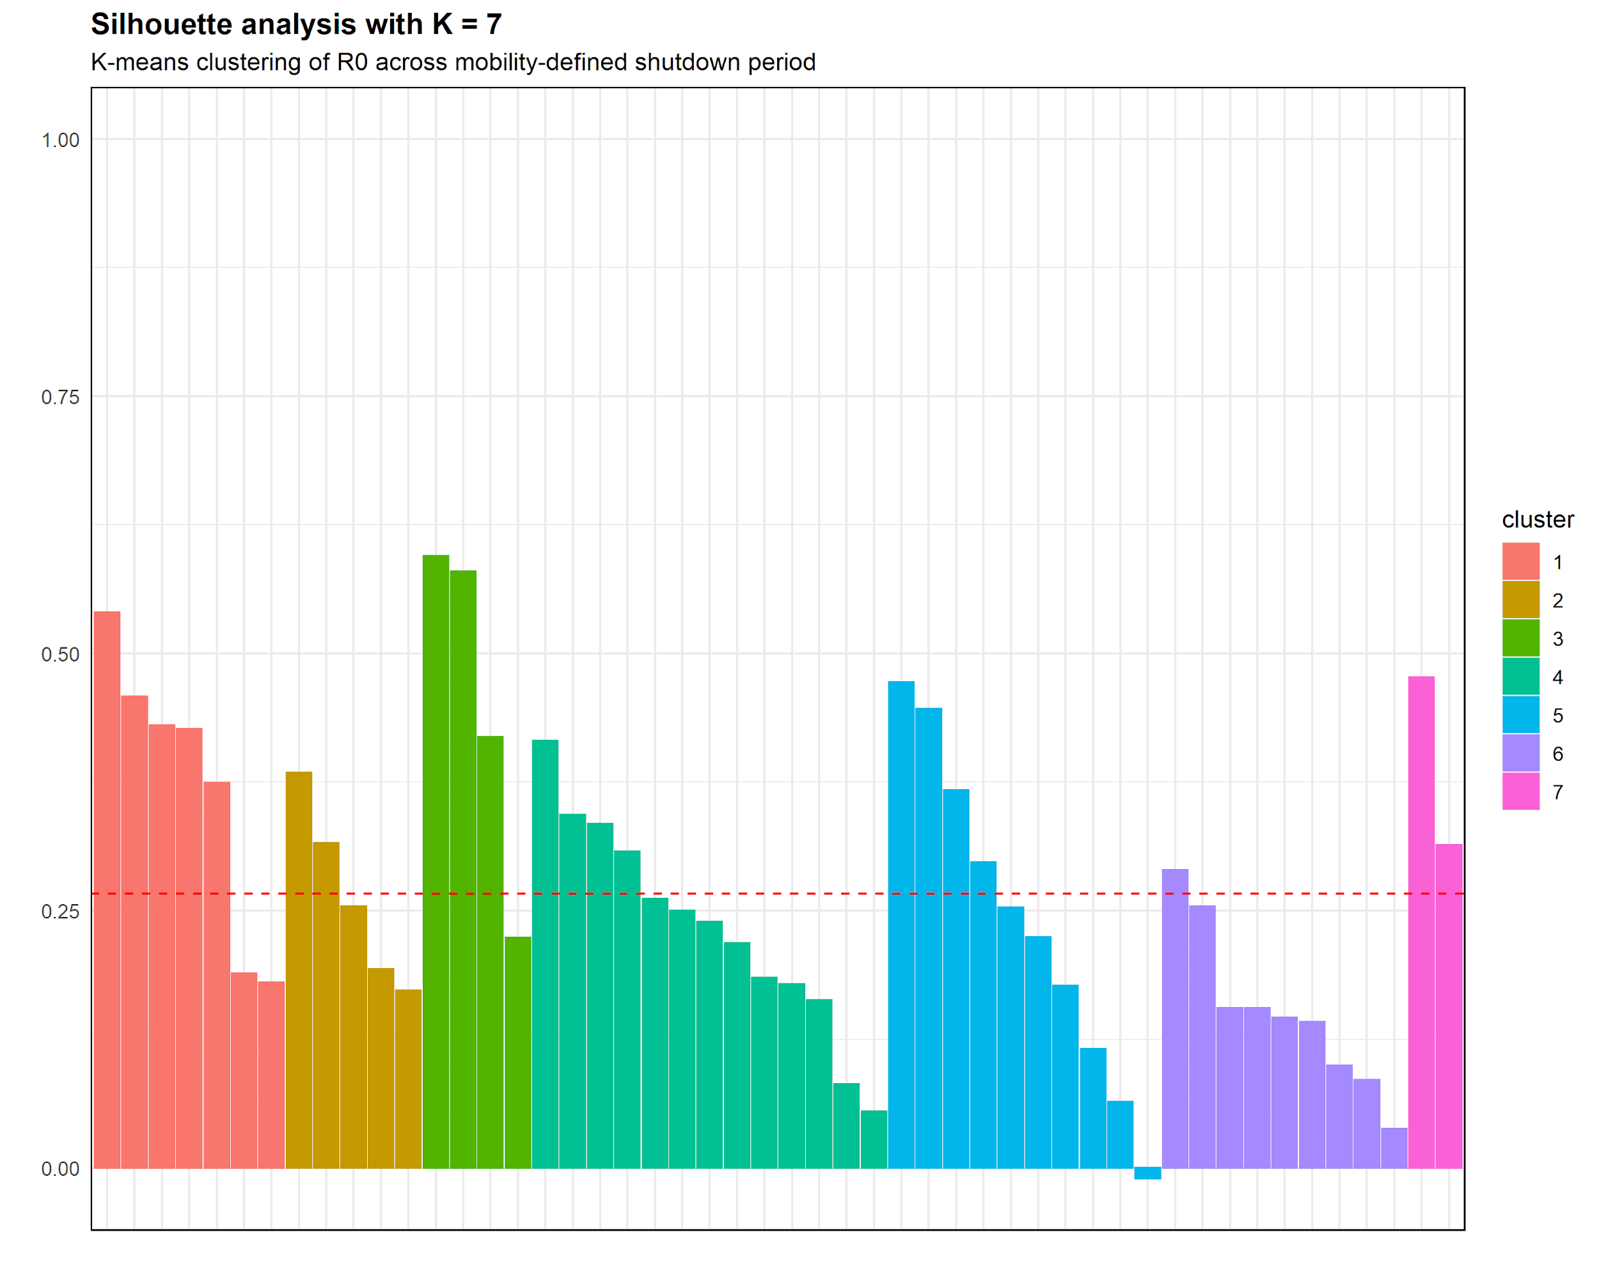
Exploratory analyses: Clustering the states

Slide 15
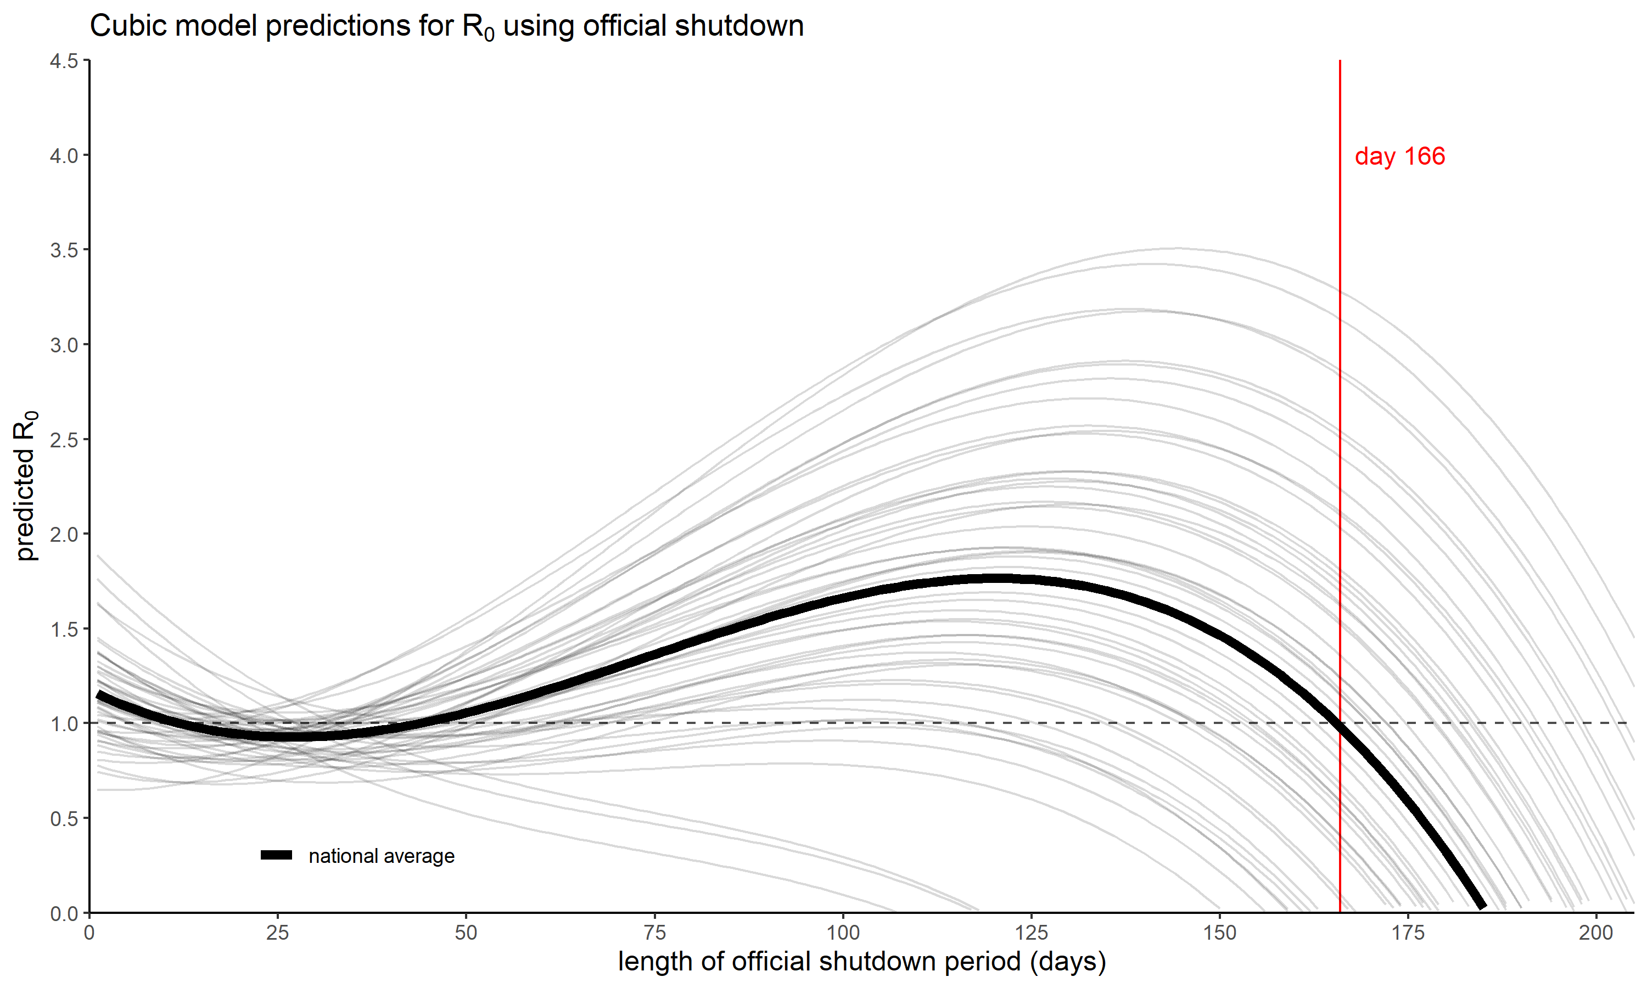
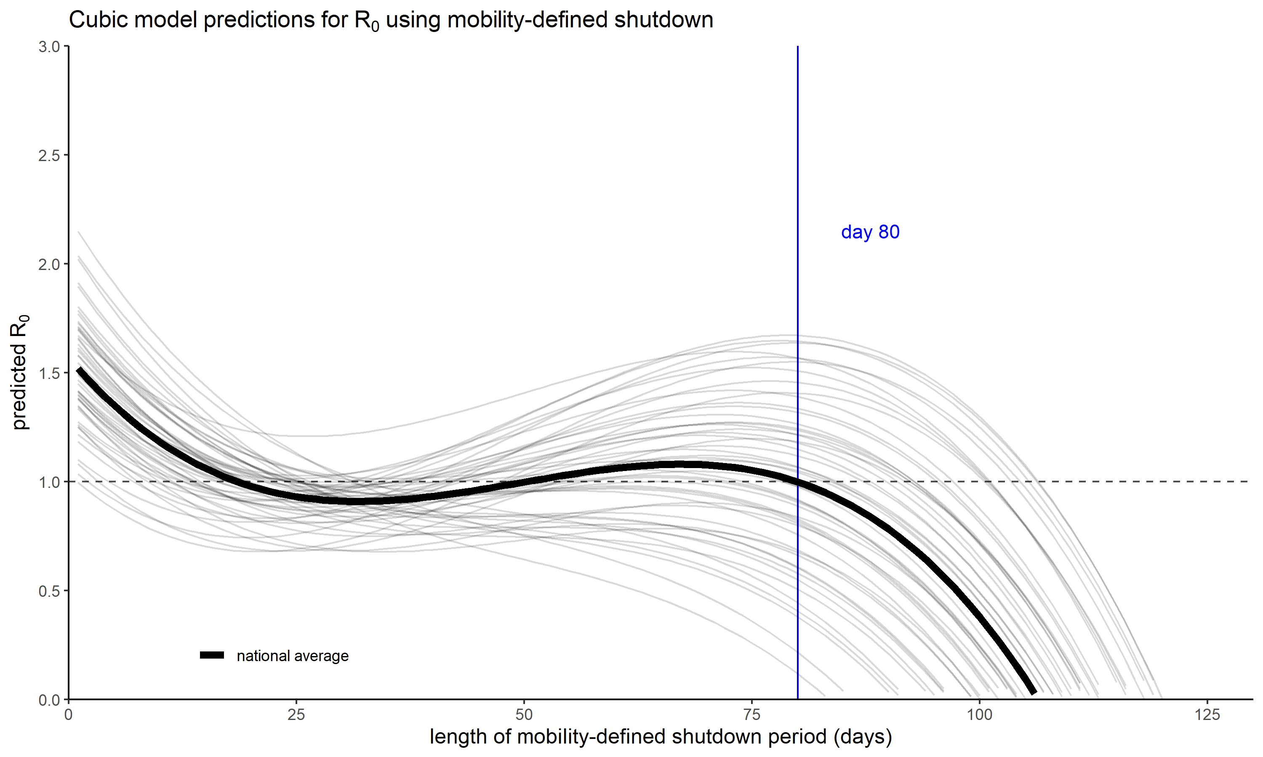
Modeling R₀ during shutdown

Slide 16
Modeling R₀ during shutdown

Slide 17
Modeling R₀ during shutdown

Slide 18
Modeling R₀ during official shutdown
model | AIC | BIC | 𝛘²(df) | 𝙥
Linear | -2935.8 | -2913.4 | - | -
Linear + Linear random effect | -4622.8 | -4589.1 | 1691.0 (2) | < 0.001
Quad + Linear random effect | -5949.5 | -5910.2 | 1328.7 (1) | < 0.001
Cubic + Linear random effect | -5985.9 | -5941.0 | 38.4 (1) | < 0.001

Slide 19
Modeling R₀ during official shutdown
model | AIC | BIC | 𝛘²(df) | 𝙥
Linear | -2935.8 | -2913.4 | - | -
Linear + Linear random effect | -4622.8 | -4589.1 | 1691.0 (2) | < 0.001
Quad + Linear random effect | -5949.5 | -5910.2 | 1328.7 (1) | < 0.001
Cubic + Linear random effect | -5985.9 | -5941.0 | 38.4 (1) | < 0.001
Cubic + Linear random effect
variable | estimate | SE | 𝙩 | 𝙥
intercept | 1.18 | 3.71E-02 | 31.67 | < 0.001
(shutdown day count) | -1.99E-02 | 1.40E-03 | -14.25 | < 0.001
(shutdown day count)² | 4.52E-04 | 2.71E-05 | 16.68 | < 0.001
(shutdown day count)³ | -2.04E-06 | 3.28E-07 | -6.23 | < 0.001

Slide 20
Modeling R₀ during mobility-defined shutdown
model | AIC | BIC | 𝛘²(df) | 𝙥
Linear | -1819.3 | -1796.0 | - | -
Linear + Linear random effect | -2757.9 | -2723.1 | 942.6 (2) | < 0.001
Quad + Linear random effect | -4966.0 | -4925.4 | 2210.1 (2) | < 0.001
Cubic + Linear random effect | -5504.8 | -5458.4 | 540.8 (1) | < 0.001

Slide 21
Modeling R₀ during mobility-defined shutdown
model | AIC | BIC | 𝛘²(df) | 𝙥
Linear | -1819.3 | -1796.0 | - | -
Linear + Linear random effect | -2757.9 | -2723.1 | 942.6 (2) | < 0.001
Quad + Linear random effect | -4966.0 | -4925.4 | 2210.1 (2) | < 0.001
Cubic + Linear random effect | -5504.8 | -5458.4 | 540.8 (1) | < 0.001
Cubic + Linear random effect
variable | estimate | SE | 𝙩 | 𝙥
intercept | 1.57 | 3.84E-02 | 40.82 | < 0.001
(shutdown day count) | -4.91E-02 | 1.35E-03 | -36.41 | < 0.001
(shutdown day count)² | 1.14E-03 | 2.85E-05 | 39.81 | < 0.001
(shutdown day count)³ | -7.64E-06 | 3.12E-07 | -24.62 | < 0.001

Slide 22
Modeling R₀ during shutdown

Slide 23
Conclusion
Nationwide, R₀ is related to shutdown length via a cubic relationship.
During shutdown, R₀ initially increased.
After 80 days of mobility-defined shutdown (or 166 days of official shutdown), the national average R₀ sank and stayed below 1.
Limitations
Assumptions about adherence to mandates
Calculation of R₀
Calculation of mobility data
Suggestions for further investigation
Individuals’ adherence to social distancing mandates
Capability of states to enforce social distancing mandates

Slide 24
References
Courtemanche, C., Garuccio, J., Le, A., Pinkston, J., & Yelowitz, A. (2020). “Strong social distancing measures in the
United States reduced the COVID-19 growth rate: Study evaluates the impact of social distancing measures on the growth rate of confirmed COVID-19 cases across the United States”. Health Affairs, 10-1377.
Google LLC. (2020). "Google COVID-19 Community Mobility Reports". https://www.google.com/covid19/mobility/
Greenstone, M., & Nigam, V. (2020). “Does social distancing matter?”. University of Chicago, Becker Friedman Institute for
Economics, 2020-26.
Systrom, K., & Vladeck, T. (2020). “Rt.live”. https://rt.live/
The New York Times. (2020). “COVID-19 data”.
https://raw.githubusercontent.com/nytimes/covid-19-data/master/us-states.csv

