Slide 1
PROJECT INTRODUCTION / 15 SEP 2026
Aha
ONE RESEARCH BASIS
Traceable research.
Freely authored explanations.
Sources + claims
+ stated gaps
Investigate a question, then choose how to explain it.
Keep the evidence separate from the medium.
HTML / PNG
PPTX / Video
Separately authored.
Not automatic conversion.
Source-first—not an automated truth engine or an “all formats” command.
AHA / README · Architecture | runtime 0.3.0 · protocol 1.0.0
01 / 09
Notes:
slide-01-purpose
Aha combines two portable Skills and a local runtime. The host Agent performs investigation and content design. Shared factual grounding does not imply shared layouts or automatic all-format generation. The diagram shows reuse of research, not a one-click conversion pipeline.,Research scope: fixed repository commit a013ea795312eab9ae2e4224998a1314eea8f718; reviewed 2026-09-15. Runtime 0.3.0; research/artifact protocol 1.0.0.,Bound Research Dossier: b547322594e90fb21a9aad36c40b7658cfe6c73d591e69481d95fdc20408a3bf. This deck translates the supported conclusions into English; it does not alter the research snapshot.,Fixed repository references:
https://github.com/sawyer0x110/aha/blob/a013ea795312eab9ae2e4224998a1314eea8f718/README.md#L1-L39
https://github.com/sawyer0x110/aha/blob/a013ea795312eab9ae2e4224998a1314eea8f718/docs/ARCHITECTURE.md#L1-L136

Slide 2
01 / RESPONSIBILITIES
Two Skills guide the work; the runtime executes it
Choose the entry by the final deliverable—not by an assumed automatic handoff.
REPORT OR INVESTIGATION
VISUAL EXPLANATION
aha-research
aha-explain
Break down the question, collect evidence, test competing explanations, and synthesize a supported answer.
Reuse suitable research—or research first—then design and author the requested medium.
Delivers a Research Dossier and readable report.
Delivers editable source, output, and candid QA.
LOCAL RUNTIME
Checks contracts and identity; packages resources and renders.
It does not establish that a source supports a conclusion.
AHA / Research Skill · Explain Skill · README
02 / 09
Notes:
slide-02-responsibilities
The two Skills share research guidance; aha-explain does not depend on the host automatically dispatching a task to aha-research. Reports can be complete deliverables without slides. Structural checks are not source-support review or evidence of host discovery.,Research scope: fixed repository commit a013ea795312eab9ae2e4224998a1314eea8f718; reviewed 2026-09-15. Runtime 0.3.0; research/artifact protocol 1.0.0.,Bound Research Dossier: b547322594e90fb21a9aad36c40b7658cfe6c73d591e69481d95fdc20408a3bf. This deck translates the supported conclusions into English; it does not alter the research snapshot.,Fixed repository references:
https://github.com/sawyer0x110/aha/blob/a013ea795312eab9ae2e4224998a1314eea8f718/skills/aha-research/SKILL.md#L1-L23
https://github.com/sawyer0x110/aha/blob/a013ea795312eab9ae2e4224998a1314eea8f718/skills/aha-explain/SKILL.md#L1-L22
https://github.com/sawyer0x110/aha/blob/a013ea795312eab9ae2e4224998a1314eea8f718/README.md#L31-L39

Slide 3
02 / IDENTITY
Bind research and source to the rendered result
Identity lets you answer “Which inputs produced this file?” It cannot answer “Is it true?”
01
02
03
Research Dossier
Artifact project
Output + receipt
BIND
RENDER
manifest.json
research.json
report.md
artifact.json
editable medium source
bound research copy
researchHash
sourceHash
outputHash
Claims, evidence and gaps remain independent of any medium.
Each claim is mapped to content or explicitly omitted with a reason.
For HTML, PNG and PPTX, the receipt binds the result to its inputs.
After an edit
Rebuild the corresponding candidate; keep an old output as history, not as proof of new source.
Video adds a separate plan, audio, and output identity chain.
AHA / Dossier implementation · Artifact contract · Render receipts · Video plan
03 / 09
Notes:
slide-03-identity
Research Dossier files store the independent report and its content identity. Artifact metadata declares one format, entry, language, dimensions, researchHash, coverage and omissions. Every claim must be covered or explicitly omitted. The coverage map is an author declaration, not semantic proof. Hashes detect identity changes, not truth. HTML/PNG/PPTX receipts and the separate video chain should not be conflated. Research changes require a new snapshot and deliberate rebinding.,Research scope: fixed repository commit a013ea795312eab9ae2e4224998a1314eea8f718; reviewed 2026-09-15. Runtime 0.3.0; research/artifact protocol 1.0.0.,Bound Research Dossier: b547322594e90fb21a9aad36c40b7658cfe6c73d591e69481d95fdc20408a3bf. This deck translates the supported conclusions into English; it does not alter the research snapshot.,Fixed repository references:
https://github.com/sawyer0x110/aha/blob/a013ea795312eab9ae2e4224998a1314eea8f718/src/research/dossier.ts#L183-L225
https://github.com/sawyer0x110/aha/blob/a013ea795312eab9ae2e4224998a1314eea8f718/src/artifacts/project.ts#L90-L168
https://github.com/sawyer0x110/aha/blob/a013ea795312eab9ae2e4224998a1314eea8f718/src/artifacts/render.ts#L39-L81
https://github.com/sawyer0x110/aha/blob/a013ea795312eab9ae2e4224998a1314eea8f718/src/media/plan.ts#L58-L101
https://github.com/sawyer0x110/aha/blob/a013ea795312eab9ae2e4224998a1314eea8f718/docs/ARCHITECTURE.md#L1-L136

Slide 4
03 / MEDIA CHOICE
Share the facts—not a fixed page layout
One project declares one format. Request several outputs only when each serves a different use.
MEDIUM | READER’S SITUATION | WHAT THE AUTHOR BUILDS | WHAT NOT TO ASSUME
HTML | Explore at a chosen pace | Rich text, SVG / Mermaid, and local interactions | Packaging is not script execution or browser QA.
PNG | Scan a fixed-size visual | A composition made for the capture viewport | A shrunken long article is not a readable one-image explanation.
PPTX | Follow a sequence; edit the explanation | Native text, shapes, tables, and charts | Whole-slide screenshots are not native slide authoring.
Video | See a mechanism change over time | Frame-driven scenes aligned to actual audio; captions + SRT | Encoding is not proof of playback or listening quality.
Re-authoring preserves the explanation’s logic while changing its reading path.
AHA / README · Architecture · Artifact project contract
04 / 09
Notes:
slide-04-media
The four rows compare authoring approaches, not measured performance or guaranteed outcomes. HTML supports bundled local assets and offline interactions. PNG must be composed for the intended dimensions. PPTX uses the supplied PptxGenJS instance and native objects. Video is an authored deterministic frame callback; actual audio duration drives frames and captions, with burned subtitles and SRT. Multiple formats require separately authored projects; there is no auto/all command.,Research scope: fixed repository commit a013ea795312eab9ae2e4224998a1314eea8f718; reviewed 2026-09-15. Runtime 0.3.0; research/artifact protocol 1.0.0.,Bound Research Dossier: b547322594e90fb21a9aad36c40b7658cfe6c73d591e69481d95fdc20408a3bf. This deck translates the supported conclusions into English; it does not alter the research snapshot.,Fixed repository references:
https://github.com/sawyer0x110/aha/blob/a013ea795312eab9ae2e4224998a1314eea8f718/README.md#L23-L39
https://github.com/sawyer0x110/aha/blob/a013ea795312eab9ae2e4224998a1314eea8f718/docs/ARCHITECTURE.md#L1-L136
https://github.com/sawyer0x110/aha/blob/a013ea795312eab9ae2e4224998a1314eea8f718/src/artifacts/project.ts#L90-L168

Slide 5
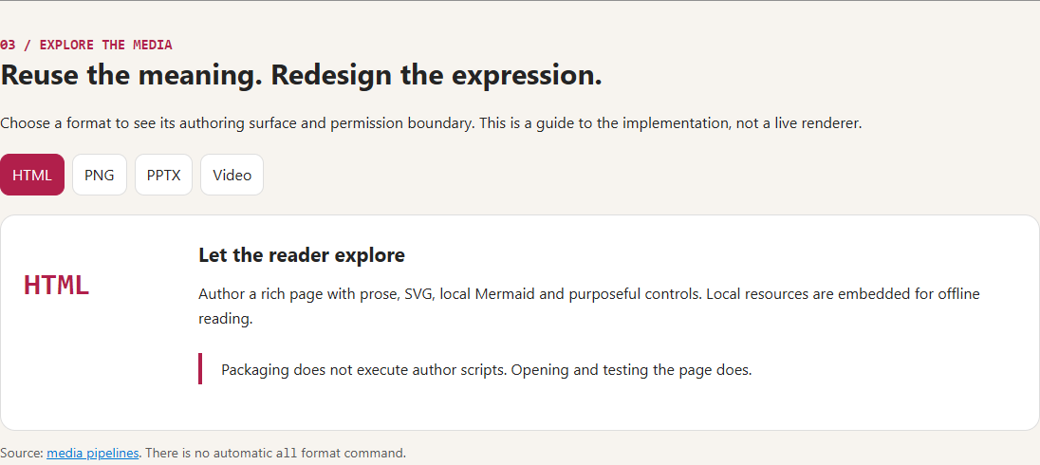
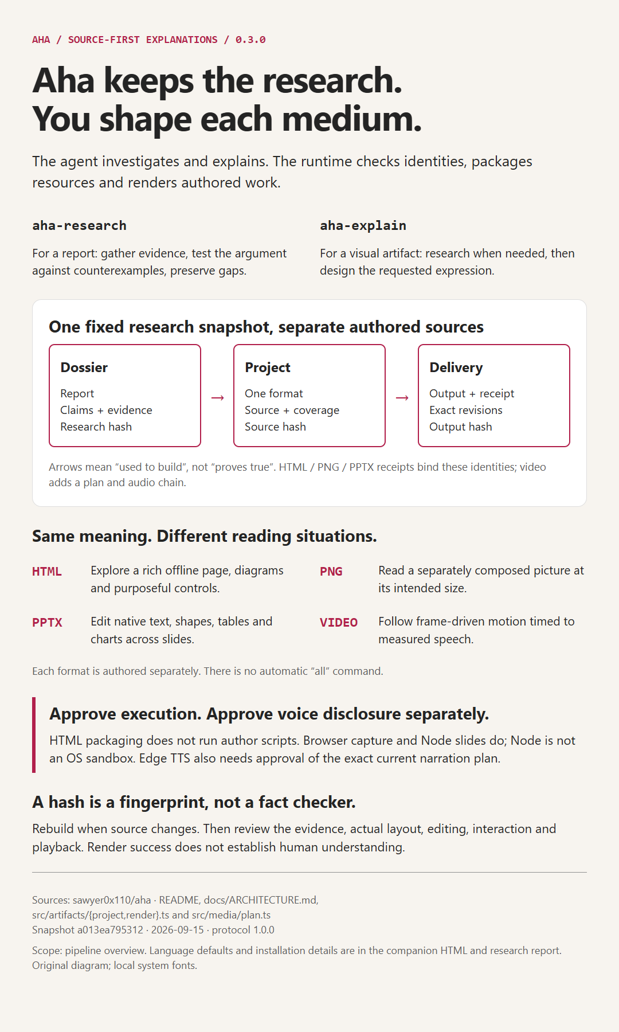
04 / ACTUAL EXAMPLES
One project: an exploratory page and a composed poster
These are the companion artifacts made from this same research—not generic format icons.
HTML / CHOOSE A FORMAT
PNG / READ THE WHOLE PATH
A purpose-built 1080 × 1800 composition.
Thumbnail here; full size in the example.
Offline controls; English / Chinese. Open the HTML to interact.
AHA / Actual companion HTML and PNG · shared research, separately designed layouts
05 / 09
Notes:
slide-demo-static
The image on the left is a capture of the actual delivered HTML format-selector section. Its controls are interactive in the HTML, not in this screenshot. The right-hand thumbnail is the actual separately authored poster. It is intentionally a thumbnail and is not presented as readable full-size poster text. The current slide remains native editable text plus supporting raster previews. These example-specific observations are production evidence, not additional general claims about Aha.,Research scope: fixed repository commit a013ea795312eab9ae2e4224998a1314eea8f718; reviewed 2026-09-15. Runtime 0.3.0; research/artifact protocol 1.0.0.,Bound Research Dossier: b547322594e90fb21a9aad36c40b7658cfe6c73d591e69481d95fdc20408a3bf. This deck translates the supported conclusions into English; it does not alter the research snapshot.,Fixed repository references:
https://github.com/sawyer0x110/aha/blob/a013ea795312eab9ae2e4224998a1314eea8f718/src/artifacts/project.ts#L90-L168
https://github.com/sawyer0x110/aha/blob/a013ea795312eab9ae2e4224998a1314eea8f718/docs/ARCHITECTURE.md#L51-L89

Slide 6
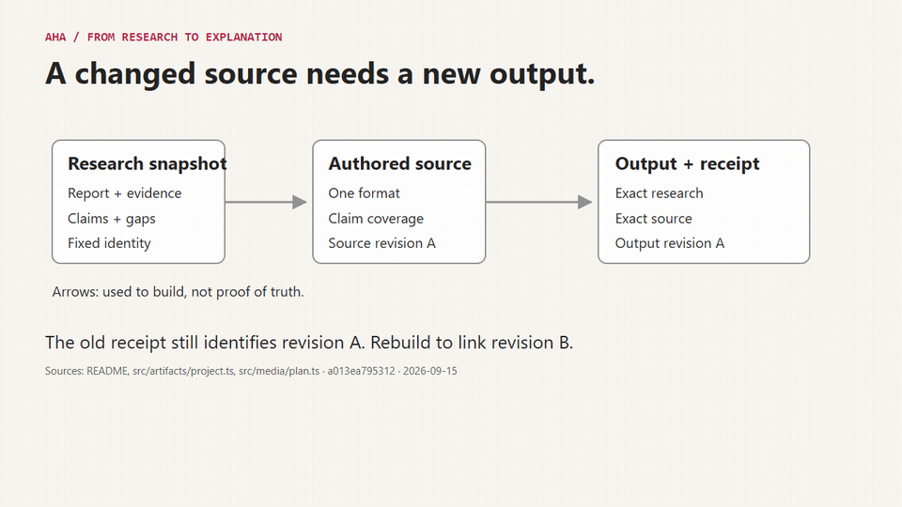
05 / PPTX + VIDEO IN ACTION
Watch a source revision change, then an approval gate open
THE PPTX EXAMPLE IS THIS SLIDE
Native text stays editable.
The motion is an embedded GIF.
Play in a slideshow to see the loop. A static preview may show only its first frame.
Video source supplies both scenes. The final narrated video uses measured speech timing—not this silent preview’s four seconds per scene.
AHA / Actual frame-driven scenes · silent 8 s preview · not an embedded narrated MP4
06 / 09
Notes:
slide-demo-motion
PptxGenJS does not expose a native animation/transition API in this locked version. This example therefore embeds a genuine multi-frame GIF as a supporting animated image instead of inventing APIs, rewriting runtime receipts, or rasterizing the entire slide. Native headings and explanatory text remain editable; the animated illustration is edited through its HTML video source and regenerated. The GIF replays source/receipt revision and exact-plan approval scenes. Its illustrative duration is 8 seconds at 15 fps, not real speech timing. Static renderers may display only a still frame; slideshow playback requires a compatible presentation app.,Research scope: fixed repository commit a013ea795312eab9ae2e4224998a1314eea8f718; reviewed 2026-09-15. Runtime 0.3.0; research/artifact protocol 1.0.0.,Bound Research Dossier: b547322594e90fb21a9aad36c40b7658cfe6c73d591e69481d95fdc20408a3bf. This deck translates the supported conclusions into English; it does not alter the research snapshot.,Fixed repository references:
https://github.com/sawyer0x110/aha/blob/a013ea795312eab9ae2e4224998a1314eea8f718/src/artifacts/render.ts#L203-L251
https://github.com/sawyer0x110/aha/blob/a013ea795312eab9ae2e4224998a1314eea8f718/src/media/plan.ts#L58-L101
https://github.com/sawyer0x110/aha/blob/a013ea795312eab9ae2e4224998a1314eea8f718/skills/aha-explain/references/video.md

Slide 7
06 / PERMISSION BOUNDARIES
Separate local execution from online narration
A request for a visual artifact does not authorize arbitrary code or external speech services.
LOCAL EXECUTION / NOT A SANDBOX
EXTERNAL VOICE / EXACT-PLAN APPROVAL
Review the source,
then approve execution.
Approve the exact plan
and its external disclosure.
Browser rendering and the PPTX author module run code. Node has host privileges; a flag or timeout is not an OS sandbox.
For online TTS, approve the full narration, provider, voice, rate, and plan hash. Changed bindings require renewed review.
IMPORTANT DISTINCTION
HTML packaging does not execute author scripts. Online service availability remains unproven until observed.
AHA / Execution contract · Render implementation · Video plan identity
07 / 09
Notes:
slide-05-permissions
Local --allow-code permission must follow review of the current code and capabilities. Browser request restrictions do not isolate arbitrary Node code. HTML packaging itself does not execute authored scripts. Online Edge TTS separately requires approval of the complete current narration plan, provider, voice, rate, disclosure scope, and exact planHash; external network authorization is also separate. Plan/source mismatches are rejected. Source or voice changes cannot be authorized by hand-editing a hash. This introduction reports the contract, not a successful live TTS run.,Research scope: fixed repository commit a013ea795312eab9ae2e4224998a1314eea8f718; reviewed 2026-09-15. Runtime 0.3.0; research/artifact protocol 1.0.0.,Bound Research Dossier: b547322594e90fb21a9aad36c40b7658cfe6c73d591e69481d95fdc20408a3bf. This deck translates the supported conclusions into English; it does not alter the research snapshot.,Fixed repository references:
https://github.com/sawyer0x110/aha/blob/a013ea795312eab9ae2e4224998a1314eea8f718/skills/shared/references/execution.md#L1-L41
https://github.com/sawyer0x110/aha/blob/a013ea795312eab9ae2e4224998a1314eea8f718/src/artifacts/render.ts#L39-L81
https://github.com/sawyer0x110/aha/blob/a013ea795312eab9ae2e4224998a1314eea8f718/src/media/plan.ts#L58-L101

Slide 8
07 / LANGUAGE & DISTRIBUTION
Language and packaging change how Aha travels
LANGUAGE CHANGES EXPRESSION
It does not rewrite the research snapshot.
DISTRIBUTION CARRIES CAPABILITY
Build → two self-contained Skill bundles
New HTML
Bilingual; English shown first
Each carries its CLI, schemas, references, and local libraries—not just the source Skill folder.
New PNG / PPTX / video
English by default
Explicit Chinese choice
Chinese artifact; same research
Browser and media tools are prepared separately.
The Agent writes and reviews translations.
A language field is not translation certification.
Build success ≠ published release,
host discovery, or installation acceptance.
AHA / Language contract · Artifact defaults · Build implementation · Architecture
08 / 09
Notes:
slide-06-language-distribution
New HTML defaults to bilingual with English initially visible. PNG, PPTX and video default to English. Explicit Chinese selection changes the artifact language rather than the Dossier. The Agent must author and check translations; a local language switch does not call a translation service. Build output contains exactly aha-research and aha-explain Skill bundles with CLI, schemas, references, local runtime libraries and notices. Source skills folders are not complete installation packages. Browser, Python and FFmpeg are not bundled. Reading a build implementation does not prove a release, host discovery or installation acceptance.,Research scope: fixed repository commit a013ea795312eab9ae2e4224998a1314eea8f718; reviewed 2026-09-15. Runtime 0.3.0; research/artifact protocol 1.0.0.,Bound Research Dossier: b547322594e90fb21a9aad36c40b7658cfe6c73d591e69481d95fdc20408a3bf. This deck translates the supported conclusions into English; it does not alter the research snapshot.,Fixed repository references:
https://github.com/sawyer0x110/aha/blob/a013ea795312eab9ae2e4224998a1314eea8f718/skills/aha-explain/references/language.md#L1-L57
https://github.com/sawyer0x110/aha/blob/a013ea795312eab9ae2e4224998a1314eea8f718/src/artifacts/project.ts#L90-L168
https://github.com/sawyer0x110/aha/blob/a013ea795312eab9ae2e4224998a1314eea8f718/scripts/build.ts#L111-L149
https://github.com/sawyer0x110/aha/blob/a013ea795312eab9ae2e4224998a1314eea8f718/docs/ARCHITECTURE.md#L1-L136
https://github.com/sawyer0x110/aha/blob/a013ea795312eab9ae2e4224998a1314eea8f718/README.md#L17-L23

Slide 9
08 / WHAT “DONE” MEANS
A valid file is not yet a good explanation
01
Research support
Do the cited sources support the claims?
THE AHA APPROACH
02
Explanation clarity
Can the reader follow the reasoning between them?
Investigate.
Author deliberately.
Check each layer.
03
Visuals + editing
Does the actual artifact read and edit well?
04
Runtime integrity
Do checks and receipts match the tested candidate?
Preserve the source.
Disclose what is still untested.
05
Human understanding
Can a real person explain or apply the idea?
These checks complement one another. Agent review is not an independent human comprehension study.
AHA / Architecture · Explain Skill | scope: repository description, not measured effectiveness
09 / 09
Notes:
slide-07-quality
The five questions are separate acceptance layers, not measured results or a maturity score. Research support, explanatory clarity, visual/native-editing quality, runtime integrity and real-person comprehension cannot substitute for one another. A passing schema check or receipt does not certify meaning. No independent human comprehension study, live-host acceptance or cross-machine PowerPoint compatibility is asserted. This deck is authored source; actual rendering and slide/editing review are separate production tasks.,Research scope: fixed repository commit a013ea795312eab9ae2e4224998a1314eea8f718; reviewed 2026-09-15. Runtime 0.3.0; research/artifact protocol 1.0.0.,Bound Research Dossier: b547322594e90fb21a9aad36c40b7658cfe6c73d591e69481d95fdc20408a3bf. This deck translates the supported conclusions into English; it does not alter the research snapshot.,Fixed repository references:
https://github.com/sawyer0x110/aha/blob/a013ea795312eab9ae2e4224998a1314eea8f718/docs/ARCHITECTURE.md#L1-L136
https://github.com/sawyer0x110/aha/blob/a013ea795312eab9ae2e4224998a1314eea8f718/skills/aha-explain/SKILL.md#L1-L22
https://github.com/sawyer0x110/aha/blob/a013ea795312eab9ae2e4224998a1314eea8f718/src/artifacts/render.ts#L39-L81

