Slide 1
6D Object Pose Estimation and 2D Grasp Feature Optimization for Robotic Grasping
Daniel Sawyer
Tian Tan

Slide 2
Presentation topics
Problem statement
Vision for object 6D pose estimation
Camera calibration(extrinsic)
Detectron Mask R-CNN tutorial
Vision for grasp tuning

Slide 3
The Problem
Getting a robot to pick items up (grasp them) in household environment
A multilevel problem that requires multiple systems working in unison
Ability to run inference remotely since the hardware required will not be available directly on the robot

Slide 4
Our Solution
Detectron’s Mask R-CNN algorithm in order to get semantic segmentation and object classification with localization
DenseFusion 6 DOF pose estimation algorithm
Grasp Tuning
Use HTTP GET/POST in order to run both networks and send/receive information to/from them remotely

Slide 5
DenseFusion 6 DoF Pose Estimation
In order to grasp objects, we need their 6 DoF pose which includes 7 values
Estimates X, Y, Z coordinates along with the Quaternion values for orientation
Gives orientation and position in order to grasp object
Needs object localization, camera calibration and mask in order to work properly
Trained on YCB and LineMod datasets which have many items that can be found in the household
Uses PyTorch

Slide 6
Architecture Overview
Two Stage Process...
Stage 1:
First stage takes an RGB image and performs semantic segmentation and localization (Detectron/Mask R-CNN)
Sends RGB and Depth converted to 3D point cloud, cropped to bounding box of object.
Stage 2:
RGBD ran through a fully convolutional network that maps each pixel
PointNet-based network that processes each point in the mask
Finally a pixel-wise fusion network that combines the two and estimates the 6 DoF pose of the object.

Slide 7
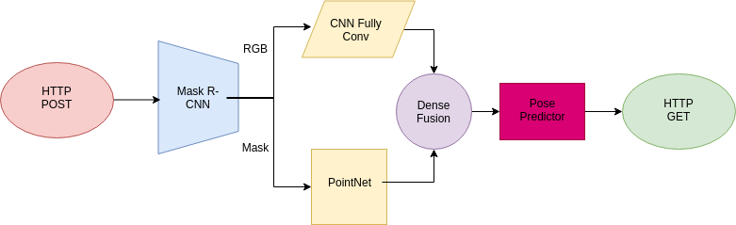
DenseFusion 6 DoF Pose Estimation
Network Architecture with HTTP transmission for remote inference:

Slide 8
HTTP Remote Inference System
Mobile Robots limited hardware resources require the use of the “Cloud”
Using HTTP’s TCP socket to transfer data, we are able to defeat those limitations as long as there is an internet connection.
Common protocol that is readily available and easy to implement
Can be implemented using Python’s Flask module in literally minutes
Before we do any of this, you have to calibrate the cameras!

Slide 9
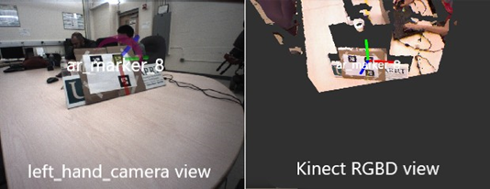
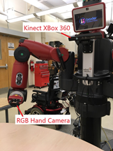
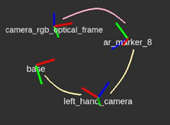
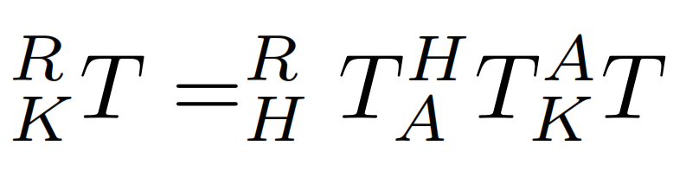
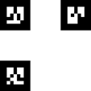
Camera Calibration(extrinsic)
https://github.com/EmaroLab/.

Slide 10
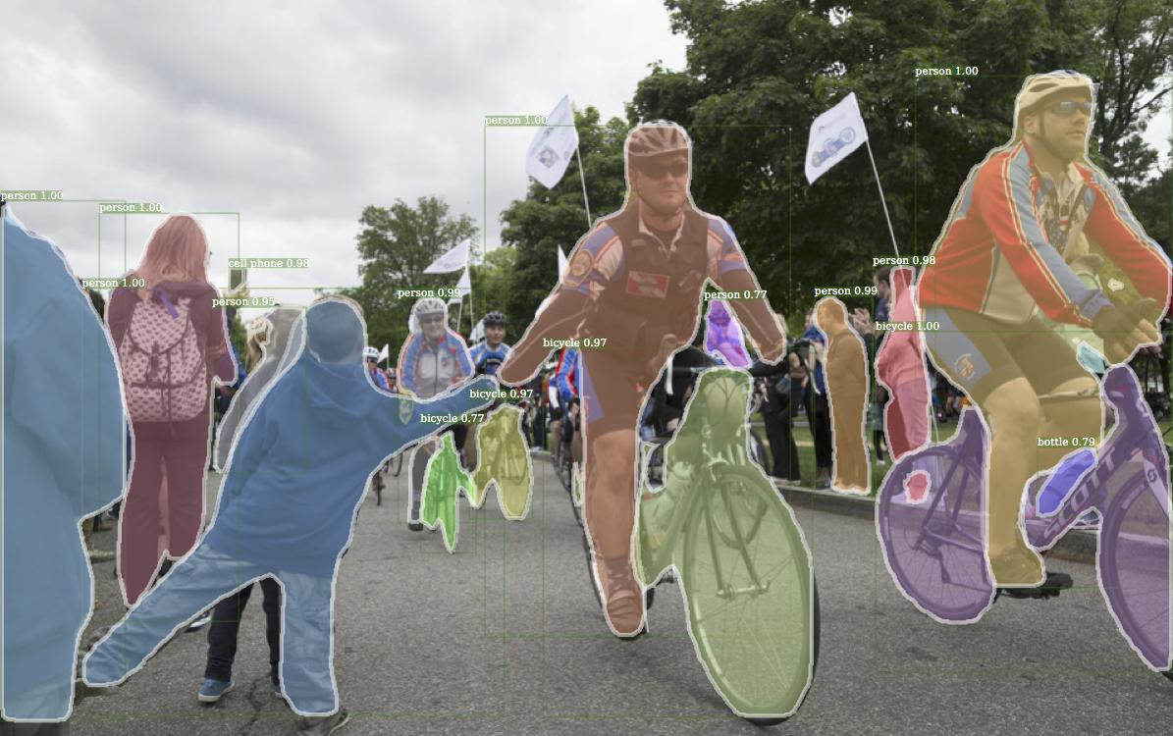
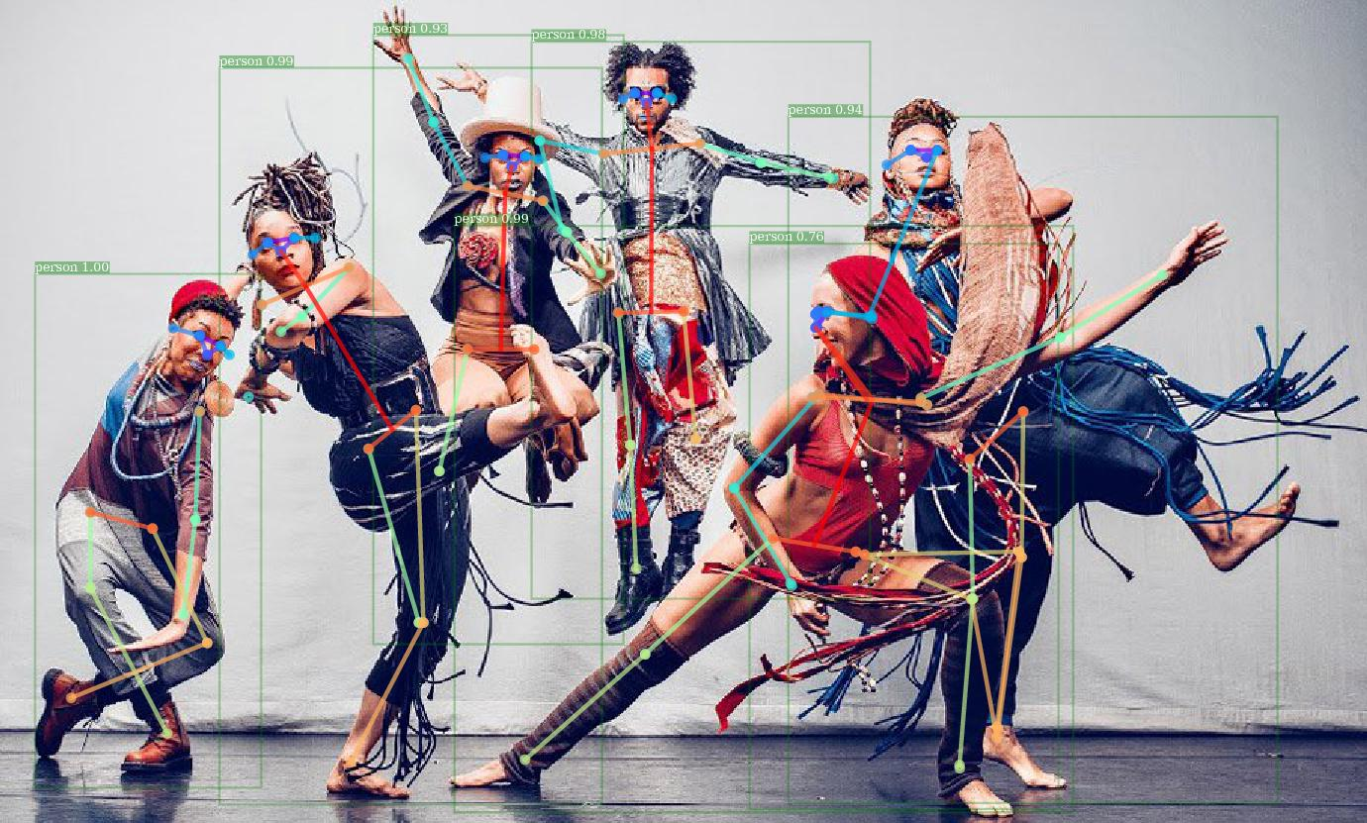
Detectron Mask R-CNN

Slide 11
What is Detectron?
Detectron is Facebook AI Research’s (FAIR) software system that implements state-of-the-art object detection algorithms
Inlcudes newest versions of Faster R-CNN, Mask R-CNN, and DensePose Human Pose Estimation
Built using Python and powered using Caffe2 which is now rolled into PyTorch
Allows use of multiple algorithms with different configuration files, has many pretrained models available, and is well documented so getting it up and running is fairly easy

Slide 12
Why Detectron?
In order to run our DenseFusion 6 DoF pose estimation we must first have an RoI (Region of Interest) of the object (bounding box), object label, and finally an object mask in order to estimate the pose
Has newest and easiest to use version of Mask R-CNN, kept up to date!
Fast and comparatively easy to get up and running
Works with newest version of PyTorch, no going around searching/installing deprecated libraries

Slide 13
Implement Mask R-CNN using Detectron
Implemented using Python 3.7, PyTorch 1.0.1, and CUDA 10
Detectron Model Zoo, all models using pretrained ImageNet backbone
Setting up Conda Environment suitable for Detectron
Set up config file and choose a pretrained model
Training using your own data

Slide 14
Implement Mask R-CNN using Detectron
Github links: https://github.com/facebookresearch/Detectron, https://github.com/sawyermade/Detectron -> with HTTP
Explanation of HTTP subsystem for transferring information
How to keep networks loaded and awaiting HTTP POST which runs inference much quicker than loading the network every time it is needed
Anaconda is your friend! Your best friend perhaps.
Live Demo

Slide 15
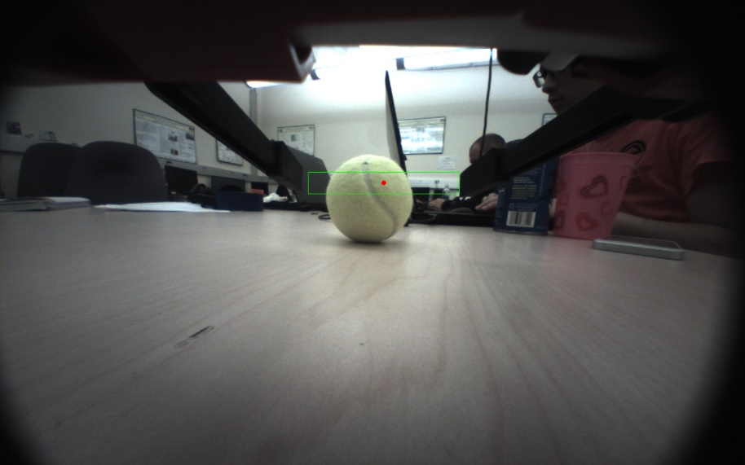
Vision for Grasp Tuning
Purpose
Reduce grasp error
Vision problem statement
*Depth camera does not work in
close range.
From single-view RGB image find
how to move the gripper so that
the object can be grasped at a
good location?

Slide 16
Vision for Grasp Tuning
Approach
Mask R-CNN detect object mask
Object 2D outline extraction from object mask
Calculate pixel-wise normal of the outline
Calculate grasp features and adjust robot gripper
Detect outline
Find contact region & outline normal
Valid contact?
YES
Continue grasp motion
Calculate grasp features
Current gripper pose
NO
Adjust grasp motion

Slide 17
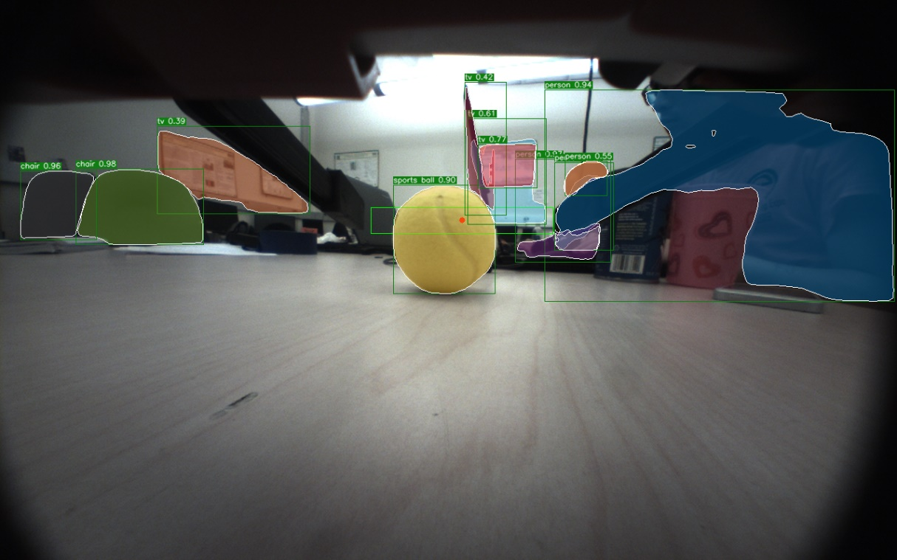
Vision for Grasp Tuning
Mask R-CNN object mask detection result

Slide 18
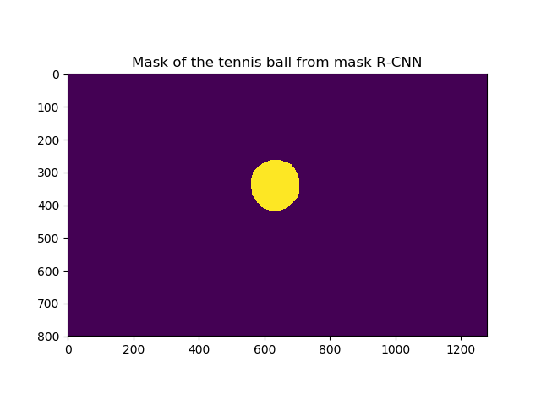
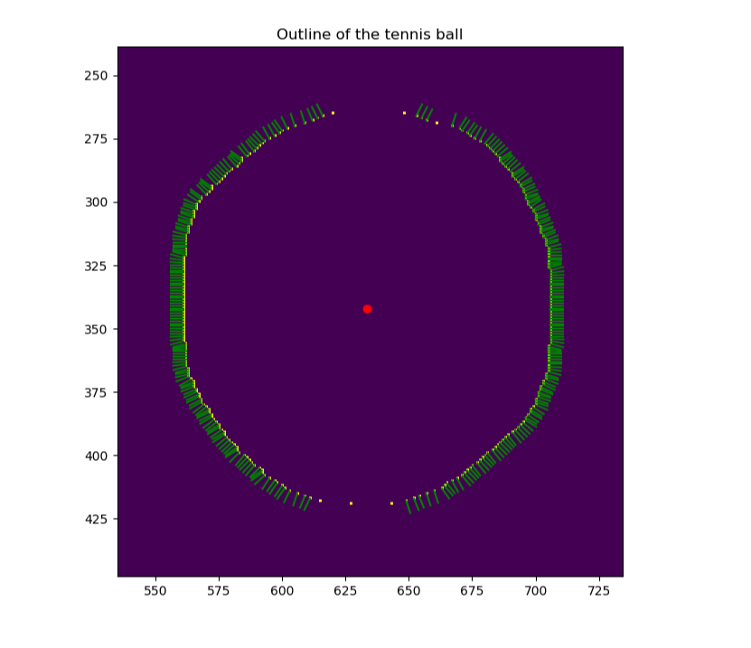
Vision for Grasp Tuning
Object outline and normal extraction results

Slide 19
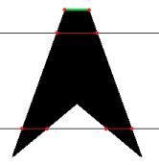
Vision for Grasp Tuning
Object outline extraction
For each row of the image find the two outline
points of each continuous region of the mask
Pixel-wise normal
Find the normal of each neighbor-vector
Choose the normal direction based on pixel position
relative to the center of the object outline
- Average the normal of neighbors

Slide 20
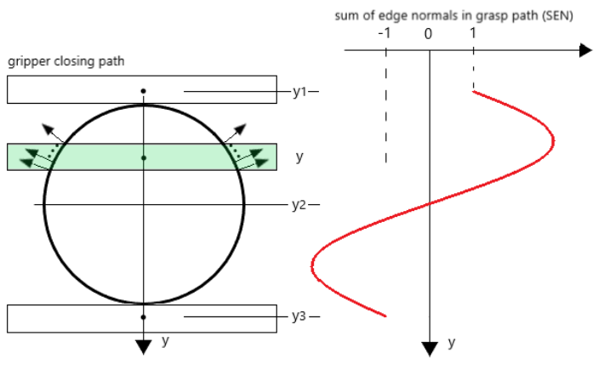
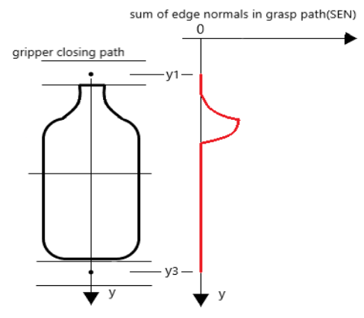
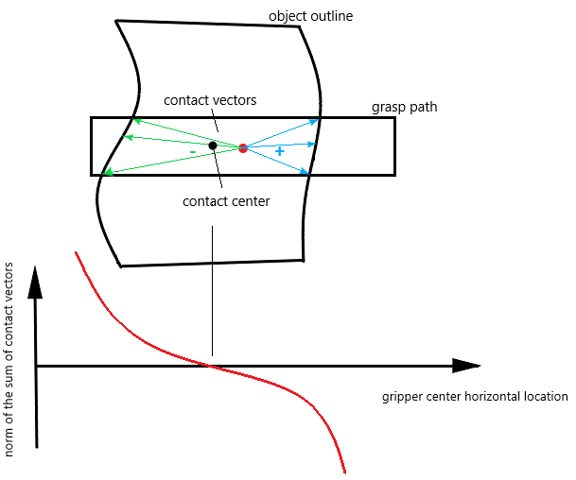
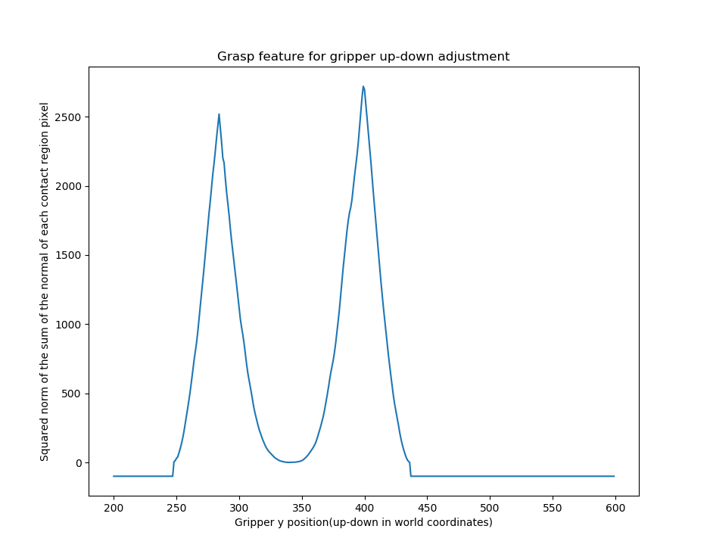
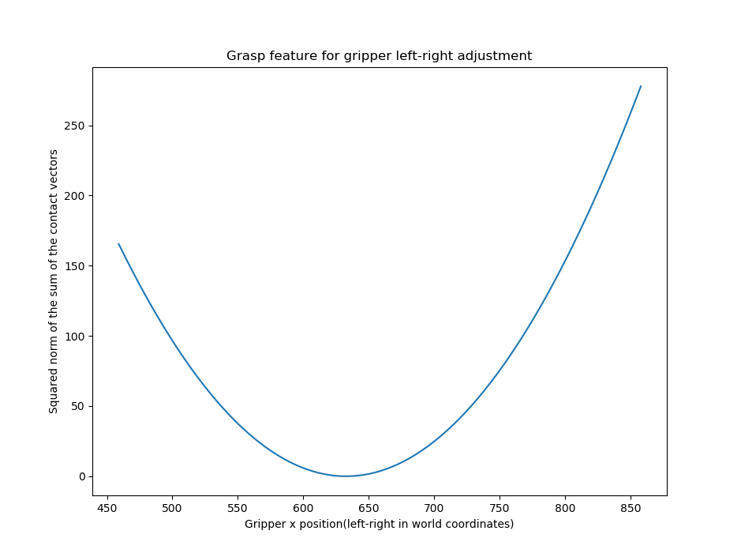
Vision for Grasp Tuning
The Theory Behind Grasp features

Slide 21
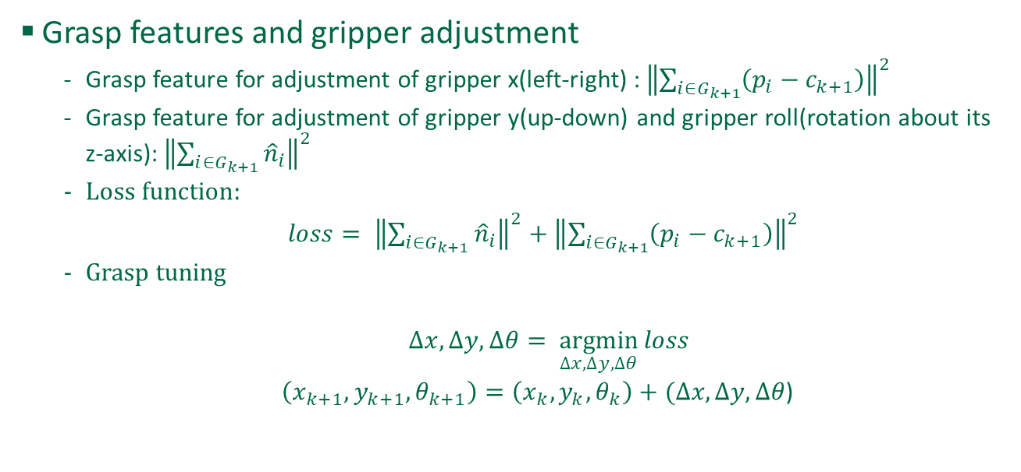
Vision for Grasp Tuning

Slide 22
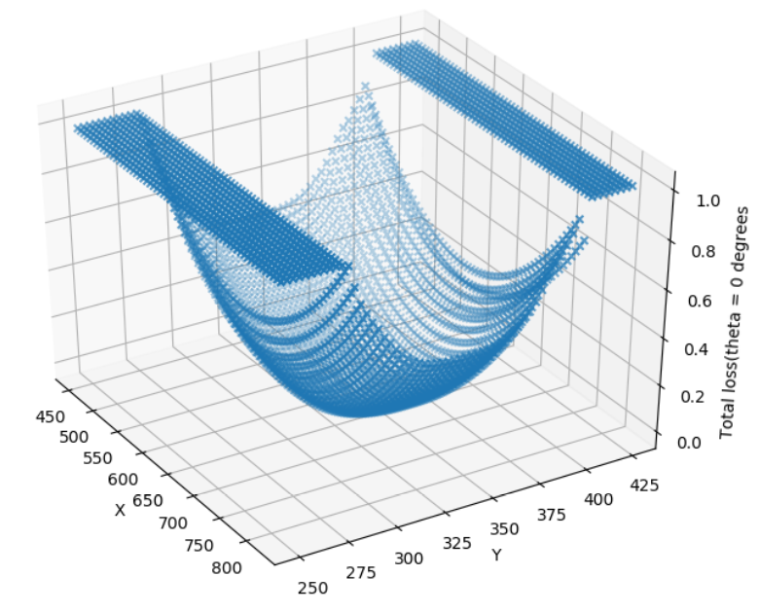
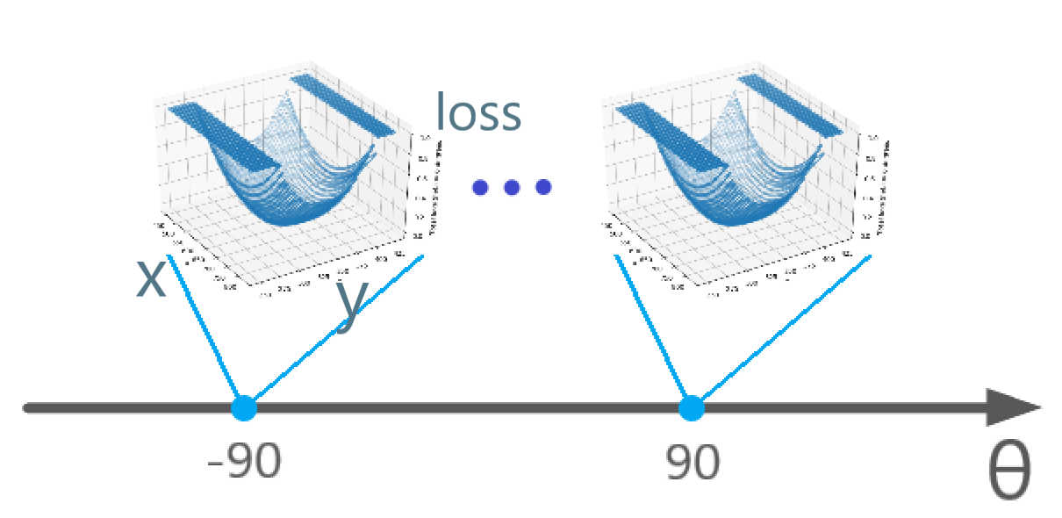
Vision for Grasp Tuning
Grasp features of real data

Slide 23
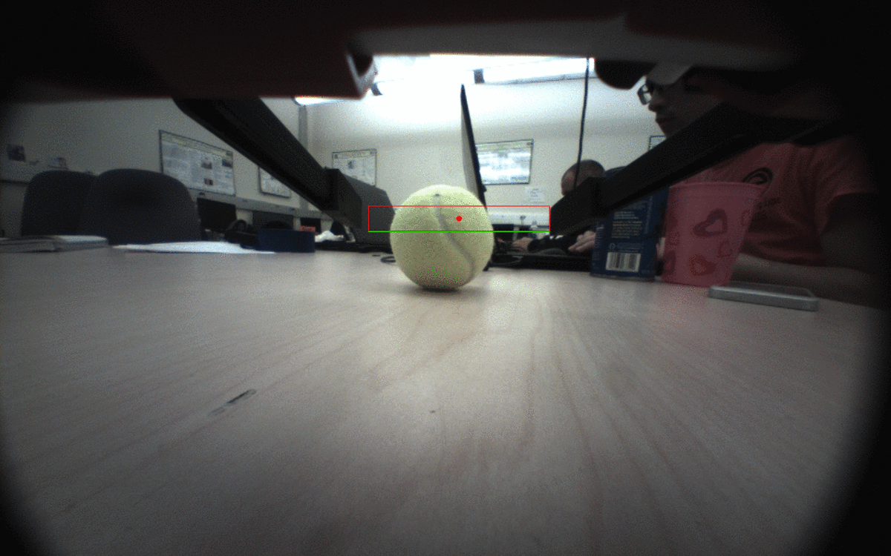
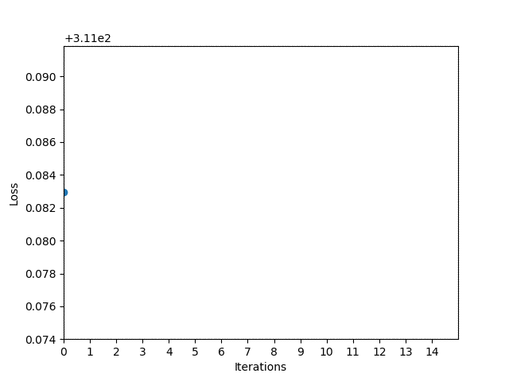
Vision for Grasp Tuning
Gripper adjustment

Slide 24
Questions?

