Slide 1
6D Object Pose Estimation and 2D Object Outline Extraction for Robotic Grasping
Daniel Sawyer
Tian Tan

Slide 2
Presentation topics
Detectron tutorial
Vision for object 6D pose estimation
Vision for grasp tuning

Slide 3
The Problem
Mask R-CNN tutorial
Getting a robot to pick items up (grasp them) in a dynamic environment
A multilevel problem that requires multiple systems working in unison
Ability to run inference remotely since the hardware required will not be available directly on the robot

Slide 4
Our Solution
Mask R-CNN tutorial
Detectron’s Mask R-CNN algorithm in order to get semantic segmentation and object classification with localization
DenseFusion 6 DOF pose estimation algorithm
Grasp Tuning
Use HTTP GET/POST in order to run both networks and send/receive information to/from them remotely

Slide 5
DenseFusion 6 DoF Pose Estimation
Mask R-CNN tutorial
In order to grasp objects, we need their 6 DoF pose which includes 7 values
Estimates X, Y, Z coordinates along with the 4 Quaternion values
Gives orientation and position in order to grasp object
Needs object localization and mask in order to work properly

Slide 6
What is Detectron?
Mask R-CNN tutorial
Detectron is Facebook AI Research’s (FAIR) software system that implements state-of-the-art object detection algorithms
Inlcudes newest versions of Faster R-CNN, Mask R-CNN, and DensePose Human Pose Estimation
Built using Python and powered using Caffe2 which is now rolled into PyTorch
Allows use of multiple algorithms with different configuration files, has many pretrained models available, and is well documented so getting it up and running is fairly easy

Slide 7
Why Detectron?
Mask R-CNN tutorial
In order to run our DenseFusion 6 DoF pose estimation we must first have an RoI (Region of Interest) of the object (bounding box), object label, and finally an object mask in order to estimate the pose
Has newest and easiest to use version of Mask R-CNN
Fast and comparatively easy to get up and running
Works with newest version of PyTorch, no going around searching/installing deprecated libraries

Slide 8
Implement Mask R-CNN using Detectron
Mask R-CNN tutorial
Implemented using Python 3.7, PyTorch 1.0.1, and CUDA 10
Detectron Model Zoo, all models using pretrained ImageNet backbone
Setting up Conda Environment suitable for Detectron
Set up config file and choose a pretrained model
Training using your own data

Slide 9
Implement Mask R-CNN using Detectron
Mask R-CNN tutorial
Github links: https://github.com/facebookresearch/Detectron, https://github.com/sawyermade/Detectron
Live demo
Explanation of HTTP subsystem for transferring information
How to keep networks loaded and awaiting HTTP POST which runs inference much quicker than loading the network every time it is needed

Slide 10
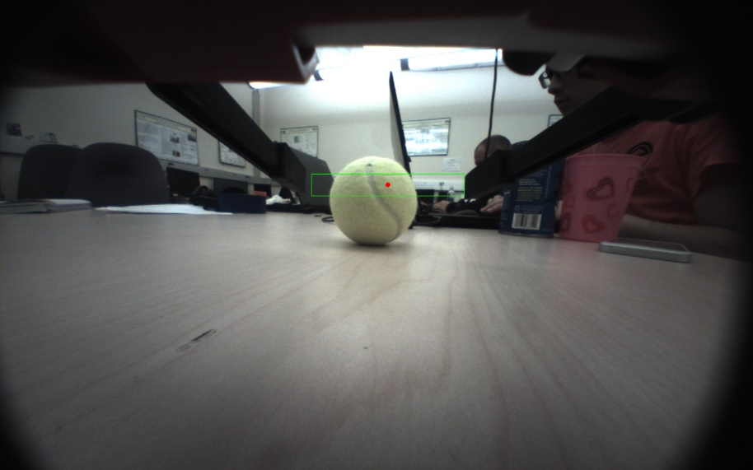
Vision for Grasp Tuning
Vision for Grasp Tuning
Purpose
Reduce grasp error
Vision problem statement
From single-view RGB image find
how to move the gripper so that
the object can be grasped at a
good location.

Slide 11
Vision for Grasp Tuning
Vision for Grasp Tuning
Approach
Mask R-CNN detect object mask
Object 2D outline extraction from object mask
Calculate pixel-wise normal of the outline
Calculate grasp features and adjust robot gripper
Detect outline
Find contact region & outline normal
Valid contact?
YES
Continue grasp motion
Calculate grasp features
Current gripper pose
NO
Adjust grasp motion

Slide 12
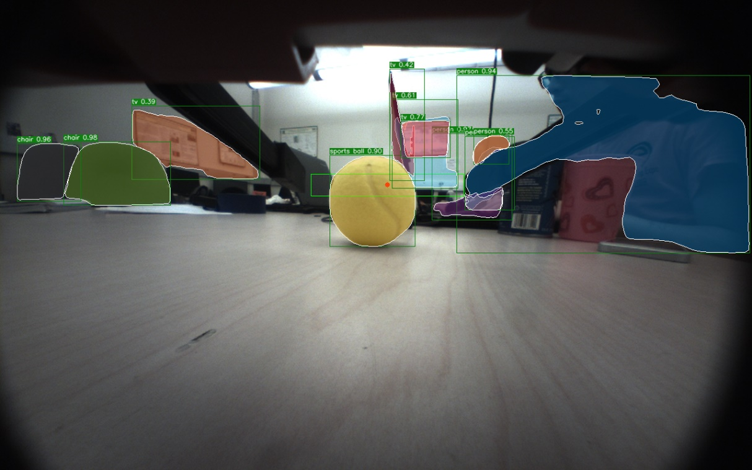
Vision for Grasp Tuning
Vision for Grasp Tuning
Mask R-CNN object mask detection result

Slide 13
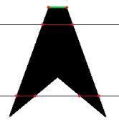
Vision for Grasp Tuning
Vision for Grasp Tuning
Object outline extraction
For each row of the image find the two outline
points of each continuous region of the mask
Pixel-wise normal
Find the normal of the vector of neighbors
Choose the normal direction based on pixel position
relative to the center of the mask
- Average the normal of neighbors

Slide 14
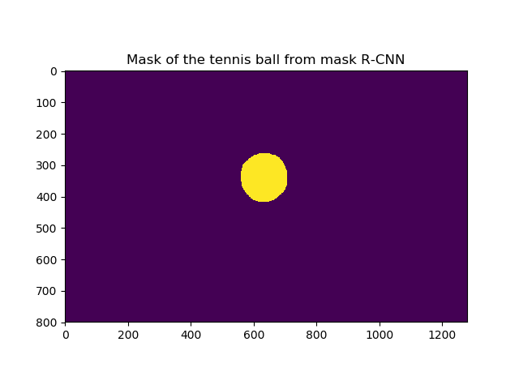
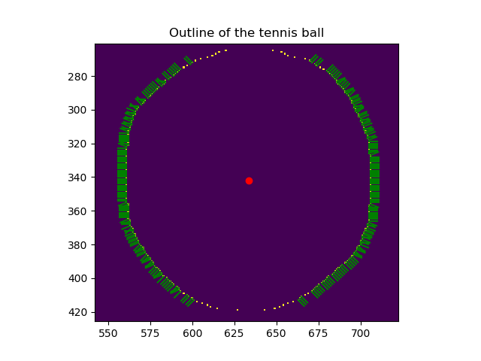
Vision for Grasp Tuning
Vision for Grasp Tuning
Object outline and normal extraction results

Slide 15
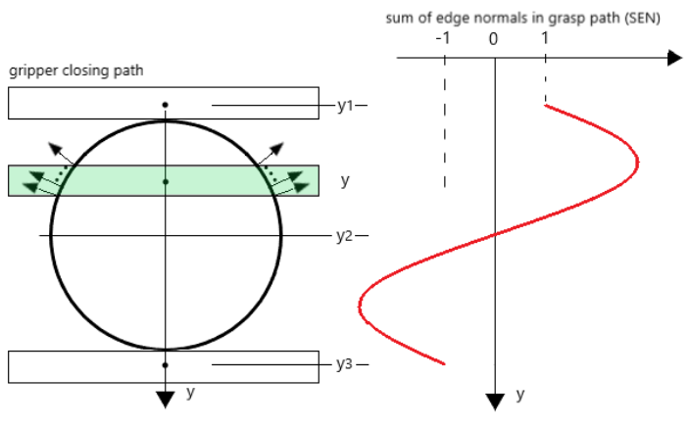
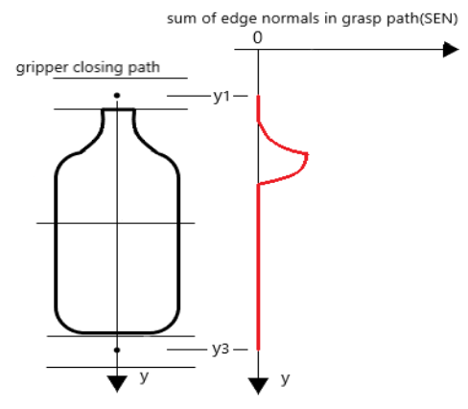
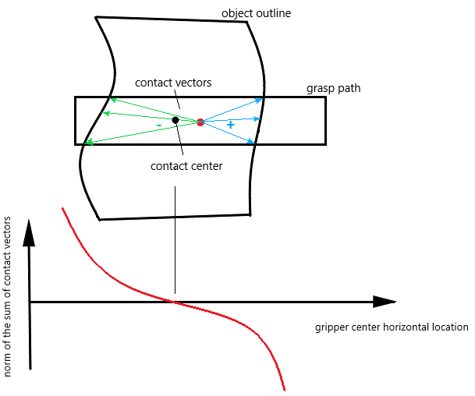
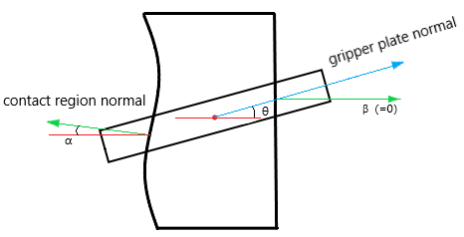
Vision for Grasp Tuning
Vision for Grasp Tuning
Grasp features

Slide 16
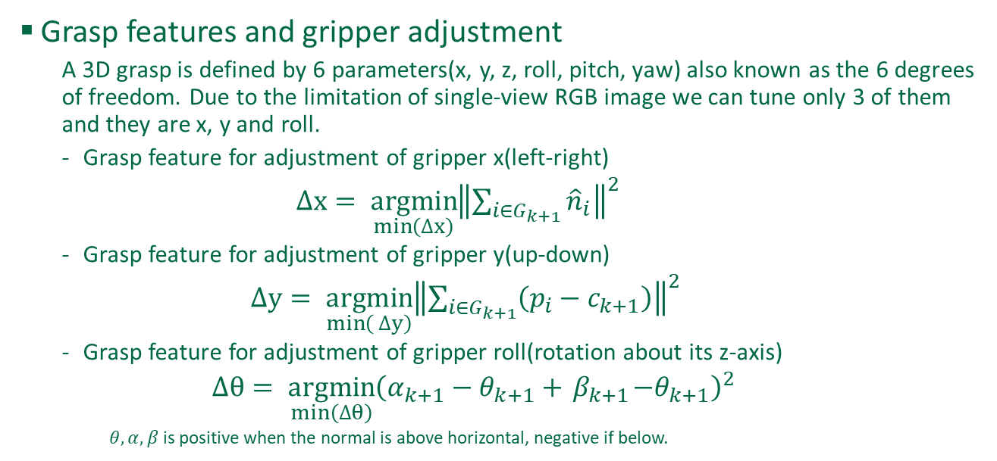
Vision for Grasp Tuning
Vision for Grasp Tuning
Grasp features and gripper adjustment
A 3D grasp is defined by 6 parameters(x, y, z, roll, pitch, yaw) also known as the 6 degrees of freedom. Due to the limitation of single-view RGB image we can tune only 3 of them and they are x, y and roll.
Grasp feature for adjustment of gripper x(left-right)
$∆x= \underset{\min\left(∆x\right)}{argmin}{{\left\|\sum_{i∈G_{k+1}}{{\hat{n}}_{i}}\right\|}^{2}}$
Grasp feature for adjustment of gripper y(up-down)
$∆y= \underset{\min\left( ∆y\right)}{argmin}{{\left\|\sum_{i∈G_{k+1}}{\left(p_{i}−c_{k+1}\right)}\right\|}^{2}}$
Grasp feature for adjustment of gripper roll(rotation about its z-axis)
$∆θ= \underset{min\left(∆θ\right)}{argmin}{{\left(α_{k+1}−θ_{k+1}+{ β}_{k+1}−θ_{k+1}\right)}^{2}}$
$θ, α, β$is positive when the normal is above horizontal, negative if below.

Slide 17
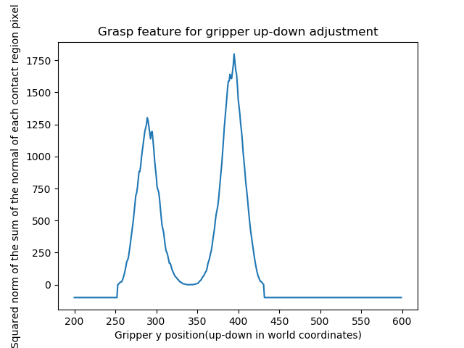
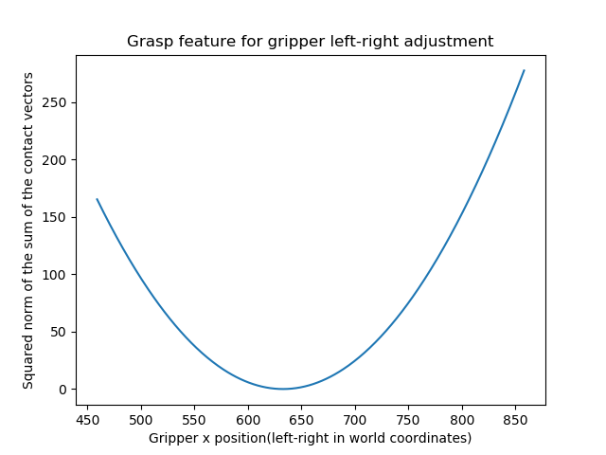
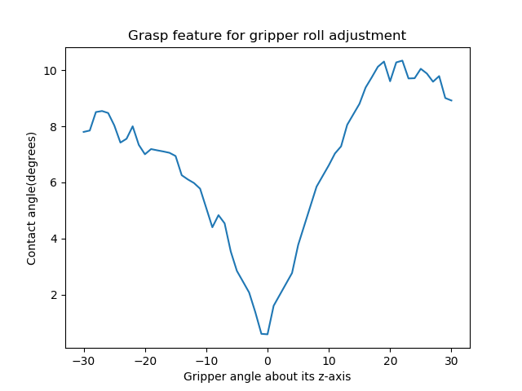
Vision for Grasp Tuning
Vision for Grasp Tuning
Grasp features and gripper adjustment results

