Slide 1
Visualizing Dataflow Graphs of Deep Learning Models in TensorFlow
Authors: Wongsuphasawat K., Smilkov D., Wexler J., Wilson J., Mane D., Fritz D., Krishnan D., Viegas F., and Wattenberg M.
Jennyfer Sanchez
Department of Computer Science and Engineering
University of South Florida
Tampa, FL 33620

Slide 2
Agenda
Problem Statement
Authors Solution
Authors Results

Slide 3
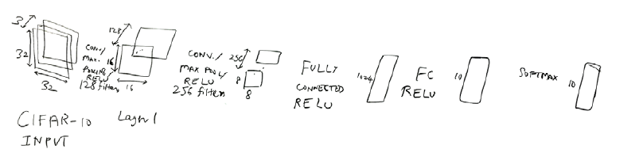
Problem
Deep learning experts usually use diagrams to depict high level structure.
Key scenarios where developers use model visualization.
  To help them understand existing models.
  To help them observe the changes they make to the code.
  To help them explain structures of models to other people.
Problem: help developers understand and communicate the structures of TensorFlow models.

Slide 4
Problem
TensorFlow model graphs challenges:
  Mismatch between graph topology and semantics
    Do not differentiate between group of operations that perform distinct functions.
    Do not show similarities between identical subgraphs.
  Graph heterogeneity
    Treats all nodes equivalently which clutters the layout.
  Interconnected nodes
    Connection between the nodes clutter the views.

Slide 5
Solution
Create a tool that can help machine learning experts to visualize their model structures.
TensorFlow Graph Visualizer
  Available in TensorBoard Repository.
  Use Dagre (JavaScript Library).
Main tasks the visualization tool should support:
  Provide an overview of the high level components.
  Recognize similarities and differences between components.
  Examine the nested structure of a high level component.
  Inspect details of individual operations.
  View quantitative data in the context of the graph.

Slide 6
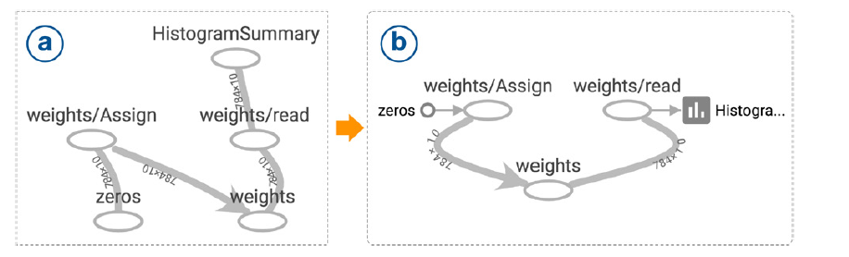
Solution
Graphs Transformations:
  Step 1: Extract Non-Critical Operations
    Extract two kind of operations: constants and summaries
    Summary node.
      - Always has one input edge from a logged operation and one output edge to the summary writer node.
    Constant node
      - Serves as an input to another operation.
      - Has only one output edge and no input edge.
Represent a constant
Represent a summary operation

Slide 7
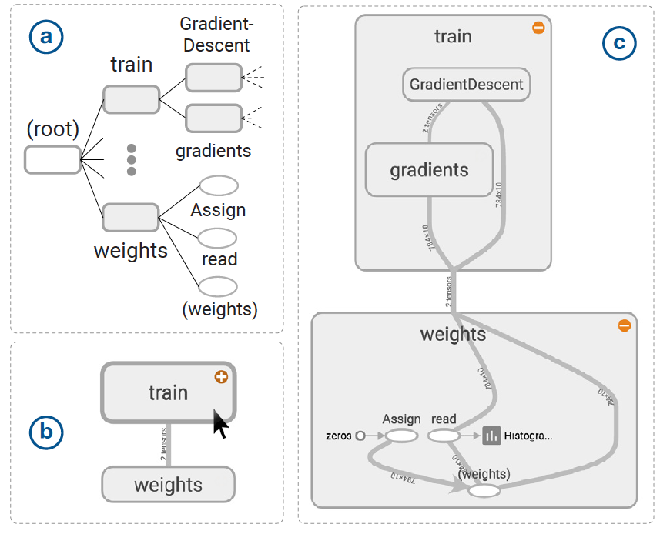
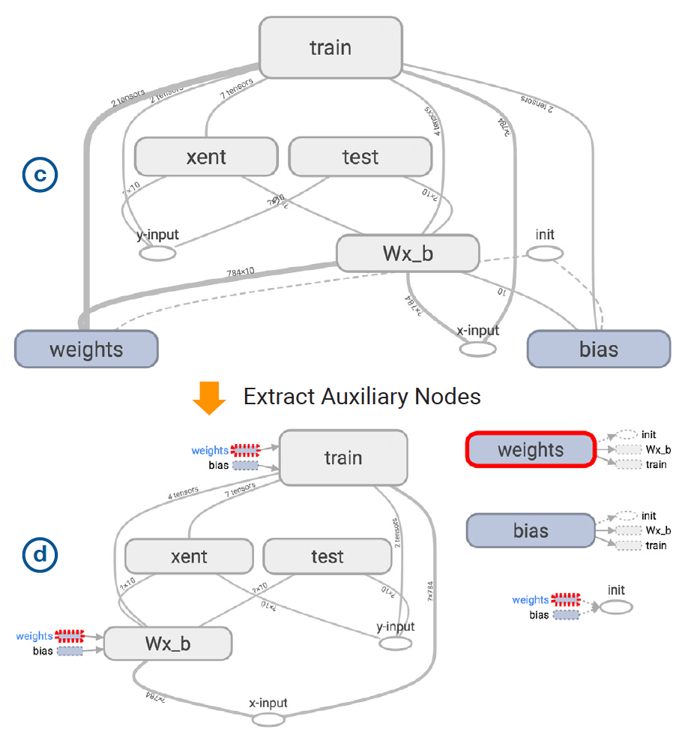
Solution
namespace
  Step 2: Build a Clustered Graph with Bundled Edges
    Build a hierarchy
      - Create a group node for each unique namespace.
    Bundling edges to enable stable and responsive expansion
      Draw group edges only between nodes within the same subgraphs.
  Step 3: Extract Auxiliary Nodes from the Clustered Graph

Slide 8
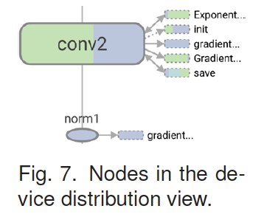
Solution
  Step 4: Identify and Highlight Repeated Structure
    Highlighting group nodes with identical structure with the same color.
    Checking subgraph similarity
      - If subgraphs do not have the same degree sequence (node’s type, node’s in degree and out degree), they are dissimilar.
    Detecting structural templates from group nodes
      - Create a hashmap to store clusters of nodes with same blocking key.
      - Examine each cluster in the hashmap to find templates of repeated modules.
  Step 5: Overlaying Additional Quantitative Data
    Use color to encode other quantitative information.

Slide 9
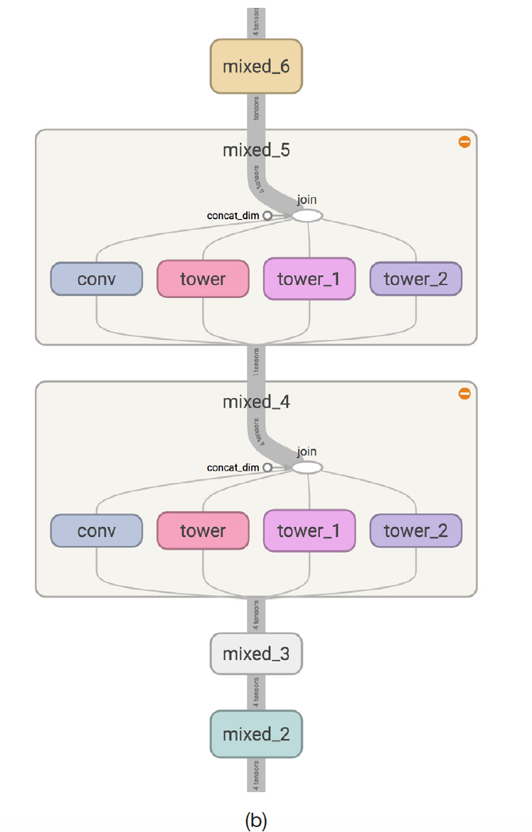
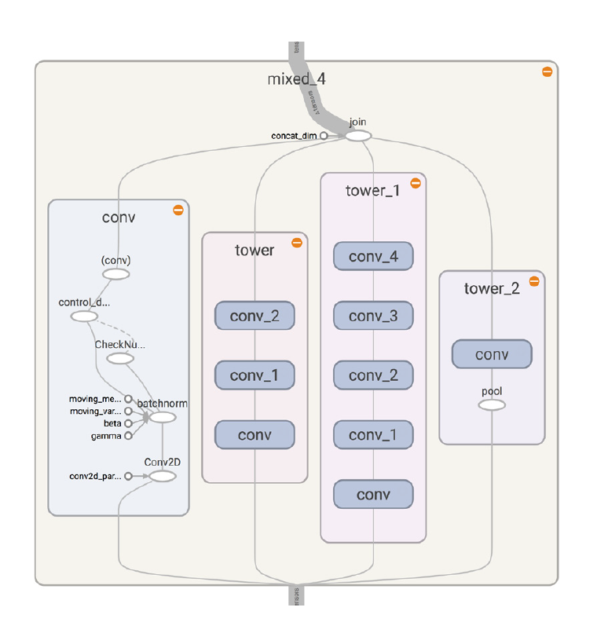
Solution
Neural Network Scenarios
  Exploring a Convolutional Network and a Very Deep Network
Figure b
Figure c
Figure a

Slide 10
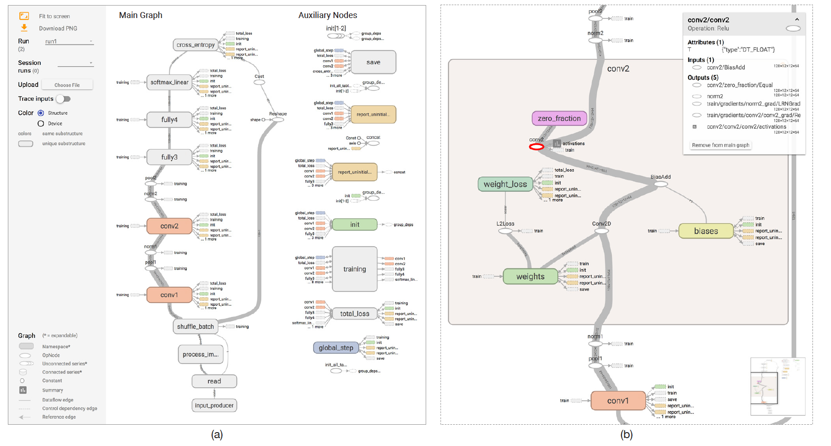
Solution

Slide 11
Results
It is a tool that provides an interactive exploration of dataflow architecture behind machine learning models.
It is a tool that has been released publicly.
Feedback has been collected from real world users
  Overall response was positive.
  Users found the visualizer was helpful to communicate their ideas.
  Works for tasks such as
    - Check model architectures.
    - Debugging model structures.

Slide 12
Results
Next Steps
Users have asked for ”two way” visualization that allow direct graph editing.
Users have asked for features to compare multiple models.
The strategy of extracting non critical nodes is successful, but is application specific.
Reactions suggest the desire for better ways to understand machine learning. Visualization may have an important role to play.

Slide 13
Thank you!

