Slide 1
The Anchoring Effect in Decision-Making with Visual Analytics
Dineshkumar Kumar
U34117554

Slide 2
About anchoring effect
A form of cognitive bias , where individual focus too heavily on first piece of information offered, when making decisions
Individuals anchor to easily accessible information and adjust from it to estimate the true value often with insufficient evidence.
This paper provides experimental evidence of Anchoring effect in visual analytics and its effect on human decision making

Slide 3
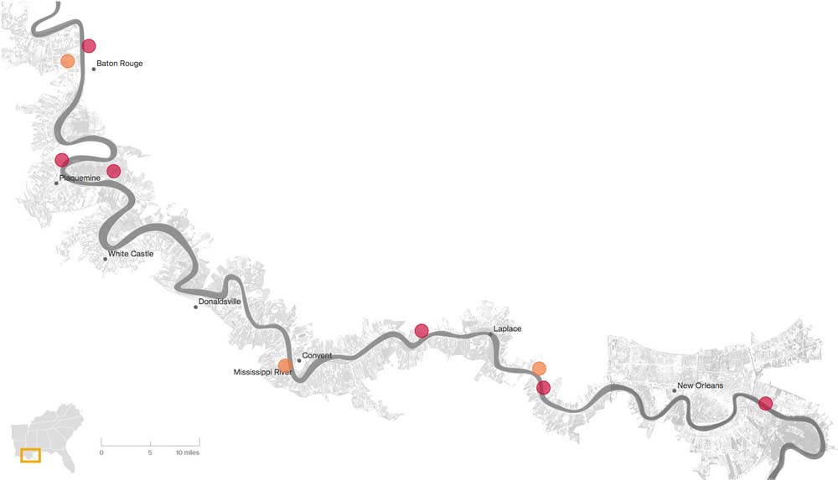
Anchoring effect example
What’s the length of Mississippi river ?
300 Miles Maybe !!

Slide 4
Anchoring effect example
What’s the length of Mississippi river ?
2000 Miles

Slide 5
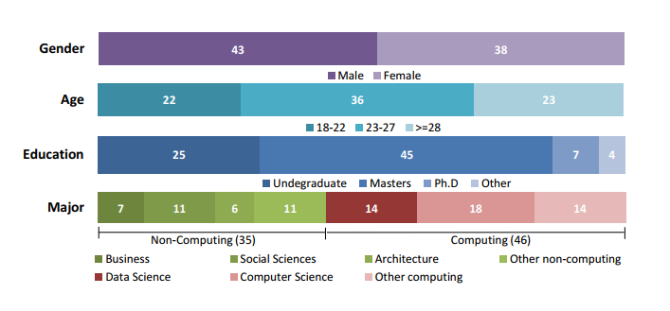
Experimental Study
Analyzing large twitter data to identify ongoing , past and future event
The Visual anchor are devised into:
Associated with time (date)
Associated with geography
The Numerical anchor are devised into:
Lower than
Higher than
81 participants

Slide 6
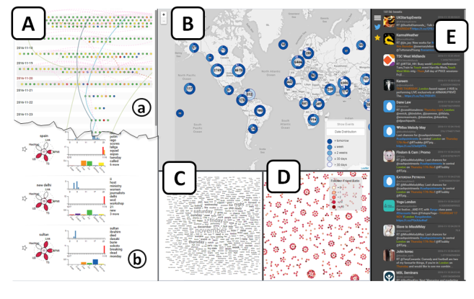

Slide 7
Anchor Design
Geo+ high or low anchor: Do you think that the number of protest events in the state of California <geo anchor first> was higher or lower than 152 (or 8) <high (or low) numerical anchor> between November 10, 2016 and November 24, 2016 <time anchor>?
Time + high or low anchor: Do you think that the number of protest events between November 10, 2016 and November 24, 2016 <time anchor first> was higher or lower than 152 (or 8) <numerical anchor> in the state of California <geo anchor>?

Slide 8
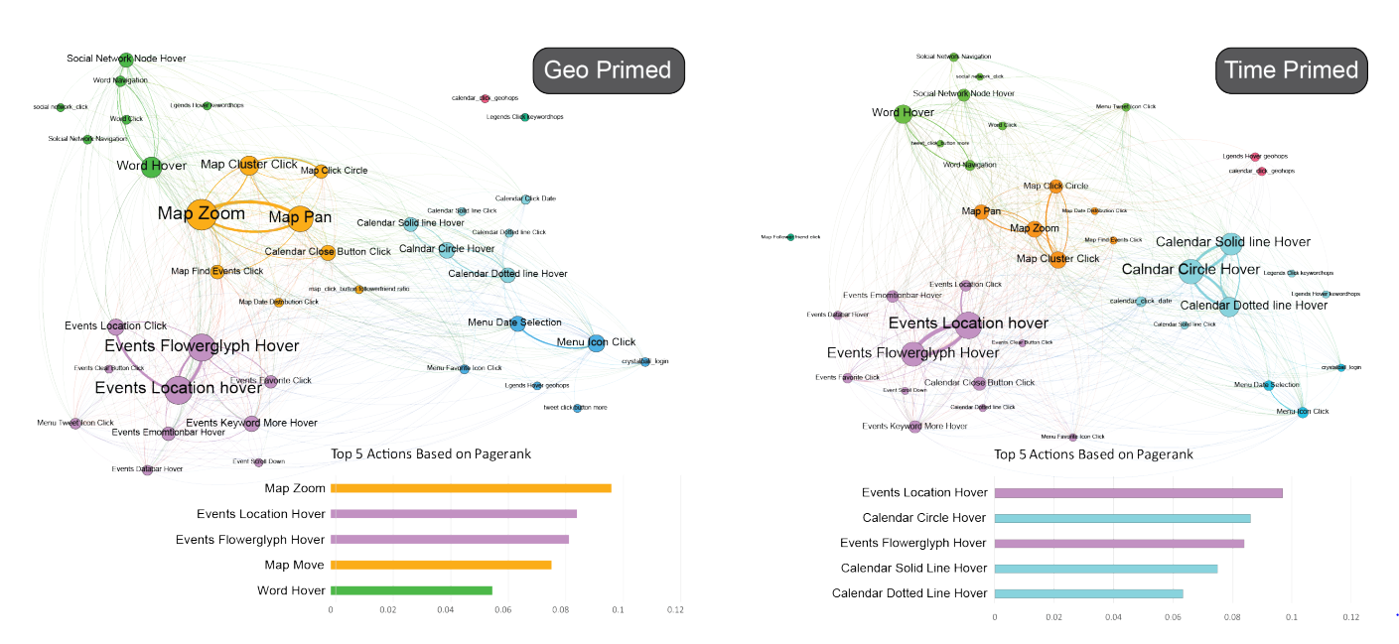

Slide 9
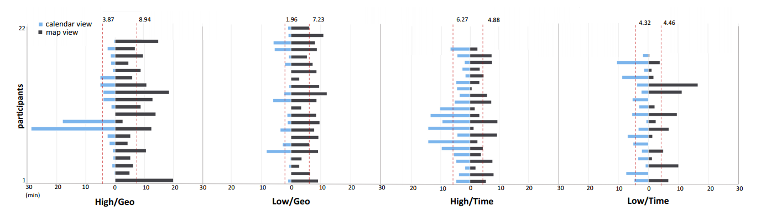
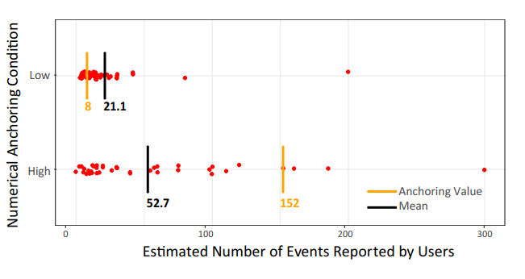
Summary of the amount of time spent in calendar and map views

Slide 10
Results
Anchoring bias does transfer to visual analytics.
The visual anchor seems to significantly impact the decision-making process
Numerical anchor has a significant effect on the decision-making outcome

Slide 11
Avoiding Anchoring effect
Consider the relevant factors: Figure out what’s important before starting to generate solutions
Reduce the impact of anchoring: List all of the arguments that reduces the number of anchors
Seek multiple perspectives: Seek multiple aspects of information & data

Slide 12

Thank You

