Slide 1
A Virtual Reality Visualization Tool for Neuron Tracing Authors: Will Usher, Pavol Klacansky, Frederick Federer, Peer-Timo Bremer, Aaron Knoll, Jeff Yarch, Alessandra Angelucci, and Valerio Pascucci
Presented By:
Bharti Goel
#U26803088

Slide 2
Main Contributions
• A design study on using consumer-grade VR technology for neuron tracing;
Need: Tracing neurons remains primarily a manual task
• A flexible and scalable backend framework that allows neuron tracing in datasets that are orders of magnitude larger than currently feasible with existing approaches; and
Need: Large data size cause time spent to analyze to increase substantially
• A comparison of the reconstruction accuracy and speed of our tool compared to the industry standard.

Slide 3
VR neuron tracing tool
Minimap
The dark gray floor represents the extent of the tracked space. Users can orient themselves in the dataset via the minimap (right), which shows the world extent in blue, the current focus region in orange, and the previously traced neuronal structures. The focus region is displayed in the center of the space. The 3D interaction and visualization provides an intuitive environment for exploring the data and a natural interface for neuron tracing, resulting in faster, high-quality traces with less fatigue reported by users compared to existing 2D tools.

Slide 4
DESIGN PROCESS
Technology Probe:
VR systems for generic scientific visualization tasks, and supported volume rendering, isosurfaces, and particle rendering.
The Prototype:
room-scale VR and includes tracked, wand-style controllers.
line drawing and simple exploration
Initial Technology Probe
Tracing wand
Navigation wand
Prototype

Slide 5
VIRTUAL REALITY TRACING TOOL
The process of tracing and navigating:
Branching from an existing line
A starting point is placed by moving the brush inside the neuron and pressing the trigger. While holding the trigger, the user follows the neuron with the brush, tracing it. To end the line, the trigger is released.
Connecting a branch back to the parent tree

Slide 6
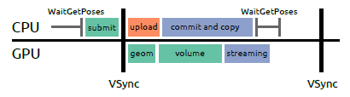
VIRTUAL REALITY TRACING TOOL
VR rendering performance (high-quality experience and prevent motion sickness)
Data Streaming :
Volume Rendering : Use GPU volume renderer.
Depth perception is difficult.
The anatomy of a single frame. WaitGetPoses blocks until 2ms before VSync and returns the latest head tracking data. This allows the renderer to start submitting work before VSync to fully utilize the GPU. We first submit draw calls for the geometry and volume, and then page in asynchronously uploaded volume data into the sparse texture.

Slide 7
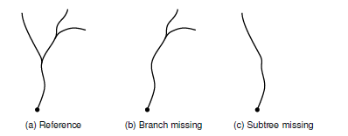
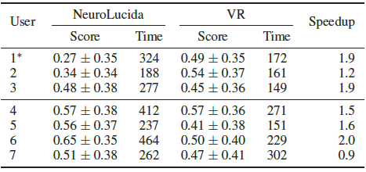
Evaluation
Structural Errors:
slight elongation, extra branch, missed branch ,etc.
DIADEM scores- Automatically compares traces.
Examples of different mistakes and their effect on the DIADEM score.
Time Constraints: Speedup.

Slide 8
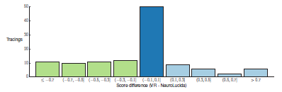
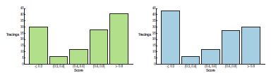
Planar Axons Reference Dataset
Differences between scores of expert traces in VR vs. NeuroLucida.
Overall experts performed within the acceptable error range (±0.1, dark blue) and sometimes better in VR (light blue) when compared to their work in NeuroLucida.
Distribution of scores (higher is better) for experts.
In (a) median score: 0.7, mean score: 0.57±0.38.
In (b) median score: 0.6, mean score 0.49±0.39.
A score of 0.8 is a tracing acceptably similar to the reference.
(a) NeuroLucida
(b) VR

Slide 9
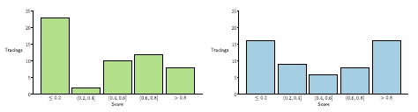
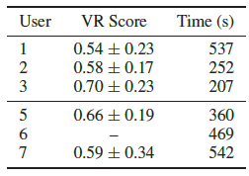
Cell Bodies Dataset
Distribution of scores (higher is better) for novices, excluding user 1.
In (a) median score: 0.5, mean score: 0.42±0.37.
In (b) median score: 0.49, mean score 0.5±0.37.
A score of 0.8 is a tracing acceptably similar to the reference.
(a) NeuroLucida
(b) VR
Average scores (with standard deviation) and times for traces on the Cell Bodies dataset. User 6 is used as the reference.

Slide 10
Stitching Issue
(a) (b) (c)
A stitching issue clearly visible in NeuroLucida (a-b), but difficult to perceive with volume rendering or isosurfacing (c). It is in fact a single neuron

Slide 11
Invisible neuron in image plane
A neuron branching along the Z plane is not visible on the image plane used to trace the main structure (left). The branch can be seen only after scrolling down the stack (right).
Only two experts traced this branch correctly in NeuroLucida, but in VR all users traced it correctly.

