Slide 1
What Would a Graph Look Like in This Layout?
A Machine Learning Approach to Large Graph Visualization
Paper Title:
Authors:
Oh-Hyun Kwon, Tarik Crnovrsanin, and Kwan-Liu Ma
Presenter:
Surya Balusu

Slide 2
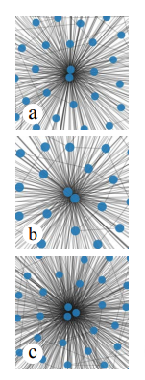
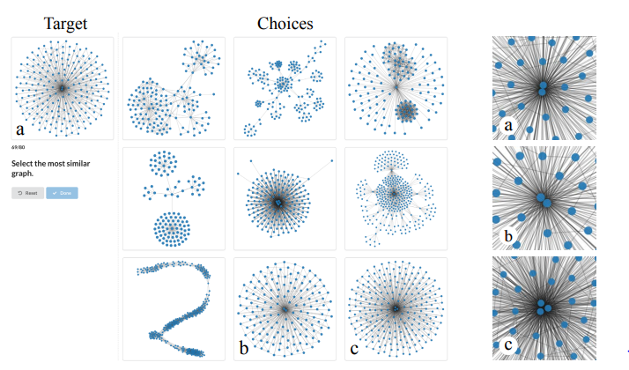
Introduction

Slide 3
Problem statement
Task 1: what the graph would look like in different layouts and what are their
corresponding aesthetic metrics ?
Task 2: Compare the topological similarity using the graph kernals and perpetual similarity by humans.

Slide 4
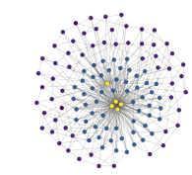
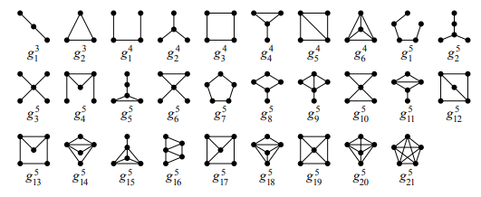

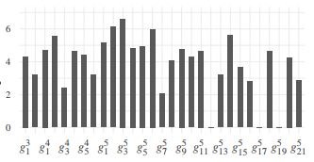
Approach

Slide 5
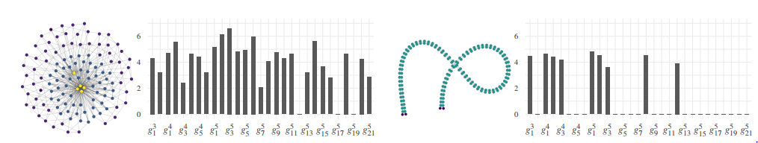
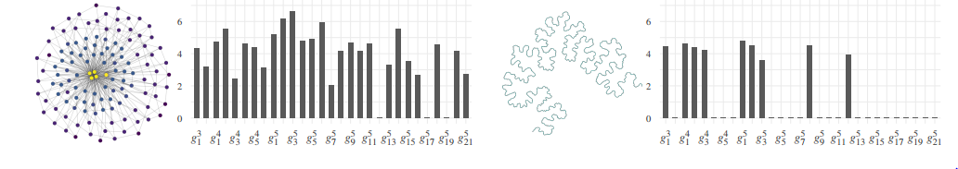
Approach

Slide 6
Approach
Layouts:
Graphlet sampling
Asthetic metrics:
Force-directed methods: FruchtermanReingold (FR) and KamadaKawai (KK)
Dimension reduction based method: High-Dimensional Embedder (HDE)
Multi-level methods: Sfdp and FM
Spectral
Treemap
Gosper
Random vertex sampling (RV)
Random walk sampling (RW)
Crosslessness (m_{c})
Minimum angle metric (m_{a})
Edge length variation (m_{l})
Shape-based metric (m_{s})

Slide 7
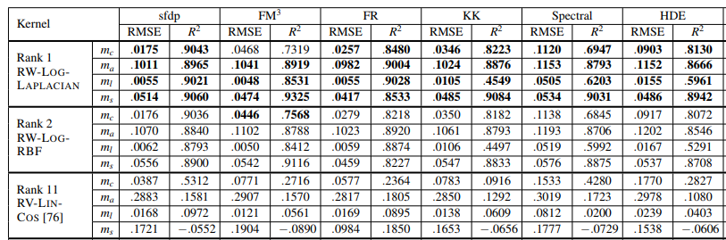
Results

Slide 8
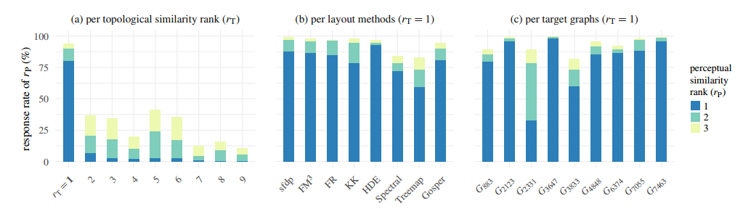
Results

Slide 9
Thank you

