Slide 1
Assignment 4 Tutorial
Jing Zhang
Fall, 2008

Slide 2
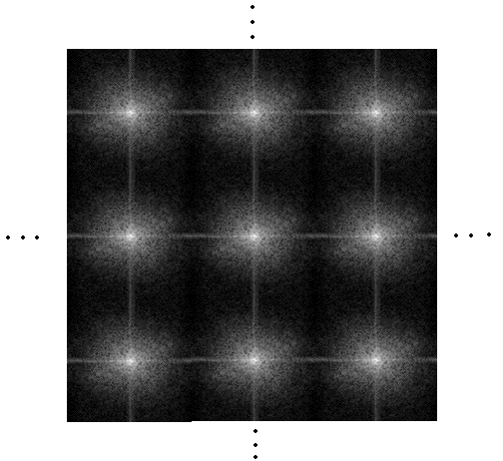
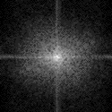
FFT
This is a FFT result of an image
Size is 256*256
256
➔
➔
256
According to the properties of FFT function,
we know that it is infinite and periodic.

Slide 3
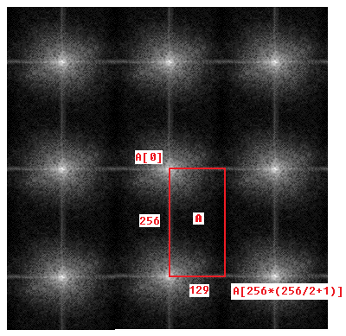
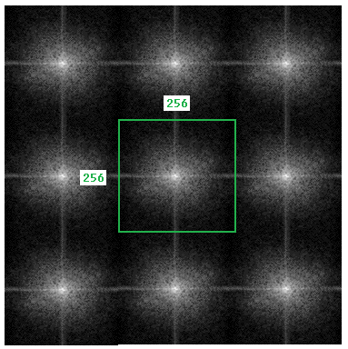
FFT
fftw_complex *A;
The A in the demo code is the region
in the red rectangle.
Size of A is M*(N/2+1)=256*129
You have to show the FFT result
(the region in the green square,
size is 256*256) as an intensity image

Slide 4

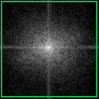
FFT
129
256
256
➔
➔
256
To obtain the green square based on red rectangle is not hard,
because we know FFT is periodic and symmetric function
(discard the last column (129th) of A)

Slide 5
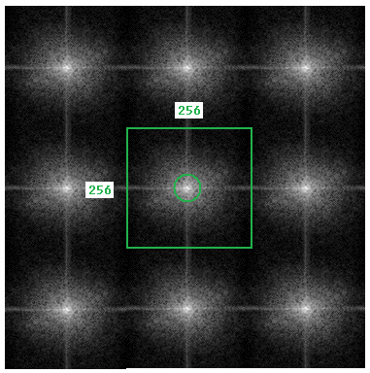
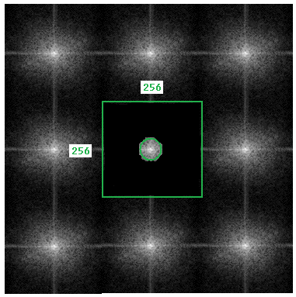
FFT
Design a circular filter,
cut-off is the radius of the green circle
For a low pass filter, all values within the
circle should keep unchanged, all values
outside the circle will be zero.

Slide 6
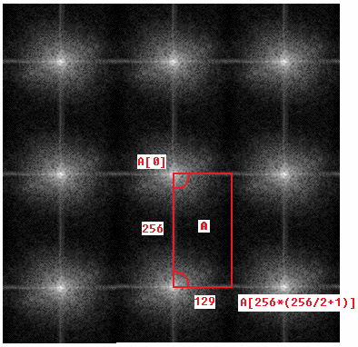
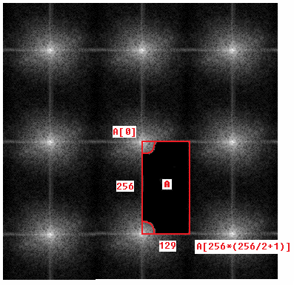
FFT
A easy way to do filtering is to keep the values in the top-left corner and
bottom-left corner of A unchanged, let other values equal zero (low-pass).
Then use rfftwnd_one_complex_to_real( ) to get IFFT result.
(I recommend you to do filtering in this way)

Slide 7

FFT
fftw_complex *B
129
256
Low pass filter B should like this, white point value is 1,
Black point value is 0.
Similarly, you can get high pass filter

