Slide 1
Using Massively Parallel Processing for Determining Inherent Privacy in Large Social Graphs
Daniel Sawyer, Hunter Morera, Kevin Hicks, Conner Wulf

Slide 2
The Problem
Structural anonymity in social graphs is integral in preserving its privacy.
The goal of this anonymization is to keep individual nodes from being recognized based on their local information in a graph such as node degree, clustering coefficient or neighborhood information.
To measure this anonymity we use linkage covariance, this is essentially the structure signature of each node in a graph.
This measure allows us to determine the inherent privacy of the graph, which is defined as the percentage of nodes in a graph that have at least k other nodes with an identical signature.

Slide 3
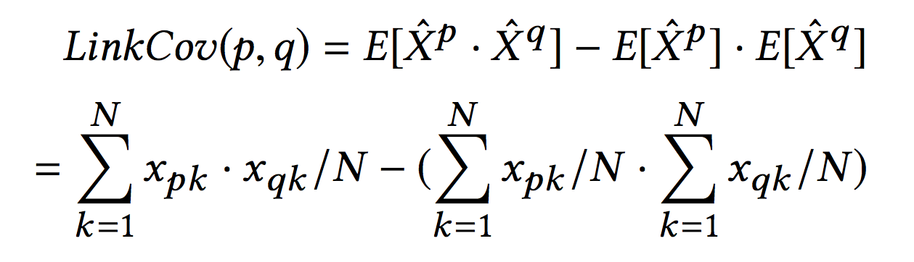
Linkage Covariance Definition

Slide 4
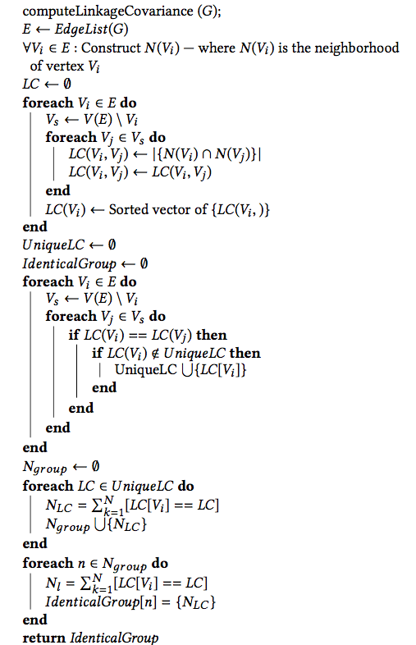
The Algorithm Used

Slide 5
CPU VS GPU
The basic idea of the algorithm is you compute a node's linkage covariance, then compare that to every other nodes linkage covariance in the graph.
As you can clearly see many computations and comparisons must be done for even a small sized graph.
Due to the complexity of the algorithm, and the fact that most social graphs are inherently large, much optimization was needed to even compute the inherent privacy of a graph on a CPU.
However, even though the algorithm will run on CPU doesnt mean its time efficient. The most optimized CPU version ran a 550k node, 925k edge graph in 34 minutes.
Compare this to the same graph run on an Nvidia Titan X Pascal with our fastest optimization which took 52.7 seconds.

Slide 6
Optimizations Used
In order to determine the privacy of the graph, our output was a histogram of the number of nodes that have a common linkage covariance, 1 being lowest (not anonymous) to n (number of nodes being the most anonymous).
Due to the creation of a histogram using over three thousand cores, and hundreds of thousands of threads, race conditions had to be accounted for. For this CUDA provides a built in function called AtomicAdd which ensures that shared memory incrementations are done in a sequential way as to prevent incorrect results due to race conditions.
To overcome the space complexity, we represented the graph as adjacency lists instead of adjacency matrix.
is reduced the memory footprint of the algorithm as real-life social graphs are large (in terms of vertices) and sparse

Slide 7
Complexity
The algorithm for computing the linkage covariance has the computational complexity of O(|V|^2 ), where V is the set of nodes in the graph.
Memory complexity can be a problem, especially when dealing with sparse graphs which will leave lots of zeros in the adjacency matrix.
With no memory complexity optimizations, the memory complexity is O(|V| ^2 ) where V is the number of nodes and each node is represented using an integer.
With memory complexity optimizations we can reduce this significantly by using an adjacency list, to {i=1,N}SUM(E(i)) where E(i) = number of edges for node i.
Memory complexity is one of the main concerns in computing this problem and what prevented us from processing larger graphs.

Slide 8
Shared Memory and Tiling
The use of shared memory is detrimental to the project. The large graphs are stored in shared memory because they would be far too large to have a copy for each thread.
How is this done? We implement what is called tiling. We load “tiles” of the graph into memory, use what we need, and tile in the rest.
How do we prevent shared memory access collisions? We do this by using atomic operations provided by nvidia and their hardware.
What are atomic operations? Remember semaphores, well semaphores are considered atomic and allow atomic operations. It creates sequential access to a resource from parallel requests.
In our case, however, CUDA’s atomic operations are implemented on a hardware level and accessed through Nvidia’s CUDA libraries.

Slide 9
Massive Parallelization
What do we mean by massive parallelization? Let us first look at the hardware.
Nvidia Titan X (Pascal)
3584 CUDA Cores, compared to intel i7 7700K with 4/8 Cores/Threads
12GB Total Global Memory
28 Multiprocessors with 128 CUDA Cores per multiprocessor
2048 max threads per multiprocessor
1024 threads per block
Compared to your standard CPU, this parallelization is several orders of magnitude greater than anything else available for consumer use.
CUDA also provides the ability to synchronize threads, which helps reduce race conditions.

Slide 10
Conclusion
Significant speed increases compared to single and multi thread CPU implementations
Shared Memory resources controlled using atomic operations
Massively Parallel calculations
Ability to process larger graphs than CPU implementation
No memory access collisions
No race conditions due to thread synchronization
Finally, anonymity calculated in a reasonable amount of time

