Slide 1
SVNIT SURAT · CSE
CampusConnect
cc.
A student campus events & community portal
CAMPUS / CONNECTED
DATABASE MANAGEMENT SYSTEMS · CS203
B.Tech. II CSE | Semester III | Academic Year 2026–27
Team: [registered team name] • Members: [add names & roll numbers]
CAMPUSCONNECT / CS203 DBMS PROJECT
01 / 09

Slide 2
01 / PROJECT REQUIREMENTS
Campus life is connected. Campus information often is not.
CampusConnect puts the everyday student experience into one database-backed portal.
!
Scattered information
⌕
Hard to discover
↗
Manual coordination
Events and notices can be spread across chats, posters, club pages, and informal networks.
Students may not know which clubs are active or where to find a relevant campus activity.
Organisers need a consistent way to publish events, maintain registrations, and share updates.
THE PROPOSED RESPONSE
One student-friendly home for events, clubs, registrations, and announcements.
DESIGNED FOR CS203
CAMPUSCONNECT / CS203 DBMS PROJECT
02 / 09

Slide 3
02 / SCOPE
Four core experiences. One shared data model.
The prototype focuses on explainable database operations rather than an oversized feature list.
✳
Discover events
◎
Join communities
↗
Stay in the loop
⌘
Manage the portal
Search future and past events; view date, venue, host club, and capacity.
Browse clubs and create or end a membership relationship.
Read announcements based on audience and optional expiry.
Admin can publish, edit, or delete event and campus content.
KEY REQUIREMENTS
Account & profile
Registration, login, profile updates
Capacity-aware registration
No duplicate pair; check available spots
Role-based administration
Admin routes protected on server
Integrity by design
PK, FK, CHECK, UNIQUE, indexes, views
CAMPUSCONNECT / CS203 DBMS PROJECT
03 / 09

Slide 4
03 / USER EXPERIENCE
Different roles. Clear boundaries.
A student-facing experience, with a separate administrator control room.
STUDENT
ADMINISTRATOR
Find what is happening.
Keep the campus feed fresh.
01
Create account
01
Publish
Name, email, department, study year
Create events, clubs, and announcements
02
Explore events & clubs
02
Maintain
Search events, join clubs, read notices
Edit event details and remove stale content
03
Take part
03
Review data
Register, cancel, update personal profile
See event counts and registration totals
CAMPUSCONNECT / CS203 DBMS PROJECT
04 / 09

Slide 5
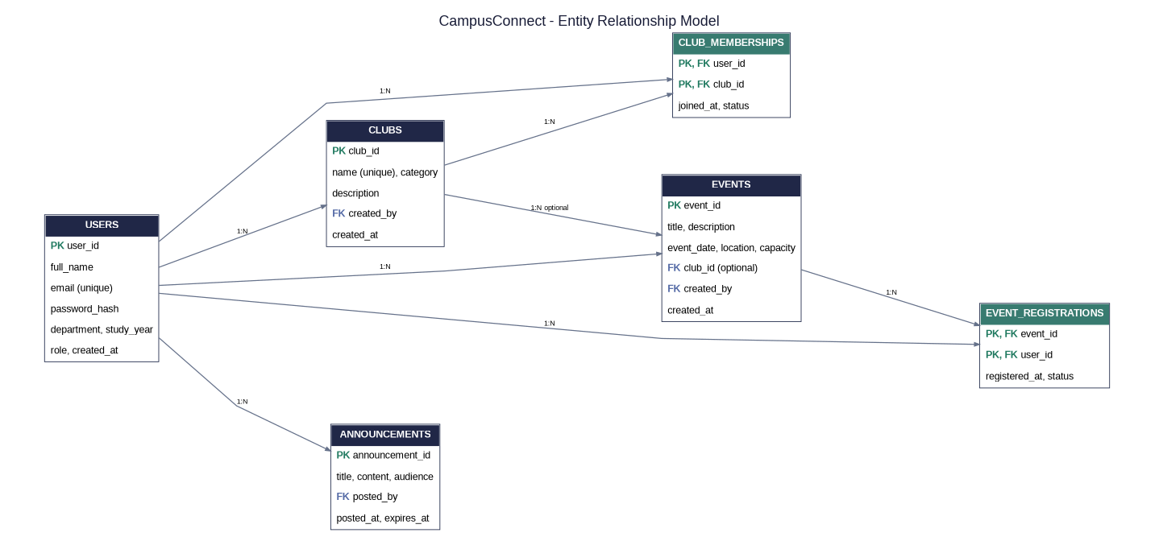
04 / CONCEPTUAL DESIGN
The ER model
Six relations cover identity, activities, and the two many-to-many relationships.
PK = primary key · FK = foreign key · Relationship cardinalities are also listed in the report.
CAMPUSCONNECT / CS203 DBMS PROJECT
05 / 09

Slide 6
05 / LOGICAL DESIGN
The relationship tables do the heavy lifting.
The logical schema maps each entity to a table and resolves many-to-many relationships explicitly.
USERS
CLUBS / EVENTS
user_id (PK) · email (UNIQUE)
full_name · password_hash · department
study_year · role · created_at
clubs: club_id (PK), name (UNIQUE)
events: event_id (PK), event_date, capacity
club_id / created_by (FK)
CLUB_MEMBERSHIPS
EVENT_REGISTRATIONS
Composite PK: (user_id, club_id)
joined_at · status
Resolves users ↔ clubs (M:N)
Composite PK: (event_id, user_id)
registered_at · status
Resolves users ↔ events (M:N)
NORMALISATION
1NF: atomic fields · 2NF: relationship attributes depend on full composite keys · 3NF: club/event/profile facts stored once
Announcements are stored separately; event registration counts are derived in a view instead of duplicated in the Events table.
CAMPUSCONNECT / CS203 DBMS PROJECT
06 / 09

Slide 7
06 / PHYSICAL DESIGN
Integrity rules are part of the database—not just the interface.
The package includes SQLite for a quick local demo and MySQL 8 DDL for SQL demonstration.
⌘
Keys & relationships
✓
Domain constraints
↗
Query performance
Primary keys, foreign keys, composite keys, and cascades prevent orphan or duplicate relationship rows.
UNIQUE email/name, CHECK ranges, and valid role/status/audience values restrict invalid data.
Indexes support event date filtering, membership counts, per-user history, and recent notices.
REPORTING VIEWS
SQL ARTEFACTS
upcoming_events_view
• schema_mysql.sql
Future events + host club + active registration count
• schema_sqlite.sql
• crud_examples.sql
CAMPUSCONNECT / CS203 DBMS PROJECT
07 / 09

Slide 8
07 / PROTOTYPE
From the browser to the database, in one simple flow.
A Flask web application connects the interface to SQL tables and business rules.
01 BROWSER
→
02 FLASK ROUTES
→
03 SQL DATABASE
HTML templates · CSS · JavaScript
Session login · validation · role checks
Foreign keys · constraints · indexes · views
LIVE DEMO SEQUENCE
A
Student account
B
Participation
C
Admin control
D
SQL proof
Sign up and log in
Register for an event + join a club
Create / edit event + publish notice
Show stored rows and reporting views
Demo credentials are for local use only. Run the browser workflow on the presentation machine before evaluation.
CAMPUSCONNECT / CS203 DBMS PROJECT
08 / 09

Slide 9
08 / TESTING & WRAP-UP
Built around the requirements.
The database schema checks pass; the team should complete browser workflow checks locally before presenting.
VERIFIED AT SCHEMA LEVEL
BEFORE FINAL SUBMISSION
✓
Six expected tables and two views created
□
Fill in team name, names, and roll numbers
✓
Composite key rejects duplicate registrations
□
Run Flask app and complete browser checks
✓
Foreign keys block orphan memberships
□
Open MySQL schema in the agreed SQL tool
✓
CHECK constraint rejects capacity = 0
□
Capture screenshots and update test status
✓
Status update and reporting count tests pass
□
Rehearse the live demo and explain the ER model
CampusConnect · One campus, more possibilities.
THANK YOU ✦
CAMPUSCONNECT / CS203 DBMS PROJECT
09 / 09

