Slide 1
EDA and ML Model for Football Goal Prediction
Rishabh Saxena
Contact Number: (+91) 7417342655
Email: saxenarishabh100@gmail.com
GitHub: https://github.com/saxena-rishabh
LinkedIn: https://www.linkedin.com/in/saxena-rishabh

Slide 2
Index
Data Preparation
EDA
Correlation Plot
Histograms
Box Plots
Model Building
Conclusion

Slide 3
Data Preparation
Dropped the unnecessary columns like 'Unnamed: 0', 'match_event_id', 'team_name', 'date_of_game', 'match_id','team_id' .
Filled missing values with most frequent values in each column.
HANDLING CATEGORICAL DATA:
Converted categorical values into numeric values using LabelEncoder() in Python.
Columns that we converted are:
area_of_shot
shot_basics
range_of_shot
home/away
lat/lng
type_of_shot
type_of_combined_shot

Slide 4
HANDLING CONTINUOUS VALUES:
Continuous data is transform into intervals with interval size of 10 units. For example, values varying between 0 to 100 will be divided into 10 intervals.
Columns that we converted are:
location_x
location_y
remaining_sec
distance_of_shot
remaining_min.1
power_of_shot.1
knockout_match.1
remaining_sec.1
distance_of_shot.1

Slide 5
EDA
We plotted Correlation Plot, Histograms and Box Plots.
Categorical data is converted into numeric data.
Continuous data is transform into intervals with interval size of 10 units. For example, values varying between 0 to 100 will be divided into 10 intervals.
First we plotted Correlation Plot to get idea about how variables correlate with ‘is_goal’ output.

Slide 6
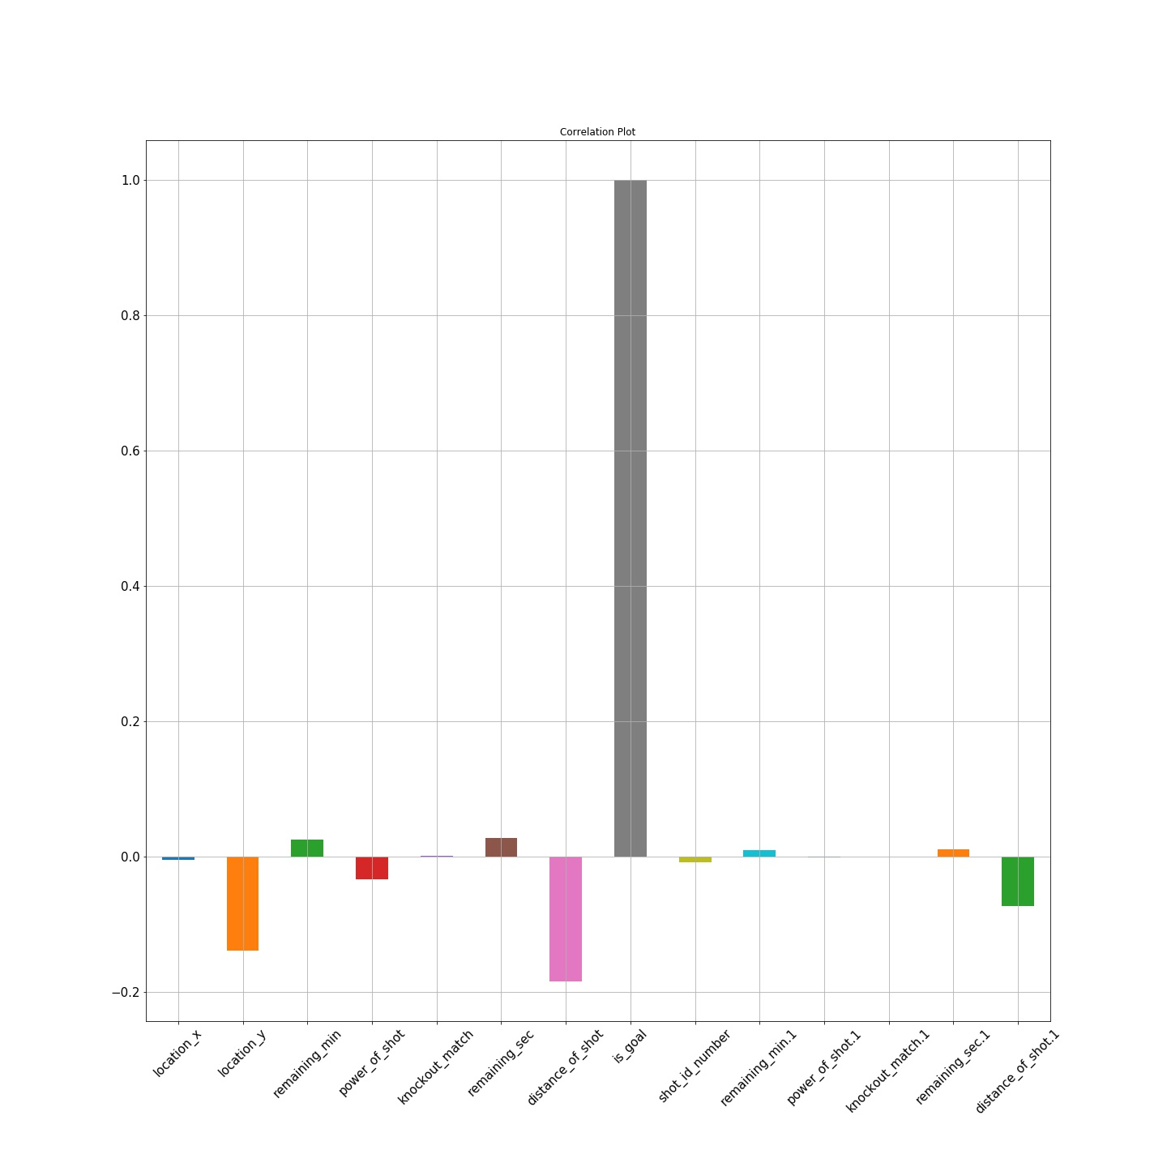

Slide 7
INSIGHTS:
From Correlation Plot, more the remaining_sec, more likely the chances of goal.
More the location_y, less the chances of goal.
Also, more the distance of shot, less likely the chances of goal.
More the distance of shot.1, less likely the chances of goal.
Remaining_min and Remaining_sec are correlated to each other. So we can take any one of them.
More the power of shot, more likely the chances of goal.
Then we plotted Histograms for each column.

Slide 8
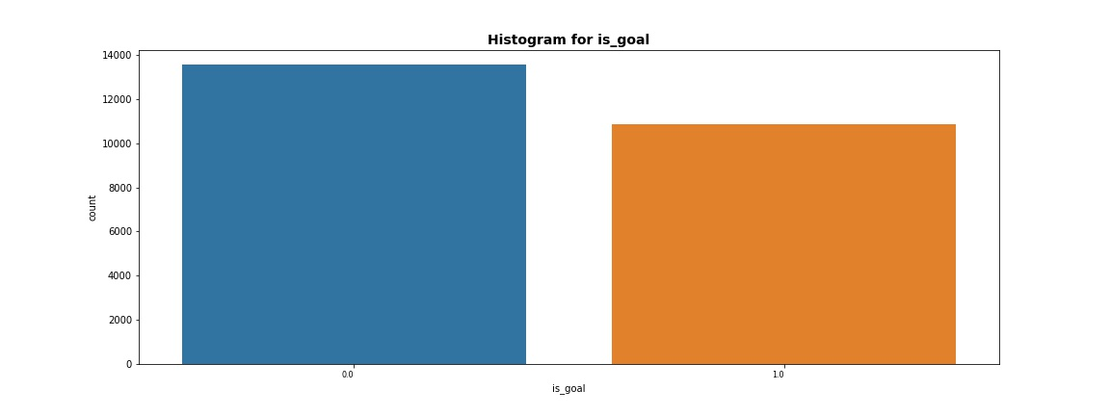
INSIGHTS: There are more 0 then 1 in ‘is_goal’

Slide 9
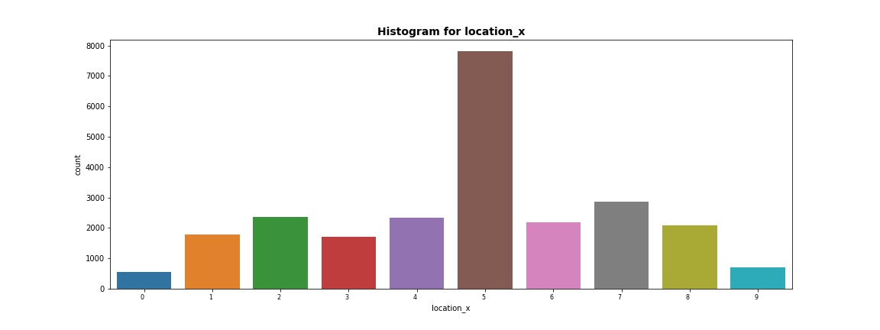
INSIGHTS: Most of the location_x are between 50-60.

Slide 10
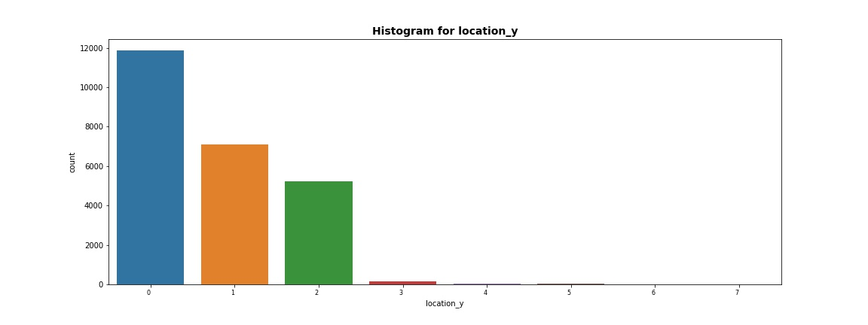
INSIGHTS: Most of the location_y are between 0-10.

Slide 11
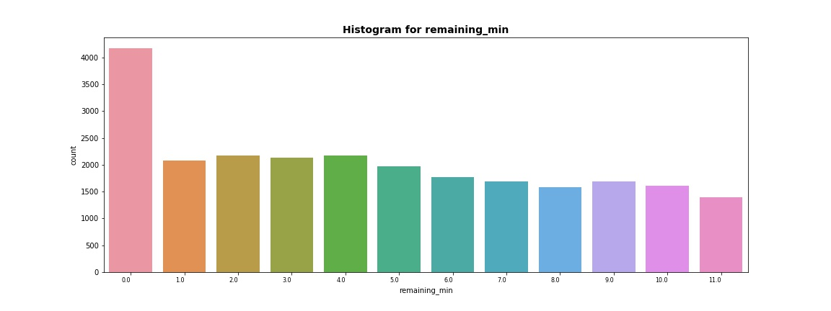
INSIGHTS: Most of the remaining_min are between 0-10 minutes.

Slide 12
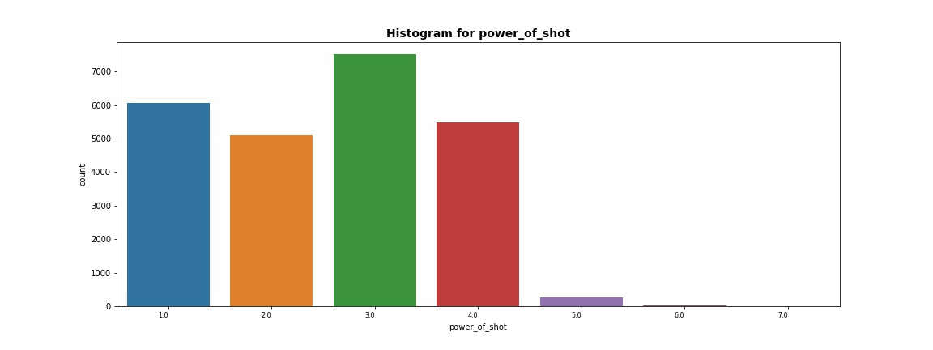
INSIGHTS: Most of the power_of_shot are 3.

Slide 13
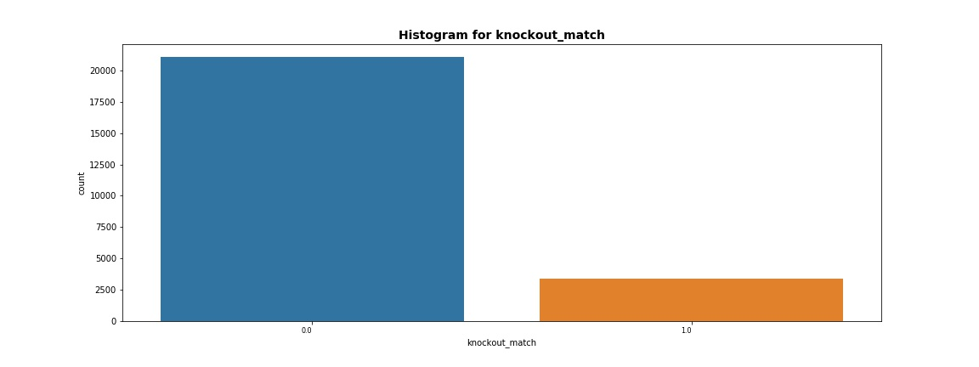
INSIGHTS: Most of the matches are not knockout matches.

Slide 14
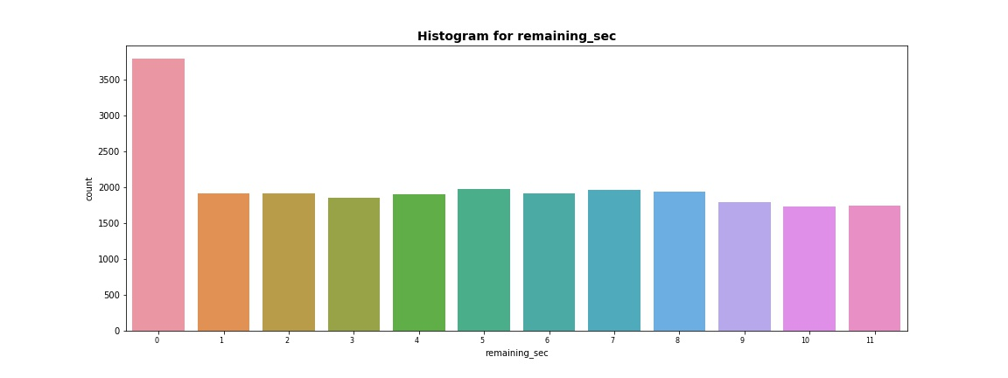
INSIGHTS: Most of the remaining_sec are between 0-10 seconds.

Slide 15
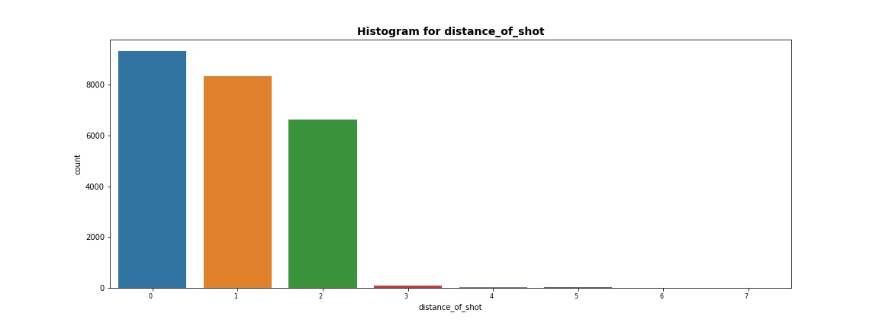
INSIGHTS: Most of the distance_of_shot are between 0-10.

Slide 16
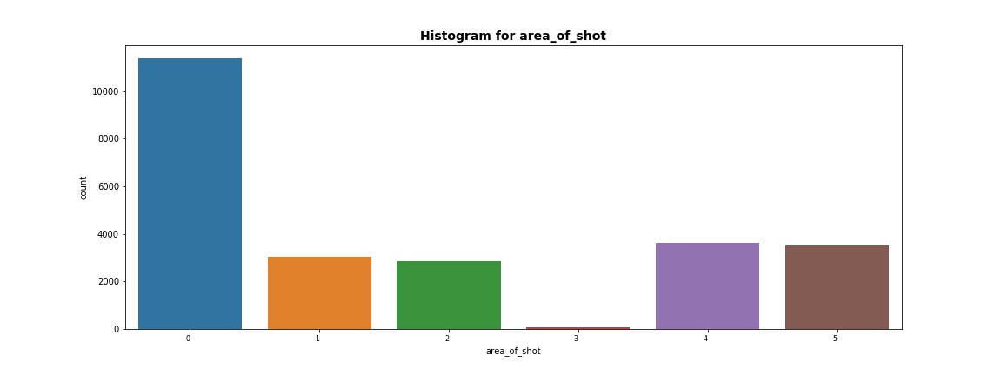
INSIGHTS: Most of the area_of_shot are 0 (Center (C)).

Slide 17
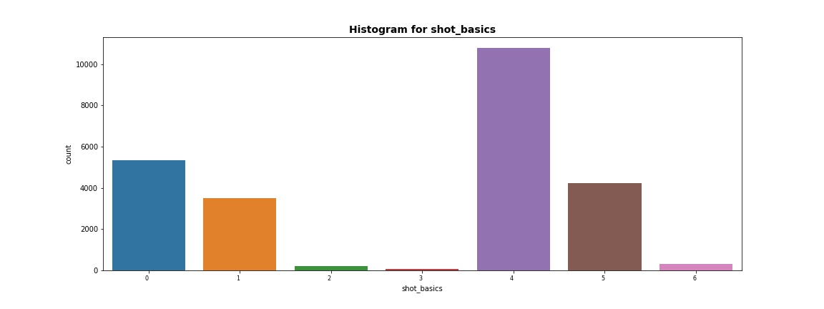
INSIGHTS: Most of the shot_basics are 4 (Mid Range).

Slide 18
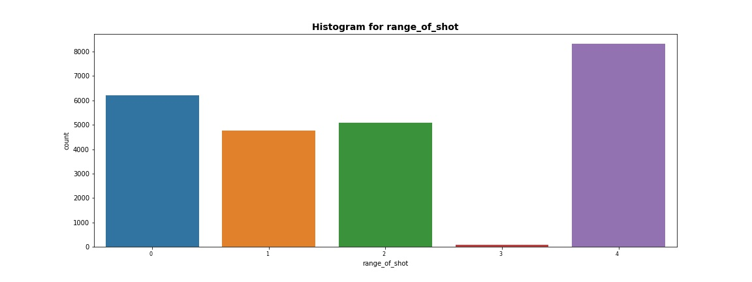
INSIGHTS: Most of the range_of_shot are Less Than 8 ft.

Slide 19
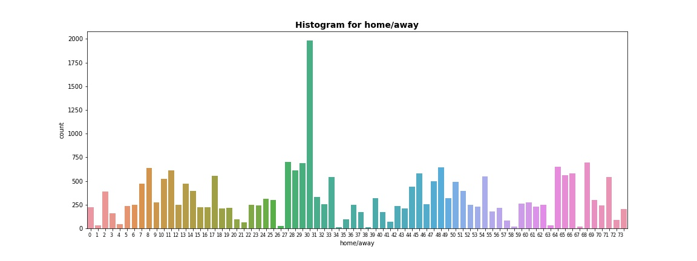
INSIGHTS: Most of the home/away are MANU @ SAS.

Slide 20
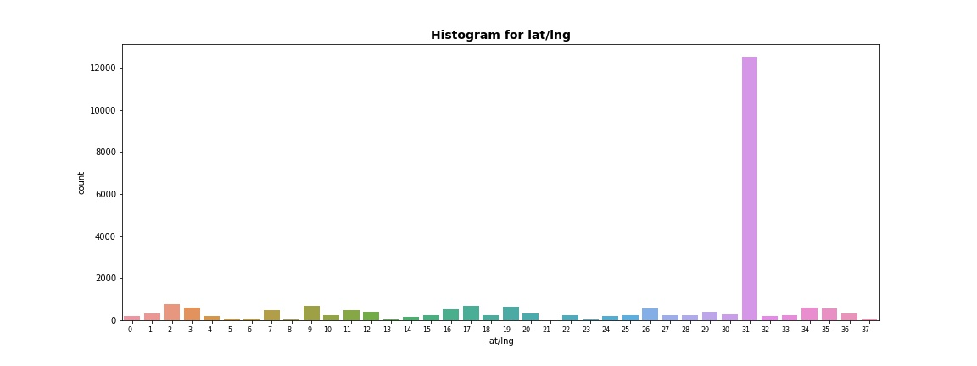
INSIGHTS: Most of the lat/lng are 42.982923, -71.446094.

Slide 21
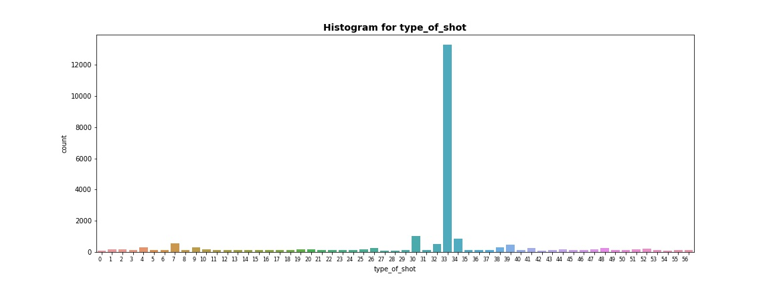
INSIGHTS: Most of the type_of_shot are shot - 39.

Slide 22
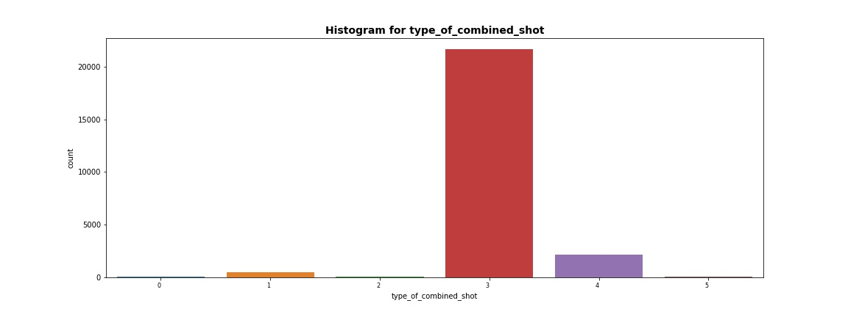
INSIGHTS: Most of the type_of_combined_shot are shot - 3.

Slide 23
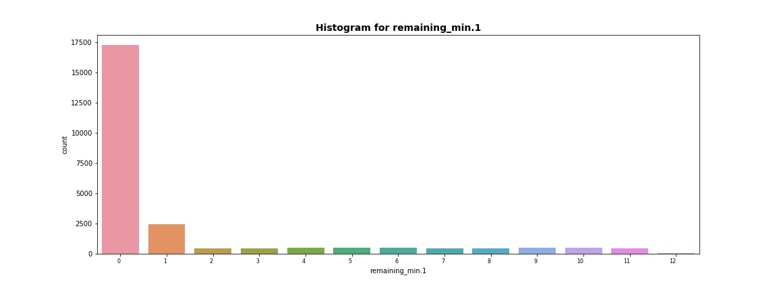
INSIGHTS: Most of the remaining_min.1 are between 0-10 minutes.

Slide 24
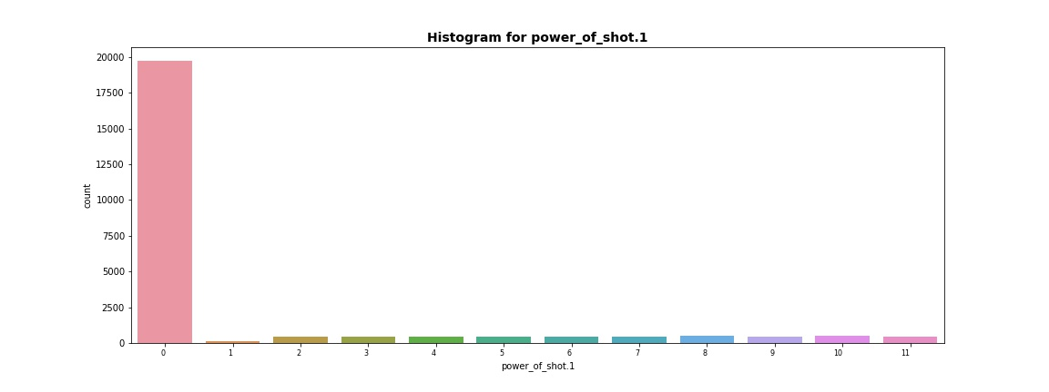
INSIGHTS: Most of the power_of_shot.1 are between 0-10.

Slide 25
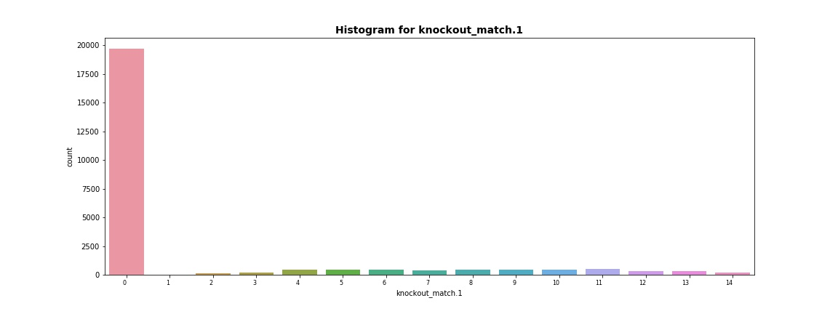
INSIGHTS: Most of the knockout_match.1 are between 0-10.

Slide 26
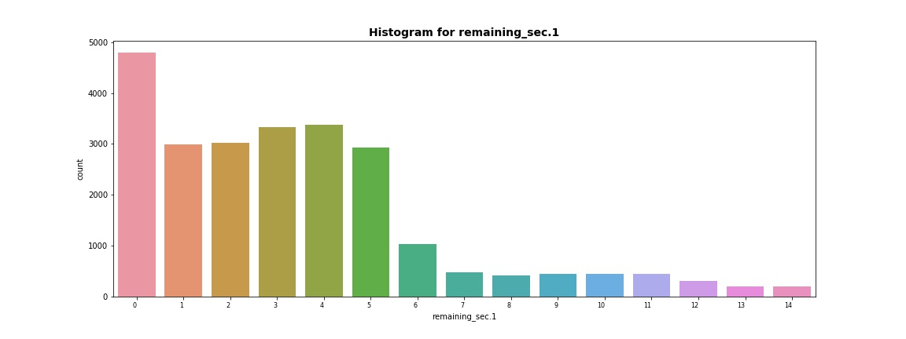
INSIGHTS: Most of the remaining_sec.1 are between 0-10 seconds.

Slide 27
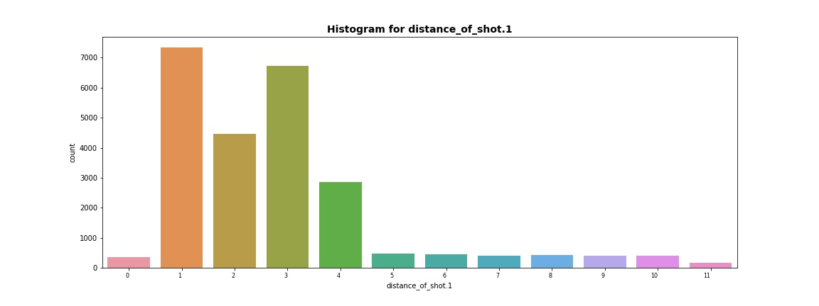
INSIGHTS: Most of the distance_of_shot.1 are between 10-20.

Slide 28
We plotted Boxplot for some columns.
Continuous data is transform into intervals with interval size of 10 units. For example, values varying between 0 to 100 will be divided into 10 intervals.
We plotted Boxplot for following columns:
location_x
location_y
remaining_min
remaining_sec
distance_of_shot
remaining_min.1
power_of_shot.1
knockout_match.1
remaining_sec.1
distance_of_shot.1

Slide 29
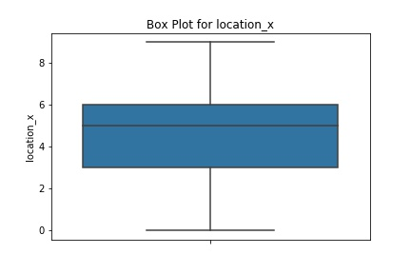
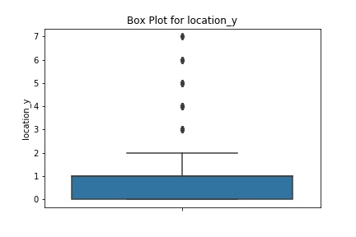

Slide 30
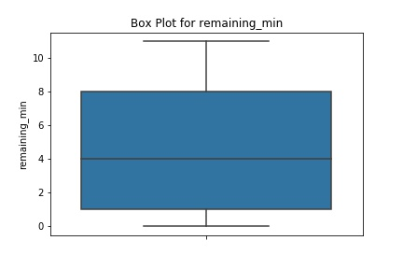
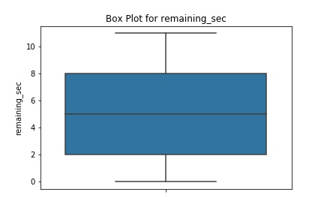

Slide 31
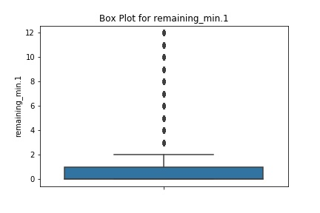
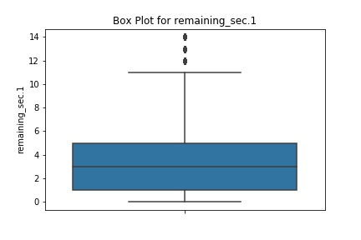

Slide 32
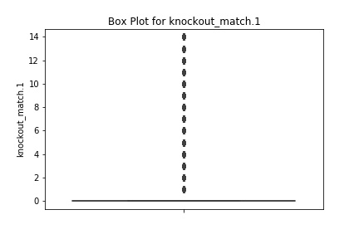
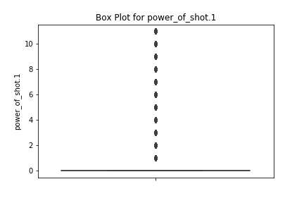

Slide 33
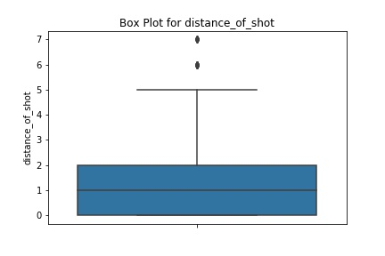
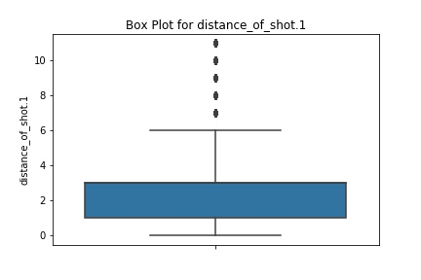
By Box Plots we get to know which feature contains outliers so that we can handle outliers.

Slide 34
Model Building
We evaluated used KNN, Random Forest and XGBoost.
Clearly XGBoost performed best and gave better accuracy.
So we choose XGBoost for final predictions.
Parameters we use for XGBoost are:
colsample_bytree=0.8
learning_rate=0.05
n_estimators=100
max_depth=7
gamma=1
min_child_weight=5
reg_alpha=0.1
booster='gbtree'
objective='binary:logistic'

Slide 35
Conclusion
IMPORTANT FEATURES:
Correlation Plot also tells us that these 5 features are more correlated with output variable ‘is_goal’ than other features.
Top 5 significant features in the dataset are:
location_y
remaining_sec
distance_of_shot
power_of_shot
distance_of_shot.1

