Slide 1
Early Stop via Prediction for Hyperparameter Tuning
Akshat Saxena

Slide 2
Dataset Generation
The dataset in the project has been generated using the following inputs and outputs :
Model Inputs :
Train_loss values for the first E epochs (E*50 per row as each epoch contains 50 batches)
Eval_loss values for the first E epochs (E values per row)
Eval_acc values for the first E epochs (E values per row)
Hyperparameters from HP_Space (4 values per row)
M - (Total Number of Epochs)
Model Output :
Eval_acc values for the epoch E = 150, representing the final accuracy after 150 epochs. (This values is taken as labels for the data)

Slide 3
Model Used :
This project has explored two regression models along with selecting optimal hyperparameters :
SVM Regressor
Hyperparameters considered: kernel, C values
Random Forest Regressor
Hyperparameters considered: n_estimators, splitting_criterion
Due to the higher performance of Random Forest Regression as compared to the SVM Regressor, the final models saved are generated using Random Forest Regressor for each of the epoch values
For example, the mean squared error generated for SVM Regressor and Random Forest Regressor for E=20 are as follows :
Random Forest Regressor : 0.00013
SVM Regressor : 0.003

Slide 4
Results
For evaluation of the model performance. the loss function used for Mean Squared Error. The regression model achieved the following mean square error on the test set for each of the values of E :
E = 5 , 0.0003659964948344581
E = 10 , 0.0002368833360881117
E = 20 , 0.00013052221600000062
E = 30, 0.00012957563249830484
E = 60, 0.00011506668472716022

Slide 5
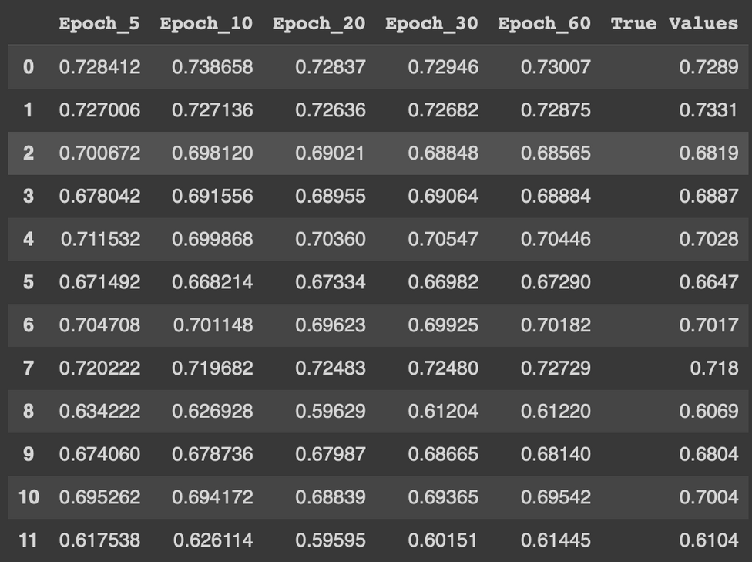
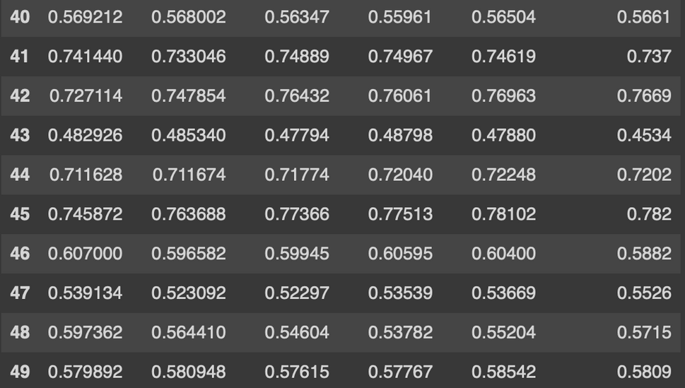
Accuracy Predictions
The two snapshots from ‘Accuracy_Predictions.csv’ show the accuracy values predicted for each E value and the true accuracy for M=150

