Slide 1
Data Analysis Project: V Store Sales Report 2022
Using Advanced Excel for Insights and Visualization
[Geetanjali Saxena] | [Feb2025]

Slide 2
Introduction
Objective: To analyze V Store Sales data and derive actionable insights.
Tools Used: Microsoft Excel (Pivot Tables, Advanced Functions, Dashboard Creation).
Dataset Overview:
- Index, Order ID, Cust ID, Gender, Age, AgeGroup, Date, Month, Status,
Channel, SKU, Category, Size, Qty, Currency, Amount, Ship-City,
Ship-State, Ship-Postal-Code, Ship-Country, B2B.

Slide 3
Data Preparation
Steps Taken:
1. Cleaned raw data by removing duplicates and handling missing values.
2. Created pivot tables for detailed analysis.
3. Segmented data by key metrics (Category, Channel, AgeGroup, etc.).

Slide 4
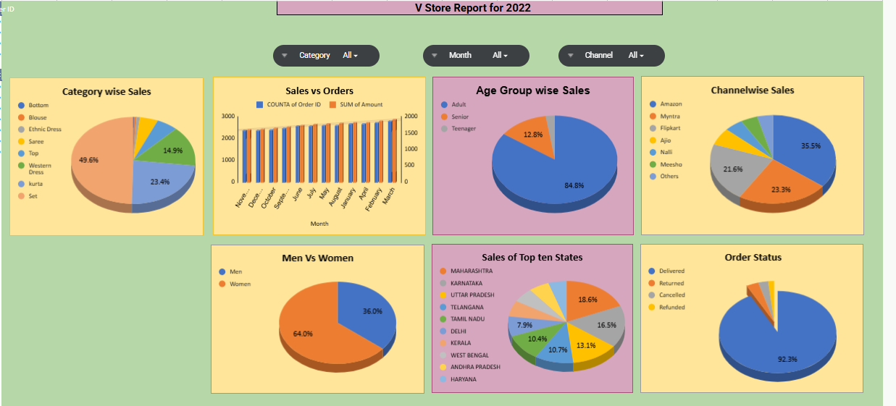
Dashboard Screenshot

Slide 5
Dashboard Overview
Components:
- Category-wise Sales
- Sales vs Orders (Monthly Trend)
- Age Group-wise Sales
- Channel-wise Sales
- Men vs Women Sales Comparison
- Sales of Top 10 States
- Order Status Analysis
Visual Aids: Charts and interactive slicers for filtering.

Slide 6
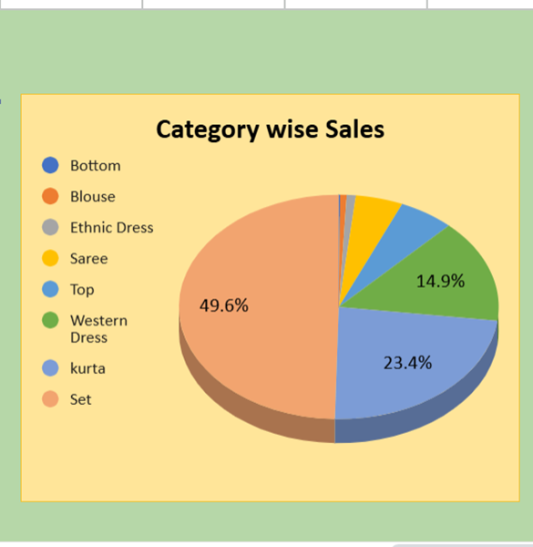
Key Insights
1. Category-wise Sales:
- Top-selling category: Sets (49.6% of total sales).
- Least-selling category: Bottoms(0.13%).

Slide 7
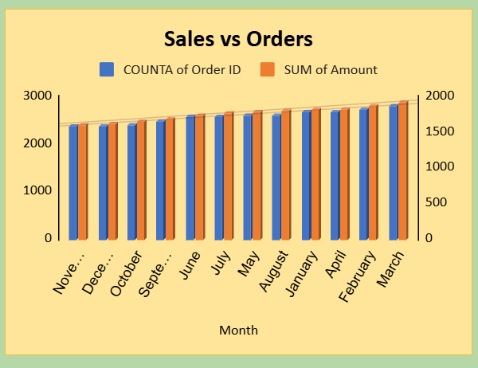
2. Sales Trend: -Highest Sales Month (Amount): March had the highest sales with ₹1,928,066. -Lowest Sales Month (Amount): November had the lowest sales with ₹1,615,356. -Highest Order Count: March had the highest number of orders (2819). -Lowest Order Count: November had the lowest number of orders (2383).

Slide 8
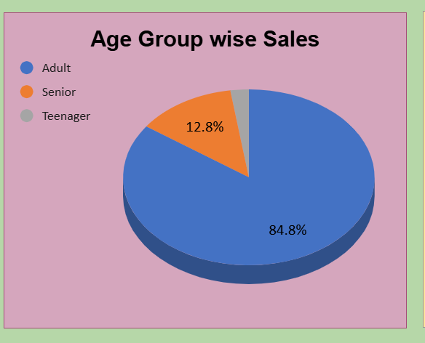
3. Customer Demographics: - Adults contribute 84.8% of total sales. - Seniors and Teenagers account for 12.8% and 2.4% respectively.

Slide 9
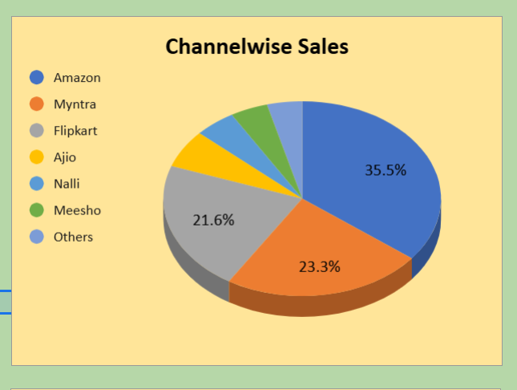
4. Channel Analysis: - Amazon leads with 35.5% of total sales. - Myntra and Flipkart follow at 23.3% and 21.6%, respectively.

Slide 10
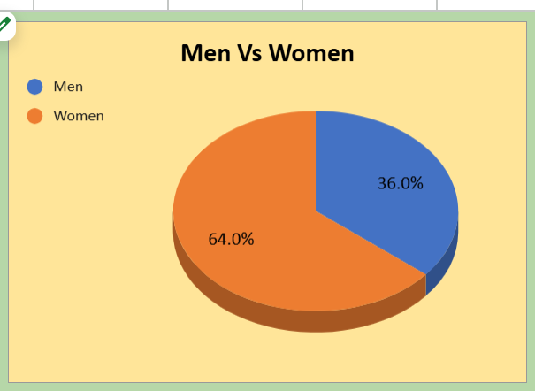
5. Gender Comparison: - Women account for 64% of sales, while Men contribute 36%.

Slide 11
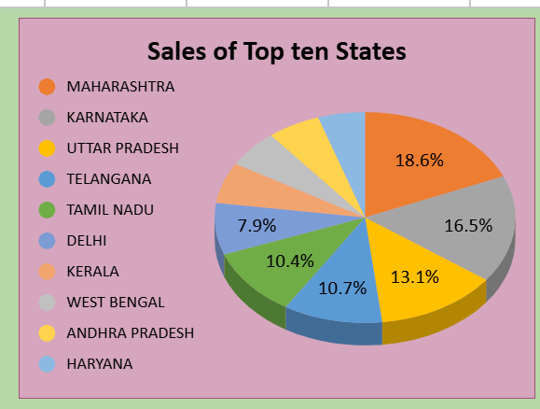
6. Regional Sales: - Maharashtra leads with 18.6%. - Karnataka and Uttar Pradesh follow with 16.5% and 13.1%.

Slide 12
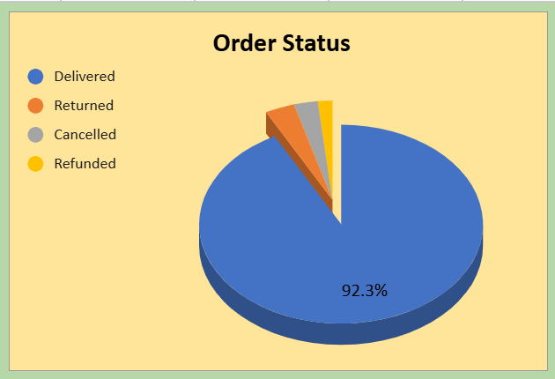
7. Order Status: - 92.3% orders were successfully delivered. - Returns, cancellations, and refunds account for the rest

Slide 13
THANK YOU

