Slide 1

STUDENT DATABASE AND RESULT MAINTENANCE SYSTEM
Made By-
Dhiraj Bhatt
Krati Saxena

Slide 2
Specifications of the project-
  Student Profile-
  Displays Student biodata.
  Displays subject wise marks.
  Displays marks of all subjects for a particular student.
  Displays CPI and SPI.
  Displays special achievements of the students
  Displays name of the students who are awarded scholarships on the basis of their merit.

Slide 3
Specifications of the project-
  Administrator Profile-
  Displays and edit Student biodata.
  Displays and edit marks of the students.
  Displays CPI and SPI.
  Displays and add special achievements of the students
  Displays name of the students who are awarded scholarships on the basis of their merit.

Slide 4
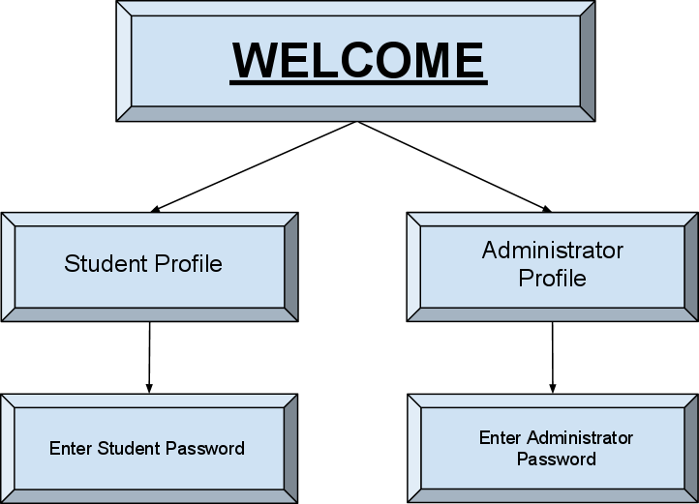

Slide 5
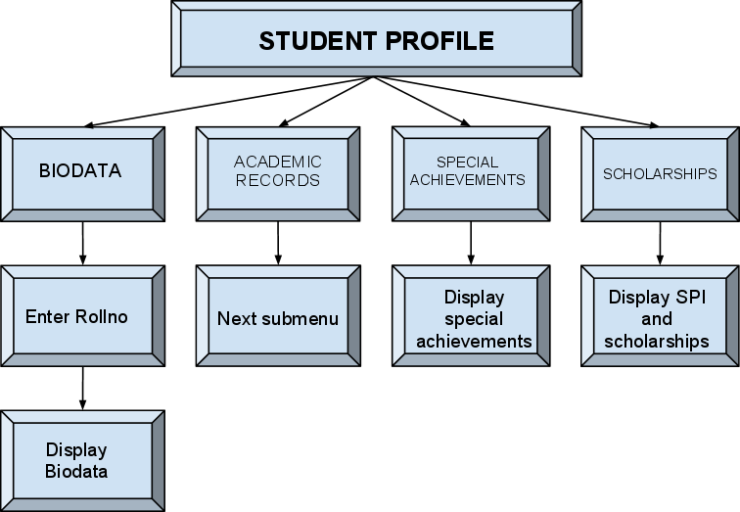

Slide 6
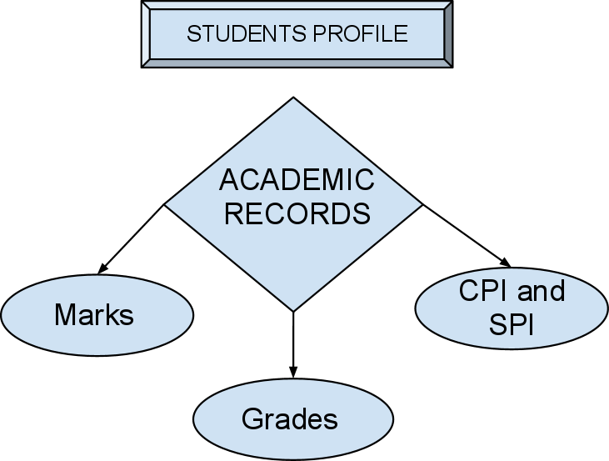

Slide 7
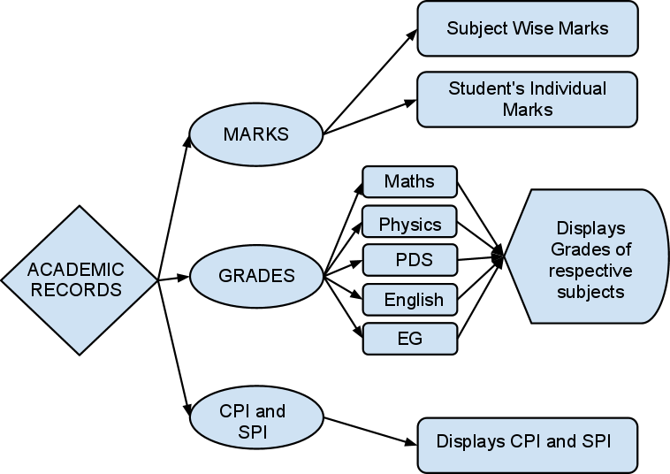

Slide 8
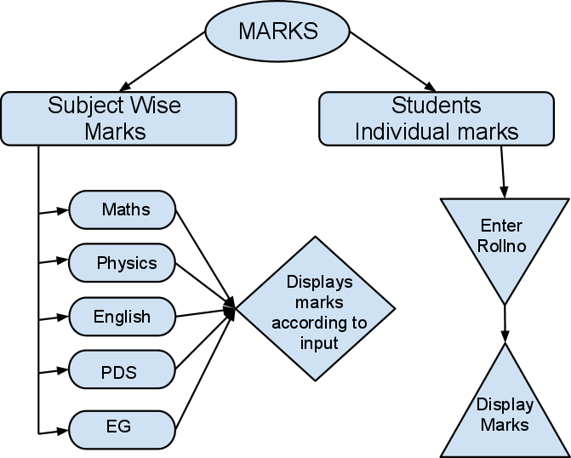

Slide 9
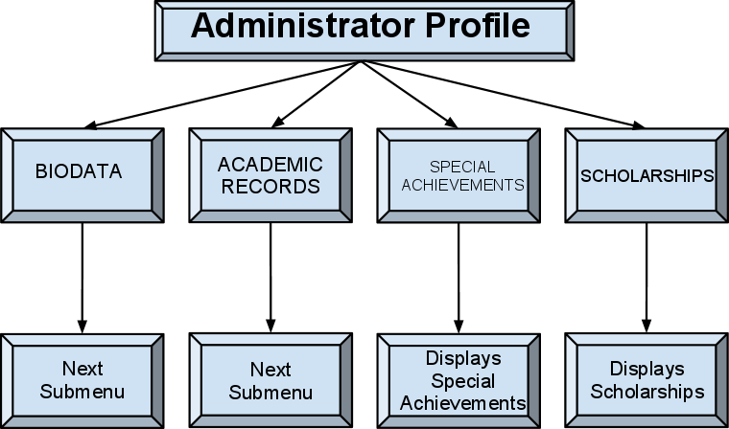

Slide 10
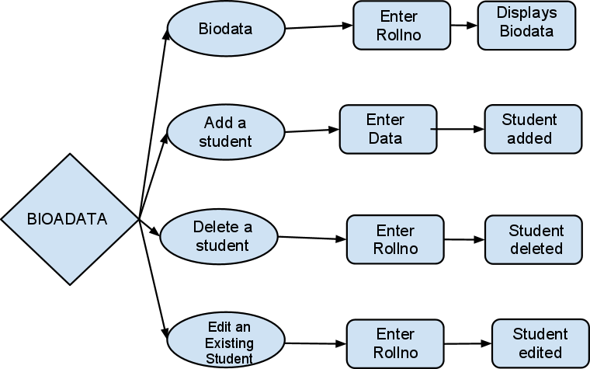

Slide 11
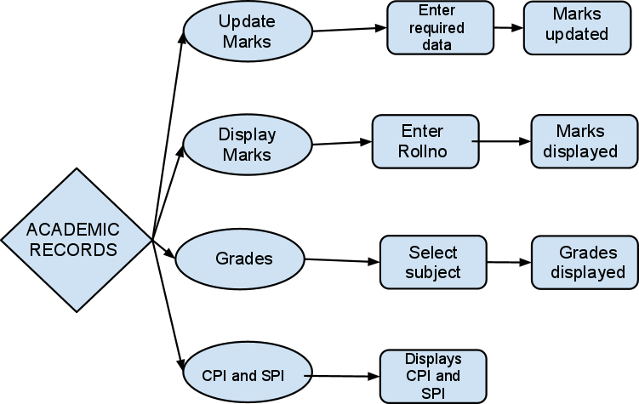

Slide 12


