Slide 1

Smart-Pad
A MINOR PROJECT PRESENTATION
Created By :
RUCHI SAXENA
SHIVANGI GUPTA
PUJA KUMARI
SWAMINI BHATT
KHUSHBOO BANSAL

Slide 2
1. Introduction
Smart-Pad is a simple text editor for Microsoft Windows.
Smart-Pad is a common text-only (plain text) editor. The resulting files—typically saved with the .txt extension—have no format tags or styles, making the program suitable for editing system files that are to be used in a DOS environment.
Smart-Pad can edit files of almost any format like txt, html etc.
Smart-Pad offers only the most basic functions, such as finding text.
Easy to use implementation of Shortcut Keys for Basic Editing Functions.

Slide 3
2. Why Smart-Pad in Java ?
As we all know, Java is platform independent Language. It can Run on any Operating System which has JVM installed.
Smart-Pad of Windows is the most simplest Text Editor Till Now.
Simplified and User Friendly Interface of Smart-Pad make it most reliable for any kind of basic Text Editing.

Slide 4
3.NotePad ENHANCE version
One can not use Windows NotePad in other Operating System.
So for Simplify the use of Smart-Pad of Windows in Other Operating System with ease, The Smart-Pad is Developed in Java.
This way, this popular tool of windows can be run on any Operating System.

Slide 5
4. Basic Features :
Shortcuts for common tasks like new, open and save.
Smart-Pad accepts text from the Windows clipboard
One can not use Windows NotePad in other Operating System.
Simple text editors like Smart-Pad may be used to edit text with markup, such as HTML
Smart-Pad Includes the ability to change the font and font style.

Slide 6
Right Click Feature for Performing Easy task of Text Editing like cut, copy, paste etc.
When clipboard data with multiple formats is pasted into Smart-Pad, the program will only accept text in the txt format.
Time and date functional ability can easily insert Time and Date Stamp in a Text Format in a txt file.

Slide 7
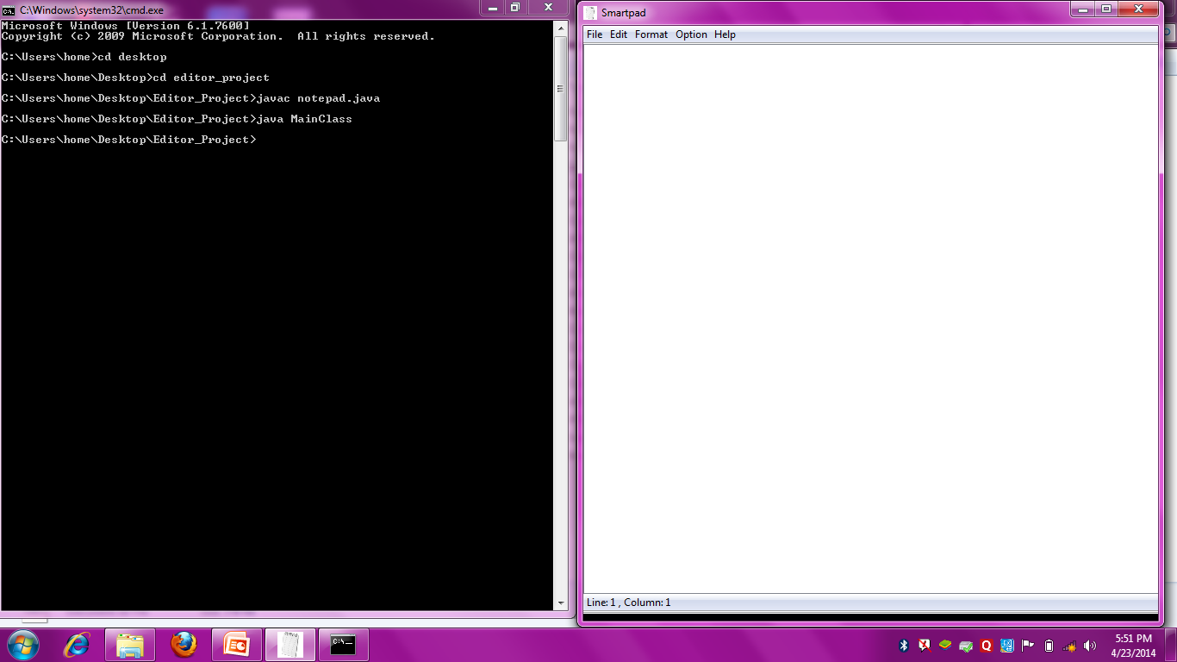
5. Snapshots

Slide 8
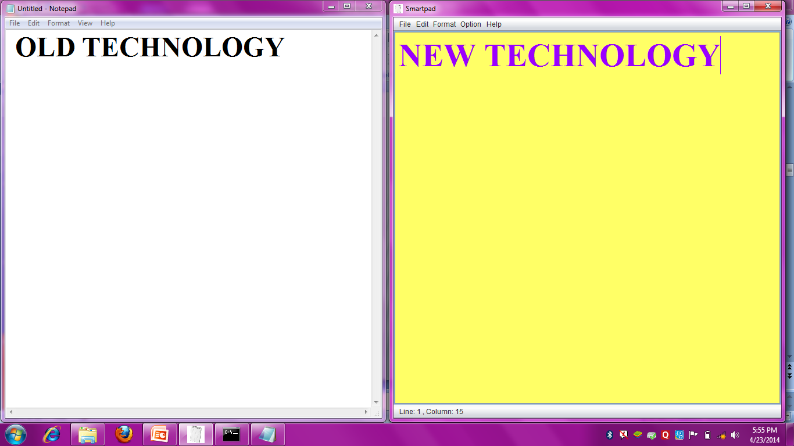

Slide 9
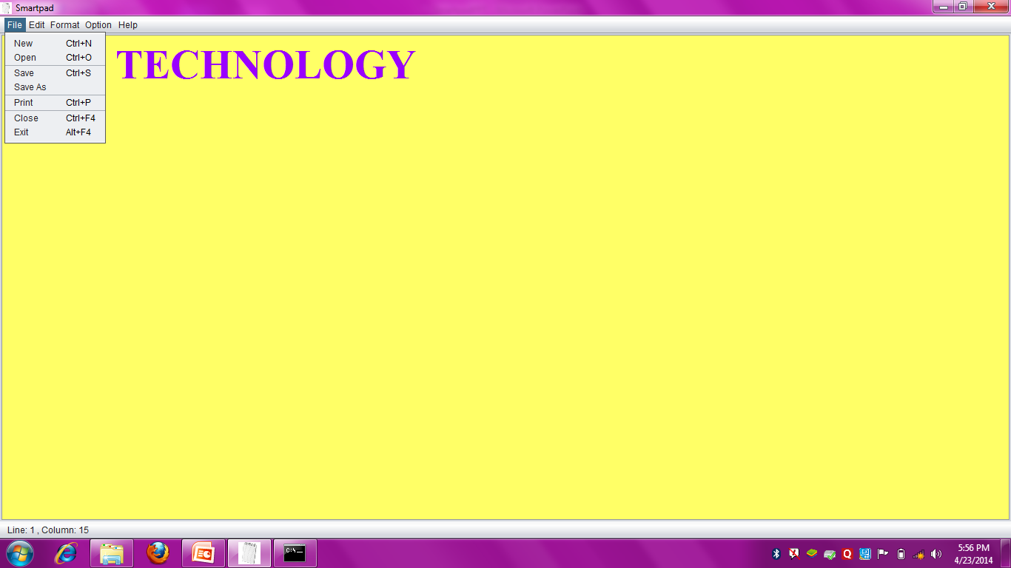

Slide 10
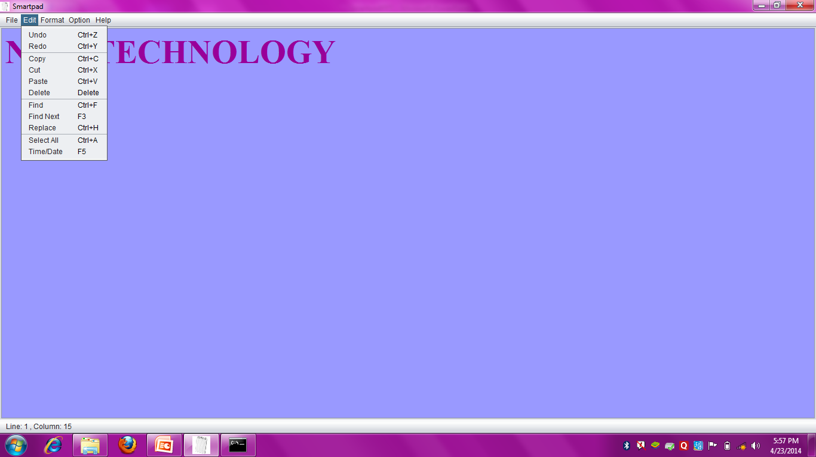

Slide 11
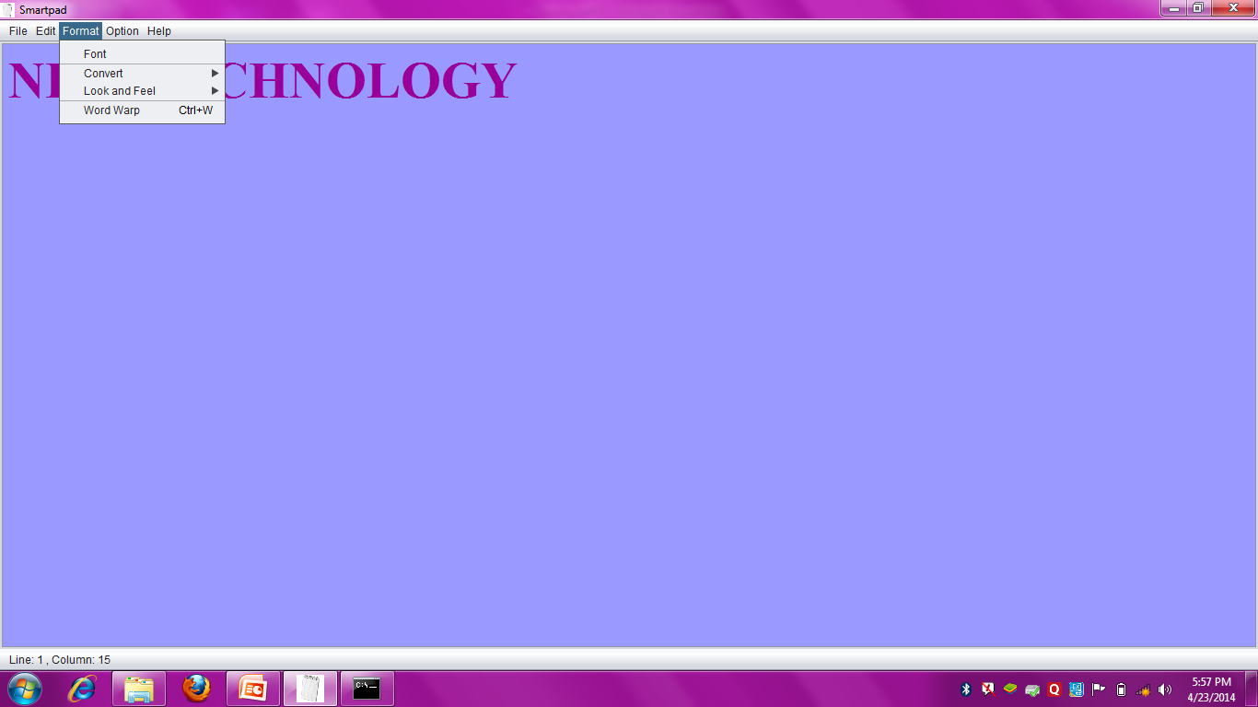
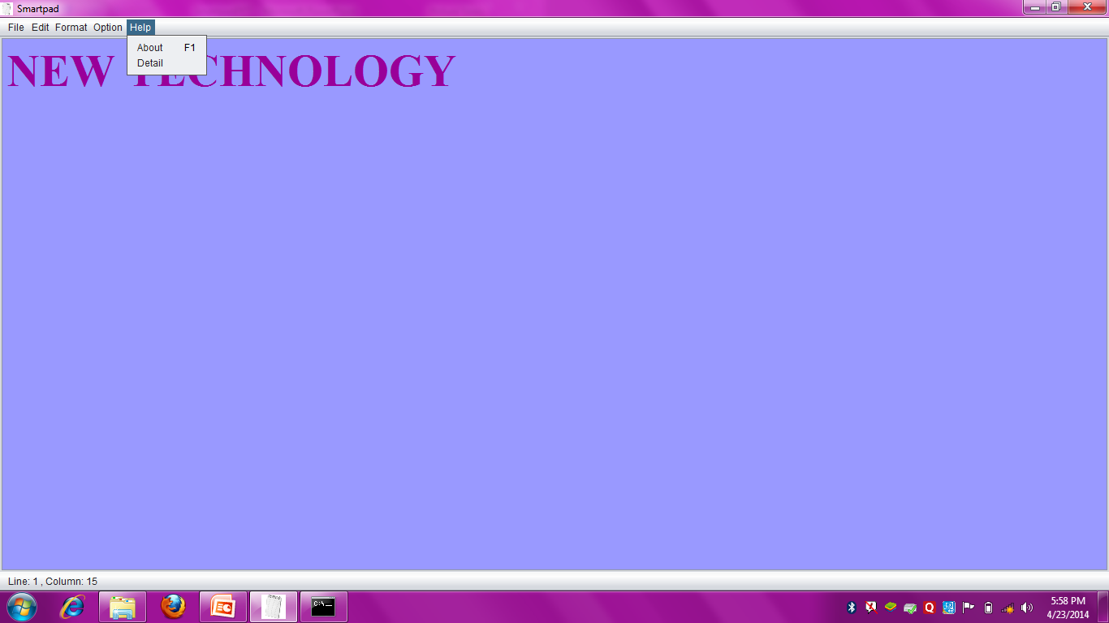
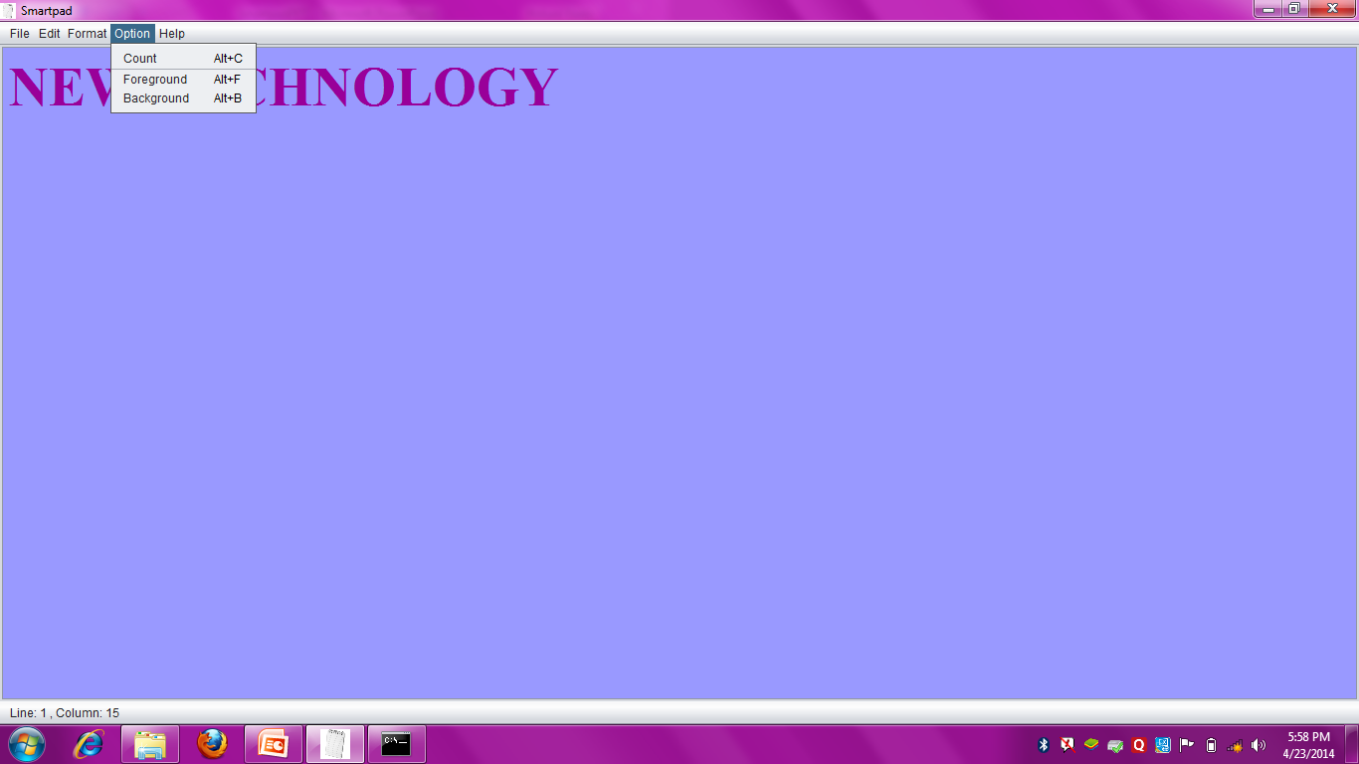

Slide 12
6. NONFUNCTIONAL REQUIREMENTS
Quality Requirements: The application has maintained good search options which generate accurate information.
Usability: Once the application is developed it can be used for different search purposes. And all the users use the system according to their requirements.
Security: The application is available for all users who are registered with us. for this user has to provide accurate details.
Supportability:The application is more supportable. It allows modifying without causing any high level architecture changes. These changes can be done managerial people.
Scalability: The application is more scalable. It can be use full for different search purposes and can be used for different people.

Slide 13
7. PROCESS MODEL ADOPTED :
This document play a vital role in the development of life cycle (SDLC) as it describes the complete requirement of the system. It means for use by developers and will be the basic during testing phase.
To develop this project we have used Spiral Model

Slide 14
SPIRAL MODEL :
SPIRAL MODEL was defined by Barry Boehm in his 1988 article, “A spiral Model of Software Development and Enhancement”.
it was the first model to explain why the iteration models. Each phase starts with a design goal and ends with a client reviewing the progress thus far.
Analysis and engineering efforts are applied at each phase of the project, with an eye toward the end goal of the project.

Slide 15
SPIRAL MODEL

Slide 16
User 1
File Name
Editior
File
Type
User 2
File Addresss
User n
fig. E-R DIAGRAM

Slide 17
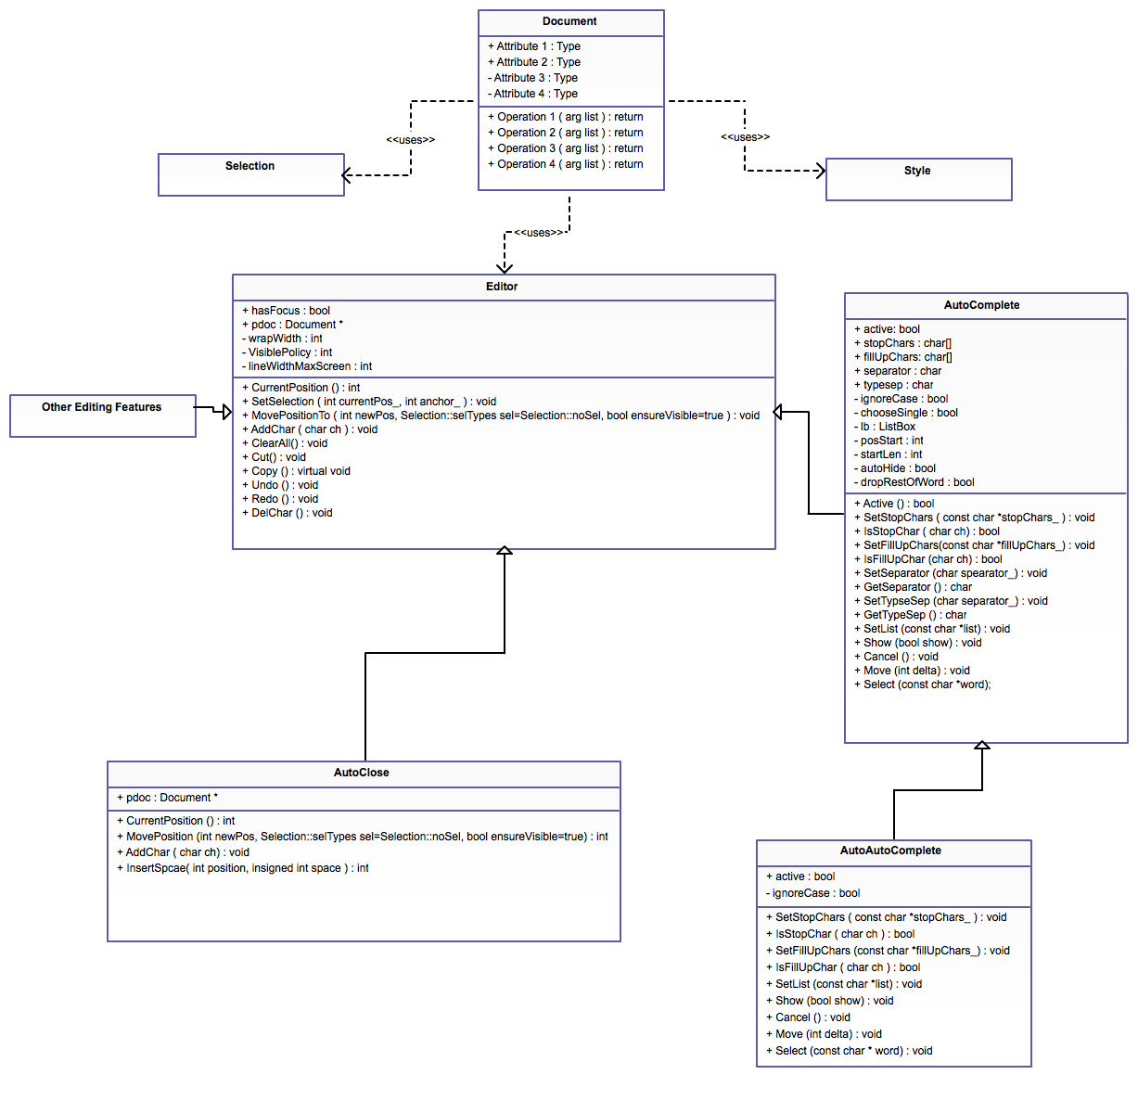
Fig. CLASS DIAGRAM

Slide 18
8. Lacking Features :
Limit on file size
Lack of Toolbar for Advance Functions.
Single Document View, (not an MDI Application).
Does not have a hex editor built in.
Text Replacement Functionality is not available in this Smart-Pad.

Slide 19
9. System Requirements :
PC with any Operating System.
Java Installed Platform.
Basic Memory.
Language: English

Slide 20
10. Updates Required :
It should have the ability to Search and Replace Text.
A file should be locked with password protection.
Utilities like Calculator, Paint and Dictionary should be added in the Menu bar
Size Limitation Should be removed
Images should be added.

Slide 21
11. REFRENCES
BIBLIOGRAPHY
Java- The Complete Reference
Software Engineering-A Practioner’s Approach, Roger.s.Pressman
WEBSITES
www.sourcecodeworld.com
www.codeprojet.com
www.roseindia.com
www.javaforbegineers.com

Slide 22

Thank You !
Any Queries ?

