Slide 1

Revolutionising B.Tech

Slide 2
Module 2: Data Cleaning
Course Name:
DATA EXPLORATION AND PREPARATION [22CSE239]
Total Hours : 9

Slide 3
Table of Content
Aim
Objectives
Data Cleaning Techniques
Handling missing data
Outlier Detection and Treatment
Data Transformation
Normalization.
Data Cleaning Tools and Libraries:
NumPy Library
Pandas Library
DateTime Library
Data Manipulation and Cleaning using python.
Self Assessments Activities –
Did You Know
Summary

Slide 4

Aim
To equip students in the concepts and mechanisms in the Artificial Intelligence technology and its introduction.

Slide 5

• Identify key steps in data exploration and preparation such as data cleaning, data wrangling. data transformation and data integration.
• Ability to code in a scalable environment to automate data cleaning and processing tasks.
• Understand the sources of data quality issues. different types of data, how data is stored and accessed.
• Explore data visually and statistically and identify patterns and abnormalities that require further investigation.
• Able to clean and transform data, identify missing or incorrect values, and merge or join datasets as needed.
• Evaluate the effectiveness and efficiency of data exploration and preparation methods in terms of their impact on downstream analysis and modelling.
Objective

Slide 6
Data clean(s)ing
Data cleansing, also referred to as data cleaning or data scrubbing, is the process of fixing incorrect, incomplete, duplicate or otherwise erroneous data in a data set.
It involves identifying data errors and then changing, updating or removing data to correct them
Data cleansing improves data quality and helps provide more accurate, consistent and reliable information for decision-making in an organization.

Slide 7
Why is clean data important?
Business operations and decision-making are increasingly data-driven, as organizations look to use data analytics to help improve business performance and gain competitive advantages over rivals.
As a result, clean data is a must for BI and data science teams, business executives, marketing managers, sales reps and operational workers.
It applies to organizations across the board, both large and small.
If data isn't properly cleansed, customer records and other business data may not be accurate and analytics applications may provide faulty information.
That can lead to flawed business decisions, misguided strategies, missed opportunities and operational problems, which ultimately may increase costs and reduce revenue and profits

Slide 8
TYPES OF ISSUES
The types of issues that are commonly fixed as part of data cleansing projects include the following:
Typos and invalid or missing data. Data cleansing corrects various structural errors in data sets. For example, that includes misspellings and other typographical errors, wrong numerical entries, syntax errors and missing values, such as blank or null fields that should contain data.
Inconsistent data. Names, addresses and other attributes are often formatted differently from system to system. For example, one data set might include a customer's middle initial, while another doesn't. Data elements such as terms and identifiers may also vary. Data cleansing helps ensure that data is consistent so it can be analyzed accurately.

Slide 9
Duplicate data. Data cleansing identifies duplicate records in data sets and either removes or merges them through the use of deduplication measures. For example, when data from two systems is combined, duplicate data entries can be reconciled to create single records.
Irrelevant data. Some data -- outliers or out-of-date entries, for example -- may not be relevant to analytics applications and could skew their results. Data cleansing removes redundant data from data set ,which streamlines data preparation and reduces the required amount of data processing and storage resources.

Slide 10
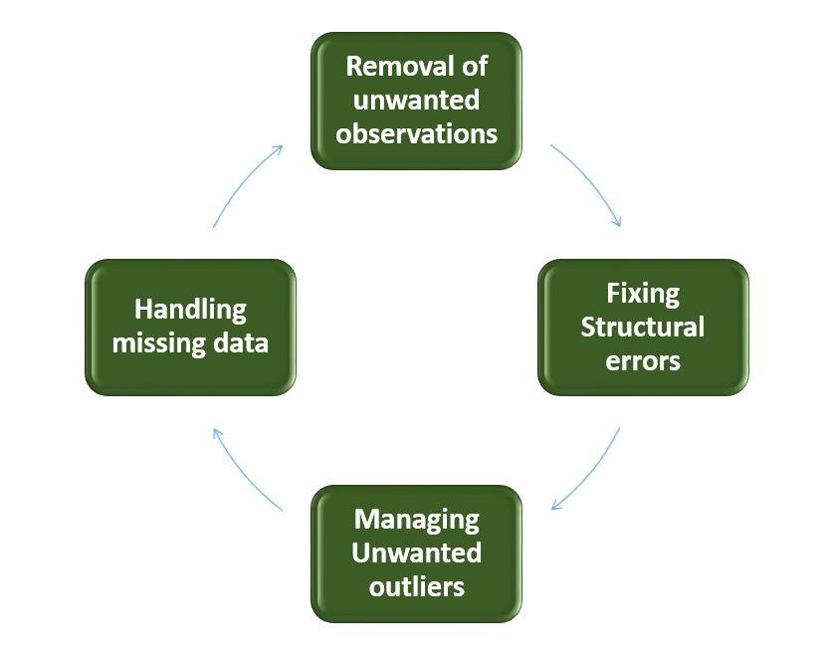
Steps to Perform Data Cleanliness
Performing data cleaning involves a systematic process to identify and rectify errors, inconsistencies, and inaccuracies in a dataset. The following are essential steps to perform data cleaning

Slide 11
Managing Unwanted outliers: Identify and manage outliers, which are data points significantly deviating from the norm. Depending on the context, decide whether to remove outliers or transform them to minimize their impact on analysis. Managing outliers is crucial for obtaining more accurate and reliable insights from the data.
Handling Missing Data: Devise strategies to handle missing data effectively. This may involve imputing missing values based on statistical methods, removing records with missing values, or employing advanced imputation techniques. Handling missing data ensures a more complete dataset, preventing biases and maintaining the integrity of analyses

Slide 12
Data in the Real World Is Dirty: Lots of potentially incorrect data, e.g., instrument faulty, human or computer error, transmission error
incomplete: lacking attribute values, lacking certain attributes of interest, or containing only aggregate data
e.g., Occupation=“ ” (missing data)
noisy: containing noise, errors, or outliers
e.g., Salary=“−10” (an error)
inconsistent: containing discrepancies in codes or names, e.g.,
Age=“42”, Birthday=“03/07/2010”
Was rating “1, 2, 3”, now rating “A, B, C”
discrepancy between duplicate records
Intentional (e.g., disguised missing data)
Jan. 1 as everyone’s birthday

Slide 13
Incomplete (Missing) Data
Data is not always available
E.g., many tuples have no recorded value for several attributes, such as customer income in sales data
Missing data may be due to
equipment malfunction
inconsistent with other recorded data and thus deleted
data not entered due to misunderstanding
certain data may not be considered important at the time of entry
not register history or changes of the data
Missing data may need to be inferred

Slide 14
How to Handle Missing Data?
Ignore the tuple: usually done when class label is missing (when doing classification)—not effective when the % of missing values per attribute varies considerably
Fill in the missing value manually
Fill in it automatically with
a global constant : e.g., “unknown”
the attribute mean
the attribute mean for all samples belonging to the same class: smarter
the most probable value: inference-based such as Bayesian formula or decision tree

Slide 15
Characteristics of clean data
Various data characteristics and attributes are used to measure the cleanliness and overall quality of data sets, including the following:
accuracy
completeness
consistency
integrity
timeliness
uniformity
validity

Slide 16
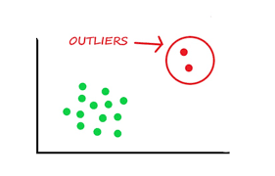
What is Outlier?
An Outlier is a data item/object that deviates significantly from the rest of the (so-called normal) objects. Identifying outliers is important in statistics and data analysis because they can have a significant impact on the results of statistical analyses.
The analysis for outlier detection is referred to as outlier mining

Slide 17
Reasons for outliers in data
Errors during data entry or a faulty measuring device (a faulty sensor may result in extreme readings).
Natural occurrence (salaries of junior level employees vs C-level employees)
Problems caused by outliers
Outliers in the data may causes problems during model fitting (esp. linear models).
Outliers may inflate the error metrics which give higher weights to large errors (example, mean squared error, RMSE).

Slide 18
Methods to identify outliers in the data
Box plots
Box plots are a visual method to identify outliers. Box plots is one of the many ways to visualize data distribution.
IQR method
IQR method is used by box plot to highlight outliers. IQR stands for interquartile range, which is the difference between q3 (75th percentile) and q1 (25th percentile). The IQR method computes lower bound and upper bound to identify outliers.
Z-score method
Z-score method is another method for detecting outliers. This method is generally used when a variable’ distribution looks close to Gaussian. Z-score is the number of standard deviations a value of a variable is away from the variable’ mean.
Z-Score = (X-mean) / Standard deviation

Slide 19
Distance from the mean’ method (Multivariate method)
Unlike the previous methods, this method considers multiple variables in a data set to detect outliers.
This method calculates the Euclidean distance of the data points from their mean and converts the distances into absolute z-scores.
Any z-score greater than the pre-specified cut-off is considered to be an outlier

Slide 20
How Outliers are Caused?
Outliers can be caused by a variety of factors, and they often result from genuine variability in the data or from errors in data collection, measurement, or recording. Some common causes of outliers are:
Measurement errors: Errors in data collection or measurement processes can lead to outliers.
Sampling errors: In some cases, outliers can arise due to issues with the sampling process.
Natural variability: Inherent variability in certain phenomena can also lead to outliers. Some systems may exhibit extreme values due to the nature of the process being studied.
Data entry errors: Human errors during data entry can introduce outliers.
Experimental errors: In experimental settings, anomalies may occur due to uncontrolled factors, equipment malfunctions, or unexpected events.
Sampling from multiple populations: Data is inadvertently combined from multiple populations with different characteristics.
Intentional outliers: Outliers are introduced intentionally to test the robustness of statistical methods

Slide 21
Data Transformation
Data transformation is the process of converting raw data into a more suitable format or structure for analysis, to improve its quality and make it compatible with the requirements of a particular task or system.
Importance of Data Transformation
Raw data, often sourced from diverse channels, may be inconsistent, contain missing values, or exhibit variations that could impact the reliability of analyses.
Data transformation addresses these challenges by cleaning, encoding, and structuring the data in a manner that makes it compatible with analytical tools and algorithms.
data transformation facilitates feature engineering, allowing the creation of new variables that may improve model performance

Slide 22
Data Transformation techniques
Manipulation
Data manipulation is the process of changing the form of an existing dataset to gain a better understanding of its content. It is often performed by combining datasets with different characteristics into one dataset.
Revising
Data revision is a technique that involves changing the format of an existing dataset to make it more useful for analysis purposes. You can do it by adding new fields, removing unimportant information, or just changing the structure and layout of your data set.
Separating
Separation is splitting a single dataset into smaller subsets based on standard criteria. It allows you to focus on specific parts of your data at any given time without worrying about missing information from other components

Slide 23
Combining/Integrating
Combination/integration refers to merging multiple datasets that have been split up into individual subsets using separation techniques such as those described above so that you can view them simultaneously instead of separately (for example, merging multiple tables).
Data Smoothing
Data smoothing involves averaging values across groups to smooth out outliers or reduce statistical noise from large swings between groups over time (for example, by taking averages over several years rather than just one).
Data Aggregation
Data aggregation involves combining similar values to get a complete picture of the underlying phenomena. For example, if you have sales records that include both dollar amounts and the number of units sold, you can aggregate them so that they are represented by just one value: total revenue or total units sold.

Slide 24
Discretization
Discretization is when you turn continuous variables into categorical variables by splitting them into discrete ranges (such as turning age into fields like 0-5 years old or 6-10 years old).
The process of discretizing data is helpful because it allows you to use algorithms that don’t work well with continuous variables (like regression) but do work well with categorical variables (like decision trees).
Generalization
Generalization is transforming a set of values into a more generic form. A single value or group of values will represent all your data points. It’s a way of ensuring that all of your data points have similar characteristics.
Attribute Construction
Attribute construction is the process of creating new attributes for existing data points. It involves splitting existing columns into multiple columns so that each represents a different aspect of the original data point.
By applying attribute construction data can be organized ensuring each column only represents one feature instead of many rolled-up features, making the data easier to work with.

Slide 25
Advantages of Data transformation
There are several advantages to data transformation in data analysis and data science. Some of the main benefits include:
Data transformation improves data quality by cleaning it, removing inconsistencies, and filling in missing values. It makes data more accurate and trustworthy, leading to more reliable results and insights.
Data transformation makes data more easily understood and usable by end-users. For example, by aggregating or summarizing the information it can be presented in a more concise and intuitive form that is easier to understand and interpret.
Data transformation enables the use of advanced data analysis techniques that require data to be in a specific format. For example, some machine learning algorithms only work with data formatted in a certain way, so data transformation is necessary to prepare data so that it can work in needed algorithms.
Data transformation helps to uncover hidden trends, patterns, and relationships in data that would not be apparent without transforming it. By applying various mathematical and statistical operations, data scientists can uncover valuable insights to help organizations make better decisions.
Data transformation reduces the time and effort required to analyze data. By automating the data transformation process, data scientists can save time and focus on more critical tasks, such as interpreting the results and generating insights.

Slide 26
Challenges of data transformation
Several challenges can arise during the data transformation process. Some of the main challenges include the following:
Data quality issues can make data transformation difficult and time-consuming. If the data is incomplete, inconsistent, or contains errors, it can be challenging to clean and prepare for further analysis.
Identifying the appropriate data transformation techniques and methods can take time and effort, especially for large and complex datasets. Data scientists must deeply understand the data and the analysis goals to choose the most effective transformation methods.
Applying data transformation techniques can be computationally intensive, especially for large datasets. It can require significant computing resources and take a long time to complete, depending on the complexity of the transformation methods and the size of the dataset.
The data transformation process can take time to automate and scale. As data volumes grow, it can become a timely endeavor to develop automated data transformation processes that can handle data’s increasing volume and complexity.
Data transformation can introduce errors and biases if not performed carefully and accurately. For example, applying the wrong transformation methods or using incorrect assumptions can result in inaccurate or misleading results. It is essential to carefully validate the results of the data transformation process to ensure their accuracy and reliability.

Slide 27
Data Normalization
Data normalization is a vital pre-processing, mapping, and scaling method that helps forecasting and prediction models become more accurate.
The current data range is transformed into a new, standardized range using this method. Normalization is extremely important when it comes to bringing disparate prediction and forecasting techniques into harmony.
Data normalization improves the consistency and comparability of different predictive models by standardizing the range of independent variables or features within a dataset, leading to more steady and dependable results.
Normalisation, which involves reshaping numerical columns to conform to a standard scale, is essential for datasets with different units or magnitudes across different features. Finding a common scale for the data while maintaining the intrinsic variations in value ranges is the main goal of normalization.
This usually entails rescaling the features to a standard range, which is typically between 0 and 1. Alternatively, the features can be adjusted to have a mean of 0 and a standard deviation of 1.
Z-Score Normalisation (Standardisation) and Min-Max are two commonly used normalisation techniques

Slide 28
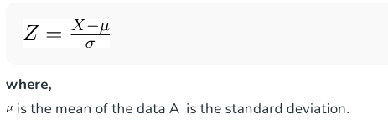
Z-score or Zero Mean (Standardisation): Using the mean and standard deviation of the data, values are normalised in this technique to create a standard normal distribution (mean: 0, standard deviation: 1). The equation that is applied is:

Slide 29

Data Normalization Techniques
Min-Max normalization:
This method of normalising data involves transforming the original data linearly. The data’s minimum and maximum values are obtained, and each value is then changed using the formula that follows.
The formula works by subtracting the minimum value from the original value to determine how far the value is from the minimum. Then, it divides this difference by the range of the variable (the difference between the maximum and minimum values).

Slide 30
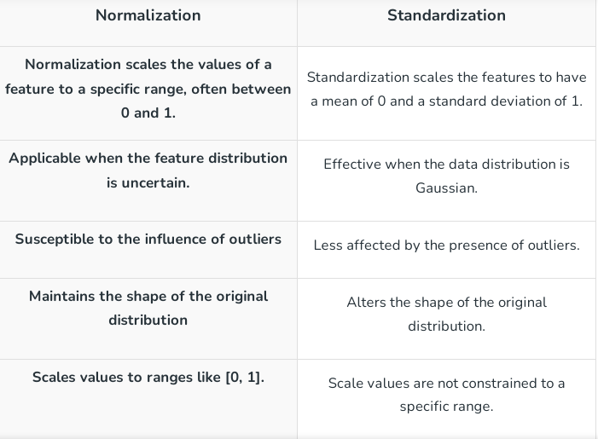
Difference Between Normalization and Standardization

Slide 31
Advantages of Data Normalization
Index searching was accelerated, which led to quicker data retrieval.
Quicker data modification commands.
The removal of redundant and null values to produce more compact data.
Reduction of anomalies resulting from data modification.
Conceptual clarity and simplicity of upkeep, enabling simple adaptations to changing needs.
Because more rows can fit on a data page with narrower tables, searching, sorting, and index creation are more efficient

Slide 32
Disadvantages of Data Normalization
It gets harder to link tables together when the information is spread across multiple ones. It gets even more interesting to identify the database.
A comprehensive understanding of the various conventional structures is essential to completing the standardisation cycle successfully. Careless use can lead to a poor plan with significant anomalies and inconsistent data.

Slide 33
Data Cleaning Tools and Libraries
Numpy
Numpy is a general-purpose array-processing package. It provides a high-performance multidimensional array object, and tools for working with these arrays. It is the fundamental package for scientific computing with Python. Numpy can also be used as an efficient multi-dimensional container of generic data.

Slide 34
Array in Numpy
Array in Numpy is a table of elements (usually numbers), all of the same type, indexed by a tuple of positive integers. In Numpy, number of dimensions of the array is called rank of the array.
A tuple of integers giving the size of the array along each dimension is known as shape of the array. An array class in Numpy is called as ndarray.
Elements in Numpy arrays are accessed by using square brackets and can be initialized by using nested Python Lists.
Creating a Numpy Array Arrays in Numpy can be created by multiple ways, with various number of Ranks, defining the size of the Array. Arrays can also be created with the use of various data types such as lists, tuples, etc.

Slide 35
Accessing the array Index
Accessing the array Index In a numpy array, indexing or accessing the array index can be done in multiple ways. To print a range of an array, slicing is done.
Slicing of an array is defining a range in a new array which is used to print a range of elements from the original array.
sliced array holds a range of elements of the original array, modifying content with the help of sliced array modifies the original array content.

Slide 36
Pandas Library
Pandas is a powerful and versatile library that simplifies tasks of data manipulation in Python . Pandas is built on top of the NumPy library and is particularly well-suited for working with tabular data, such as spreadsheets or SQL tables. Its versatility and ease of use make it an essential tool for data analysts, scientists, and engineers working with structured data in Python.
Pandas do the following
Data set cleaning, merging, and joining.
Easy handling of missing data (represented as NaN) in floating point as well as non-floating point data.
Columns can be inserted and deleted from DataFrame and higher dimensional objects.
Powerful group by functionality for performing split-apply-combine operations on data sets.
Data Visulaization

Slide 37
Pandas Data Structures
Pandas generally provide two data structures for manipulating data, They are:
Pandas Series
A Pandas Series is a one-dimensional labeled array capable of holding data of any type (integer, string, float, python objects, etc.). The axis labels are collectively called indexes.
Pandas Series is nothing but a column in an Excel sheet. Labels need not be unique but must be a hashable type. The object supports both integer and label-based indexing and provides a host of methods for performing operations involving the index.
DataFrame
Data frame is a two-dimensional data structure with labeled axes (rows and columns).

Slide 38
DateTime Library
Python Datetime module supplies classes to work with date and time. These classes provide several functions to deal with dates, times, and time intervals. Date and DateTime are an object in Python, so when you manipulate them, you are manipulating objects and not strings or timestamps.

Slide 39
The DateTime module is categorized into 6 main classes –
date – An idealized naive date, assuming the current Gregorian calendar always was, and always will be, in effect. Its attributes are year, month, and day. you can refer to – Python DateTime – Date Class
time – An idealized time, independent of any particular day, assuming that every day has exactly 24*60*60 seconds. Its attributes are hour, minute, second, microsecond, and tzinfo. You can refer to – Python DateTime – Time Class
date-time – It is a combination of date and time along with the attributes year, month, day, hour, minute, second, microsecond, and tzinfo. You can refer to – Python DateTime – DateTime Class
timedelta – A duration expressing the difference between two date, time, or datetime instances to microsecond resolution. You can refer to – Python DateTime – Timedelta Class
tzinfo – It provides time zone information objects. You can refer to – Python – datetime.tzinfo()
timezone – A class that implements the tzinfo abstract base class as a fixed offset from the UTC

Slide 40
Following is a structure of a basic data-cleaning essential steps:
Loading the CSV file: The CSV file is loaded as a data frame using the pandas module in Python.
Preprocessing the Data: The data has multiple attributes and mostly these are not in a format that Machine Learning modules can understand. Hence following key preprocessing steps can be applied:
Removing duplicates: Duplicate rows in a dataset can cause errors or bias in analysis, so it’s important to remove them.
Correcting inconsistent data: Inconsistent data can arise due to errors in data entry or data integration.
Handling outliers: Outliers can skew analysis, so it’s important to handle them appropriately.
Formatting data: Data may need to be formatted to meet the requirements of the analysis.

Slide 41
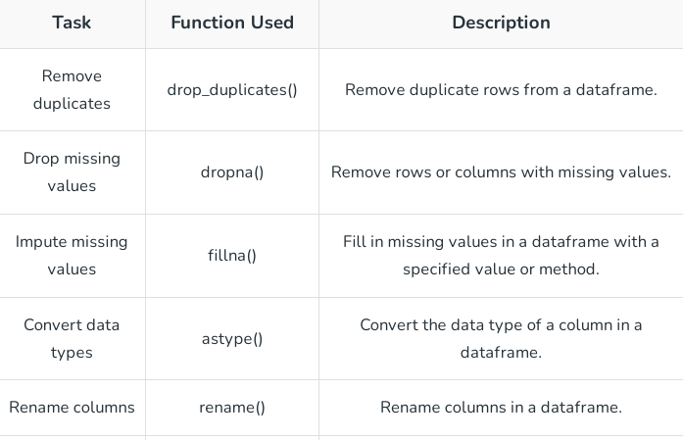
Data Manipulation and Cleaning using python.

Slide 42
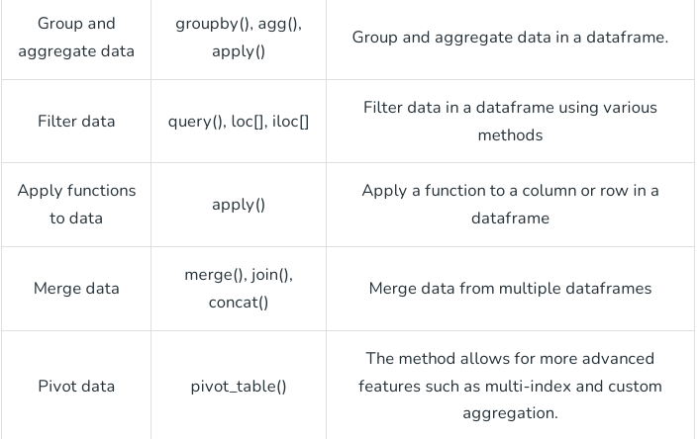
Data Manipulation and Cleaning using python

Slide 43
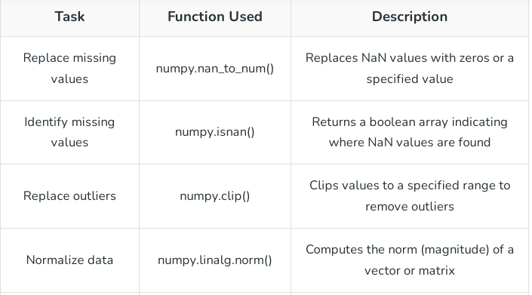
Data Manipulation and Cleaning using python

Slide 44
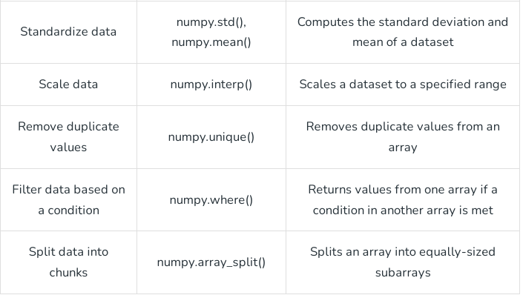
Data Manipulation and Cleaning using python

Slide 45
Self Assessments and Activities
Here are some assessments you can use to evaluate students understanding of Data cleaning process
Quizzes
In class Participation
Programming assessments

Slide 46

Did You Know?
A statistician and data scientist known for creating several widely used R packages for data analysis and visualization
Hadley Wickham

Slide 47

Summary
Outcomes: students able to
Able to implement data cleaning process

Slide 48
Thank you

