Slide 1
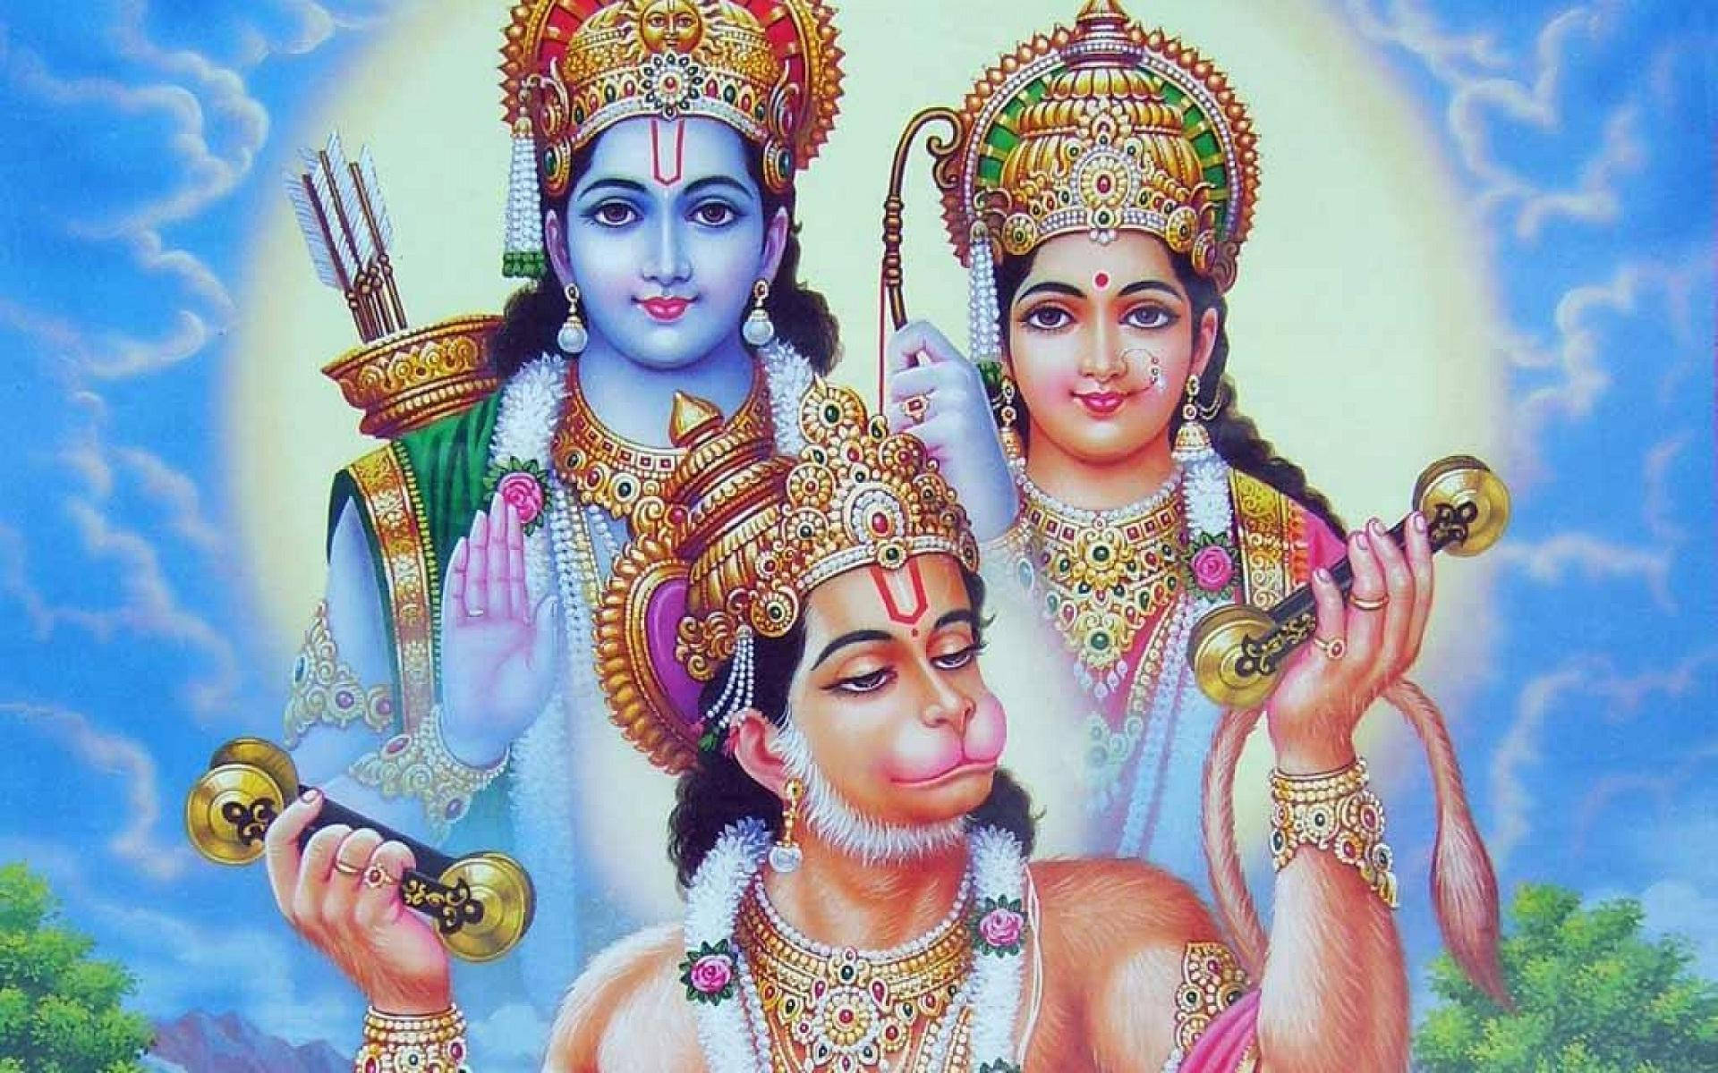
॥ श्री सीतारामचन्द्राय नमः ॥
Introduction to Valmiki Ramayana
The Adi Kavya — The First Poem of Humanity
Composed by Maharishi Valmiki, the Ramayana is one of the two great Indian epics (Itihasa), narrating the divine pastimes of Lord Sri Rama.
Images courtesy: ISKCON Desire Tree & Hare Krishna Wallpapers

Slide 2
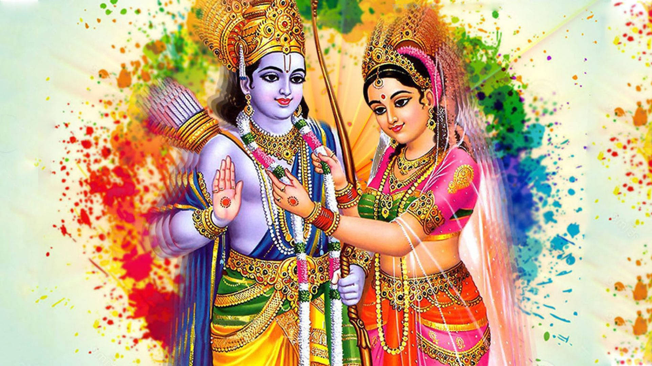
Maharishi Valmiki & The Epic
About Valmiki
• Known as the 'Adi Kavi' (the First Poet)
• Composed the first shloka (verse) in Sanskrit poetry
• Inspired by witnessing a hunter's cruelty to a bird
• Sage Narada urged him to write Lord Rama's story
The Ramayana at a Glance
• 24,000 verses (shlokas) in 7 books (Kandas)
• Written in the Anushtubh metre
• Narrates events of Treta Yuga
• Central theme: Dharma, devotion & ideal conduct
• Rama is the Supreme Lord descended as the ideal king

Slide 3
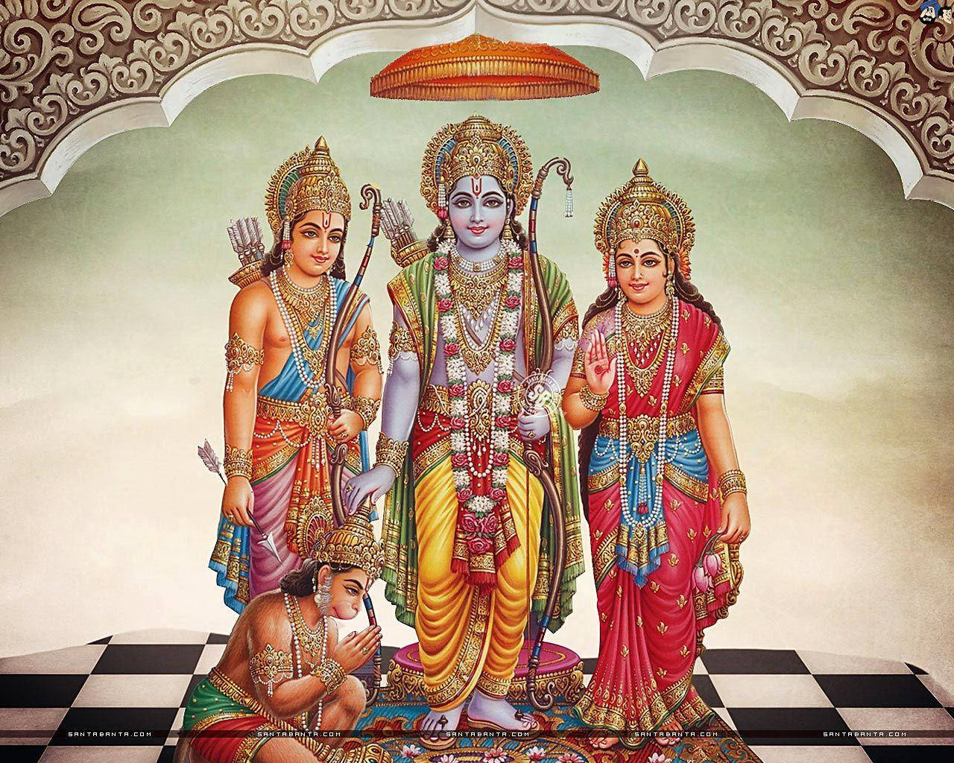
The Seven Kandas (Books) of Valmiki Ramayana
1. Bala Kanda
5. Sundara Kanda
Birth & early life of Rama; Rama breaks Shiva's bow
Hanuman leaps to Lanka; finds Sita; burns Lanka
2. Ayodhya Kanda
6. Yuddha Kanda
Rama's exile for 14 years; Bharata's devotion
Great war; Ravana's defeat; Rama reunites with Sita
3. Aranya Kanda
7. Uttara Kanda
Forest adventures; Sita's abduction by Ravana
Rama's rule (Rama Rajya); the ideal kingdom
4. Kishkindha Kanda
Alliance with Sugriva & Hanuman's emergence
"Sitaayaah Charitam Mahat" — Valmiki Ramayana is truly the noble story of Sita
Images courtesy: ISKCON Desire Tree & Hare Krishna Wallpapers | Jai Sri Ram!

