Slide 1
Data Bootcamp Final Project - House Price Prediction
Claire Park (sp5741) Kidae Hong (kh3220)

Slide 2
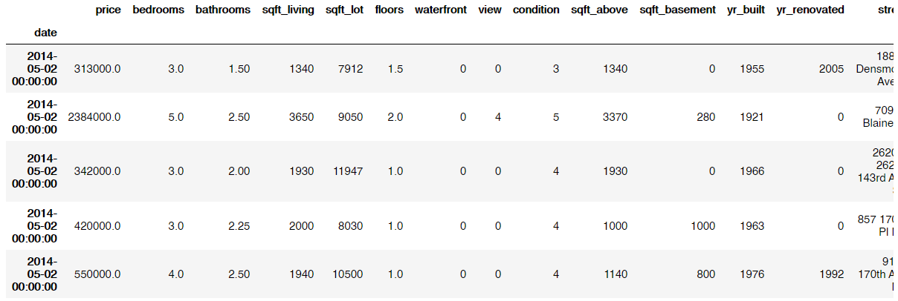
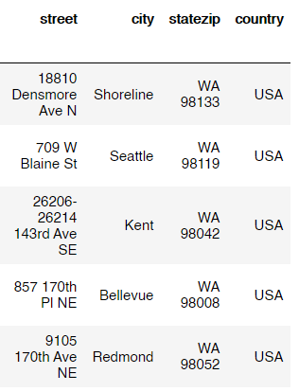
1. Data
Source: https://www.kaggle.com/shree1992/housedata
The data contains 4600 rows and 18 columns. It shows various attributes of each house including the price, # of bedrooms and bathrooms, sqft, floors, view score, condition score, etc.

Slide 3
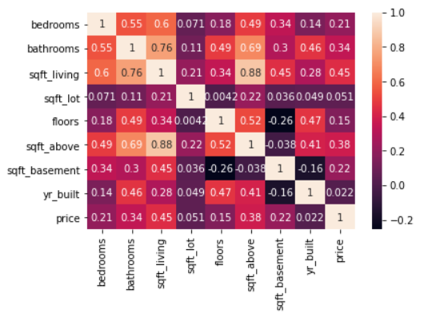
2. Data exploration & planning
First, we examined our target variable ‘price’ and found that there are some houses with 0 price. We dropped those rows for the better prediction quality.
Next, we investigated correlations between numeric variables to select one to investigate.
It looks like most variables are highly correlated with sqft_living, so we decided to choose this one as x variable for our prediction modeling.
Since the sqft_living data is skewed, we made a separate column called ‘lnsqft’ which contains logged value of sqft_living.

Slide 4
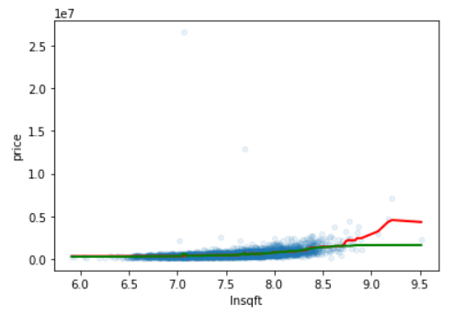
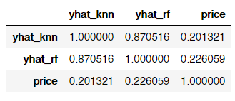
3. Modeling & Comparison
Then we created two models to predict ‘price’ using ‘Insqft’.
We maximized each model’s score and then compared their r-squared scores.
Random forest
KNN
As a result,
Since the Random Forest model shows higher r-squared score than the KNN classifier, so we will choose the Random Forest model as our final model for the house price prediction.

