Slide 1

LOGO
ThermAlert
Machine Overheat Detection System
Faculty-in-charge: Dr. Manish Kumar Bajpai

Slide 2


CONTENTS
01
02
03
04
PART
PART
PART
PART
Introduction
Objectives
Circuit
Future Goals

Slide 3
PART-01
Introduction

Slide 4

Issues caused by Overheating
Damage to circuits
01
Overheating can damage the circuits in an appliance, making it useless.
Performance Issues
02
Overheating can cause a number of performance issues in electric motors.
Fire or Explosion
03
In extreme cases, overheating can cause a fire or explosion, which can lead to personal injury and property damage.

Slide 5
PART-02
Objectives

Slide 6

Prevention
1
To make efficient overheat detector using Arduino / Microcontroller, sensors and alarm system.
Alarming
2
To alarm the user about the overheated system, so that some actions can be taken.
Add title text
Add title text
Detection
3
It can also be used in detecting the room temperature and the alarm will be activated if the temperature is higher than required.

Slide 7
PART-03
Circuit

Slide 8


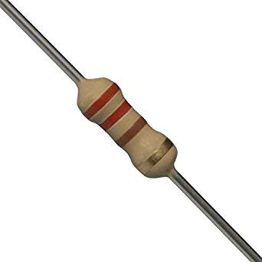
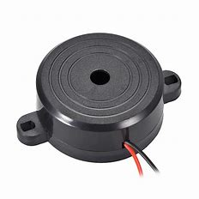

Components Used
Arduino Uno R3
Temperature Sensor
Resistors
Buzzer
LED

Slide 9

Block Diagram
Power Supply
Temperature Sensor
Arduino
Buzzer
LED

Slide 10
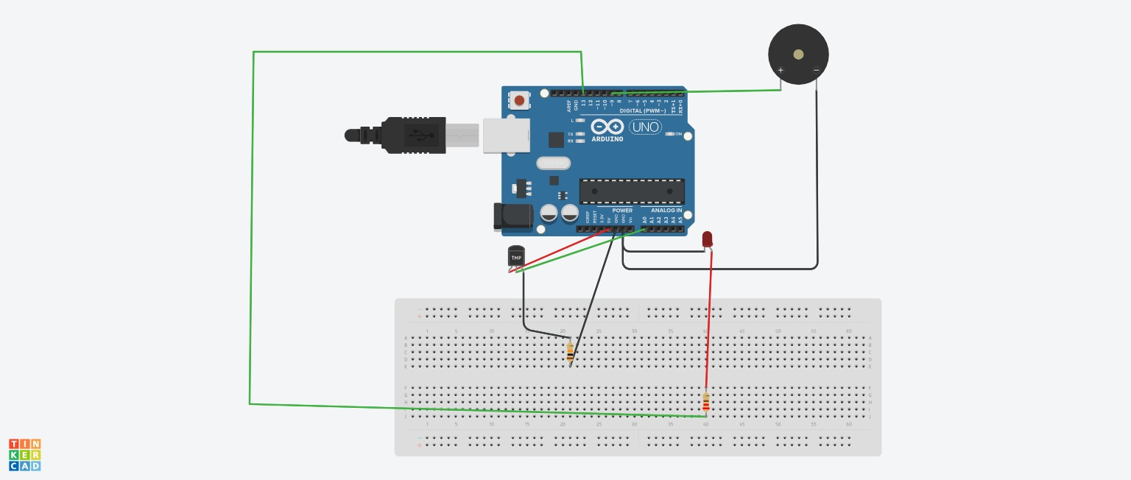
Circuit Diagram

Slide 11
Working
The project utilizes a temperature sensor connected to the targeted machine.
Arduino code is programmed to trigger a buzzer alarm when the temperature surpasses a specified threshold value.
When the temperature remains within the threshold, the buzzer remains silent, and the green LED illuminates.
Upon exceeding the threshold, the buzzer activates, and the red LED turns on.

Slide 12
PART-04
Future Goals

Slide 13
Future Goals
Planning to add reset and set buttons
Make this model useful as a home appliance
Usage of Wifi Models so that threshold temperature can be set using mobile phones.

Slide 14
Team Members
01
02
03
04
Kamat Uttara Milan
Kadam Sayali Ananda
Joyee
Biswas
Devanshi
Gupta
05
Sri Sai Geethika Anumolu

Slide 15




LOGO
THANK YOU
www.freeppt7.com
16/02/20XX
https://www.freeppt7.com

