Slide 1

AI-105 Neural Network Binary Classification Using Keras
James McCaffrey Microsoft Research Thursday, September 27, 2018
Redmond, WA 10:00 – 11:00 AM

Slide 2
Agenda and Goals
Installing Anaconda, TensorFlow, Keras (very briefly)
Data normalization and encoding (very briefly)
Binary classification vs. multiclass classification
Callbacks, dropout, regularization, train-validate-test, etc.

Slide 3
The Process
1. Understand the data. 2. Clean, normalize, encode (programmatic or external). 3. Read data into memory. 4. Create neural network. 5. Train the network/model. 6. Evaluate the model. 7. Save the model (incrementally or final). 8. Use the model to make predictions.

Slide 4
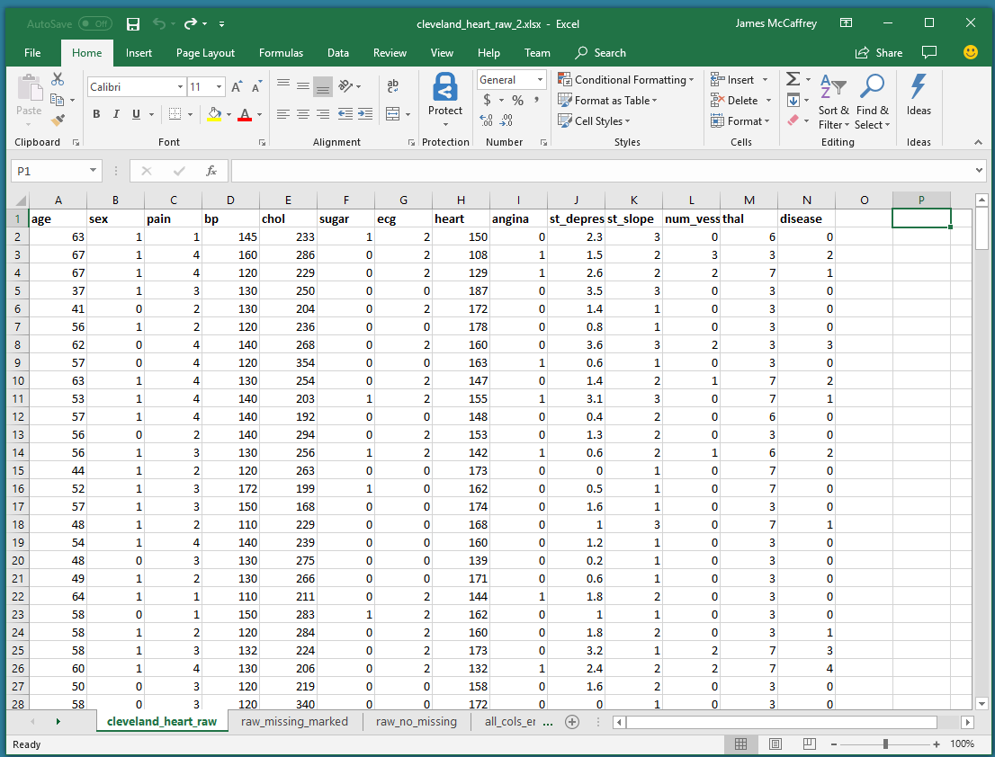

Slide 5
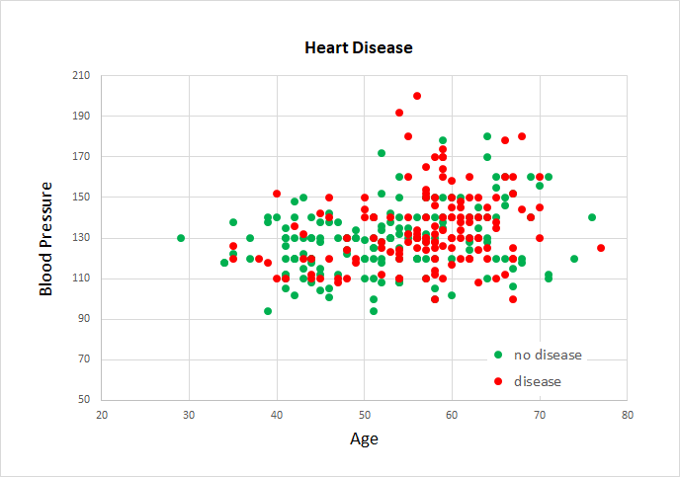

Slide 6
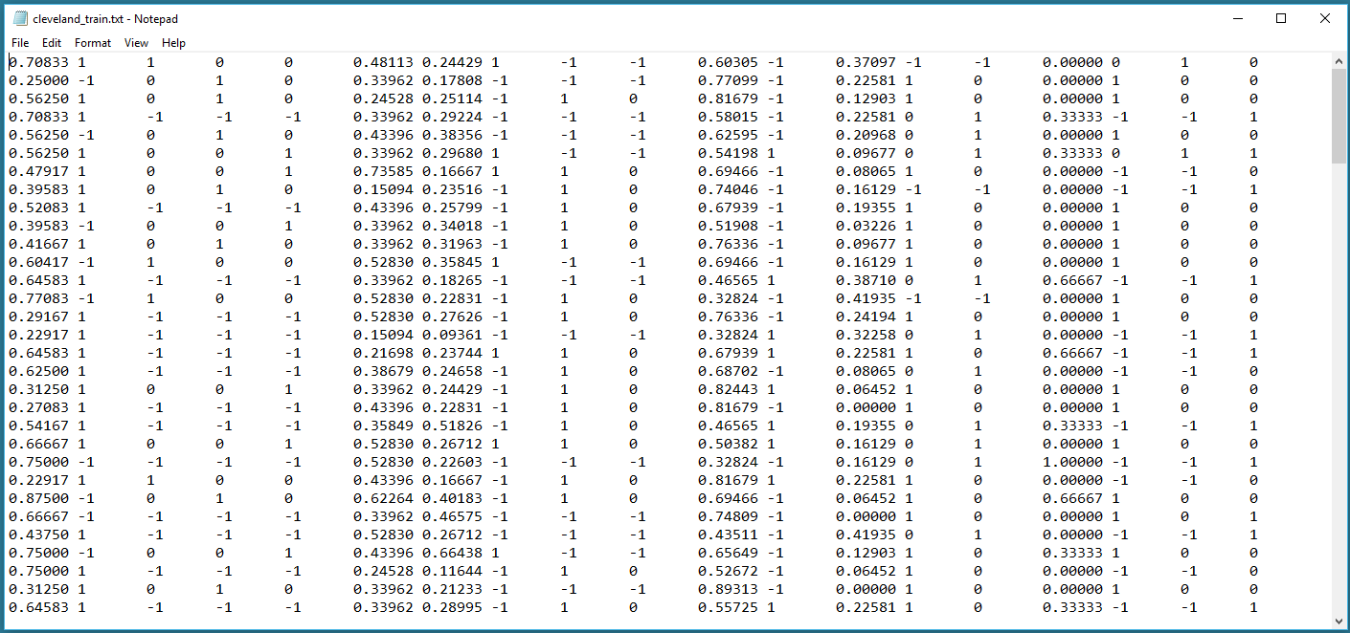

Slide 7
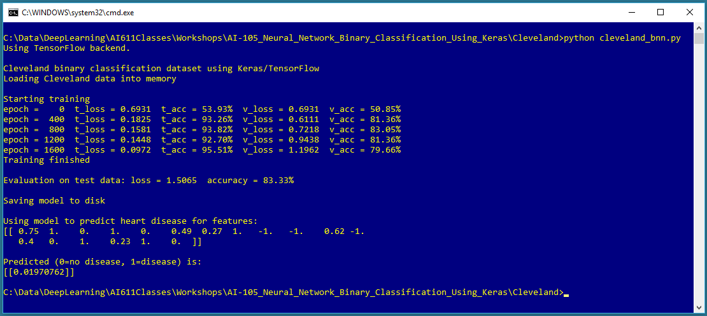

Slide 8
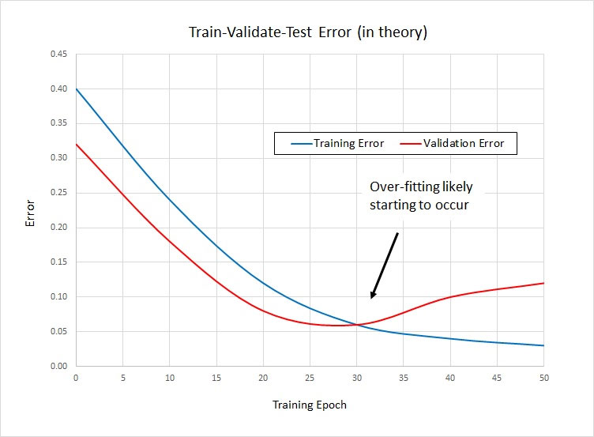

Slide 9
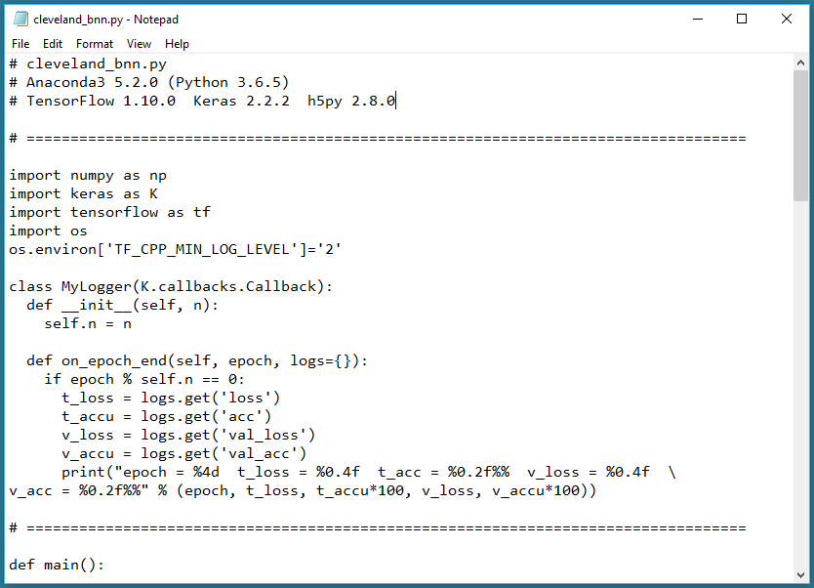

Slide 10
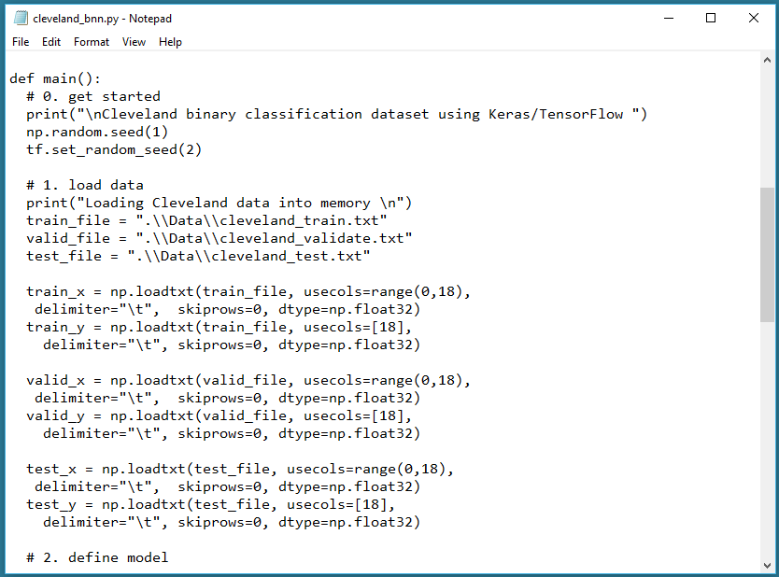

Slide 11
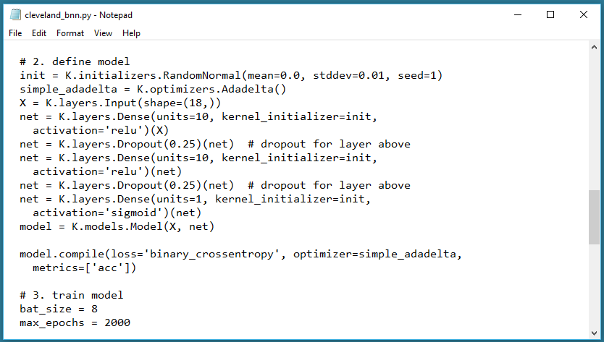

Slide 12
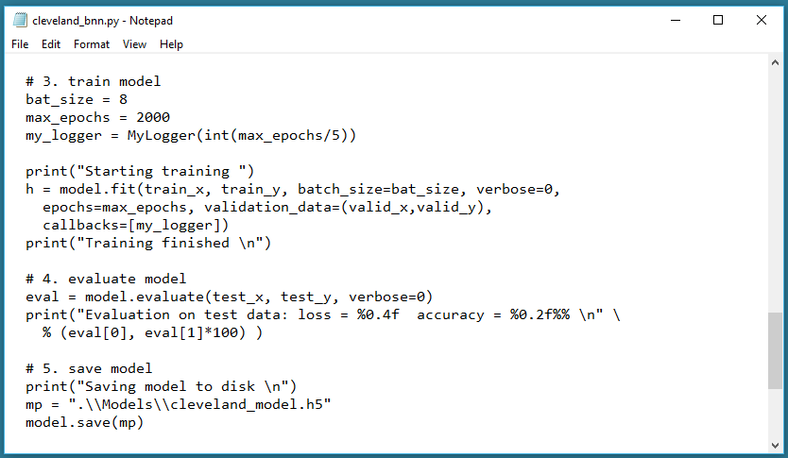

Slide 13
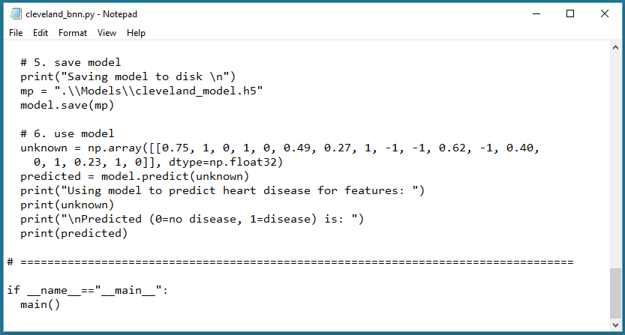

Slide 14
Summary – Neural Network Binary Classification
Data Preparation
==============================================
1. delete rows with missing
2. min-max numeric features
3. 1-of(N-1) encode categorical features
4. 0-1 encode class labels
(external prep vs. programmatic prep)
Read Data
==============================================
1. using pandas library most common
2. np.loadtxt() most flexible
3. entirely into memory vs. buffered reader
Define Neural Network Model
==============================================
1. number hidden layers - hyperparam
2. hidden activation - tanh or relu
3. output node - one, sigmoid activation
4. initialization - highly sensitive - glorot
5. dropout - hyperparam
Train Neural Network Model
==============================================
1. batch size - hyperparam
2. max epochs - hyperparam
3. train-validate-test: good in principle only
4. SGD, Adam, Adadelta (improved Adagrad),
RMSprop(recurrent NNs)
5. loss - binary cross entropy (or SE)
Evaluate Model
==============================================
1. intended to spot overfitting
2. mostly use accuracy
3. loss - comparison purposes
4. beware unbalanced class labels
Save Model
==============================================
1. weights only or entire model
2. h5 vs. ONNX
3. at end vs. incremental / checkpoint
Use Model
==============================================
1. don't forget to normalize
2. consider looking at raw output

Slide 15
Learn Neural Network Binary Classification
Create a binary classification prediction model for the Banknote Authentication dataset.
There are 1,371 data items. There are four numeric predictor variables: banknote image variance, skewness, kurtosis, entropy. The variable to predict is "authentic" (0) or "forgery" (1).
See https://archive.ics.uci.edu/ml/datasets/banknote+authentication.
Sample:
3.6216,8.6661,-2.8073,-0.44699,0 4.5459,8.1674,-2.4586,-1.4621,0 . . . -1.3971,3.3191,-1.3927,-1.9948,1 0.39012,-0.14279,-0.031994,0.35084,1 . . .

Slide 16
Other Techniques for Binary Classification
Technique | Disadvantages
Decision trees | Overfitting, sensitivity
Support vector machine (SVM) | Brittle, hyperparameters, implementation complexity
Naive Bayes | Categorical predictors only, independence of predictors
Winnow | Binary predictors only
Boosting | Independence of predictors
Logistic regression | Linearly separable problems only
k-NN | Numeric predictors only, local geometry
Cluster classification | Numeric predictors only
Perceptron | Linearly separable problems only
Linear discriminant analysis (LDA) | Numeric predictors only, linearly separable problems only

Slide 17
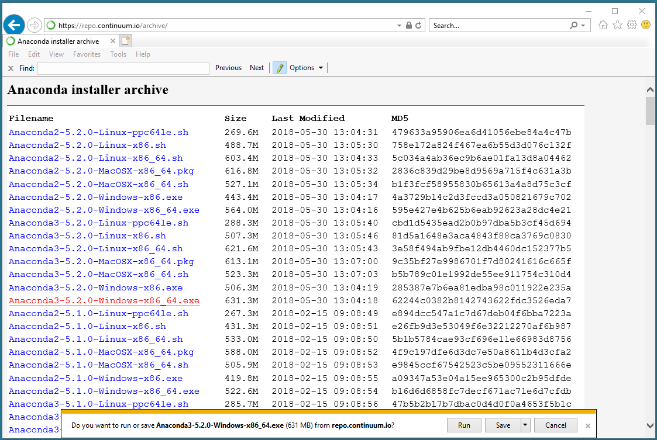

Slide 18
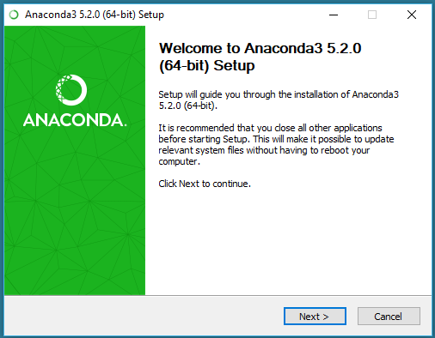
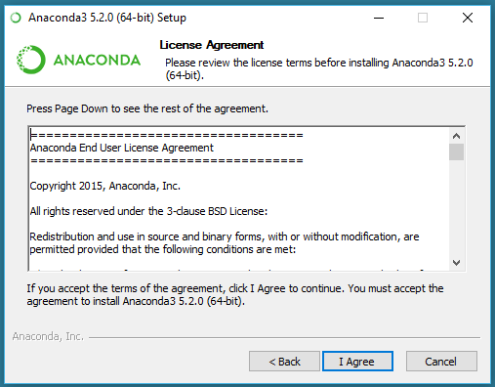

Slide 19
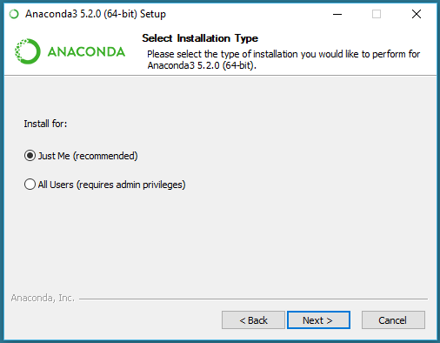
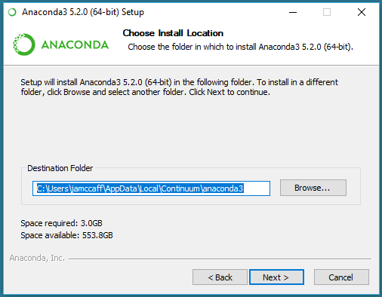

Slide 20
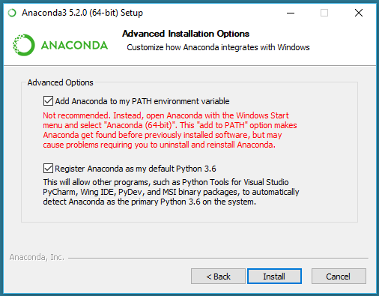
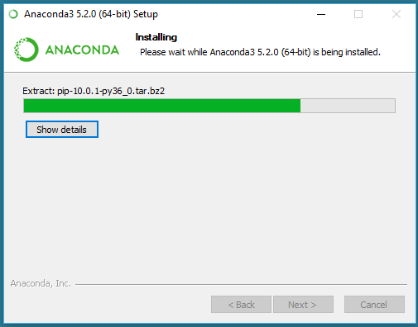

Slide 21
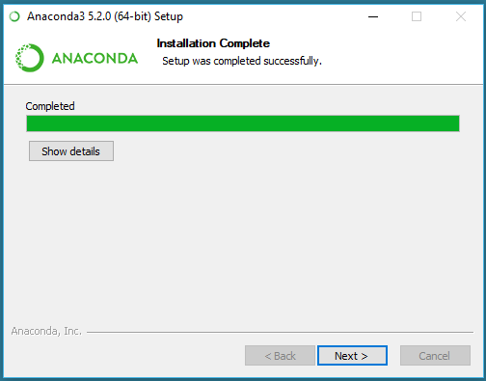
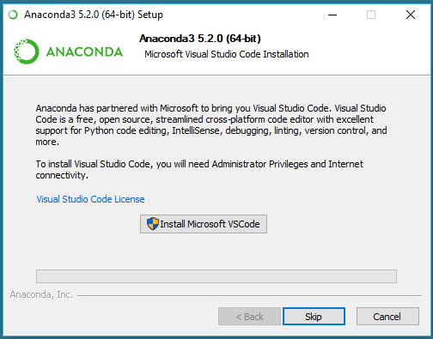

Slide 22

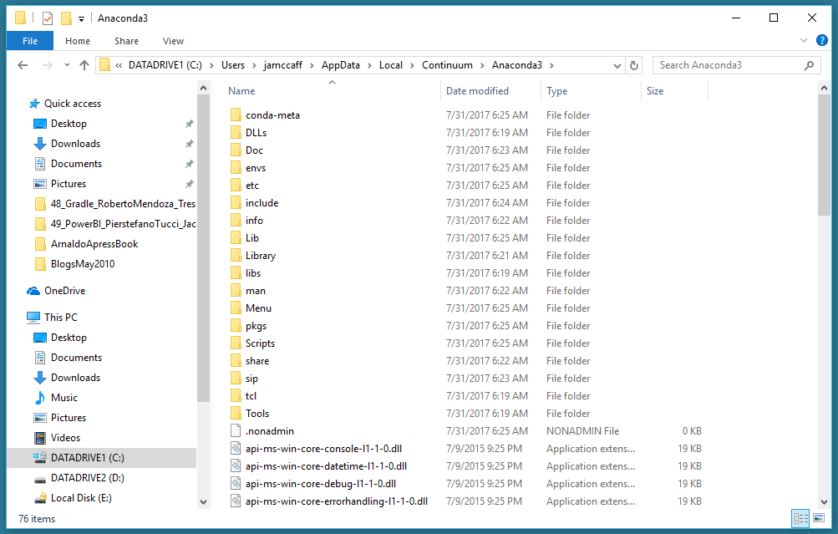

Slide 23
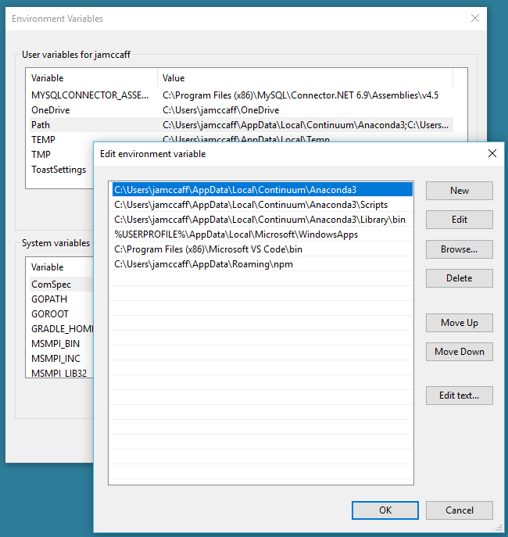
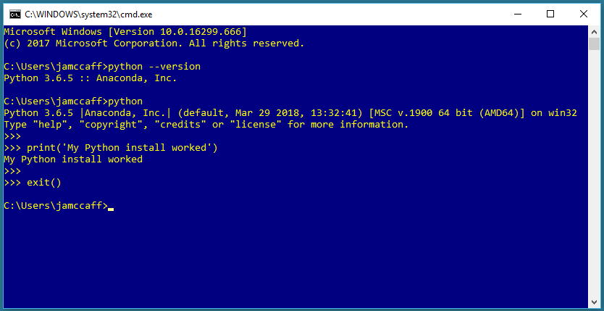

Slide 24
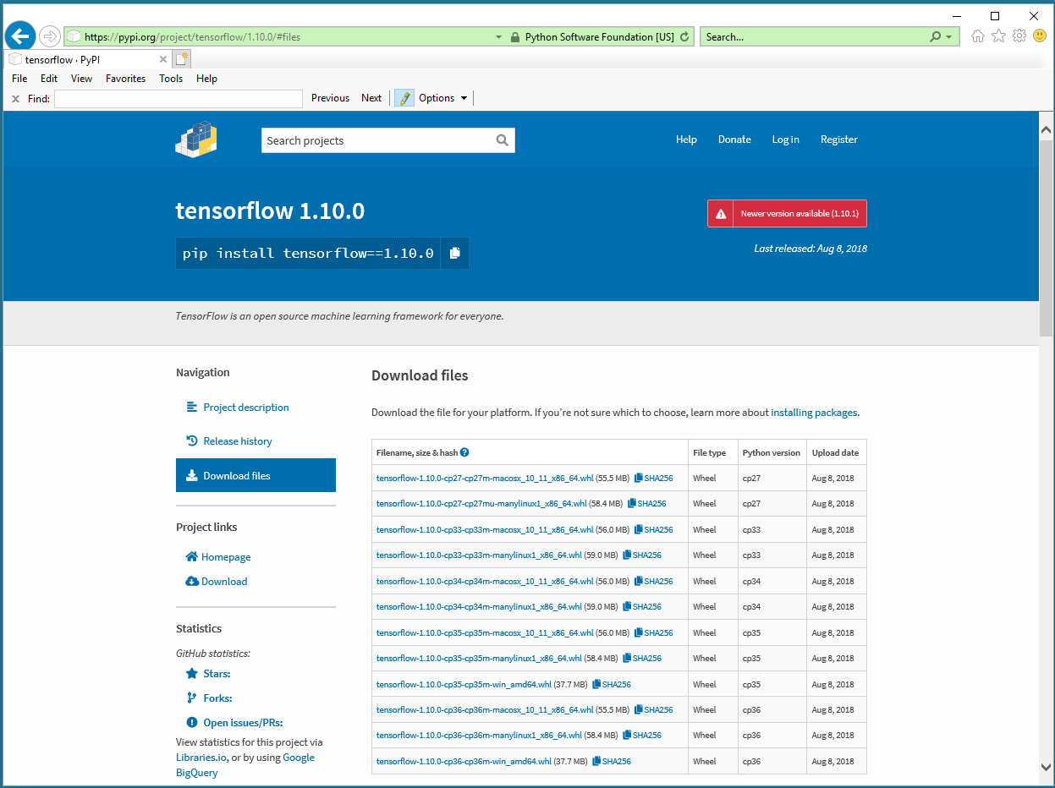
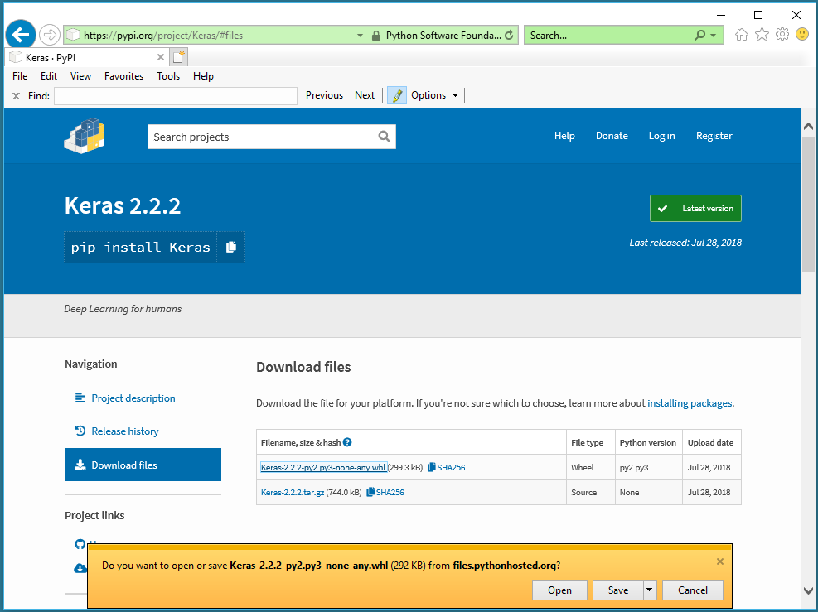
https://pypi.org/project/tensorflow/1.10.0/
https://pypi.org/project/Keras/2.2.2/

Slide 25
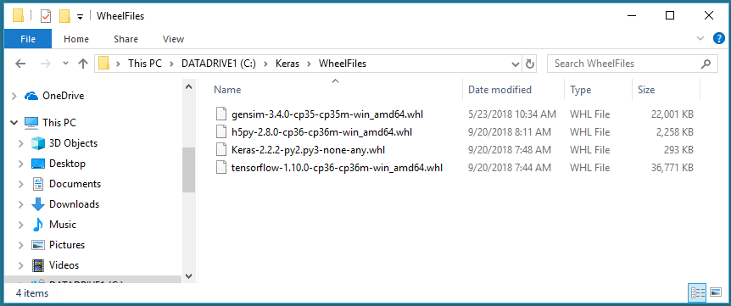

Slide 26
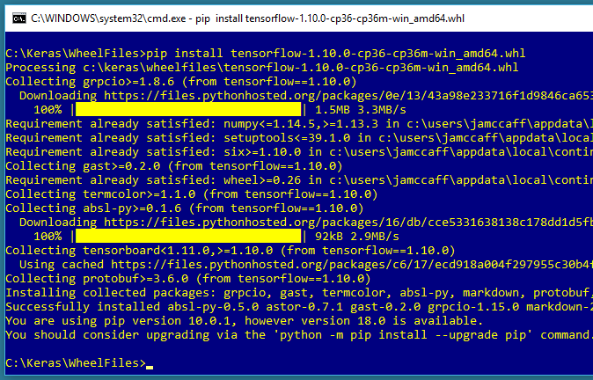

Slide 27
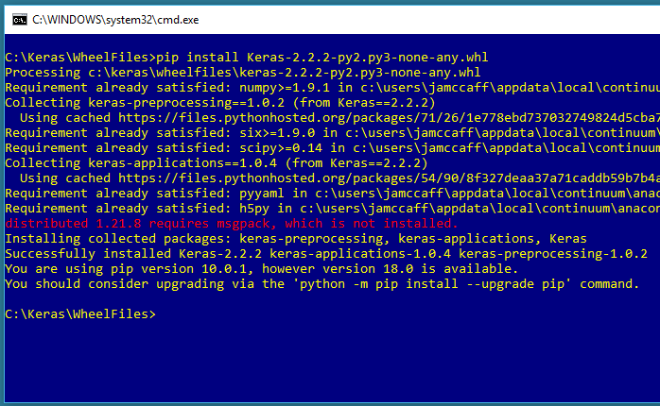

Slide 28
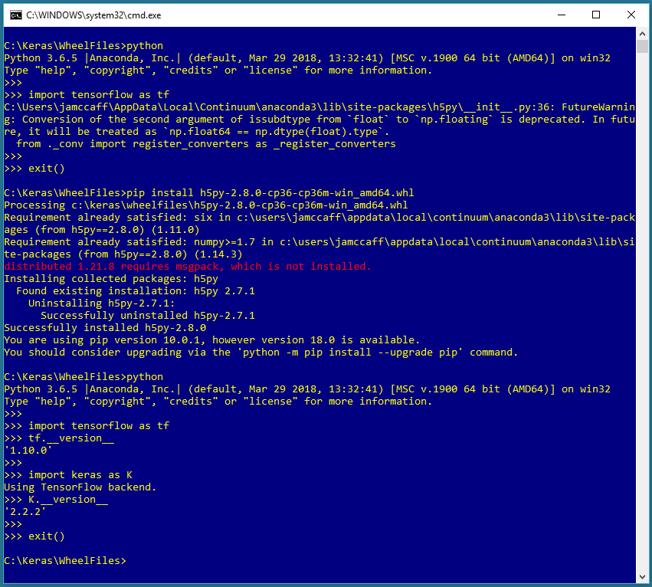

Slide 29
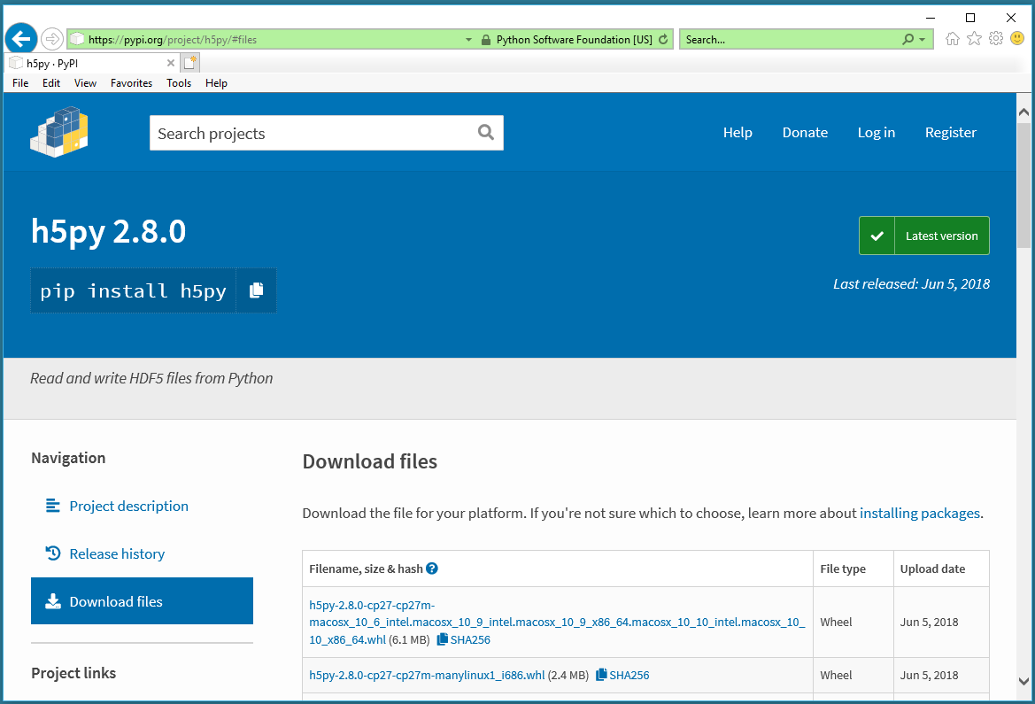

Slide 30
Thank You!
Neural Network Binary Classification Using Keras
James McCaffrey Microsoft Research jamccaff@microsoft.com https://jamesmccaffrey.wordpress.com

