Slide 1

AI-103 Introduction to Neural Networks Using Keras
James McCaffrey Microsoft Research Thursday, September 20, 2018
Redmond, WA 10:00 – 11:00 AM

Slide 2
Agenda and Goals
Installing Anaconda, TensorFlow, Keras
Preparing data for use by Keras
Creating, training, evaluating, saving, using a NN
History, callbacks, dropout, regularization, batch norm, etc.

Slide 3
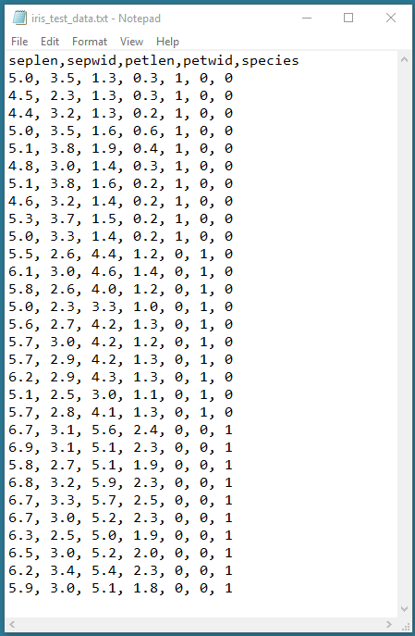
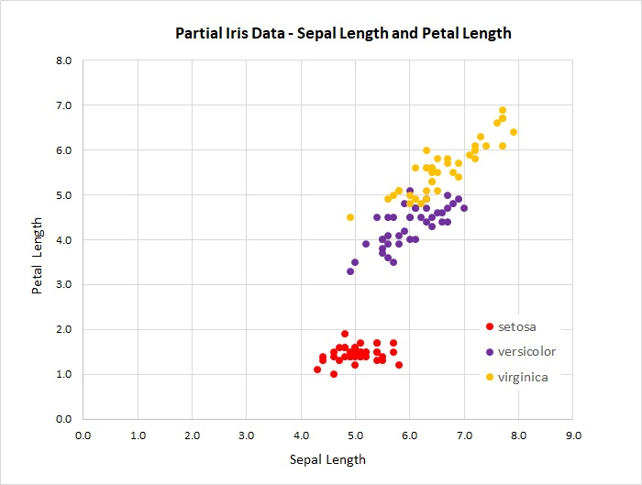

Slide 4
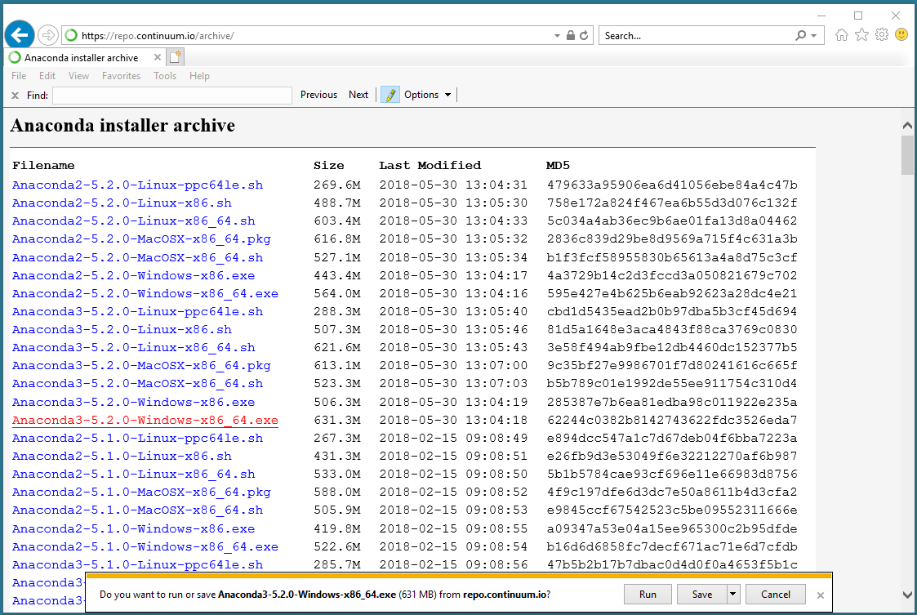

Slide 5
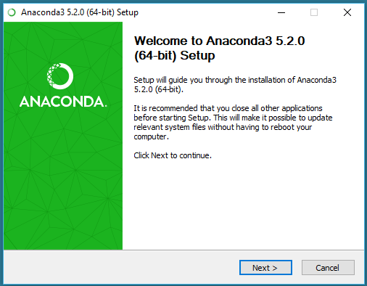
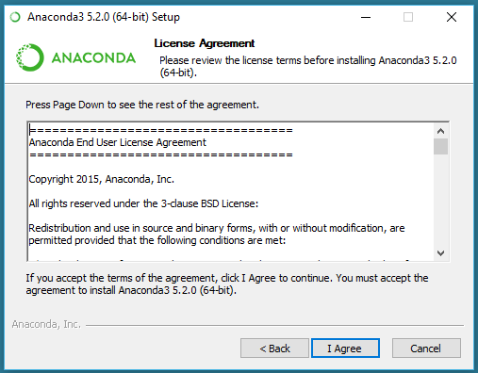

Slide 6
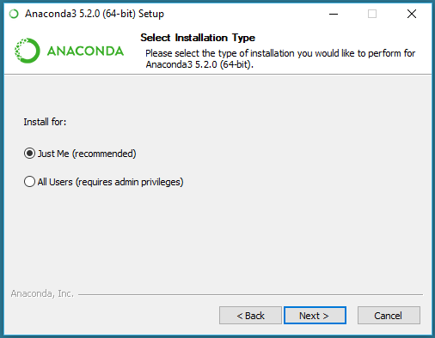
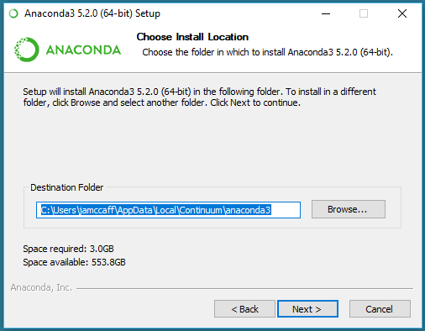

Slide 7
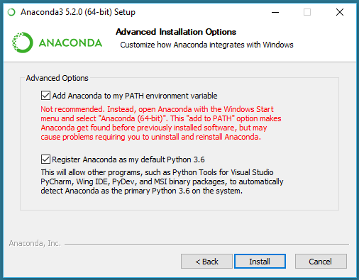
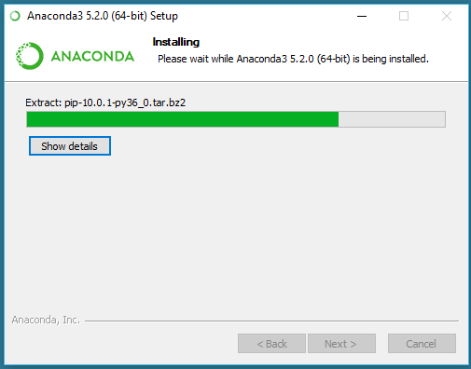

Slide 8
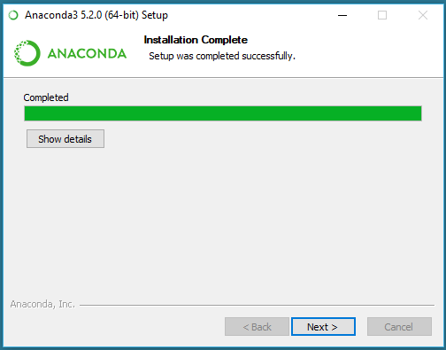
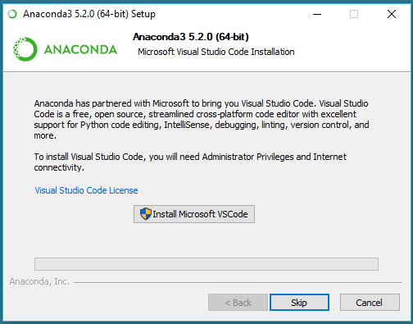

Slide 9
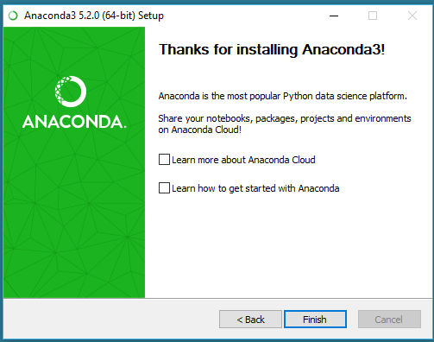
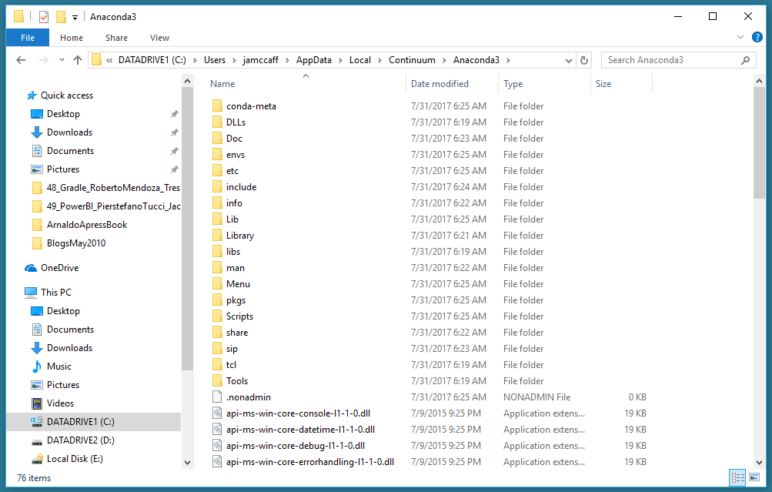

Slide 10
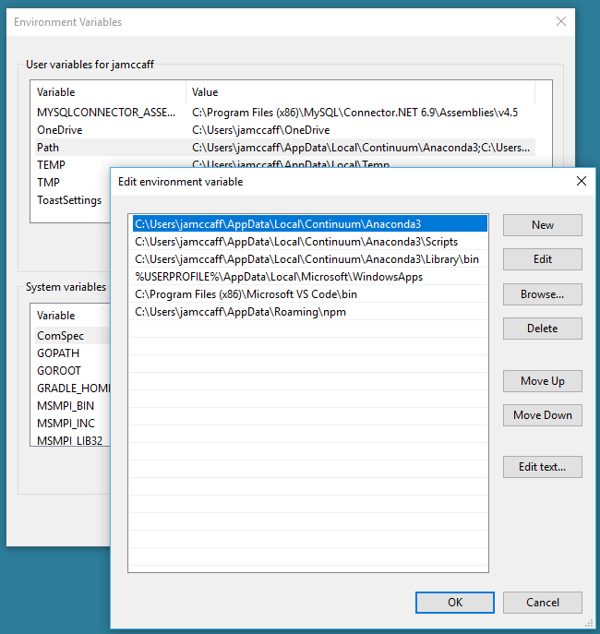
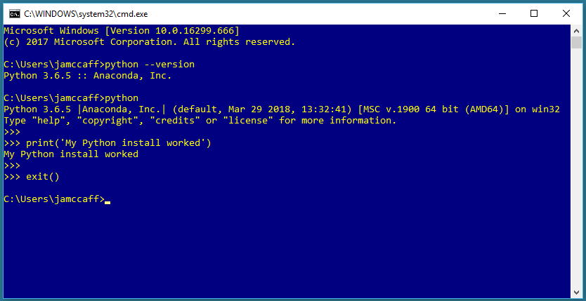

Slide 11
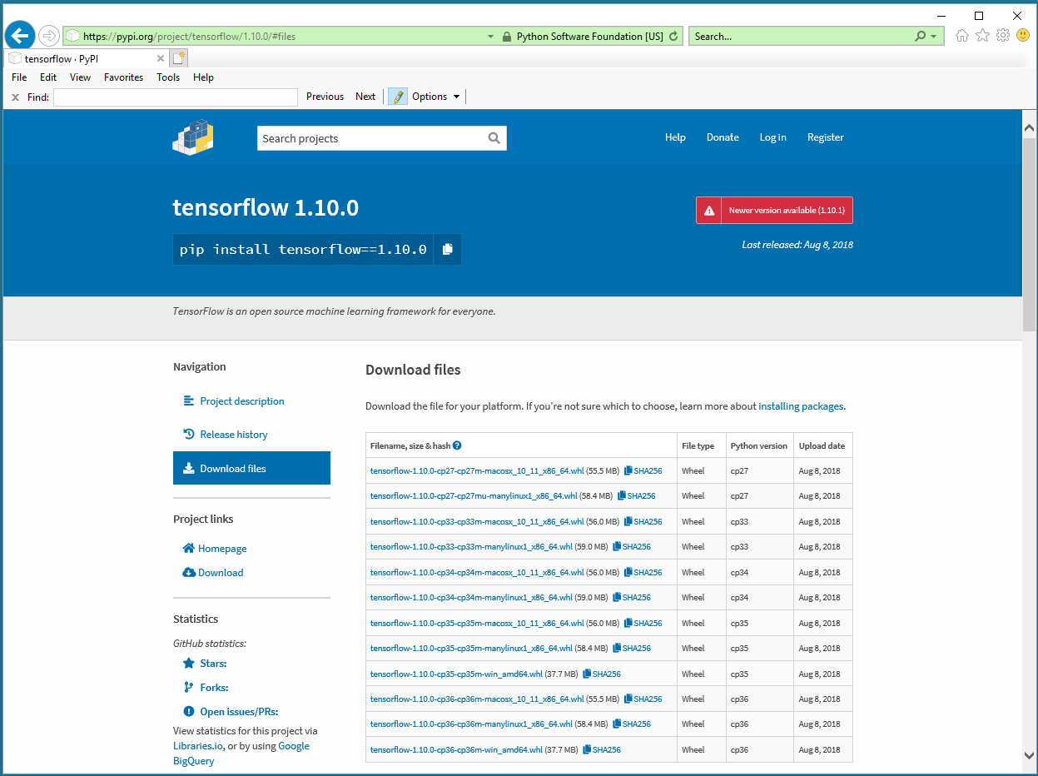
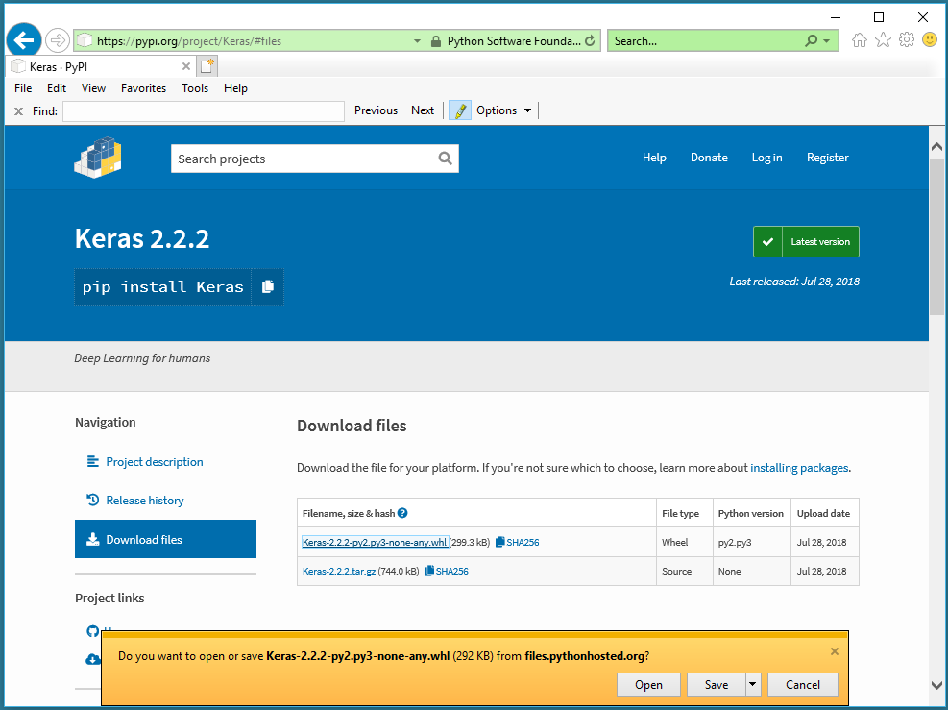
https://pypi.org/project/tensorflow/1.10.0/
https://pypi.org/project/Keras/2.2.2/

Slide 12
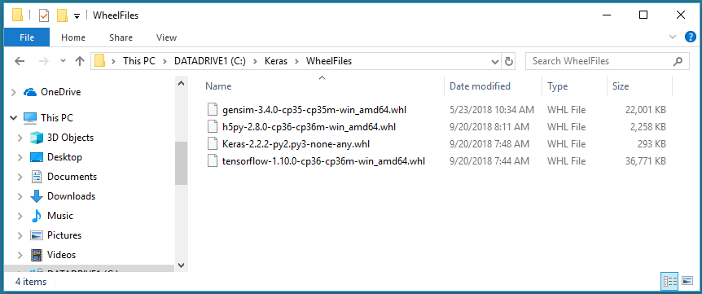

Slide 13
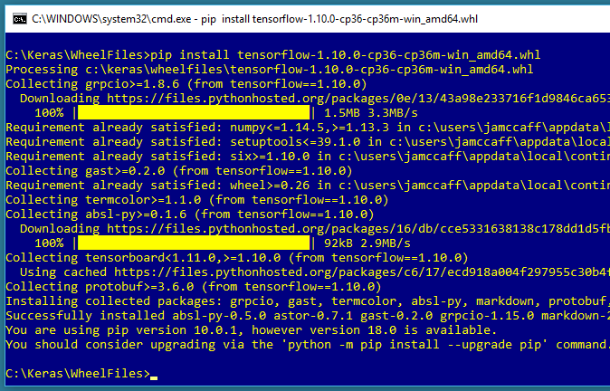

Slide 14
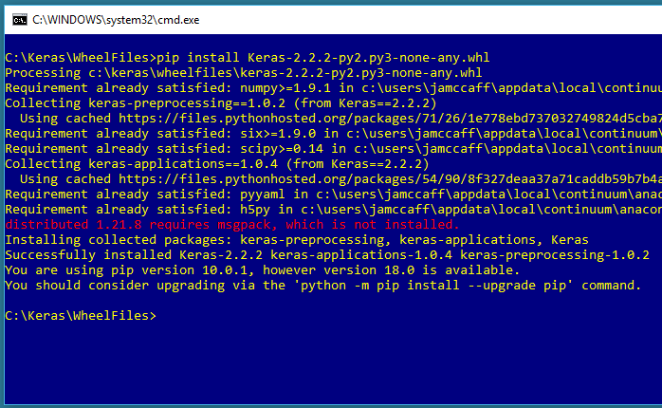

Slide 15
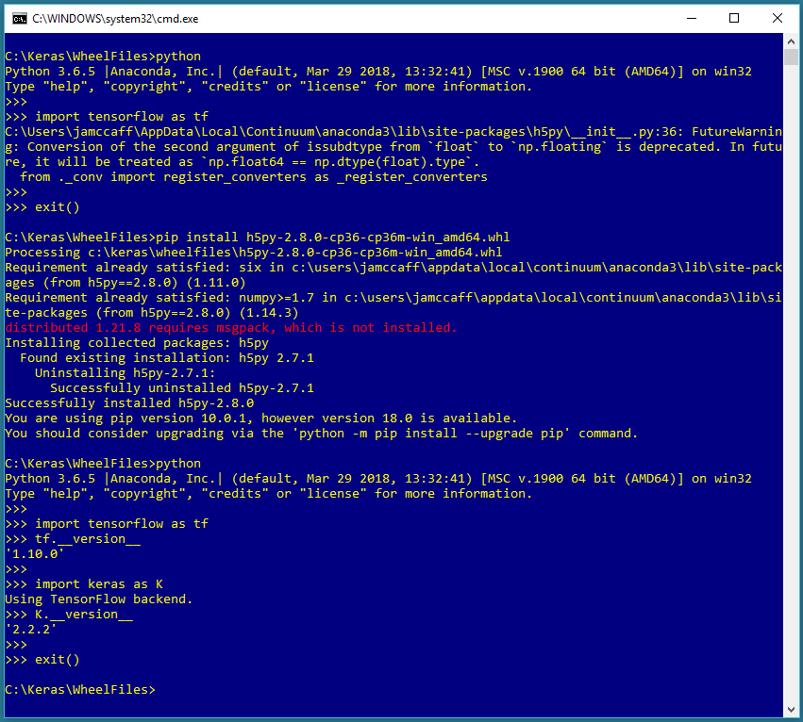

Slide 16
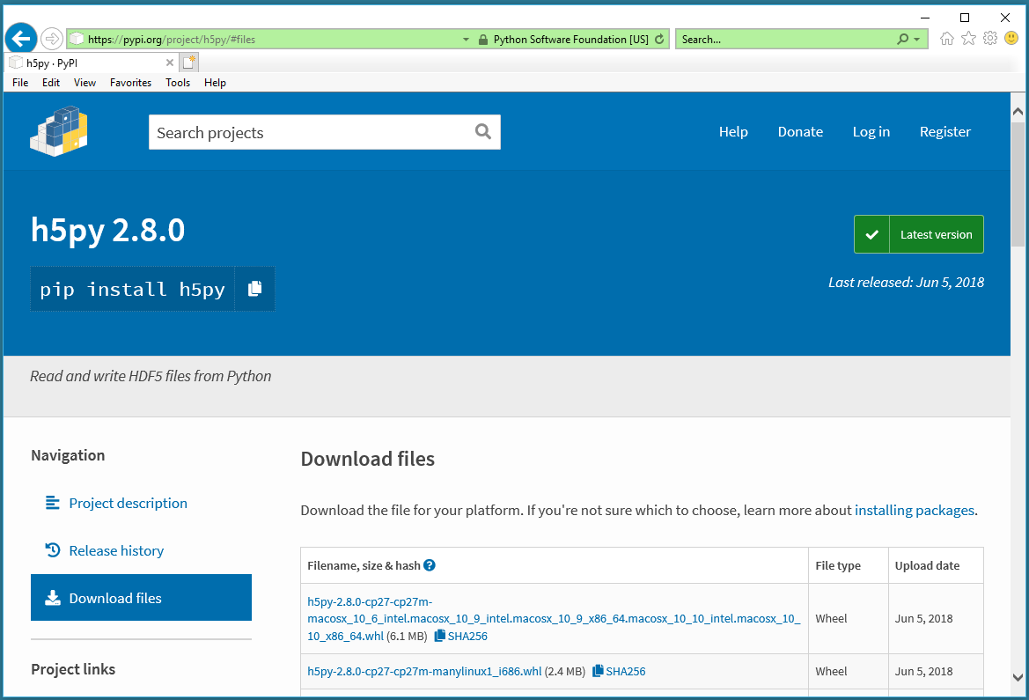

Slide 17
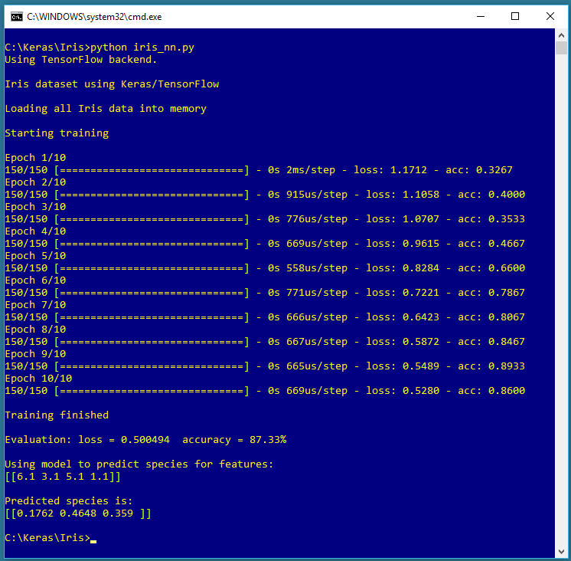
6.1
0.1762
3.1
0.4648
5.1
0.3590
1.1
(4 * 5) + (5 * 3) + (5) + (3) = 43

Slide 18
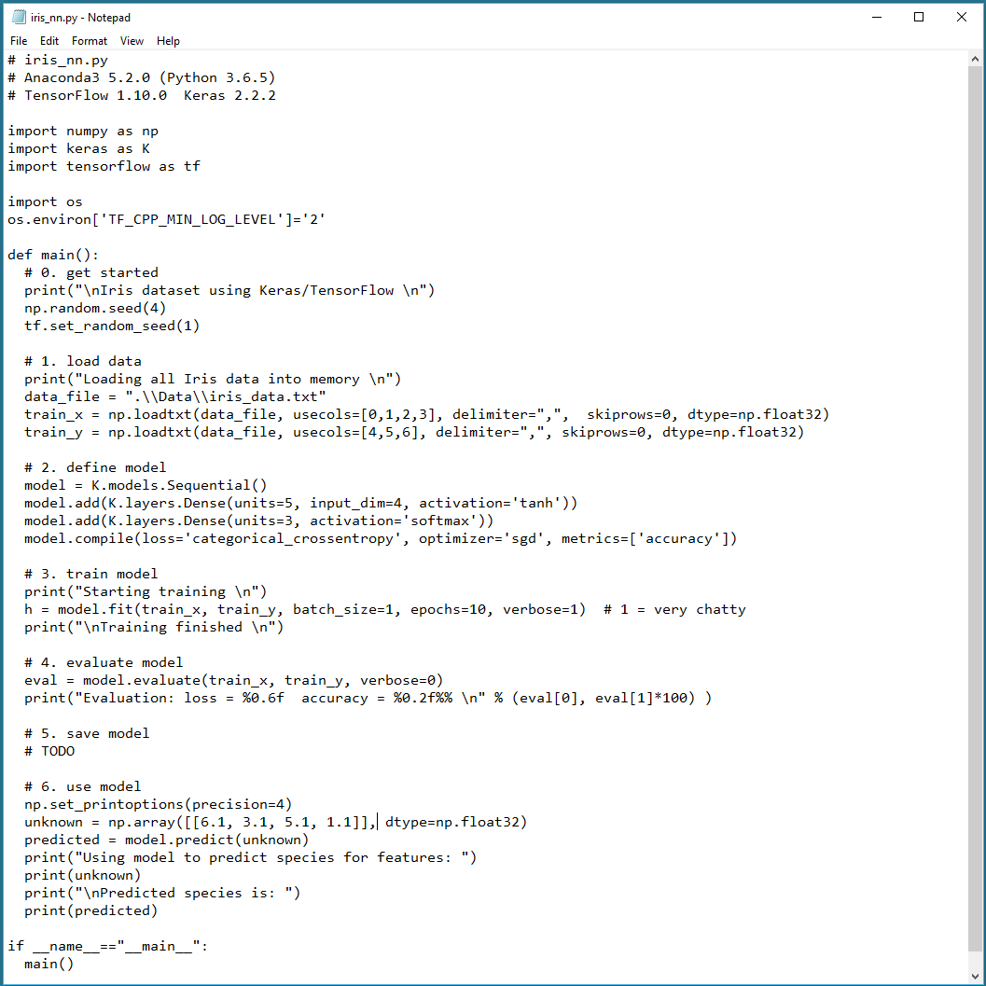

Slide 19
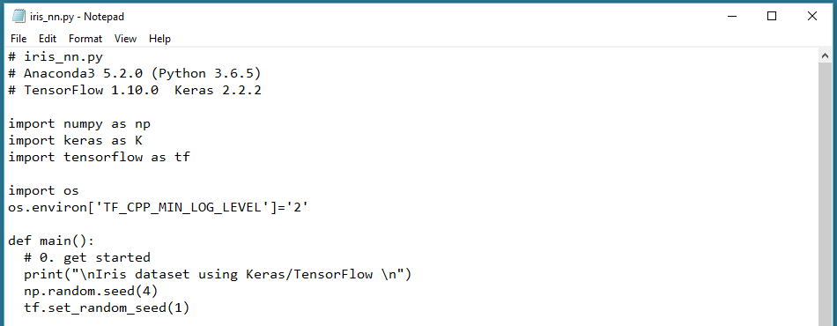

Slide 20
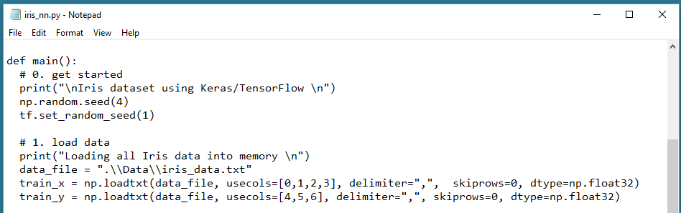

Slide 21
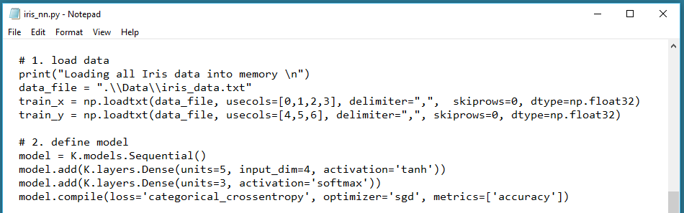

Slide 22
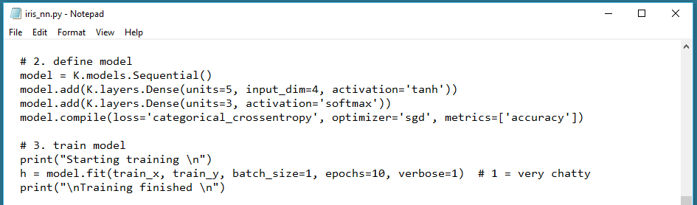

Slide 23
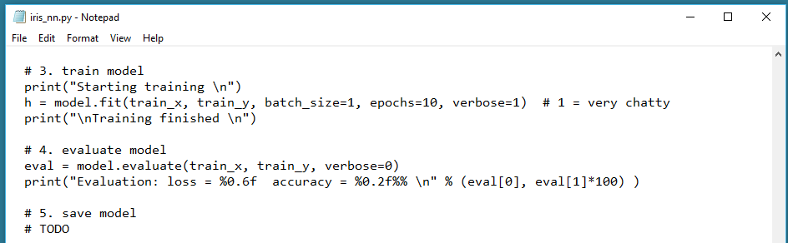

Slide 24
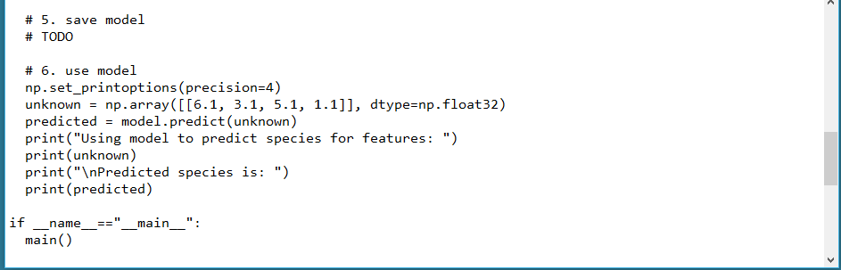

Slide 25
Next steps:
Data normalization
Data encoding
Error and loss functions
Optimization algorithms
Deep architecture
Dropout
Regularization
Batch normalization

Slide 26
Thank You!
Introduction to Neural Networks Using Keras
James McCaffrey Microsoft Research jamccaff@microsoft.com https://jamesmccaffrey.wordpress.com

