Slide 1
Pre-Training and Knowledge Distillation with unlabeled data
Compliant LU v-team

Slide 2
Agenda
Motivation
Methodology
Knowledge Distillation
Pre-training
Experiments
Model deployment
Future work

Slide 3
Motivation
Compliant LU
Challenge: Possible gaps between eyes on/off data distribution
Assumption:
Limited in-domain labeled data from eyes-on
Abundant in/out domain unlabeled data from eyes-on
Goals:
Benefit from unlabeled data while maintain scalability
Proposed methods should be robust to distribution mismatch
Quarter goals
Propose a robust slot tagging approach for communication voice skill
Target on Message and Contact name
Notes:
One expected challenge: Possible gaps between eyes on/ off data distribution, meaning that our labeled training data is different from the user
People from different enterprise can say totally different stuff.
If we only use labeled data from eyes-on, there
We really want to bridge this gap via using unlabeled data, we all know a well-known solution is to use pre-trained model. However, due to

Slide 4
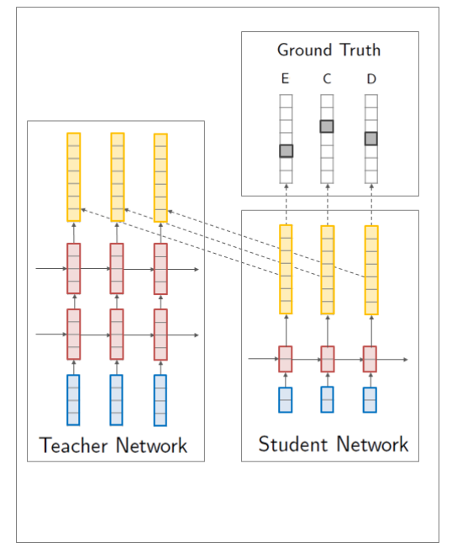
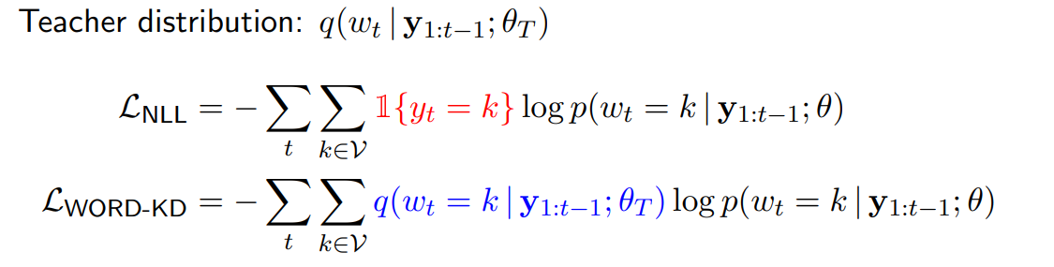

Knowledge Distillation (Bucila et al., 2006; Hinton et al., 2015; Yoon et al., 2016)
Train a larger teacher model first to obtain teacher distribution q(·)
Train a smaller student model p(·) to mimic the teacher
Unlabeled data
Labeled data
Transfer set
Notes:
Knowledge distillation is to accelerate and improve learning of a new network (student) by transferring knowledge from a previously learned network (teacher).
Generally the Teacher models deliver excellent performance, but they can be huge and computationally expensive. Hence, these models can not be deployed in limited resource environments or when real-time inference is expected.
Mention three important components: teacher network, student network and transfer set

Slide 5
Methodology
Sequence level distillation motivation
Multiple targets instead of single target
The sequence distillation is particularly important for Cortana slot tagging , because wrong predictions can propagate forward in production
Related work
Advanced distillation loss
Layer-wise distillation loss
Structural-aware distillation loss
Another line of Research focus on using additional unlabeled data source to improve distillation
Our hypothesis:
Factorized sequence distillation + unlabeled data can provide strong baseline
Notes:
Sequence distillation has been well studied
Mention that Factorized sequence distillation already provides a strong baseline
Previous literature on KD focuses on exploring the knowledge representation and the strategies for distillation. However, both the teacher and student learn from the same training data without adapting the different learning capabilities.
Due to the difference in model capacities, the student may not benefit fully from the same data points on which the teacher is trained.
The sequence distribution is particularly important for Cortana slot tagging , because wrong predictions can propagate forward in production.
Compared with previously study, we focus more on two directions:
We investigate two axes that have been under-studied in previous work: student model size and amount/quality of unlabeled data.

Slide 6
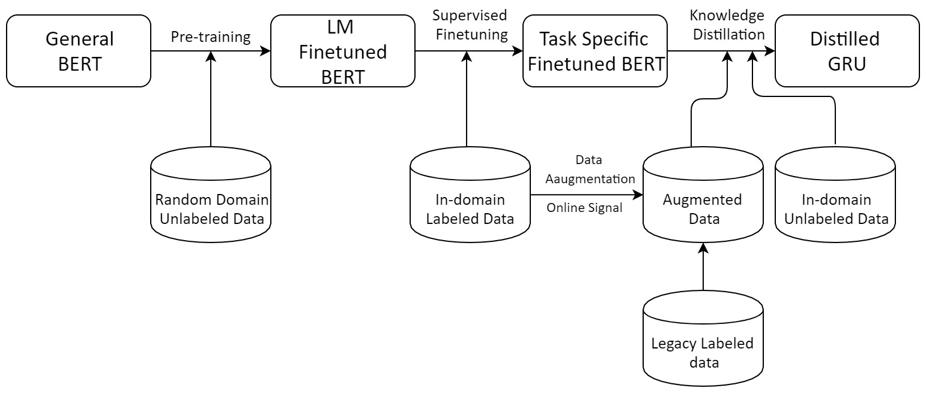
Three-stage training:​
In-domain pre-training​
In-domain fine-tuning​
Sequence level Distillation
Teacher Network
Student Network
Transfer set

Slide 7
Questions to Answer
How unlabeled data help knowledge distillation?
Whether the Transfer set helps student model
Teacher model pre-training
Whether the proposed method is robust to distribution mismatch?
How to bridge the distribution gap in compliant and non-compliant?

Slide 8
Questions to Answer
How unlabeled data help knowledge distillation?
Whether the Transfer set helps student model
Teacher model pre-training
Whether the proposed method is robust to distribution mismatch?
How to bridge the distribution gap in compliant and non-compliant?

Slide 9
Distillation Performance
 | Precision | Recall | F1 | Latency
Teacher model – Finetuned BERT | 0.8663 (0.8968) | 0.8705 (0.8930) | 0.8685 (0.8832) | 100 ms
Distilled GRU (768- 600 hidden units) with labeled+unlabeled data (transfer set) | 0.8200 (0.8861) | 0.8109 ( 0.8796) | 0.8191 (0.8732) | 4 ms
Distilled GRU (768- 600 hidden units) with labeled data only | 0.6609 (0.8139) | 0.7562 (0.8352) | 0.7053 (0.8364) | 4 ms
GRU Trained from scratch | 0.64 (0.8373) | 0.74 (0.8360) | 0.69 (0.8230) | 4 ms
LCCRF—from production | 0.82 (0.88) | 0.68 (0.81) | 0.74 (0.82) | 0.1 ms
LCCRF+Rule –from production | 0.83 (0.93) | 0.82 (0.91) | 0.82 (0.92) | 0.6 ms
Annotated data: Cortana Legacy data + Teams voice skill data (19k training data)
Transfer set: Labeled data + in-domain unlabeled data
Evaluation data: Teams Measurement set
Take away:
Distillation is helpful
Adding unlabeled data further improves distillation
Some slots are easier to match
Table 1: Score for message slot.
(Overall score for all slots) in parentheses
Notes:
Scoring the log set / training set via Teacher Model to get Soft Label.
Should we include the score for message slots? focus on message slot?
I think we can remove the score for messages slots in this side, and focus on the overall
All of the latency are measured in qas in our local dev machine l
Better change the name

Slide 10
Unlabeled data in Pre-training
 | Precision | Recall | F1
Without unlabeled data | 0.7642 | 0.8060 | 0.7845
In-domain unlabeled data | 0.8663 | 0.8706 | 0.8685
2% sampled Random-domain unlabeled data | 0.8376 | 0.8209 | 0.8291
2% sampled Random-domain unlabeled data + In-domain unlabeled data | 0.8325 | 0.8159 | 0.8241
4% sampled Random-domain unlabeled data + In-domain unlabeled data | 0.8038 | 0.8358 | 0.8195
Production ML Model LCCRF | 0.82 | 0.68 | 0.74
Production ML Model + Rule | 0.83 | 0.82 | 0.82
Teacher network performance for message slot after pre-training on different datasets
Notes:
Our assumption here is that a better teacher model usually leads to better student model
More description? About how should we answer this question--- with some experiment settings, all of the other settings are fixed, the only difference is that we vary the unlabeled data source

Slide 11
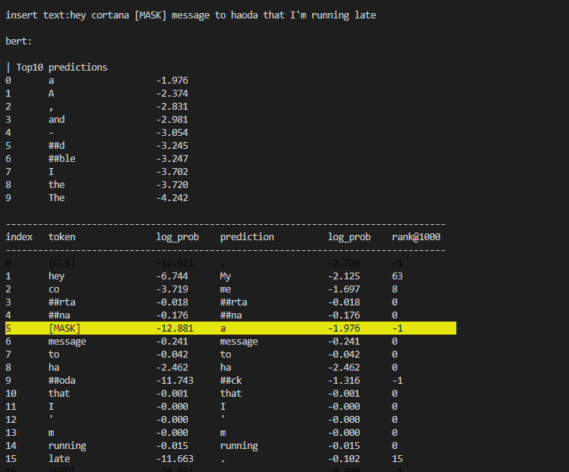
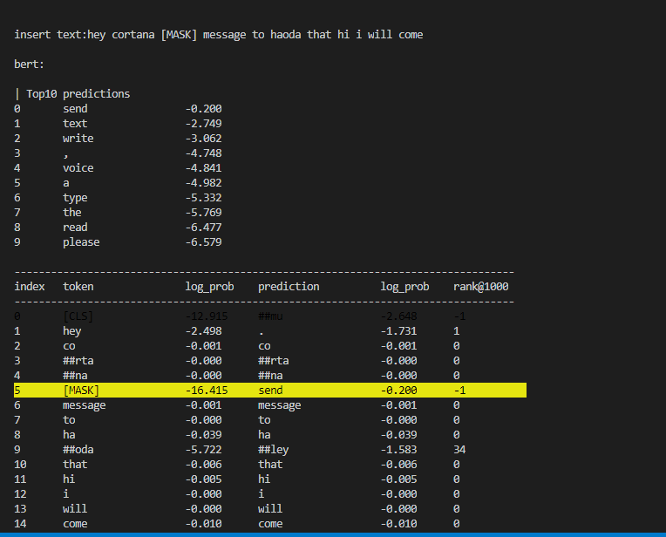
Why unlabeled data helps pre-training?
Open-domain pre-training
In-domain pre-training
Notes:
What kind of knowledge are learned after in-domain pre-training.
Mask out the verb in the sentence and ask the model to predict that specific sentence
Since Cortana related knowledge is not contained in the public training corpus, so we think to answer this question, the model has to learn some in-domain knowledge through in-domain pre-training.

Slide 12
Questions to Answer
How unlabeled data help knowledge distillation?
Whether the Transfer set helps student model
Teacher model pre-training
Whether the proposed method is robust to distribution mismatch?
How to bridge the distribution gap in compliant and non-compliant?

Slide 13
Understanding the compliant and non-compliant gap
Experiment settings:
Labeled Training data and Testing data are from different distribution
Goals:
Evaluate whether our current model is robust to distribution mismatch
Understand whether unlabeled data can help narrow the distribution gap
Understand the behavior of current LU for open text and contact name
Datasets: Generate Adversarial examples for LU from cortana response and smart reply response
Notes:
Using publicly available text data to train predictive models for use in privacy-aware enterprise settings is a very fruitful direction in the area of document understanding. However, when the labeled training dataset (source domain) is different from the unlabeled test (target domain), the two datasets likely follow different distributions. This application setting violates the i.i.d. assumption made by classic supervised learning methods and calls for domain adaptation techniques to properly account for this difference
Ref:https://openreview.net/pdf?id=BJgAGp5qLH

Slide 14
Dataset description
Data
MSIT name lexicon: ~1M names. Cleaned too short names. Sample 90% for first name only, and 10% for full name. Popular first names. [('Michael', 4249), ('David', 3951), ('Wang', 3136), ('John', 2952), ('Li', 2868), ('Zhang', 2663), ('Daniel', 2523), ('Robert', 2476), ('James', 2404), ('Thomas', 2351)]
SmartReply response candidate: ~12M. Mix of model output and human curated. All from aether non-compliant experiments. Example: [('Thank you', 996), ('Thanks', 547), ('Ok, thanks', 481), ('Will do', 389), ('Got it, thanks', 380)
Algorithm
Sample one of annotation slot examples (send_text with <message>, ~600)
Sample one of names from MSIT lexicon (~1M names) for <contact_name>
Sample one of reply candidates from SmartReply candidates (~12M)
Examples:
Send a message to Nayan that i think its okay, Send message to Abhishek do you have a pic

Slide 15
Dataset description
A little hard case that includes person name within message, for example, send a message to Minwoo, Hi Minwoo.
Data
MSIT name lexicon: same as above
Cortana queries that has <contact_name> - no communication and messaging-related scenario. ~650K.
Algorithm
Sample one of annotation slot examples (~2k)
If <message> presents: Sample <contact_name> from MSIT name lexicon and <message> from candidate query set
If no <message> present: Sample <contact_name> and append “Hi/Hello <contact_name>”
Example:
Send a message to Boshuizen saying it's hilbun, Hey Cortana, send a text to Nemani hey Neman

Slide 16
 | Synthetic Target Set (Message ~ SmartReply) |  | Synthetic Target Set (Message containing person name) |  | #Queries in training
 | Precision | Recall | Precision | Recall | Labeled | Unlabeled
LCCRF (Small) | 0.77 | 0.69 | 0.52 | 0.42 | 800 | N/A
LCCRF (+AutoLabel) | 0.74 | 0.63 | 0.61 | 0.55 | 800 | 1.2M
Teacher (BERT) | 0.8741 | 0.8201 | 0.7995 | 0.7859 | 800 | 1M
Student (GRU) | 0.8238 | 0.7872 | 0.7198 | 0.7000 | 800 | 1M
Student (GRU) + in-domain | 0.8898 | 0.8488 | 0.8803 | 0.8548 | 800 | 1.2M
Take away:
Teacher model is relatively robust to distribution mismatch
Student model’s generalization ability still limits by its capacity
Adding unlabeled data from similar distribution helps distillation
Notes:
Labeled data sources: ~ 1k Teams data
Unlabeled data sources:
1M CLU Studio data removing label
In-domain Unlabeled data: generated from same Template

Slide 17
 | Synthetic Target Set (Message ~ SmartReply) |  | Synthetic Target Set (Message containing person name) |  | #Labeled queries (train)
 | Precision | Recall | Precision | Recall
Prod model---retraining lccrf on the same data
Teacher model | 0.8741 | 0.8201 | 0.7995 | 0.7859
Distilled model with unlabeled data from teams traffic | 0.8238 | 0.7872 | 0.7198 | 0.7000
Distilled model with in-domain unlabeled data + teams traffic | 0.8898 | 0.8488 | 0.8803 | 0.8548
Experiment settings:
Labeled data sources: ~ 1k Teams data
Unlabeled data sources:
1M CLU Studio data removing label
In-domain Unlabeled data: generated from same Template
Take away:
Teacher model is relatively robust to distribution mismatch
Student model’s generalization ability still limits by its capacity
Adding unlabeled data from similar distribution helps distillation
Notes:
We may need to add another

Slide 18
Qualitative analysis
Ground Truth | Prod Model Prediction | Distilled model Prediction
Message <contact_name> Nevet </contact_name> <message> let me know and i will look </message> | Message Nevet <message> let me know and i will look </message> | Message <contact_name> Nevet </contact_name> <message> let me know and i will look </message>
Let <contact_name> Oliveira </contact_name> know <message> i appreciate your offer </message> | Let <contact_name> Oliveira </contact_name> know i appreciate your offer | Let <contact_name> Oliveira </contact_name> know <message> i appreciate your offer </message>
Message <contact_name> Loh </contact_name> that <message> We have not heard from you </message> | Message <message> Loh that We have not heard from you </message> | Message <contact_name> Loh </contact_name> that <message> We have not heard from you </message>
Send message to <contact_name> Barczak </contact_name> that <message> back with you later </message> | Send message to <contact_name> Barczak </contact_name> that back with you later | Send message to <contact_name> Barczak </contact_name> that <message> back with you later </message>
Ground Truth | Prod Model Prediction | Distilled model Prediction
Cortana send a message to <contact_name> Alex </contact_name> <message> bye Alex </message> | Cortana send a message to <<message> > Alex bye Alex </message> | Cortana send a message to <contact_name> Alex </contact_name> <message> bye Alex </message>
Cortana send a message to <contact_name> Alex </contact_name> that <message> bye Alex </message> | Cortana send a message to <contact_name> Alex </contact_name> that < contact_name > bye Alex </ contact_name > | Cortana send a message to <contact_name> Alex </contact_name> that <message> bye Alex </message>
Send a message to <contact_name> Senoo </contact_name> that <message> hi Senoo </message> | Send a message to <contact_name> Senoo </contact_name> that hi Senoo | Send a message to <contact_name> Senoo </contact_name> that <message> hi Senoo </message>
Hey Cortana. Send message to <contact_name> Bronitskiy </contact_name> that <message> kannappa speaking </message> | Hey Cortana. Send message to <contact_name> Bronitskiy </contact_name> that kannappa speaking | Hey Cortana. Send message to <contact_name> Bronitskiy </contact_name> that <message> kannappa speaking </message>
Open Text
Open Text with contact name
Notes:
Message contents

Slide 19
Reproduce results in compliant
Goal: Generate unlabeled data that have similar distribution
Assumption: limited labeled in-domain seed data
Approaches:
Select in-domain data based on sentence embedding
What if this is new scenario and no candidate data in CIV
Given the seed data + we do query expansion if selected size is not expected
To increase data variance in both action and responses
If we can expansion query from limited seeded data ( similar to the test distribution)---- and get reasonable results

Slide 20
 | SmartReply Response |  | Contactname Response |  | Teams Blind
 | Precision | Recall | Precision | Recall | Precision | Recall
Prod model | 0.8774 | 0.6584 | 0.8099 | 0.6921 | ~ | ~
Teacher model | 0.8741 | 0.8201 | 0.7995 | 0.7859 | 0.88 | 0.87
Distilled model with unlabeled CIV data (~50k) | 0.66 | 0.62 | 0.73 | 0.65 | 0.85 | 0.80
Distilled model with query expansion seed data (~500k) | 0.9133 | 0.8570 | 0.76 | 0.78 | 0.87 | 0.86
Notes:
me
In-domain unlabeled data
Augmented unlabeled data from language model
Selected unlabeled data from cortana impression view
Labeled data only

Slide 21


Path to Shipping
Offline latency/memory test and optimization
Graph optimization and dynamic length of input
Onnx-1.4 → Onnx-1.6 (Thanks to QAS!)
Target measurement sets
Synthetic measurement sets for messaging skill
Data donation and query expansion
E2E offline measurement – Prod vs new model
Shadow flighting and E2E perf metrics (stress test)
AB Flight on Northstar

Slide 22
Latency
*This was measured in a dev machine and a real latency in data center (Model D) may be slower.

Slide 23
Future Work
Application wide: Extend the knowledge distillation framework
To different domains in Teams
To intent/domain classification
Select in-domain unlabeled data from eyes-off traffic for both training and evaluation
Semantic based search
Contextual aware query expansion
Technology
Layer wise distillation and Stage
Different teacher checkpoint
Ensemble Teacher with beam search

Slide 24
Reference
Bucila, C., Caruana, R., and Niculescu-Mizil, A. (2006). Model Compression. In Proceedings of KDD.
Hinton, G., Vinyals, O., and Dean, J. (2015). Distilling the Knowledge in a Neural Network. arXiv:1503.0253
Kim, Y. and Rush, A.M., 2016, November. Sequence-Level Knowledge Distillation. In Proceedings of the 2016 Conference on Empirical Methods in Natural Language Processing (pp. 1317-1327).

Slide 25
Appendix

Slide 26
Model capacity experiment?
Conclusion: the model capacity is a key factor to the final performance
If time permits? Along with the memory/latency experiment
We can show the hyperparameter validation loss for different model

