Slide 1

Powerlifting
Aidan Kelley
Jenalee Swain
Sarah (Jung Hee) Son
Steve Young

Slide 2
Data Design
Remove columns
2. Filter Rows based on specified criteria for USPA and USAPL
3. Covert selected columns to float data type
Convert ‘Place’ column to integer
Covert ‘Date’ column to date
Data Cleaning
Replace NaN values with 0
Delete rows where ‘AgeClass’ is blank
Extract year from ‘Date’ column to a new column ‘Year’
Convert kg to lb
Export the new dataframe as a new CSV file

Slide 3
Gender Split

Slide 4
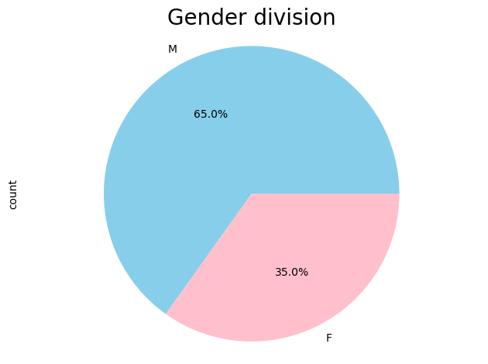
Gender Division of Illinois USAPL & USPA Athletes
2012-2023 timespan
USAPL & USPA Federations
Male Athletes:
1323
Female Athletes:
708
Notes:
Value.count by Gender
Pie chart

Slide 5
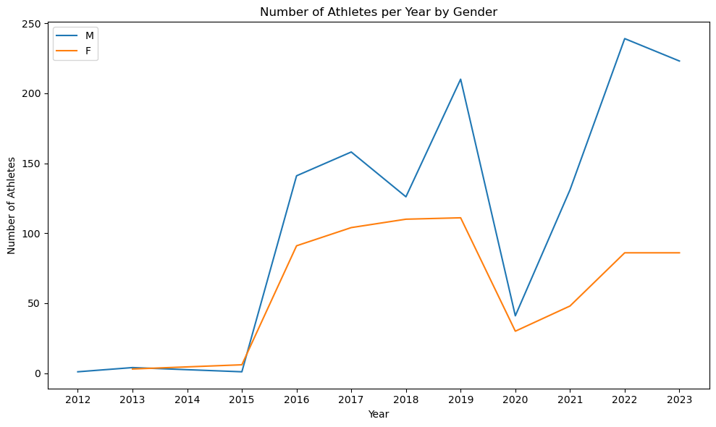
Number of Athletes per Year by Gender
Notes:
Fiilter ‘firstplace’ = place =1

Slide 6
First Place by Age Class and Gender

Slide 7
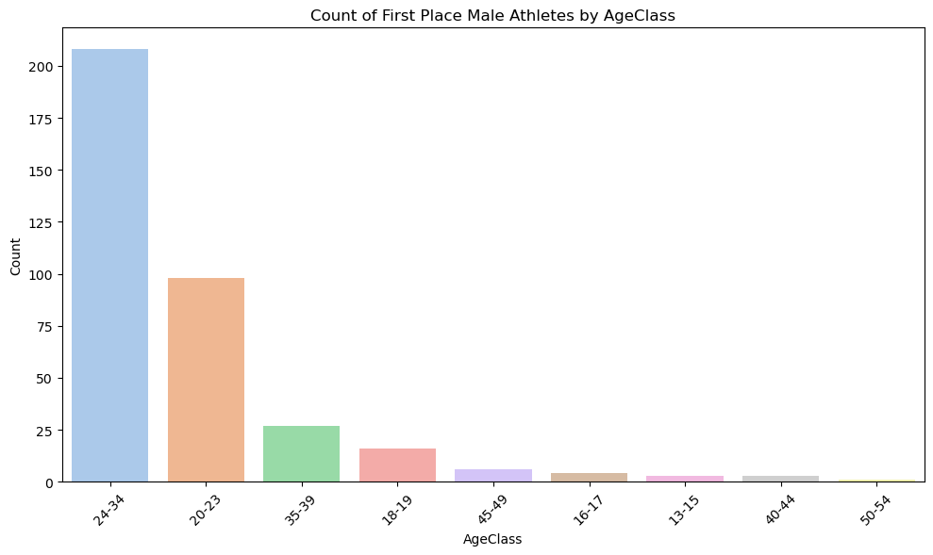
Count of First Place Male Athletes by Age Class
Age Class
24-34
208
20-23
98
35-39
27
18-19
16
45-49
6
Notes:
Fiilter ‘firstplace’ = place =1

Slide 8
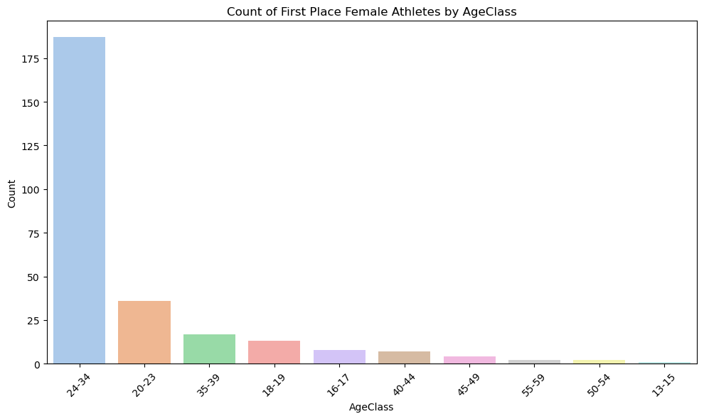
Count of First Place Female Athletes by Age Class
Age Class:
24-34
187
20-23
36
35-39
17
18-19
13
16-17
8

Slide 9
Body Mineral Density by Gender & Age

Slide 10
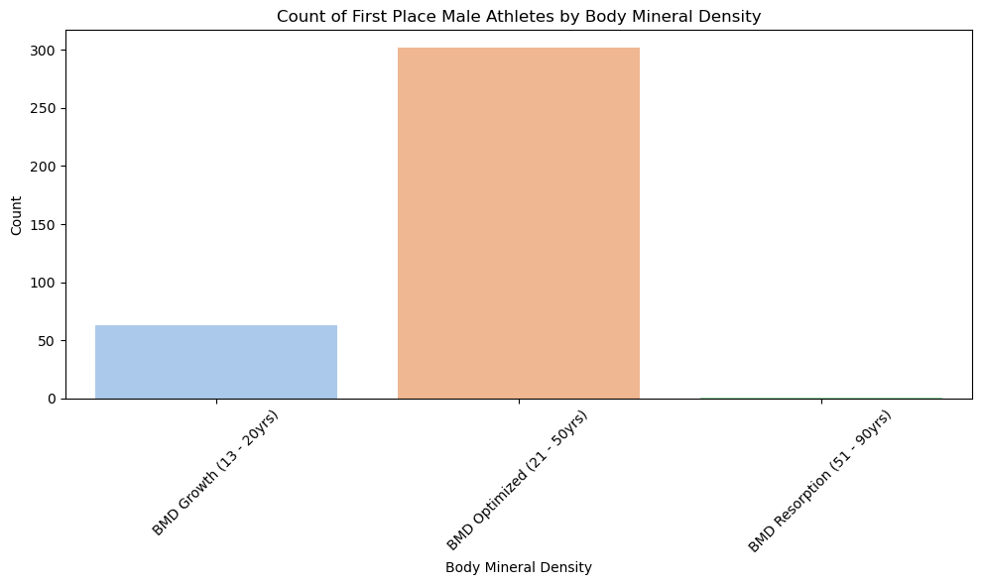
Body Mineral Density Male Athletes

Slide 11
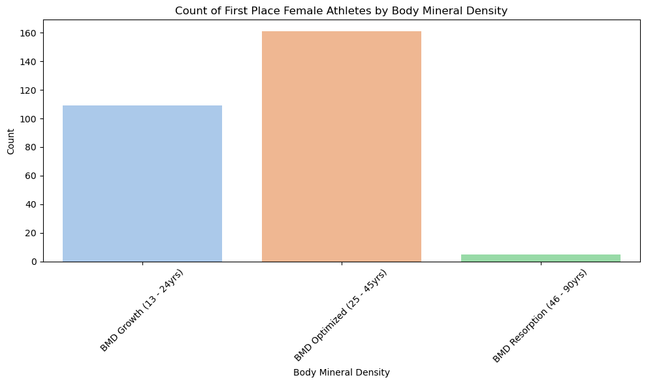
Body Mineral Density Female Athletes

Slide 12
Best Attempt of Each Lift

Slide 13
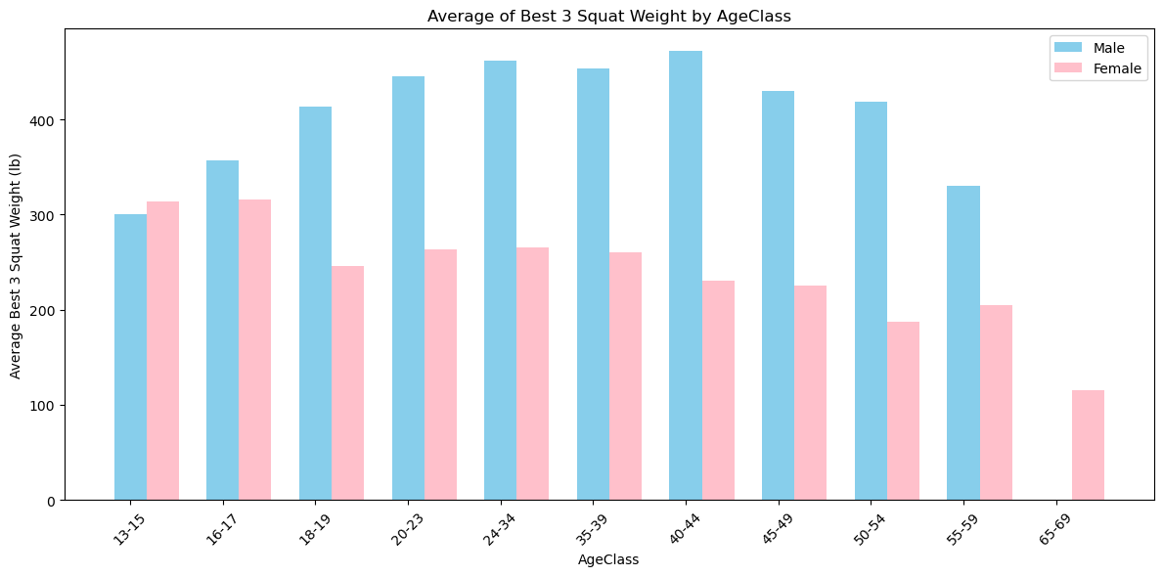
Best Squat Attempt Male vs Female

Slide 14
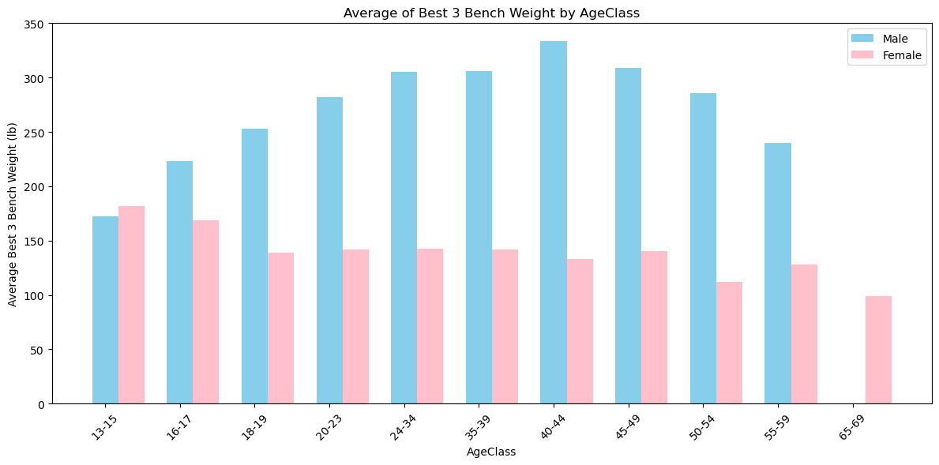
Best Bench Attempt Male vs Female

Slide 15

Best Deadlift Attempt Male vs Female

Slide 16
Average Weight Lifted

Slide 17
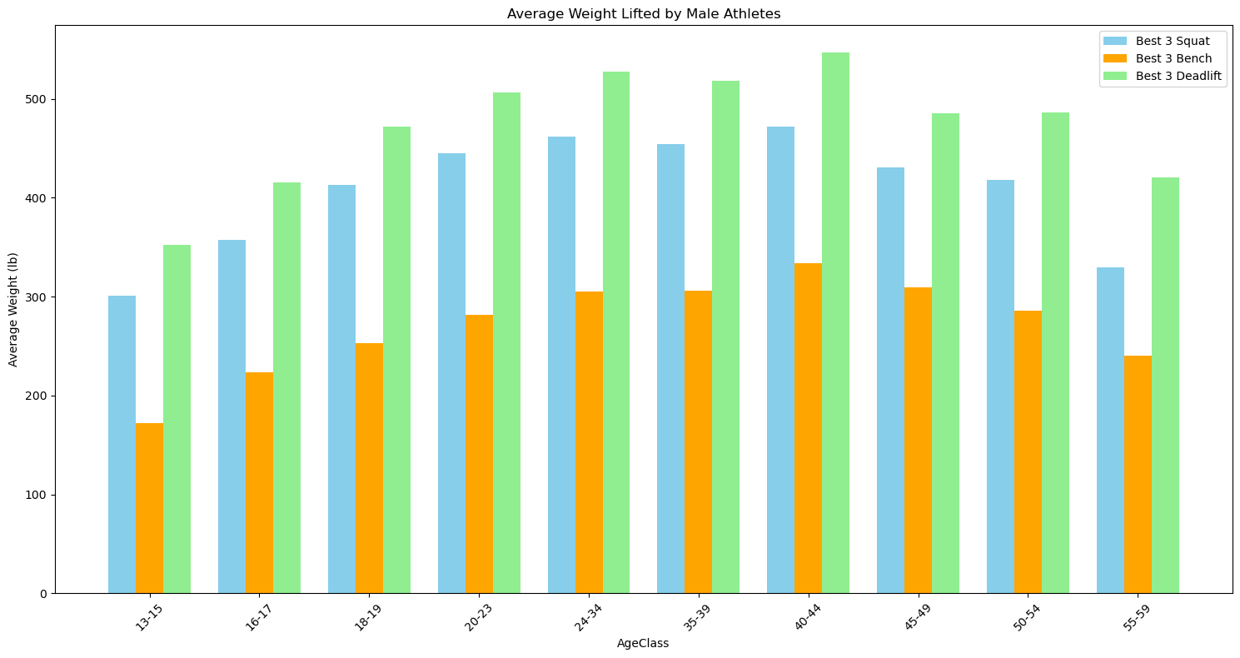
Average Weight Lifted by Male Athletes

Slide 18
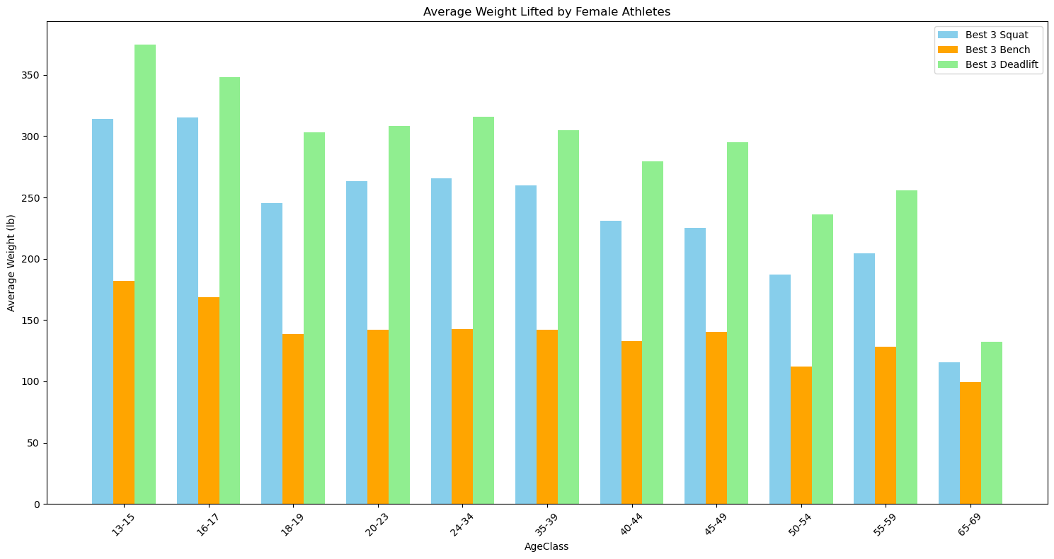
Average Weight Lifted by Female Athletes

Slide 19
DOTS Dynamic Objective Total Score is a calculation of the amount lifted as a ratio to the body weight of the athlete.

Slide 20
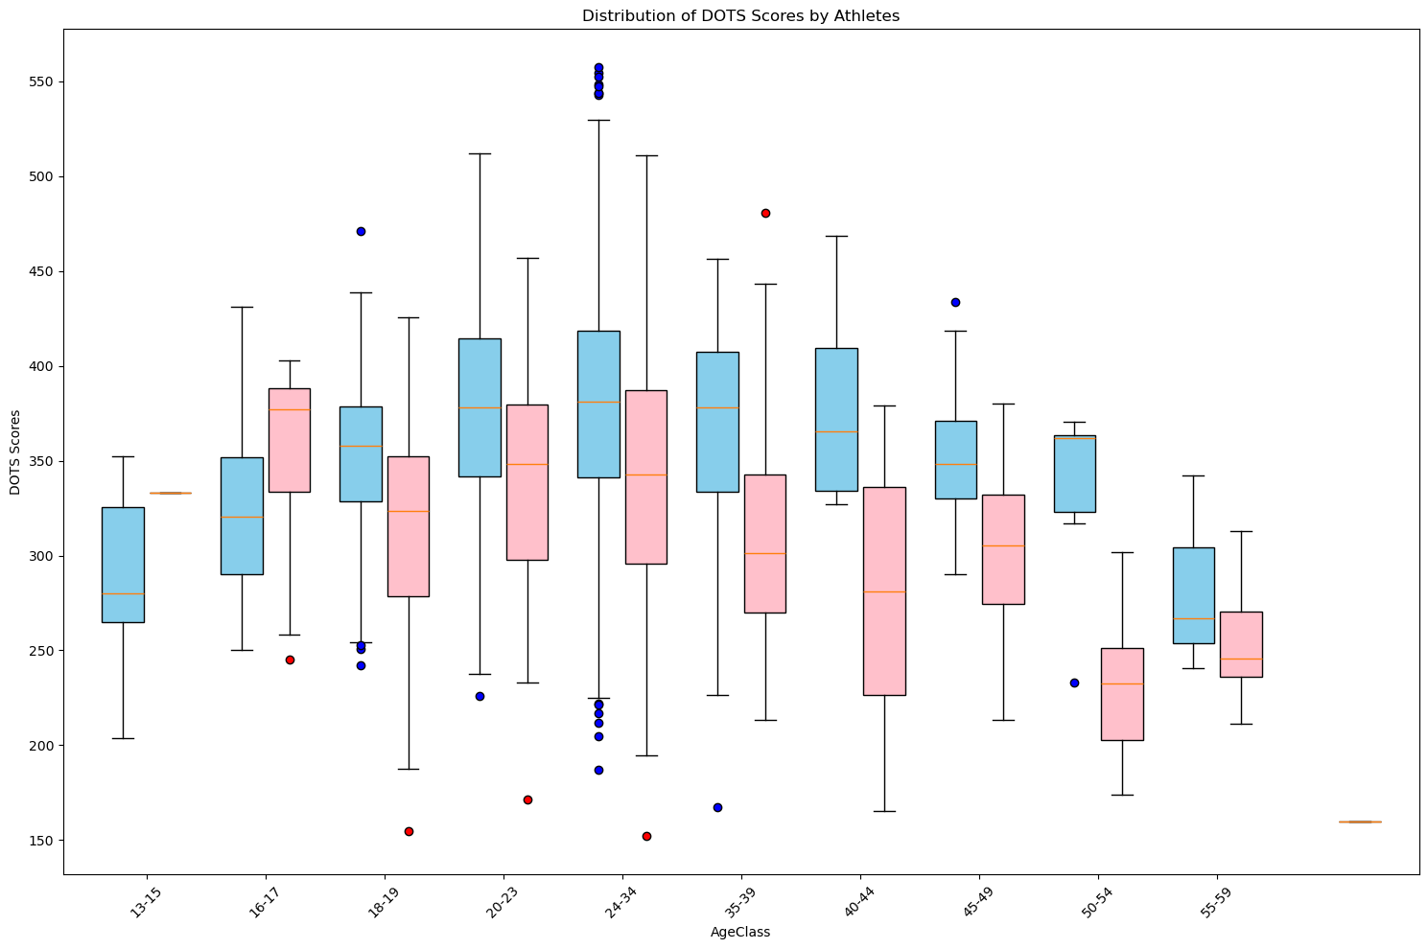
DOTS Scores by Athletes

Slide 21
Correlation

Slide 22
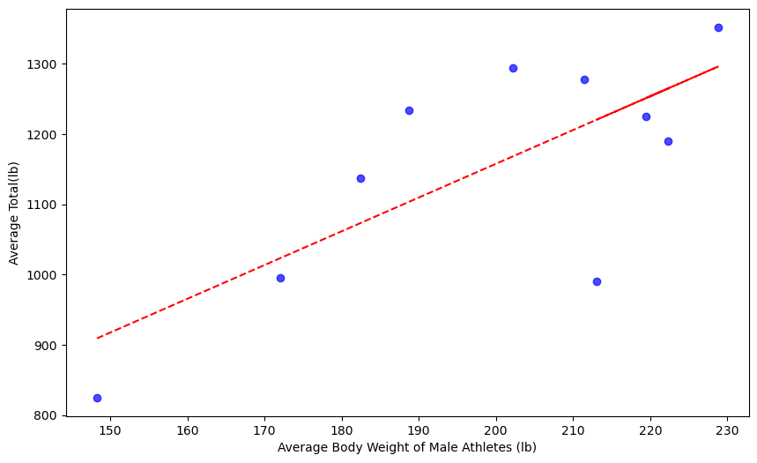
Correlation between Male Athlete bodyweight (lb) and the average Total (lb) is 0.74

Slide 23
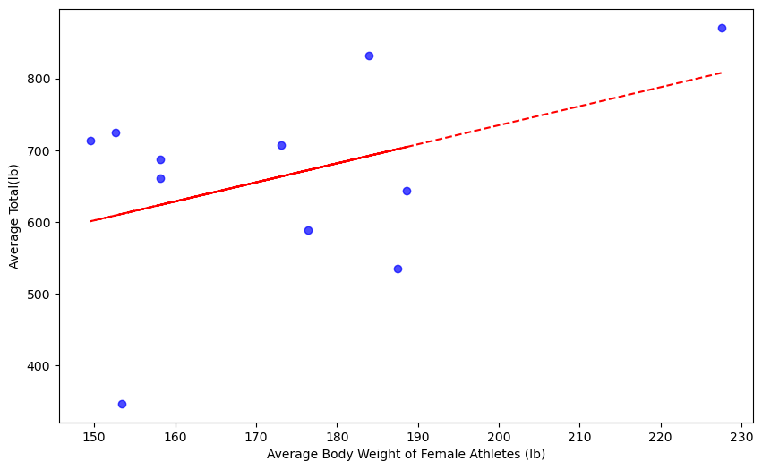
Correlation between Female Athlete bodyweight (lb) and the average Total (lb) is 0.43

