Slide 1

Powerlifting
Aidan Kelley
Jenalee Swain
Sarah (Jung Hee) Son
Steve Young

Slide 2
Data Design
Remove columns
2. Filter Rows based on specified criteria for USPA and USAPL
3. Covert selected columns to float data type
Convert ‘Place’ column to integer
Covert ‘Date’ column to date
Data Cleaning
Replace NaN values with 0
Delete rows where ‘AgeClass’ is blank
Extract year from ‘Date’ column to a new column ‘Year’
Convert kg to lb
Export the new dataframe as a new CSV file

Slide 3
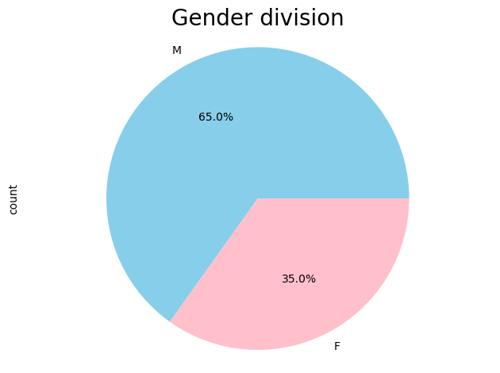
Gender Division of Illinois USAPL & USPA Athletes
2012-2023 timespan
USAPL & USPA Federations
Male Athletes:
1323
Female Athletes:
708
Notes:
Value.count by Gender
Pie chart

Slide 4
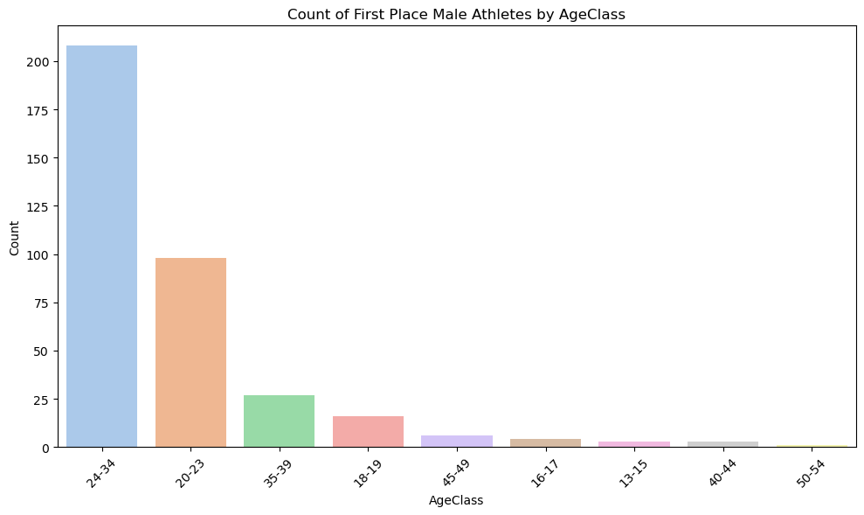
Count of First Place Male Athletes by Age Class
Age Class
24-34
208
20-23
98
35-39
27
18-19
16
45-49
6
Notes:
Fiilter ‘firstplace’ = place =1

Slide 5
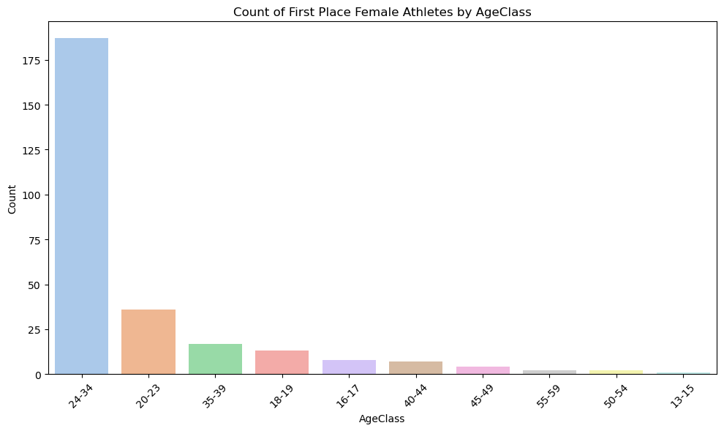
Count of First Place Female Athletes by Age Class
Age Class:
24-34
187
20-23
36
35-39
17
18-19
13
16-17
8

Slide 6
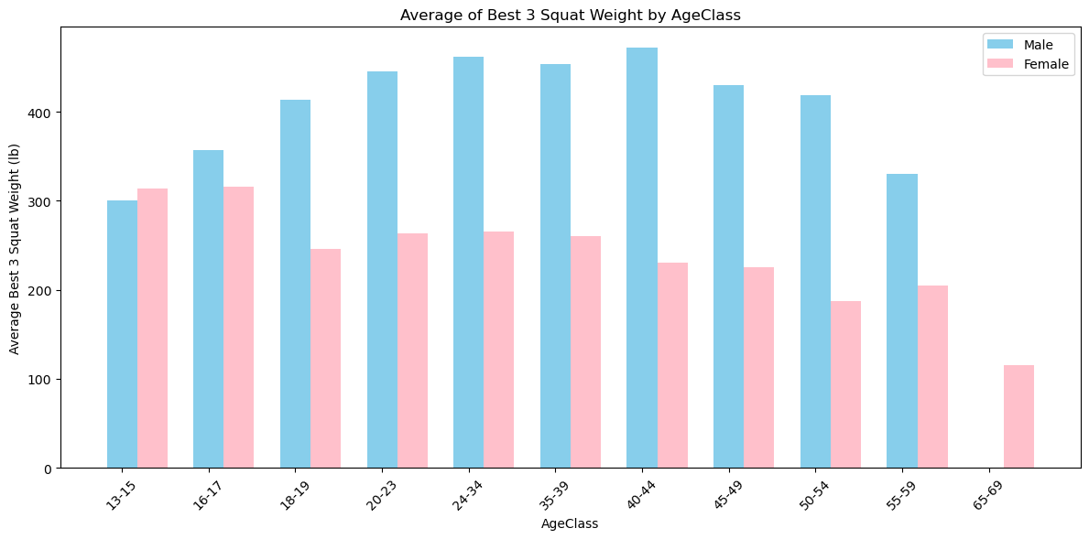
Best Squat Attempt Male vs Female

Slide 7
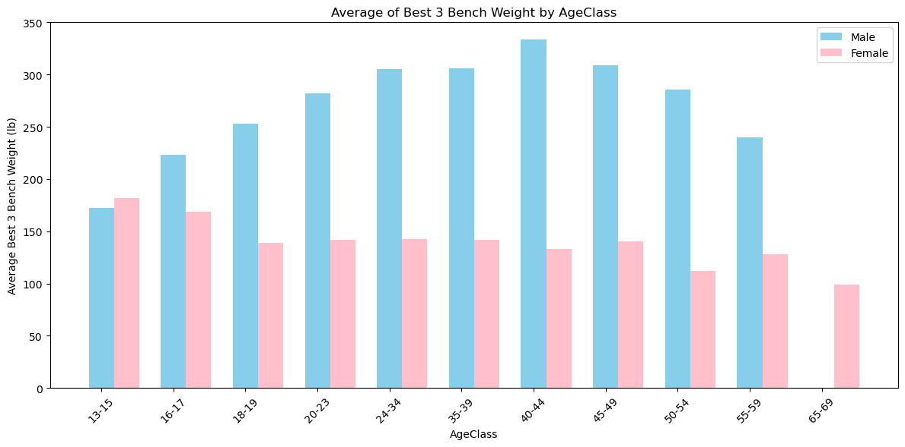
Best Bench Attempt Male vs Female

Slide 8

Best Deadlift Attempt Male vs Female

Slide 9
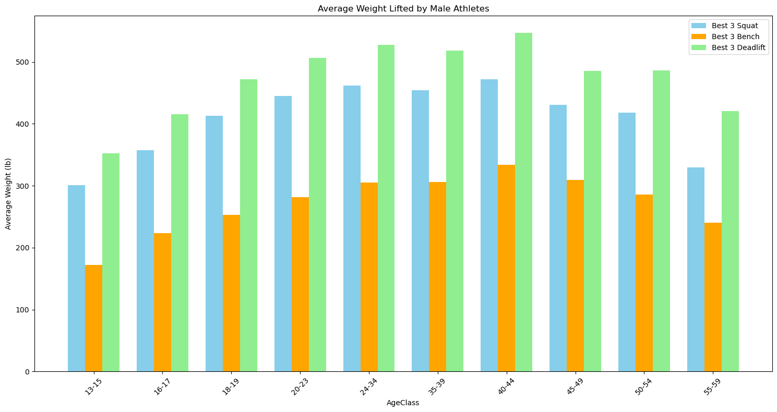
Average Weight Lifted by Male Athletes

Slide 10
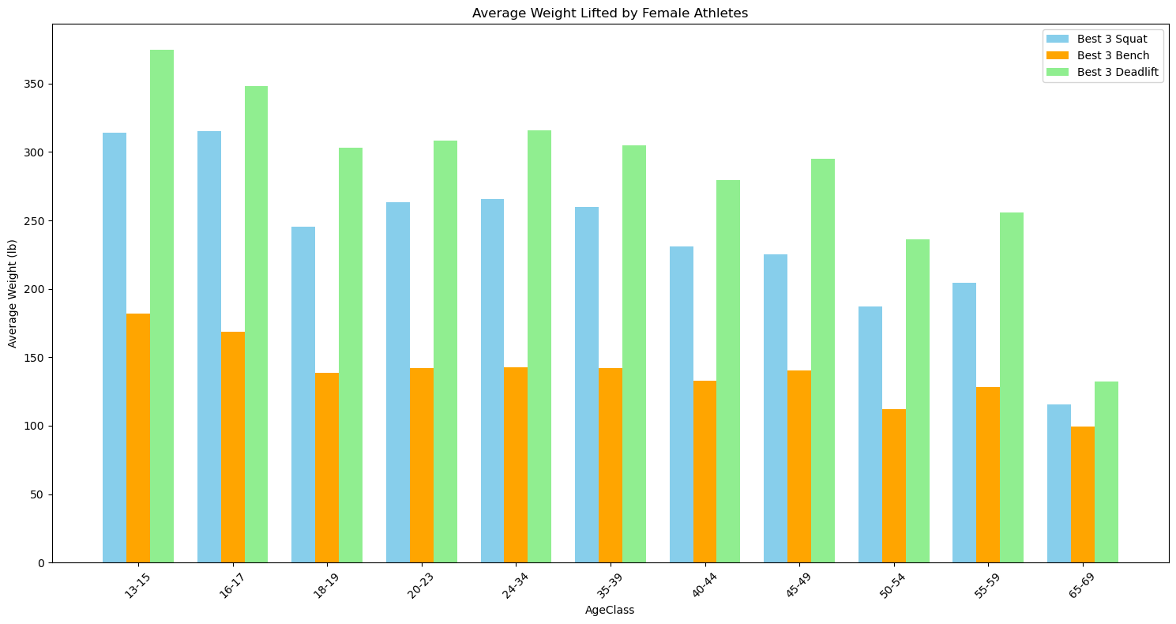
Average Weight Lifted by Female Athletes

