Slide 1

Project Powerlifting
Aidan Kelley
Jenalee Swain
Sarah (Jung Hee) Son
Steve Young

Slide 2
Introduction & Proposal

Slide 3
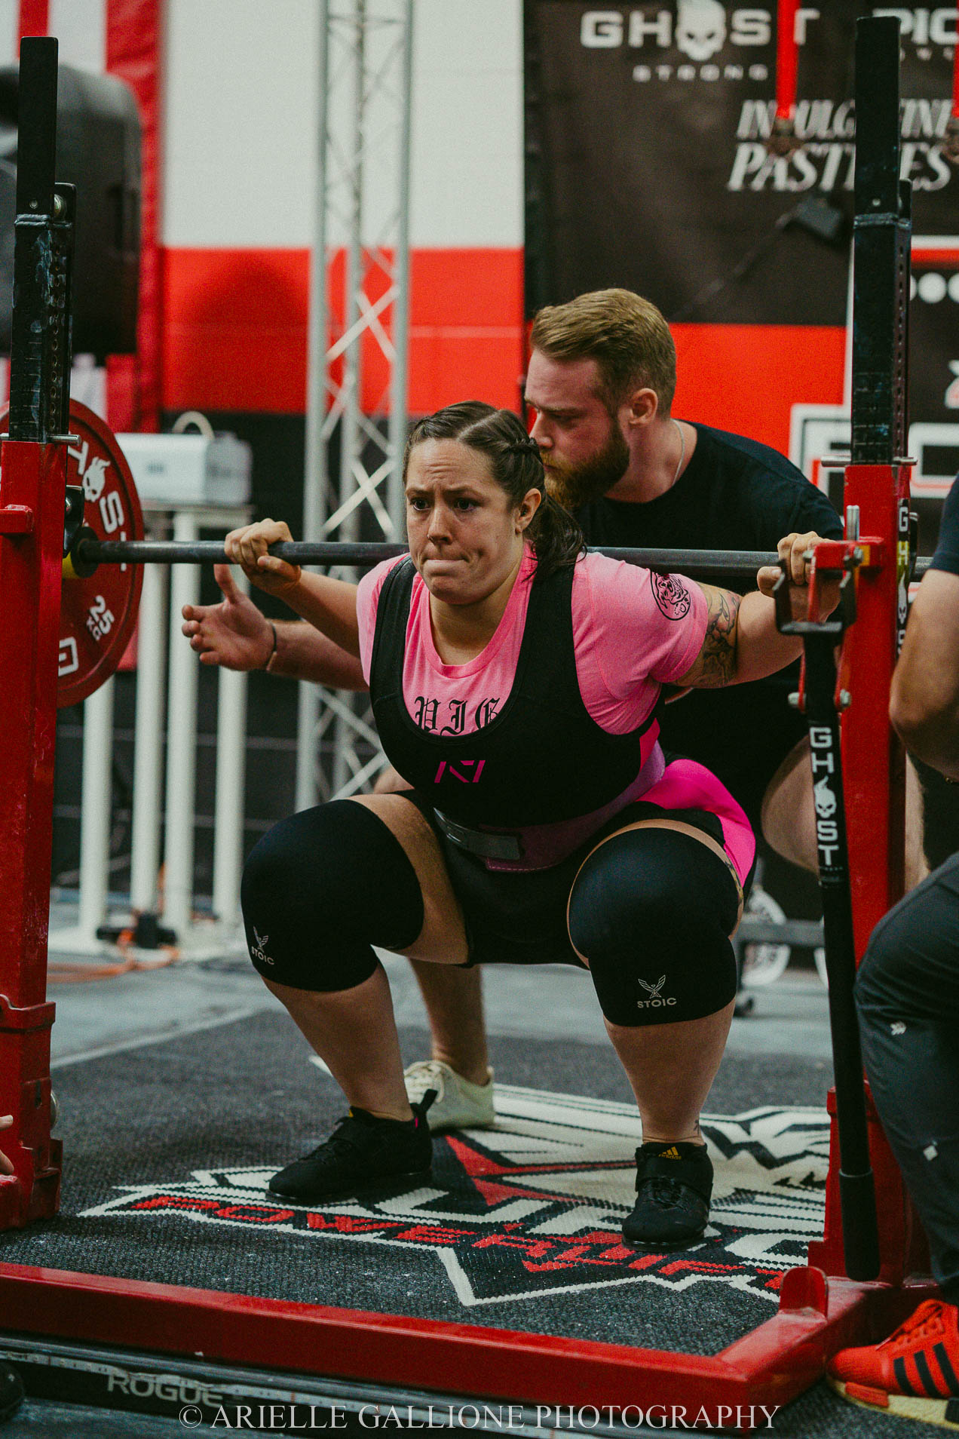
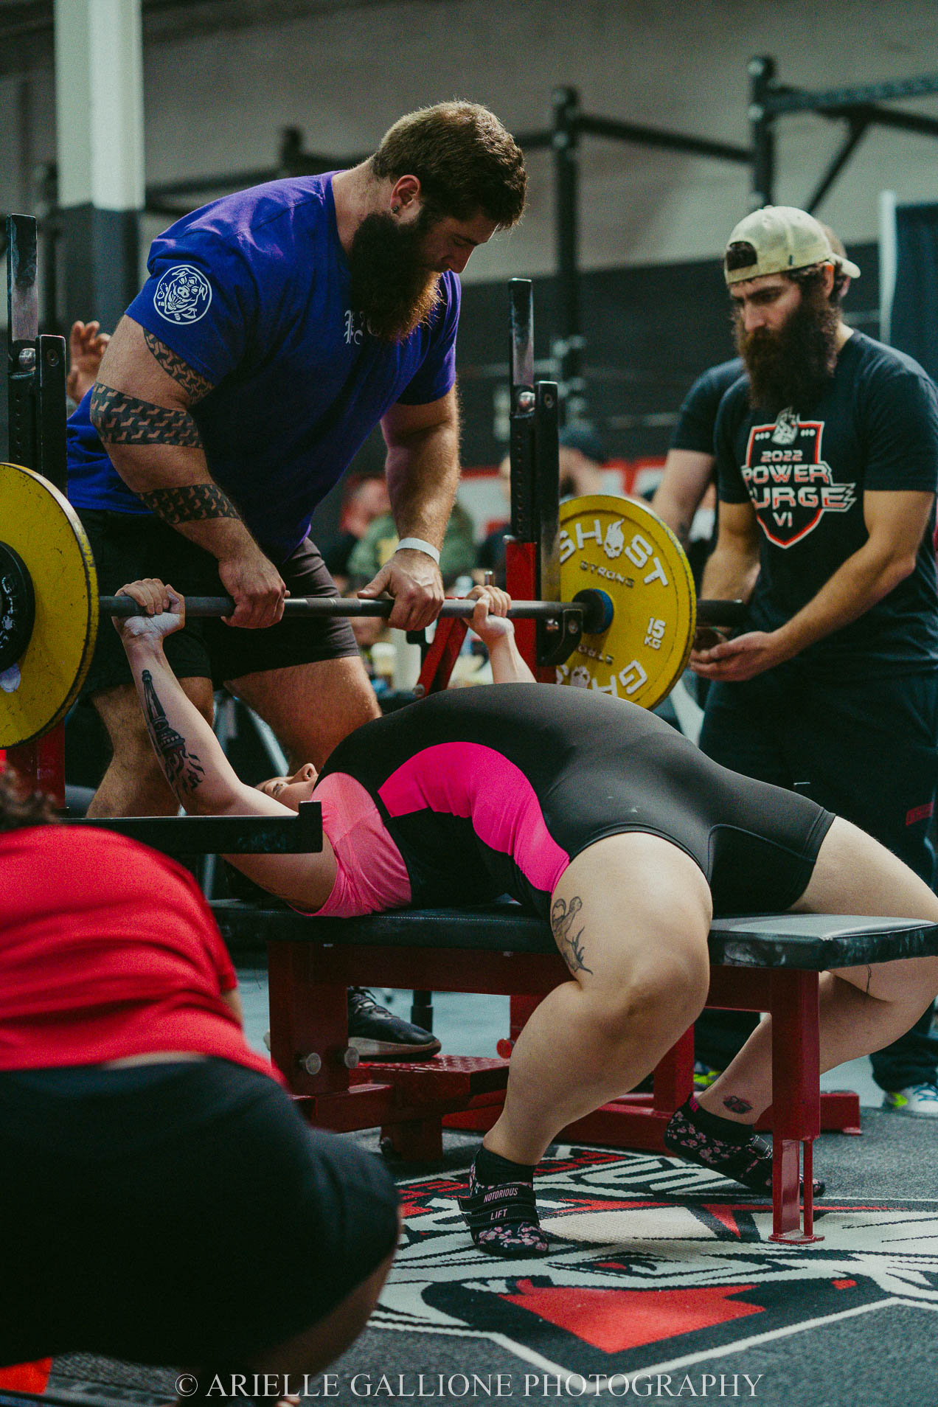
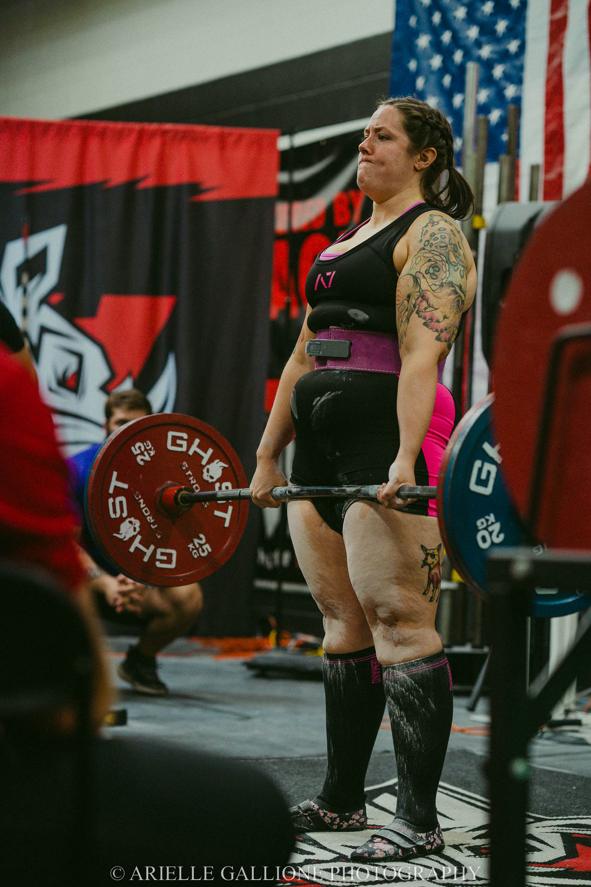
Introduction to Powerlifting
Powerlifting is a sport that consists of three lifts:
squat, bench press, and deadlift.
Data was pulled from Openpowerlifting.org.

Slide 4
Proposal Questions
Does age have a correlation with performance in powerlifting competitions?
How each gender performs across different age and weight ranges?
Will higher body weight affect how much weight an athlete lifts overall?

Slide 5
Data Design

Slide 6
Data Design
Remove columns
2. Filter Rows based on specified criteria for USPA and USAPL
3. Convert selected columns to float data type
Convert ‘Place’ column to integer
Covert ‘Date’ column to date
Data Cleaning
Replace NaN values with 0
Delete rows where ‘AgeClass’ is blank
Extract year from ‘Date’ column to a new column ‘Year’
Convert kg to lb
Export the new dataframe as a new CSV file

Slide 7
Gender Split

Slide 8
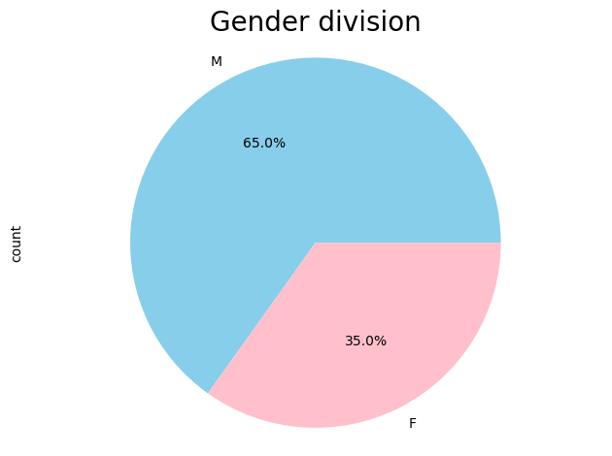
Gender Division of Illinois USAPL & USPA Athletes
2012-2023 timespan
USAPL & USPA Federations
Male Athletes:
1323
Female Athletes:
708
Notes:
Value.count by Gender
Pie chart

Slide 9
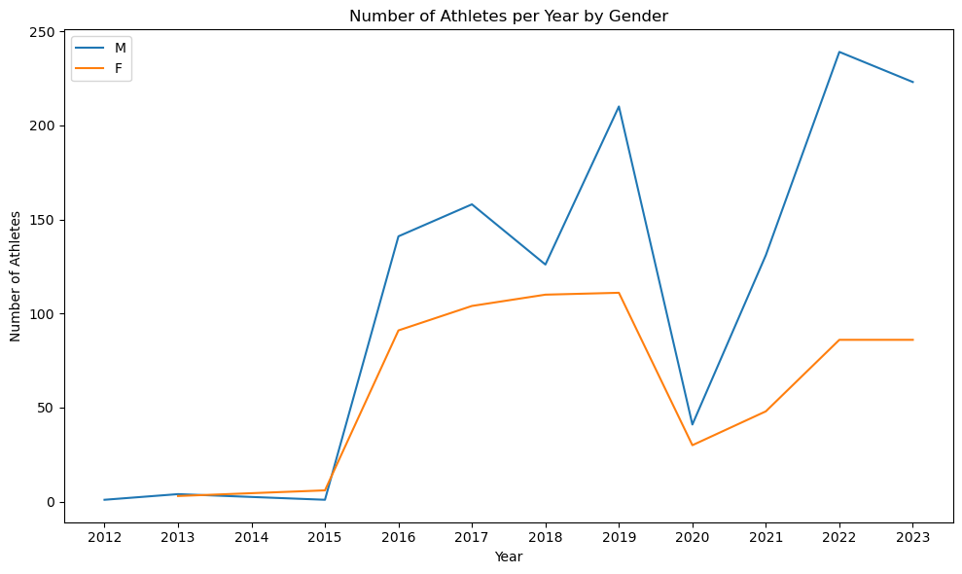
Number of Athletes per Year by Gender
Notes:
Fiilter ‘firstplace’ = place =1

Slide 10
First Place by Age Class and Gender

Slide 11
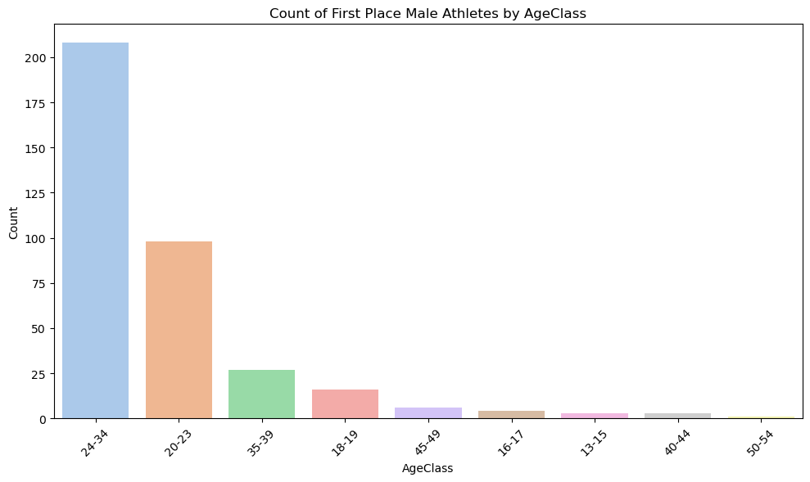
Count of First Place Male Athletes by Age Class
Age Class
24-34
208
20-23
98
35-39
27
18-19
16
45-49
6
Notes:
Fiilter ‘firstplace’ = place =1

Slide 12
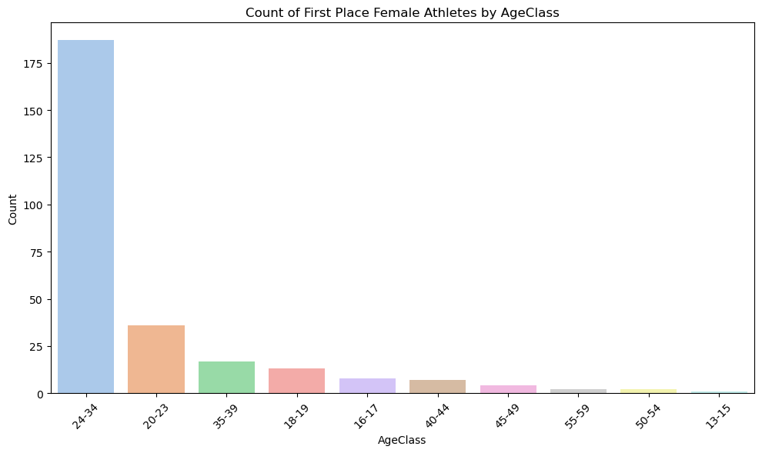
Count of First Place Female Athletes by Age Class
Age Class:
24-34
187
20-23
36
35-39
17
18-19
13
16-17
8

Slide 13
Body Mineral Density by Gender & Age

Slide 14
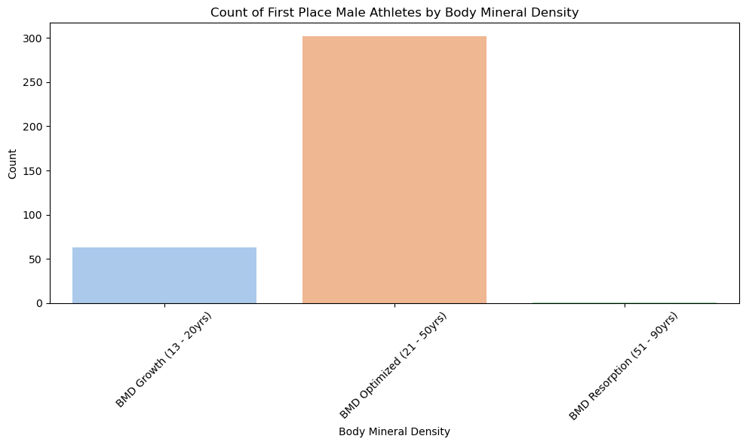
Body Mineral Density Male Athletes

Slide 15
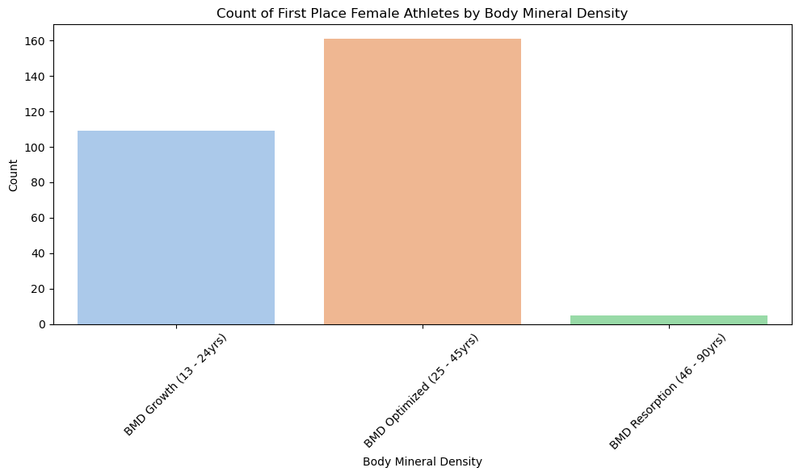
Body Mineral Density Female Athletes

Slide 16
Best Attempt of Each Lift

Slide 17
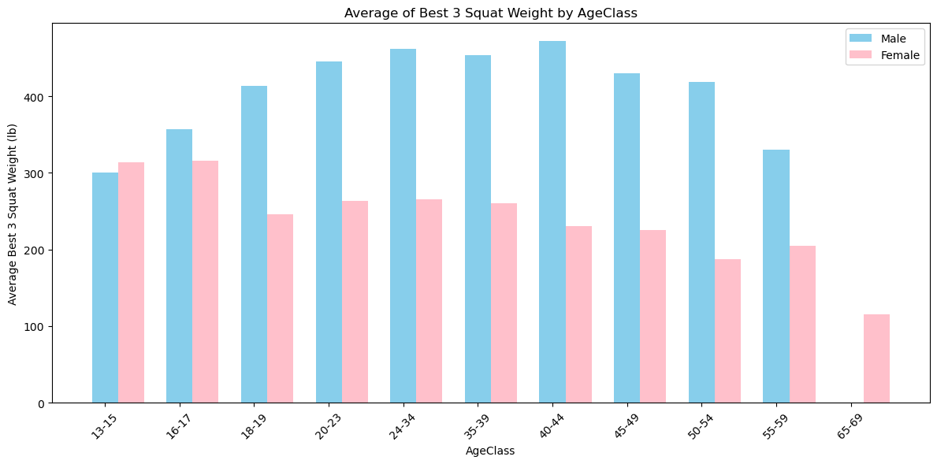
Best Squat Attempt Male vs Female

Slide 18
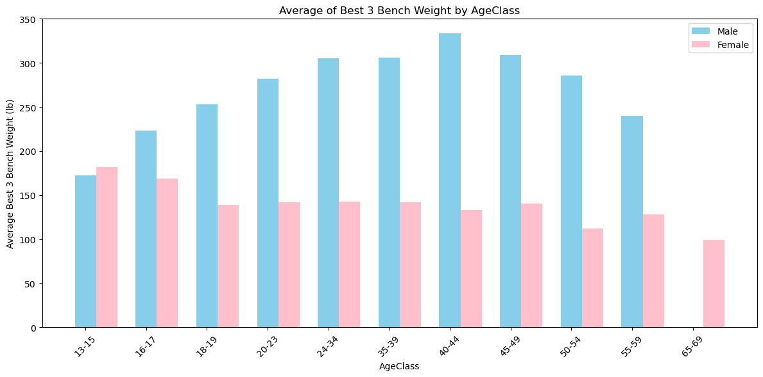
Best Bench Attempt Male vs Female

Slide 19

Best Deadlift Attempt Male vs Female

Slide 20
Average Weight Lifted

Slide 21
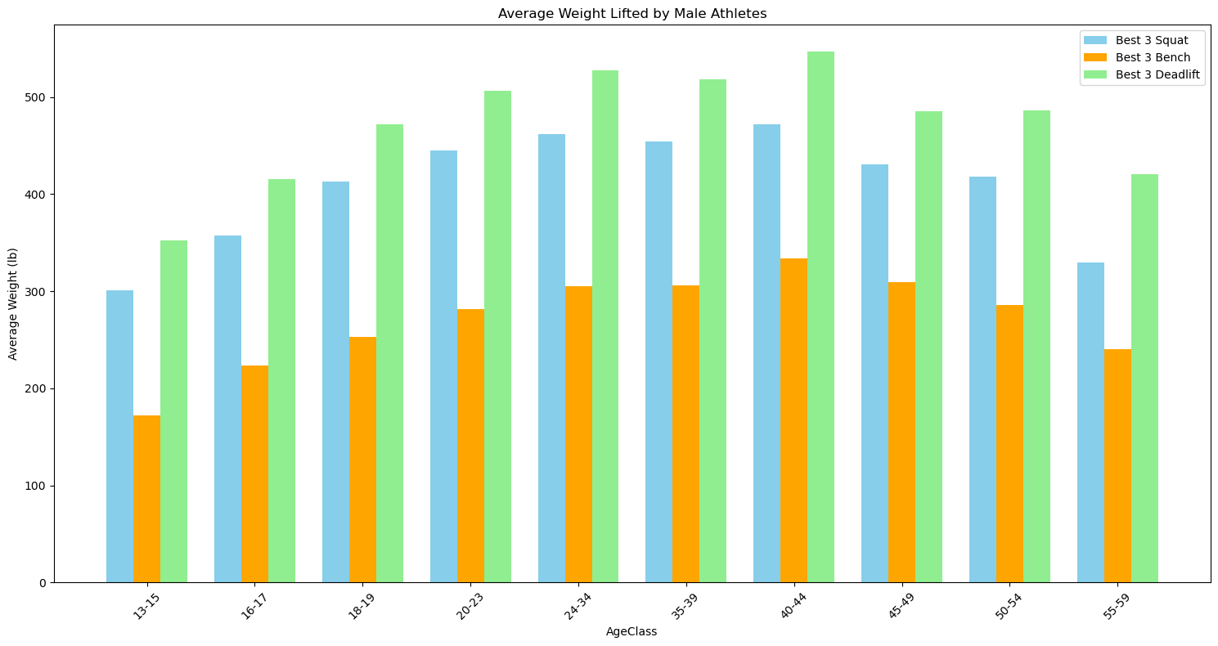
Average Weight Lifted by Male Athletes

Slide 22
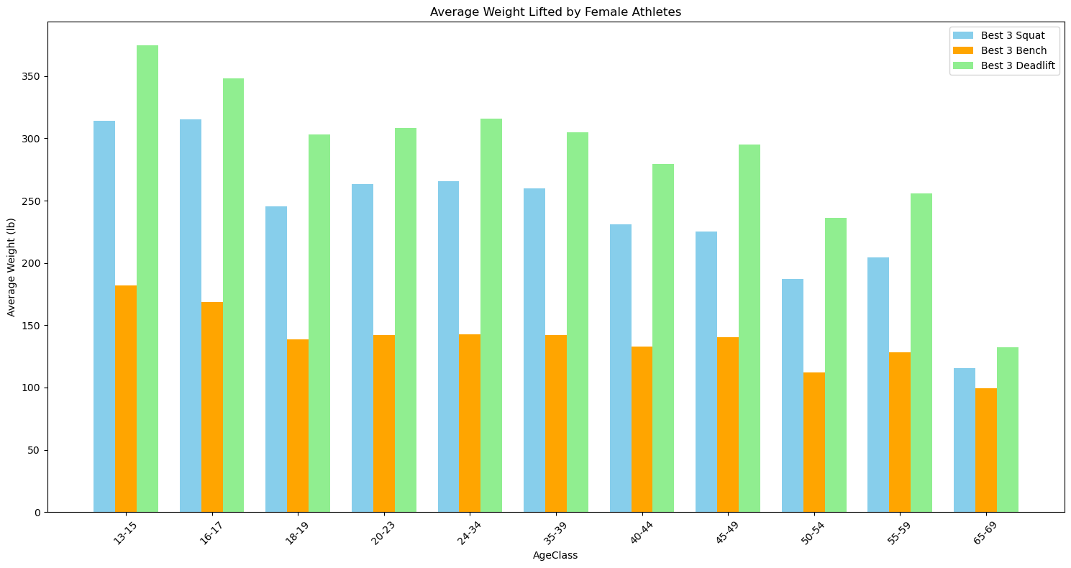
Average Weight Lifted by Female Athletes

Slide 23
DOTS Dynamic Objective Total Score is a calculation of the amount lifted as a ratio to the body weight of the athlete.

Slide 24
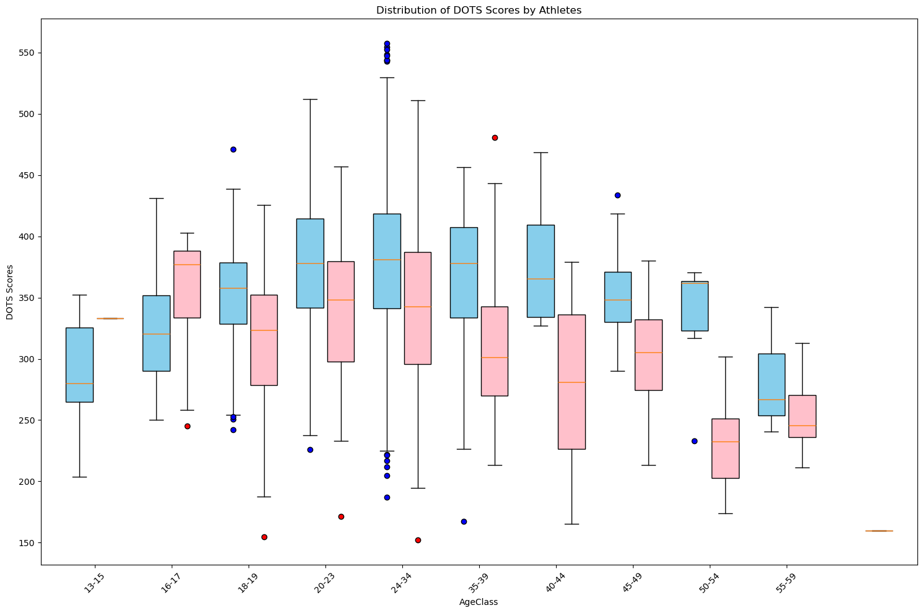
DOTS Scores by Athletes

Slide 25
Correlation

Slide 26
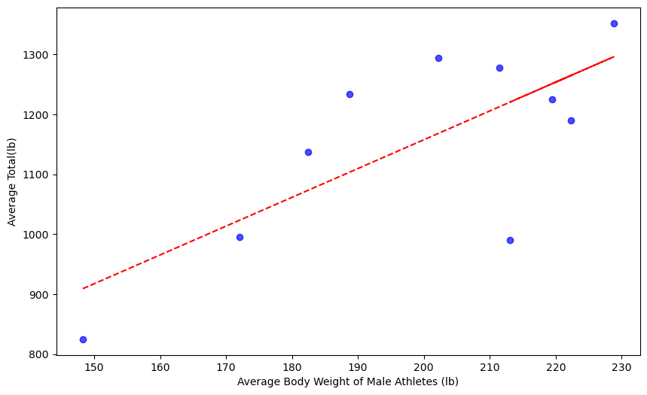
Correlation between Male Athlete bodyweight (lb) and the average Total (lb) is 0.74

Slide 27
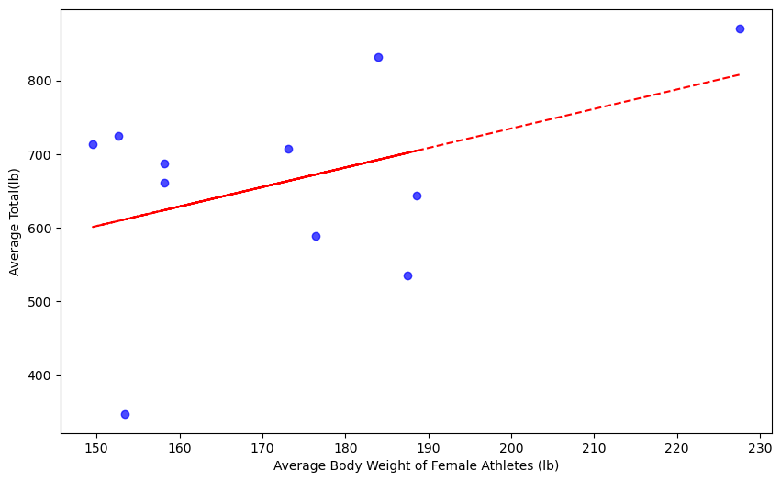
Correlation between Female Athlete bodyweight (lb) and the average Total (lb) is 0.43

Slide 28
Conclusive Thoughts

