Slide 1
Inference of Non-Violent Crime in Chicago
Yuejun Wu

Slide 2
Violent Crime
Non-Violent Crime
Homicide
Robbery
Aggravated Assault
Rape
THEFT
NON-CRIMINAL
MOTOR VEHICLE THEFT
DECEPTIVE PRACTICE
BURGLARY
PUBLIC PEACE VIOLATION
INTERFERENCE WITH PUBLIC OFFICER
PUBLIC INDECENCY
INTIMIDATION
BATTERY
ASSAULT
OBSCENITY

Slide 3
Hypothesis
Occurrence of non-violent is positively related to temperature
Occurrence of non-violent is positively related to unemployment rate
Occurrence of non-violent is positively related to air quality index (Higher AQI indicates lower air quality)

Slide 4
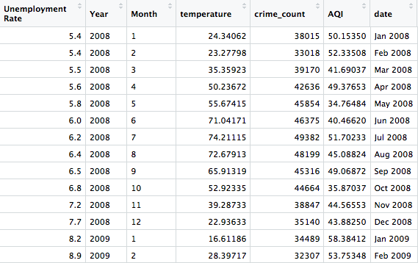
Data
Kaggle: Chicago Crimes 2008 – 2011
National Oceanic and Atmospheric Administration: Temperature data
United States Environmental Protection Agency :AQI
Illinois Department of Employment Security: Unemployment rate

Slide 5
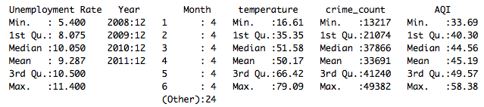

Characteristics of dataset
Covariance Table:

Slide 6
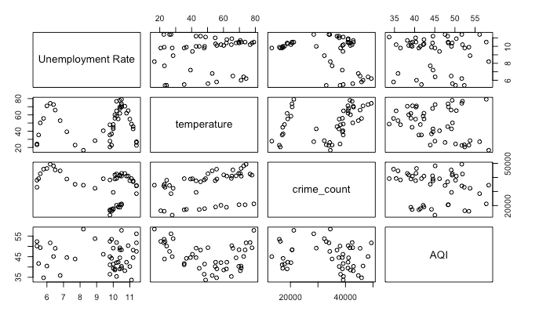
Pairwise

Slide 7
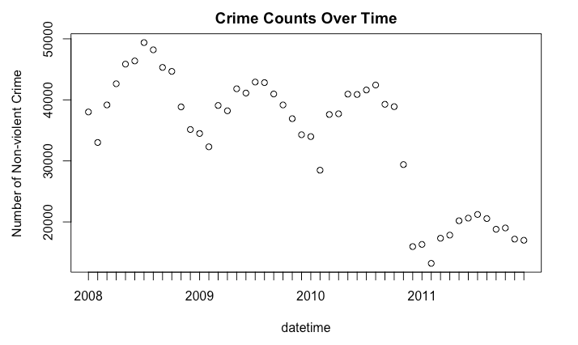
Categorical Variables
Temperature?
Year?

Slide 8
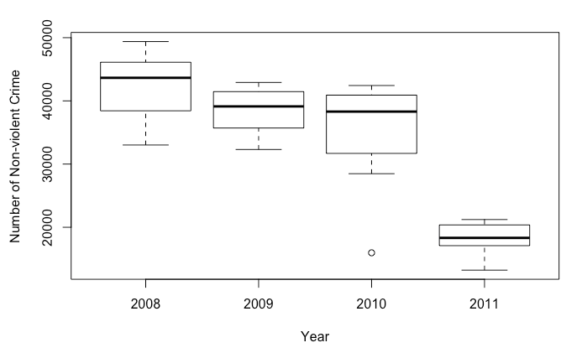
Number of non-violent crime decreases over years

Slide 9
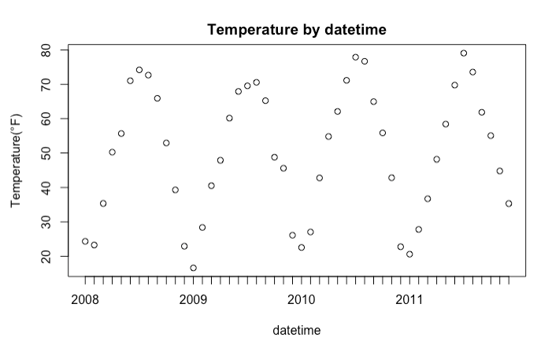
Number of non-violent crime has patterns with different temperature

Slide 10
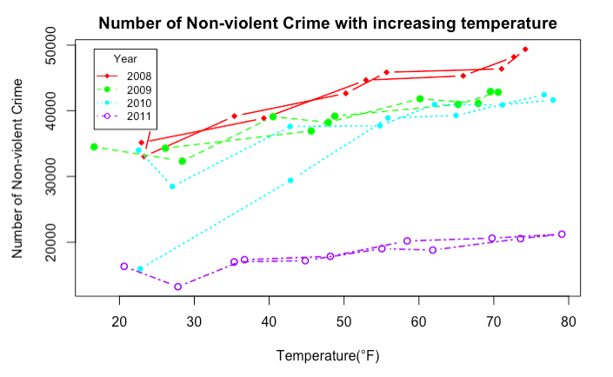

Slide 11
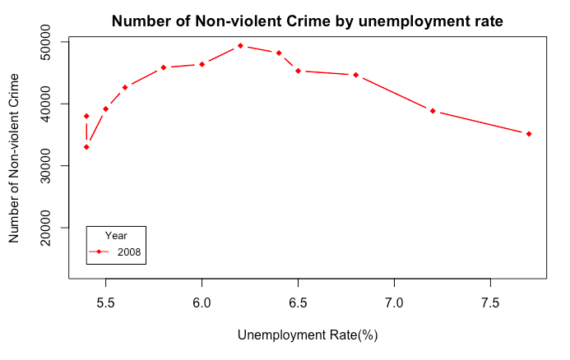
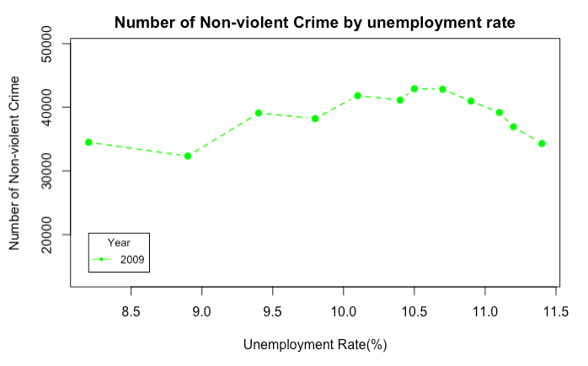
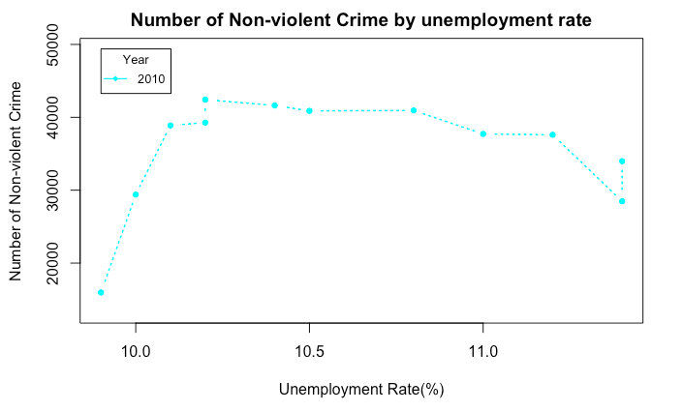
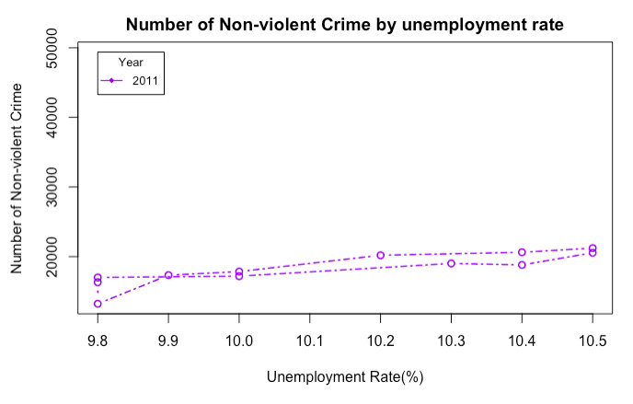

Slide 12
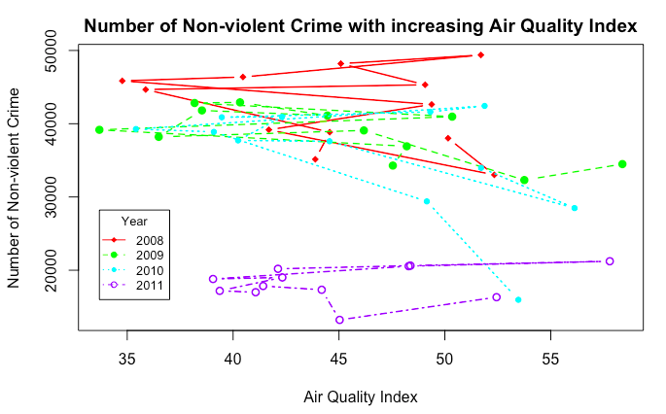
No obvious pattern for AQI related to #crimes

Slide 13
Linear Regression Model
Dependent variable is numeric (Number of non-violent crime): how 1 unit change in each predictor affect the number of change in dependent variable
Easy to interpret with few predictors
Not a classification problem
No overfitting/high dimensional problem (predictors are few)

Slide 14
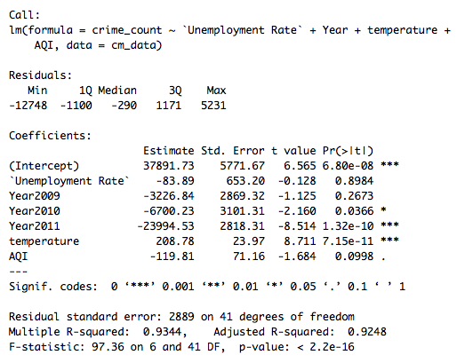

Slide 15
Interpretation
F test indicates the model could explain some of dependent variable
Temperature is positively related to crime occurrence
Unemployment rate is not significant under my model, and the coefficient is negative:
Dataset is too small. We can’t tell an observable pattern each year.
Choice of data is not representable: 2008 financial crisis. Low crime in 2011 might due to some important factors other than unemployment rate.
Air quality is not related to crime. Graph statistics shows it already.
Year 2009 is not significantly different from Year 2008, while 2010 and 2011 are:
There might be other factors that explain the decrease in crime over years. (government help after financial crisis, more budget in Chicago PD, etc.)

Slide 16
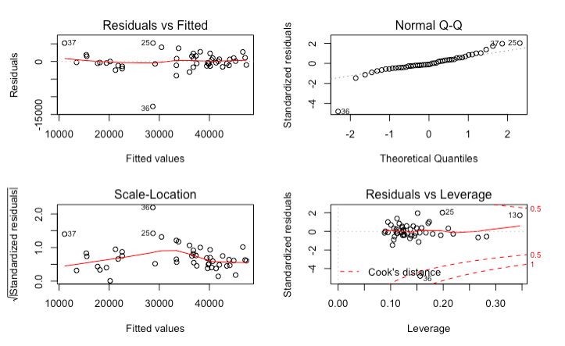
Diagnostic

Slide 17
Improvement
More dataset -> pattern in unemployment rate
Daily data instead of monthly data -> more accurate pattern on temperature data
Incremental data on temperature -> drastic change in temperature might lead to occurrence in non-violent crime
Violent crime -> Is there a difference in how temperature affects violent vs. non-violent crime

Slide 18
Questions

