Slide 1
Agenda
Strangler
Backend for Frontend (BFF)
Saga
Database per Service
CQRS
Circuit Breaker
Event Sourcing
Spring Cloud Gateway

Slide 2
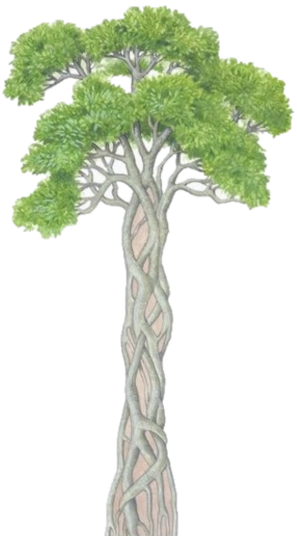
Strangler Pattern
This pattern is used to decompose an existing, monolithic application. Since applying all the above design patterns to them will be difficult because breaking them into smaller pieces at the same time it's being used live is a big task.
The Strangler pattern creates two separate applications that live side by side in the same URI space. Over time, the newly refactored application “strangles” or replaces the existing monolithic application.
Banyan Tree

Slide 3
Strangler Pattern
Strangler Application
Service
Service
Service
Service
Service
Service
Service
Service
Service
Service
Service
Service
Service
Service
Service
……
Service
Service
Time
Monolith
App
Monolith
App
Monolith
App
……
Monolith
App
Existing Features
New Features

Slide 4
Strangler Pattern
Pilot mode – One approach.
I built a microservice using strangler pattern, but still I roll it out in pilot mode. For instance, if I have 500K users in my application. I will say 497K users will use legacy application. And 3K will use modernized microservice.
3K.
First phase is, lets say 20 users.
Gradually increase it day by day and in one week, reach out to 3K. And it two to three weeks, you roll it out to all.
API gateway, use a switch to route to new service or existing service. Use pilotflag. Control it in Database or IAM or entitlement system.
100 functionalities – Monolith.
You developed 10 microservices to fulfill these 100 functionalities.
You can roll out all these 10 to just 20 users.

Slide 5
Strangler Pattern
Ms1 (new)
GW
Monolith(legacy)

Slide 6
Backend for Frontend (BFF)
Creates a specialized backend service for each type of client (e.g., mobile, web, desktop).
Instead of having a single API Gateway, each client gets its own dedicated backend, which provides an optimized API tailored to the client’s specific needs.
Minimizes over-fetching or under-fetching of data by customizing the backend logic for each client type.
Useful when you need to optimize the API for specific devices, such as mobile apps with limited bandwidth or web apps with more complex UI but have different data requirements, response formats, or processing logic.

Slide 7
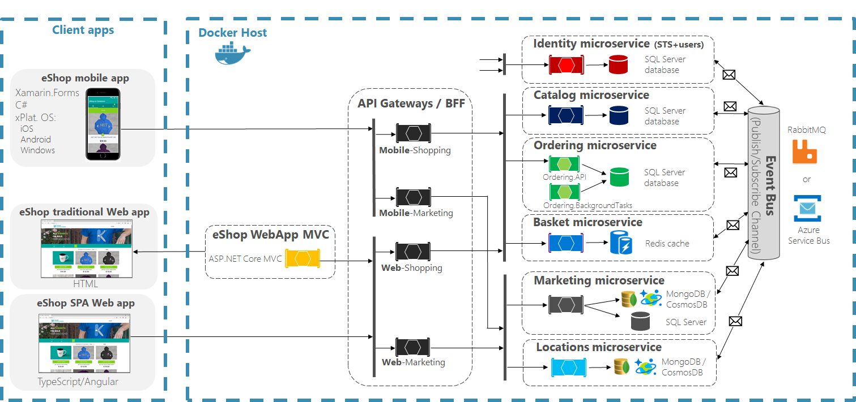
Backend for Frontend (BFF)

Slide 8
API Gateway vs. Backend for Frontend (BFF)
Aspect | API Gateway | Backend for Frontend (BFF)
Purpose | Single entry point for all clients and services. | Separate backends tailored to each client (e.g., mobile, web).
Client Optimization | One-size-fits-all for all clients. | Optimized for each client type (e.g., mobile, web, desktop).
Cross-Cutting Concerns | Centralized (security, logging, rate-limiting, etc.). | Handled individually in each BFF.
Complexity | Simpler for the client, but may become a monolith. | More complex due to multiple BFFs, but more modular.
Performance | Can introduce latency due to additional processing. | More efficient for clients (tailored APIs reduce overhead).
Maintainability | Easier to manage as there is a single entry point. | More components to manage and maintain (one BFF per client).
Use Case | Best for systems where clients have similar needs. | Best for systems with diverse client needs and data handling.

Slide 9
Database Per Service
One database per microservice must be designed; it must be private to that service only. It should be accessed by the microservice API only.
It cannot be accessed by other services directly.
Catalog Microservice
Authentication Microservice
Order Microservice

Slide 10
Database Per Service
Client onboarding.
Account origination
Transfers
Bill payments
Statements
Instant transfers
Deposit account origination
Loan account origination
Internal transfers
External transfers
Instant transfers
Bill payments
Statements
Client onboarding

Slide 11
Command Query Responsibility Segregation (CQRS)
Once we implement database-per-service, there is a requirement to query, which requires joint data from multiple services.
CQRS suggests splitting the application into two parts :
Command side - Handles the Create, Update, and Delete requests.
Query side - Handles the query part by using the materialized views.
Client Request
(Command, Query)
Database
Service
Client Request
(Command, Query)
Command Service
Database
Database
Query
Service
Standard, non-CQRS architecture
CQRS architecture
Notes:
When services are developed by decomposing business capabilities/subdomains, the services responsible for user experience have to pull data from several microservices.
The problem with traditional architectural patterns is that the same data model or DTO is used to query as well as update a data source. This can be the go-to approach when your application is related to just CRUD operations and nothing more. But when your requirements suddenly start getting complex, this basic approach can prove to be a disaster.
In practical applications, there is always a mismatch between the read and write forms of data, like the extra properties you may require to update. Parallel operations may even lead to data loss in the worst cases. That means, you will be stuck with just one Data Transfer Object for the entire lifetime of the application unless you choose to introduce yet another DTO, which in-turn may break your application architecture.
CQRS allows for separate data stores and models (data or ORM) for Commands and Queries. The data between data stores is usually synchronized asynchronously using a service bus.
An architecture that is built upon the CQS pattern will follow the same logical separation, but Queries and Commands will be executed on the same datastore and share the same model. It should be noted though that you can use CQS in an application that does not have a data store at all.
https://www.codewithmukesh.com/blog/cqrs-in-aspnet-core-3-1/#0-what-is-cqrs

Slide 12
Command Query Responsibility Segregation (CQRS)
Client Request
(Command, Query)
Client Request
(Command, Query)
Database (CUD tables)
Materialized Views
Command Service
Command Service
Database (same tables)
Query
Service
Query
Service
CQRS architecture
CQRS architecture
Transfer
Service
CUD
Mat view order
Scale only the read only service
Composite
Service
Statement
R
Mat view product
Notes:
When services are developed by decomposing business capabilities/subdomains, the services responsible for user experience have to pull data from several microservices.
The problem with traditional architectural patterns is that the same data model or DTO is used to query as well as update a data source. This can be the go-to approach when your application is related to just CRUD operations and nothing more. But when your requirements suddenly start getting complex, this basic approach can prove to be a disaster.
In practical applications, there is always a mismatch between the read and write forms of data, like the extra properties you may require to update. Parallel operations may even lead to data loss in the worst cases. That means, you will be stuck with just one Data Transfer Object for the entire lifetime of the application unless you choose to introduce yet another DTO, which in-turn may break your application architecture.
CQRS allows for separate data stores and models (data or ORM) for Commands and Queries. The data between data stores is usually synchronized asynchronously using a service bus.
An architecture that is built upon the CQS pattern will follow the same logical separation, but Queries and Commands will be executed on the same datastore and share the same model. It should be noted though that you can use CQS in an application that does not have a data store at all.
https://www.codewithmukesh.com/blog/cqrs-in-aspnet-core-3-1/#0-what-is-cqrs

Slide 13
Saga Pattern
Problem: When each service has its own database and a business transaction spans multiple services, how do we ensure data consistency across services?
Solution: Saga pattern is the solution.
A Saga is a sequence of local transactions where each local transaction updates the database and publishes a message or event to trigger the next local transaction. If a local transaction fails then the saga executes a series of compensating transactions that undo the changes made by the preceding local transactions.
Notes:
A Saga represents a high-level business process (such as booking a trip) that consists of several low-level Requests that each update data within a single service.
For example, for an e-commerce application where customers have a credit limit, the application must ensure that a new order will not exceed the customer’s credit limit. Since Orders and Customers are in different databases, the application cannot simply use a local ACID transaction.
https://blog.couchbase.com/saga-pattern-implement-business-transactions-using-microservices-part/
https://www.cloudamqp.com/blog/2019-12-12-when-to-use-rabbitmq-or-apache-kafka.html
https://www.upsolver.com/blog/kafka-versus-rabbitmq-architecture-performance-use-case

Slide 14
Saga Pattern Implementation
Confirm
Payment
Payment
(Confirm Payment)
Order
(Create Order)
Stock
(Reserve Stock
Saga Log
Start Order
End Payment
Saga Execution
Coordinator
(SEC)
Start
Create Order
Cancel
Payment
Cancel
Order
Release
Stock
End
Reserve Stock
Saga Flow
Saga Execution Coordinator
Notes:
Solving distributed transaction management problem in microservices architecture using Saga – IBM Developer

Slide 15
Saga Execution Coordinator
The Saga Execution Coordinator (SEC) maintains a Saga log that contains the sequence of events of a particular flow.
If a failure occurs within any of the components, the SEC queries the logs and helps identify which components are impacted and in which sequence the compensating transactions must be executed.
If the SEC component itself fails, it can read the SEC logs when coming back, to identify which of the components are successfully rolled back, identify which ones were pending, and start calling them in reverse chronological order.

Slide 16
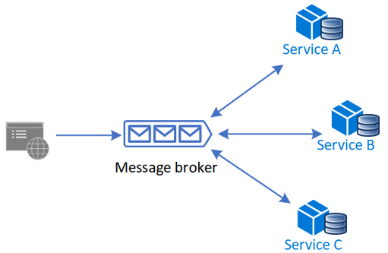
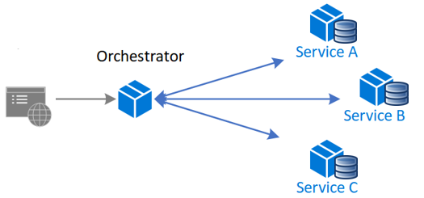
Saga Pattern Implementation
Choreography – each local transaction publishes domain events to the message broker that trigger local transactions in other services.
Orchestration – an orchestrator (object) tells the participants what local transaction to execute.
Notes:
Distributed Transactions in Microservices (dotnetuniversity.com)
Two Phase Commit:
Not really recommended for many microservice-based systems because 2pc is synchronous (blocking)
Reduce throughput due to locks
Not support by many NoSQL databases or message brokers
GitHub - Azure-Samples/saga-orchestration-serverless: An orchestration-based saga implementation reference in a serverless architecture

Slide 17
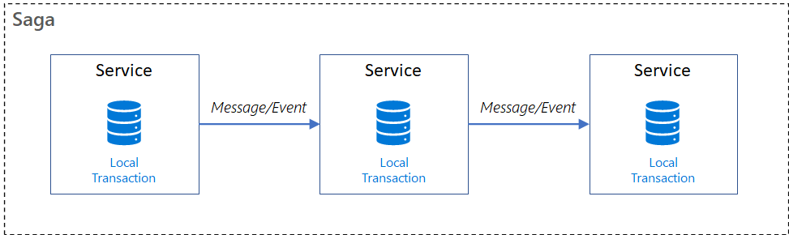
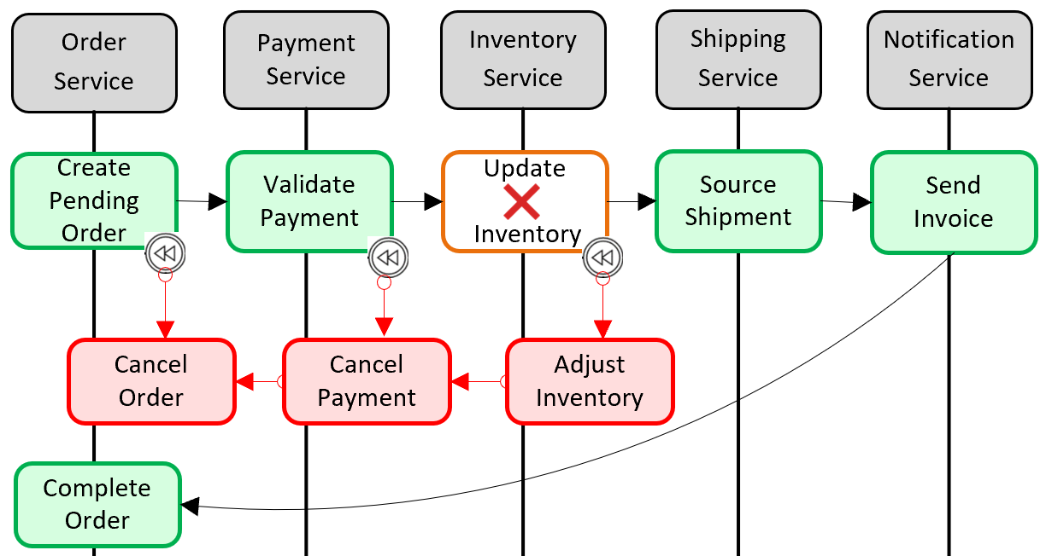
Saga Pattern Implementation
Notes:
Solving distributed transaction management problem in microservices architecture using Saga – IBM Developer
How to Create Distributed Transaction Using MassTransit in your .Net Core Micro-services | by Mortaza Ghahremani | Medium

Slide 18
Saga Pattern Implementation
Event
M1
M2
M1
M2
Notes:
Solving distributed transaction management problem in microservices architecture using Saga – IBM Developer
How to Create Distributed Transaction Using MassTransit in your .Net Core Micro-services | by Mortaza Ghahremani | Medium

Slide 19
Saga Pattern Implementation
Start payment – ps.payment()
Cancel payment – ps.cancelpayment()
Cancel order – os.cancelorder()
Maintain the ledger or log of all the events and how to rollback.
SagaCoordinator
Notes:
Solving distributed transaction management problem in microservices architecture using Saga – IBM Developer
How to Create Distributed Transaction Using MassTransit in your .Net Core Micro-services | by Mortaza Ghahremani | Medium

Slide 20

Circuit Breaker Pattern
A circuit breaker is an electronic component like fuse that opens a circuit so that no current can flow through it. As a result, it prevents the damage caused by excess current from an overload or short circuit.
To prevent an application from trying to invoke a remote service or access a shared resource if this operation is highly likely to fail.
The circuit-breaker tracks the number of times an API call has failed. Once it crosses a threshold number of failures in a row, it doesn't even try to call the API for subsequent requests.
Notes:
A circuit breaker is an electronic component like fuse that opens a circuit so that no current can flow through it. As a result, it prevents the damage caused by excess current from an overload or short circuit.
This pattern isn't recommended:
For handling access to local private resources in an application, such as in-memory data structure. In this environment, using a circuit breaker would add overhead to your system.
As a substitute for handling exceptions in the business logic of your applications.
Implementing the Circuit Breaker pattern | Microsoft Docs
Circuit Breaker · App-vNext/Polly Wiki (github.com)

Slide 21
Event Sourcing
Event Sourcing is a pattern where state changes are captured as a series of events, rather than storing the current state directly. Each event represents a meaningful change in the system.
The current state is reconstructed by replaying all past events.
Why Use Event Sourcing?
Full audit trail — know exactly what happened
Easy rollback & time-travel debugging
Enables CQRS and event-driven design
Flexible projections for read models

Slide 22
Event Sourcing
Open an account . When I open, I have to put some money. $25
Then after 2 days, I credit some money. $50
Then after 2 days, I debit some money. $25
Fardaus -- $50
$25 +
$50 +
$25 -

Slide 23
Introduction to Spring Cloud Gateway

Slide 24
What is Spring Cloud Gateway?
Spring Cloud Gateway is a gateway service built on Spring Framework.
It acts as a reverse proxy to route client requests to backend microservices.
Specifically Built for Cloud-Native API Gateway Patterns.
Supports routing, filtering, and security out of the box.

Slide 25
Key Features of Spring Cloud Gateway

Slide 26
Key Features of Spring Cloud Gateway
Dynamic Routing: Routes incoming requests by URI, headers, etc.
Filters: Modify incoming requests and responses (auth, logging).
Load Balancing: Integrates with service discovery tools like Eureka.
Circuit Breaker: Provides fault tolerance for service failures.
Rate Limiting: Controls request rates to protect backend services.

Slide 27
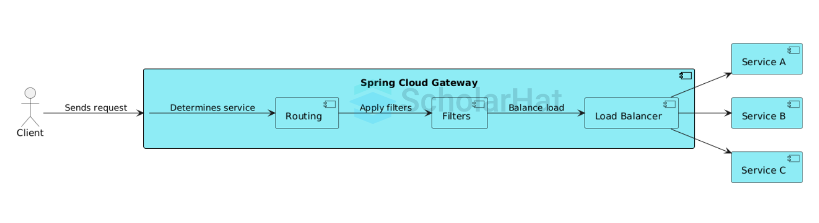
Gateway-Based Microservices Architecture

Slide 28
Gateway-Based Microservices Architecture
Orders (8081, 8082)
GW(8080)
DMZ
RED
Products (8082)

Slide 29
Benefits & Use Cases of Spring Cloud Gateway

Slide 30
Benefits & Use Cases of Spring Cloud Gateway
Centralized entry point for microservices APIs.
Simplifies security management (e.g., OAuth2 integration).
Improves monitoring and logging of API calls.
Enables request transformation and validation.
Ideal for cloud-native architectures needing flexible routing.

