Slide 1
Agenda
Microservices Principles
DDD
gRPC, demo
Granularity, Autonomy, Idempotency
API first development
What is Twelve-Factor App?
The Twelve-Factors
Benefits of Twelve-Factor App

Slide 2
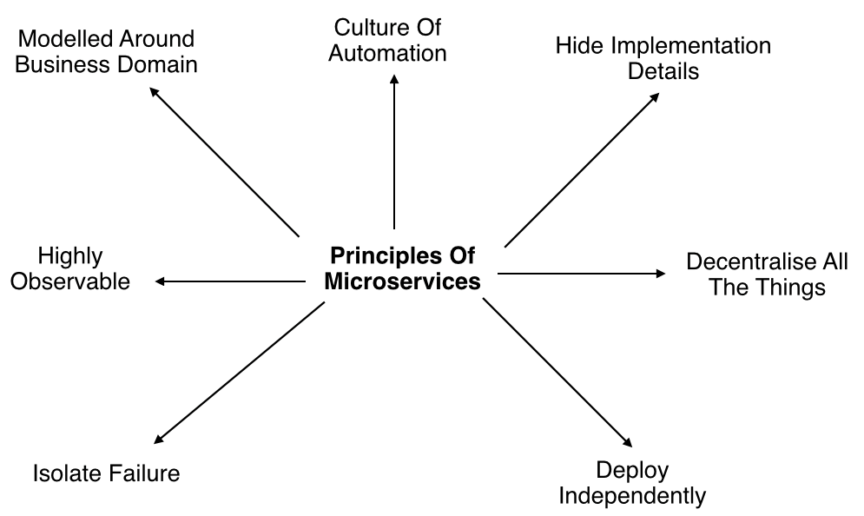
Microservices Principles

Slide 3
How will you track the request that’s going to different microservices?
Distributed tracing – spanid, traceid
Dynatrace
m1
m2
m3

Slide 4
Microservices Principles Contd..
Modelled around business domain : Separate system capability into different domains and each domain will focus on one thing and its associated logic.
Culture of Automation : Follow the culture of automation by designing it for continues integration and continuous delivery.
Hide implementation details : Hiding the internal details reduce the coupling and helps to do changes and improvement without affecting the overall architecture.
Decentralization : There is no centralized database, usually each service is designed to manage its own database.

Slide 5
Microservices Principles Contd..
Deploy Independently : Each service can be deployed independently.
Failure Isolation : The impact of a failure is less in microservice architecture compares to monolithic type as it will only affect that particular service and its associates. Other services can keep running.
Highly Observable : The services should collect as much information to analyze what is happening within each of them like log events and stats.

Slide 6
When to use Microservices Architecture
Large applications that require a high release velocity.
Complex applications that need to be highly scalable.
Applications with rich domains or many subdomains.
An organization that consists of small development teams.

Slide 7
Advantages of Microservices
Language independent and framework independent.
Support Independent development, deployment, and versioning.
Even you can scale them in seconds without compromising the integrity of an application.
Better fault isolation keeps other services to work even on failure.
Zero downtime upgrades.
Services can be from different servers or different datacenters.
Supports CI/CD.
Notes:
Self-healing refers to the process of recovery (generally from psychological disturbances, trauma, etc.), motivated by and directed by the patient, guided often only by instinct. Such a process encounters mixed fortunes due to its amateur nature, although self-motivation is a major asset.

Slide 8
Challenges of Microservices
Complexity - A microservices application is more complex as compared to the equivalent monolithic application.
Development and testing - Building and testing a service that relies on other services need domain understanding and refactoring them can be difficult.
Lack of governance - The decentralized approach to building microservices has advantages, but it also leads to so many problems like maintenance because of many different languages and frameworks.
Network congestion and latency - The use of many small, services can result in additional latency because of interservice communication and a long chain of service dependencies. So design APIs carefully and use asynchronous communication patterns.

Slide 9
Challenges of Microservices Contd..
Data Integrity - Each microservice is responsible for its own data persistence. As a result, data consistency can be a challenge.
Management - To be successful with microservices requires a mature DevOps culture. Correlated logging across services can be challenging for a single user operation.
Versioning - Be careful while updating a service. It must not break services that depend on it. So without careful design, you might have problems with backward or forward compatibility.
Skillset - Microservices are highly distributed systems. So need a skilled and experience team to implement it.

Slide 10
NFR
24 x 7
Response is 3 ms.
Concurrent users is 500.
Deposit
Loans
Statements
Transfers
Which decides the tech arch – Functional vs Non functional

Slide 11
NFR
Notepad – Document editor
Online MS word – Document editor
Collab word editors
18 months
3 months
Both the application has to co-exist. For pilot customers, go with redesign. For other customers, use legacy.

Slide 12
NFR
Fallback strategy?
UAT region has to be 99.99% same like Production. Do aggressive testing, bring in more business users to test before you go for complete shutdown of legacy.
Transfer between accounts within the same bank. Savings account to credit card.
Develop this as microservice. In the front end, make the switch for pilot customers.

Slide 13
NFR
FE, BE, DB
FE – No change
BE – Microservice
DB – No change
IT services
Not from product background

Slide 14
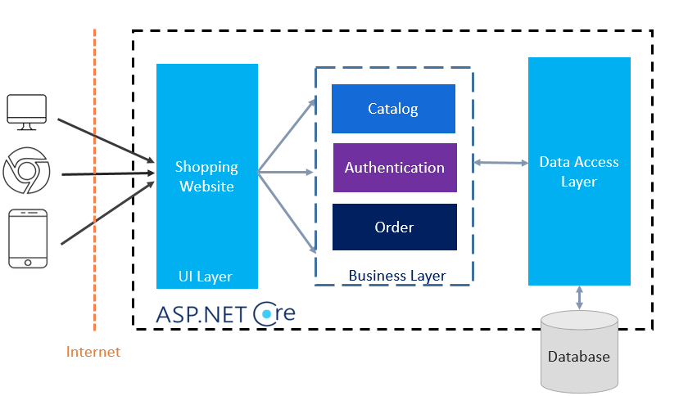
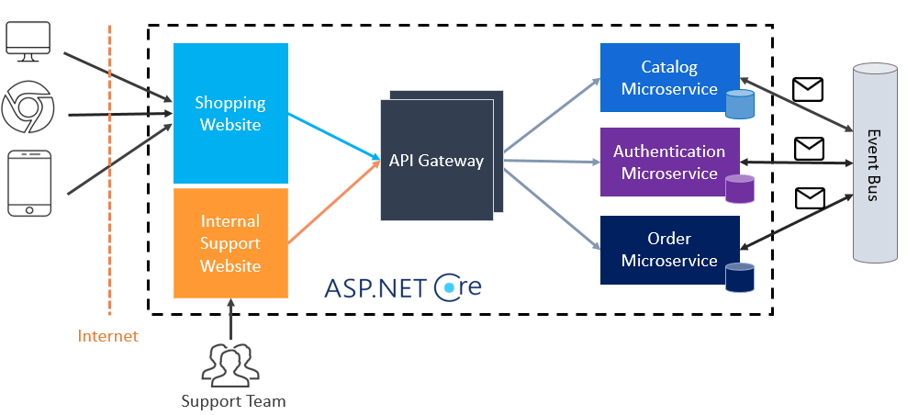
N-Layer App to Microservices

Slide 15
DDD
Key concepts
Domain: The subject area your application addresses
Model: Abstract system that describes selected aspects of the domain
Ubiquitous Language: Shared language between developers and domain experts
Bounded Context: Explicit boundary within which a model is defined and applicable
Notes:
Heroku was acquired by Salesforce.com in 2010.

Slide 16
DDD
Entity: Has a unique identity (e.g., User, Order)
Value Object: No identity, defined by its attributes (e.g., Address)
Aggregate: Cluster of domain objects treated as a unit
Repository: Interface for accessing aggregates
Service: Business logic that doesn’t naturally fit in an entity or value object
Notes:
Heroku was acquired by Salesforce.com in 2010.

Slide 17
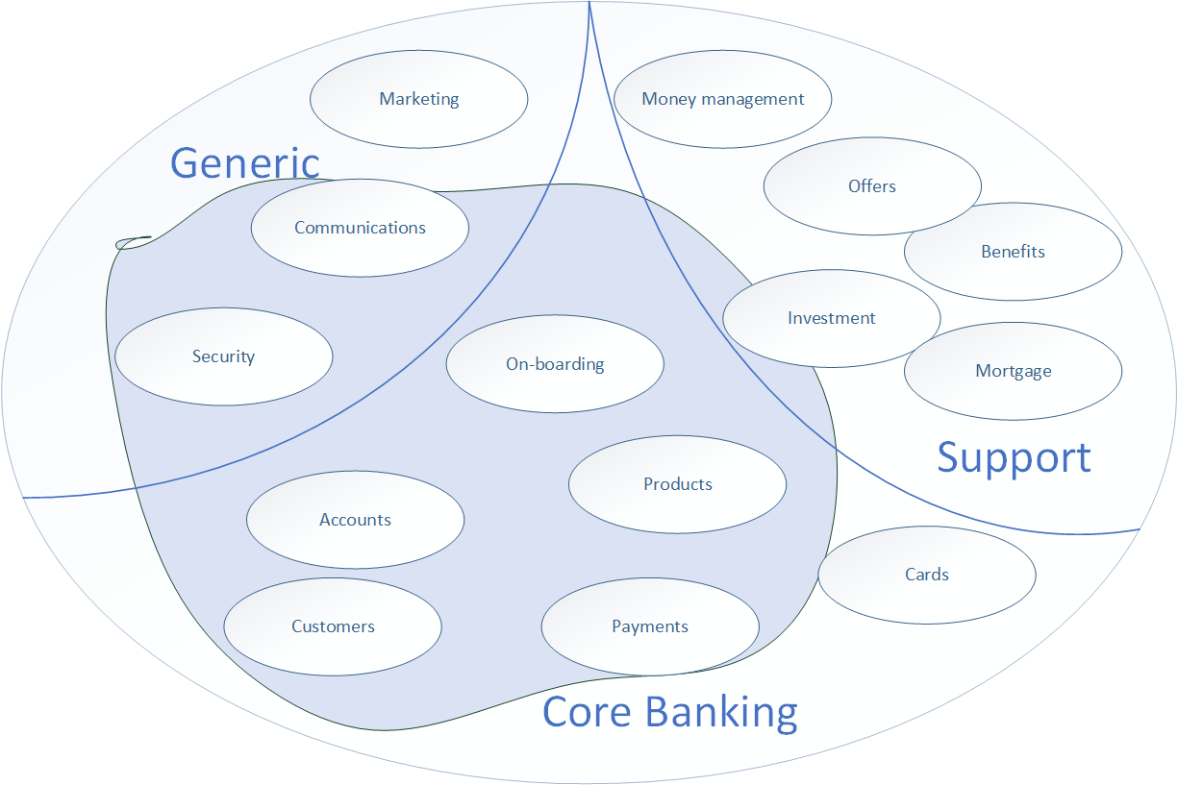
DDD – Fictitious core banking platform
Notes:
Heroku was acquired by Salesforce.com in 2010.

Slide 18
Reference architecture
Service | Responsibilities
Customer Service | Onboarding, KYC, customer profile management
Account Service | Create/maintain accounts, balance checks
Transaction Service | Handle debits, credits, journal entries
Loan Service | Origination, disbursement, repayment schedules
Cards Service | Issue cards, manage PINs, block/unblock
Payments Service | Process internal and external payments
Risk/Fraud Service | Transaction scoring, anomaly detection
Notification Service | Email, SMS, in-app notifications
Audit & Logging | Immutable transaction and service logs
Reporting & Analytics | Real-time and batch analytics
Compliance Service | AML checks, regulatory reporting
Notes:
Heroku was acquired by Salesforce.com in 2010.

Slide 19
Reference architecture
+----------------------------------------------------------+
| User Interface / Channels |
| (Web, Mobile, ATM, POS, IVR, Contact Center, API) |
+------------------------+---------------------------------+
|
v
+----------------------------------------------------------+
| API Gateway / BFF (Backend for Frontend) |
| - Request Routing, Authentication, Rate Limiting |
+------------------------+---------------------------------+
|
v
+----------------------------------------------------------+
| Microservices Layer (Domain-Driven Design) |
| - Customer Service - Loan Service |
| - Account Service - Payments Service |
| - Cards Service - Notification Service |
| - Transactions Service - Audit & Logging |
| - Compliance/KYC Service - Risk & Fraud Detection |
+------------------------+---------------------------------+
|
v
+----------------------------------------------------------+
| Service Mesh (Optional) |
| - Observability, Traffic Management, Security |
+------------------------+---------------------------------+
|
v
+----------------------------------------------------------+
| Data & Integration Layer |
| - Polyglot Persistence (SQL, NoSQL, Ledger DB) |
| - Event Store / CQRS |
| - Data Lakes / Analytics |
| - Change Data Capture / CDC |
+----------------------------------------------------------+
|
v
+----------------------------------------------------------+
| External Systems / Integration Services |
| - Core Banking Ledger (legacy if co-existing) |
| - Credit Bureaus, Payment Networks, SWIFT, etc. |
| - FinTech / RegTech Integration |
+----------------------------------------------------------+
Notes:
Heroku was acquired by Salesforce.com in 2010.

Slide 20
RPC
M1(8081)
REST
M2 (9001)
Stub
Client
Server
HTTP2
IPC
In process
Out of process
Search for a word and count the word
p1
RPC
p2
Notes:
Heroku was acquired by Salesforce.com in 2010.

Slide 21
gRPC
gRPC (gRPC Remote Procedure Call) is a modern open-source high-performance RPC framework.
Initially developed by Google; now part of the Cloud Native Computing Foundation (CNCF).
Uses Protocol Buffers (Protobuf) as the interface definition language (IDL).
Supports multiple languages (Go, Java, Python, C++, Node.js, etc.).
Notes:
Heroku was acquired by Salesforce.com in 2010.

Slide 22
gRPC
Efficient & Fast: Binary data format (Protocol Buffers) is smaller and faster than JSON/XML.
Strongly Typed Contracts: Schema-first approach using .proto files.
Bi-directional Streaming: Supports 4 types of communication:
Unary RPC
Server Streaming
Client Streaming
Bi-directional Streaming
Built-in Code Generation: Stubs and client/server code are auto-generated from .proto.
Built on HTTP/2: Enables multiplexing, flow control, header compression, and more.
Notes:
Heroku was acquired by Salesforce.com in 2010.

Slide 23
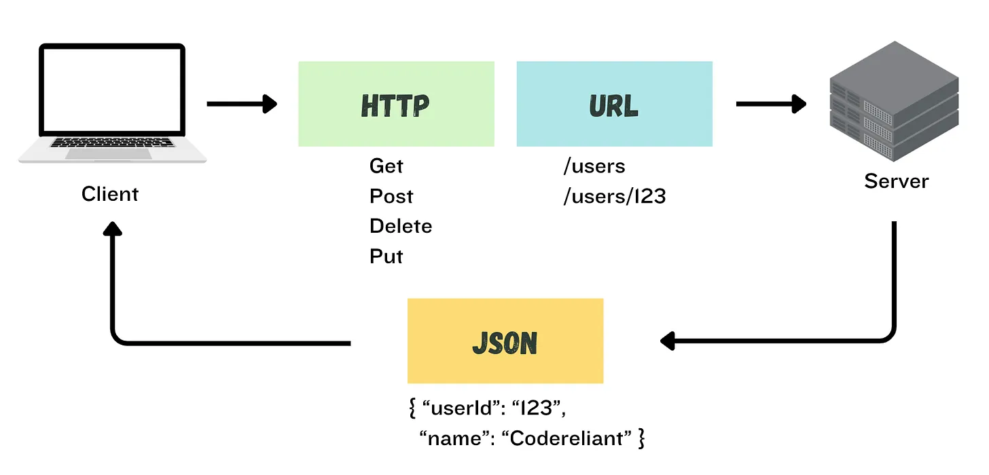
REST
Notes:
Heroku was acquired by Salesforce.com in 2010.

Slide 24
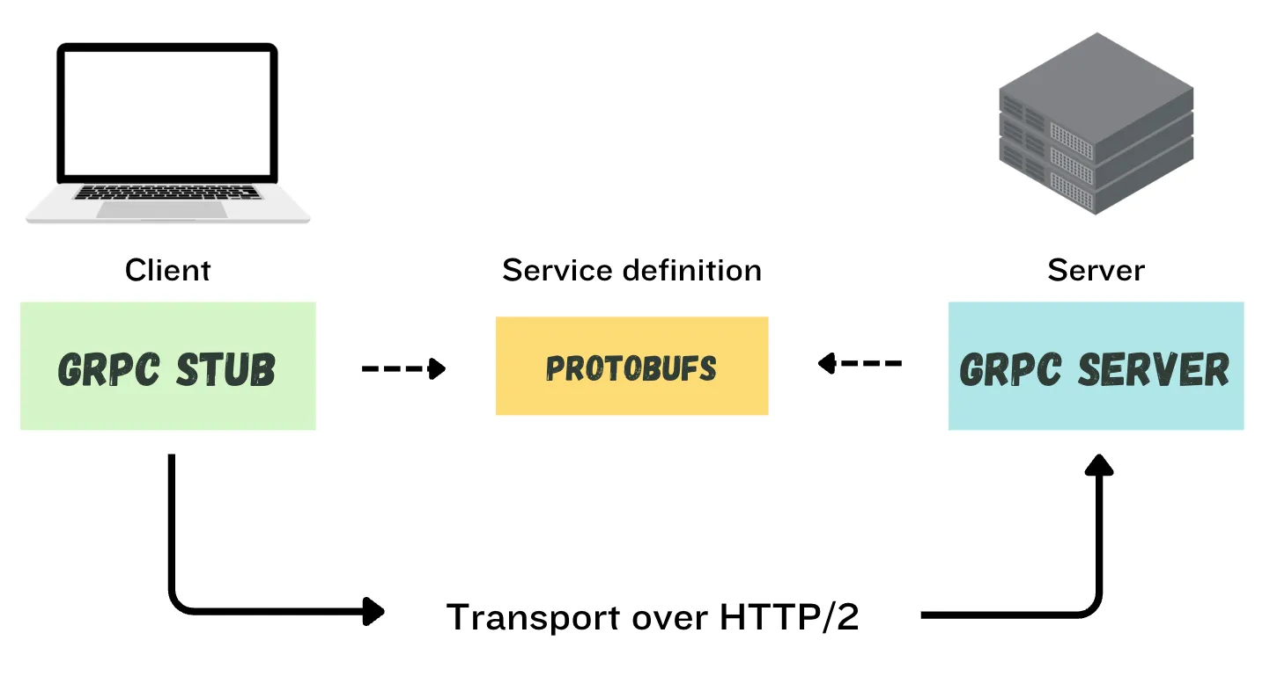
gRPC
Notes:
Heroku was acquired by Salesforce.com in 2010.

Slide 25
gRPC
GreeterService (Hello, Welcome) (HelloRequest, HelloReply)
RestController
Client
REST
Stub
HappyBday service (HelloRequest, HelloReply)
Notes:
Heroku was acquired by Salesforce.com in 2010.

Slide 26
gRPC
Feature | gRPC | REST
Protocol | HTTP/2 | HTTP/1.1
Data Format | Protobuf (binary) | JSON (text)
Performance | High | Moderate
Streaming | Yes (Bi-directional) | Limited (via HTTP)
Code Gen | Yes (auto-generated stubs) | Manual
Browser Support | Limited (use gRPC-Web) | Full
Notes:
Heroku was acquired by Salesforce.com in 2010.

Slide 27
gRPC Demo
Demo.
Notes:
Heroku was acquired by Salesforce.com in 2010.

Slide 28
AWS well architected framework
Notes:
Heroku was acquired by Salesforce.com in 2010.

Slide 29
What is Twelve-Factor App?
The Twelve-Factor App methodology was created by Adam Wiggins and engineers at Heroku while building Heroku platform.
First presented by Adam Wiggins in 2011.
Later due to their generic and platform independent implementation they are released as fundamental guidelines for any cloud ready application.
Include defined practices around version control, environment configuration, isolated dependencies, executing apps as stateless resources, working with backing services like database, queue, and much more.
Notes:
Heroku was acquired by Salesforce.com in 2010.

Slide 30
The Twelve-Factors
I. Codebase
II. Dependencies
III. Config
IV. Backing services
V. Build, Release run
VI. Processes
VII. Port binding
VIII. Concurrency
IX. Disposability
X. Dev/prod parity
XI. Logs
XII. Admin processes

Slide 31
1. Codebase
One Codebase Many Deploy

Slide 32
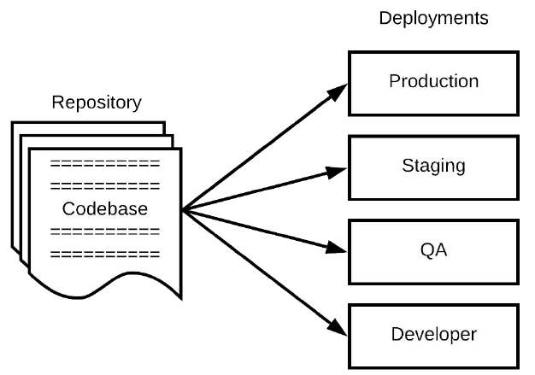
Codebase
An app codebase must be stored in a repository managed by a VCS such as Git.
Must be 1-to-1 correlation between the codebase and the app.
A distributed app can have multiple codebases, one for each distributed module.
Multiple apps cannot share code. Such code must be factored out as shared libraries
Notes:
Codebase - The source code for the application that will be compile or interpreted before execution.
Repository (repo) - Codebase managed within a VCS (Version Control System) system.
Deploy - An installation of the app with a specific configuration for a specific use case and/or audience.

Slide 33
Codebase
Release branch – Raise PR
Build gets triggered
Merge to master
Build gets triggered
Deploy to Dev.
Raise a PR for Dev to SIT
Raise a PR for SIT to UAT
Deploy repo are separate.
Code base is not duplicated. One single codebase. Just deploy scripts for each region will be separate.
Dev → SIT → UAT → Preprod → Prod
Notes:
Codebase - The source code for the application that will be compile or interpreted before execution.
Repository (repo) - Codebase managed within a VCS (Version Control System) system.
Deploy - An installation of the app with a specific configuration for a specific use case and/or audience.

Slide 34
2. Dependencies
Explicitly Declare and Isolate

Slide 35
Dependencies
Declare dependencies along with their specific versions (if required) in a manifest like package.json in npm.
Use dependency isolation tool to prevent accidental import of unwantead dependencies.
Use dependency manager i.e. packaging system like nuget or npm to fetch all required dependencies from their sources and maintain them in a local repository.
Notes:
Dependency Ü Any library module used by the app which
is either developed/managed by the developer or by a 3rd
party vendor requires. A dependency is identified by its
name, version, vendor, and download source.
Dependency Manifest Ü A document within the codebase
that lists all the dependencies for the app. E.g. pom.xml,
build.gradle, gemfile, etc.
Dependency Manager Ü A separate module which is part
of the build toolchain that processes the dependency
manifest, manages and download all the required
dependencies from their sources before the codebase is
taken to the compilation. E.g. Maven, Gradle, PIP, etc.
Dependency Isolation Ü A separate module which is part
of the build toolchain which provides dependencies
isolation for each app within an environment such that a
dependency within an isolation (virtual environment)
cannot be used by another app from the other isolation.
E.g. Virtualenv, etc.

Slide 36
3. Config
Store Config in the Environment

Slide 37
Config
A 12-factor app requires strict separation of config and code.
Config is not checked into the app’s repository.
A config contains secrets such as passwords, or db connection strings
config should be stored in environment variables.
App packaging, containerization runtimes, and orchestration systems provides facility to define config for the app thru environment variables based on the deploy type.
Notes:
Dependency Ü Any library module used by the app which
is either developed/managed by the developer or by a 3rd
party vendor requires. A dependency is identified by its
name, version, vendor, and download source.
Dependency Manifest Ü A document within the codebase
that lists all the dependencies for the app. E.g. pom.xml,
build.gradle, gemfile, etc.
Dependency Manager Ü A separate module which is part
of the build toolchain that processes the dependency
manifest, manages and download all the required
dependencies from their sources before the codebase is
taken to the compilation. E.g. Maven, Gradle, PIP, etc.
Dependency Isolation Ü A separate module which is part
of the build toolchain which provides dependencies
isolation for each app within an environment such that a
dependency within an isolation (virtual environment)
cannot be used by another app from the other isolation.
E.g. Virtualenv, etc.

Slide 38
4. Backing Services
Treat backing services as attached resources

Slide 39
Backing Services
Backing services are treated as attached resources, whether they are locally managed or third party services.
They can be accessed easily via a URL or other credentials, and even they can swap to each other.
Backing Services Examples are:
Data Store
SMTP
Caching Systems
Azure Storage
Notes:
Dependency Ü Any library module used by the app which
is either developed/managed by the developer or by a 3rd
party vendor requires. A dependency is identified by its
name, version, vendor, and download source.
Dependency Manifest Ü A document within the codebase
that lists all the dependencies for the app. E.g. pom.xml,
build.gradle, gemfile, etc.
Dependency Manager Ü A separate module which is part
of the build toolchain that processes the dependency
manifest, manages and download all the required
dependencies from their sources before the codebase is
taken to the compilation. E.g. Maven, Gradle, PIP, etc.
Dependency Isolation Ü A separate module which is part
of the build toolchain which provides dependencies
isolation for each app within an environment such that a
dependency within an isolation (virtual environment)
cannot be used by another app from the other isolation.
E.g. Virtualenv, etc.

Slide 40
5. Build, Release and Run
Strictly separate build and run stages

Slide 41
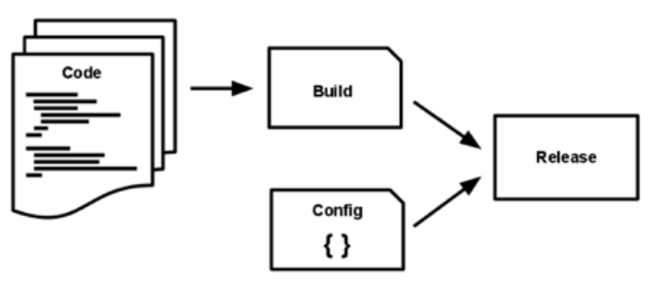
Build, Release and Run
BUILD = codebase + dependencies + assets
RELEASE = BUILD + config
RUN = run process against RELEASE
There must be a separate pipeline for build and release process.
The “run” can run multiple times from the same “release” on the environment.
Also, the “release” can run multiple times from the same “build” with different configs.
Notes:
Dependency Ü Any library module used by the app which
is either developed/managed by the developer or by a 3rd
party vendor requires. A dependency is identified by its
name, version, vendor, and download source.
Dependency Manifest Ü A document within the codebase
that lists all the dependencies for the app. E.g. pom.xml,
build.gradle, gemfile, etc.
Dependency Manager Ü A separate module which is part
of the build toolchain that processes the dependency
manifest, manages and download all the required
dependencies from their sources before the codebase is
taken to the compilation. E.g. Maven, Gradle, PIP, etc.
Dependency Isolation Ü A separate module which is part
of the build toolchain which provides dependencies
isolation for each app within an environment such that a
dependency within an isolation (virtual environment)
cannot be used by another app from the other isolation.
E.g. Virtualenv, etc.

Slide 42
6. Processes
Execute the app as one or more stateless processes

Slide 43
Processes
An app process(es) must be designed to run stateless and share nothing.
Any state that requires persistent must be handled by the backing services (e.g. database).
The idea of stateless services, help us to scale them by creating multiple instances.
App should save the sessions in a database rather than holding it in its memory.
Notes:
Dependency Ü Any library module used by the app which
is either developed/managed by the developer or by a 3rd
party vendor requires. A dependency is identified by its
name, version, vendor, and download source.
Dependency Manifest Ü A document within the codebase
that lists all the dependencies for the app. E.g. pom.xml,
build.gradle, gemfile, etc.
Dependency Manager Ü A separate module which is part
of the build toolchain that processes the dependency
manifest, manages and download all the required
dependencies from their sources before the codebase is
taken to the compilation. E.g. Maven, Gradle, PIP, etc.
Dependency Isolation Ü A separate module which is part
of the build toolchain which provides dependencies
isolation for each app within an environment such that a
dependency within an isolation (virtual environment)
cannot be used by another app from the other isolation.
E.g. Virtualenv, etc.

Slide 44
7. Port Binding
Export services via port binding

Slide 45
Port Binding
An app should be fully self-contained; means it does not requires runtime injection of a web server/container.
An app should only bind to a TCP/UDP port rather than the complete address set i.e. IP address and TCP/UDP port.
An app port binding should be configurable; not hard coded in the codebase.
Apps with port binding bring flexibility of getting run within the same environment where all the other processes are bind to different unique ports.
Notes:
Dependency Ü Any library module used by the app which
is either developed/managed by the developer or by a 3rd
party vendor requires. A dependency is identified by its
name, version, vendor, and download source.
Dependency Manifest Ü A document within the codebase
that lists all the dependencies for the app. E.g. pom.xml,
build.gradle, gemfile, etc.
Dependency Manager Ü A separate module which is part
of the build toolchain that processes the dependency
manifest, manages and download all the required
dependencies from their sources before the codebase is
taken to the compilation. E.g. Maven, Gradle, PIP, etc.
Dependency Isolation Ü A separate module which is part
of the build toolchain which provides dependencies
isolation for each app within an environment such that a
dependency within an isolation (virtual environment)
cannot be used by another app from the other isolation.
E.g. Virtualenv, etc.

Slide 46
8. Concurrency
Scale out via the process model

Slide 47
Concurrency
To ensure the scalability of an app, more copies of the app (processes) should be deployed rather than making the app larger.
The share-nothing, horizontal partitioning nature of twelve-factor app processes means that adding more concurrency is a simple and reliable operation.
Tools such as Kubernetes can really help you here.
Notes:
Dependency Ü Any library module used by the app which
is either developed/managed by the developer or by a 3rd
party vendor requires. A dependency is identified by its
name, version, vendor, and download source.
Dependency Manifest Ü A document within the codebase
that lists all the dependencies for the app. E.g. pom.xml,
build.gradle, gemfile, etc.
Dependency Manager Ü A separate module which is part
of the build toolchain that processes the dependency
manifest, manages and download all the required
dependencies from their sources before the codebase is
taken to the compilation. E.g. Maven, Gradle, PIP, etc.
Dependency Isolation Ü A separate module which is part
of the build toolchain which provides dependencies
isolation for each app within an environment such that a
dependency within an isolation (virtual environment)
cannot be used by another app from the other isolation.
E.g. Virtualenv, etc.

Slide 48
9. Disposability
Maximize robustness with fast startup and graceful shutdown

Slide 49
Disposability
An app process should be design in a way that it can be tear down, terminated, and restart again in moments.
An app process should have minimum startup time.
An app process should shut down gracefully on terminate signal.
An app process should also be robust against sudden failure, and should be architect to handle unexpected, non-graceful termination without losing the in progress workload requests.
Notes:
Dependency Ü Any library module used by the app which
is either developed/managed by the developer or by a 3rd
party vendor requires. A dependency is identified by its
name, version, vendor, and download source.
Dependency Manifest Ü A document within the codebase
that lists all the dependencies for the app. E.g. pom.xml,
build.gradle, gemfile, etc.
Dependency Manager Ü A separate module which is part
of the build toolchain that processes the dependency
manifest, manages and download all the required
dependencies from their sources before the codebase is
taken to the compilation. E.g. Maven, Gradle, PIP, etc.
Dependency Isolation Ü A separate module which is part
of the build toolchain which provides dependencies
isolation for each app within an environment such that a
dependency within an isolation (virtual environment)
cannot be used by another app from the other isolation.
E.g. Virtualenv, etc.

Slide 50
10. Dev/Prod Parity
Keep development, staging, and production as similar as possible

Slide 51
Dev/Prod Parity
An app’s engineering process should be design to support CI/CD.
The engineering process should minimize the dev and prod gap.
Keeping dev, staging and prod similar will ensure anyone can understand it and provide releases.
This ensures great development with limited errors, and also enables better scalability.
Notes:
Dependency Ü Any library module used by the app which
is either developed/managed by the developer or by a 3rd
party vendor requires. A dependency is identified by its
name, version, vendor, and download source.
Dependency Manifest Ü A document within the codebase
that lists all the dependencies for the app. E.g. pom.xml,
build.gradle, gemfile, etc.
Dependency Manager Ü A separate module which is part
of the build toolchain that processes the dependency
manifest, manages and download all the required
dependencies from their sources before the codebase is
taken to the compilation. E.g. Maven, Gradle, PIP, etc.
Dependency Isolation Ü A separate module which is part
of the build toolchain which provides dependencies
isolation for each app within an environment such that a
dependency within an isolation (virtual environment)
cannot be used by another app from the other isolation.
E.g. Virtualenv, etc.

Slide 52
11. Logs
Treat logs as event streams

Slide 53
Logs
Logs provide visibility into the behavior of a running app.
An app should write its logs to its output stream that should be configurable from the environment.
Don’t route or store logs in files.
Use Splunk or Logstash/ELK Stack for logging.
Notes:
Dependency Ü Any library module used by the app which
is either developed/managed by the developer or by a 3rd
party vendor requires. A dependency is identified by its
name, version, vendor, and download source.
Dependency Manifest Ü A document within the codebase
that lists all the dependencies for the app. E.g. pom.xml,
build.gradle, gemfile, etc.
Dependency Manager Ü A separate module which is part
of the build toolchain that processes the dependency
manifest, manages and download all the required
dependencies from their sources before the codebase is
taken to the compilation. E.g. Maven, Gradle, PIP, etc.
Dependency Isolation Ü A separate module which is part
of the build toolchain which provides dependencies
isolation for each app within an environment such that a
dependency within an isolation (virtual environment)
cannot be used by another app from the other isolation.
E.g. Virtualenv, etc.

Slide 54
12. Admin Processes
Run admin/management tasks as one-off processes

Slide 55
Admin Processes
An app often comes with various one-off administrative processes for maintenance tasks like cleaning temporary or unused or malformed data etc.
Admin tasks should run as separate process(es) against the same release. Hence any failure either in admin process or app's own process do not impact each other.
Admin code must ship with application code to avoid sync issues.
Notes:
Dependency Ü Any library module used by the app which
is either developed/managed by the developer or by a 3rd
party vendor requires. A dependency is identified by its
name, version, vendor, and download source.
Dependency Manifest Ü A document within the codebase
that lists all the dependencies for the app. E.g. pom.xml,
build.gradle, gemfile, etc.
Dependency Manager Ü A separate module which is part
of the build toolchain that processes the dependency
manifest, manages and download all the required
dependencies from their sources before the codebase is
taken to the compilation. E.g. Maven, Gradle, PIP, etc.
Dependency Isolation Ü A separate module which is part
of the build toolchain which provides dependencies
isolation for each app within an environment such that a
dependency within an isolation (virtual environment)
cannot be used by another app from the other isolation.
E.g. Virtualenv, etc.

Slide 56
Benefits of Twelve-Factor App
Use declarative formats for setup automation. This minimizes the time and cost for new developers joining the project
Have a clean contract with the underlying operating system, offering maximum portability between execution environments
Suitable for deployment on modern cloud platforms, thus removing the need for servers and systems administration
Limits differences between development and production, enabling continuous deployment for maximum agility
Can scale up without any major changes to tooling, architecture, or development practices, hence performance is a priority
Notes:
Ensures scalability and resilience (Recovery) to the design
You will get enormous scalability and resilience capabilities without actually doing any explicit development for that.
Ease in system maintenance
You will get several advantages in system maintenance by utilizing various tools and software that provides automation in testing, delivery, deployment, monitoring, and reporting, making software maintenance an easy job.
Helps avoid the cost of software erosion
You will be able to make quicker and periodic maintenance on your app that includes adding new features, changes.

