Slide 1
Kolkata – A Scope for Food Lovers and Businesses

Slide 2
The Importance of Exploring Venues in the City
Kolkata – a visitor’s bird eye view for food and tourism
Important for visitors to choose locality of stay and dining depending upon budget – accessibility – host of other factors
Reliability on information pool that guides them with the same
Definition of a good eating joint – Price aspects ? Ratings ?
Useful for restaurateurs/hoteliers for considering business plans
Useful for online aggregators to ramp up client bases

Slide 3
Data Acquisition and Cleaning
Data obtained from Foursquare API and Zomato API
Radius of 4 Kilometres chosen from city centre to allocate data points
Data merged basis latitude-longitude exactness/proximity
Raw data shape – 129 rows of data*7 columns of attributes
Duplicate data entries and zero rated venues removed
Average price introduced as price range throws less information
Filtered data final shape – 39 rows of data*8 columns of attributes
Final attributes considered – venue name, venue category, latitude, longitude, address, average price, rating, price range

Slide 4
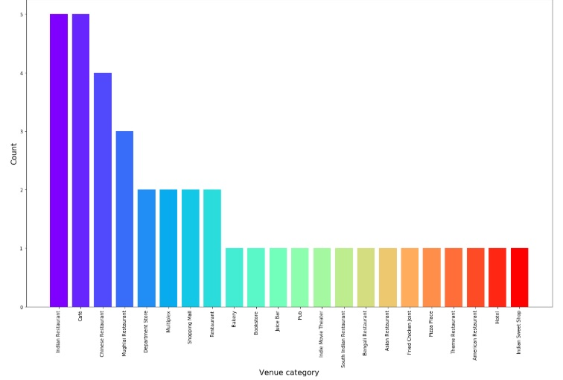
Venues – Indian restaurants dominate
Most frequently visited places
- Indian restaurants
- Cafes
- Chinese restaurants

Slide 5
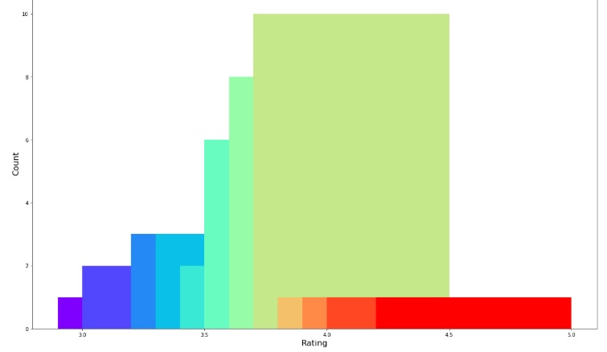
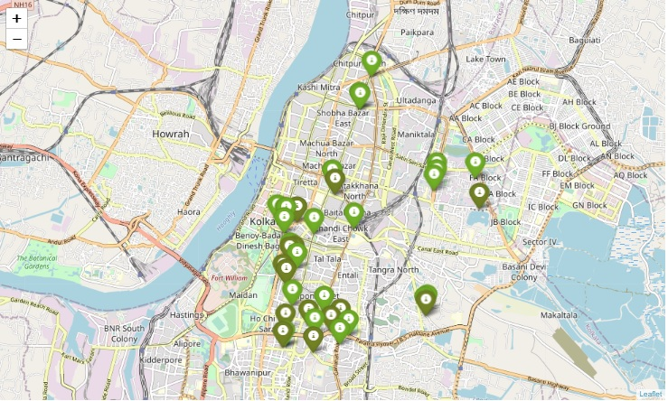
Ratings – Highest in the Posh Zone
Substantial chunk rated the highest
Highest rated places – corresponding to the posh and party loving zones in the city

Slide 6
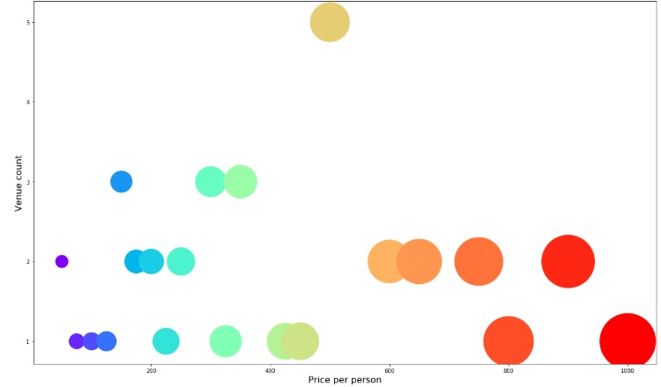
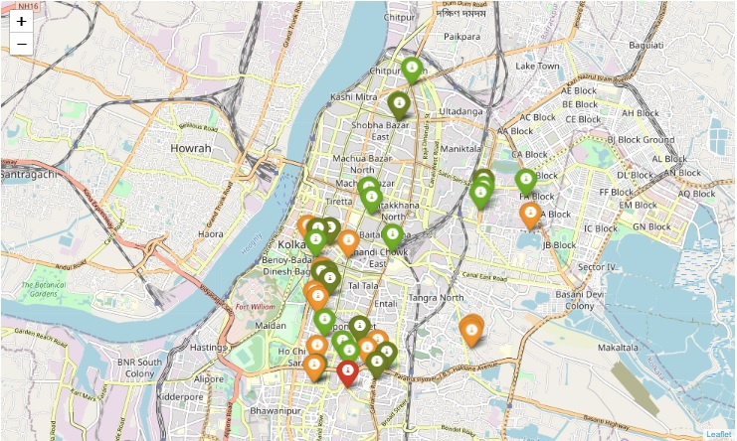
Price – Pays for Ratings ??
Pocket friendly options preferred
Highest rated prices – High on price – Leave to individual judgement
Good data point for restauranteurs to plan business models

Slide 7
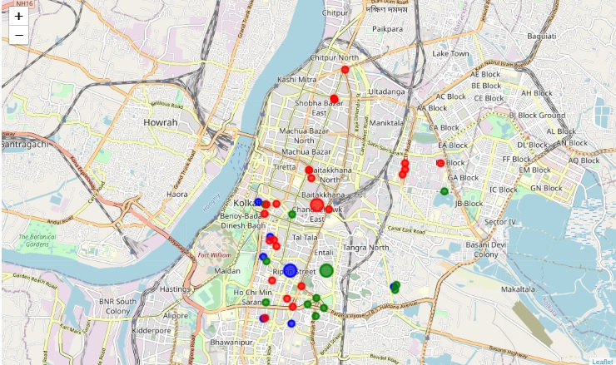
Clustering Techniques
Venues clustered into 3 zones basis price-location-ratings-cuisine choices
Cluster 0 (Green) - sparsely spread to the boundaries of the city centre
Cluster 1 (Red) - evenly spread across the city
Cluster 2 (Blue) - sparsely spread to the boundaries of the city centre

Slide 8
Clustering – A Boon for Venue Selection
Cluster 0 (Green) – Park Circus et al - dominated by Indian restaurants - moderately priced and moderately rated
Preferable for someone who is keen for food Indian food and not much ado on service parameters
Cluster 1 (Red) – Esplanade et al - spread across fast food joints/bakeries/multi-cuisine restaurants - pocket friendly and decently rated
Preferably for those running on a budget but pretty good in terms of taste
Cluster 2 (Blue) – Chinese restaurants – scattered around the city – high priced and high rated

Slide 9
Clustering – Other Utilities
Can be utilized by restauranteur/hoteliers to analyse target audience and location of operation vis-à-vis cost parameters
Can be utilized by online aggregators to build up a good customer database by simply allowing the customer to browse venues in the city basis various search criteria like name or ratings or price.

Slide 10
Conclusion and Future Directions
Purposeful model constructed to explore good restaurants and eateries in Kolkata considering a host of factors
Higher preference towards good food at affordable prices
Pockets of cuisines - some moderately priced while others priced higher
Ratings highly considered also while deciding upon location
Accessibility of options very much prioritised
Therefore helps visitors to plan in advance their cuisines and food trips
Helpful for businesses and online aggregators as well

