Slide 1

BML-536 Quality Management
When quality
metrics lie.
Goodhart's Law, metric gaming, and the hidden failure of KPI-driven quality management.
Sayak Pranab Ghosh · MBA | Term 5 · IIT Roorkee | 25810071

Slide 2
To begin with a question —
If a factory reports
fewer defects every month,
does that necessarily mean
its quality is improving?
Hold that thought — we'll return to it.

Slide 3
You can't manage
what you can't see.
Quality management, everywhere, starts with measurement.
Process
Measure
Decide
the work that actually happens
a number we choose to record
and then act on that number

Slide 4
What most firms watch.
A. Defect rate
B. Reject rate
C. Customer complaints
D. Returns & warranty claims
E. On-time delivery
F. Audit score
G. Customer satisfaction
H. Scrap & rework
None of these numbers is wrong by itself. Each one, though, can be softened, reclassified, or nudged once it becomes a target.

Slide 5

But measurement carries a hidden problem!
What happens when improving the score
becomes more important than improving the process?
Once a measure becomes a target, its relationship to reality begins to bend.

Slide 6
Goodhart's Law, in plain words.
A measure can describe reality well — until it turns into a high-stakes target. Once careers depend on hitting a number, people start moving the number, not the reality it was meant to track.¹
As a measure —
The number reflects the process. It helps us learn.
As a target —
The number becomes the goal. It stops being a mirror of the process.
¹ Paraphrase; see references.

Slide 7
Same number. Two different stories.
On the dashboard they look identical. Underneath, they aren't.
Healthy —
Distorted —
Process improves
Metric must improve
↓
↓
Real quality improves
Behaviour shifts
↓
↓
Metric improves
Number improves — reality may not
The number is a symptom of real work.
The number is a performance for the report.

Slide 8
Goodhart's Law does not mean
"don't use targets."
The problem is not measurement. The problem is when one number becomes too powerful.
Four conditions make a metric vulnerable —
One —
Two —
Three —
Four —
Single.
High-stakes.
Easy to move.
Loosely linked.
One metric dominates judgement.
Pay, ranking, appraisal or blame depend heavily on it.
Classification, timing or sampling can alter the result.
The KPI can improve without customer quality improving.
Good metrics guide attention. Badly designed targets redirect behaviour.

Slide 9
The Quality Mirage.
A situation in which measured quality
improves faster than the underlying reality
it is supposed to represent.

Slide 10
Why do people game metrics?
What tightens around the number —
A. Pressure.
B. Incentives.
C. Ranking.
D. Fear of missing.
E. Appraisal.
Often not simply because people are dishonest — but because the system changes what they are rewarded for.
When the number carries appraisal, ranking, bonus or blame with it, the number becomes the thing to protect.
Paraphrase; see references.

Slide 11
What it looks like on the shop floor.
For each target, a shortcut. Same number on the report — different reality underneath.
The target |  | The shortcut
Reduce defects | → | Call borderline defects "minor".
Fewer complaints | → | Discourage complaints from being logged.
Lower inspection failure rate | → | Soften inspection or avoid tough samples.
100% on-time delivery | → | Ship incomplete or rushed orders.
Higher output | → | Skip inspection time or cut corners.
Not dishonest people — a system that quietly rewards the shortcut.

Slide 12
Three ways a quality metric can lie.
Not always deliberate — behavioural failure modes when the target starts to matter more than the process.
Classification —
Timing —
Sampling —
The event occurs, but its label changes.
The event is recorded outside the measurement window.
The measurement process itself changes.
example
example
example
Rework completed just before the monthly defect report closes.
Easier samples inspected more often than the difficult ones.
"Defect" becomes
"minor deviation".
The process does not have to improve for the KPI to improve.
Sometimes only the definition, timing or sample changes.

Slide 13
Precision Components Ltd.
An illustrative case — a mid-sized manufacturer, invented for teaching.
Management issues a directive: monthly rejected units must fall below 1%.
Month 1
Month 6
Reported
Reported
2.1%
0.9%
Actual
Actual
The target is tied to appraisals and monthly rankings. Meeting it begins to matter for how people are seen inside the organisation.
2.3%
2.5%
Dashboard is close to reality.
After pressure, they've drifted apart.
Numbers are fictional. Precision Components Ltd. is hypothetical.

Slide 14
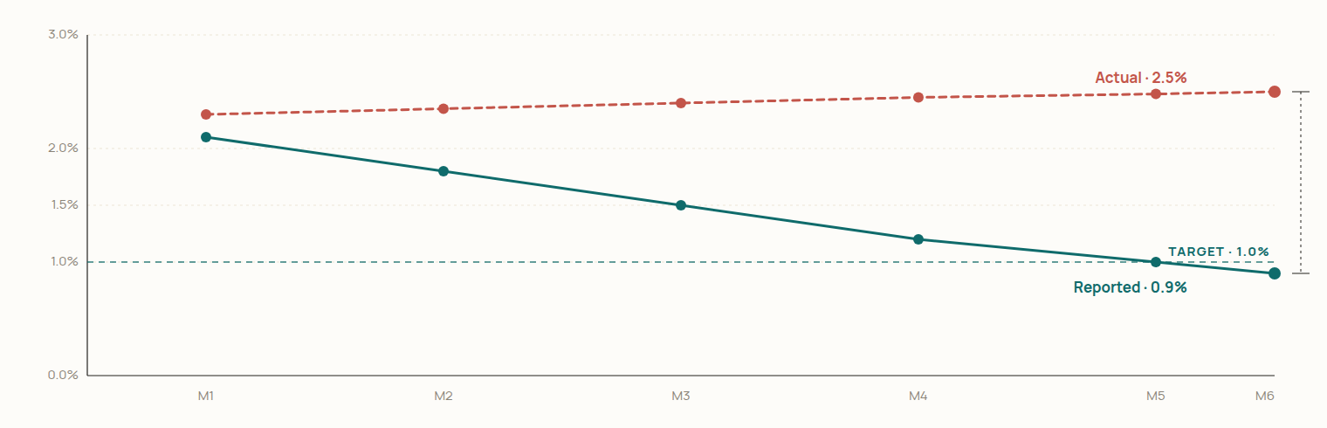
They improved the measurement,
not the quality.
Precision Components Ltd., across six months.
Dashboard hits the target by month five.
The real process quietly gets a little worse.
Fictional data, for illustration.

Slide 15
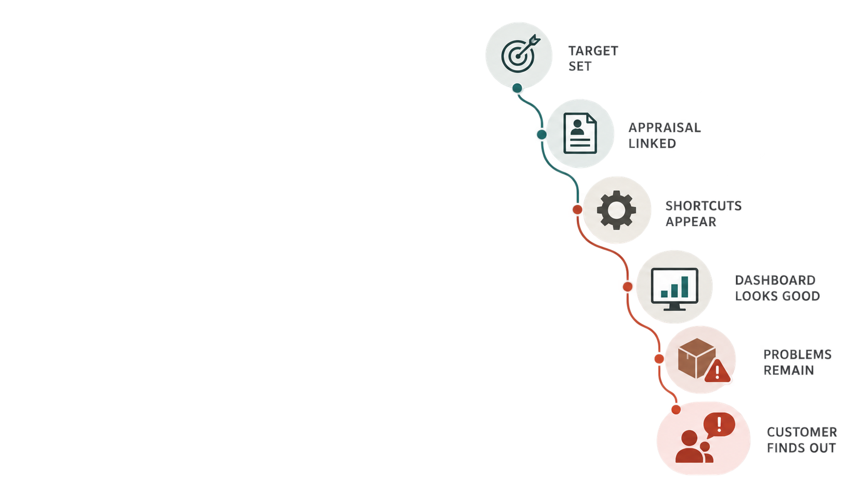
From a target to a complaint,
in a few short steps.
A target is set on a quality number.
Reward and appraisal start to depend on it.
Each team focuses on its own score.
Small shortcuts appear — reclassify, soften, rush.
The report stops matching the floor.
Managers see a healthy dashboard.
Real problems remain — sometimes get worse.
The customer finds out.

Slide 16
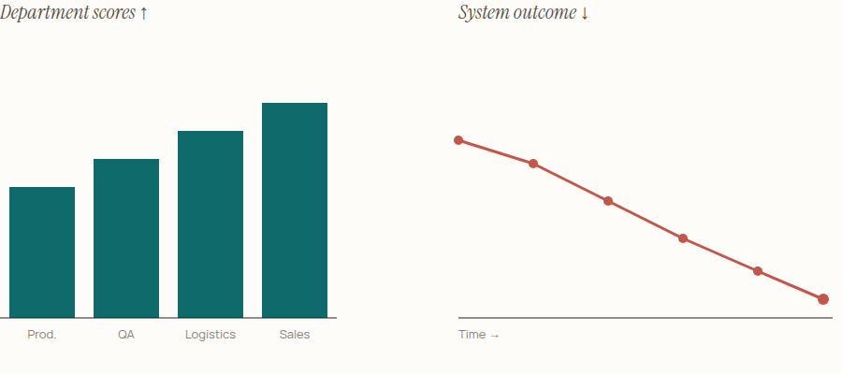
Every department can win —
and the system can still lose.
Judge the system by what it delivers — not by the local scores each department manages to post.
In Deming's terms —
³ Deming Institute, System of Profound Knowledge.

Slide 17
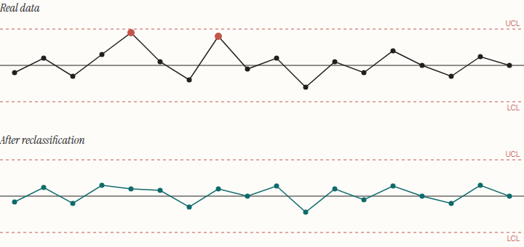
If the data is wrong,
the control chart is wrong too.
What breaks —
Real vs sanitised —
A. Variation looks smaller than it is.
B. Special causes stop showing up.
C. Capability indices mislead.
The chart still looks like a chart. It just no longer tells the truth about the process.

Slide 18
A defect doesn't disappear. It moves.
Gaming the metric doesn't remove the cost — it shifts where and when we pay.
Caught inside the plant —
Reaches the customer —
Cheap to fix.
Expensive to fix.
Rework at the line.
Extra inspection.
Scrap.
Never seen by the customer.
→
Returns.
Warranty claims.
Field service and recalls.
Loss of trust.
if hidden
A defect suppressed inside the plant becomes a claim outside it.

Slide 19
Two things drift when the numbers lie.
The customer experience —
Management decisions —
Internal KPIs go green.
Decisions rest on a false floor.
Customers still notice — variation between units, reliability slipping, delivery on paper only.
Investment aimed at the wrong root cause; risk missed until it surfaces; board oversight built on numbers that don't hold.
Bad measurement doesn't just hide bad quality. It produces bad decisions.
⁴ Fisher & Kordupleski (2021).

Slide 20
Audit the metric — not only the process.
Sometimes the measurement system itself needs to be audited.
1.
Who controls the number?
Can the person being evaluated influence how it is recorded?
2.
Can definitions move?
Has "defect", "complaint" or "on-time" quietly been redefined?
3.
Can timing move?
Can failures be shifted into another reporting period?
4.
What external signal should agree with it?
Returns, warranty claims, customer complaints.
5.
What behaviour changed?
What happened after the target became important?
A trustworthy KPI needs measurement integrity.

Slide 21
So, what can managers actually do?
1.
Don't rely on a single number.
2.
Check the inside against the outside.
Read defect rate alongside returns, rework, scrap, complaints, variation.
Customer feedback and warranty data are the honest check on internal KPIs.
3.
Be suspicious of sudden improvement.
4.
Reward improvement, not compliance.
"Too good to be true" is a signal to investigate, not a win to celebrate.
Recognise real root-cause work — not a number that landed on target.
5.
Make reporting problems safe.
6.
Look at the system, not just the box.
Separate what you use to learn from what you use to punish.
Evaluate outcomes at the system level, not only at the departmental KPI.

Slide 22
Read every metric through three lenses.
Measure + Context + Behaviour.
Measure —
Context —
Behaviour —
The number itself.
The story around it.
What it rewards.
Chosen carefully. Defined precisely. Read together with its honest companions — returns, rework, scrap, complaints, variation.
What changed in the process, the mix, or the inspection rule? Does the number still mean what it used to mean?
Who gains and who is judged when it moves? What shortcut does that quietly reward?

Slide 23
A good quality system does not merely produce good numbers.
It produces good outcomes
that the numbers truthfully represent.
When a quality metric improves,
are we improving reality — or only the metric?
Thank you.
Sayak Pranab Ghosh · MBA Term 5 · IIT Roorkee · BML-536

Slide 24
References
Ideas paraphrased throughout. No direct quotes unless independently verified.
Mattson, C. A., Bushardt, R. L., & Artino, A. R. Jr. (2021). “When a Measure Becomes a Target, It Ceases to Be a Good Measure.” Journal of Graduate
Medical Education, 13(1), 2–5.
Elton, L. (2004). Goodhart's Law and Performance Indicators in Higher Education. Evaluation and Research in Education. tandfonline.com/doi/abs/10.1080/09500790408668312.
General principle of target-driven distortion in performance indicators.
Fisher, N. I., & Kordupleski, R. E. (2021). Performance Measurement: Issues, Approaches, and Challenges. Harvard Data Science Review. hdsr.mitpress.mit.edu/pub/0svq7n0h.
Basis for weak reporting systems distorting decisions and oversight.
The Deming Institute. System of Profound Knowledge. deming.org/explore/sopk
Tools used for ideation/design assistance: ChatGPT, Claude, Gemini
Precision Components Ltd. and every figure in the case slides are fictional — illustration only.

