Slide 1

Basics of Neural Network Programming
Derivatives
deeplearning.ai
Notes:
<number>

Slide 2
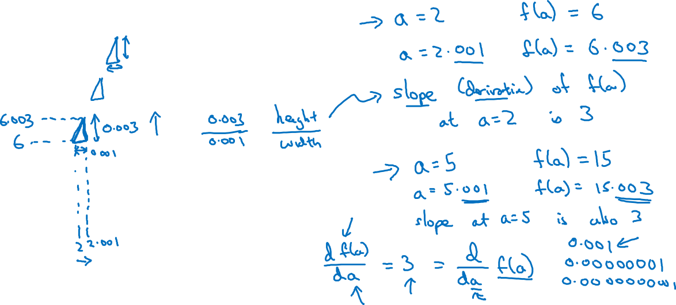


Intuition about derivatives
$f\left(a\right)=3a$
$a$

Slide 3
Basics of Neural Network Programming
More derivatives examples
deeplearning.ai
Notes:
<number>

Slide 4
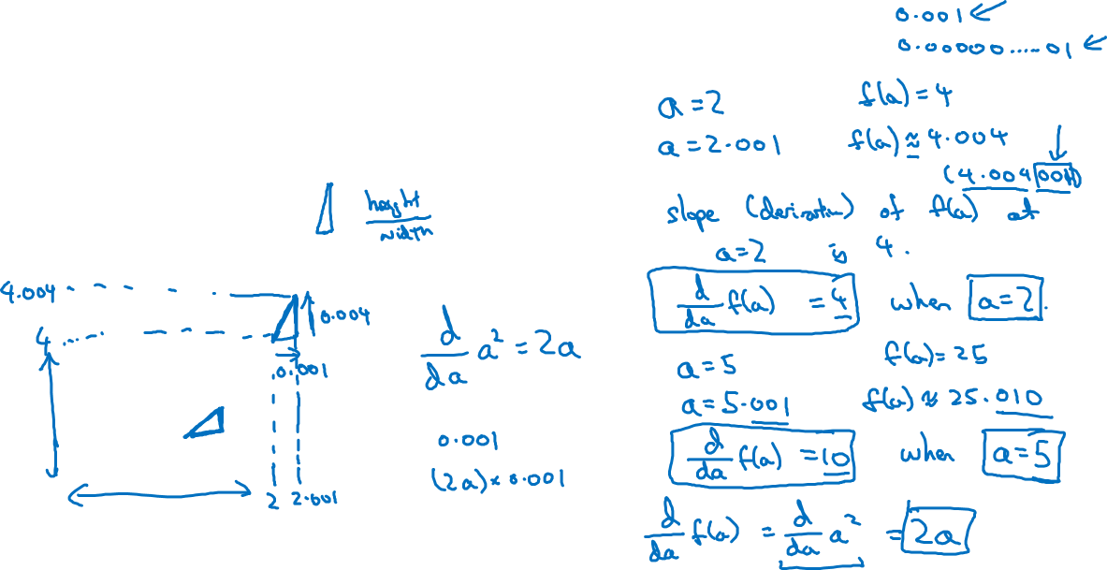


Intuition about derivatives
$f\left(a\right)=a^{2}$
$a$

Slide 5
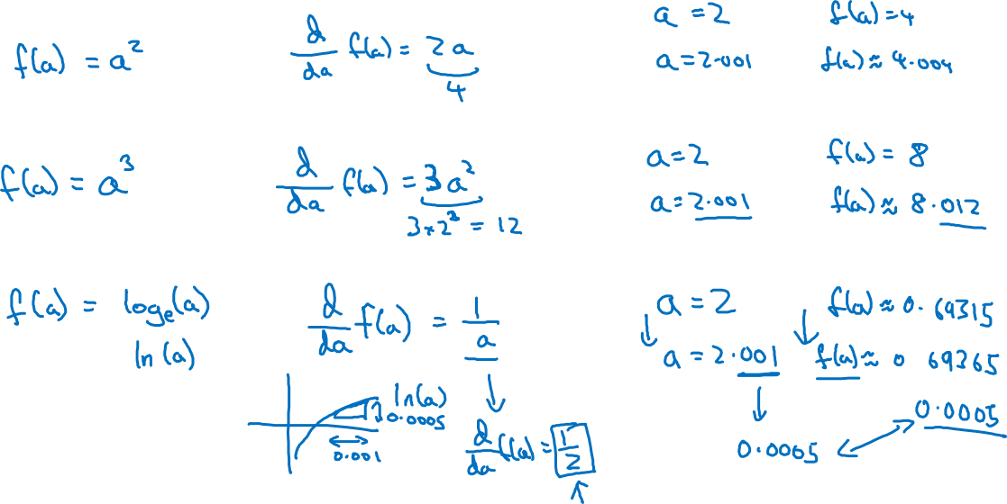
More derivative examples

