Slide 1

Basics of Neural Network Programming
Vectorization
deeplearning.ai
Notes:
<number>

Slide 2
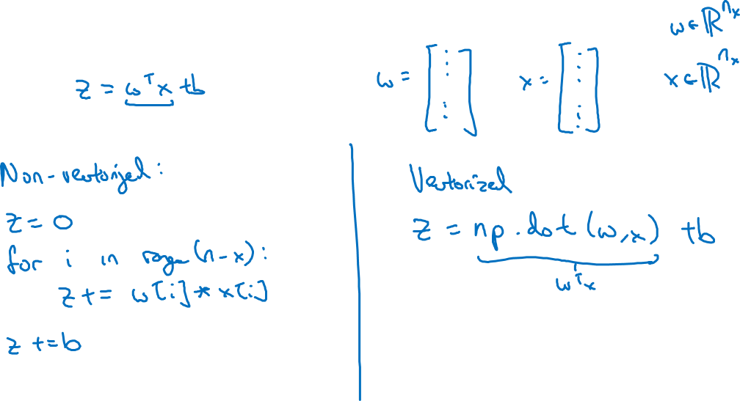
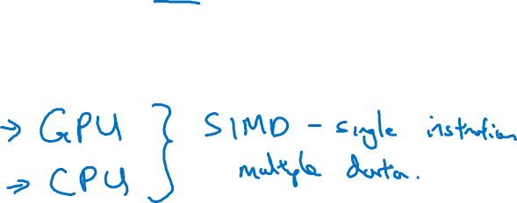
What is vectorization?

Slide 3
Basics of Neural Network Programming
More vectorization
examples
deeplearning.ai
Notes:
<number>

Slide 4
Neural network programming guideline
Whenever possible, avoid explicit for-loops.

Slide 5
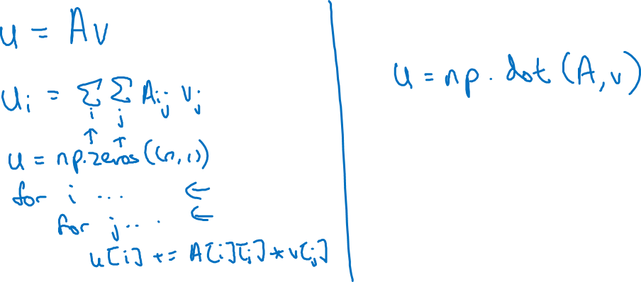
Neural network programming guideline
Whenever possible, avoid explicit for-loops.

Slide 6
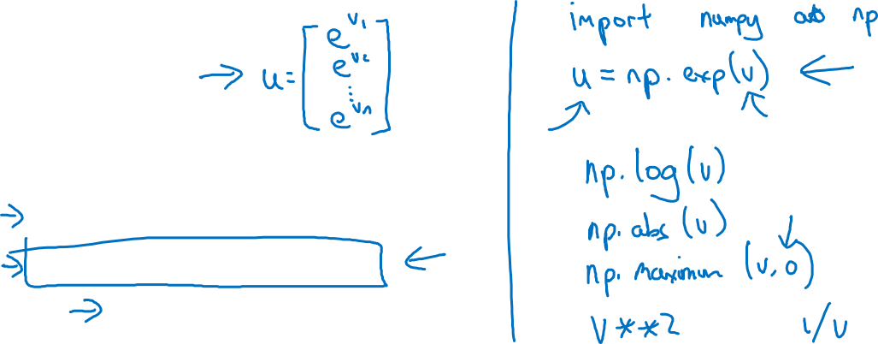
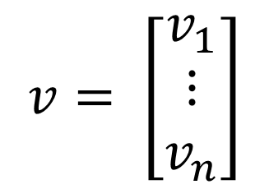
Vectors and matrix valued functions
Say you need to apply the exponential operation on every element of a matrix/vector.
$v=\left[\begin{matrix}v_{1} \\ ⋮ \\ v_{n}\end{matrix}\right]$
u = np.zeros((n,1))
for i in range(n):
u[i]=math.exp(v[i])

Slide 7
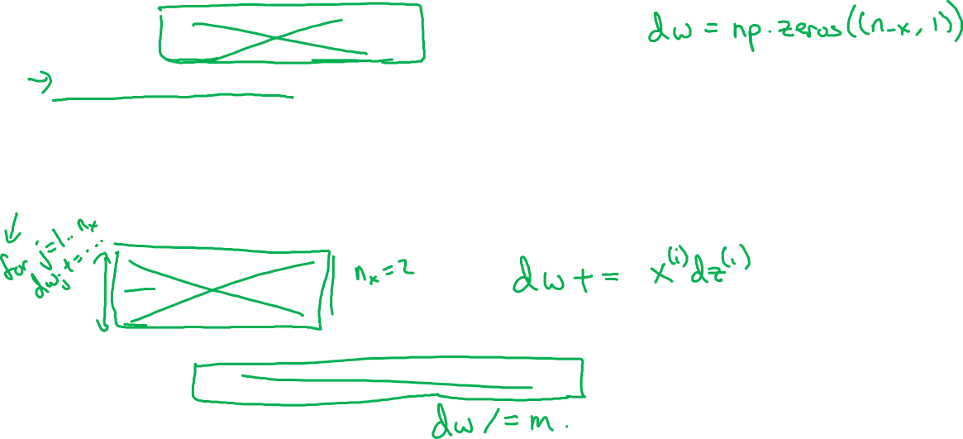
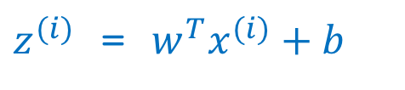
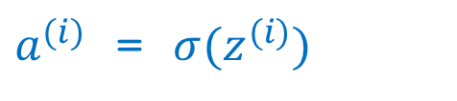
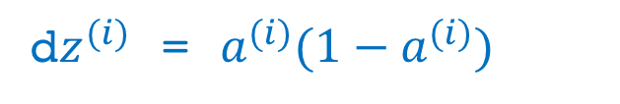
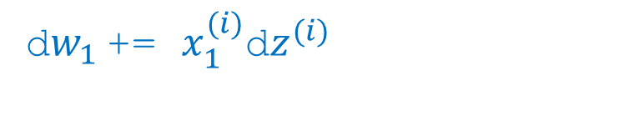
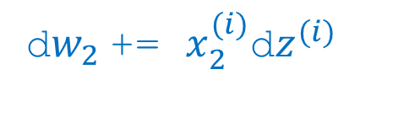

Logistic regression derivatives
J = 0, dw1 = 0, dw2 = 0, db = 0
for i = 1 to n:
=
=
+=
d =
d+=
d+=
db += d
J = J/m, d = d/m, d = d/m, db = db/m

