Slide 1



GLOBAL SUPERSTORE PROFIT PREDICTION
Mr. Prashant Karhale
(Centre Coordinator)
Mr. Akshay Tilekar
(Project Guide)
Group No. 8
223315 SONIA A. DHARANKAR
223349 SAYALI P. PENDHARKAR

Slide 2
CONTENTS
1) Introduction
2) Dataset Description
3) Preprocessing
4) Data Visualization
5) Methodology and Machine Learning Models
6) ARIMA Results and Observations
7) Facebook Prophet Results and Observations
8) References
9) Conclusion

Slide 3
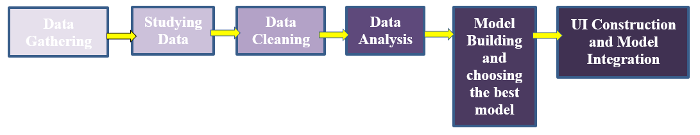
INTRODUCTION
In this project, we are going to develop a model to predict the future Profit of a Superstore.
This is a time series based prediction.
On the basis of historical data, forecasting has been done for a period of 1 month and 3 months.
Profit prediction is important for any business to get an insight for setting goals, selecting target customers and plan investment in marketing, advertisements etc.
Workflow

Slide 4
DATASET
The dataset has been taken from ‘Kaggle’ https://www.kaggle.com/datasets/apoorvaappz/global-super-store-dataset
The dataset is named ‘Global Superstore_2011_to_2014’.
The target column is ‘Profit’ and is dependent on the feature ‘Order Date’
Products have been divided under three main categories: ‘Office Supplies’, ‘Technology’ and ‘Furniture’.
Product Categories had more subcategories: Accessories, Appliances, Art, Binders, Bookcases, Chairs, Copiers, Envelopes, Fasteners, Furnishings, Labels, Machines, Paper, Phones, Storage, Supplies and Tables.
Order Dates range from year 2011 to year 2014. This is considered as the historical data for prediction.

Slide 5
PRE PROCESSING
Use of Google Colab Notebook
Use of Pandas Library
Dataset was cleaned to eliminate null, missing and duplicate values.
The columns irrelevant to the models were removed.
Multiple rows with same dates but with different Product IDs/Products were consolidated into single unique rows.

Slide 6
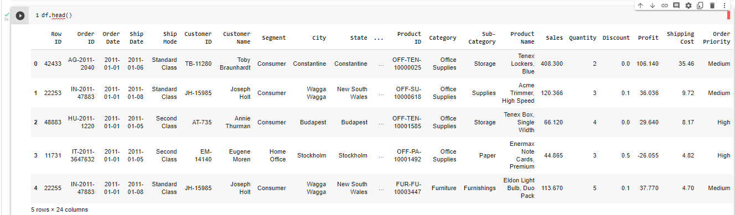
DATA BEFORE PEPROCESSING
Multiple rows such that many products under different categories sold on same date

Slide 7
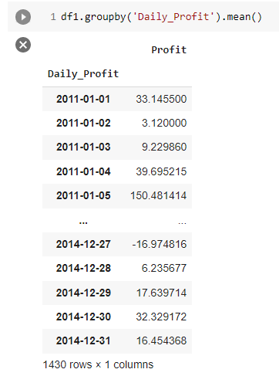
DATASET AFTER PREPROCESSING
Mean Profit calculated for ,
each unique Order Date for all products sold
under three different main categories.
Two main columns selected for Prediction: Order Date and Profit(target column)
Order Date column renamed as ‘Daily_Profit’

Slide 8
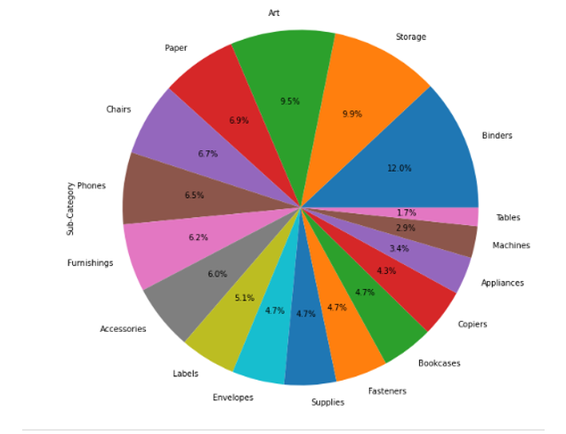
DATA VISUALIZATION
SUBCATEGORY WISE PRODUCTS

Slide 9
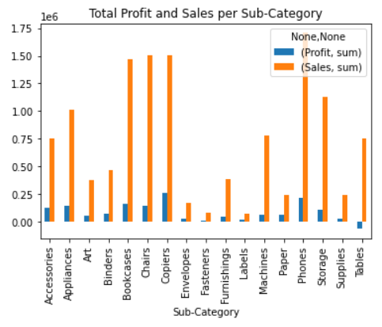
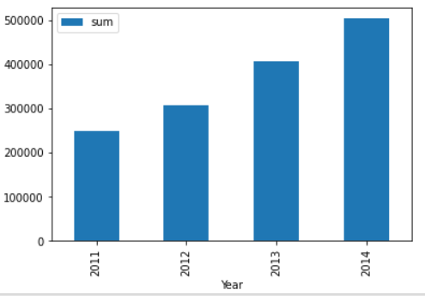
TOTAL PROFIT AND SALES PER SUBCATEGORY
TOTAL PROFIT PER YEAR

Slide 10
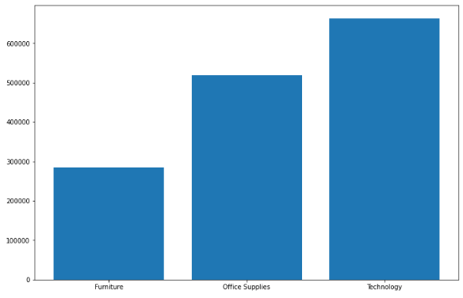
PRODUCT CATEGORY WISE TOTAL PROFIT CONTRIBUTION

Slide 11
METHODOLOGY AND MACHINE LEARNING MODELS
Autoregressive Integrated Moving Average (ARIMA)
Facebook Prophet

Slide 12
ARIMA
Parameter Combination Selection for the Model using Grid Search
Finding the best hyperparameters p,d,q
Choosing the lowest AIC value for fitting the model
Model Fitting
Plotting the diagnostics: Standardized residual or ‘p’, Normal Q-Q,
Histogram plus estimated density, Correlogram
Validating Forecasts
Checking Mean Squared Error and Root Mean Squared error
Producing and Visualizing forecasts
Comparison of Profit from Furniture and Office Supplies.

Slide 13
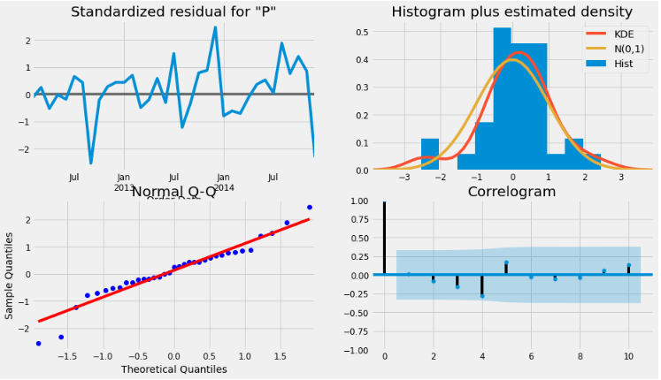
ARIMA MODEL DIAGNOSTICS
KDE line is close to
N(0,1) where N(0,1)
Is the standard
Notation for normal
Distribution With
mean 0 and
Standard deviation 1
Residuals have
low correlation
with lagged versions
of itself
Ordered distribution
Of residuals follows
linear trend
These are indications that residuals are normally distributed

Slide 14
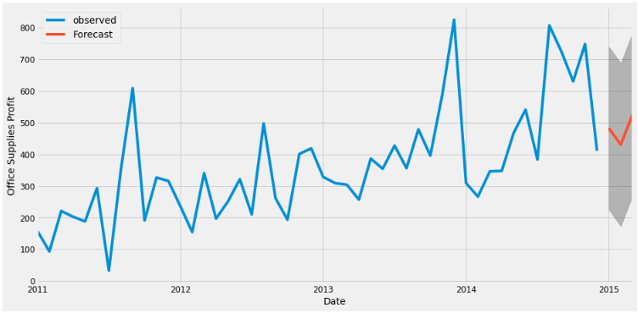
3 MONTHS AHEAD FORECAST
Forecast : From 1 January 2015 to 31 March 2015

Slide 15
FACEBOOK PROPHET
Installing pystan and fbprophet
Renaming Order Date column as ‘ds’ and Profit column as ‘y’
Using FBProphet helper function ‘make_future_dataframe’ for
making future prediction
Producing One month ahead forecast for ‘Office Supplies’ category
Producing One month ahead forecast for ‘Furniture’ category
Comparison of forecasts.

Slide 16
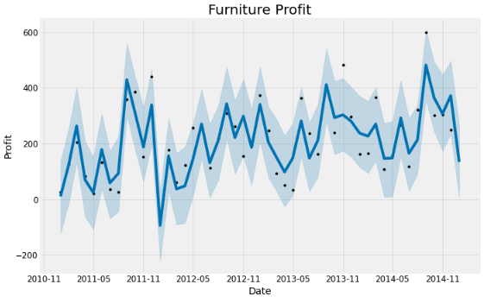
ONE MONTH AHEAD FORECAST
OF PRODUCT CATEGORY ‘FURNITURE’

Slide 17
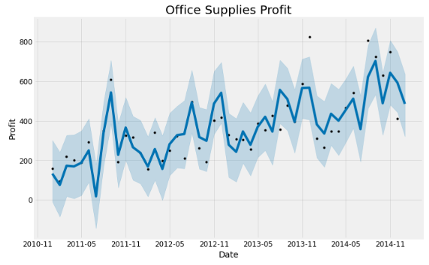
ONE MONTH AHEAD FORECAST OF
PRODUCT CATEGORY ‘OFFICE SUPPLIES’

Slide 18
CONCLUSION
These models have not only helped in visualizing the yearly trends of three different product Categories sold by the superstore but have also given a valuable insight into the future.
In the future, the accuracy of the models can be improved by applying more performance measurements and other machine learning algorithms.
This study can help the manufacturing industries to predict profit that can be earned from different categories of products, making investment decisions, setting target customers, conducting lookahead planning, and estimating expenditure for manufacturing, transportation and labor.

Slide 19
REFERENCES
https://www.digitalocean.com/community/tutorials/a-guide-to-time-series-forecasting-with-arima-in-python-3
https://www.digitalocean.com/community/tutorials/a-guide-to-time-series-forecasting-with-prophet-in-python-3
https://www.kaggle.com/datasets/apoorvaappz/global-super-store-dataset
https://www.kaggle.com/code/tanmaygangurde/global-superstore-ml/notebook

Slide 20
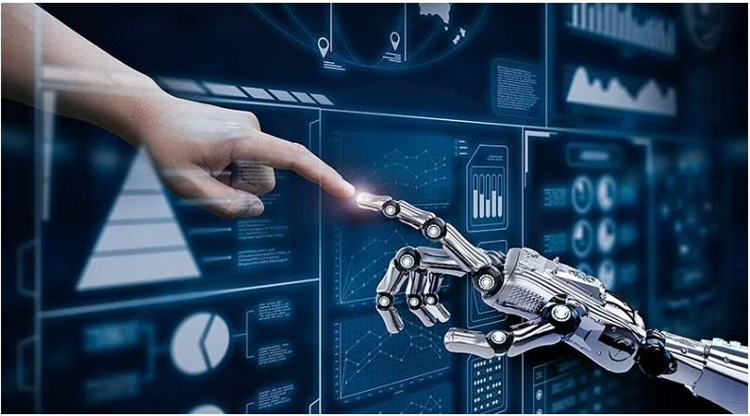
THANK YOU!

